Slide 1
1 UMI counts >5 distance < 4

Slide 2
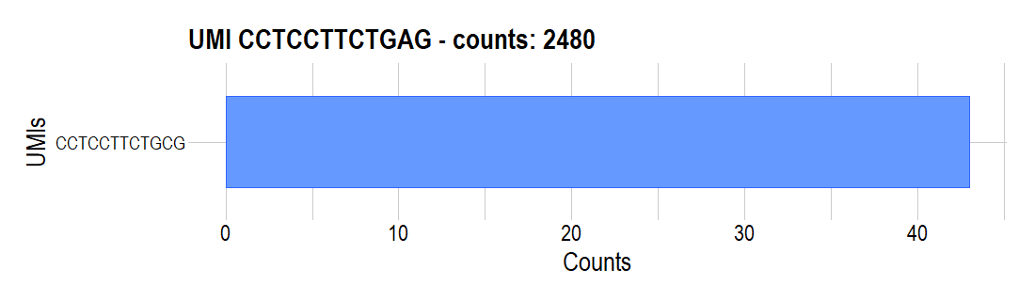
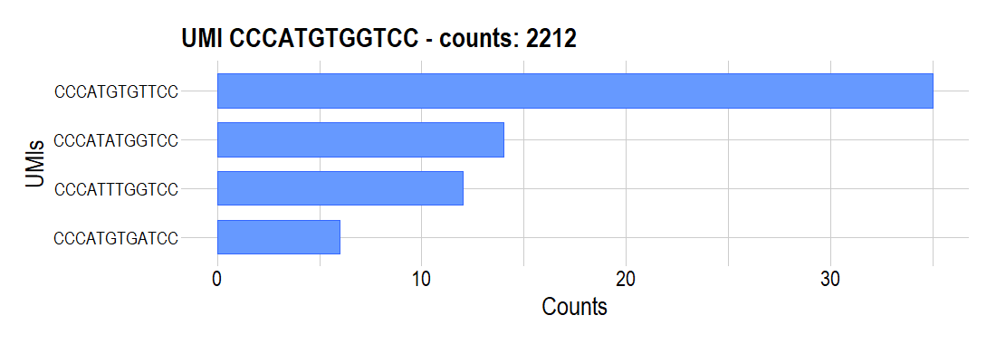
1. UMI counts >5, distance < 4

Slide 3
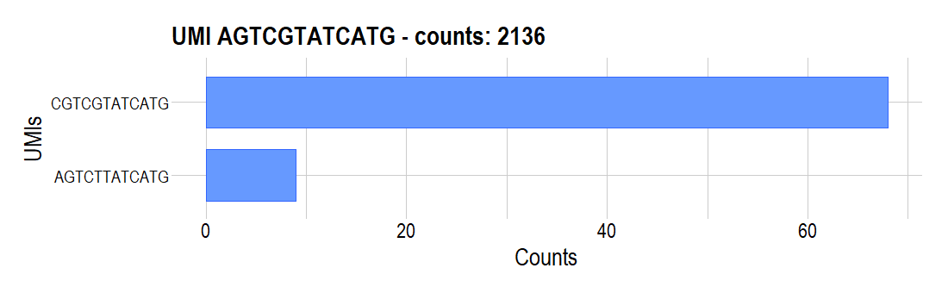
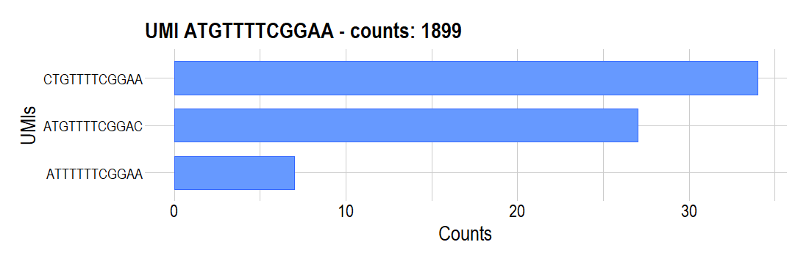
1. UMI counts >5, distance < 4

Slide 4
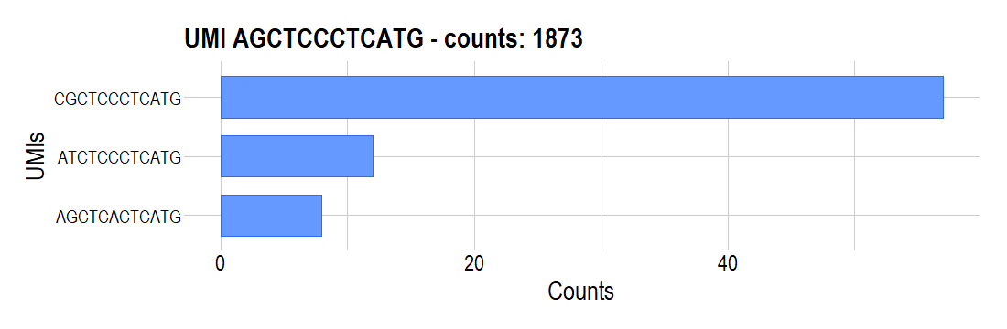
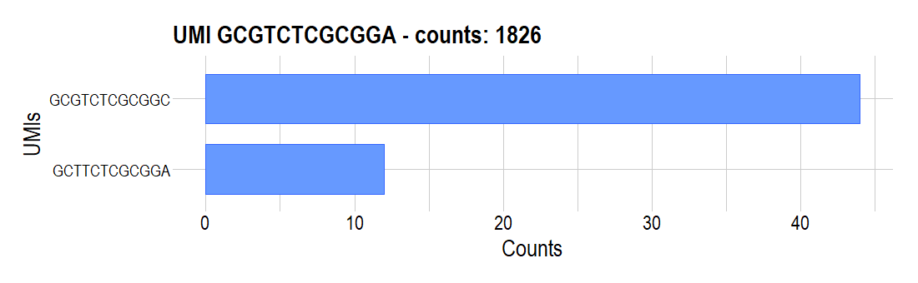
1. UMI counts >5, distance < 4

Slide 5
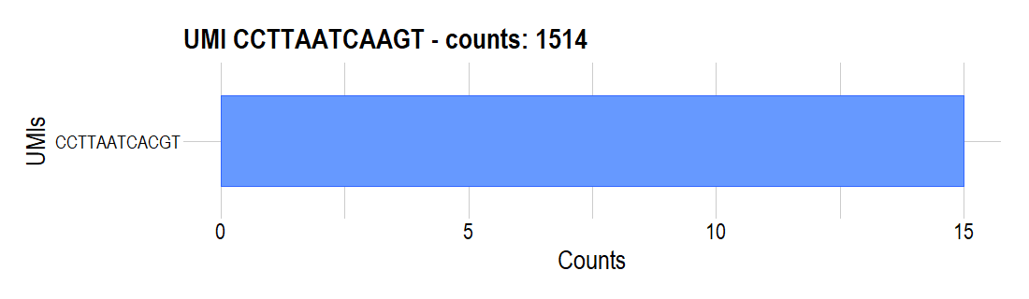
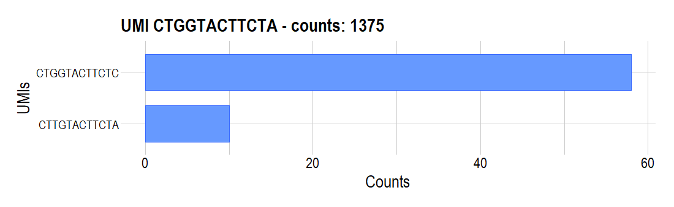
1. UMI counts >5, distance < 4

Slide 6
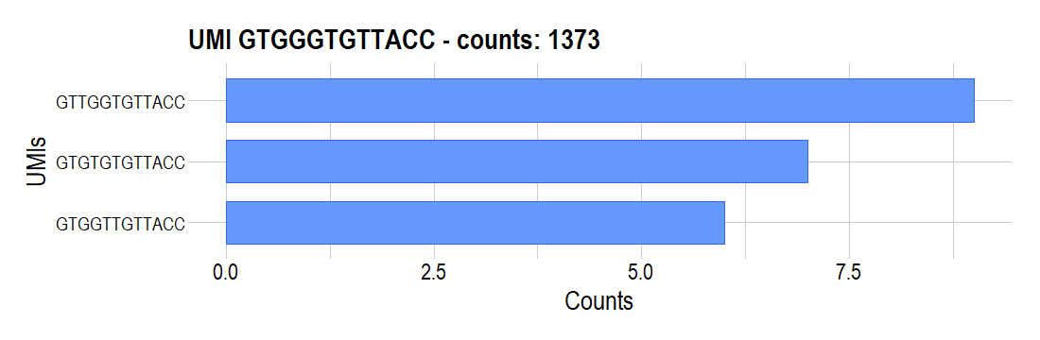
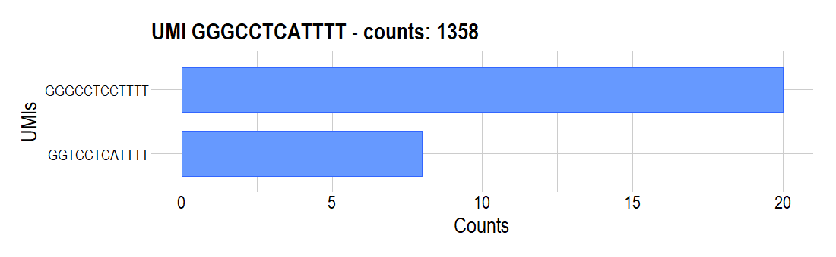
1. UMI counts >5, distance < 4

Slide 7
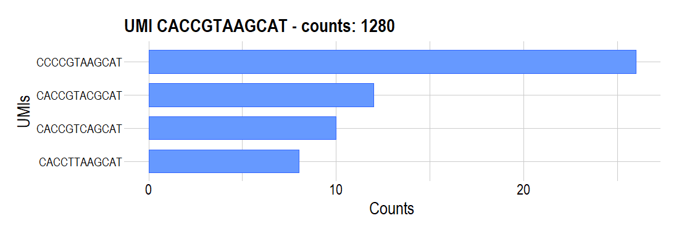
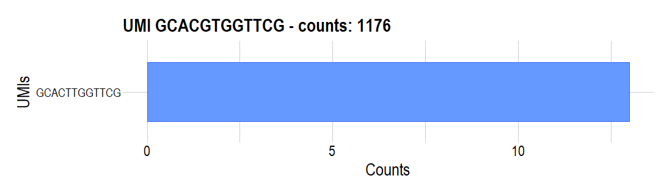
1. UMI counts >5, distance < 4

Slide 8
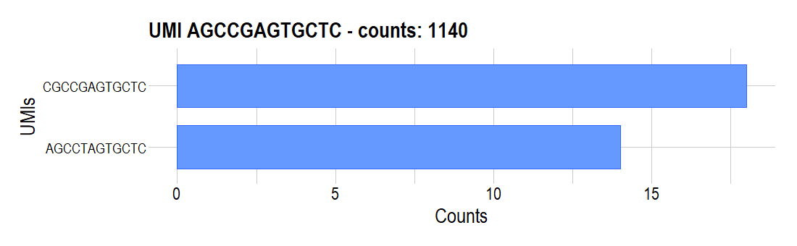
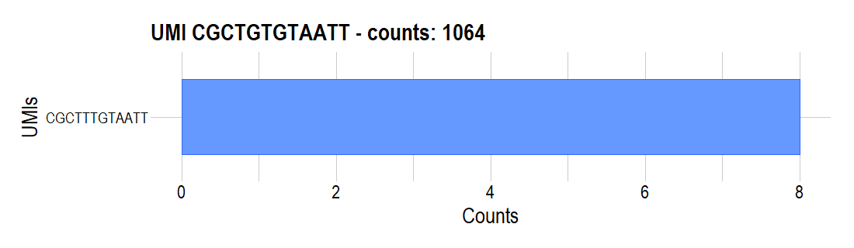
1. UMI counts >5, distance < 4

Slide 9

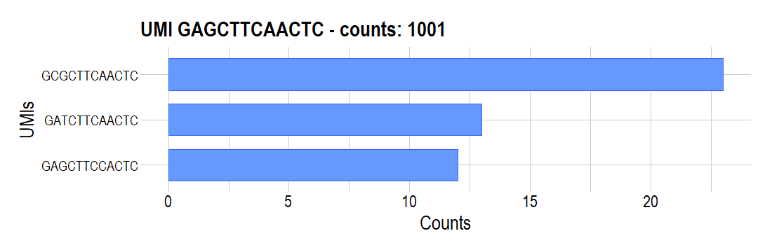
1. UMI counts >5, distance < 4

Slide 10
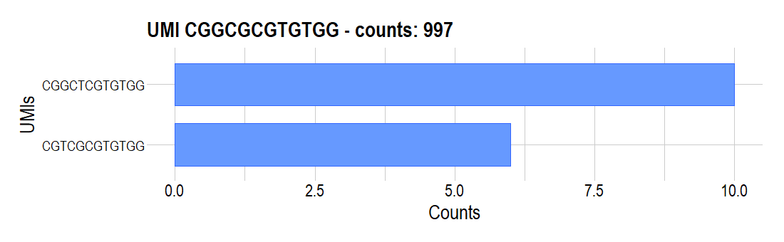
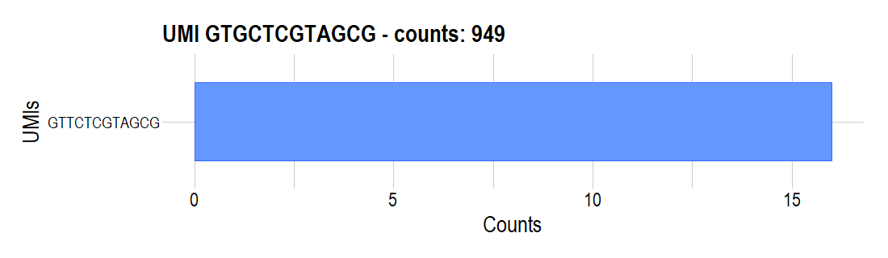
1. UMI counts >5, distance < 4

Slide 11
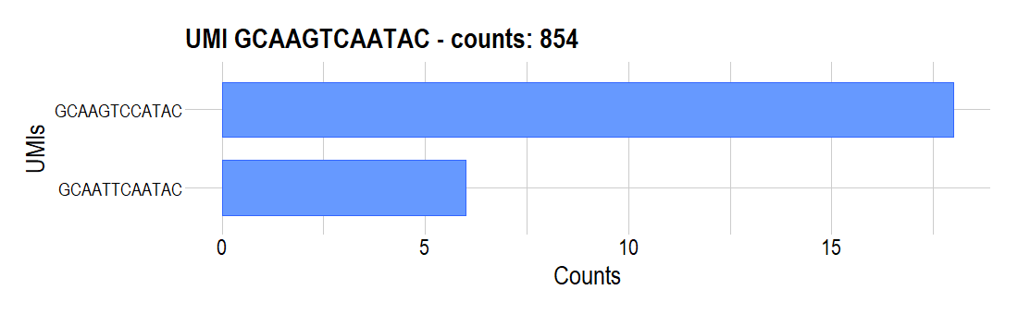

1. UMI counts >5, distance < 4

Slide 12
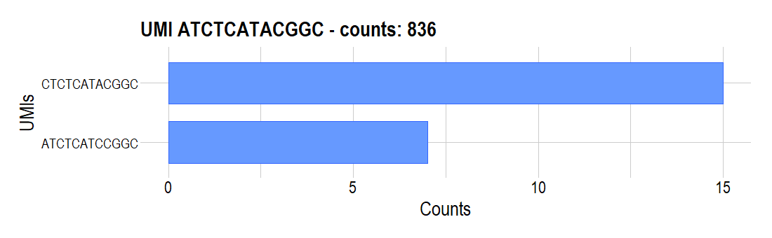
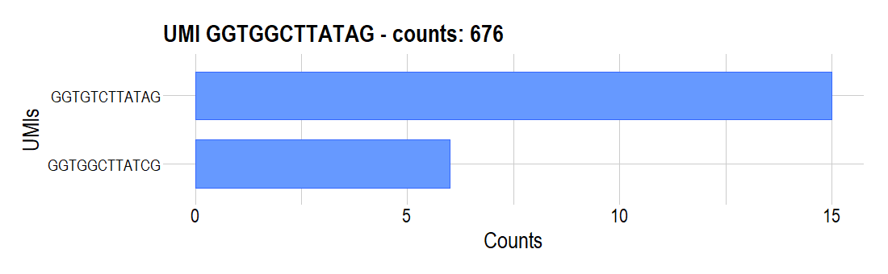
1. UMI counts >5, distance < 4

Slide 13
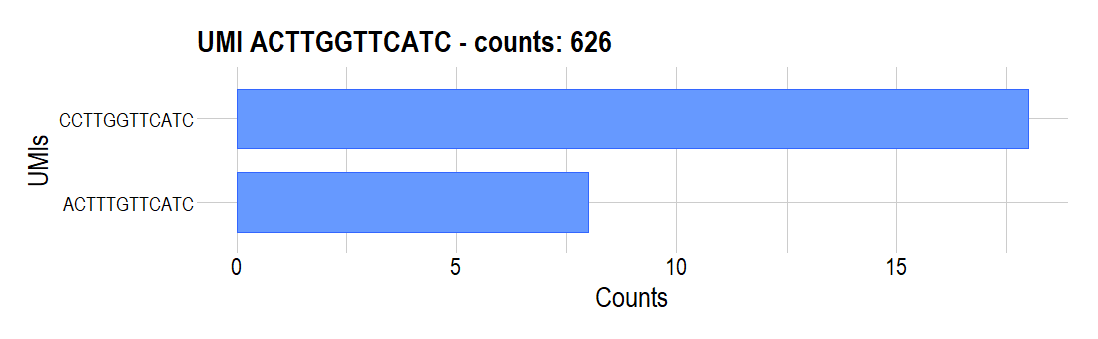
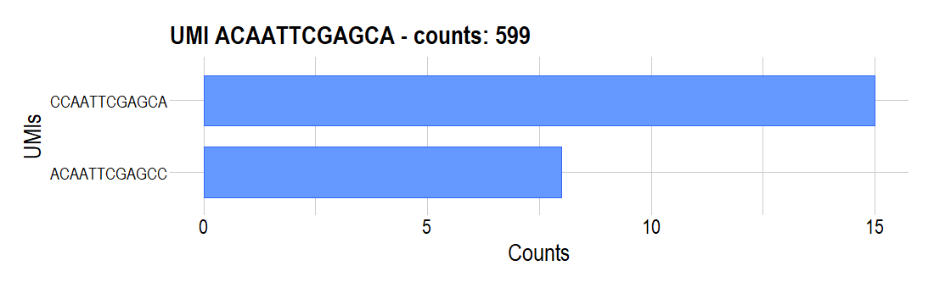
1. UMI counts >5, distance < 4

Slide 14
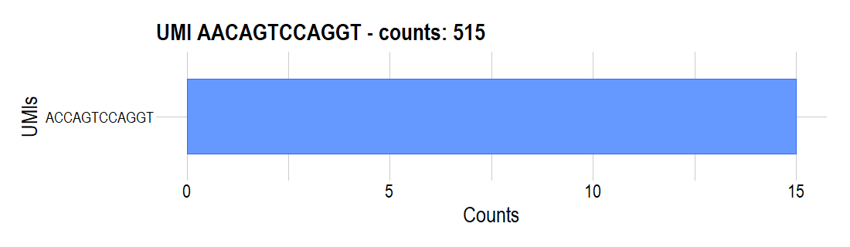

1. UMI counts >5, distance < 4

Slide 15

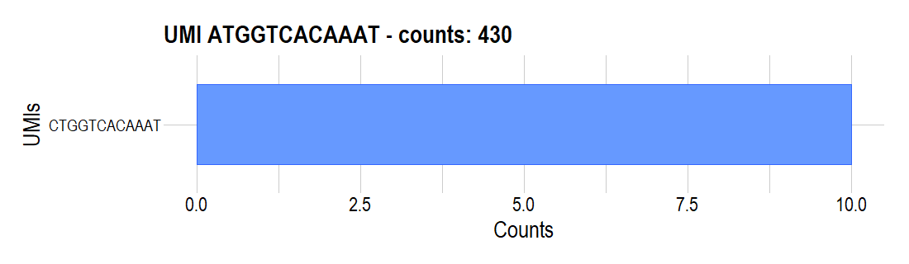
1. UMI counts >5, distance < 4

Slide 16
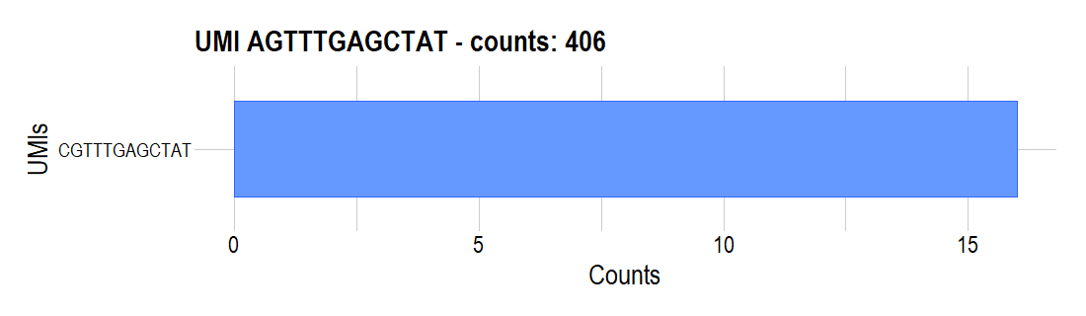
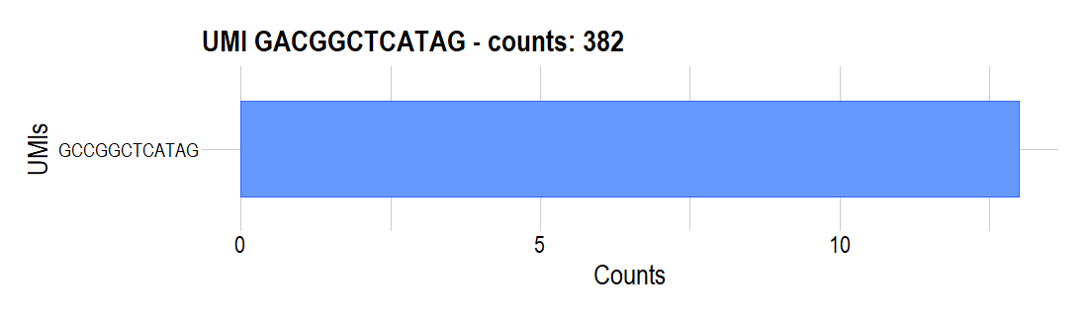
1. UMI counts >5, distance < 4

Slide 17
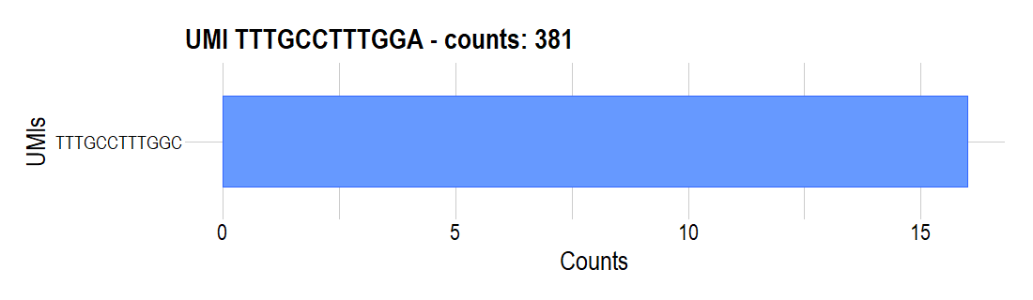

1. UMI counts >5, distance < 4

Slide 18
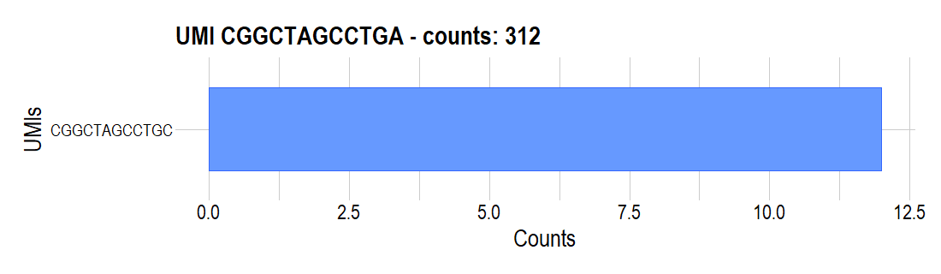
1. UMI counts >5, distance < 4

Slide 19
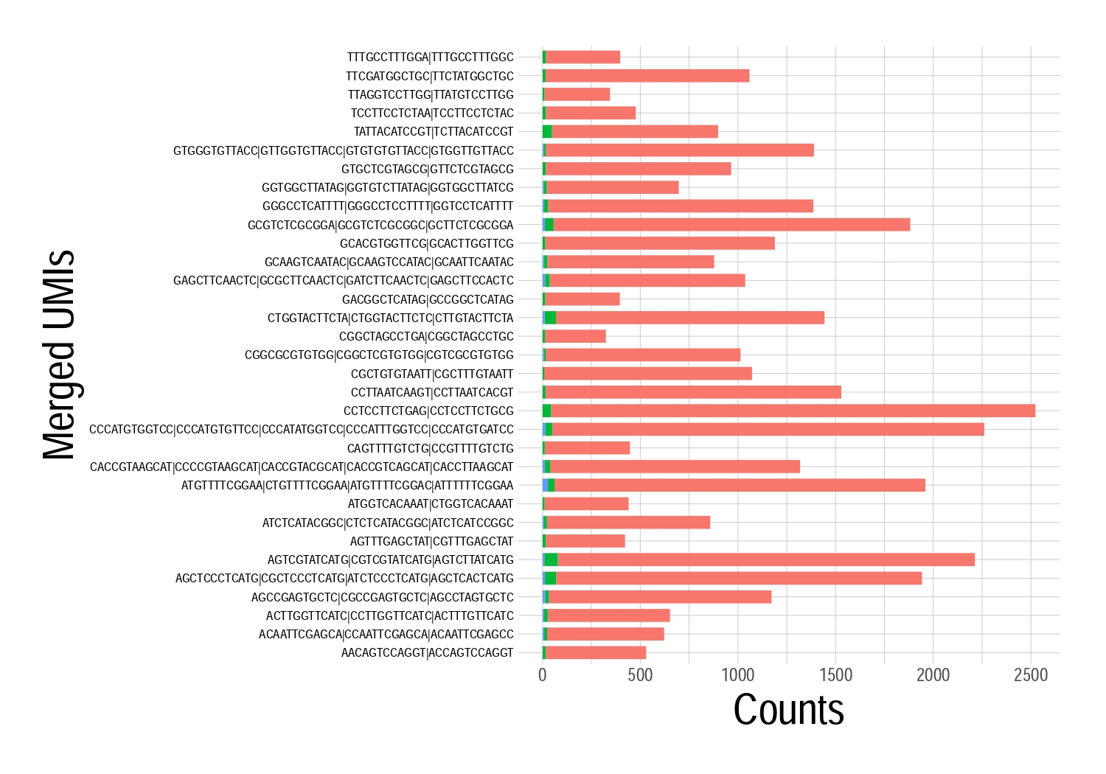
Συγκεντρωτικό διάγραμμα

Slide 20
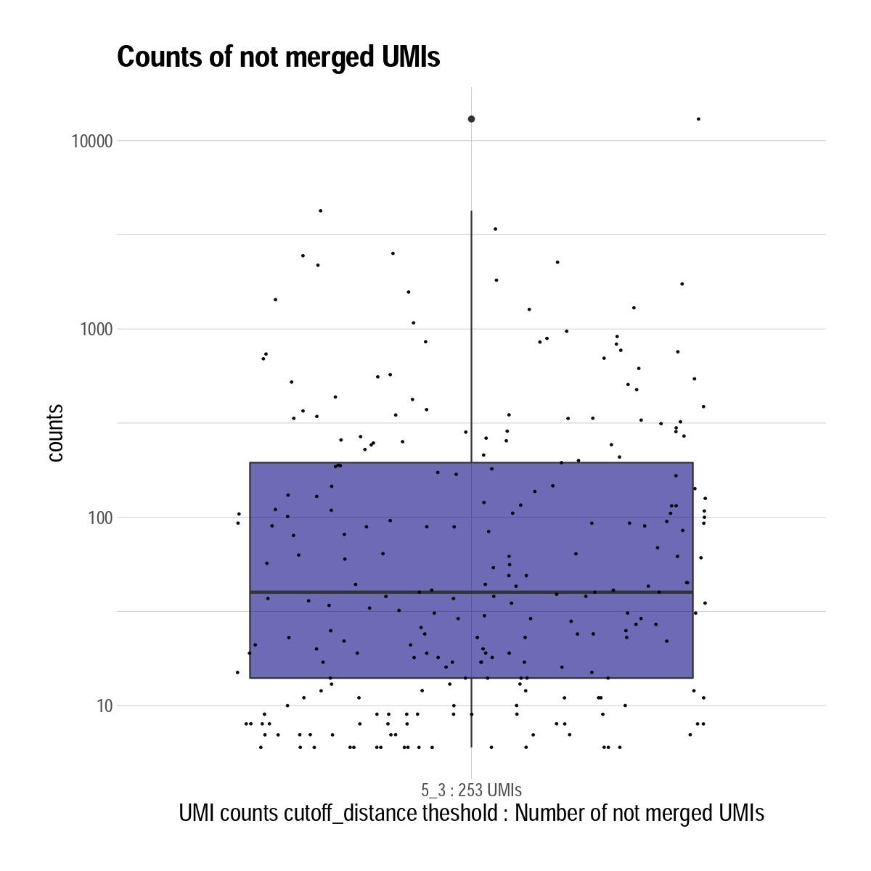
Μένουν 253 UMIs που δε γίνονται συνένωση με κάποιο άλλο
Τα counts τους κυμαίνονται σε:

Slide 21
2 UMI counts >5 distance < 31

Slide 22
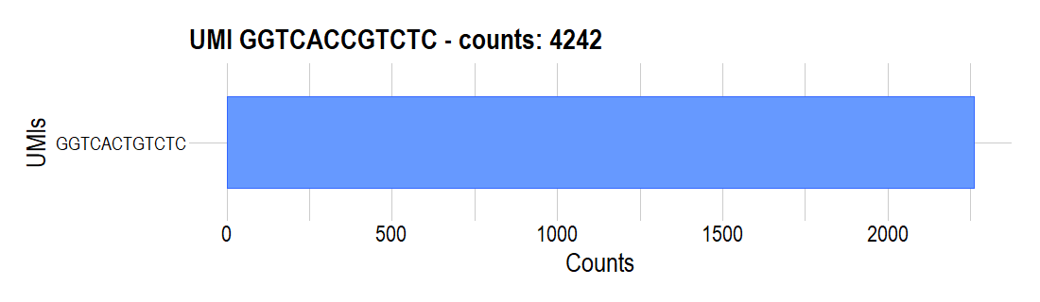
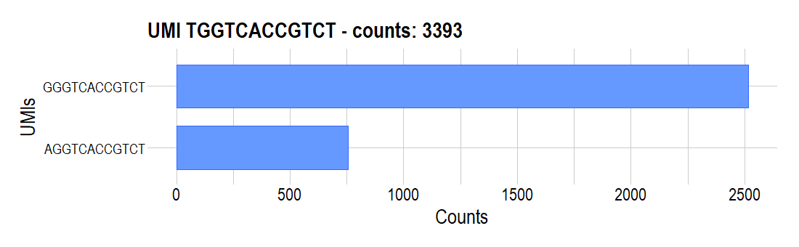
2. UMI counts >5, distance < 31

Slide 23
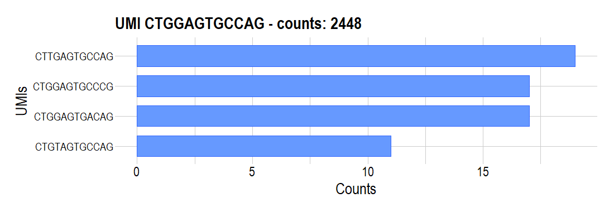
2. UMI counts >5, distance < 31

Slide 24

2. UMI counts >5, distance < 31

Slide 25
2. UMI counts >5, distance < 31

Slide 26
2. UMI counts >5, distance < 31

Slide 27
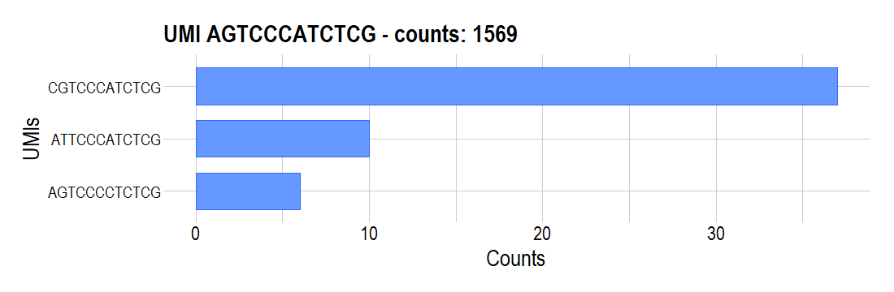
2. UMI counts >5, distance < 31

Slide 28
2. UMI counts >5, distance < 31

Slide 29
2. UMI counts >5, distance < 31

Slide 30
2. UMI counts >5, distance < 31

Slide 31
2. UMI counts >5, distance < 31

Slide 32
2. UMI counts >5, distance < 31

Slide 33
2. UMI counts >5, distance < 31

Slide 34
2. UMI counts >5, distance < 31

Slide 35
2. UMI counts >5, distance < 31

Slide 36
2. UMI counts >5, distance < 31

Slide 37
2. UMI counts >5, distance < 31

Slide 38
2. UMI counts >5, distance < 31

Slide 39
2. UMI counts >5, distance < 31

Slide 40
2. UMI counts >5, distance < 31

Slide 41
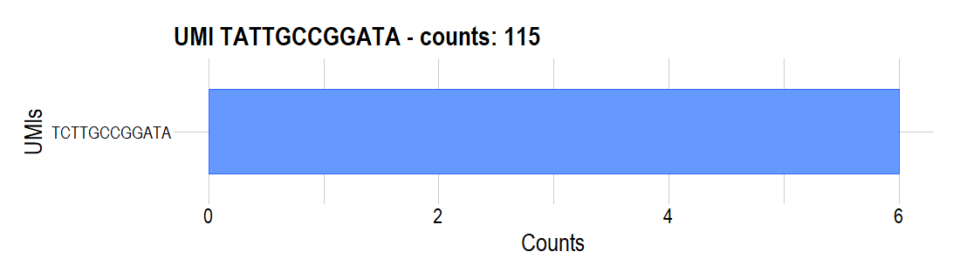
2. UMI counts >5, distance < 31

Slide 42
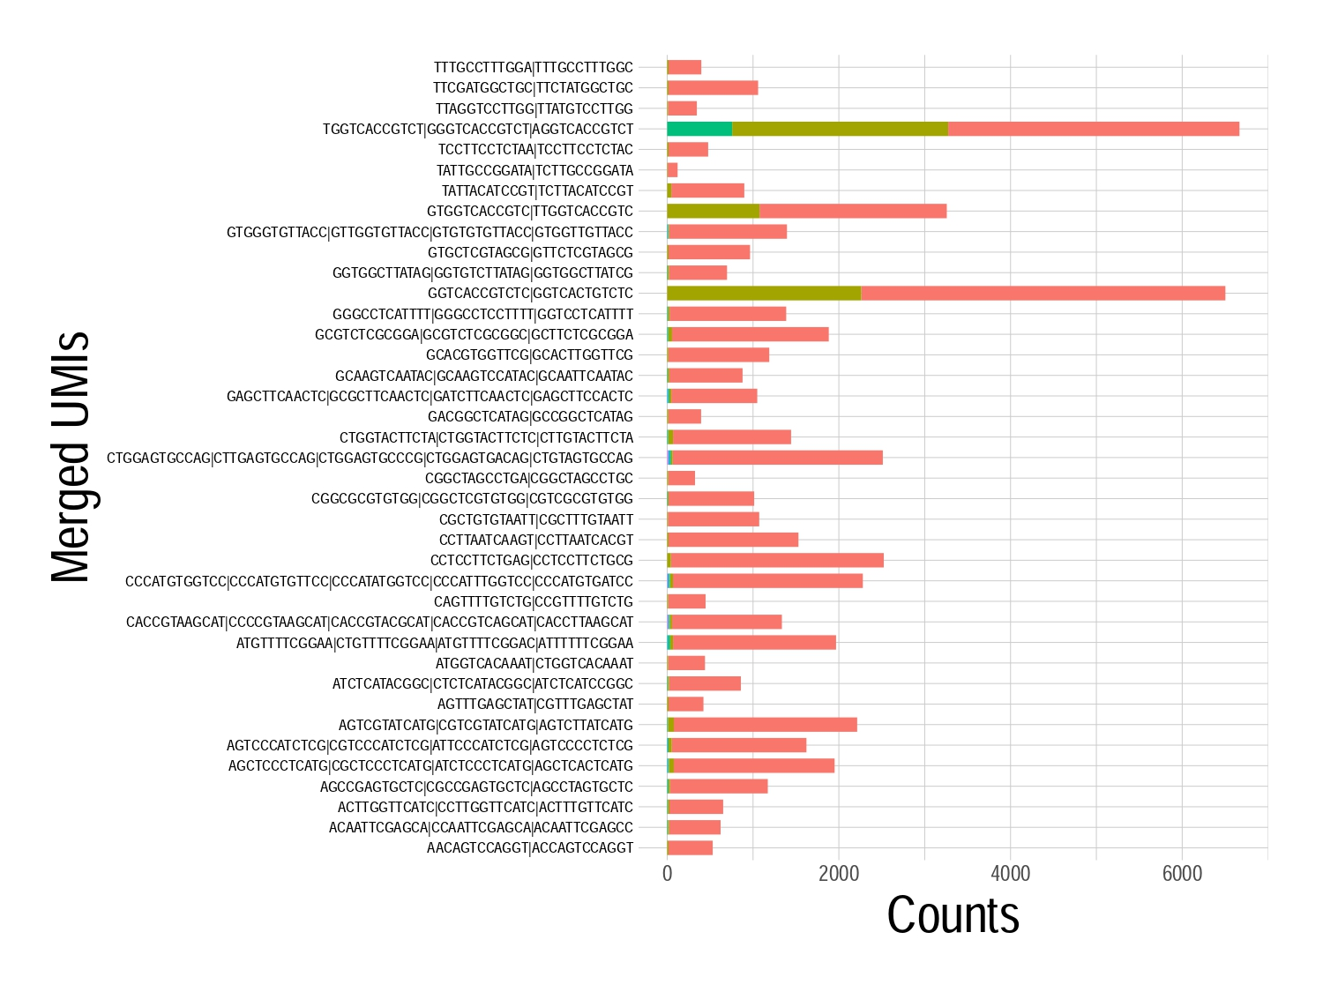
Συγκεντρωτικό διάγραμμα

Slide 43
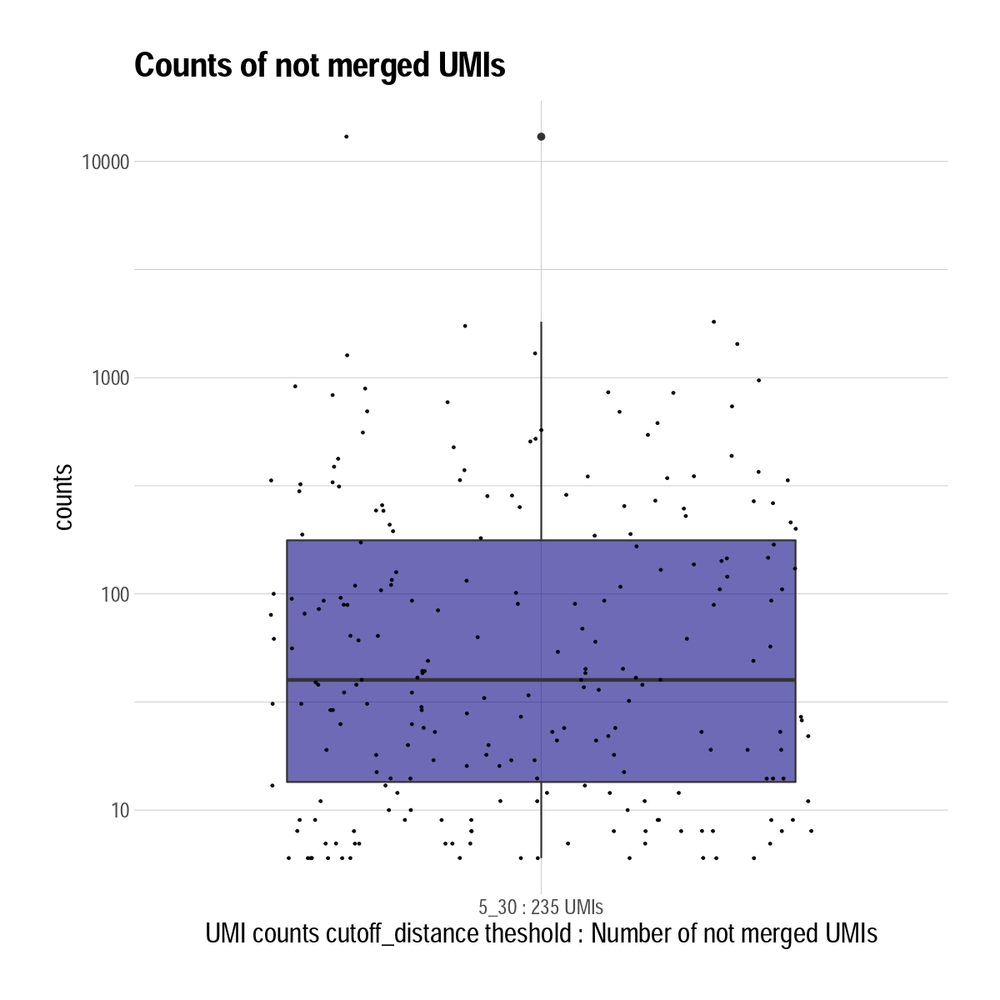
Μένουν 235 UMIs που δε γίνονται συνένωση με κάποιο άλλο
Τα counts τους κυμαίνονται σε:

Slide 44
3 UMI counts >10 distance < 4

Slide 45
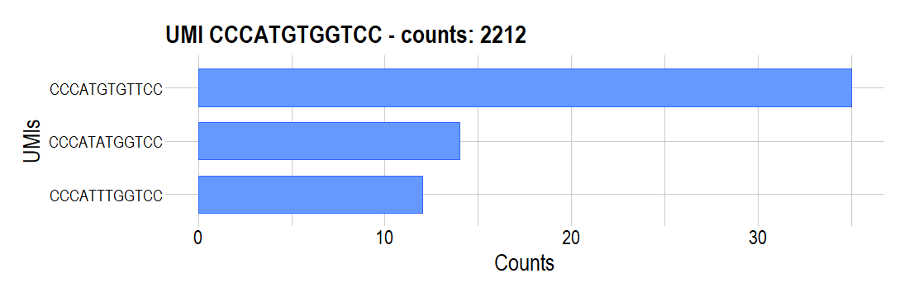
3. UMI counts >11, distance < 4

Slide 46

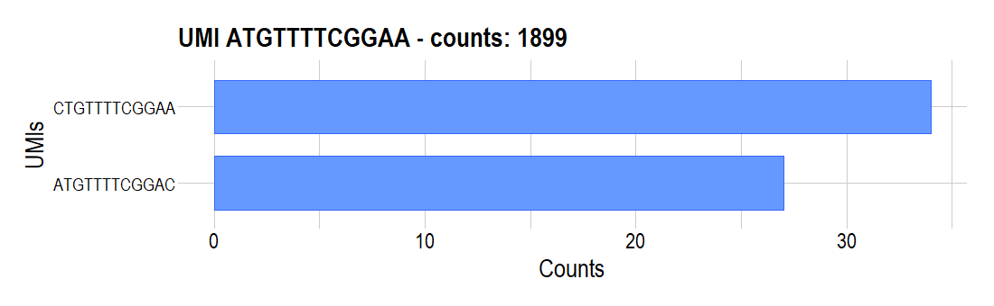
3. UMI counts >11, distance < 4

Slide 47
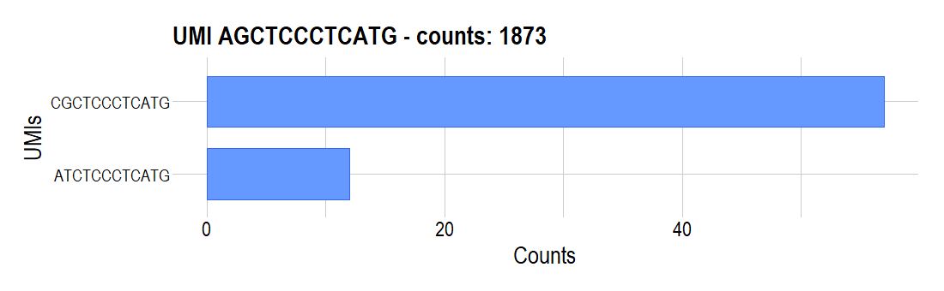
3. UMI counts >11, distance < 4

Slide 48

3. UMI counts >11, distance < 4

Slide 49


3. UMI counts >11, distance < 4

Slide 50
3. UMI counts >11, distance < 4

Slide 51
3. UMI counts >11, distance < 4

Slide 52
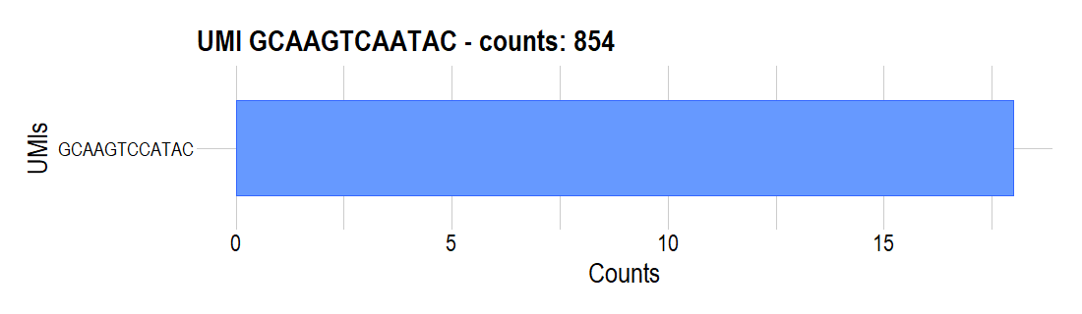
3. UMI counts >11, distance < 4

Slide 53

3. UMI counts >11, distance < 4

Slide 54


3. UMI counts >11, distance < 4

Slide 55

3. UMI counts >11, distance < 4

Slide 56
3. UMI counts >11, distance < 4

Slide 57
3. UMI counts >11, distance < 4

Slide 58
3. UMI counts >11, distance < 4

Slide 59
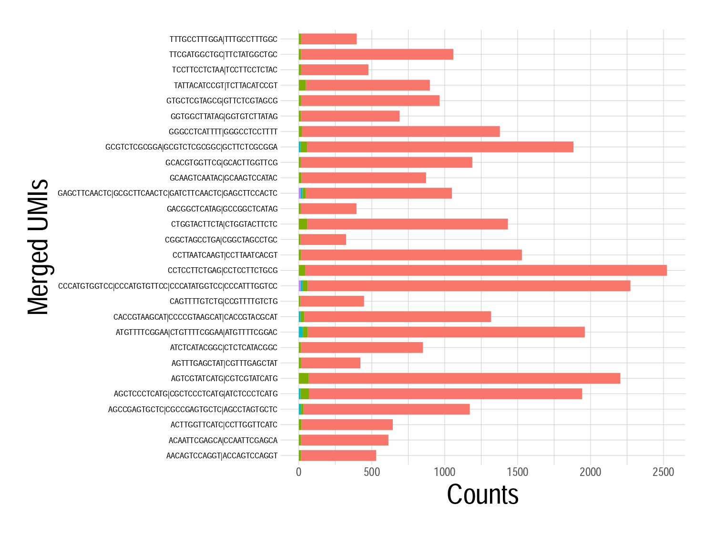
Συγκεντρωτικό διάγραμμα

Slide 60
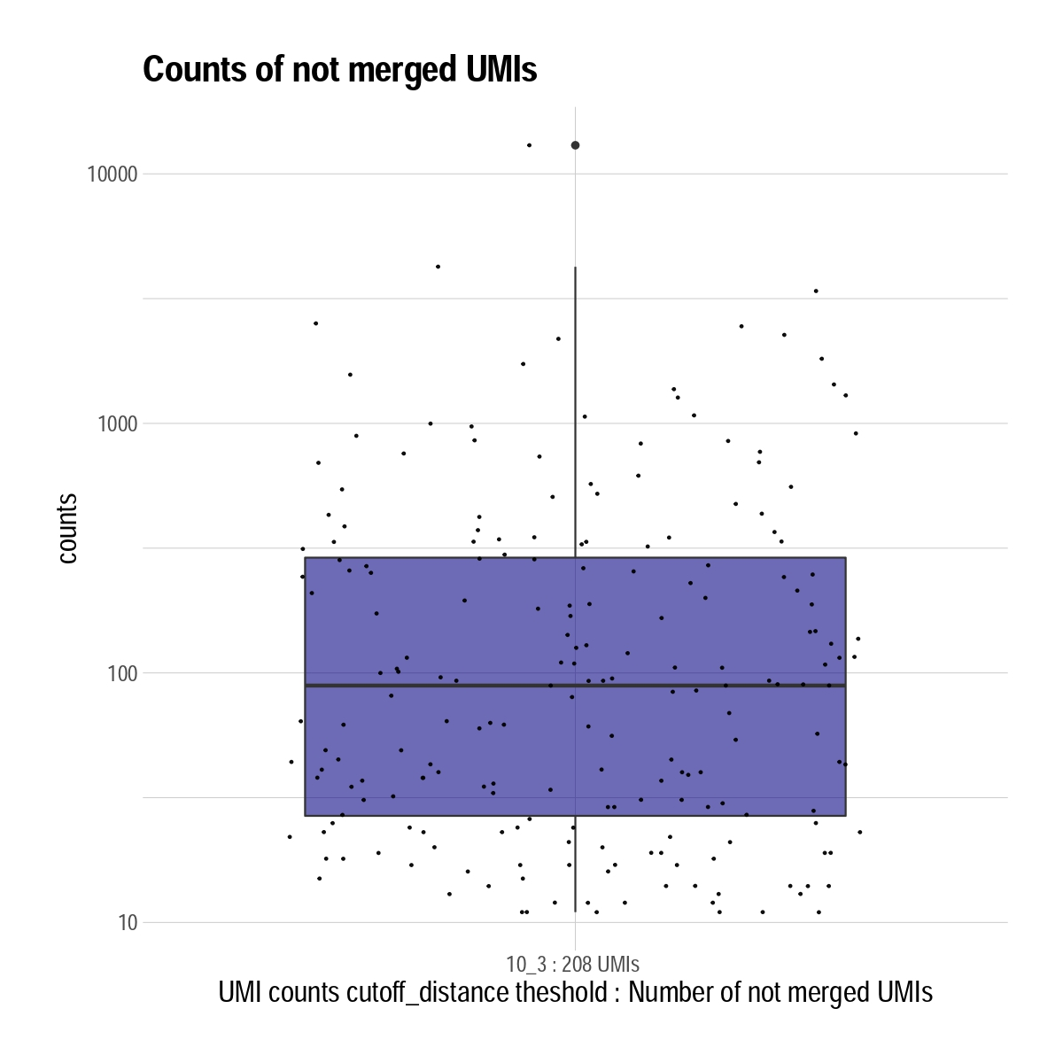
Μένουν 208 UMIs που δε γίνονται συνένωση με κάποιο άλλο
Τα counts τους κυμαίνονται σε:

Slide 61
4 UMI counts >11 distance < 31

Slide 62
4. UMI counts >11, distance < 31

Slide 63
4. UMI counts >11, distance < 31

Slide 64
4. UMI counts >11, distance < 31

Slide 65
4. UMI counts >11, distance < 31

Slide 66
4. UMI counts >11, distance < 31

Slide 67

4. UMI counts >11, distance < 31

Slide 68
4. UMI counts >11, distance < 31

Slide 69
4. UMI counts >11, distance < 31

Slide 70
4. UMI counts >11, distance < 31

Slide 71
4. UMI counts >11, distance < 31

Slide 72
4. UMI counts >11, distance < 31

Slide 73
4. UMI counts >11, distance < 31

Slide 74
4. UMI counts >11, distance < 31

Slide 75
4. UMI counts >11, distance < 31

Slide 76
4. UMI counts >11, distance < 31

Slide 77
4. UMI counts >11, distance < 31

Slide 78
4. UMI counts >11, distance < 31

Slide 79
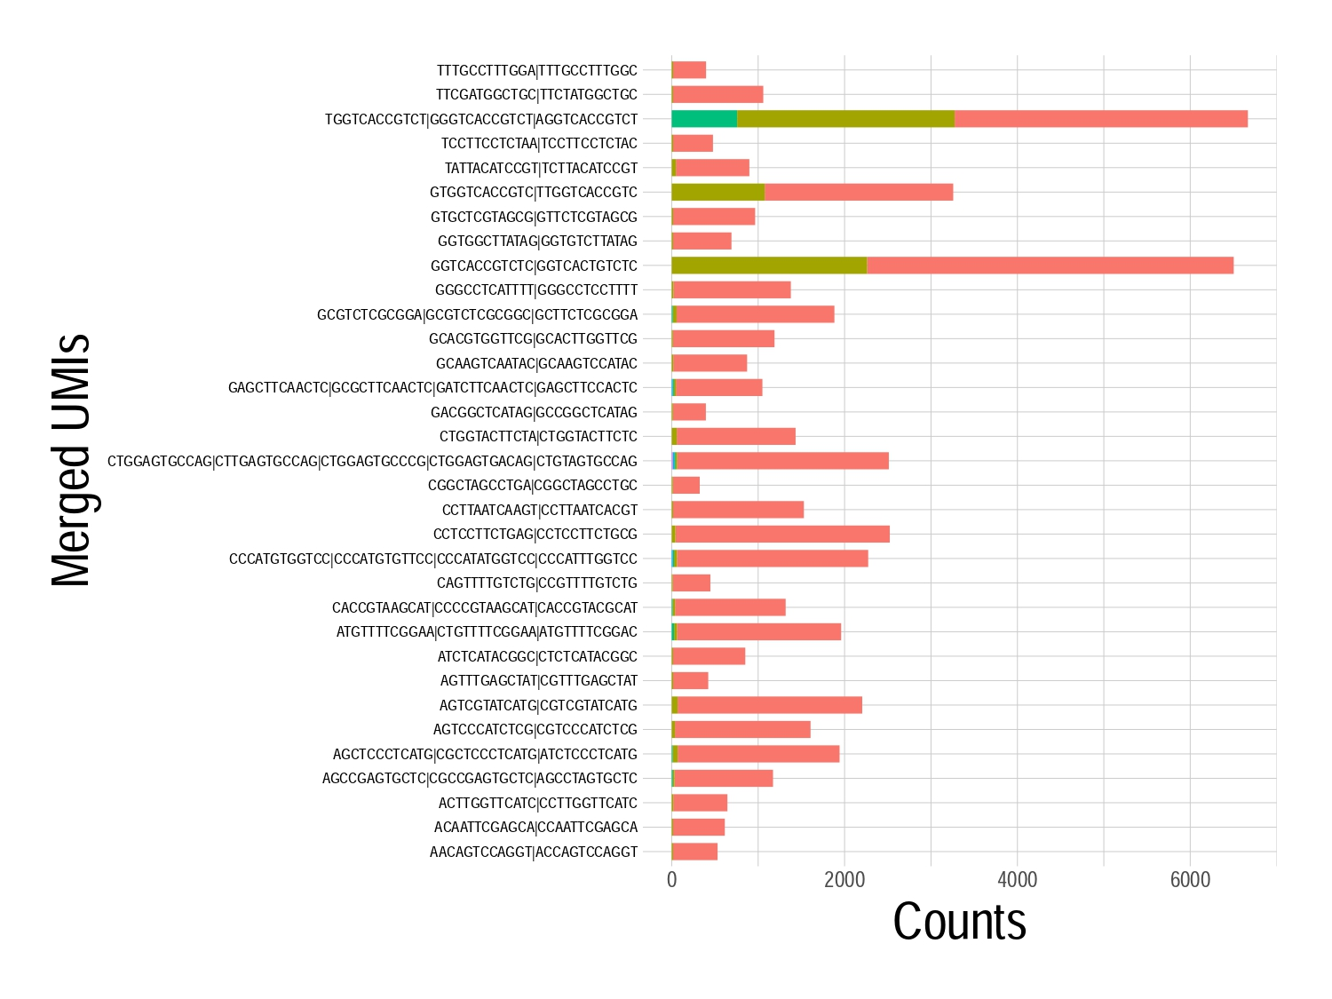
Συγκεντρωτικό διάγραμμα

Slide 80

Μένουν 194 UMIs που δε γίνονται συνένωση με κάποιο άλλο
Τα counts τους κυμαίνονται σε:

Slide 81
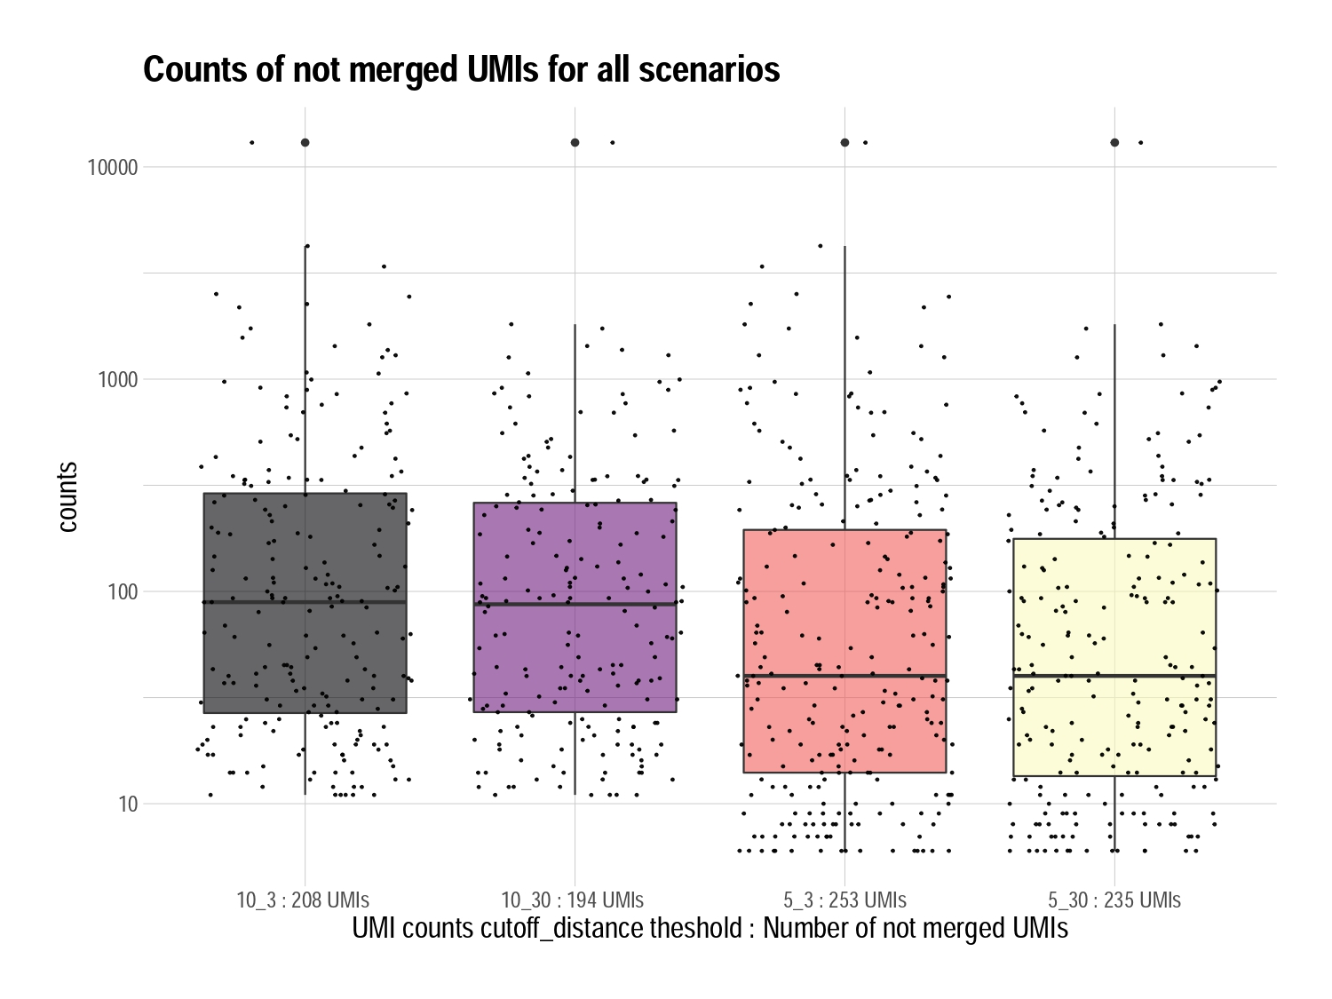

Slide 82
