Slide 1
Bubble Plot with Clinical Covariates

Slide 2
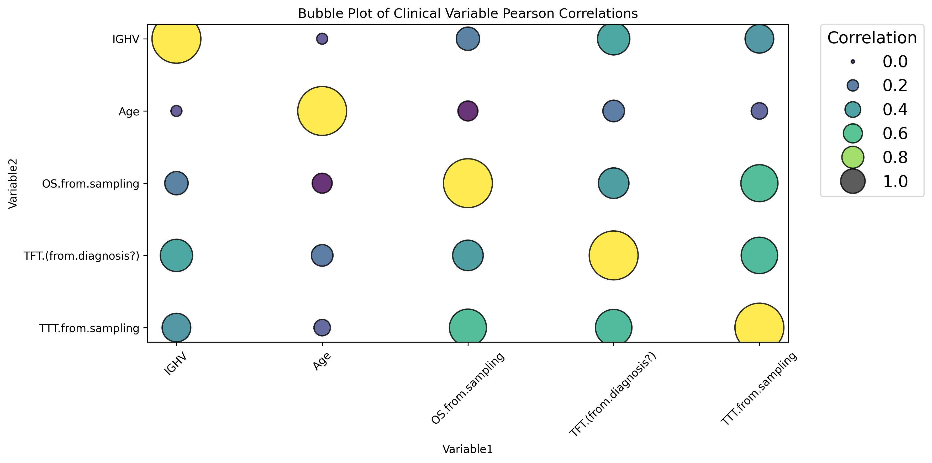
Clinical Covariates between BCMO’s metadata

Slide 3
FOR SURVIVAL STATUS (OS)

Slide 4
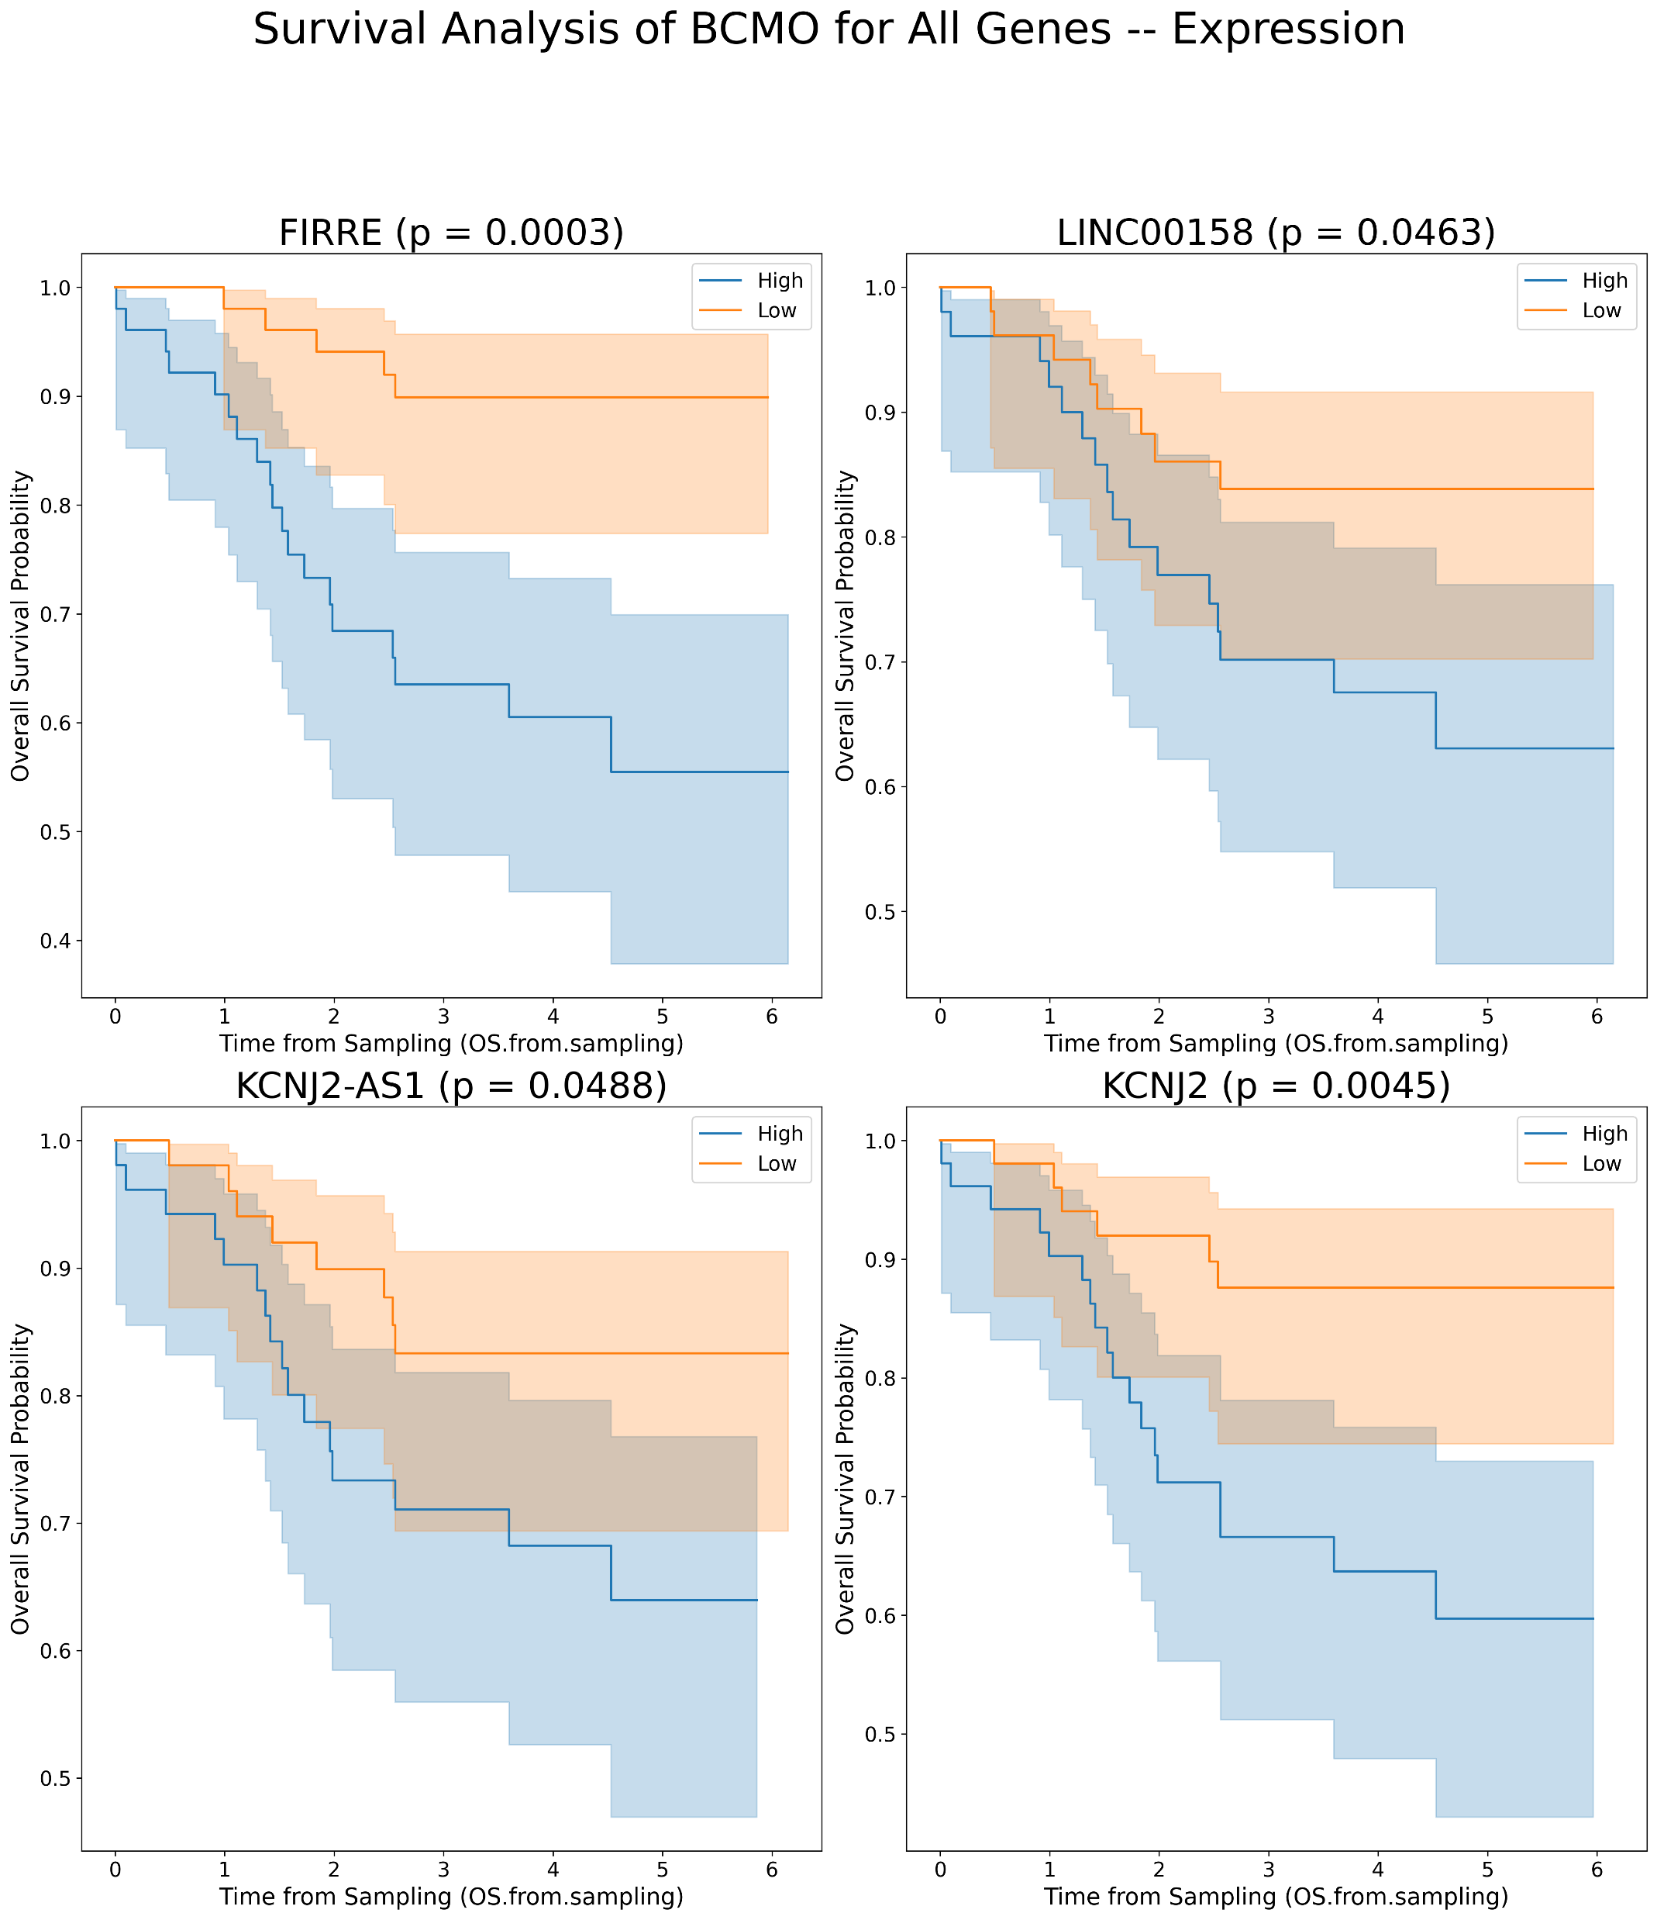
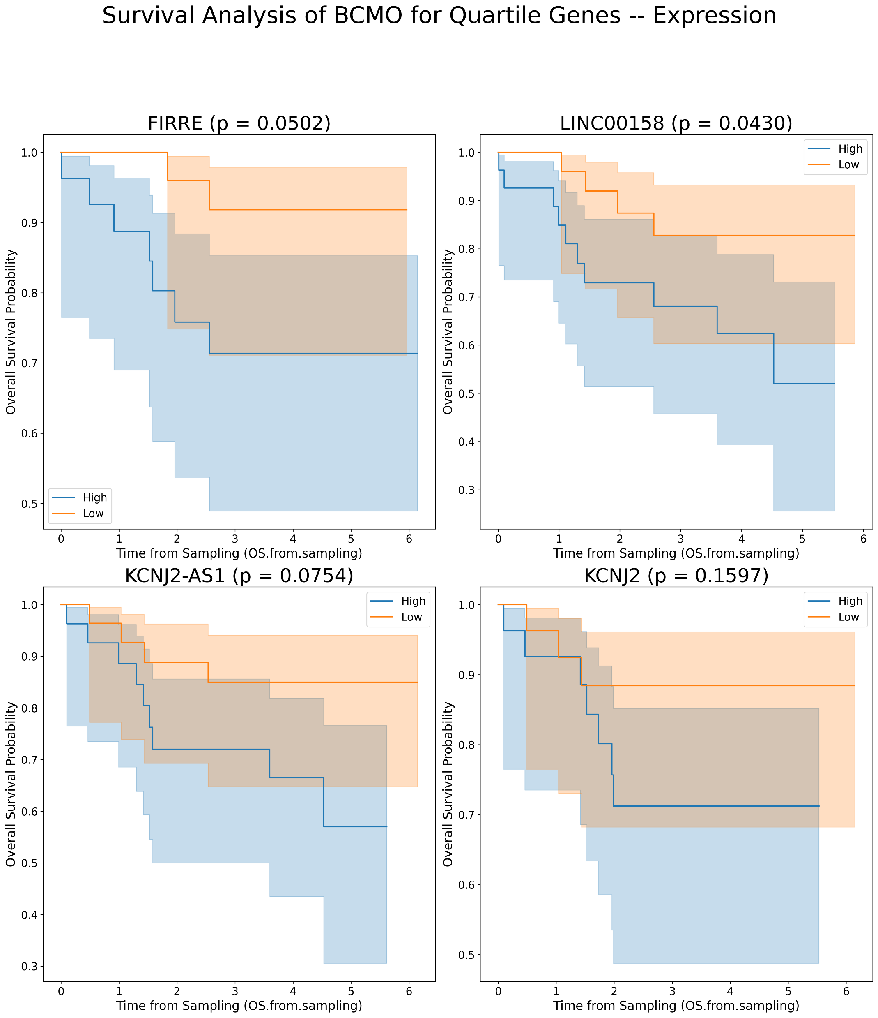
Kaplan Meier’s for lncRNAs plots for OS in BCMO [Expression values]
A
B

Slide 5
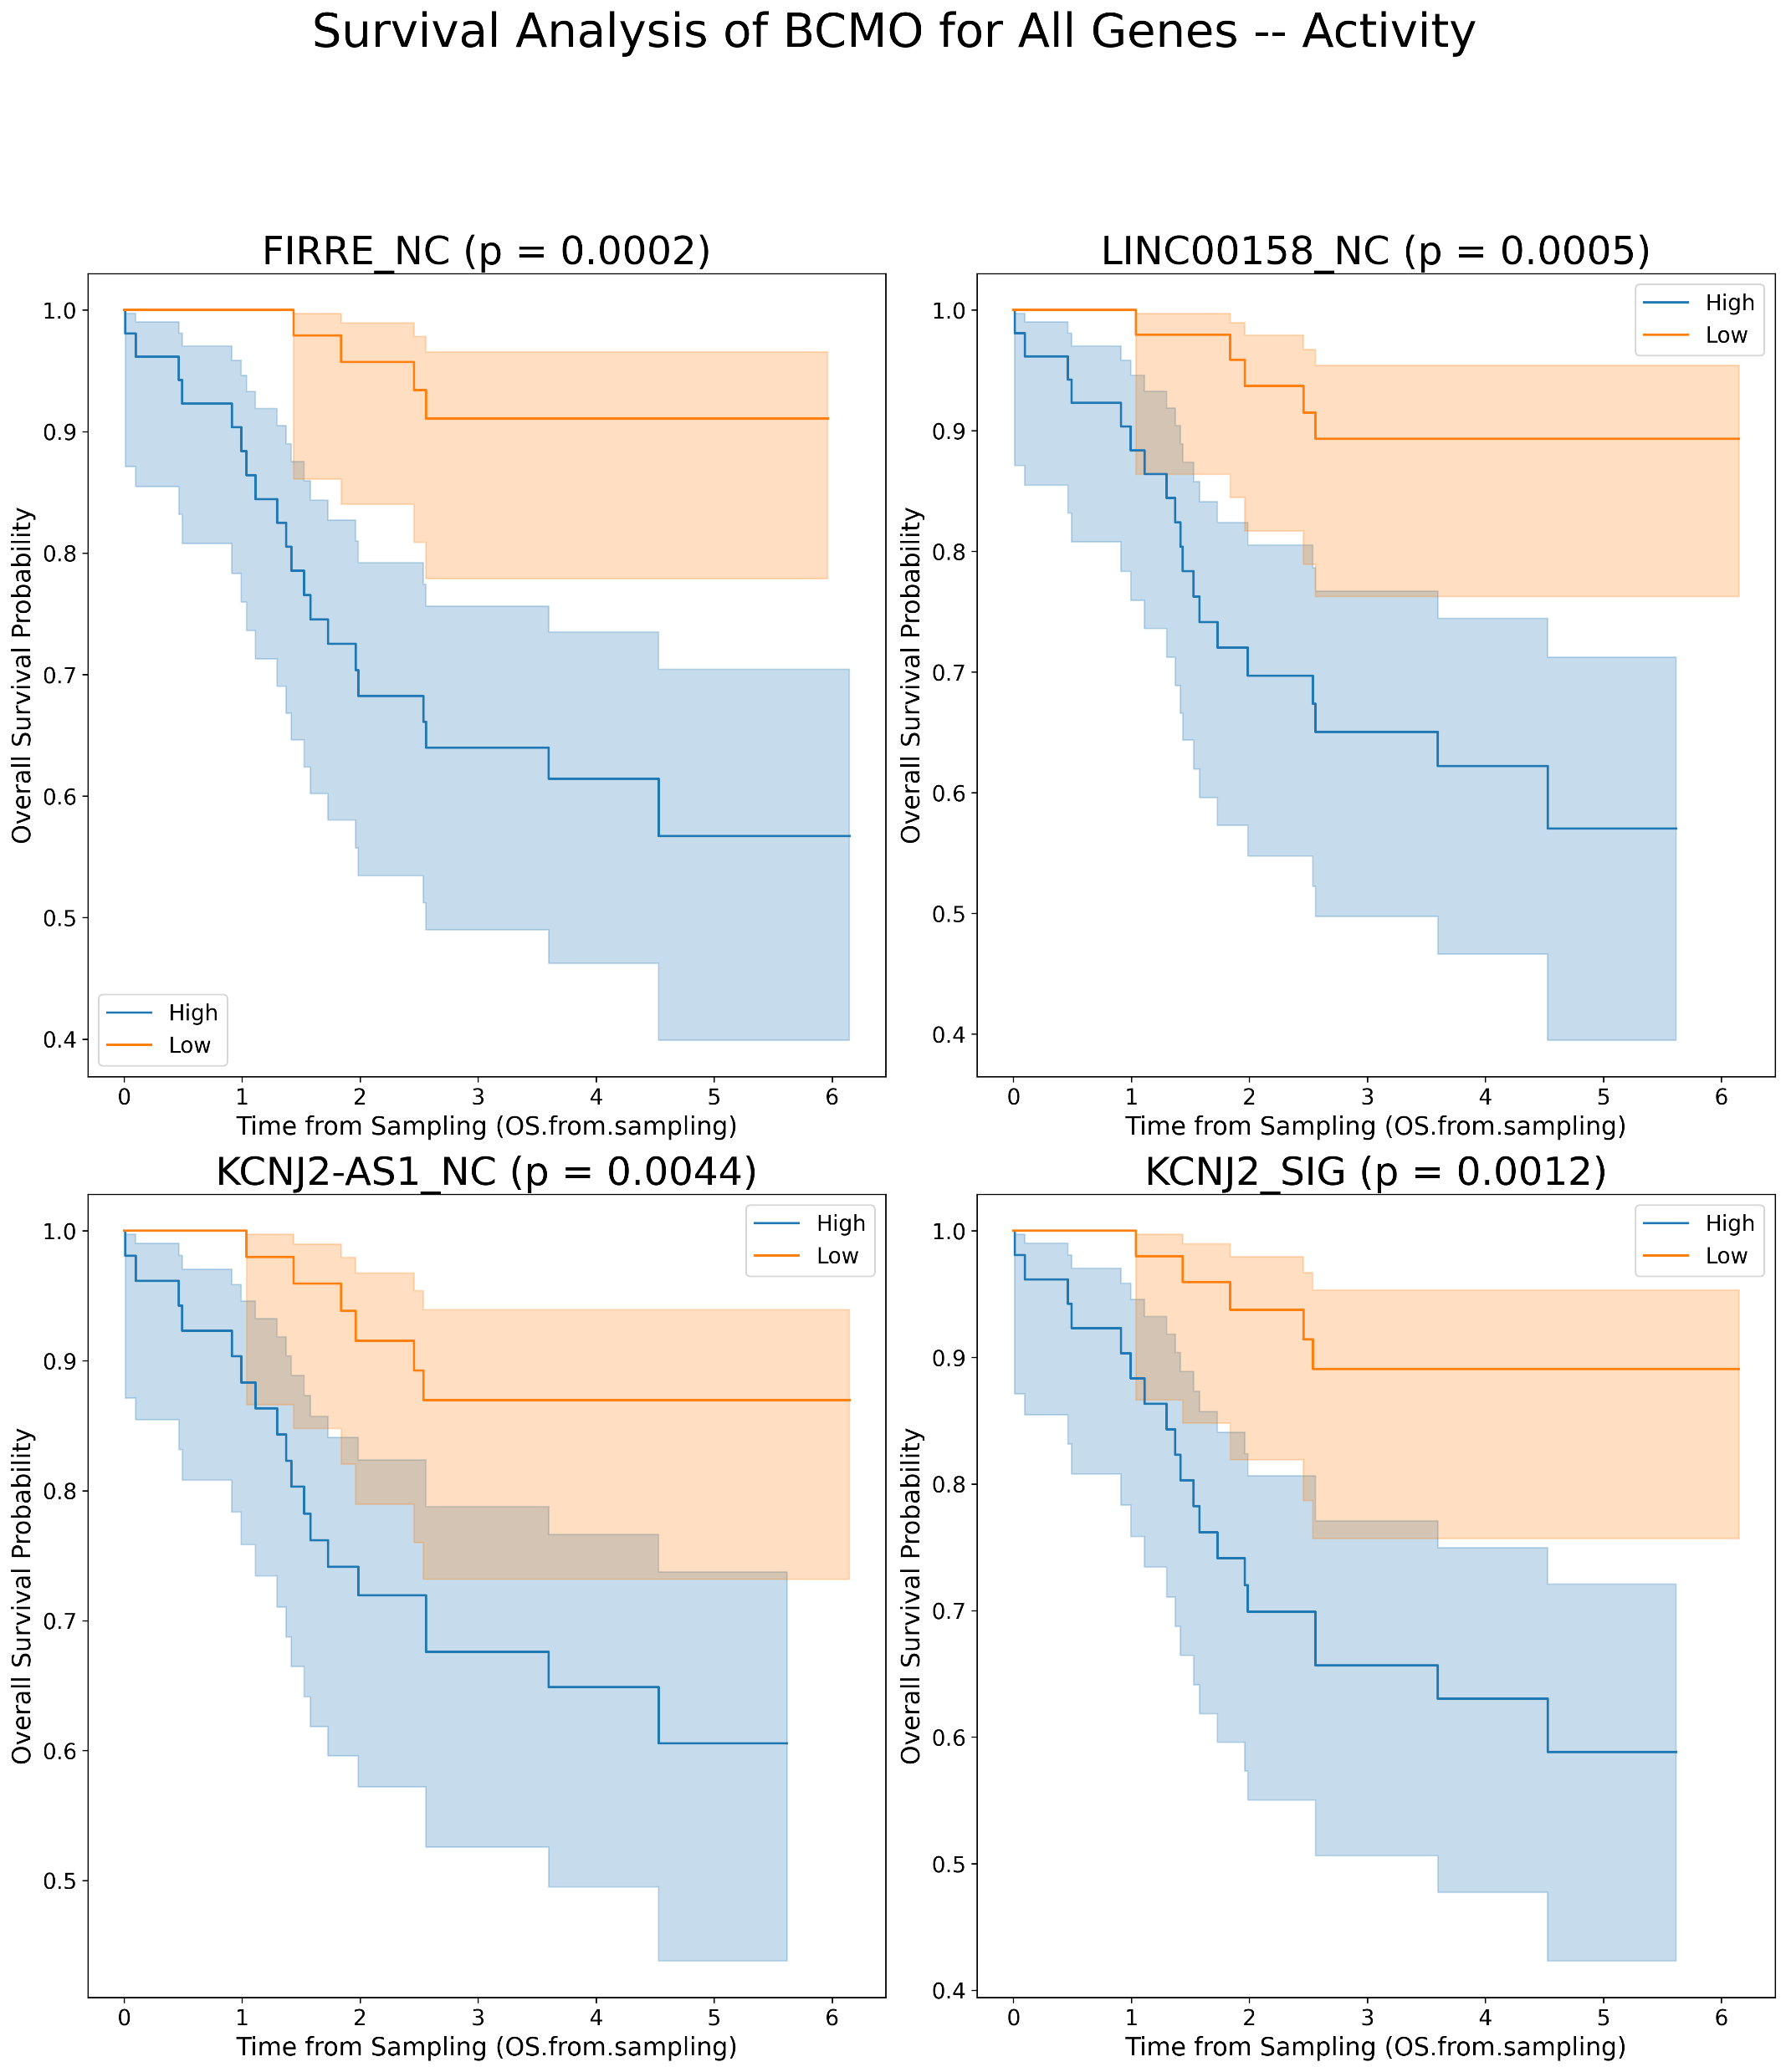
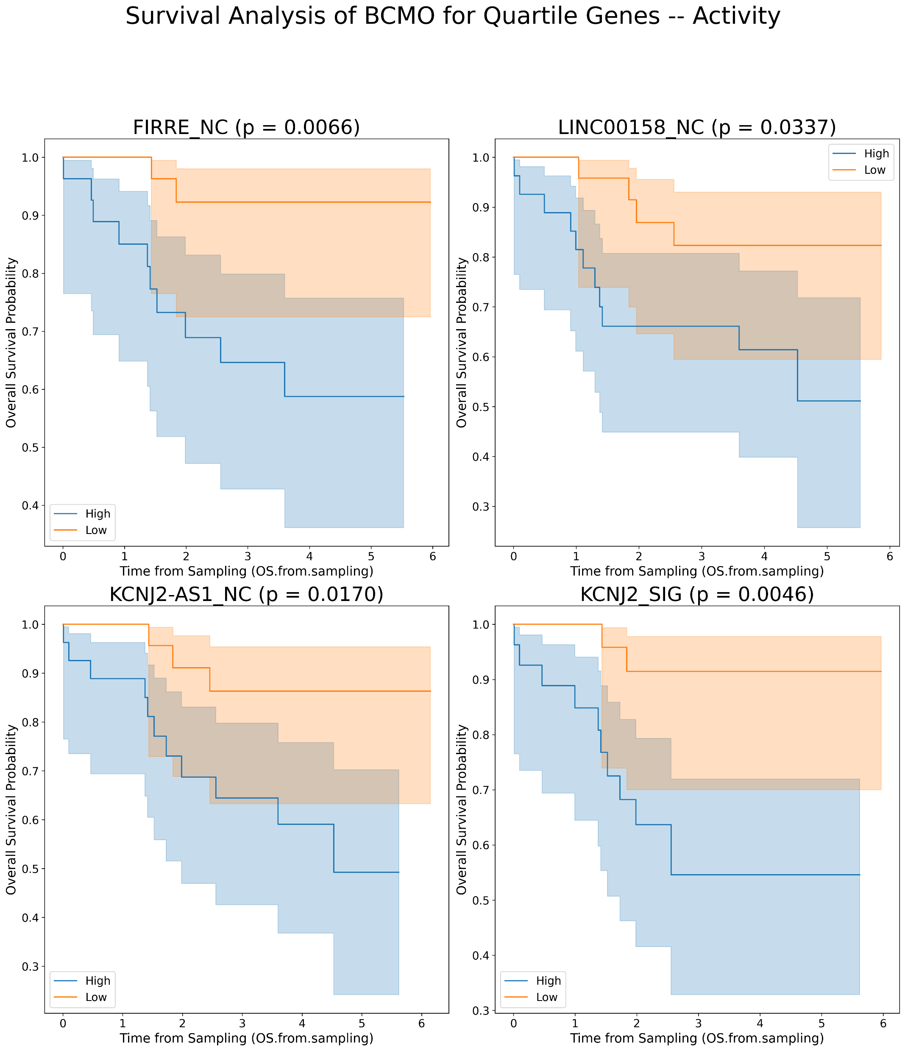
Kaplan Meier’s for lncRNAs plots for OS in BCMO [Activity values]
A
B

Slide 6
FOR TFT

Slide 7
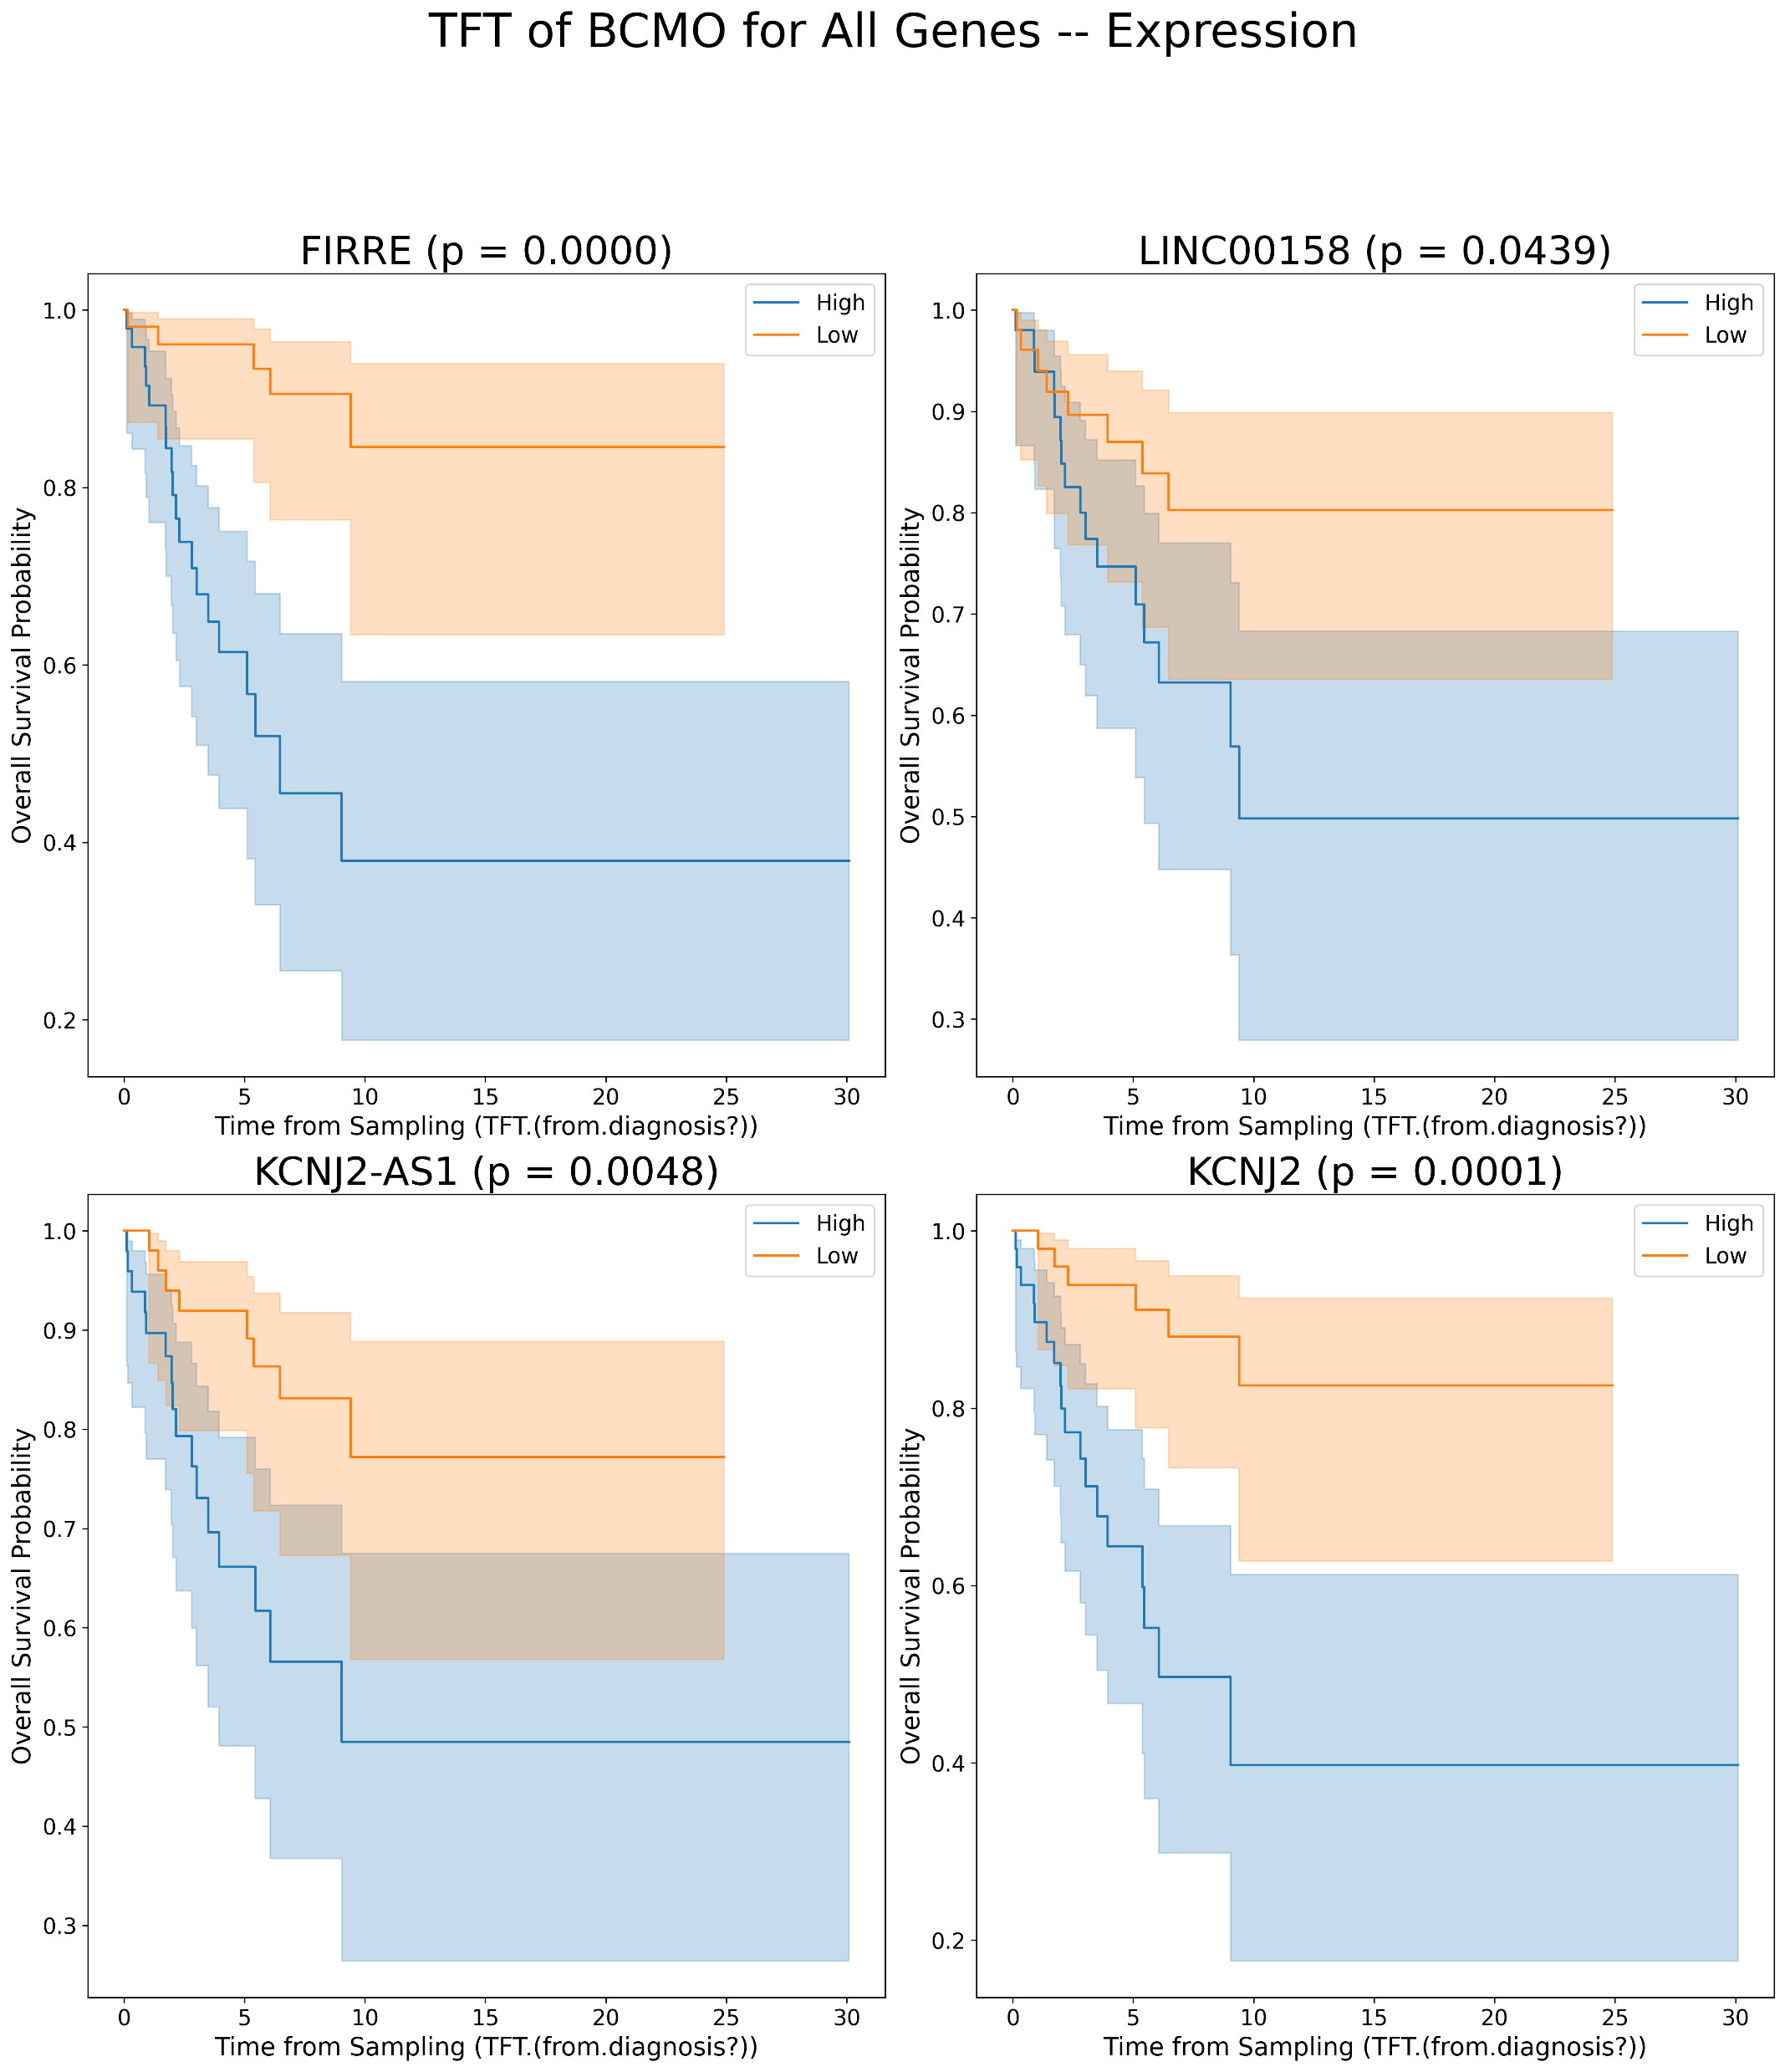
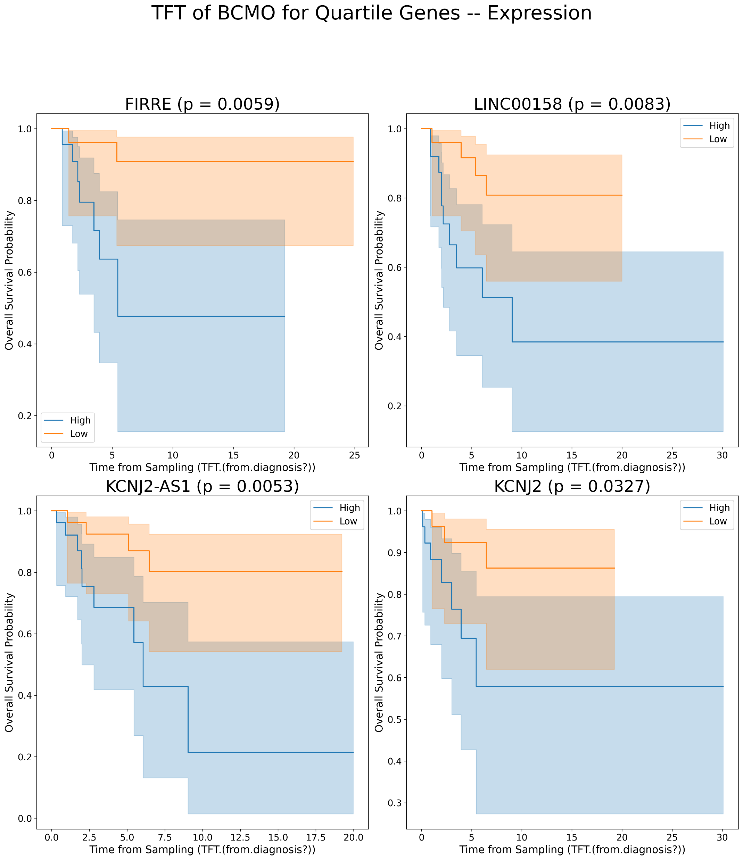
Kaplan Meier’s for lncRNAs plots for TFT in BCMO [Expression values]
A
B

Slide 8
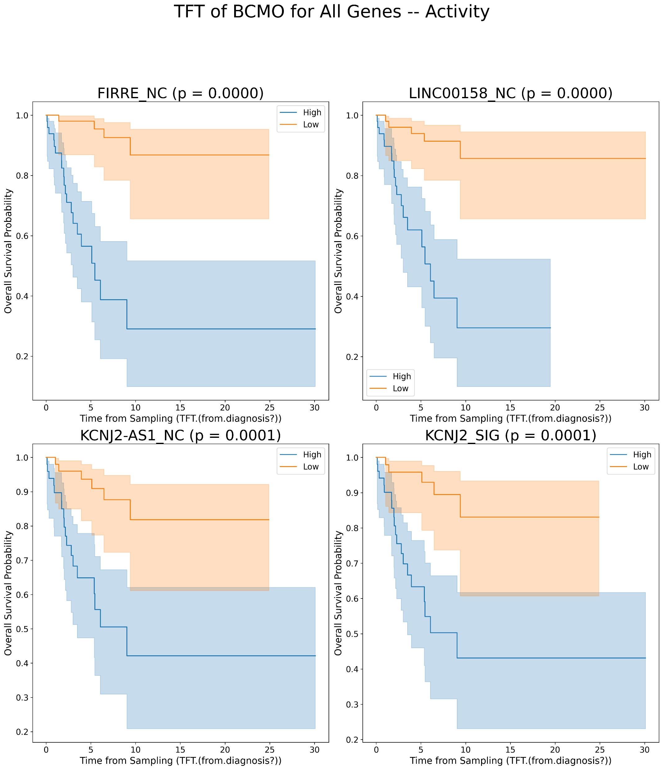
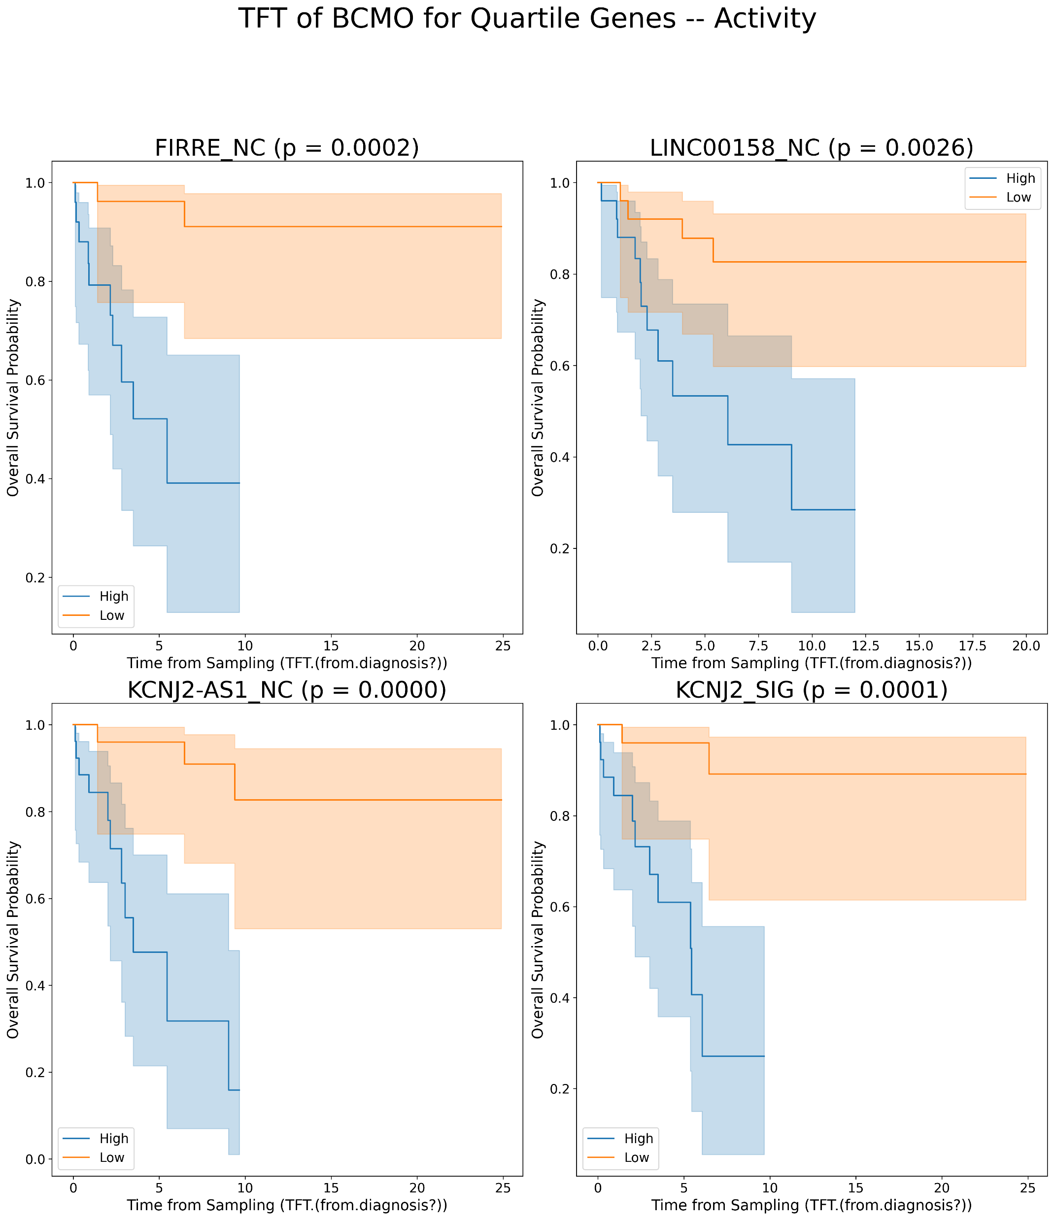
Kaplan Meier’s for lncRNAs plots for TFT in BCMO [Activity values]
A
B

Slide 9
FOR TTT

Slide 10
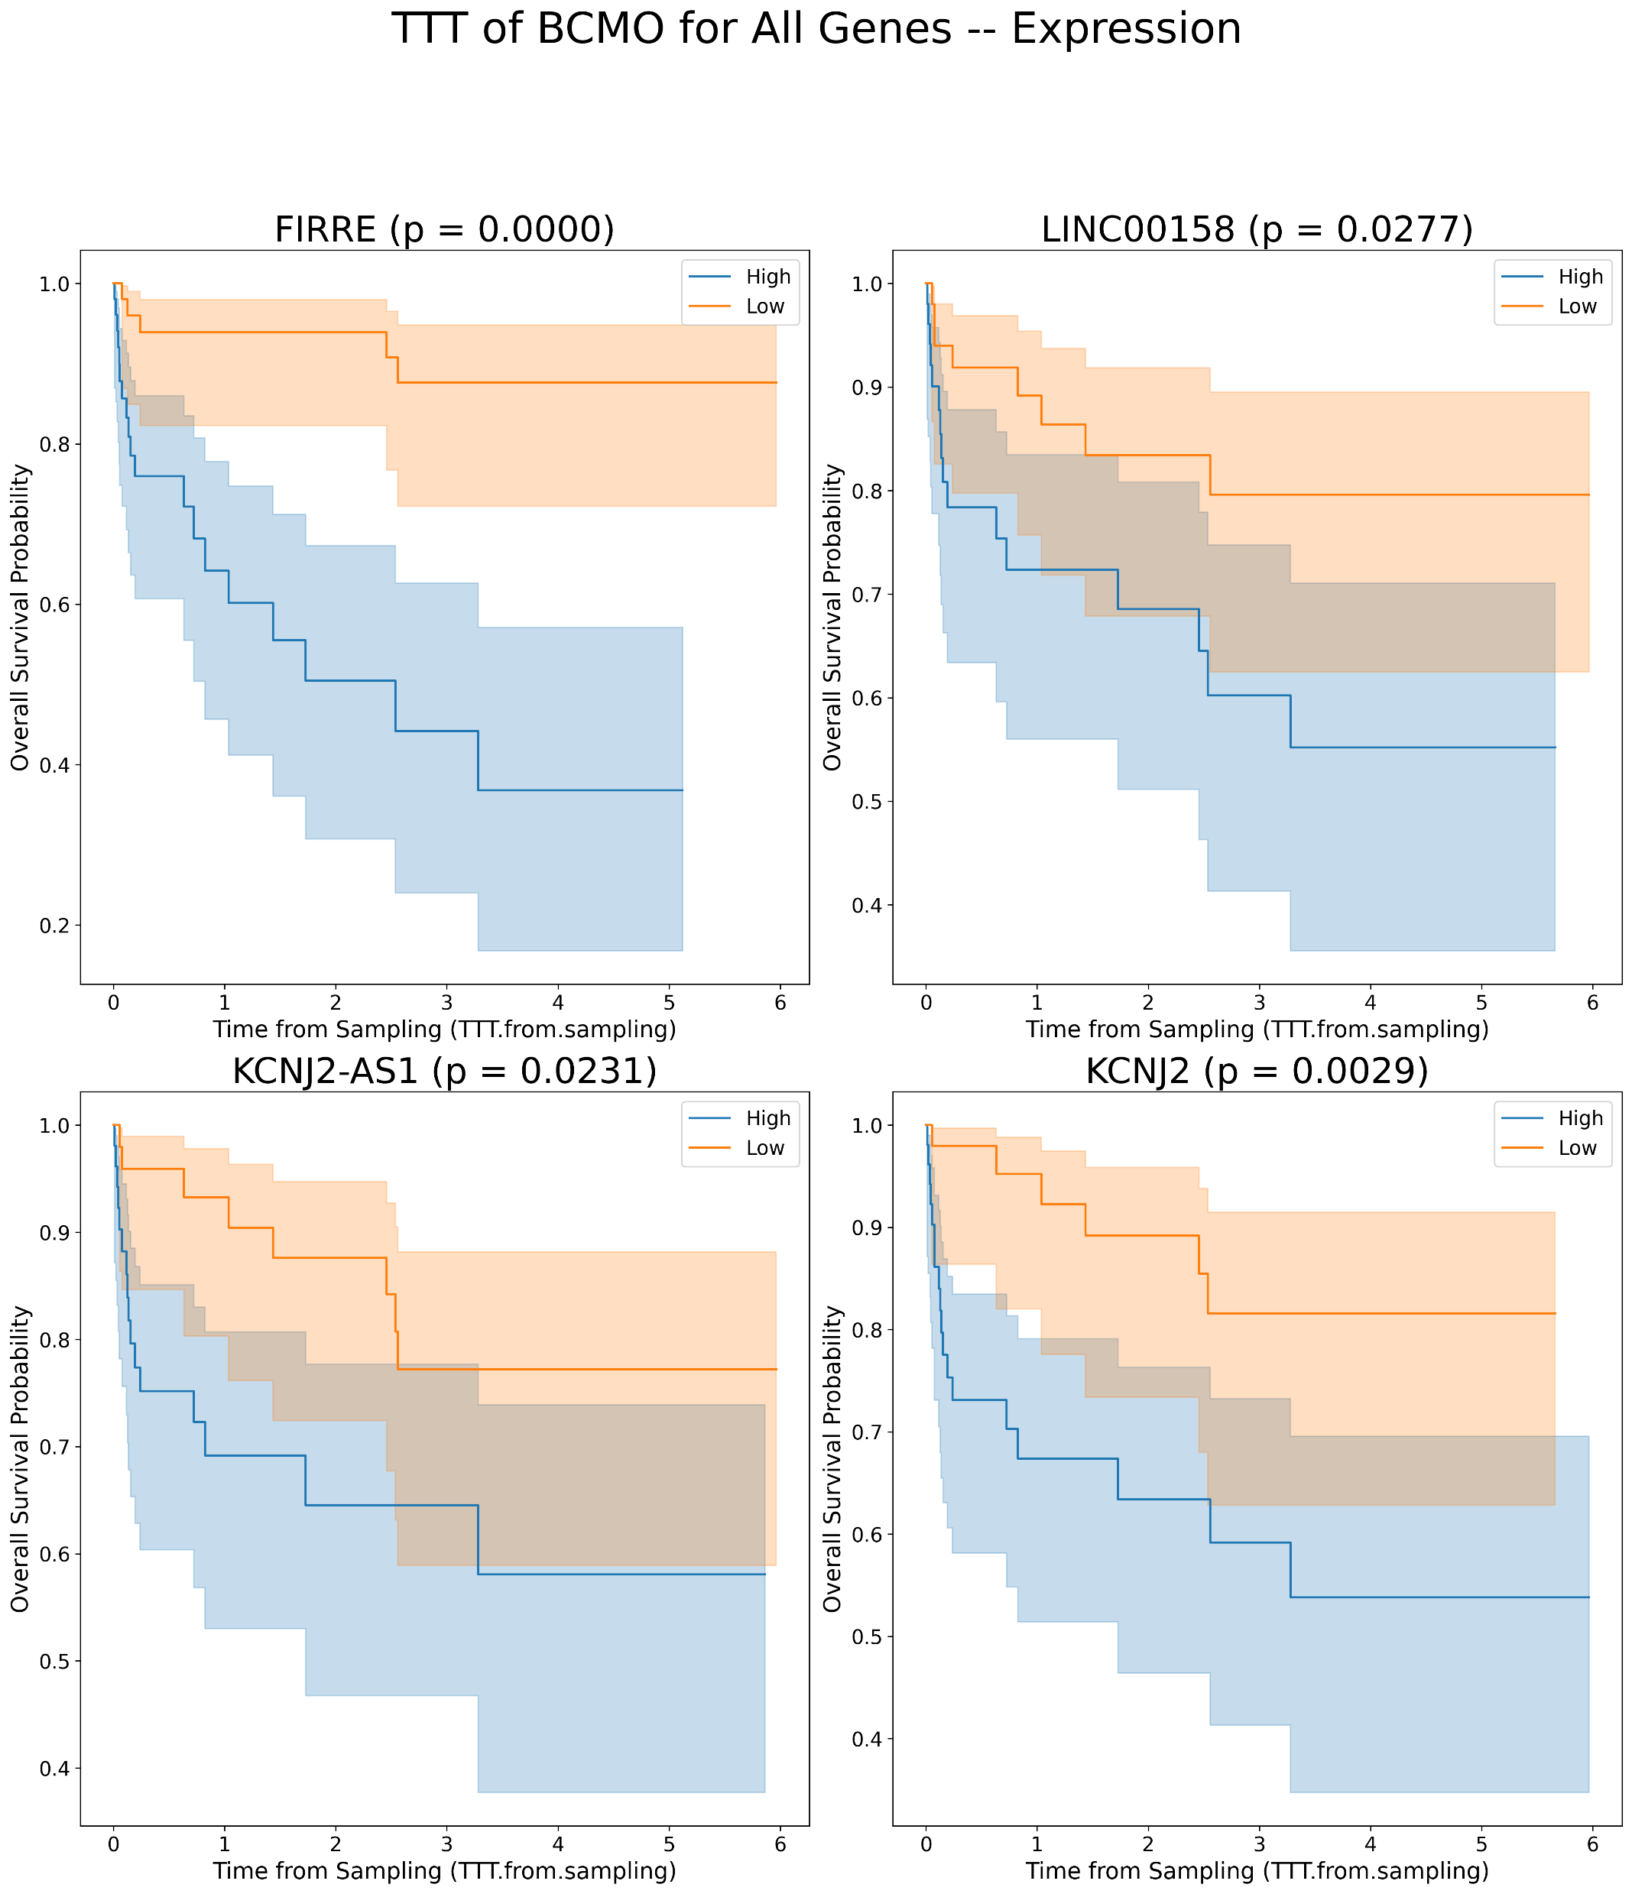
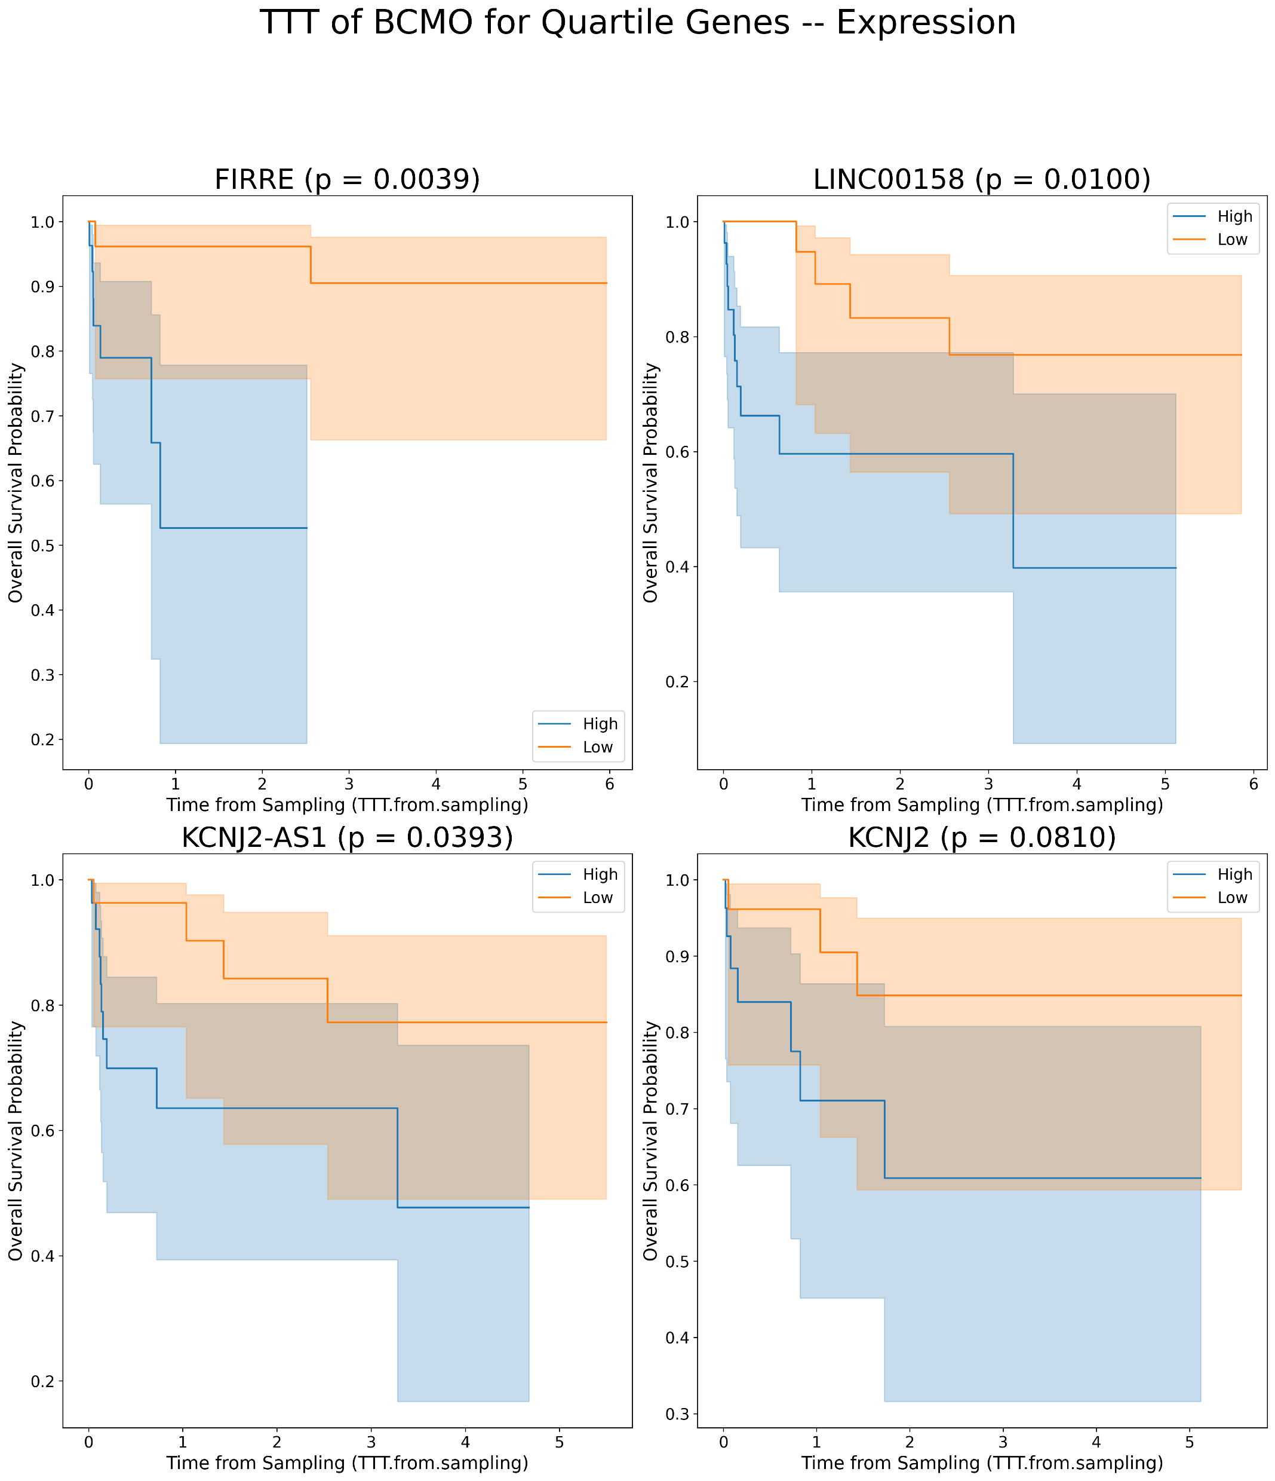
Kaplan Meier’s for lncRNAs plots for TTT in BCMO [Expression values]
A
B

Slide 11
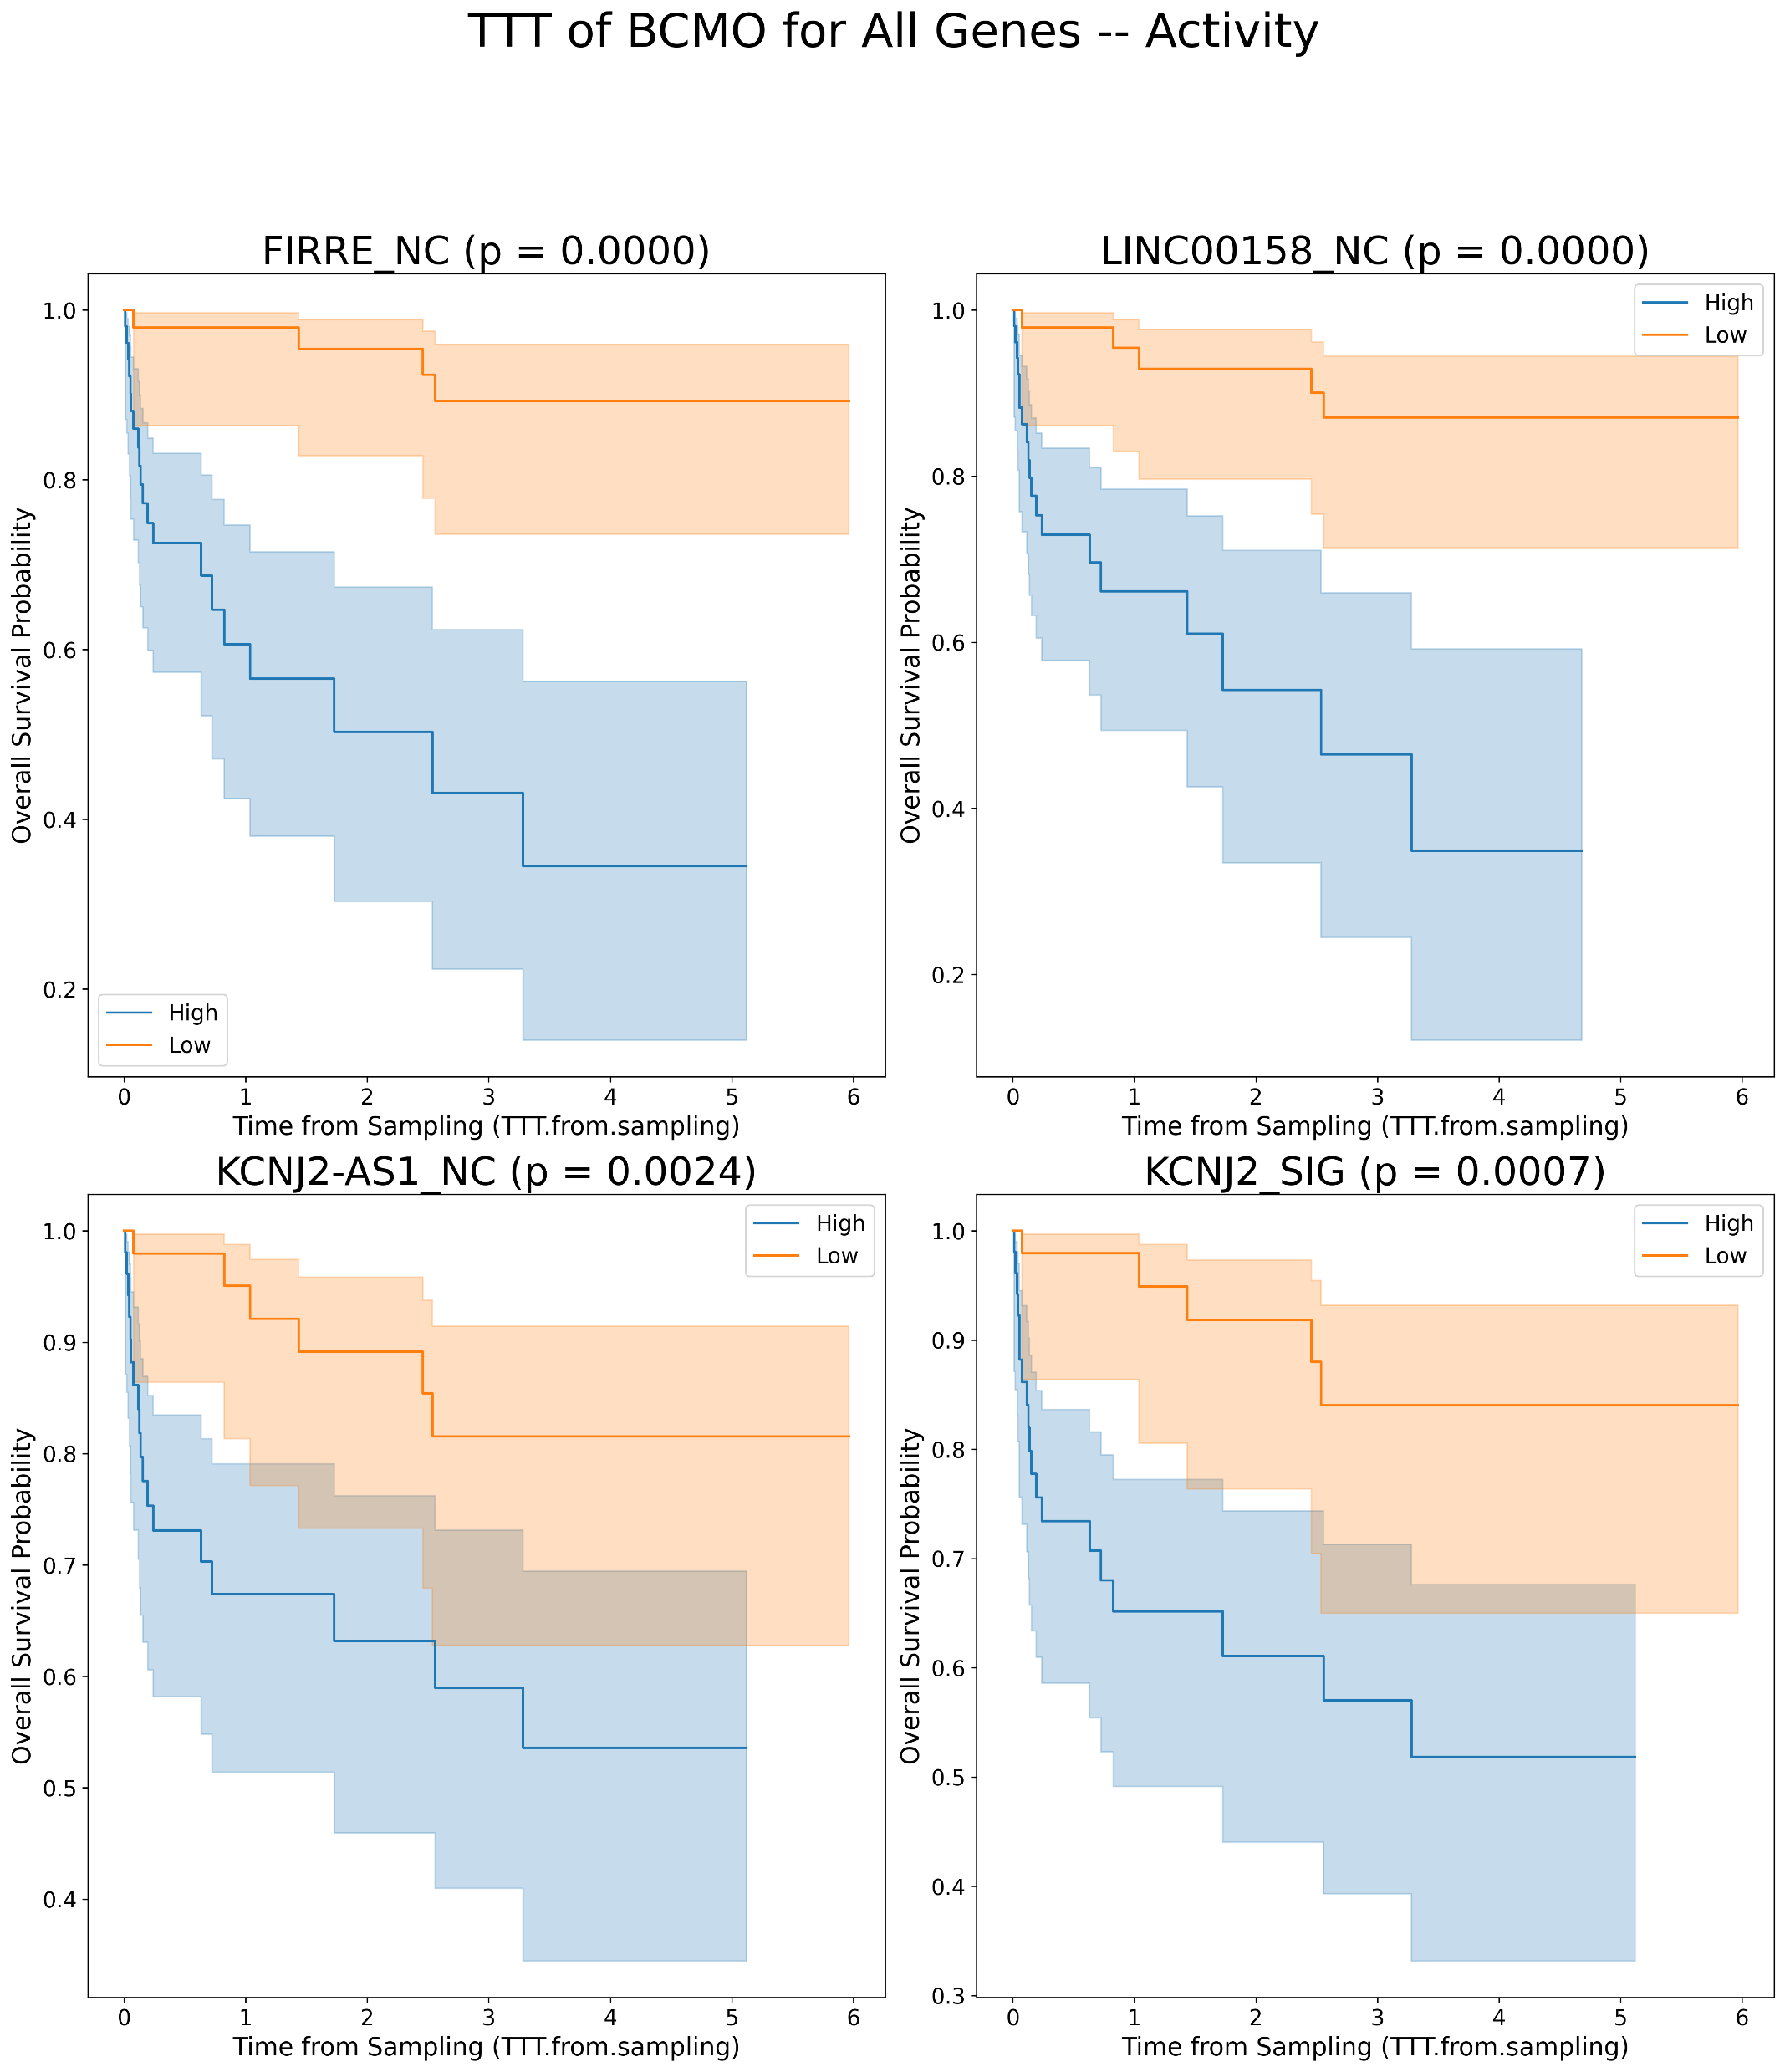
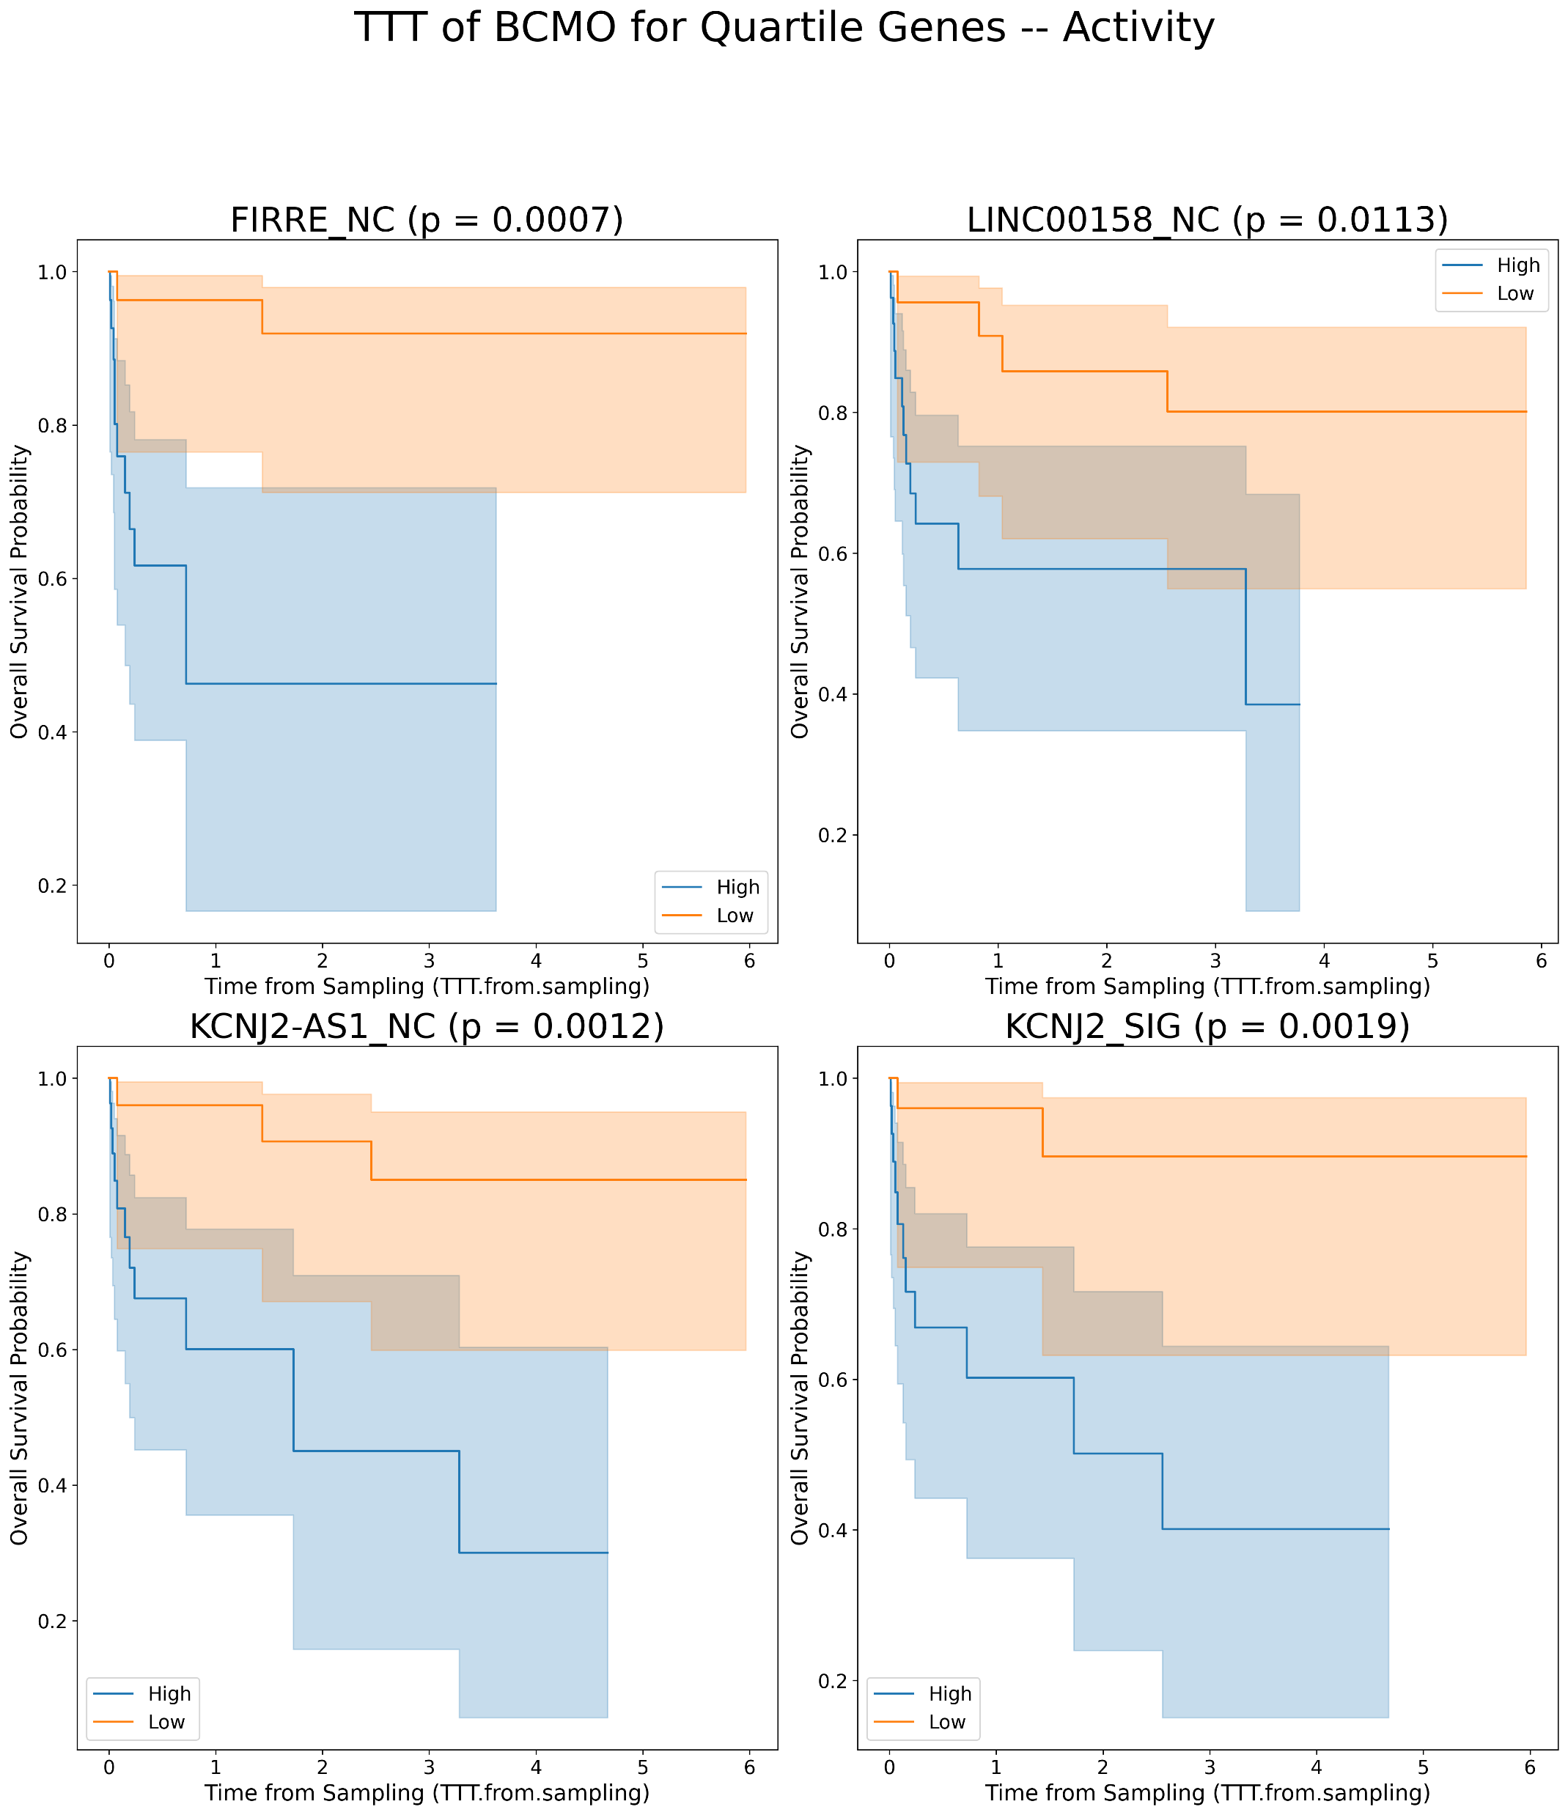
Kaplan Meier’s for lncRNAs plots for TTT in BCMO [Activity values]
A
B

