Slide 1
Bubble Plot with Clinical Covariates

Slide 2
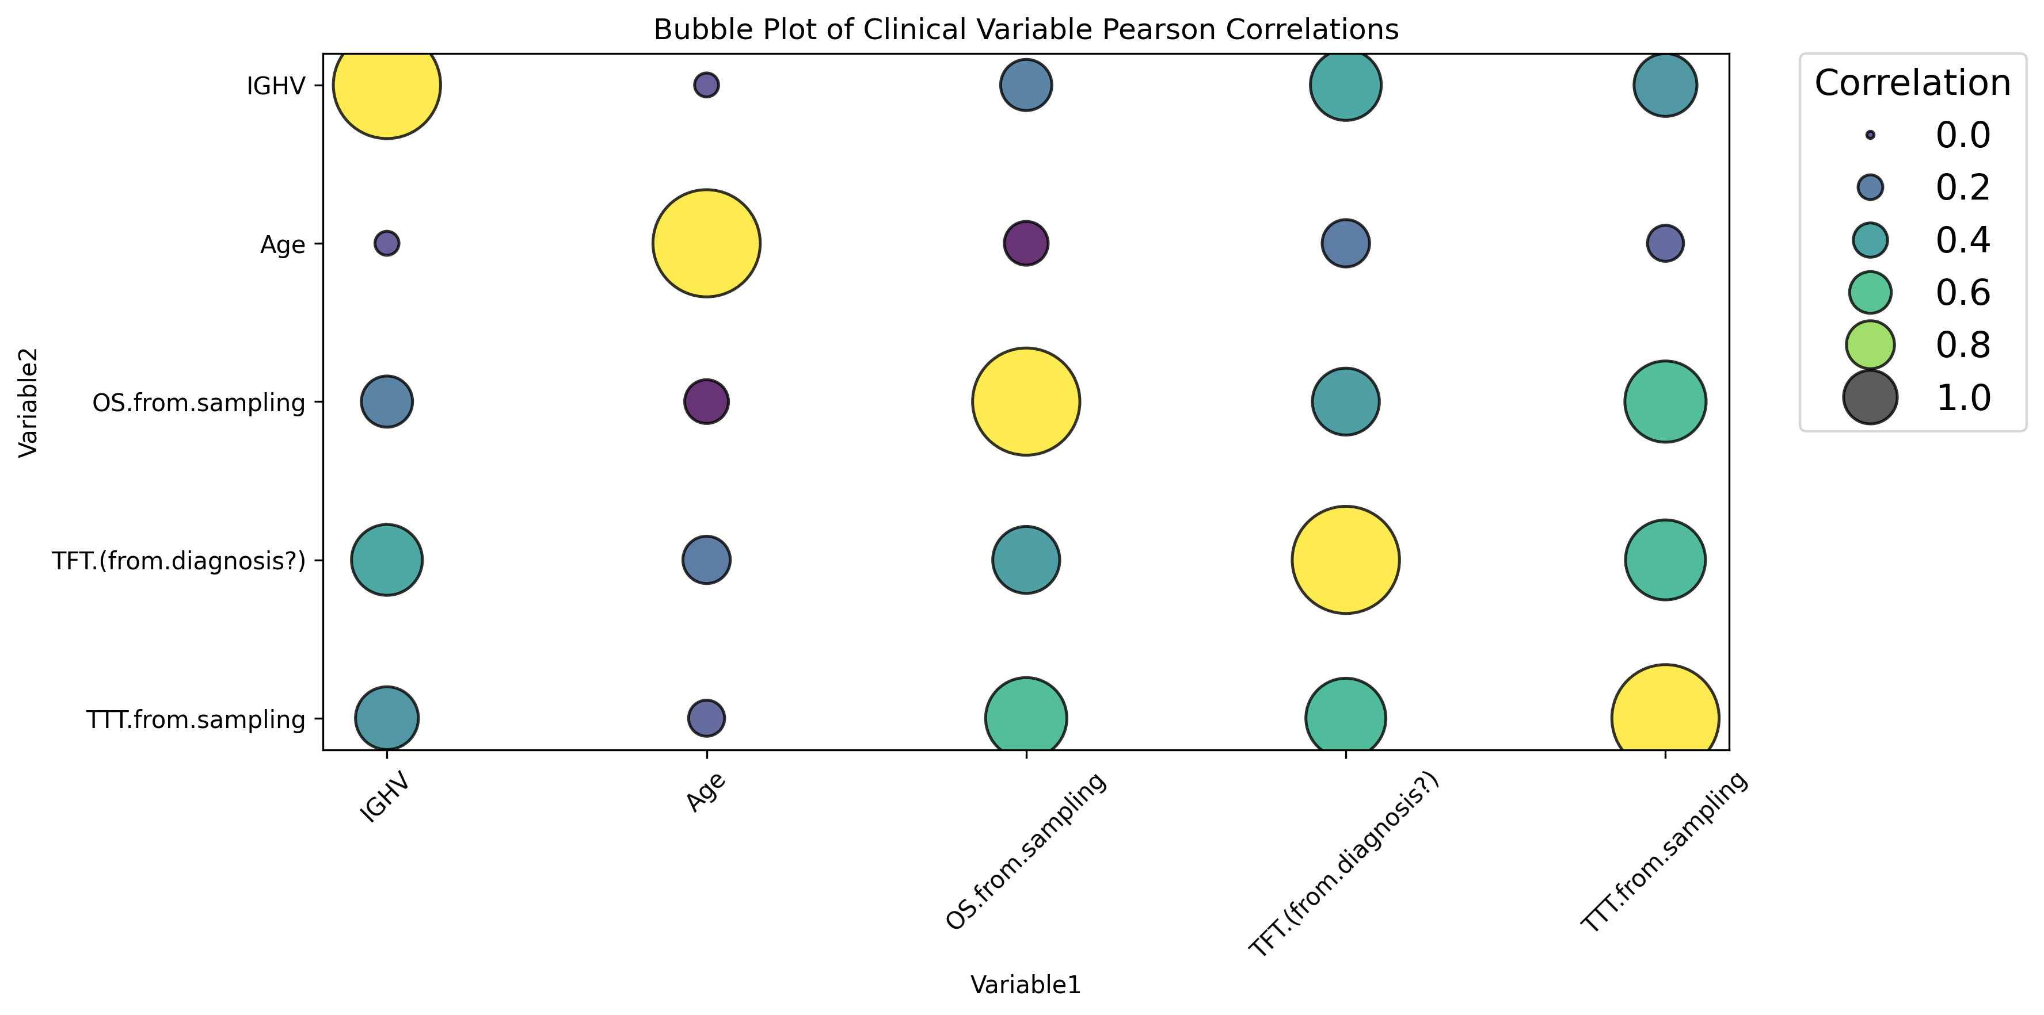
Clinical Covariates between BCMO’s metadata

Slide 3
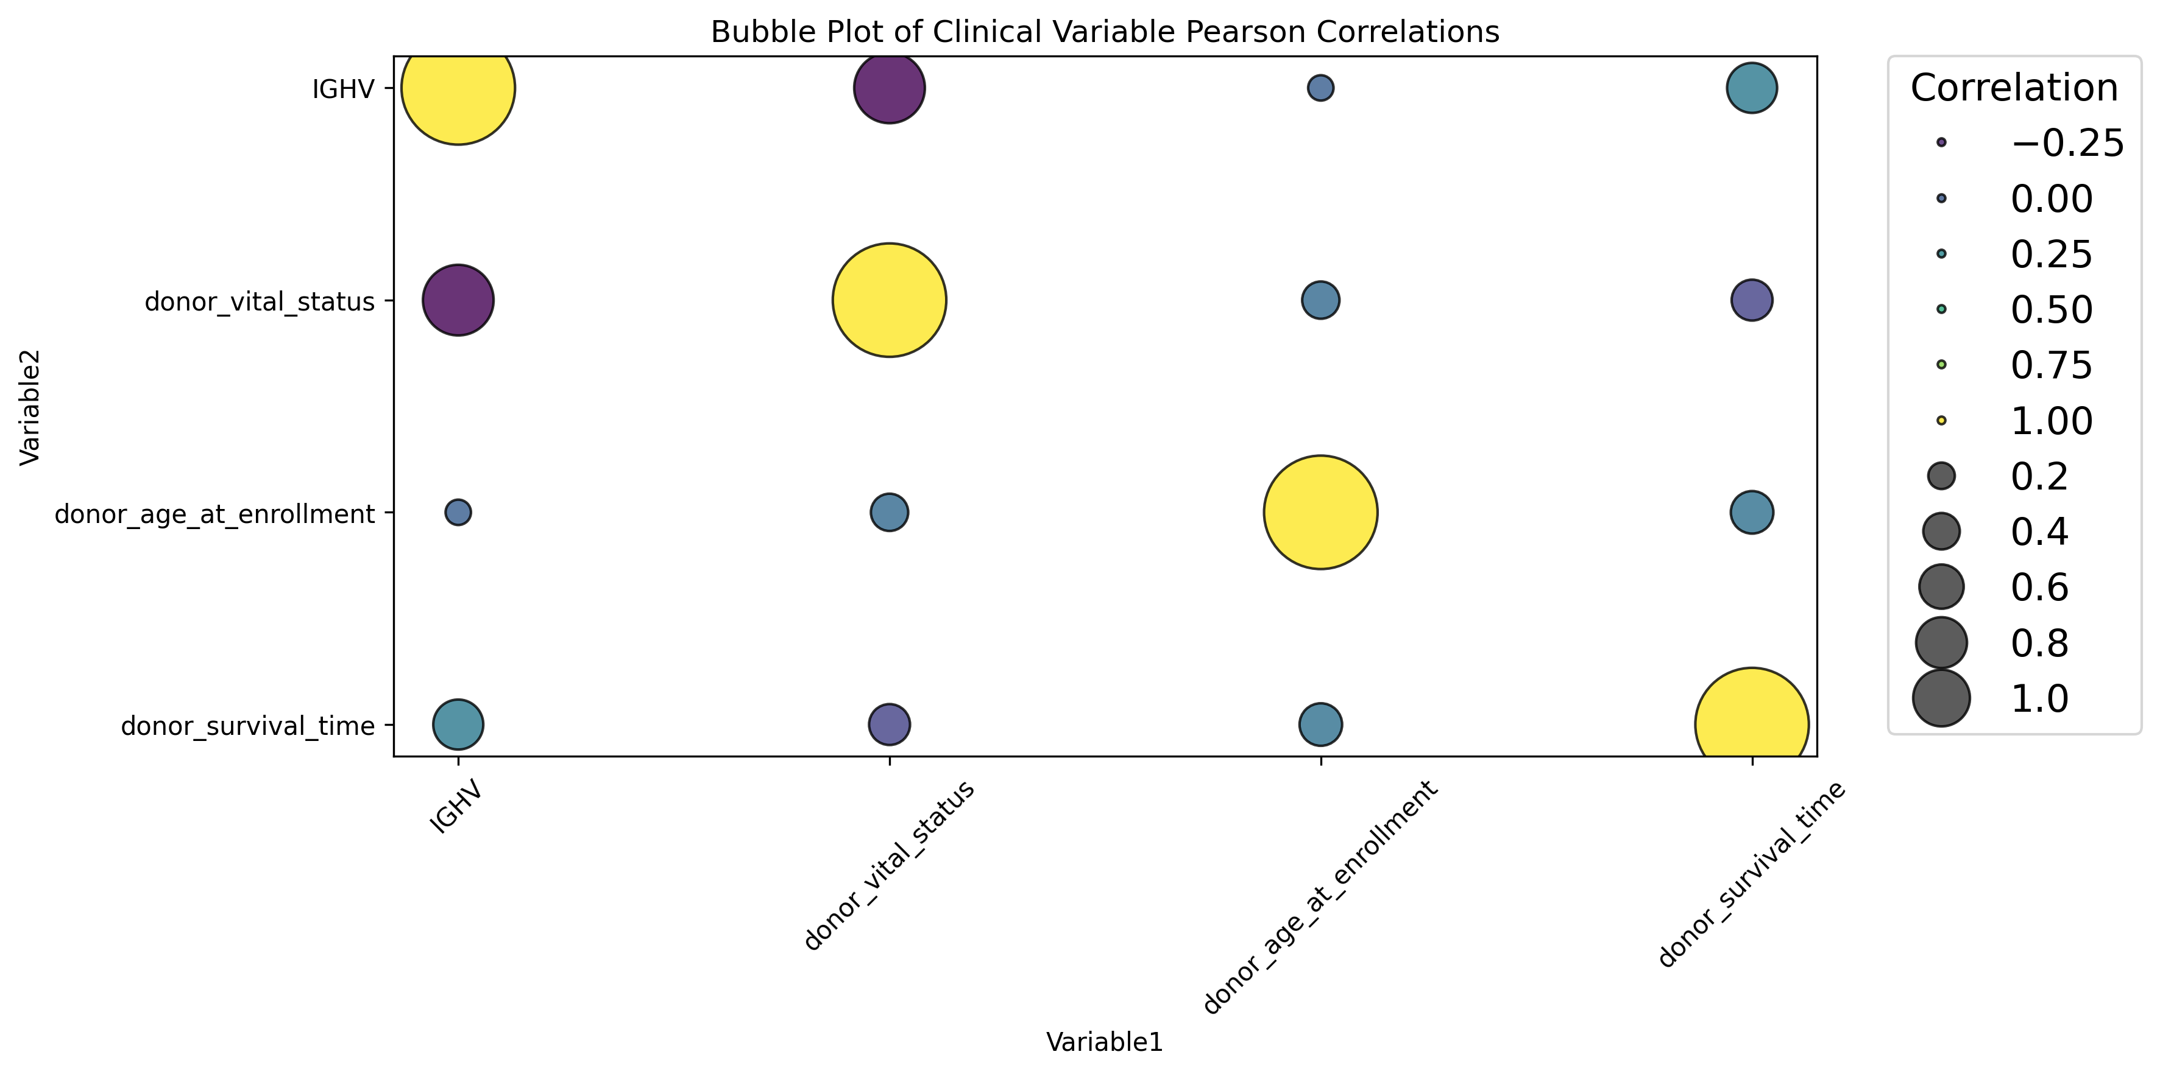
Clinical Covariates between ICGC’s metadata

Slide 4
BCMO

Slide 5
FOR SURVIVAL STATUS (OS)

Slide 6
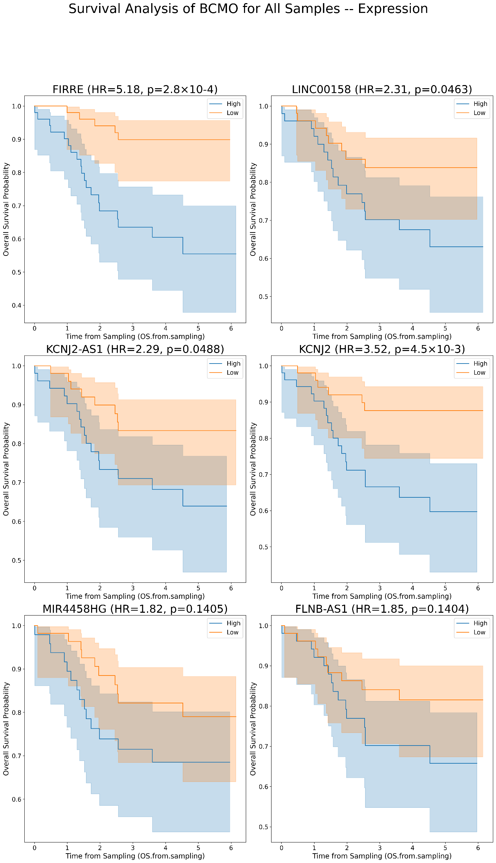
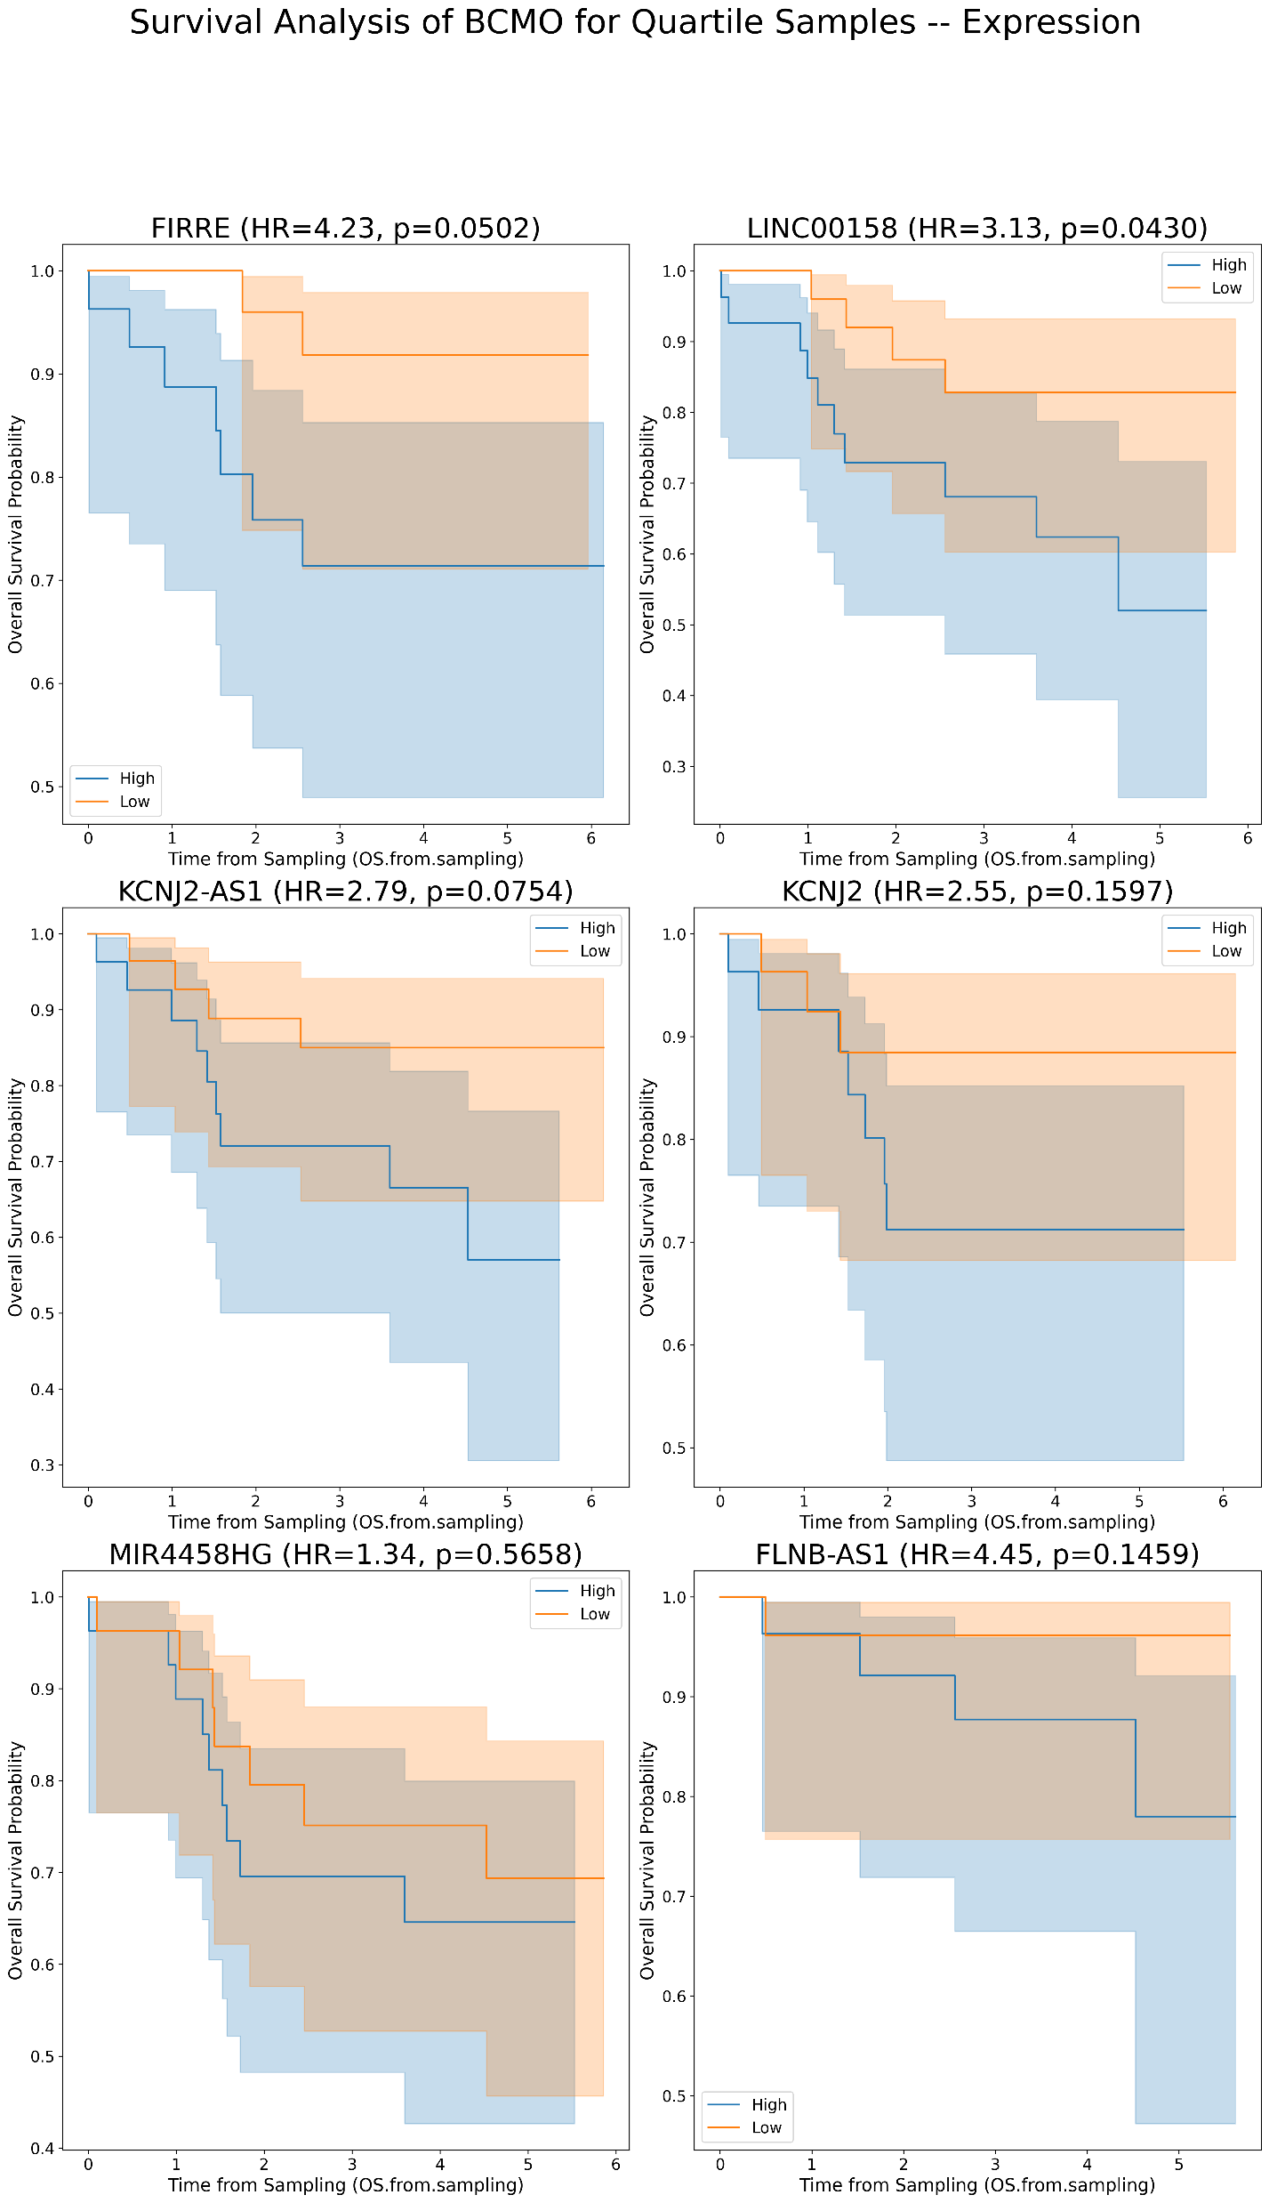
Kaplan Meier’s for lncRNAs plots for OS in BCMO [Expression values]
A
B
A
B

Slide 7
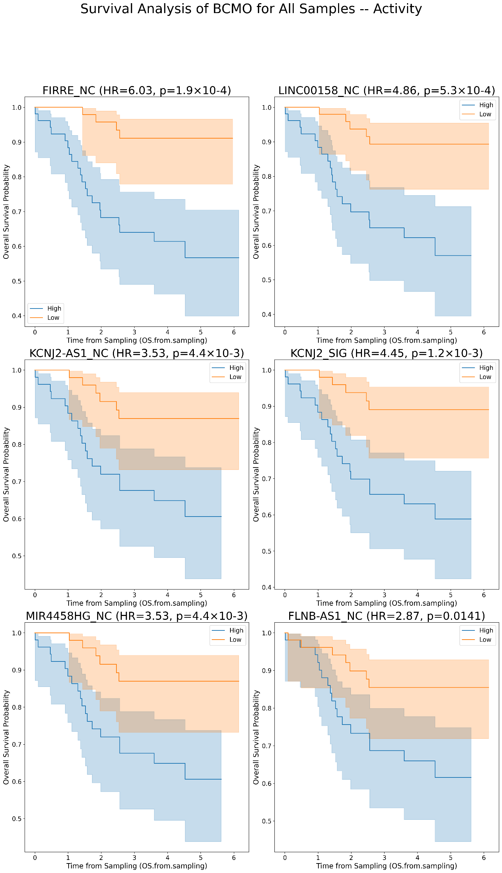
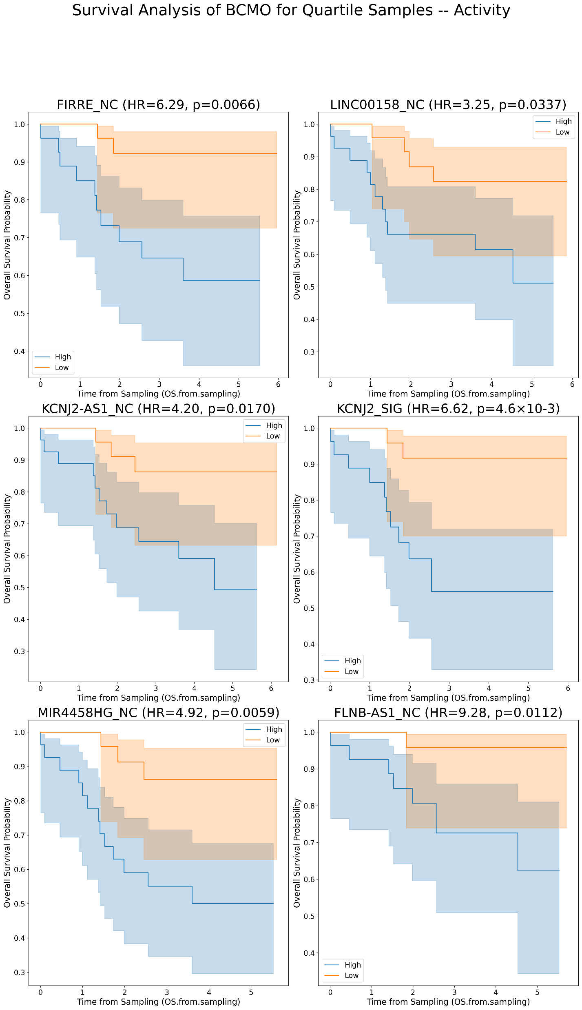
Kaplan Meier’s for lncRNAs plots for OS in BCMO [Activity values]
A
B

Slide 8
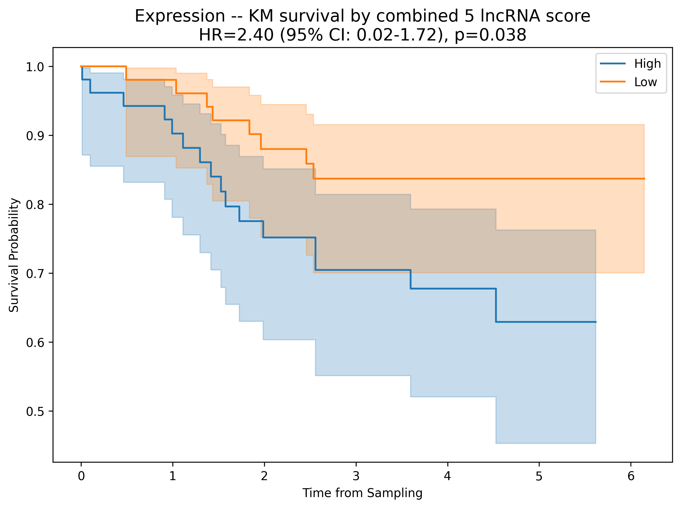
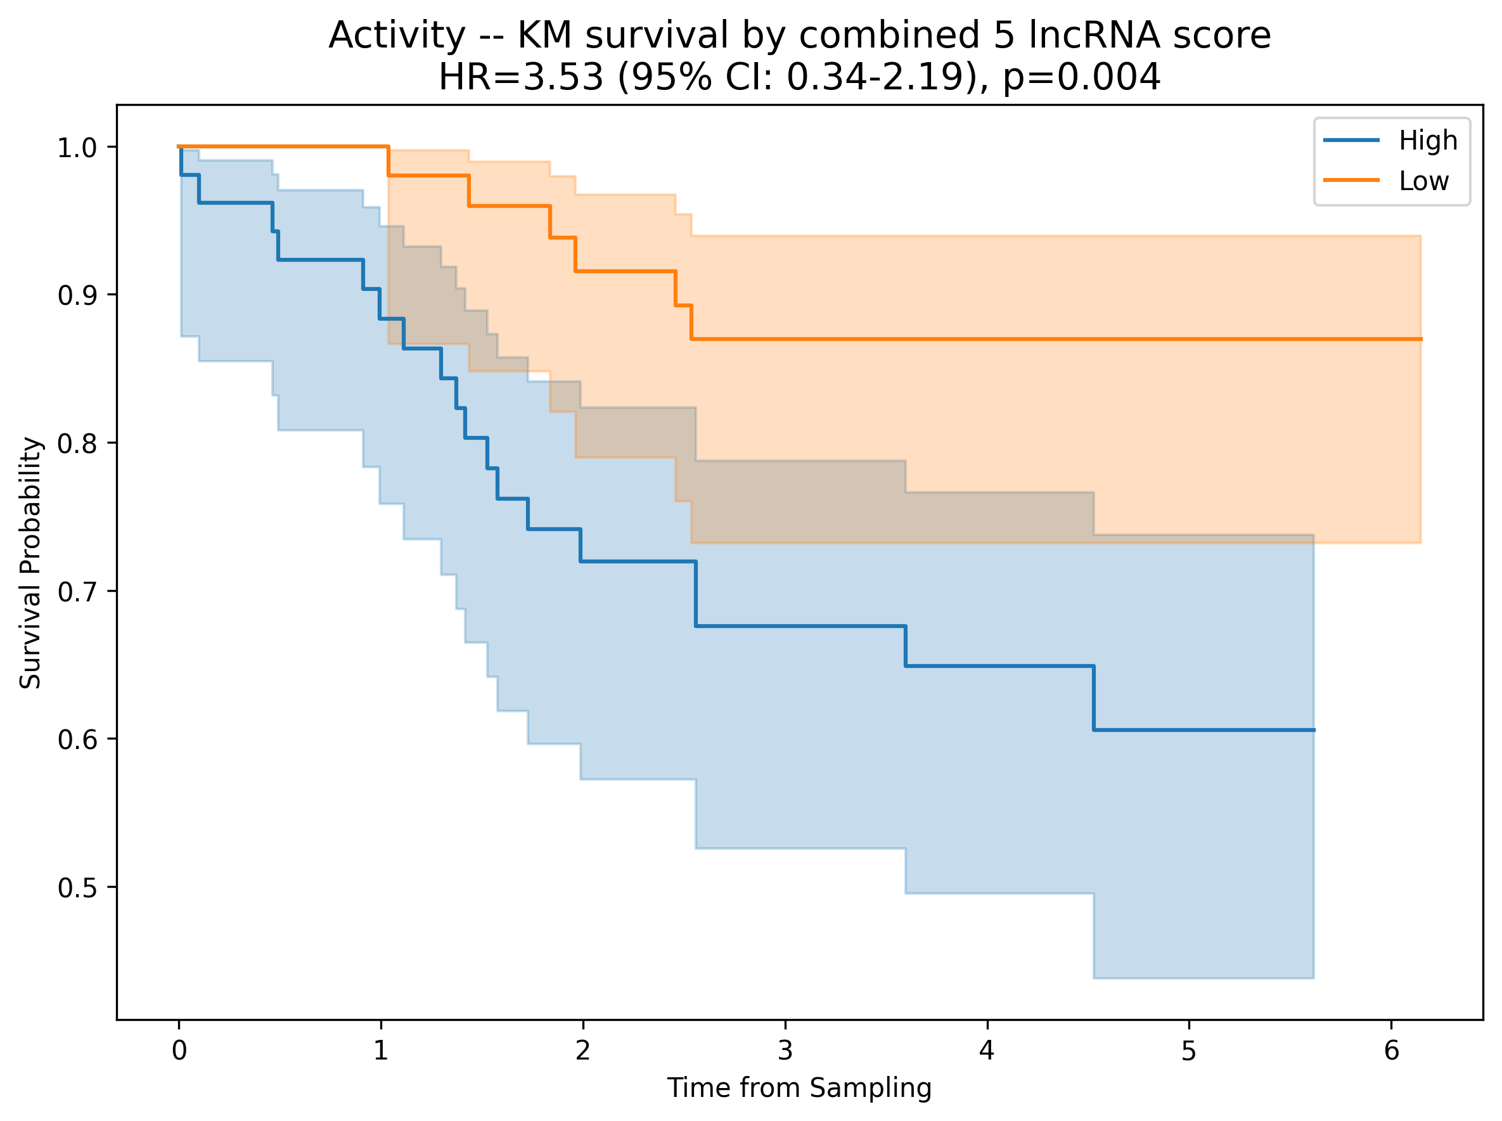
Kaplan Meier’s for combining 5 sign. lncRNAs plots for OS in BCMO [Activity values]

Slide 9
FOR TFT

Slide 10
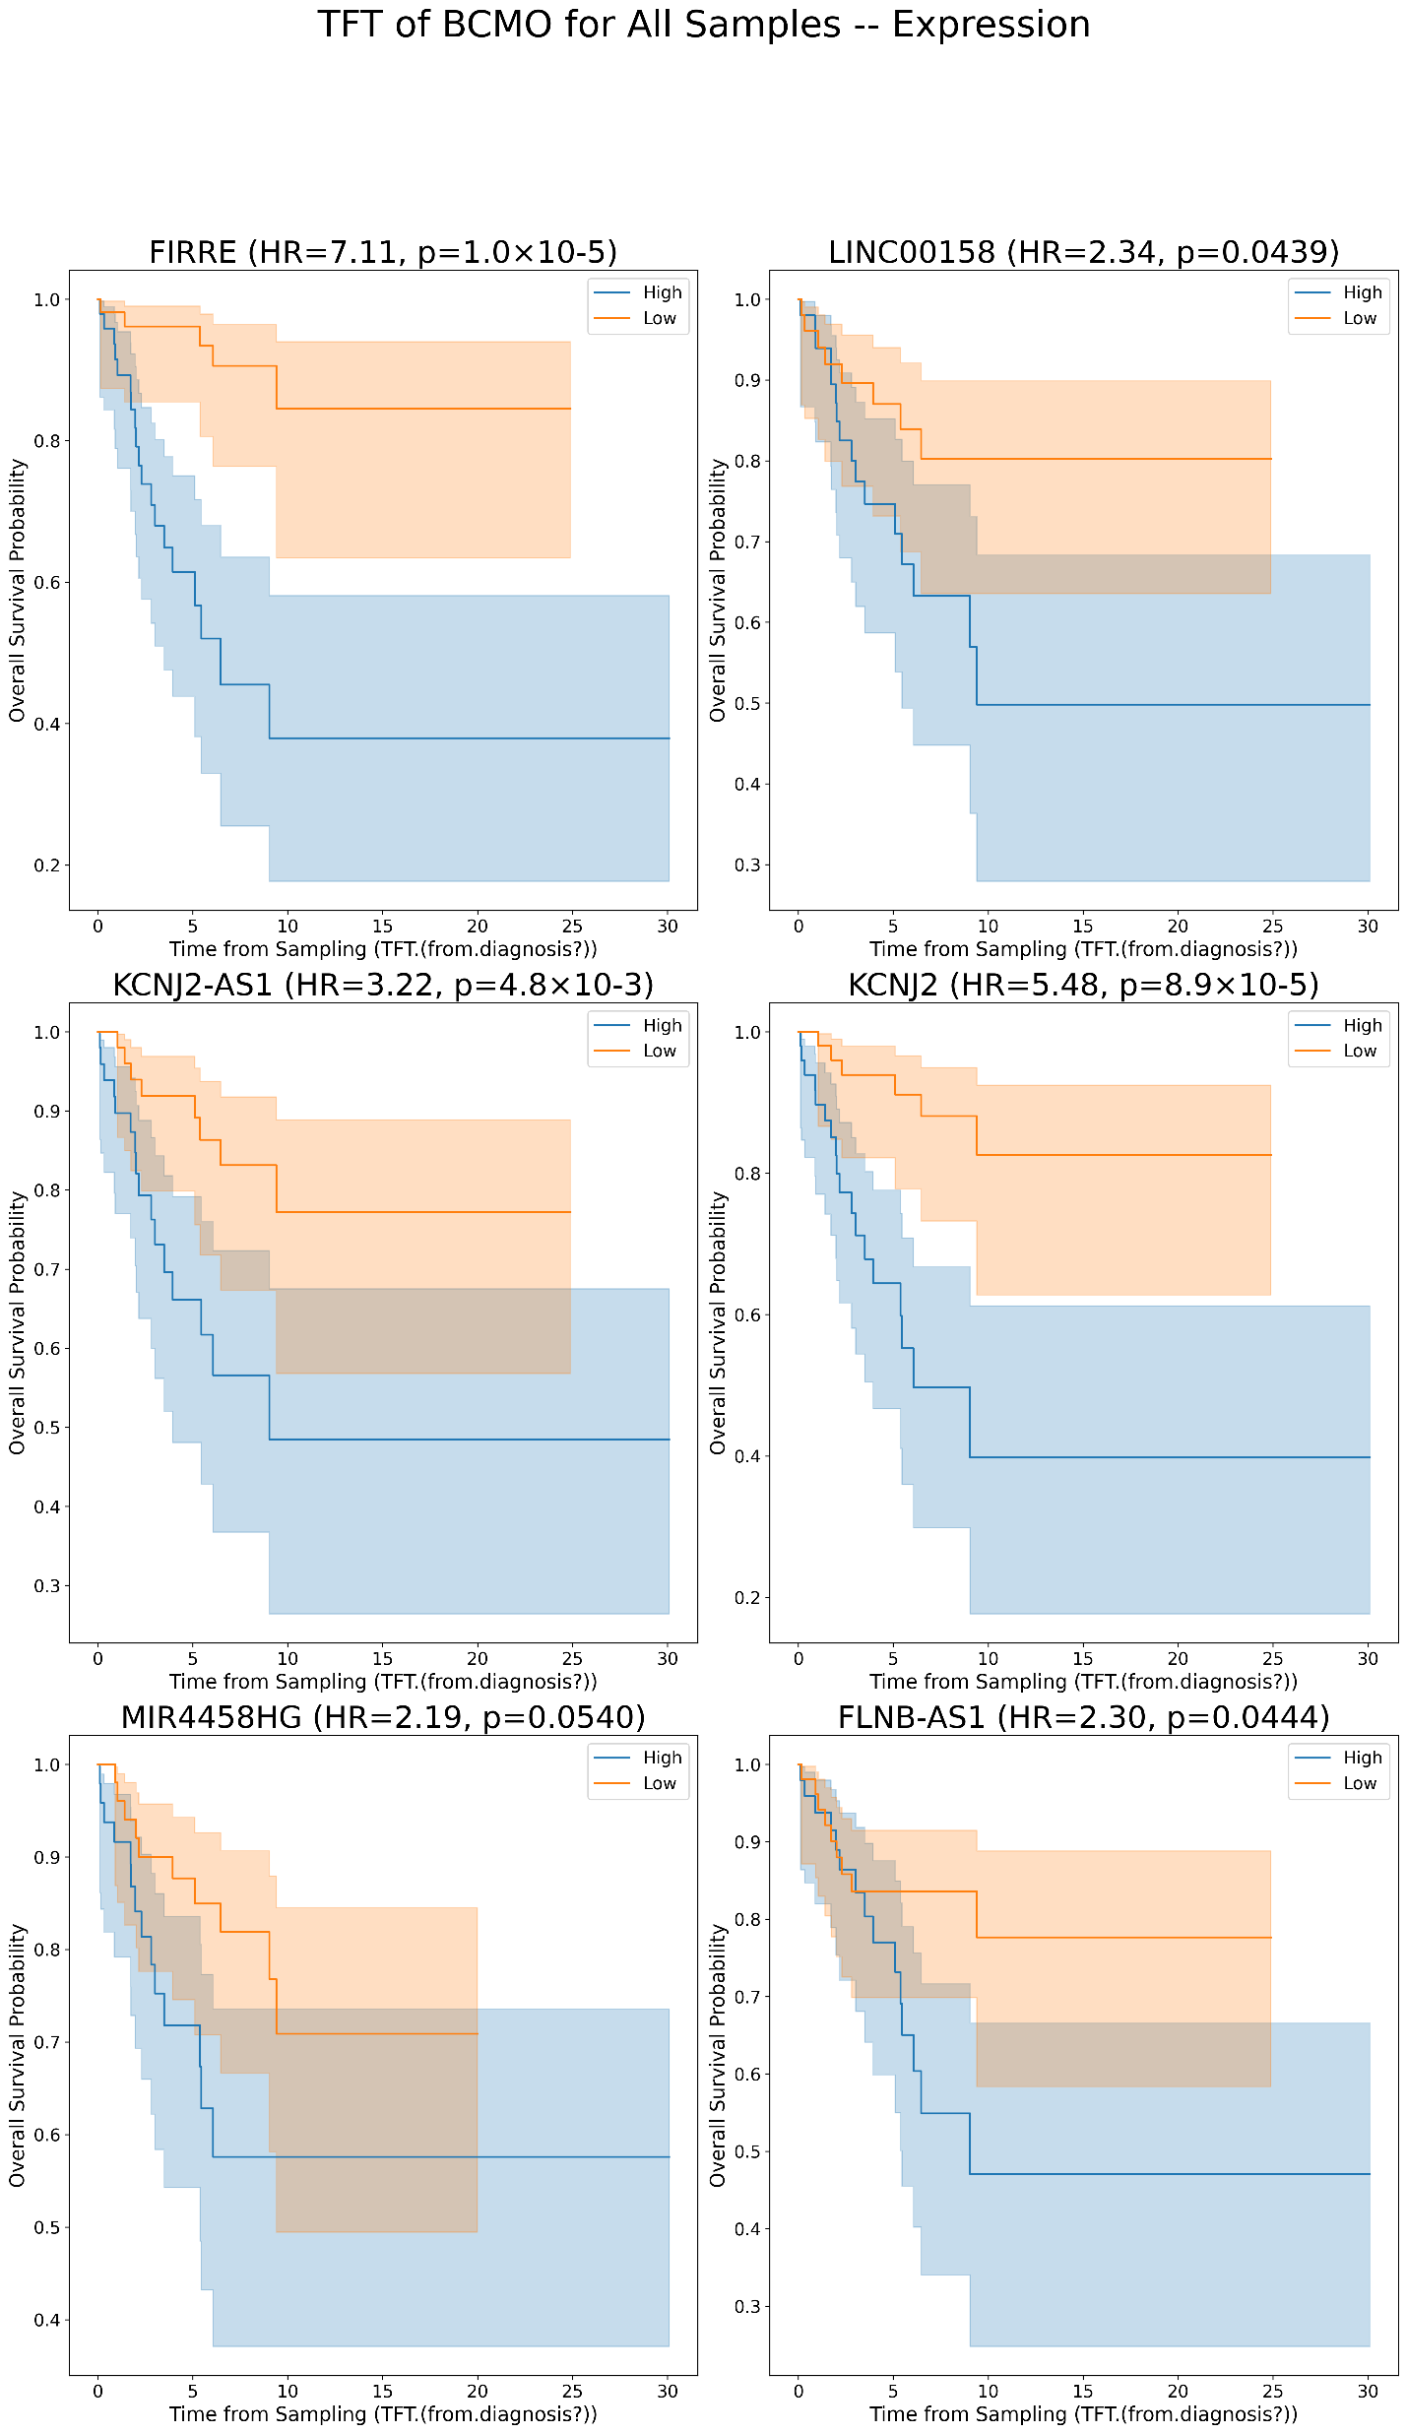
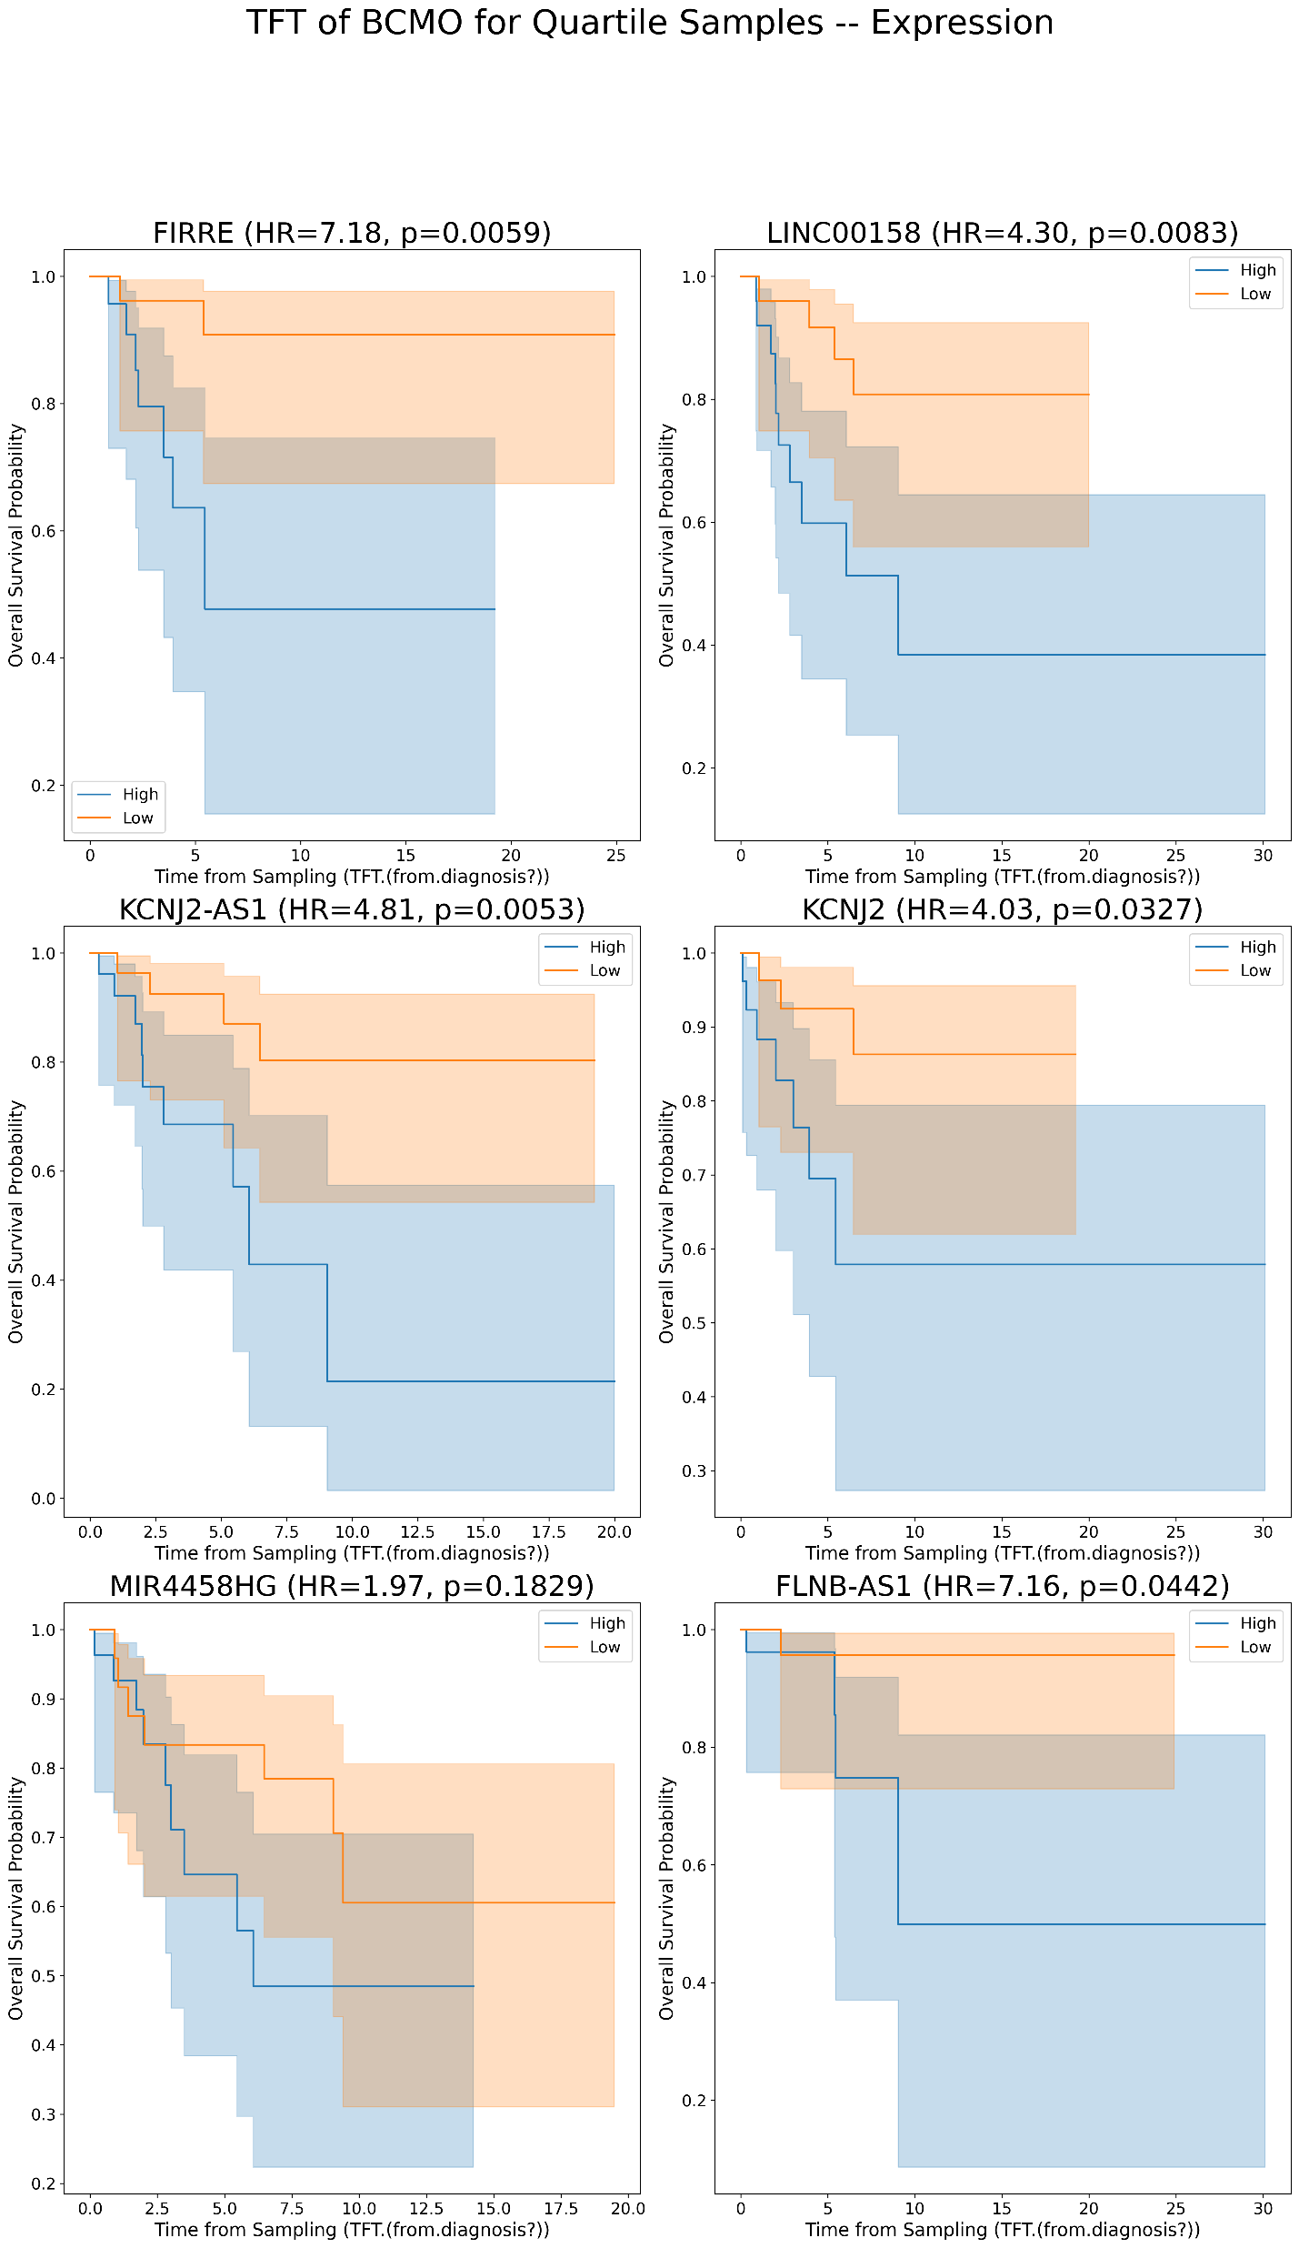
Kaplan Meier’s for lncRNAs plots for TFT in BCMO [Expression values]
A
B

Slide 11
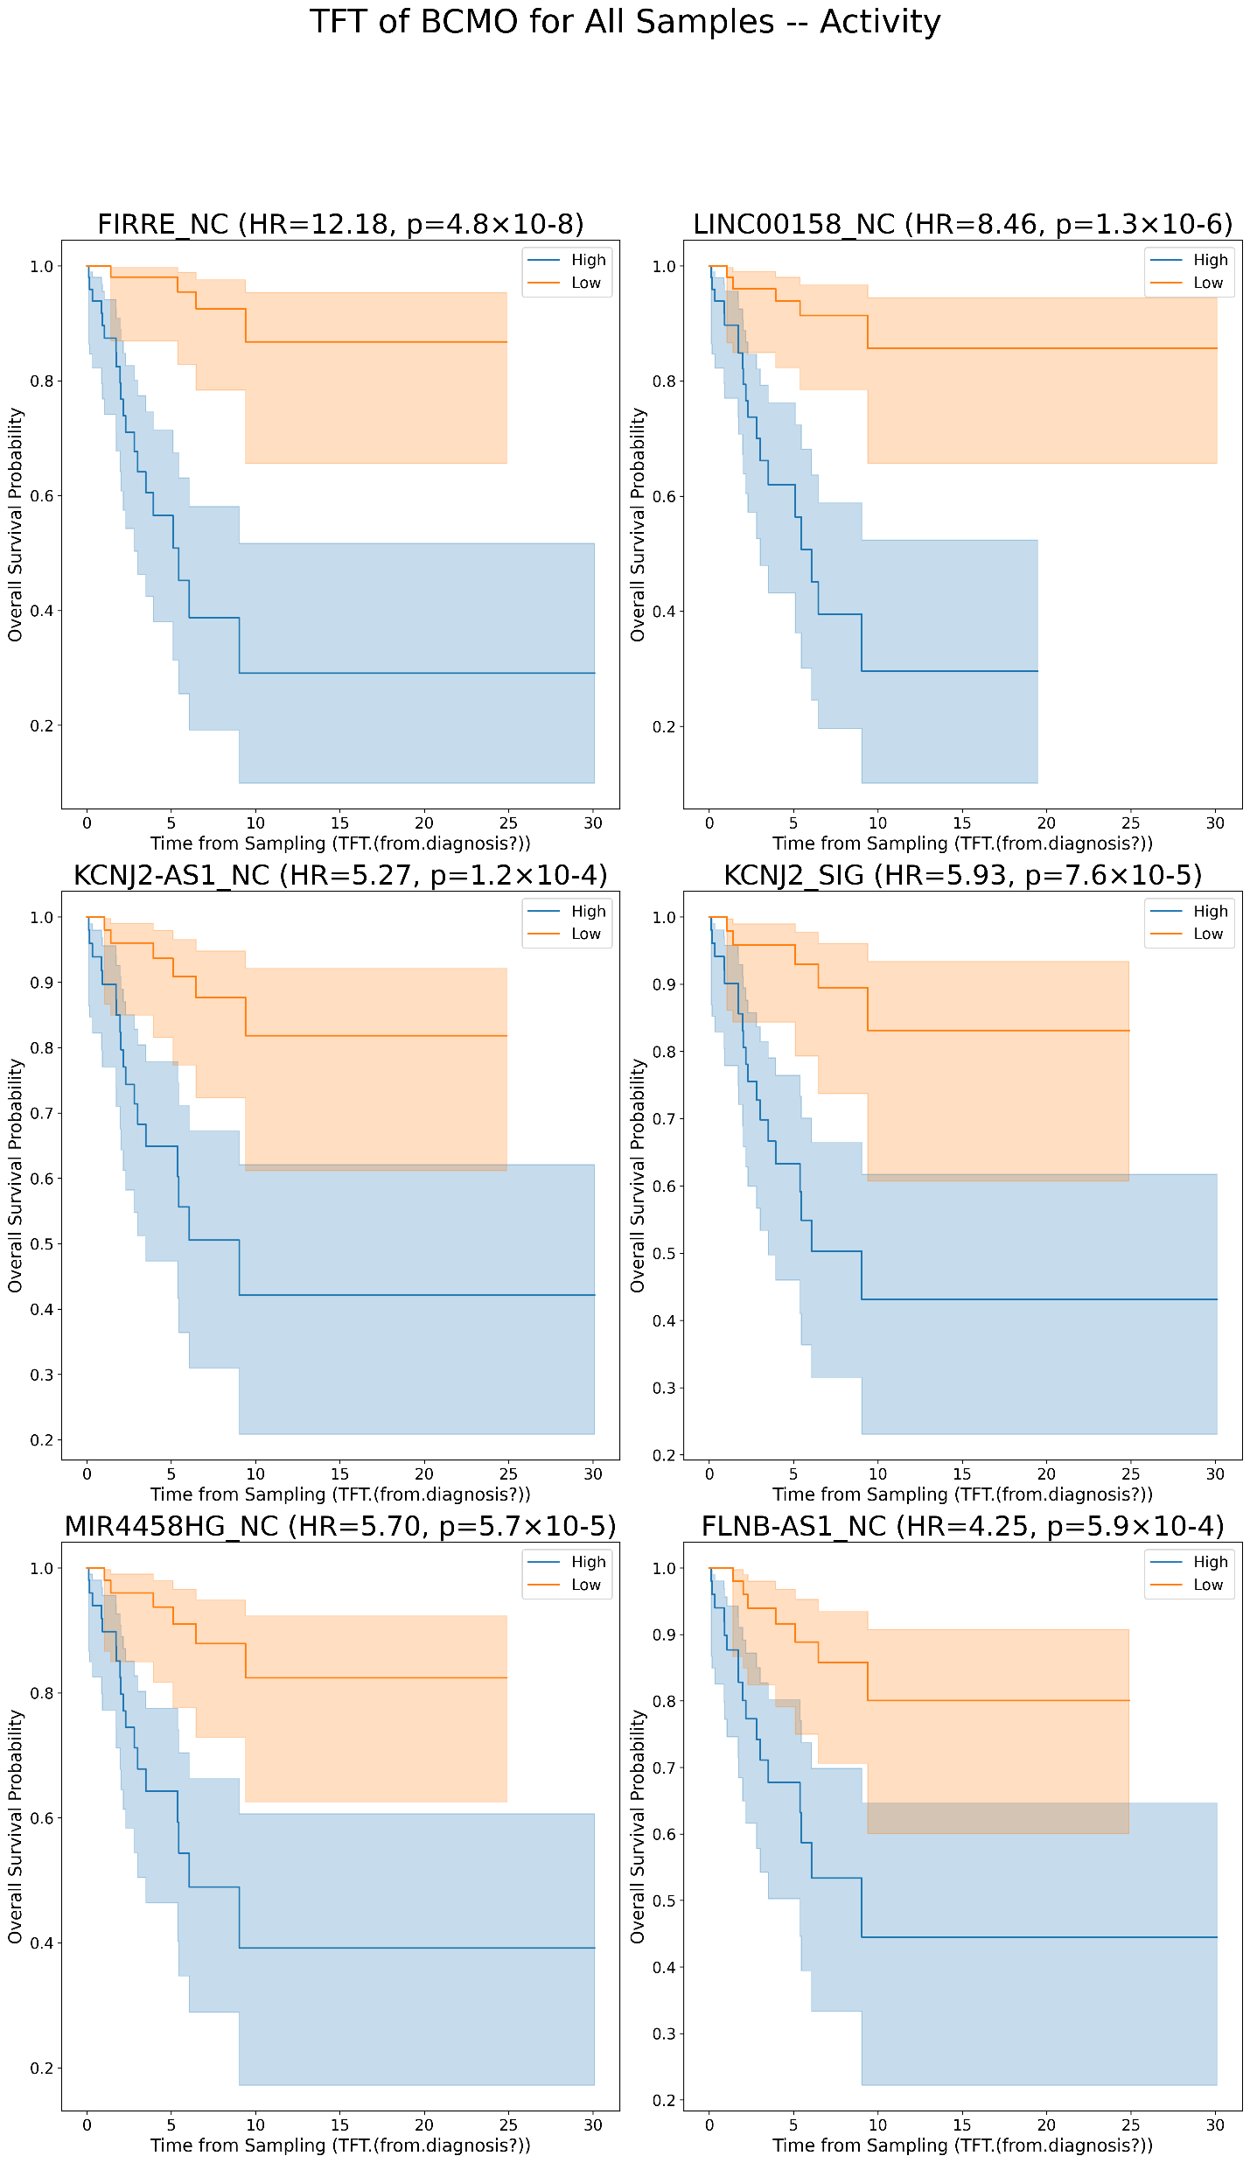
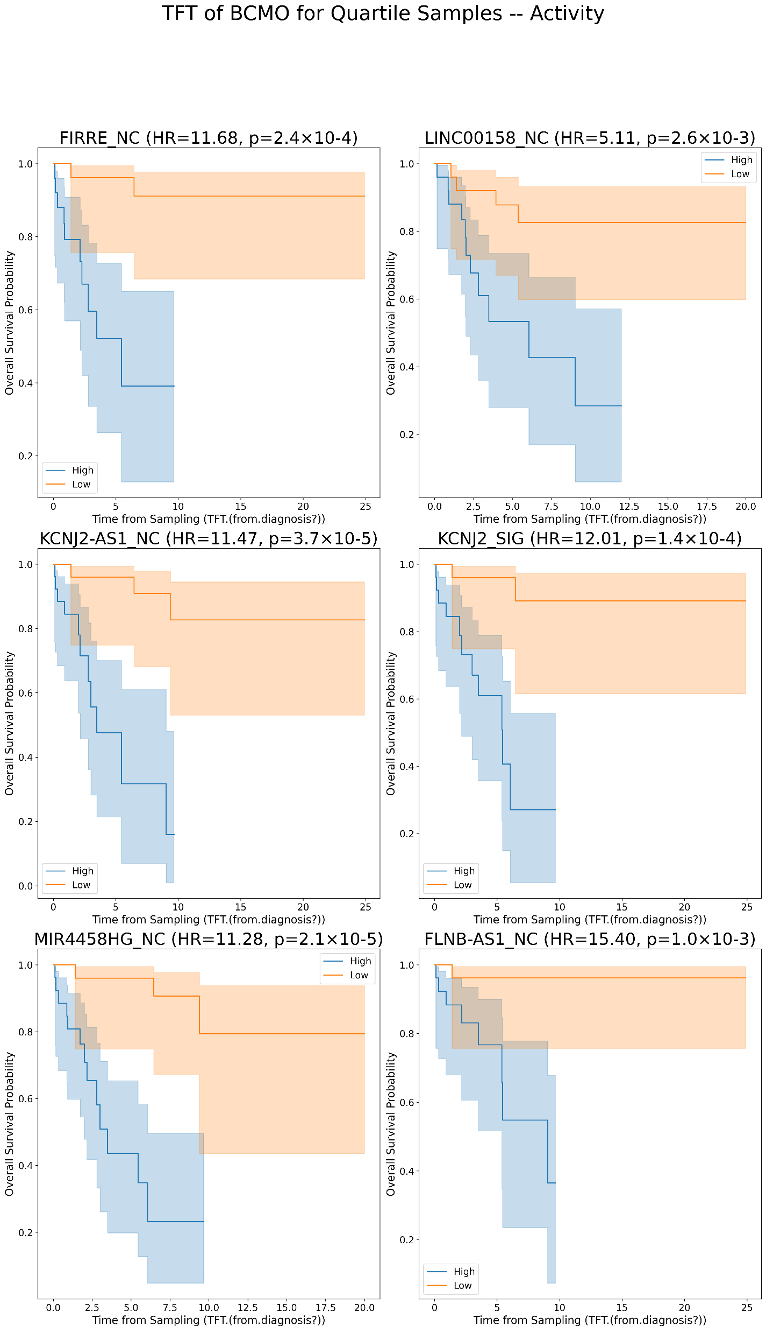
Kaplan Meier’s for lncRNAs plots for TFT in BCMO [Activity values]
A
B

Slide 12
FOR TTT

Slide 13
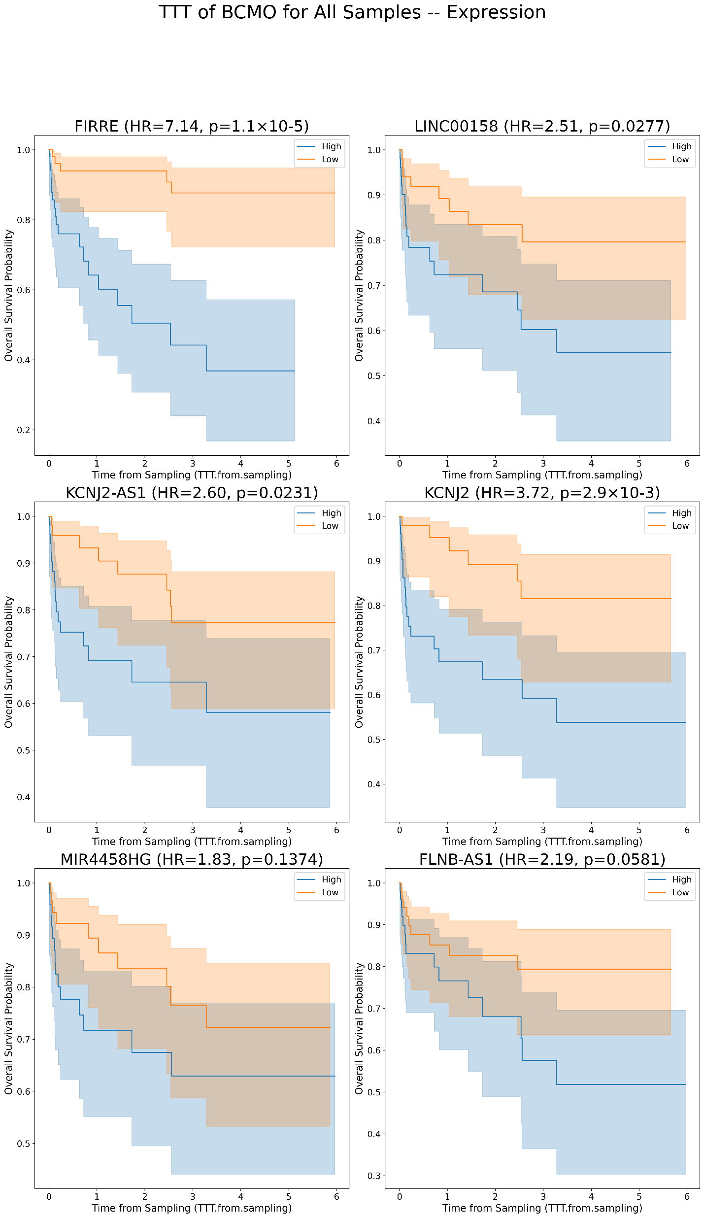
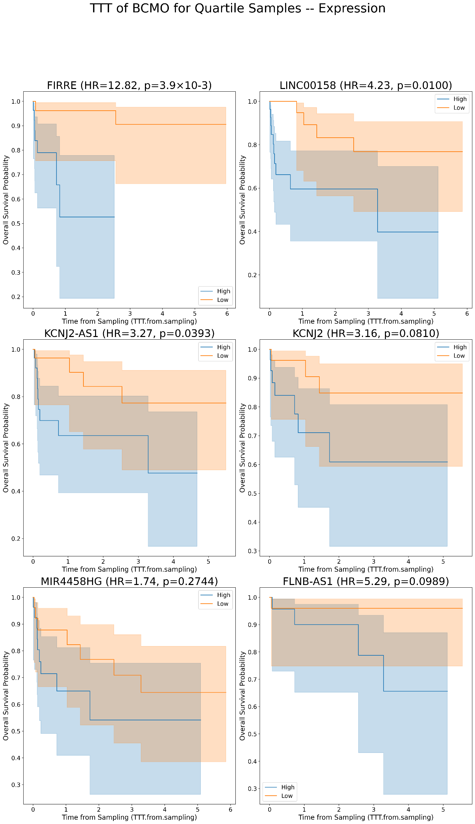
Kaplan Meier’s for lncRNAs plots for TTT in BCMO [Expression values]
A
B

Slide 14
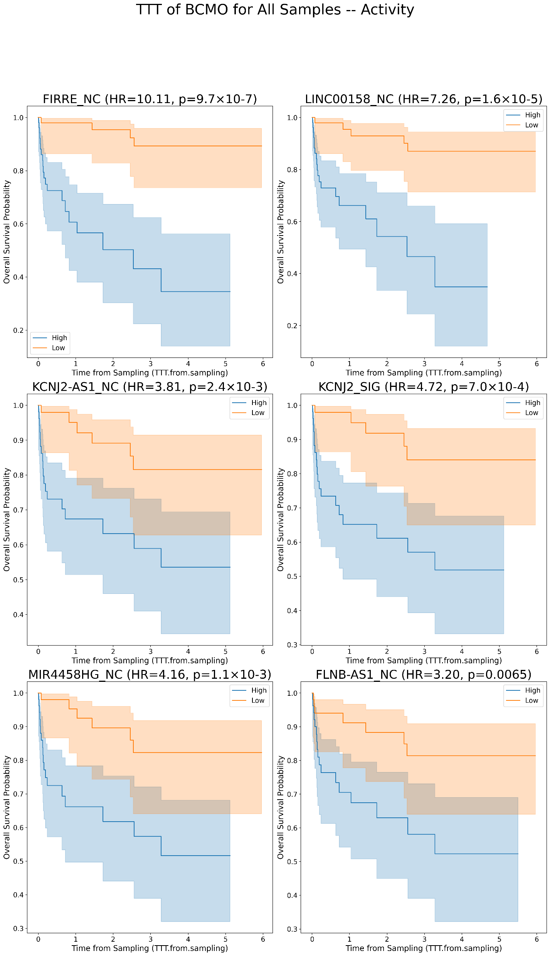
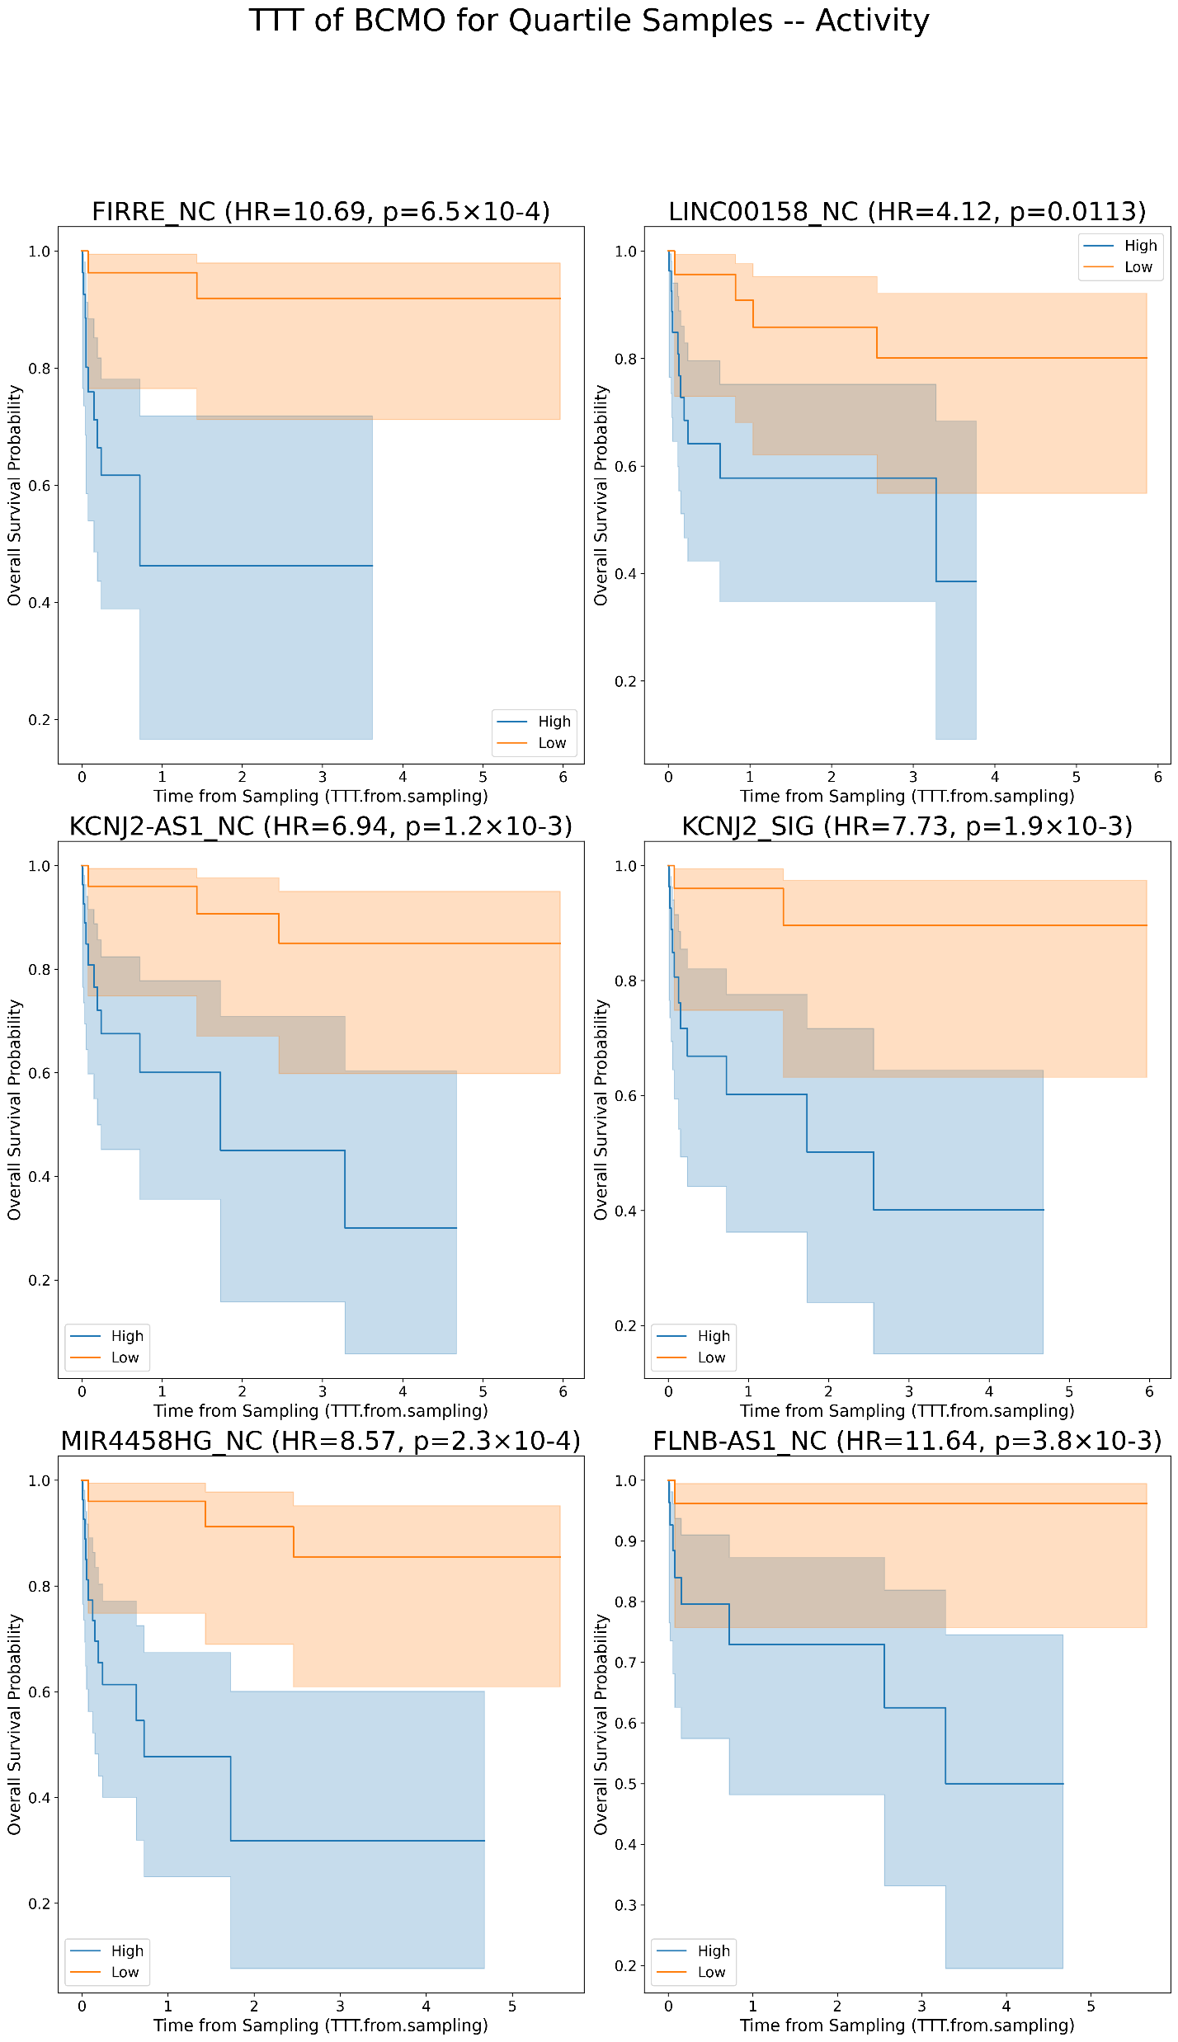
Kaplan Meier’s for lncRNAs plots for TTT in BCMO [Activity values]
A
B

Slide 15
ICGC Survival Status (OS)

Slide 16
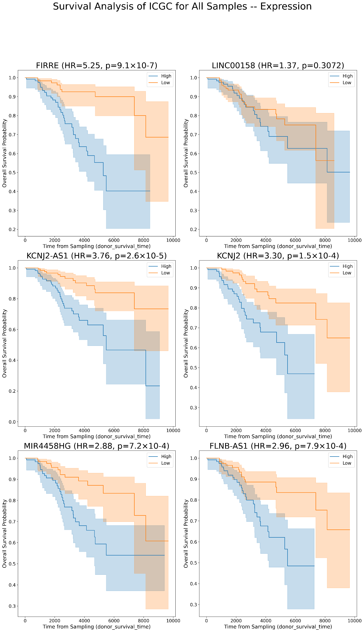
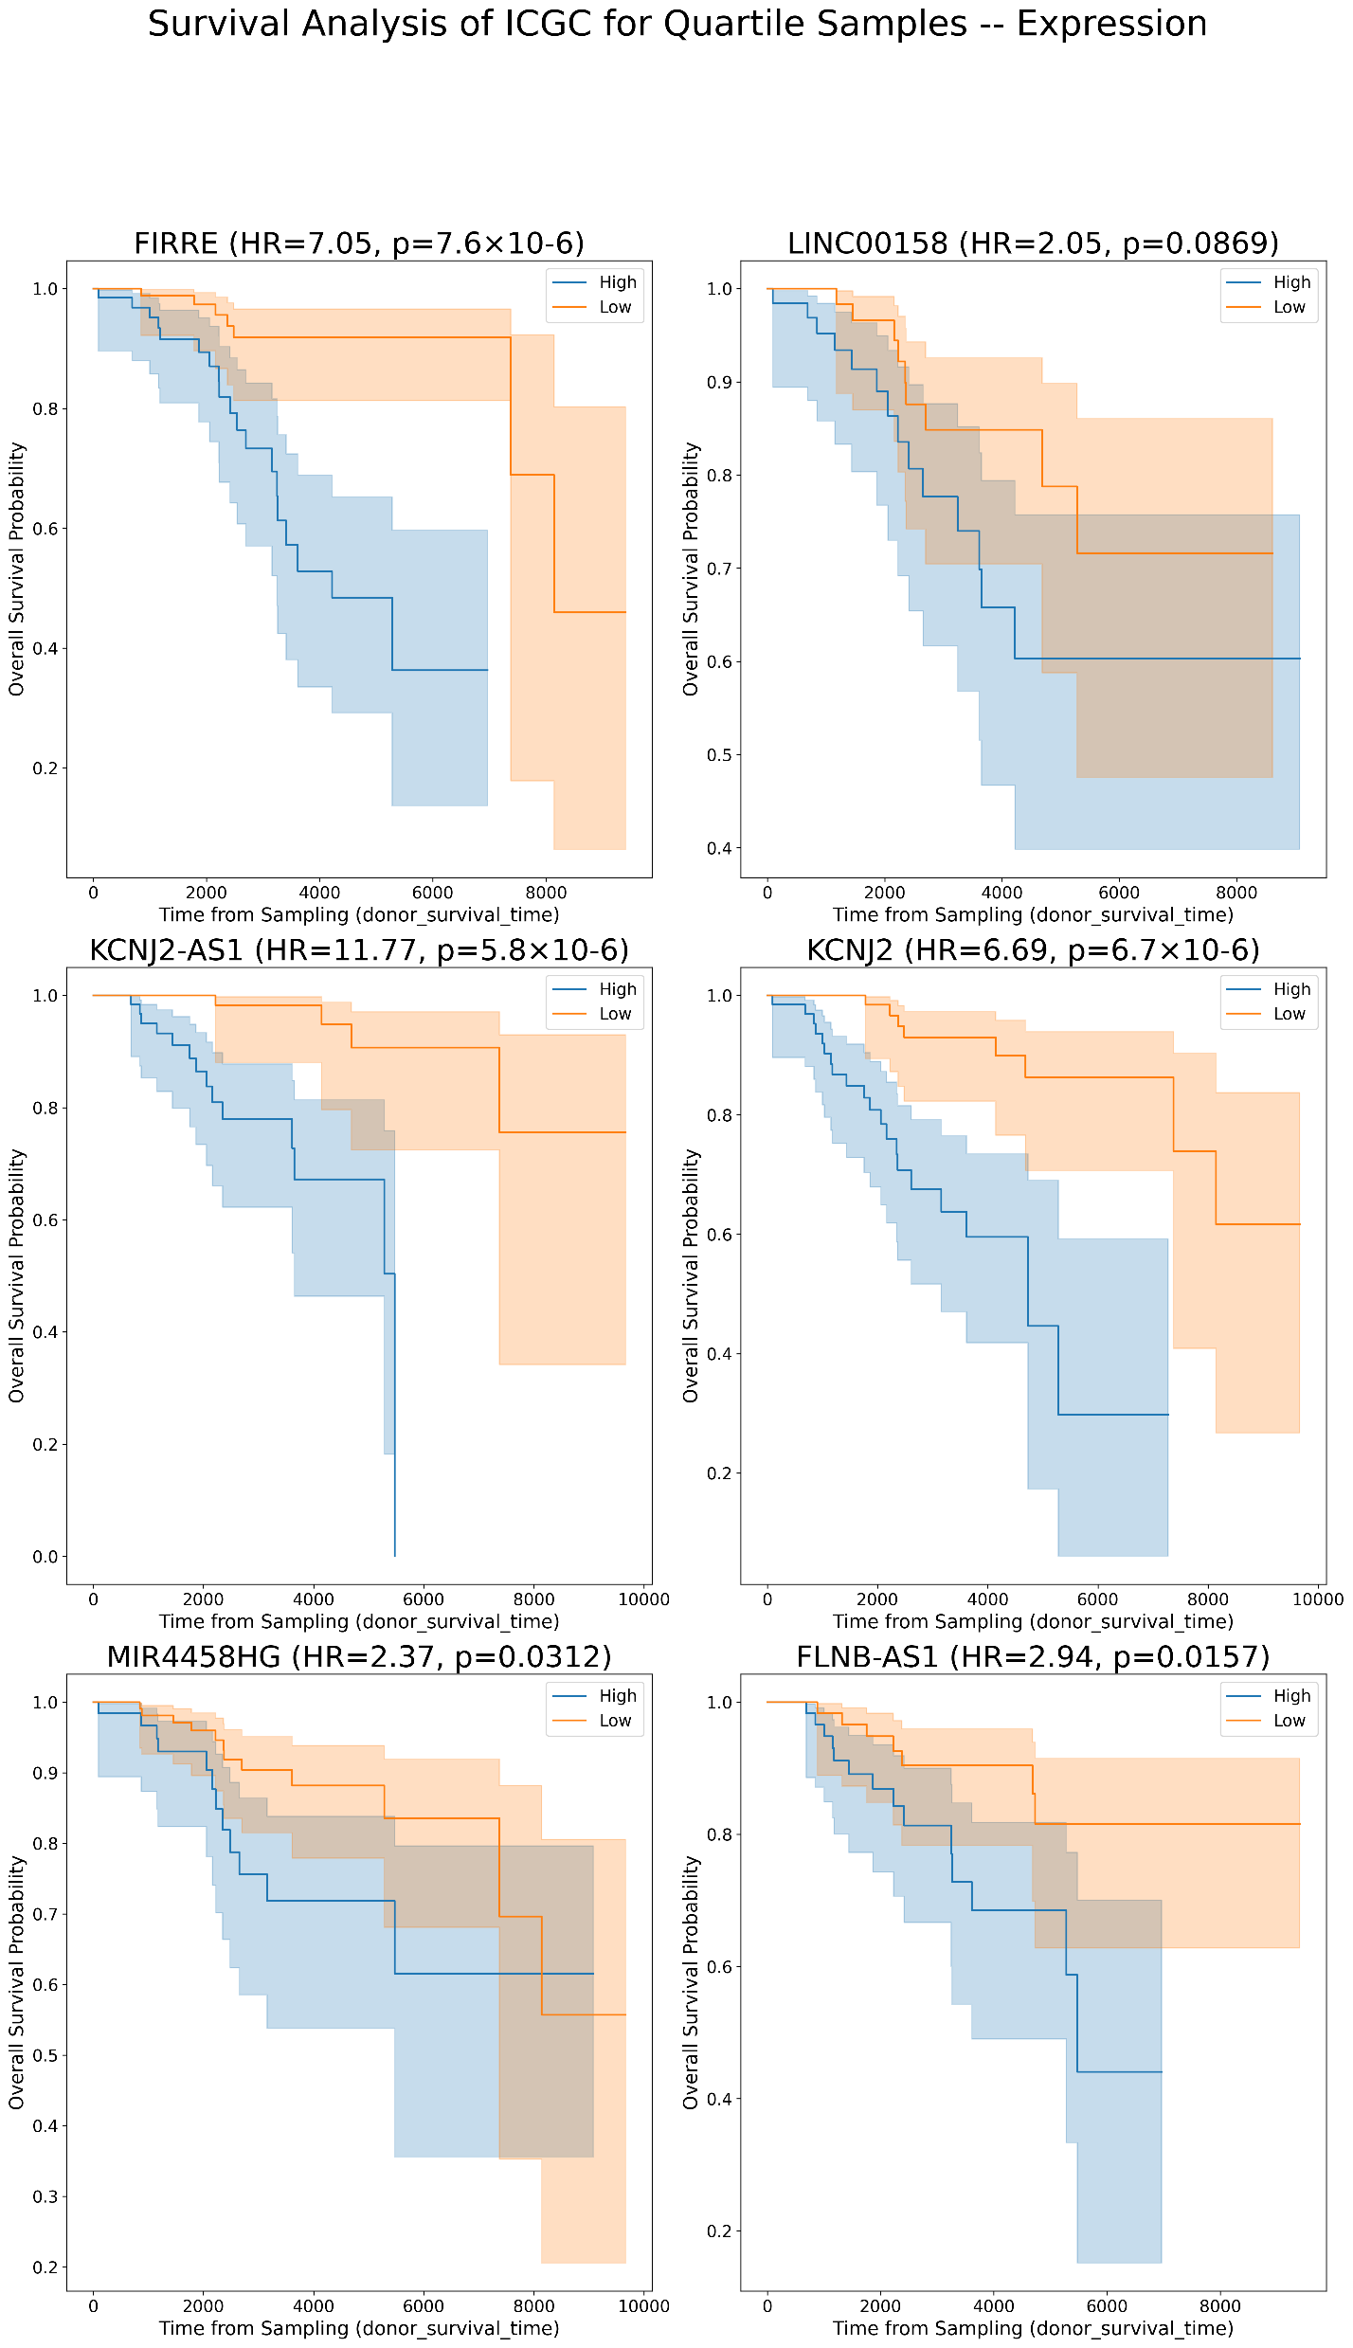
Kaplan Meier’s for lncRNAs plots for OS in ICGC [Expression values]
A
B

Slide 17
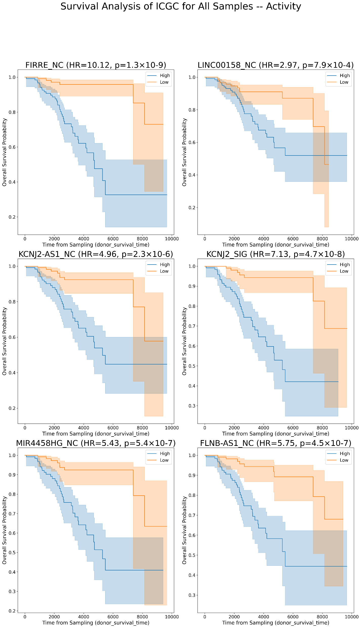
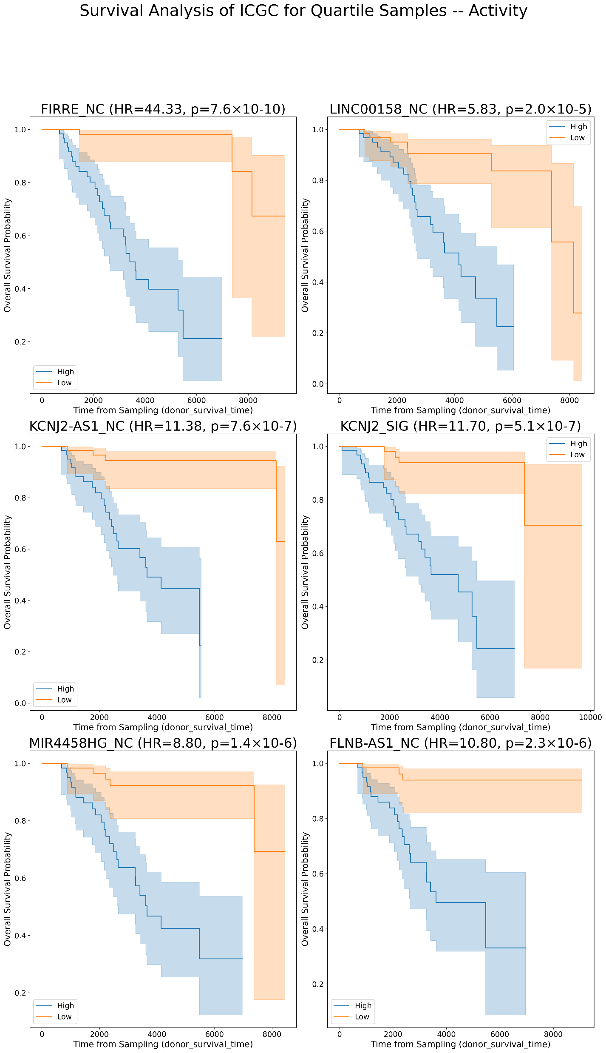
Kaplan Meier’s for lncRNAs plots for OS in ICGC [Activity values]
A
B

Slide 18
BCMO
Kaplan Meier’s by splitting into U/M CLL

Slide 19
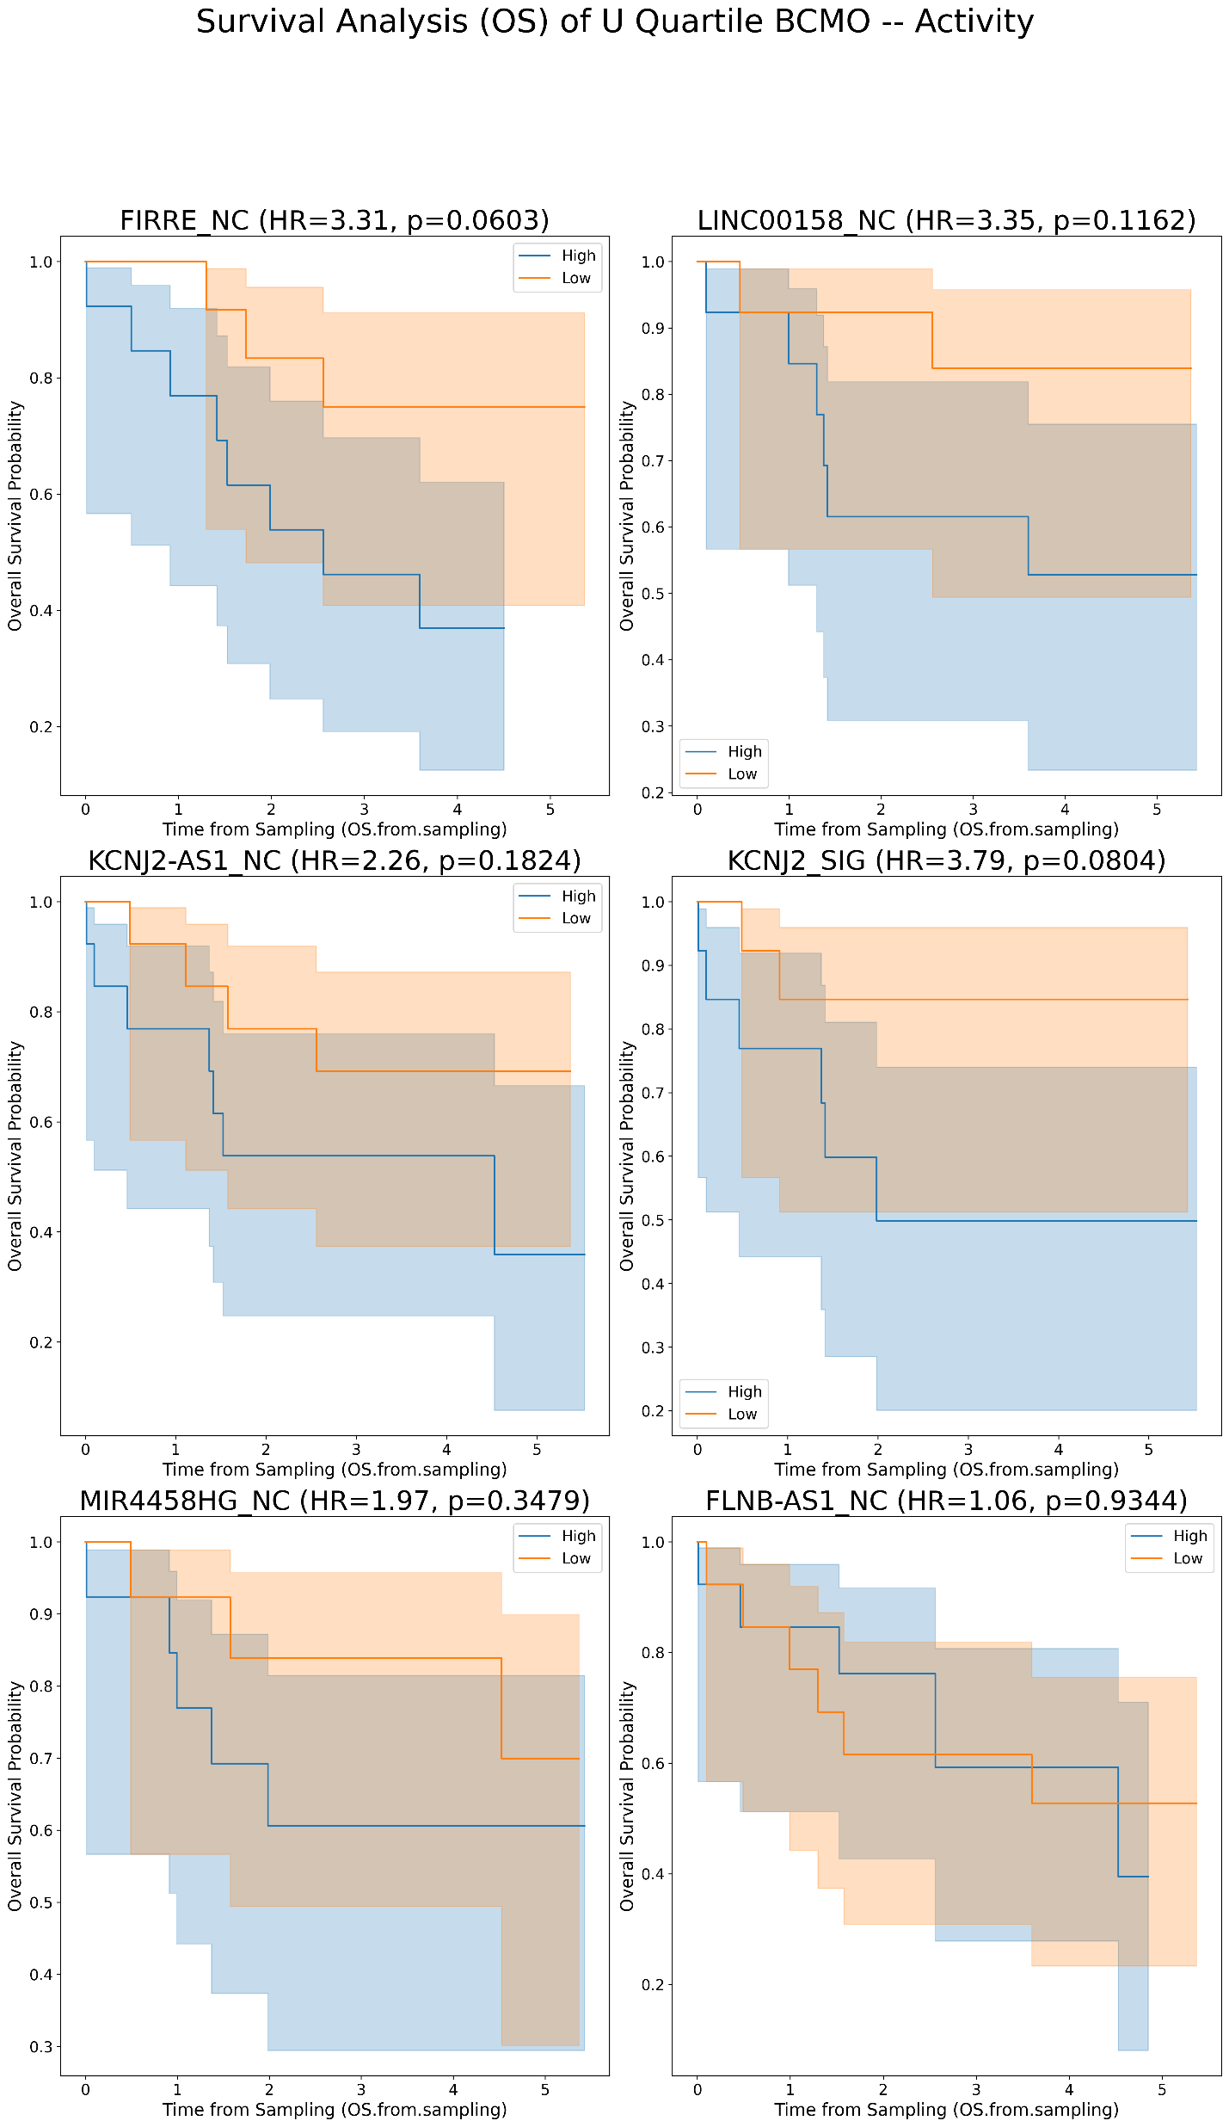
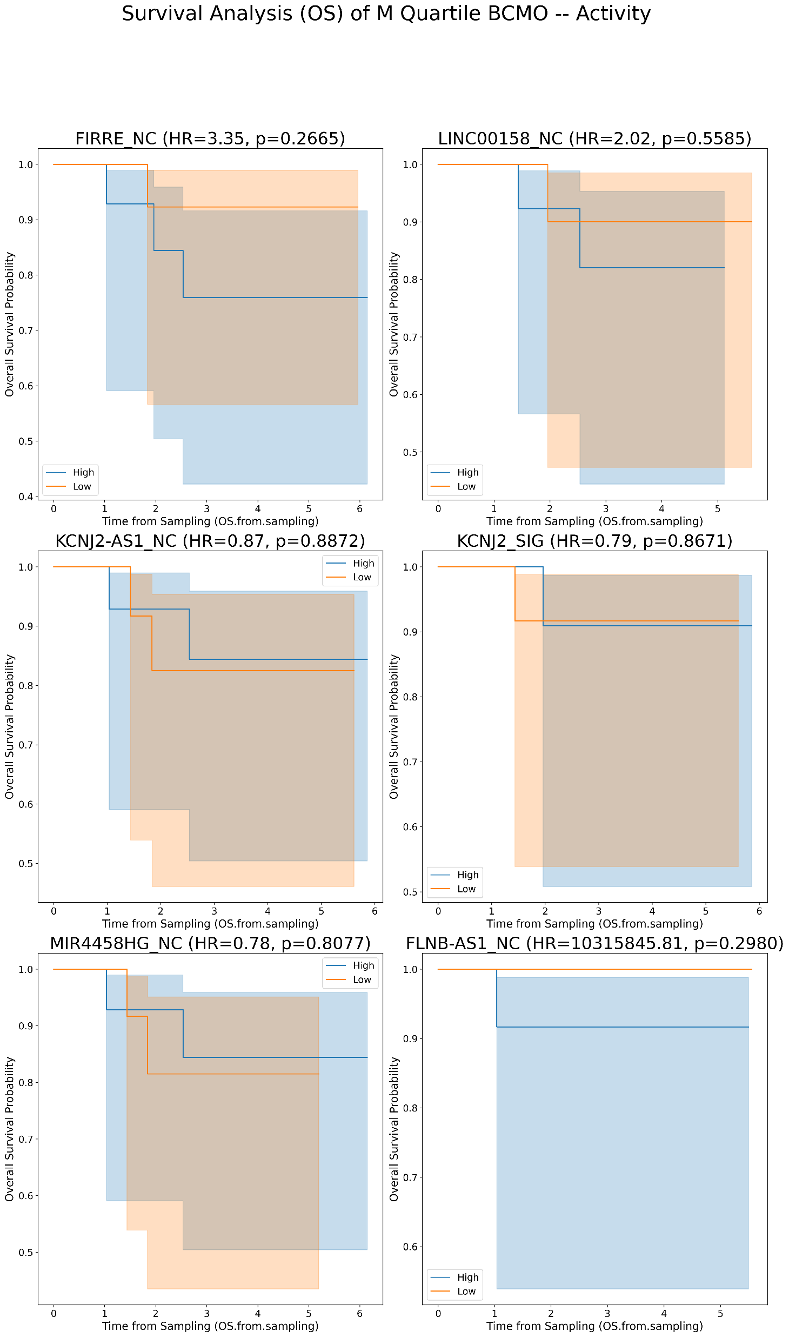
Kaplan Meier’s plots for lncRNAs for OS in BCMO with Activity values [U/M comparison]
A [uCLL]
B [mCLL]
Quartile samples:
25% [high-low]
Activity values

Slide 20
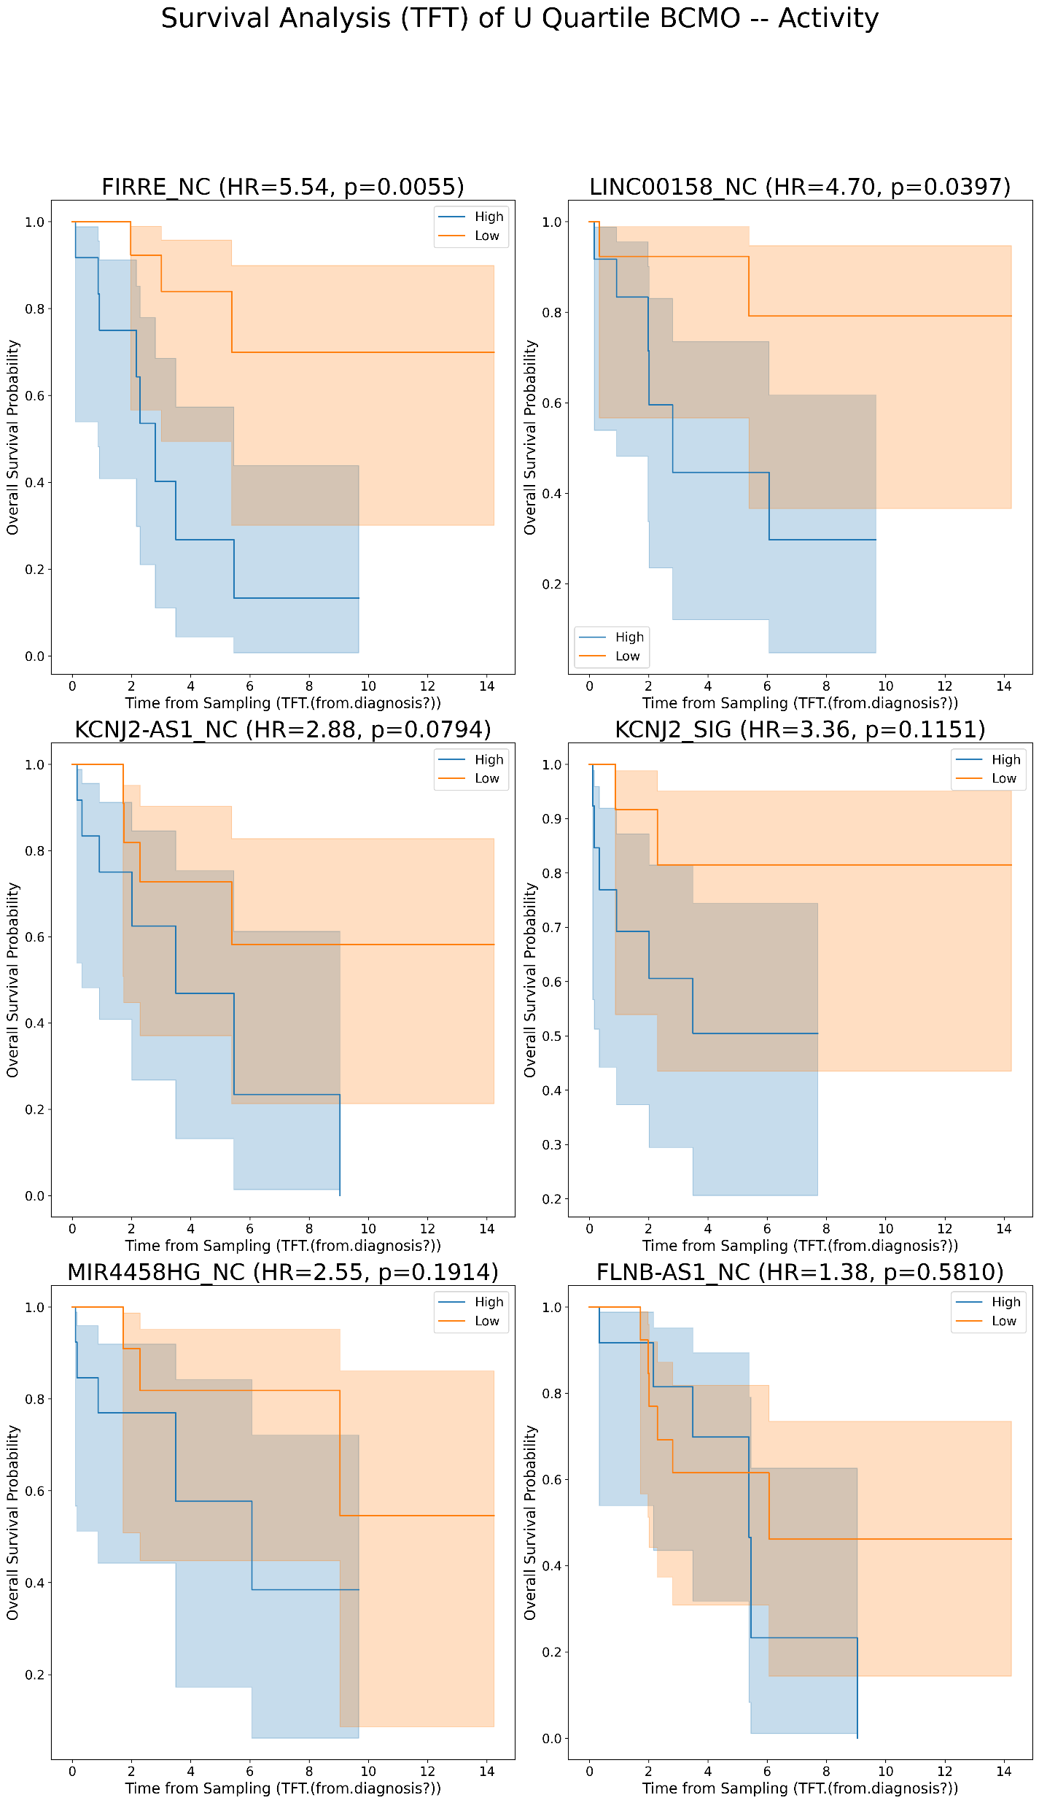
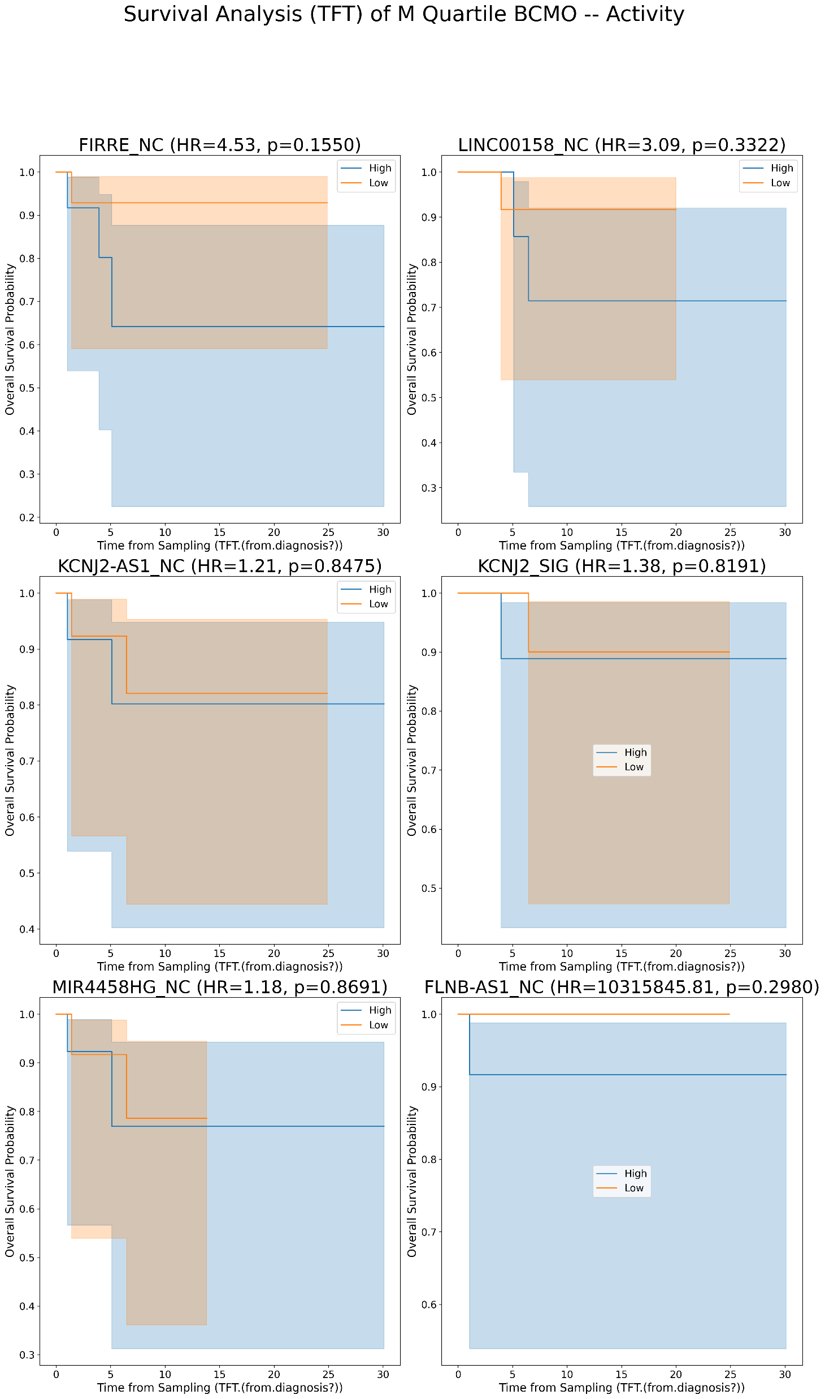
Kaplan Meier’s plots for lncRNAs for TFT in BCMO with Activity values [U/M comparison]
A [uCLL]
B [mCLL]
Quartile samples:
25% [high-low]
Activity values

Slide 21
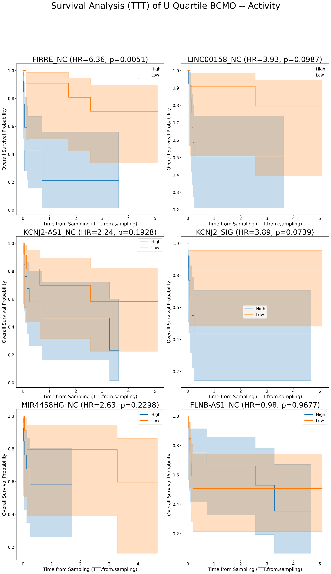
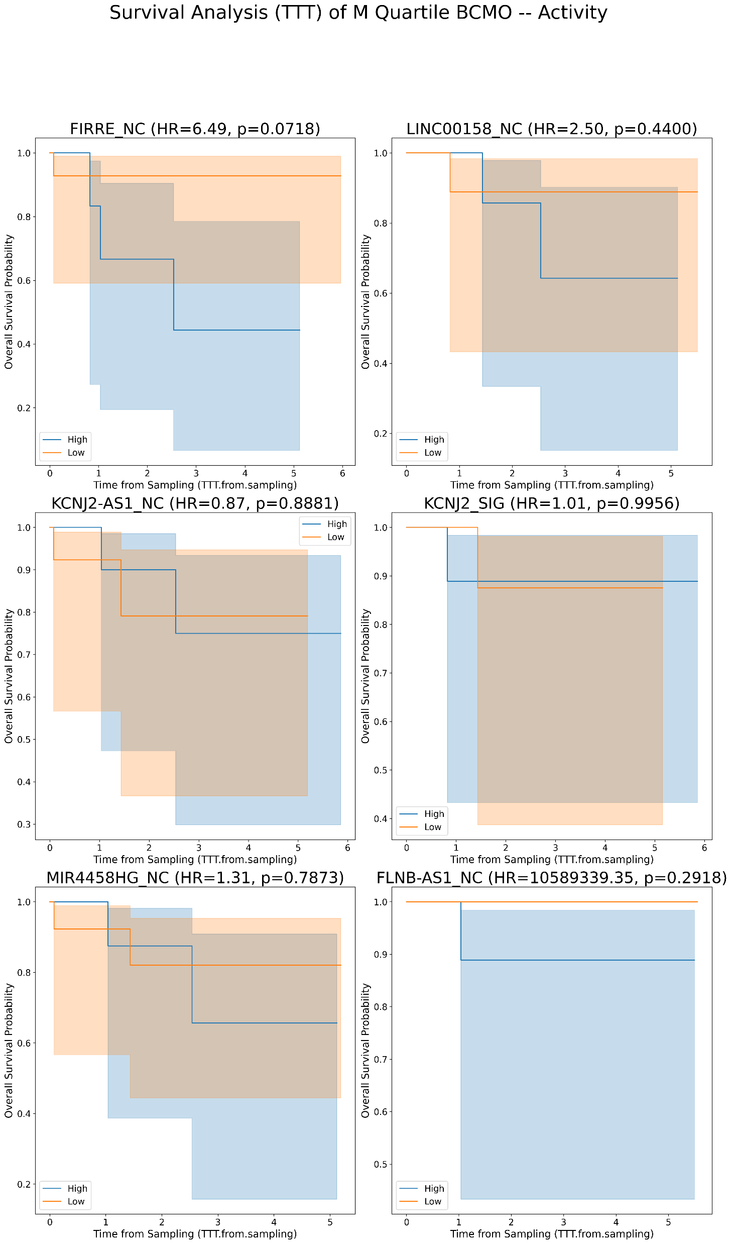
Kaplan Meier’s plots for lncRNAs for TTT in BCMO with Activity values [U/M comparison]
A [uCLL]
B [mCLL]
Quartile samples:
25% [high-low]
Activity values

Slide 22
ICGC
Kaplan Meier’s by splitting into U/M CLL

Slide 23
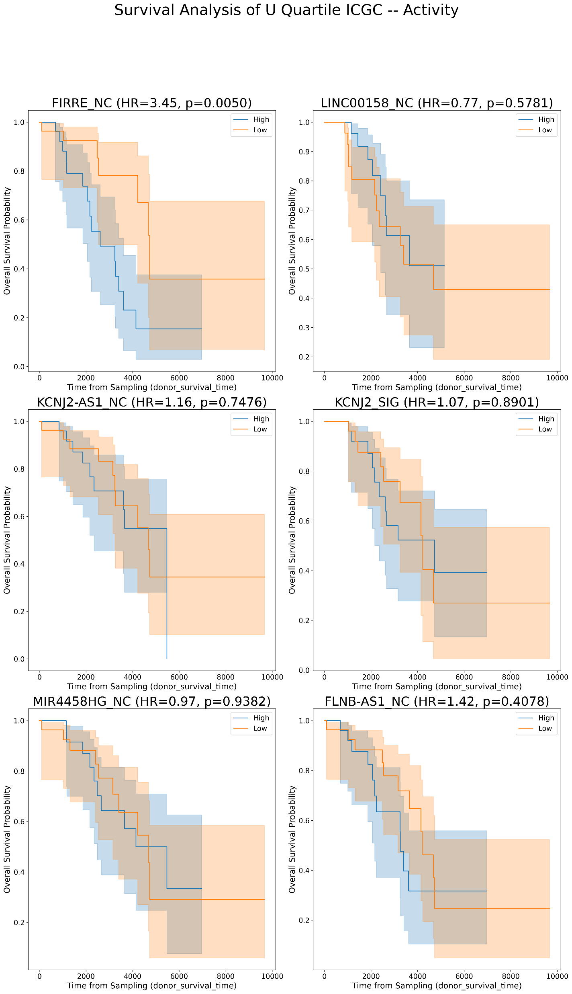
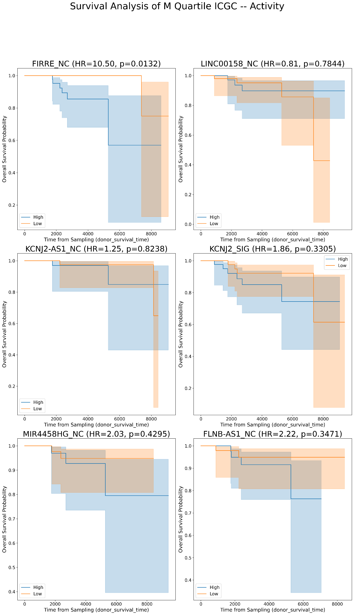
Kaplan Meier’s plots for lncRNAs for OS in ICGC with Activity values [U/M comparison]
A [uCLL]
B [mCLL]
Quartile samples:
30%* [high-low]
Activity values
*30% considered due to the small number of samples in the death rate

