Slide 1
Bubble Plot with Clinical Covariates

Slide 2
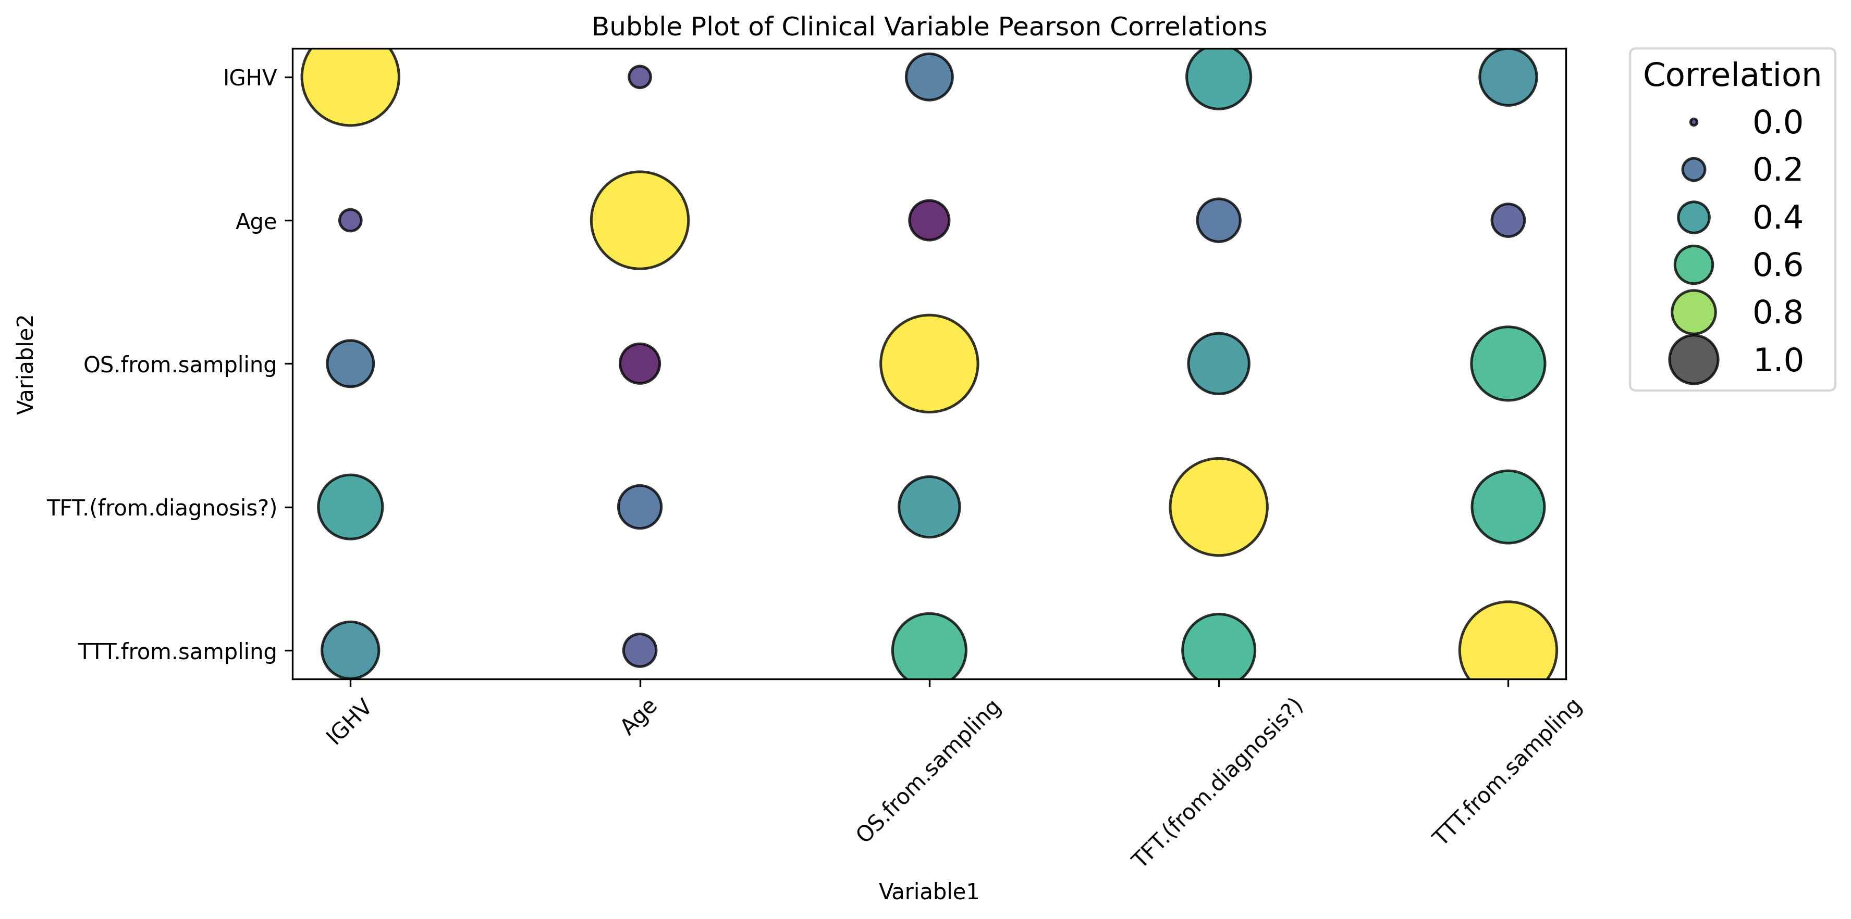
Clinical Covariates between BCMO’s metadata

Slide 3
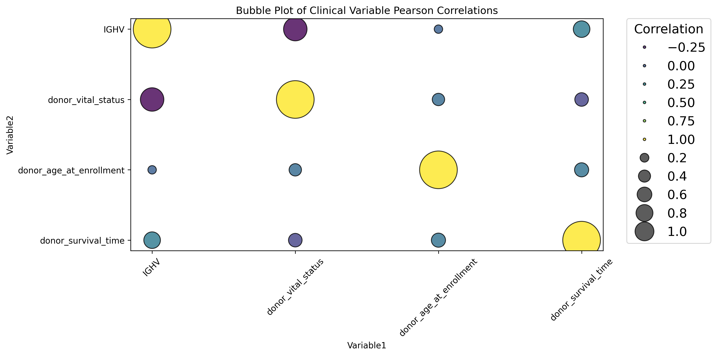
Clinical Covariates between ICGC’s metadata

Slide 4
BCMO

Slide 5
FOR SURVIVAL STATUS (OS)

Slide 6
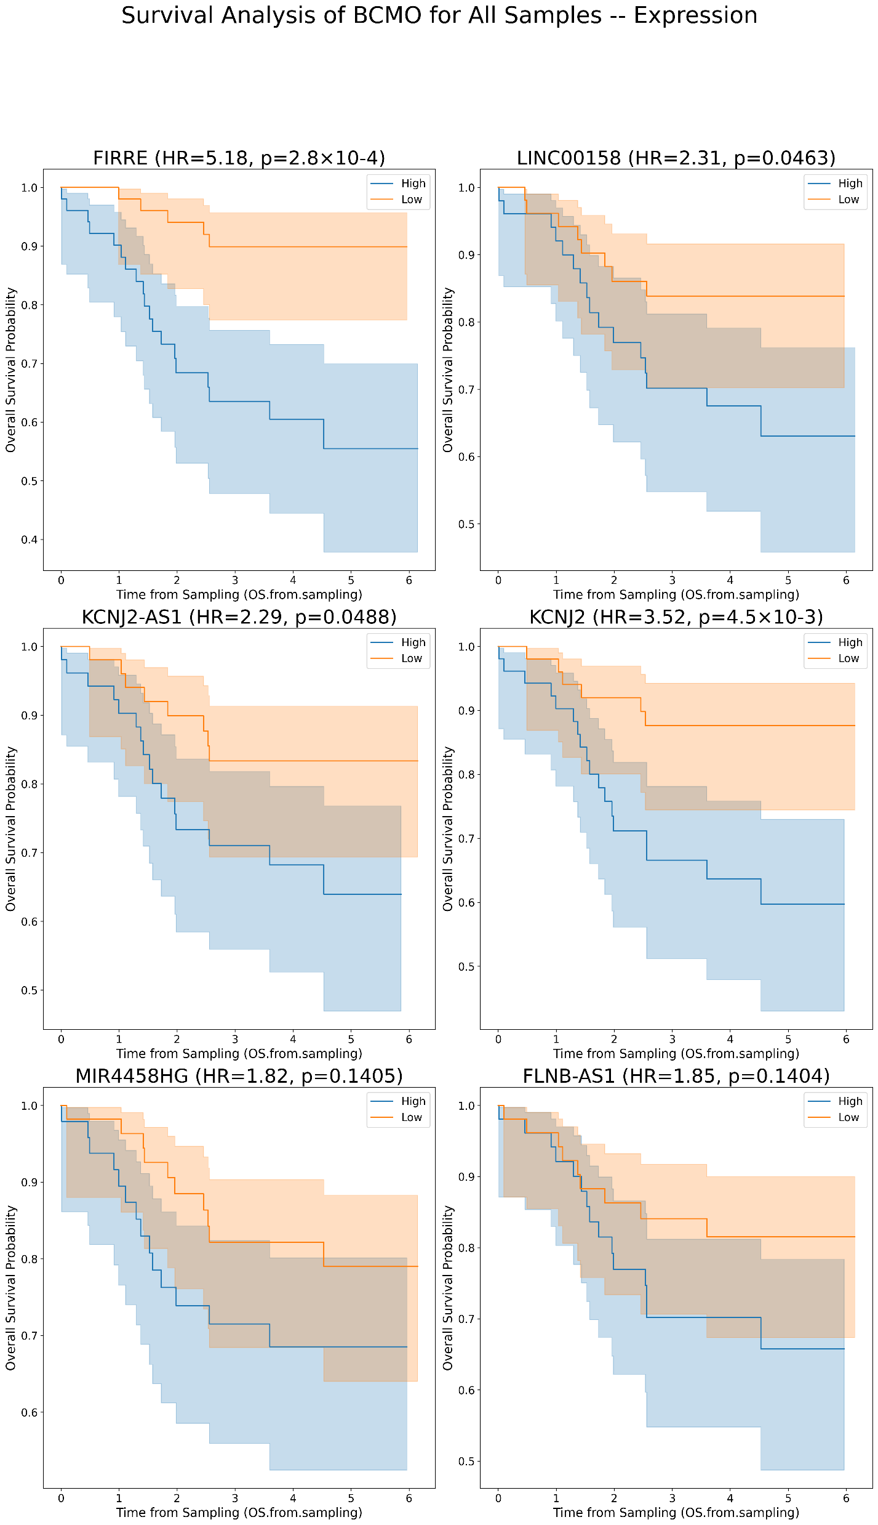
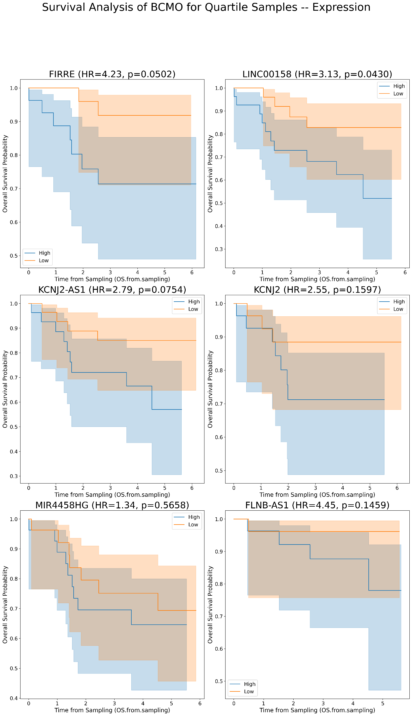
Kaplan Meier’s for lncRNAs plots for OS in BCMO [Expression values]
A
B
A
B

Slide 7
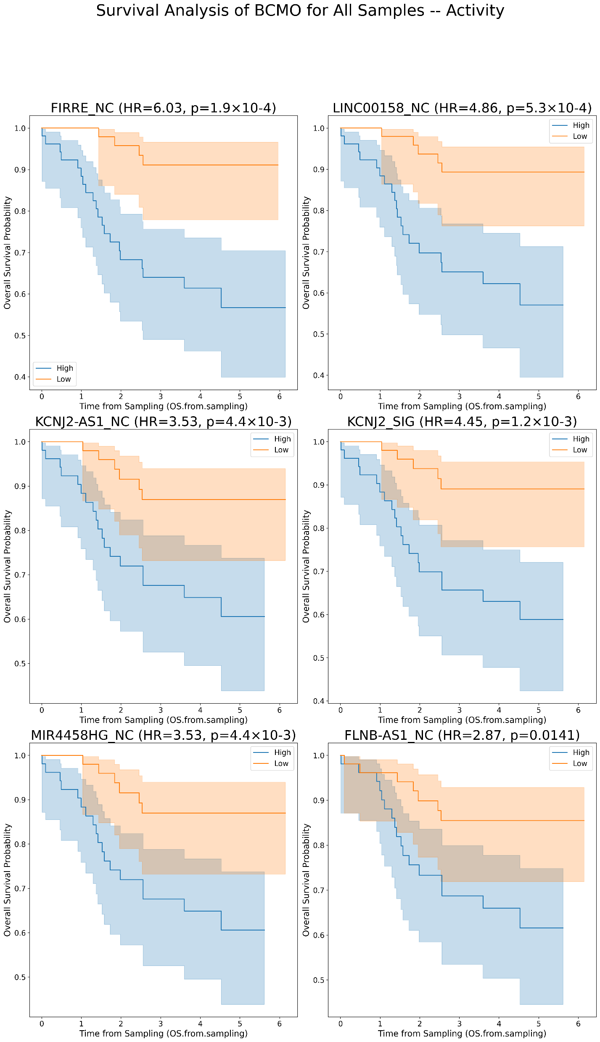
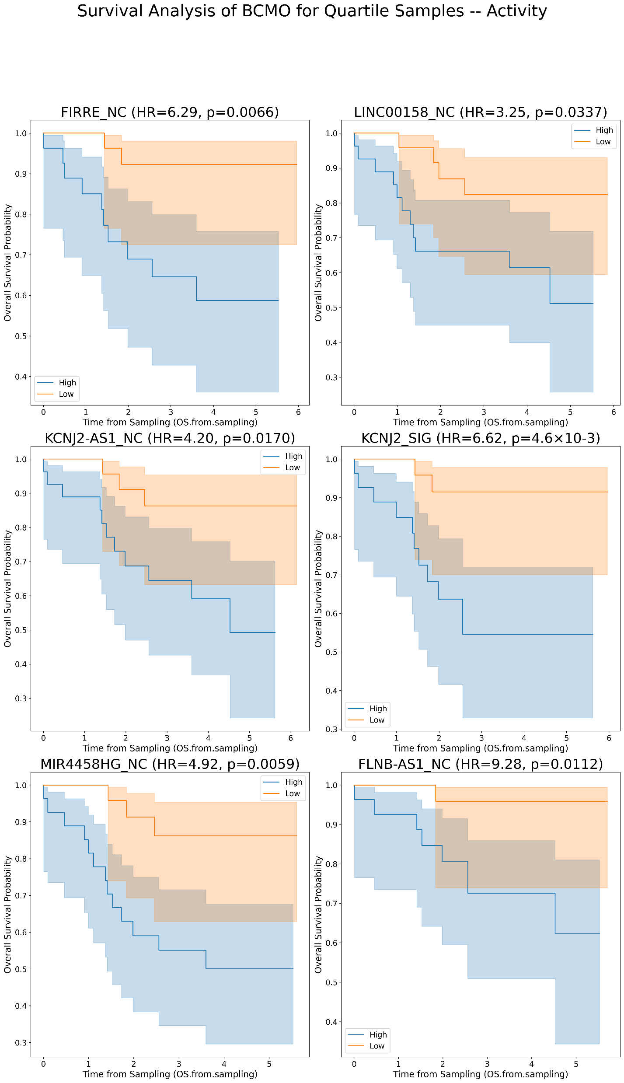
Kaplan Meier’s for lncRNAs plots for OS in BCMO [Activity values]
A
B

Slide 8
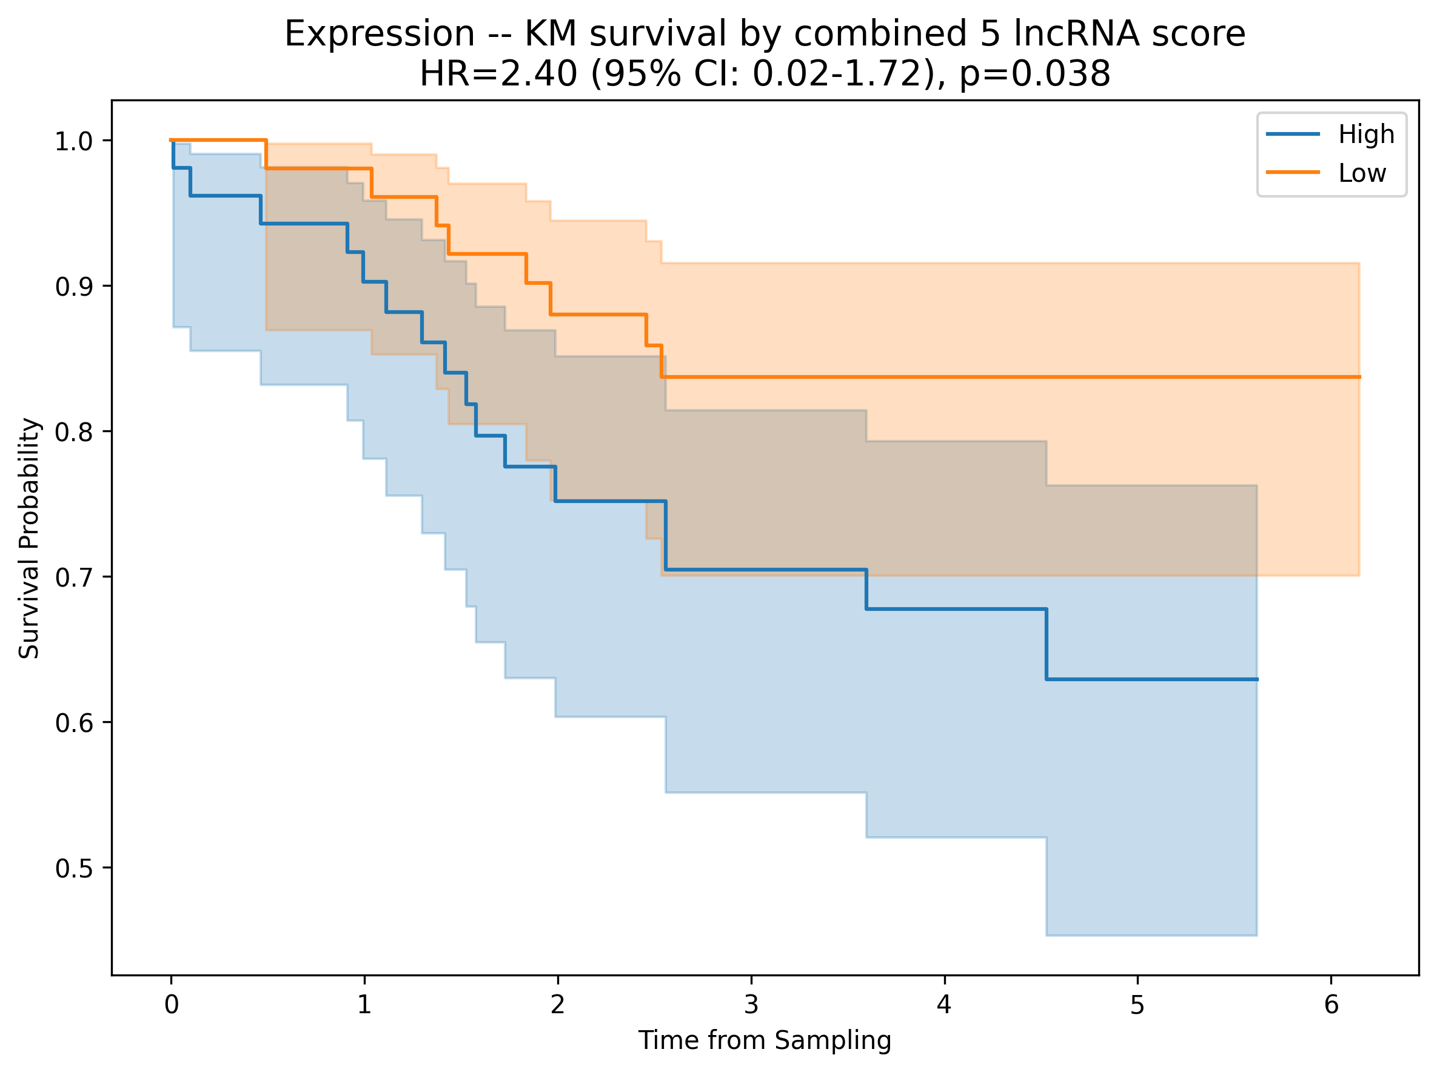
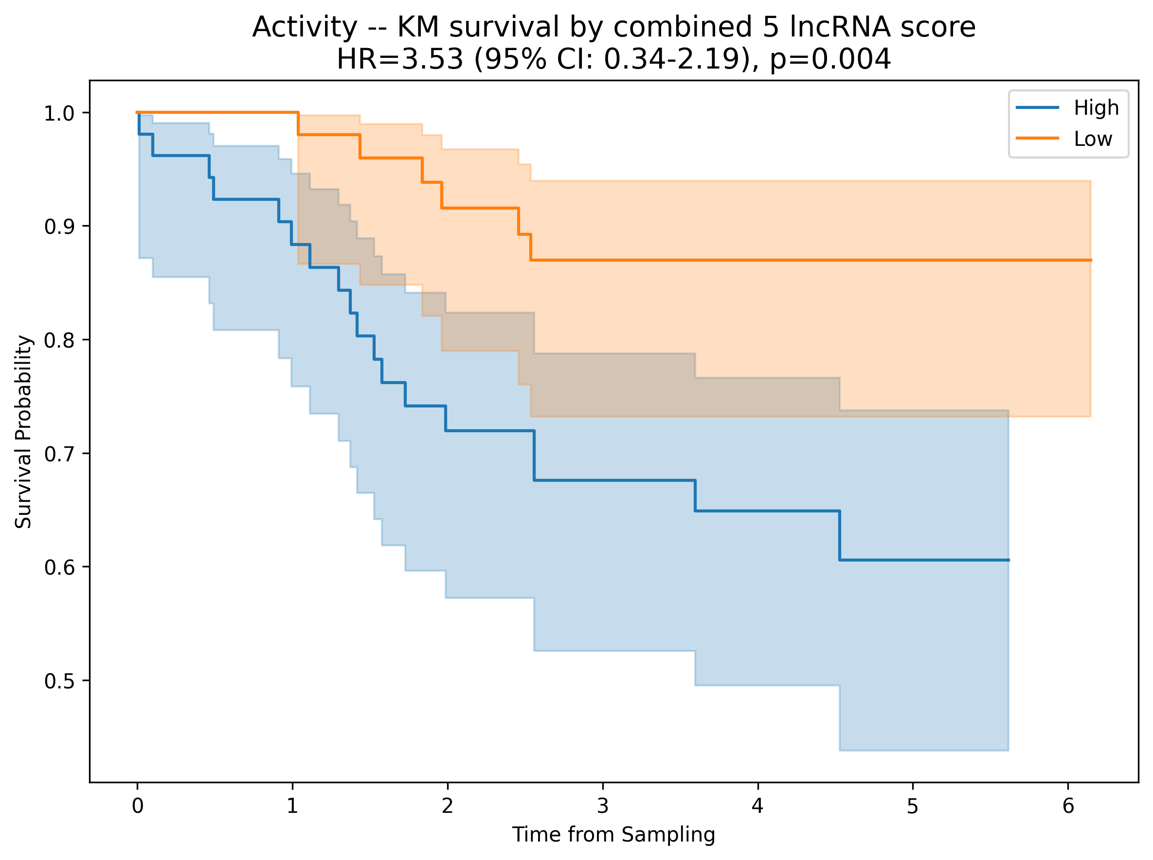
Kaplan Meier’s for combining 5 sign. lncRNAs plots for OS in BCMO [Activity values]

Slide 9
FOR TFT

Slide 10
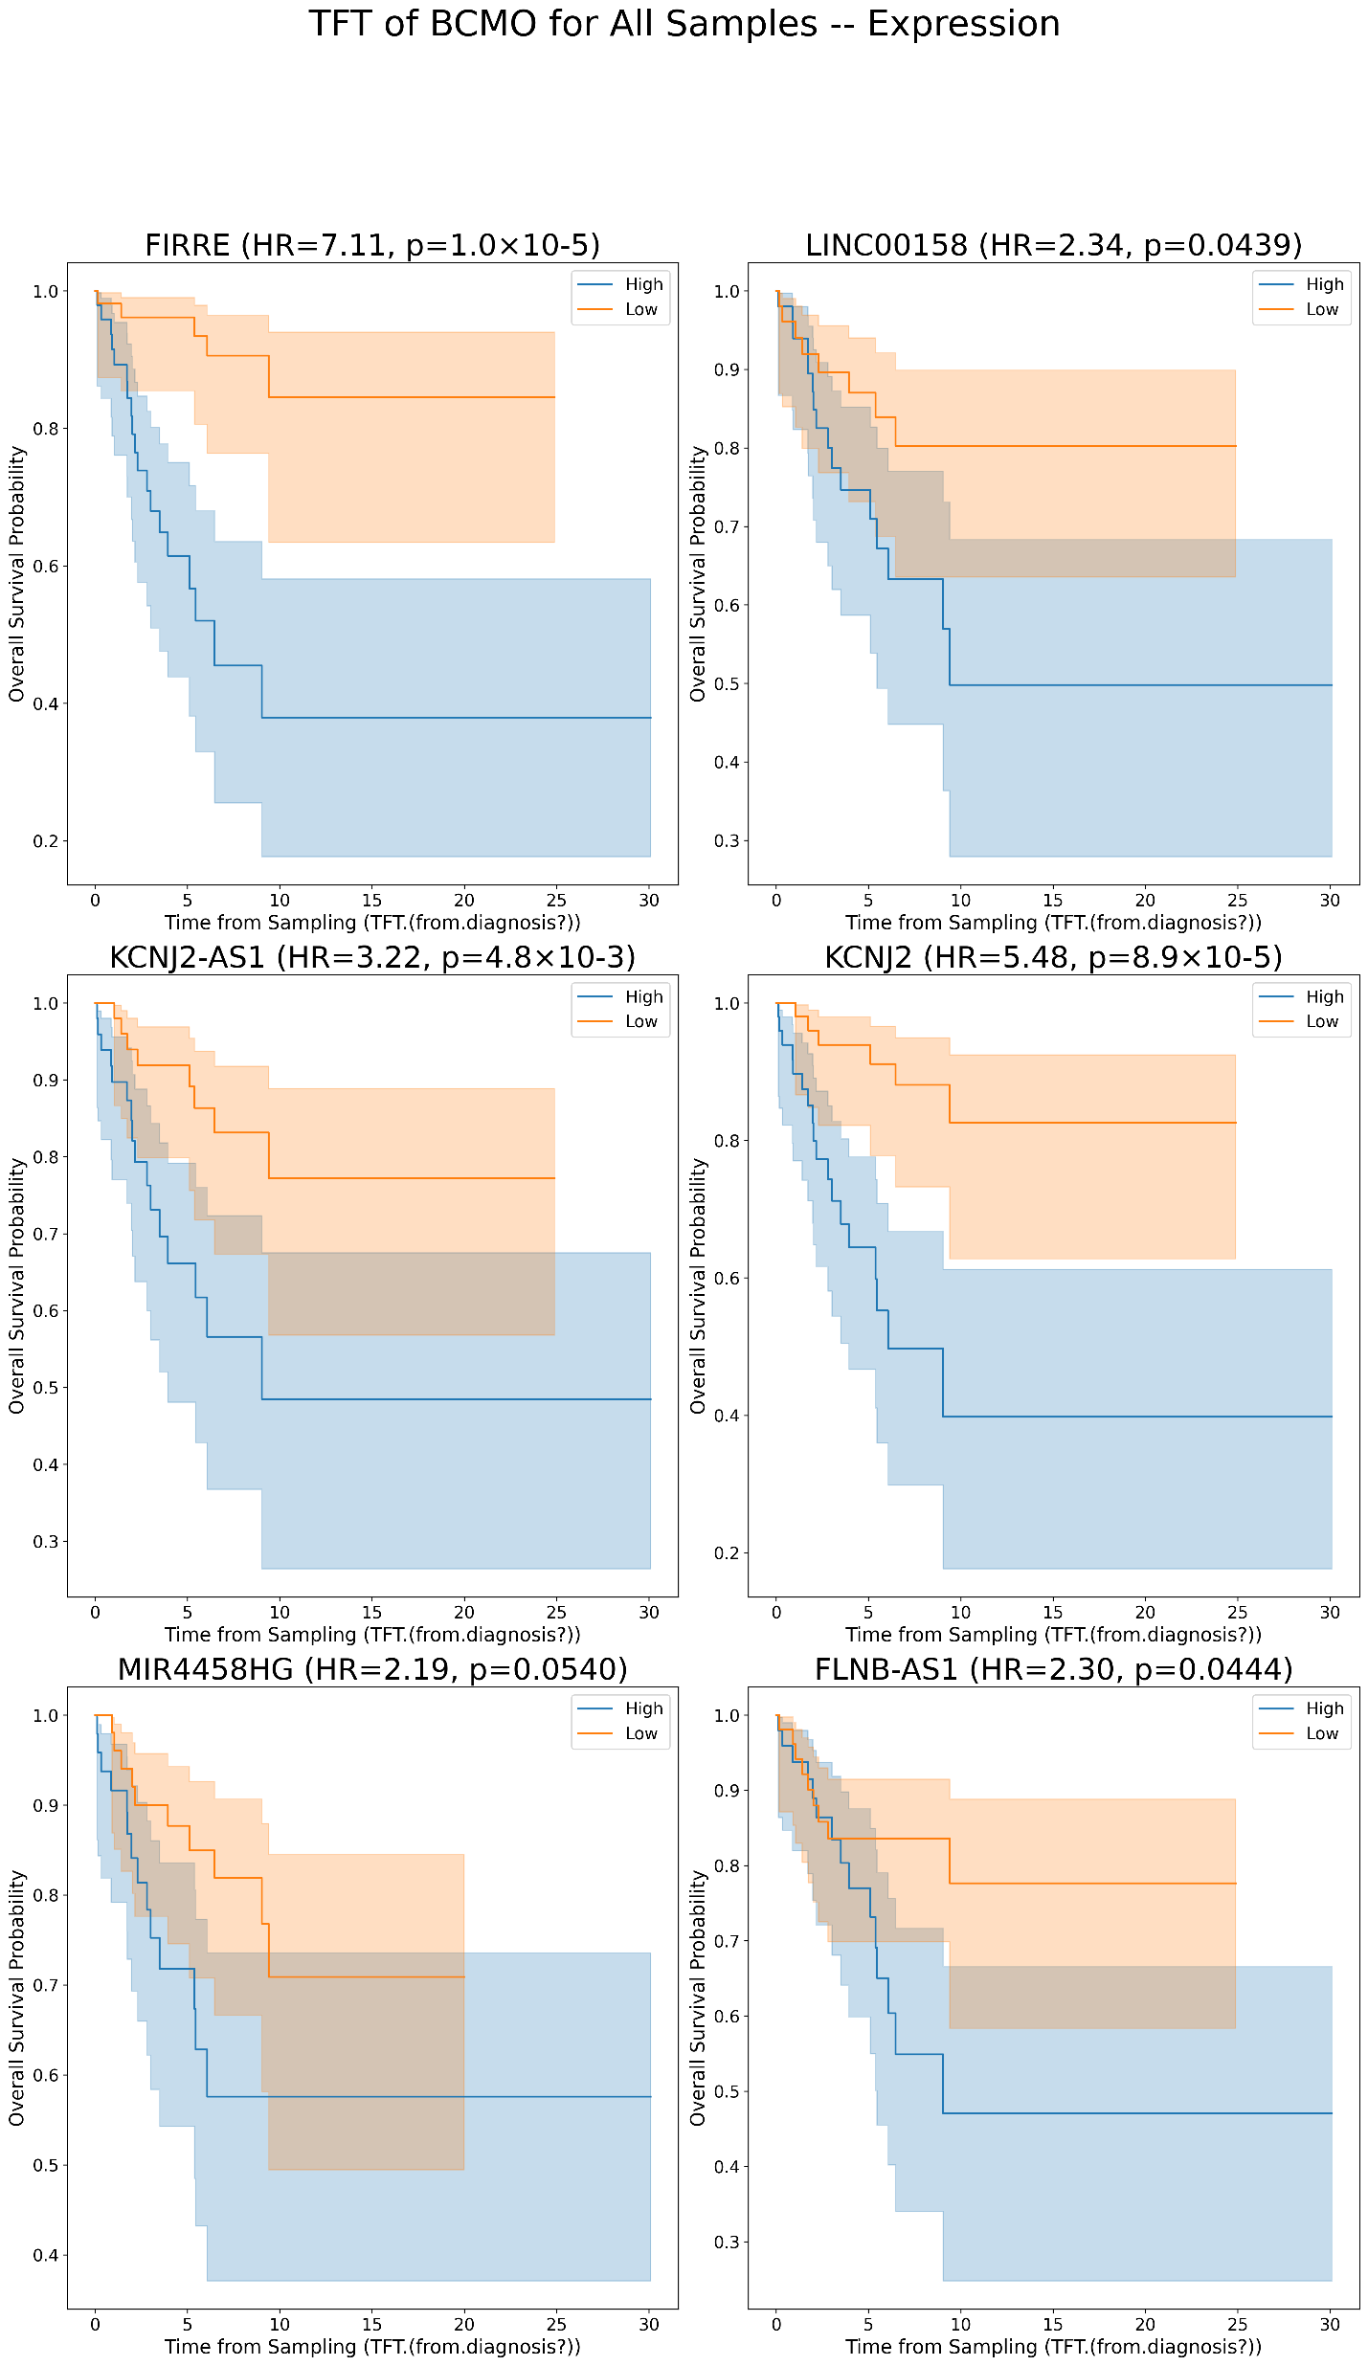
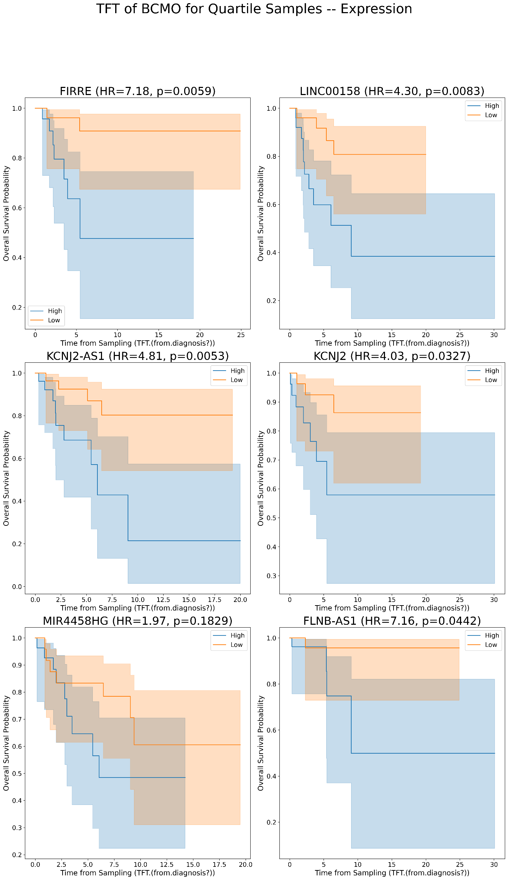
Kaplan Meier’s for lncRNAs plots for TFT in BCMO [Expression values]
A
B

Slide 11
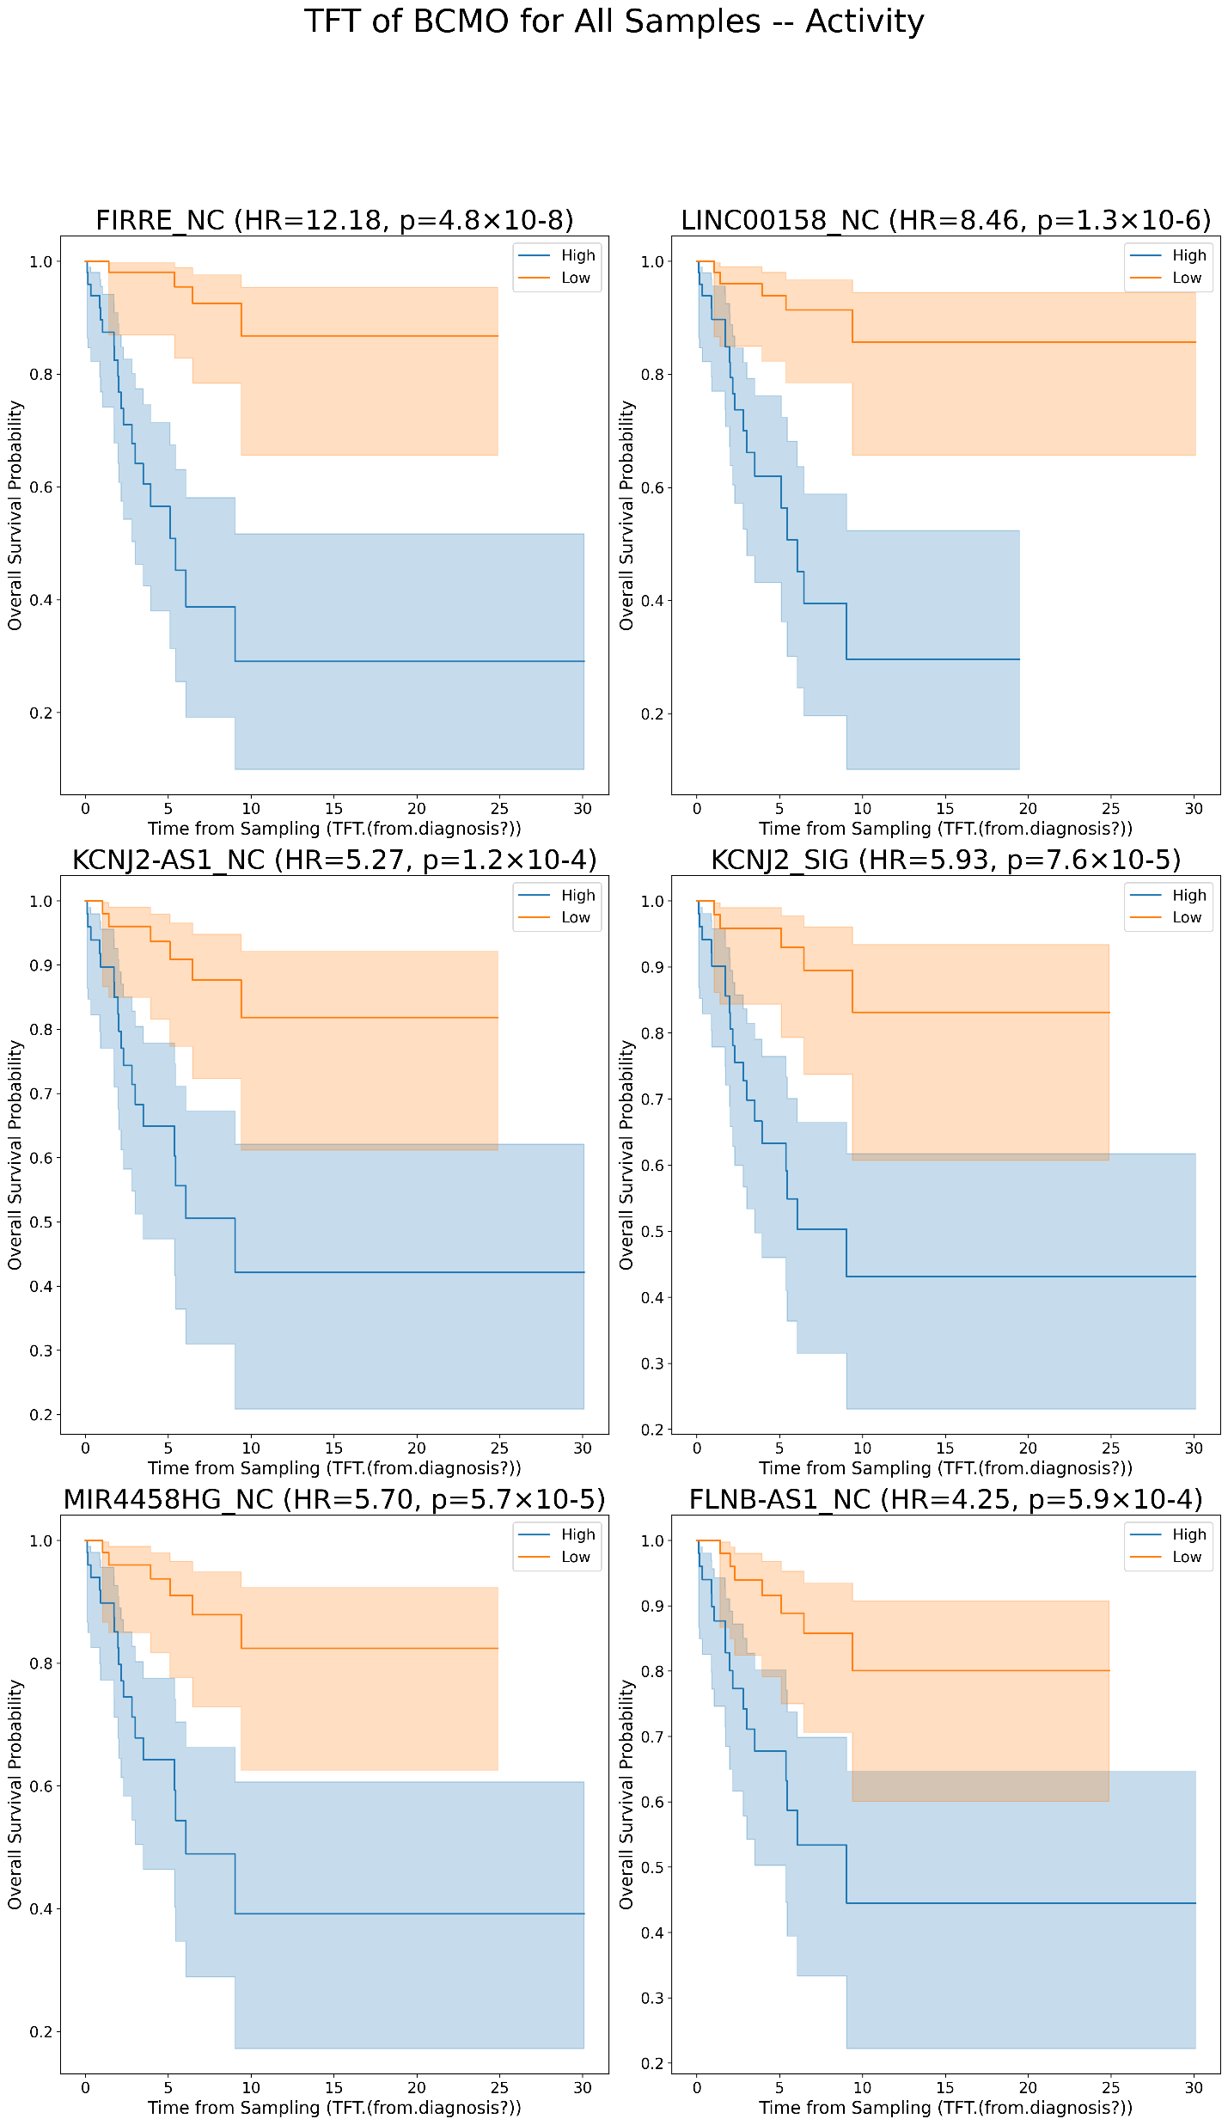
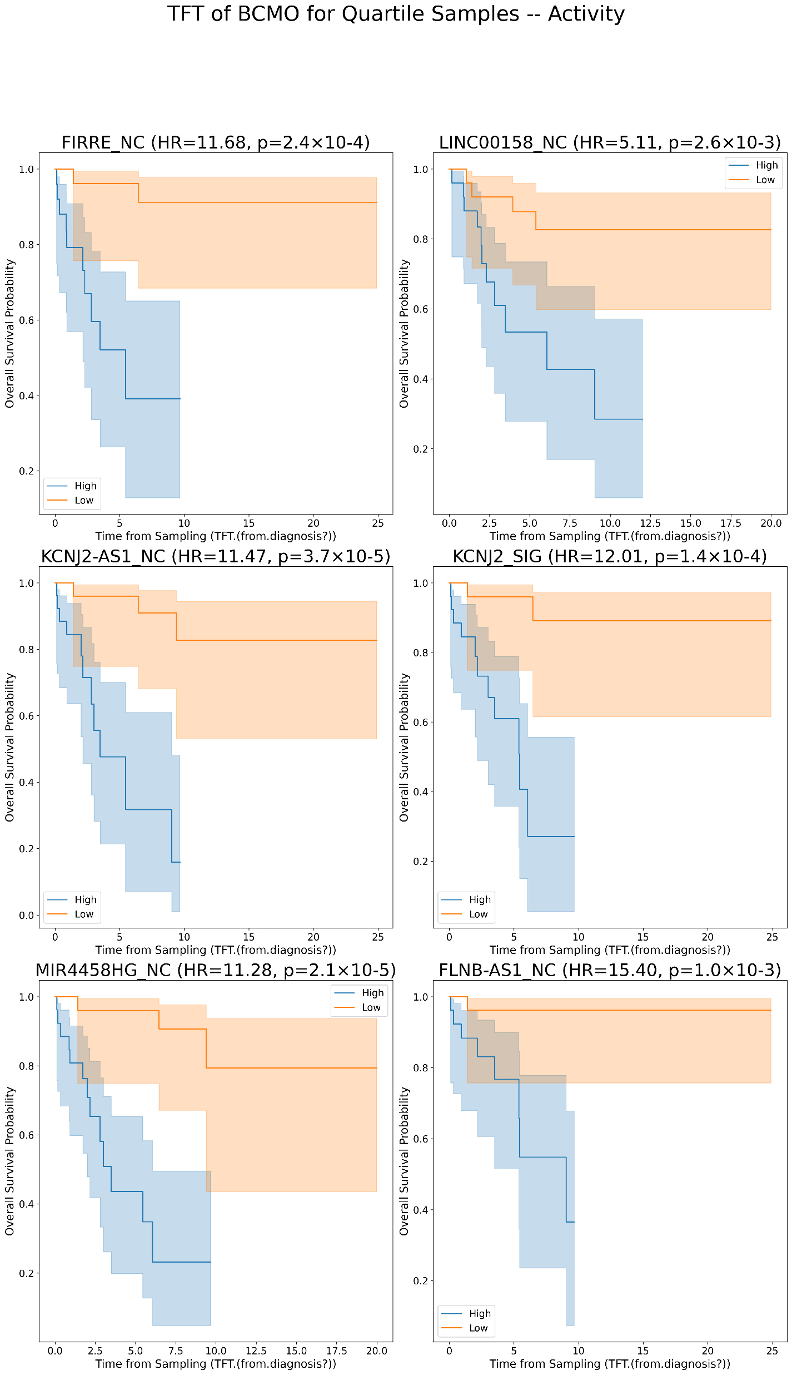
Kaplan Meier’s for lncRNAs plots for TFT in BCMO [Activity values]
A
B

Slide 12
FOR TTT

Slide 13
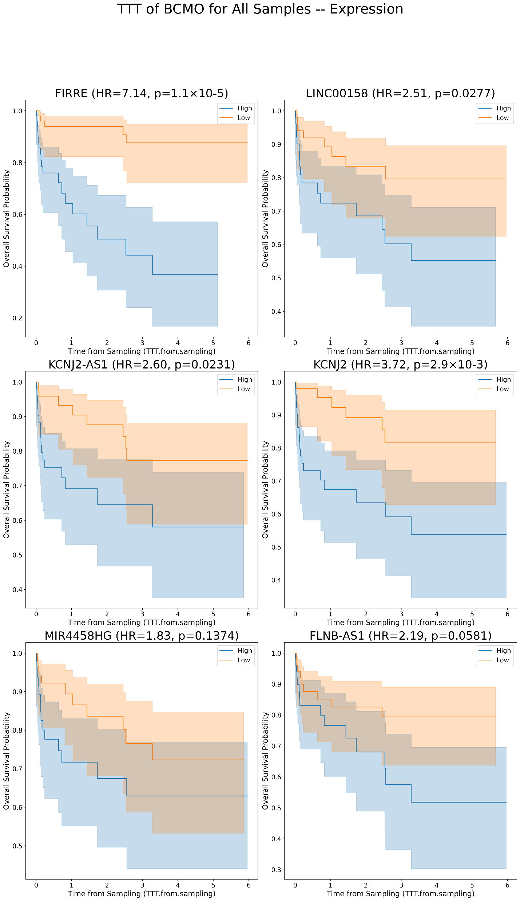
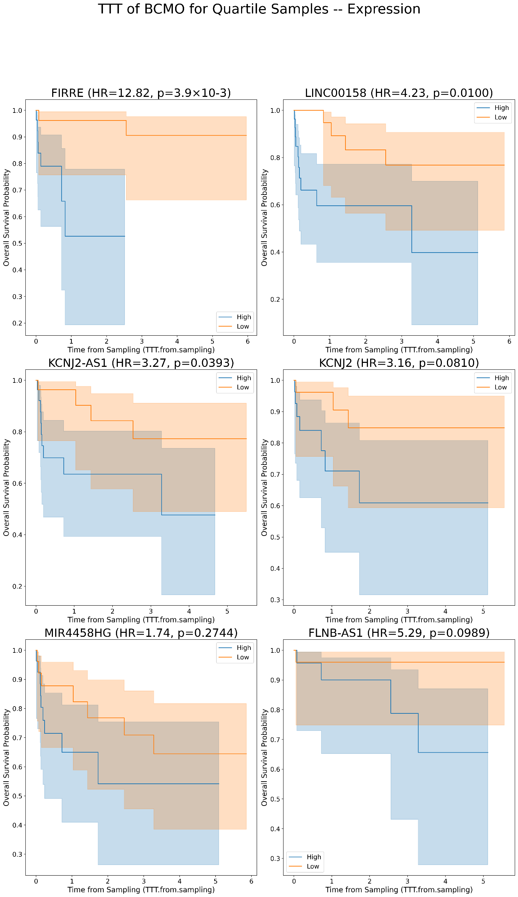
Kaplan Meier’s for lncRNAs plots for TTT in BCMO [Expression values]
A
B

Slide 14
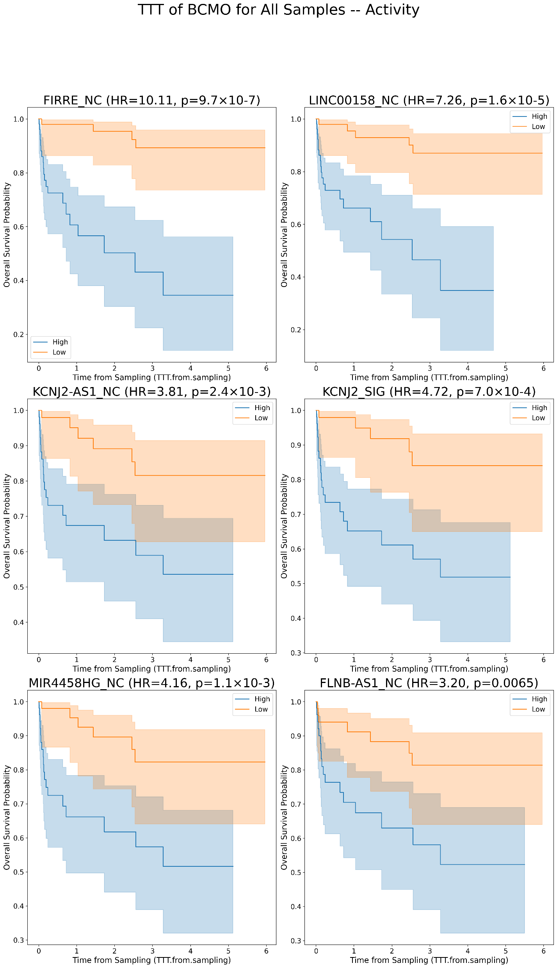
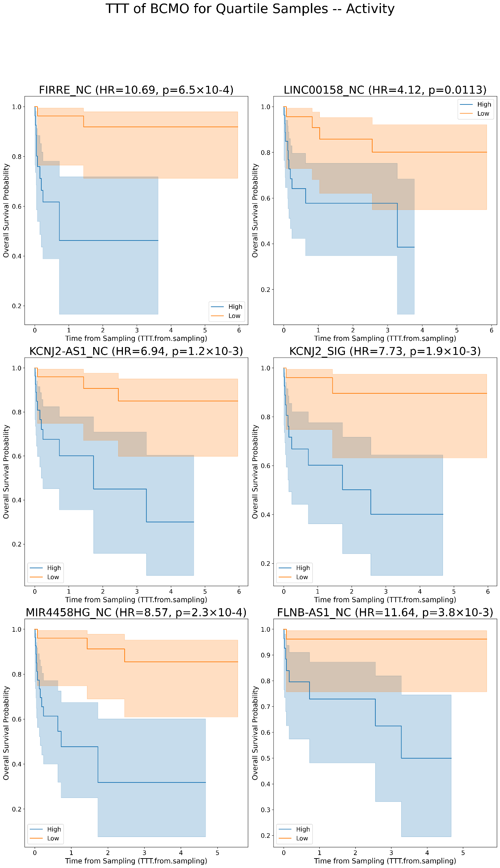
Kaplan Meier’s for lncRNAs plots for TTT in BCMO [Activity values]
A
B

Slide 15
ICGC Survival Status (OS)

Slide 16
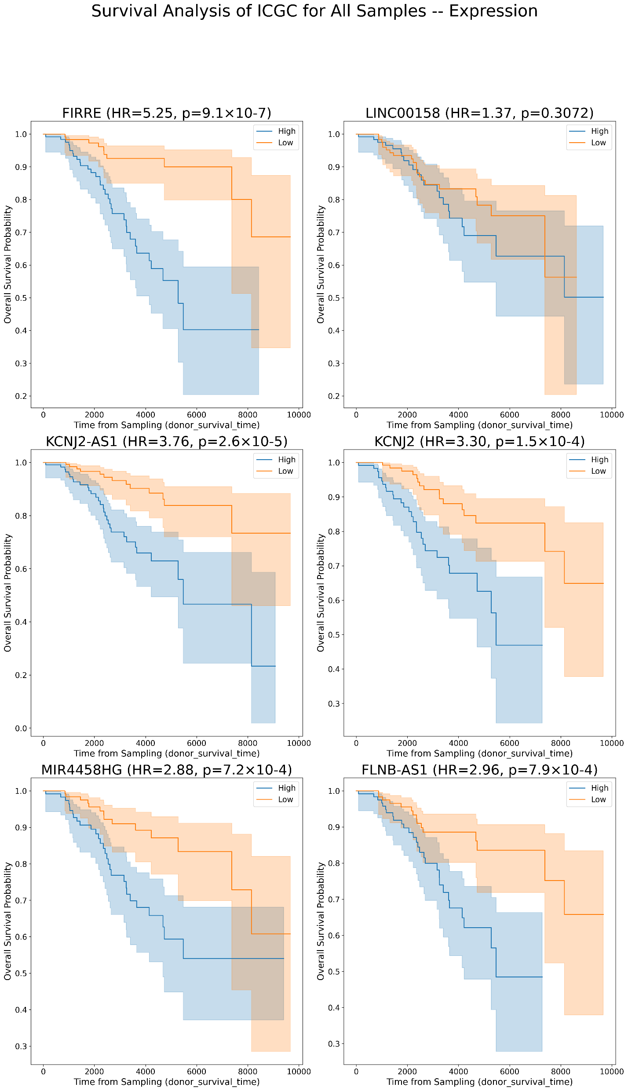
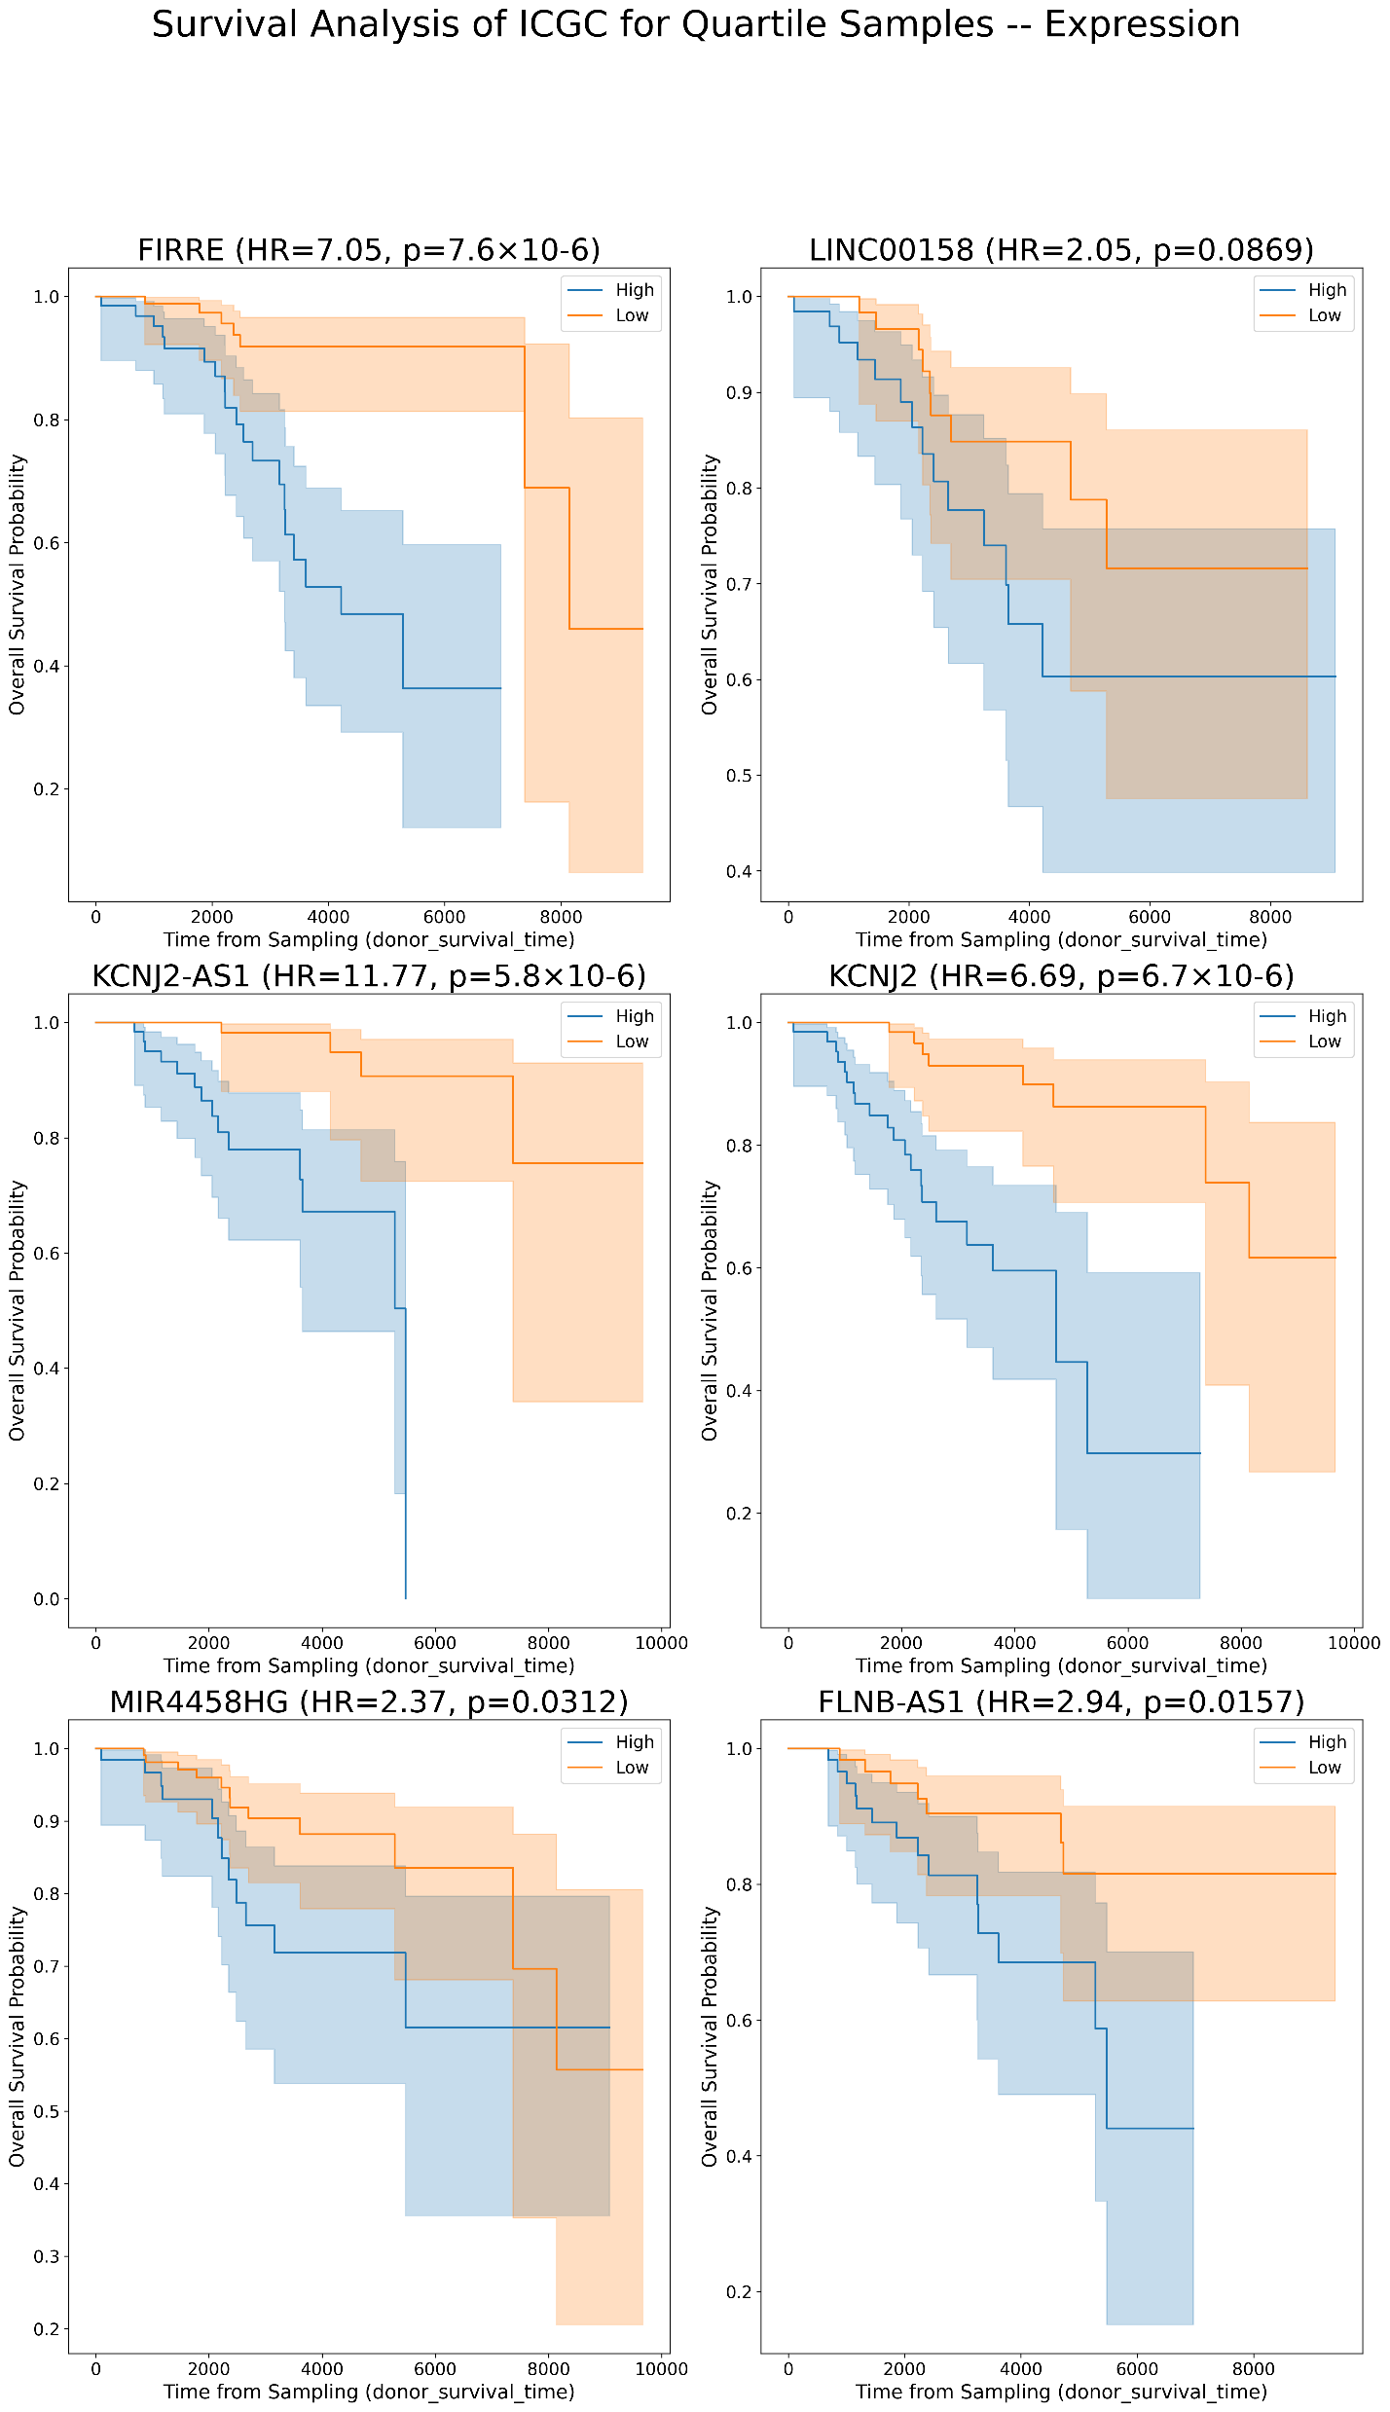
Kaplan Meier’s for lncRNAs plots for OS in ICGC [Expression values]
A
B

Slide 17
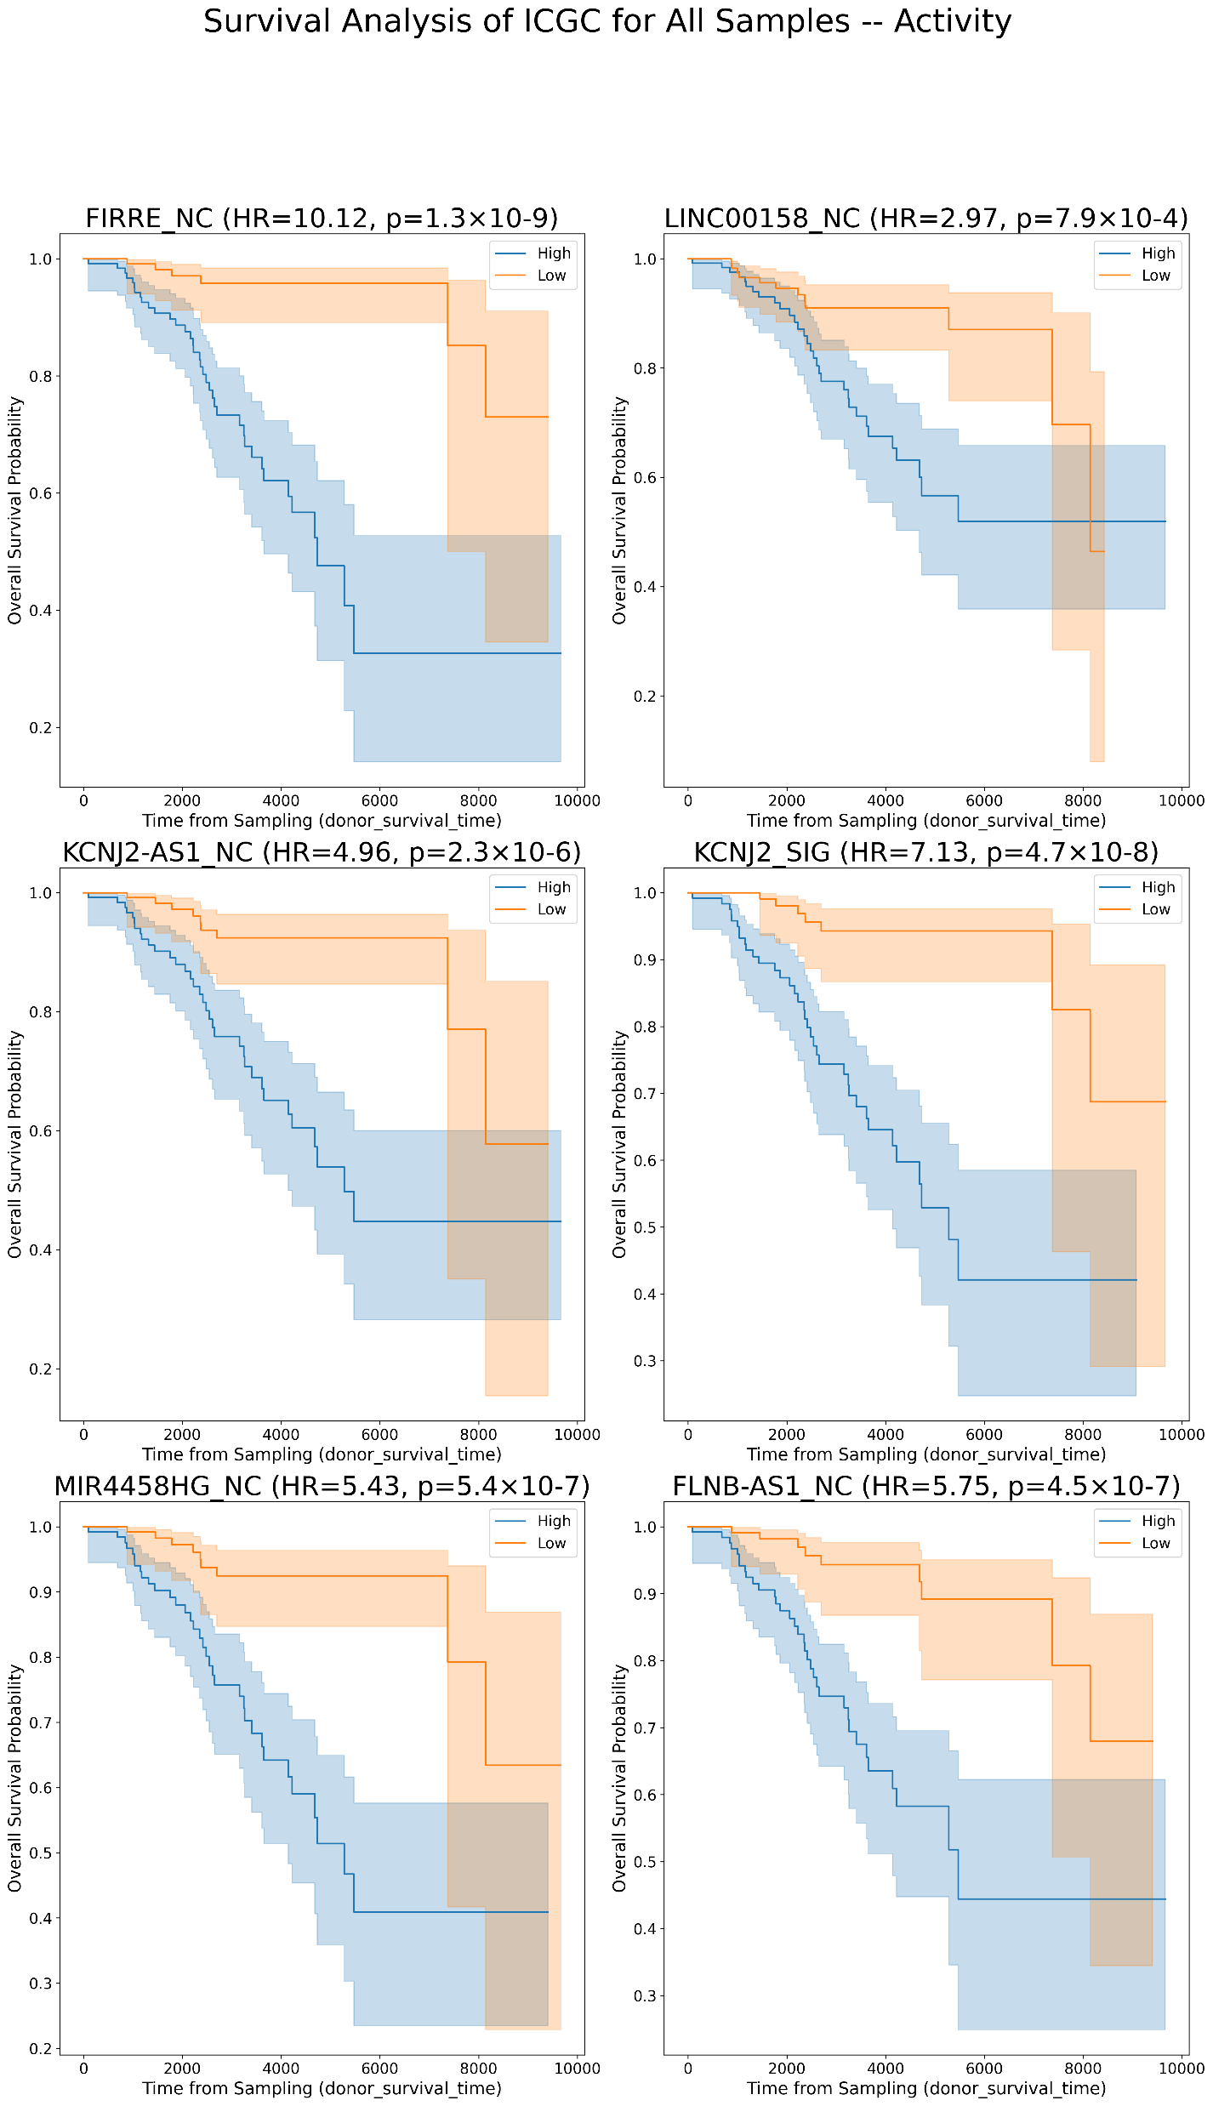
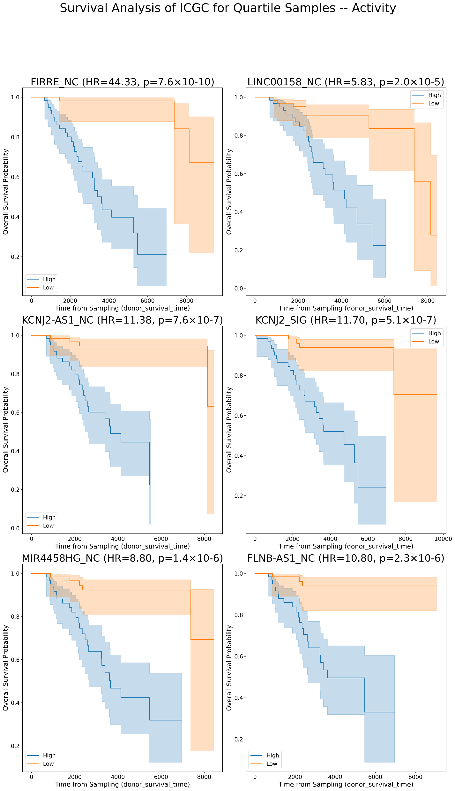
Kaplan Meier’s for lncRNAs plots for OS in ICGC [Activity values]
A
B

