Slide 1
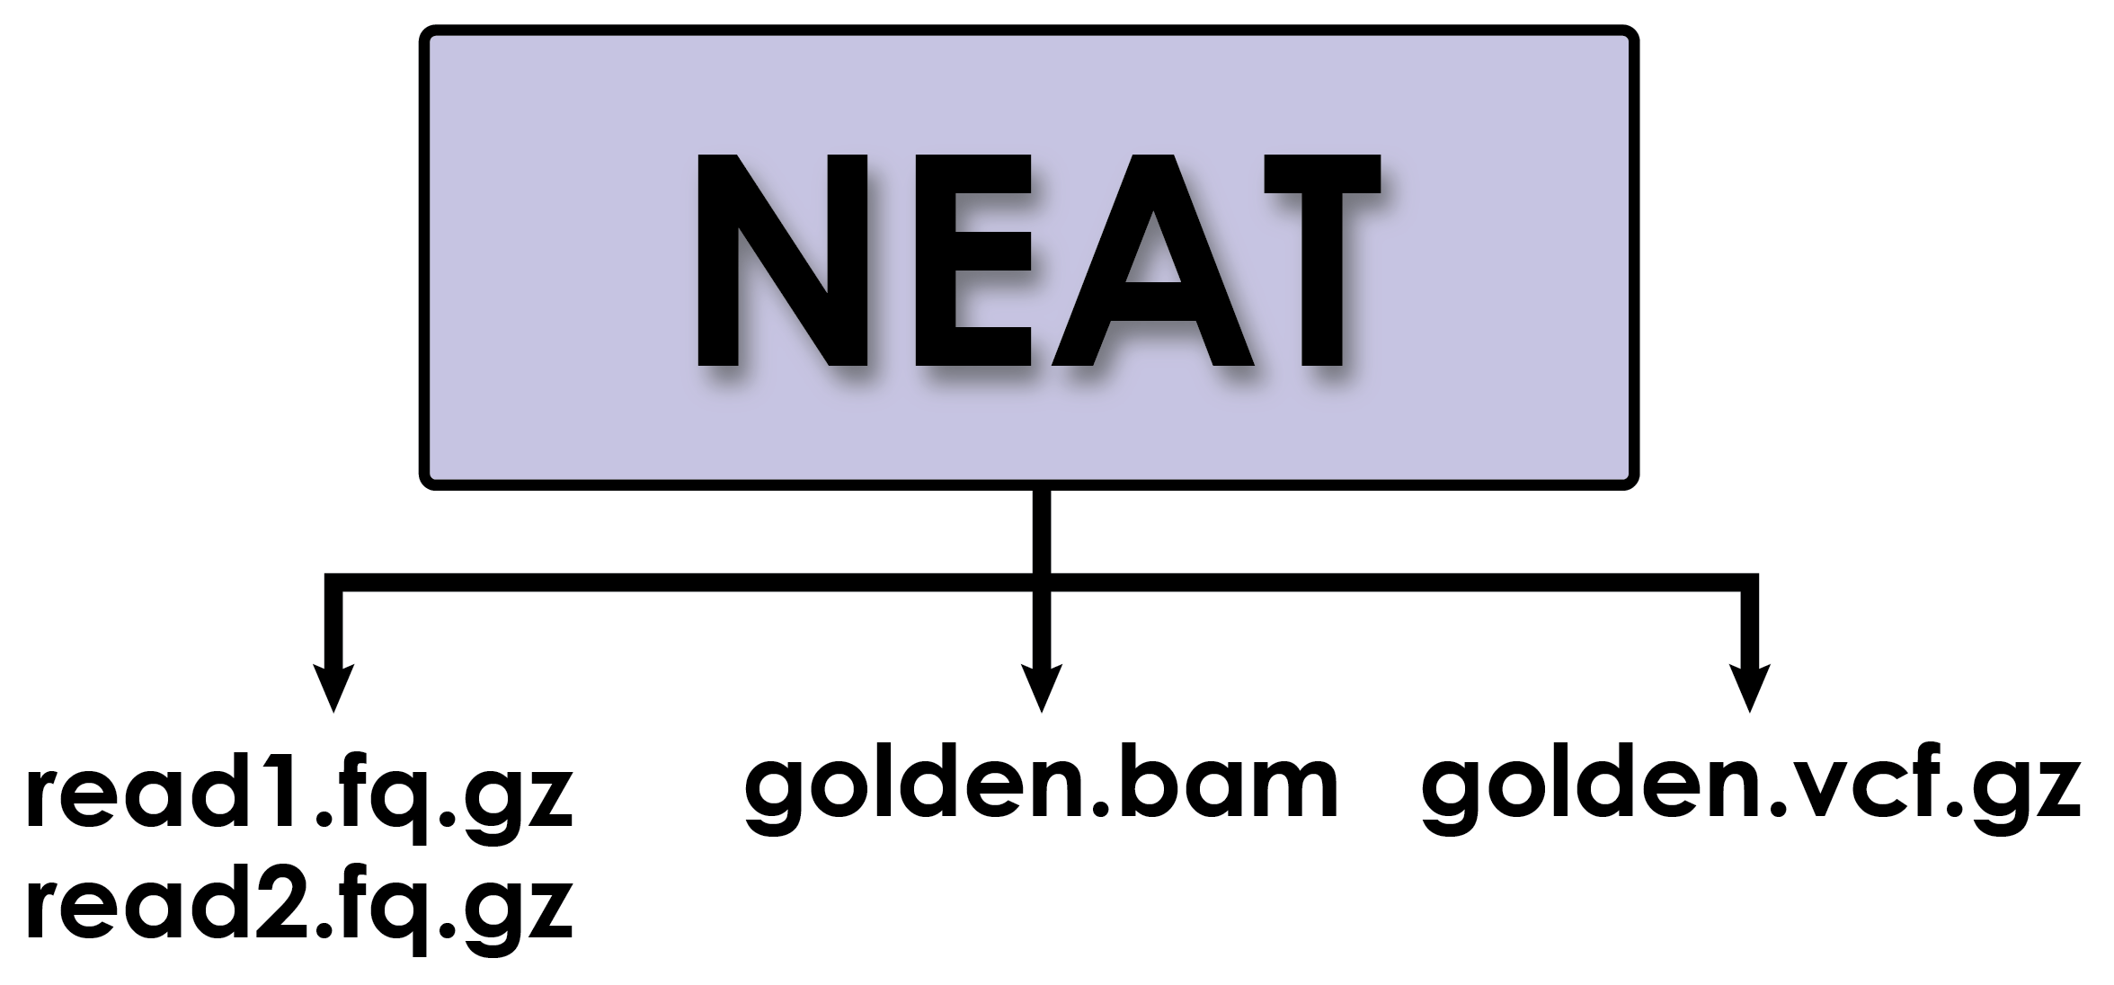
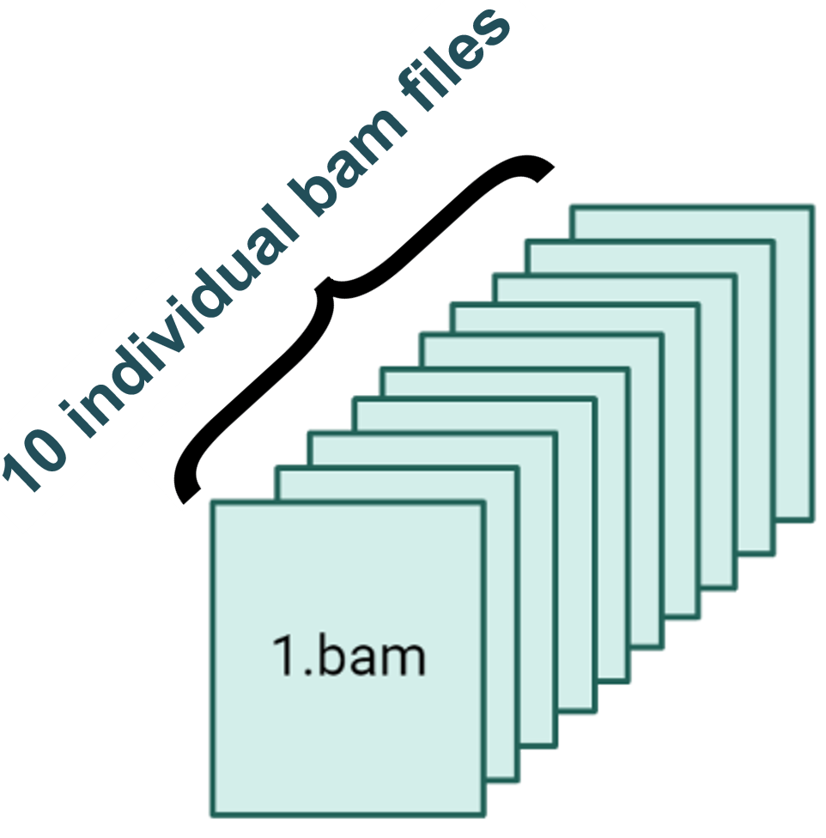

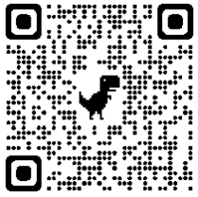
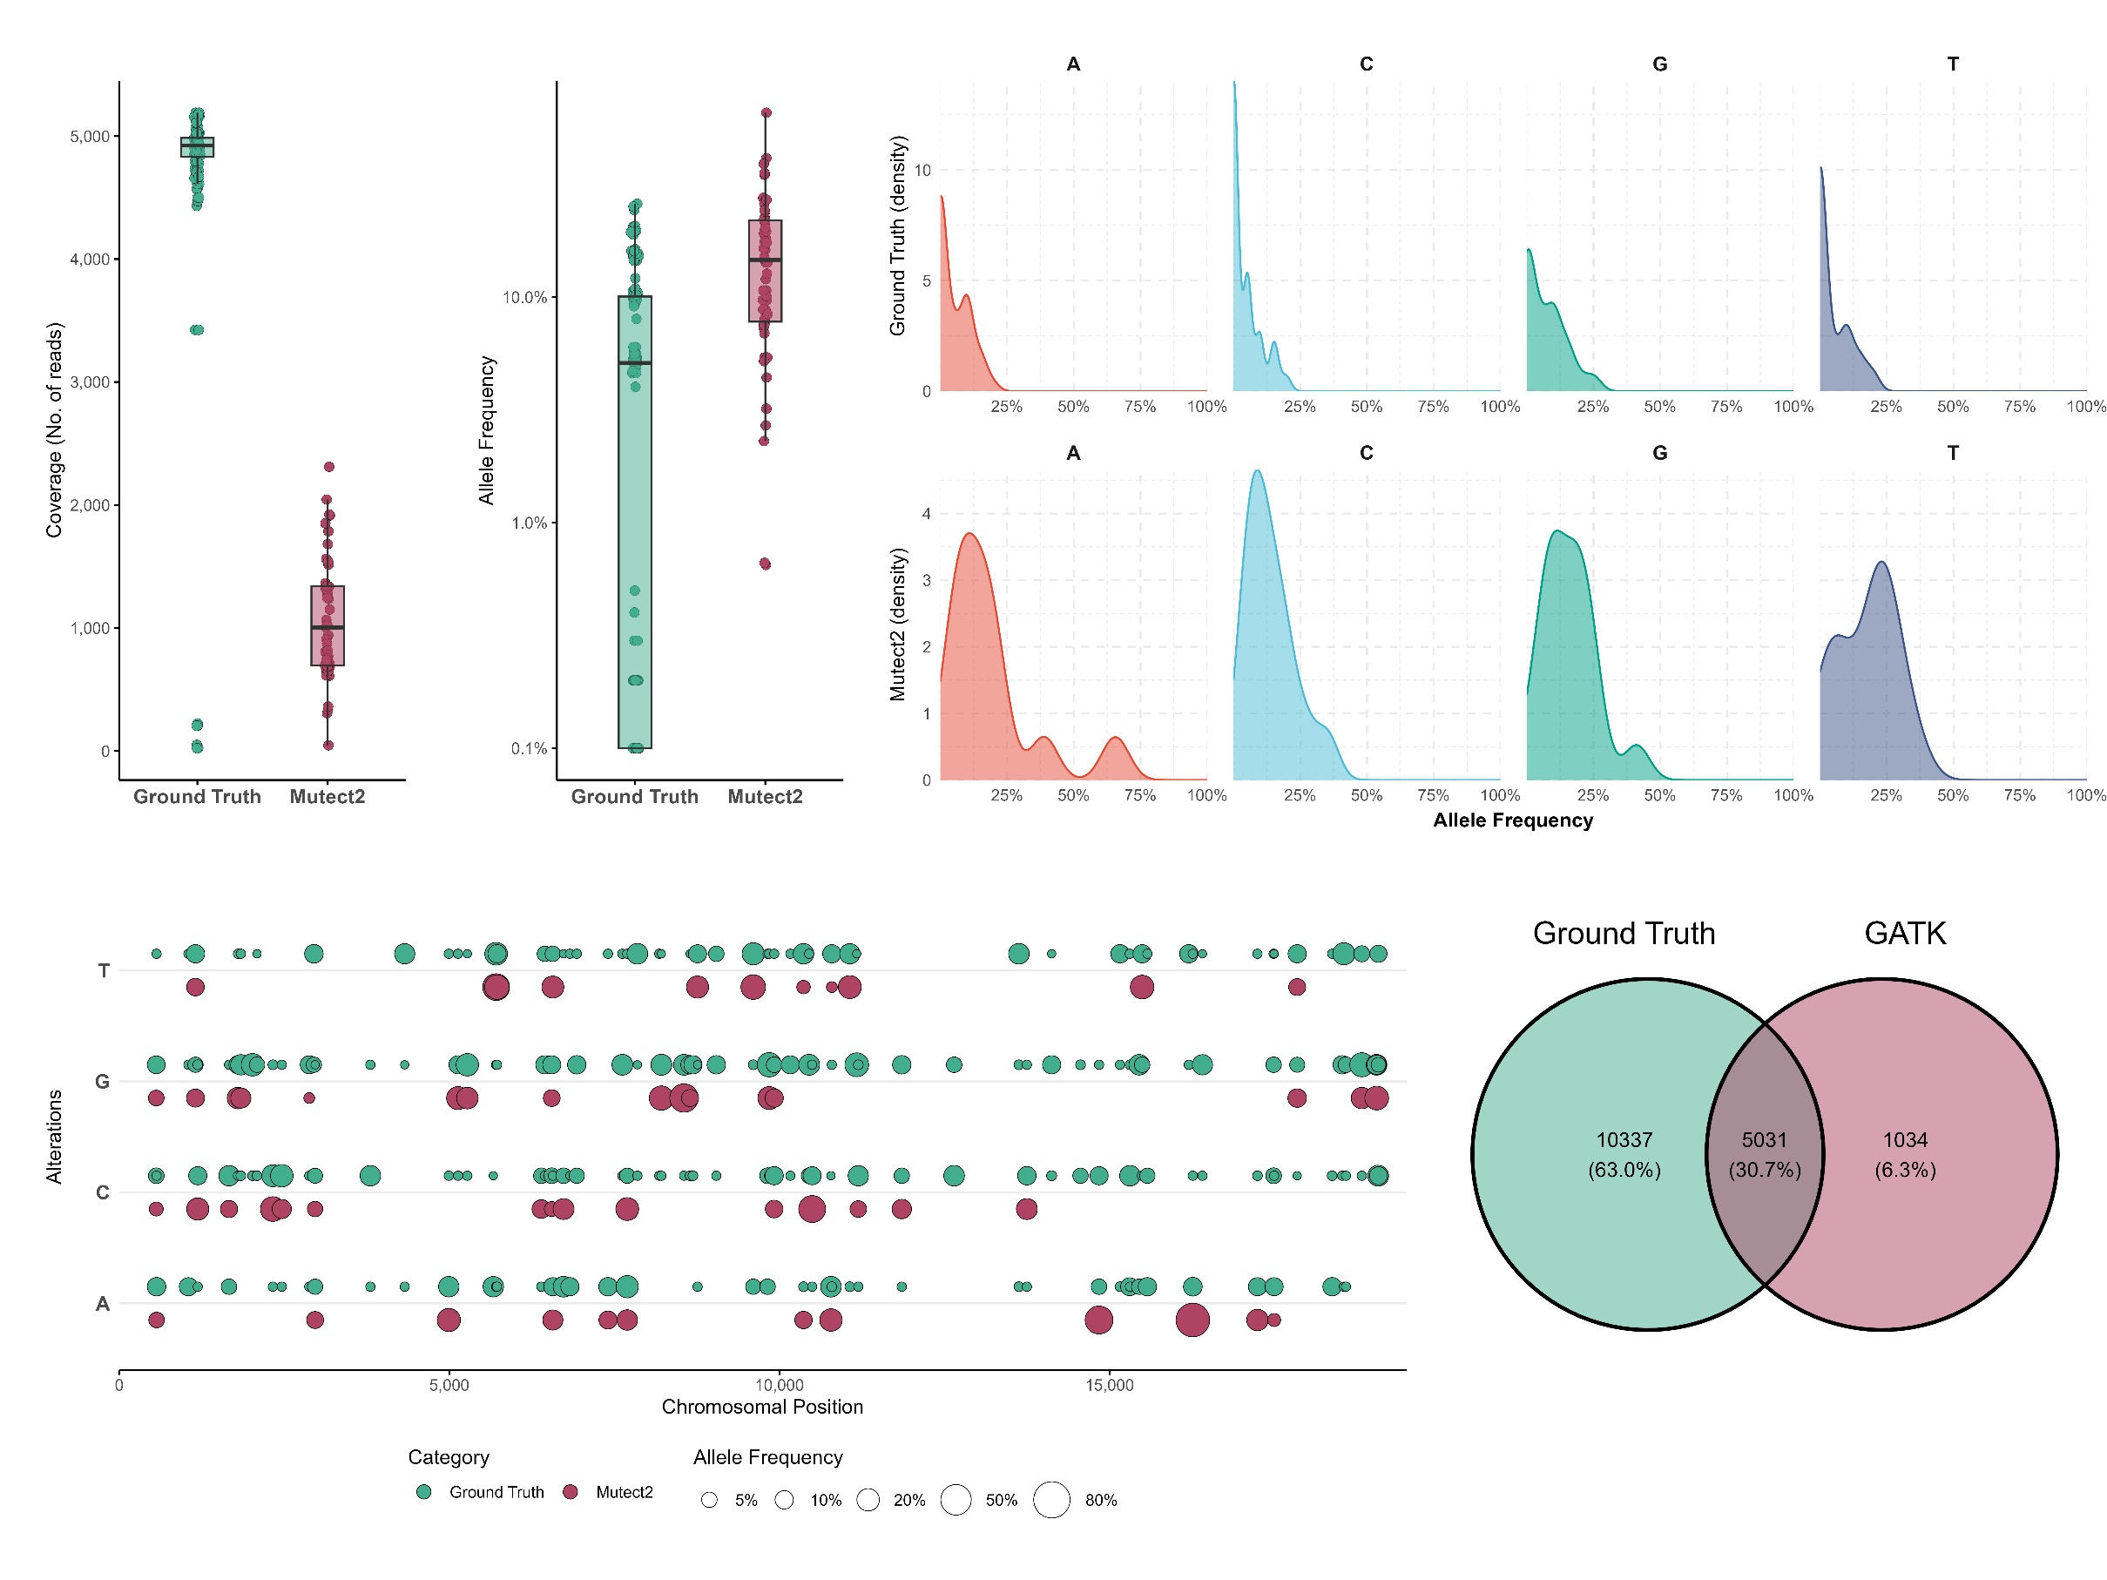







Synthetic Genomics Data Generation and Evaluation for the Use Case of Benchmarking Somatic Variant Calling Algorithms
Fragkouli Styliani-Christina^{1, 2}, Pechlivanis Nikos¹, Agathangelidis Andreas², Psomopoulos Fotis¹
¹Institute of Applied Biosciences, Centre of Research and Technology Hellas, Thermi, 57001, Thessaloniki, Greece
²Department of Biology, National and Kapodistrian University of Athens, Athens 10679, GR
1. Synthetic «Gold Standard» Dataset Generation
1
To learn more about our work please visit
Merge bam files
x500 coverage
Gold Standard Mutations of
100% Allele Frequency
x5000 coverage
Gold Standard Mutations of
10% Allele Frequency
2. Benchmarking GATK-Mutect2
2
Down-sampling effect
.
Difficulty to identify mutations of low frequencies
Overlap for Entire Dataset
sfragkoul@certh.gr
sfragkoul
@scfragkoul

