Slide 1
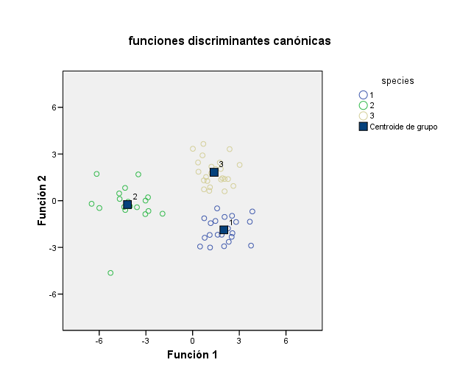
BrachyMorpho12withtypes7mar2025_63samples_3classes

