Slide 1

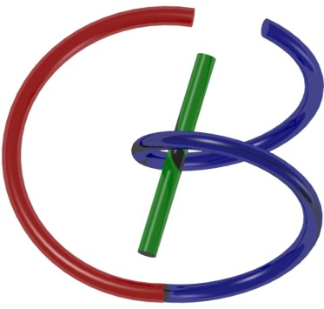
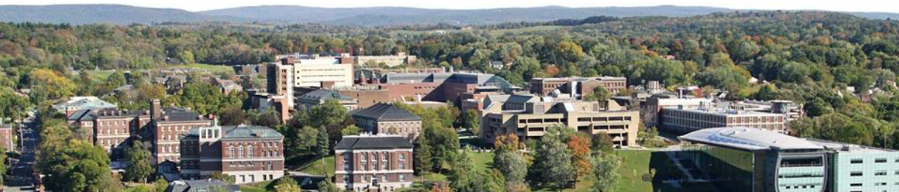
38655 BMED-2300-02
Lecture 4: Convolution
Ge Wang, PhD
Biomedical Imaging Center
CBIS/BME, RPI
wangg6@rpi.edu
January 26, 2018

Slide 2
BB Schedule for S18
Tue | Topic | Fri | Topic
1/16 | Introduction | 1/19 | MatLab I (Basics)
1/23 | System | 1/26 | Convolution
1/30 | Fourier Series | 2/02 | Fourier Transform
2/06 | Signal Processing | 2/09 | Discrete FT & FFT
2/13 | MatLab II (Homework) | 2/16 | Network
2/20 | No Class | 2/23 | Exam I
2/27 | Quality & Performance | 3/02 | X-ray & Radiography
3/06 | CT Reconstruction | 3/09 | CT Scanner
3/20 | MatLab III (CT) | 3/23 | Nuclear Physics
3/27 | PET & SPECT | 3/30 | MRI I
4/03 | Exam II | 4/06 | MRI II
4/10 | MRI III | 4/13 | Ultrasound I
4/17 | Ultrasound II | 4/20 | Optical Imaging
4/24 | Machine Learning | 4/27 | Exam III
Office Hour: Ge Tue & Fri 3-4 @ CBIS 3209 | wangg6@rpi.edu
Kathleen Mon 4-5 & Thurs 4-5 @ JEC 7045 | chens18@rpi.edu

Slide 3
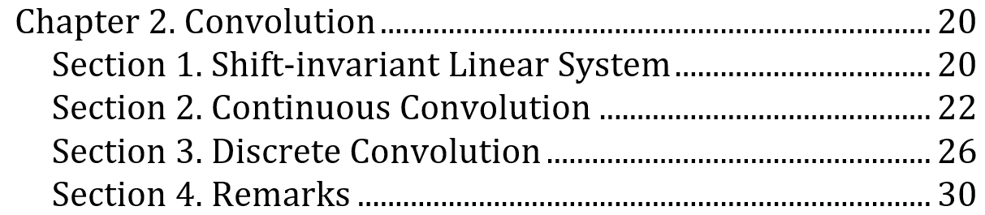
Outline

Slide 4


Slide 5


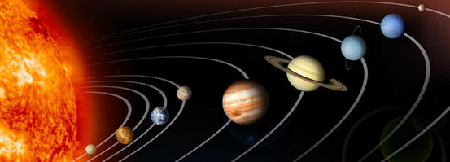
First Push Must Be an Impulse
Notes:
first driving force Why planets revolve around the sun
"first impetus"

Slide 6

Impulse to Momentum Change

Slide 7
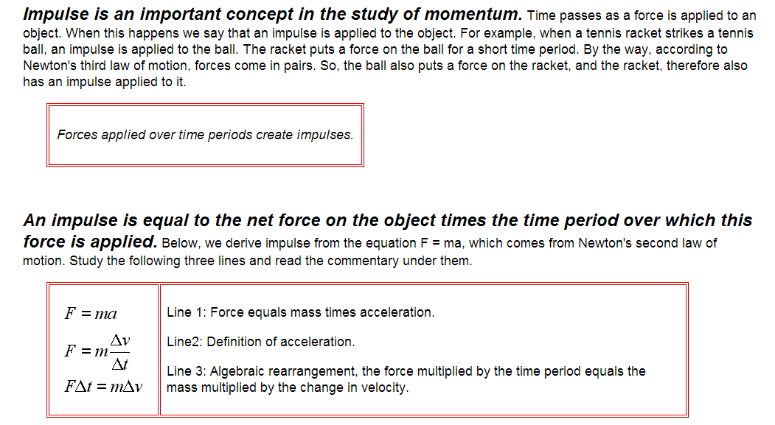
Impulse to Momentum Change

Slide 8
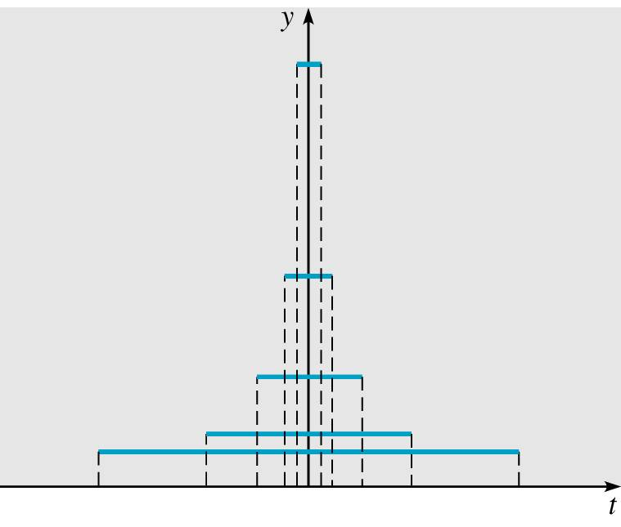
Impulse as an Overall Effect

Slide 9
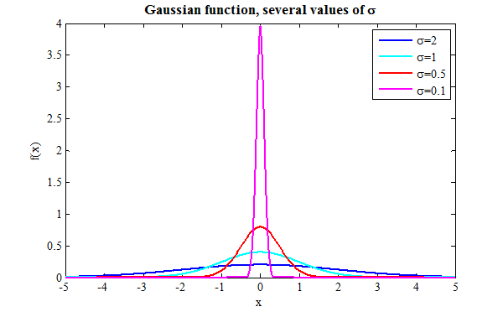
Regardless of Functional Shapes
A forcing/driving function d_{τ}(t) as an impulse
d_{τ}(t) gets taller and narrower as τ → 0 but the area under the curve remains the same

Slide 10
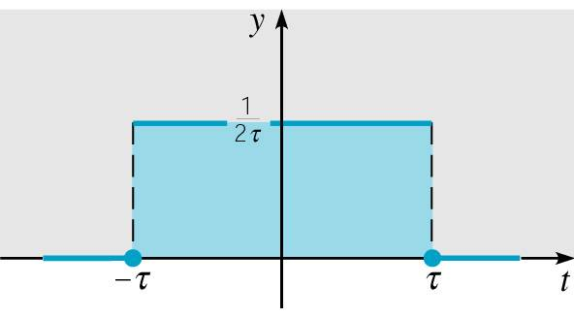
Relying on the Limiting Process

Slide 11

Given the Effect of an Impulse
Why Does It Need a Limiting Process?
Idealized to be thorough, and perfect
What is the shape of the delta function?
We don’t know, and who cares? And if you do
All shapes are possible, and equally possible?
Hence, we have a probabilistic description, and we know for sure only if we measure it!
Does it sound like quantum mechanics?

Slide 12
Dirac δ Function
The unit impulse function is an example of a generalized function and is usually called the Dirac delta function
The effect matters but the shape does not
And, we have the discrete version:

Slide 13
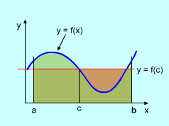
Mean Value Theorem

Slide 14
Representing a Continuous Function
The product of the delta function and a continuous function f can be measured to give a unique result
Therefore, a sample is recorded

Slide 15
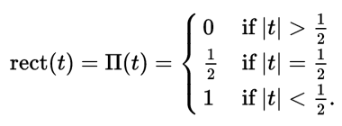
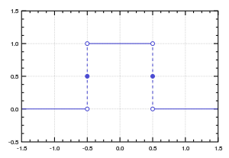
Discrete δ Function

Slide 16
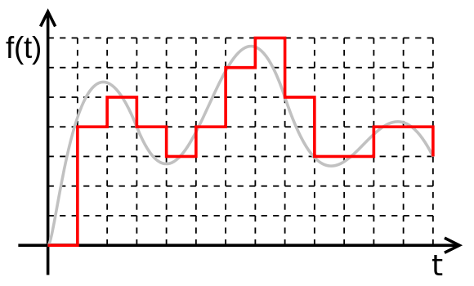
As a Sum of Rect/Gate Functions

Slide 17
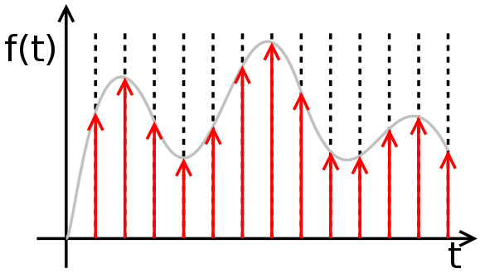
As a Sum of Deltas

Slide 18
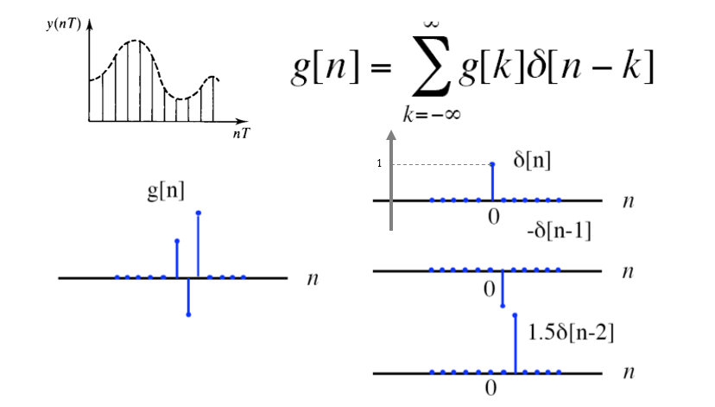
Representing a Discrete Function

Slide 19
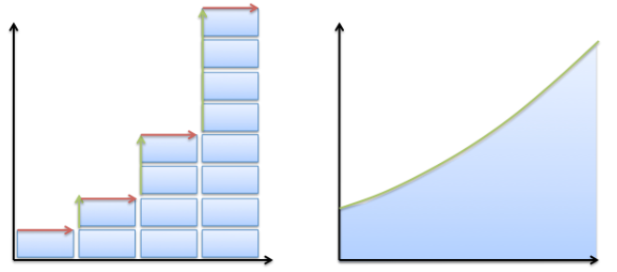
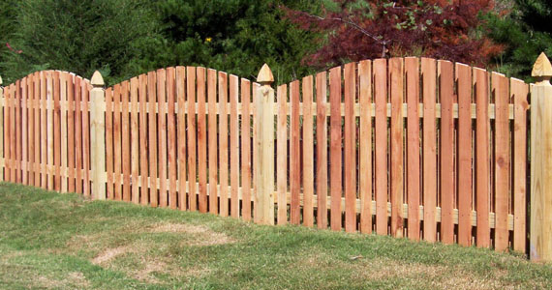
Continuous Versus Discrete

Slide 20
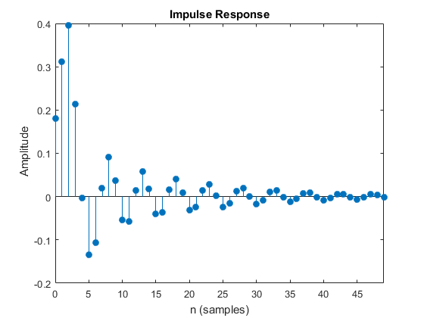
Impulse to Shift-Invariant System
Amplitude h(n)
Time n

Slide 21

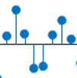
Linear System Output (Discrete)
x(n)
h
y(n)
δ(n)
h
h(n)
δ(n-k)
h
h(n-k)
x(k)δ(n-k)
h
x(k)h(n-k)
x(k)δ(n-k)
h
x(k)h(n-k)
x(n)
h
x(k)h(n-k)

Slide 22
System Output (Continuous)
x(t)
h
y(t)
δ(t)
h
h(t)
δ(t-τ)
h
h(t-τ)
x(τ)δ(t-τ)
h
x(τ)h(t-τ)
x(τ)δ(t-τ)dτ
h
x(τ)h(t-τ)dτ
x(t)
h
x(τ)h(t-τ)dτ

Slide 23
Output as Convolution
Express Input as Many Impulses
Have the Response to Each Impulse
Sum All the Responses to Form the Output

Slide 24
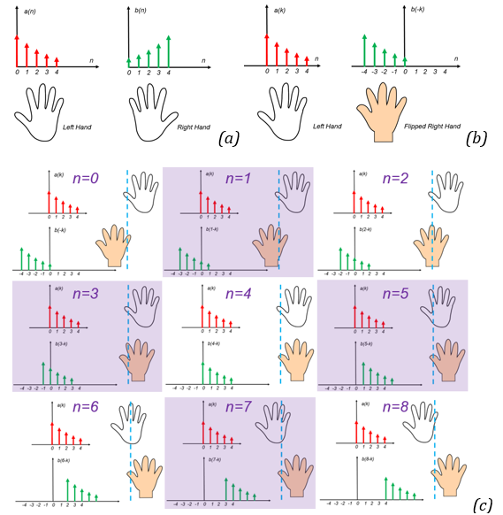

Hands-on Example

Slide 25
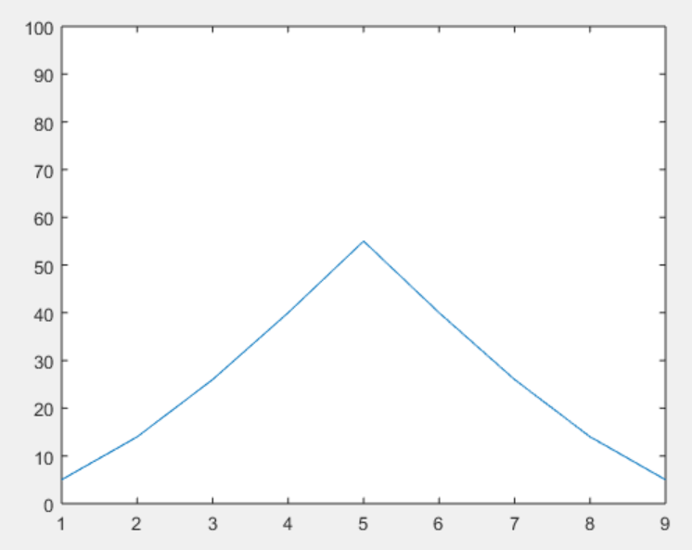
Hands-on Result
>>
x=[5 4 3 2 1];
h=[1 2 3 4 5];
y=conv(x,h);
plot(y); ylim([0 100]);
>>

Slide 26

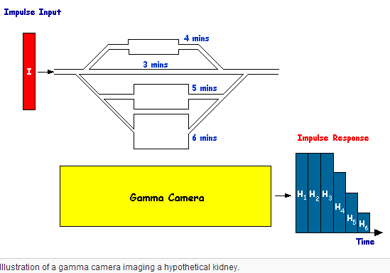

Slide 27
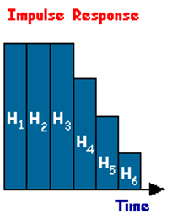
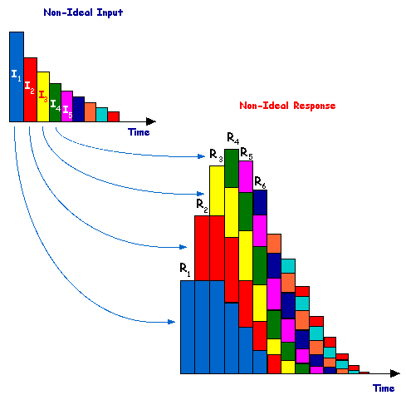

Slide 28
Minds-on Example
Convolve the following two functions:
Replace t with τ in f(t) and g(t)
Choose to flip and slide g(τ) since it is simpler and symmetric
Functions may overlap:
f(t)
g(t)
2
3
*
t
t
2
-2
2
3
g(t-τ)
2
f(τ)
τ= t
τ
2
-2 + t
2 + t

Slide 29
1st & 2nd of 5 Steps
Case I: t < -2
No overlap
Area under the product being zero
Case II: -2 ≤ t < 0
g(t) partially overlaps f(t)
Area under the product is
3
g(t-τ)
2
f(τ)
τ= t
τ
2
-2 +t
2 + t
3
g(t-τ)
2
f(τ)
τ
2
-2 + t
2 + t

Slide 30
Rest 3 of 5 Steps
Case III: 0 ≤ t < 2
g(t) contains f(t)
Case IV: 2 ≤ t < 4
Partial overlap again
Case V: t ≥ 4
Area under their product is zero
3
g(t-τ)
2
f(τ)
τ
2
-2 + t
2 + t
3
g(t-τ)
2
f(τ)
τ
2
-2 + t
2 + t

Slide 31
Whole Solution
y(t)
6
t
-2
0
2
4

Slide 32
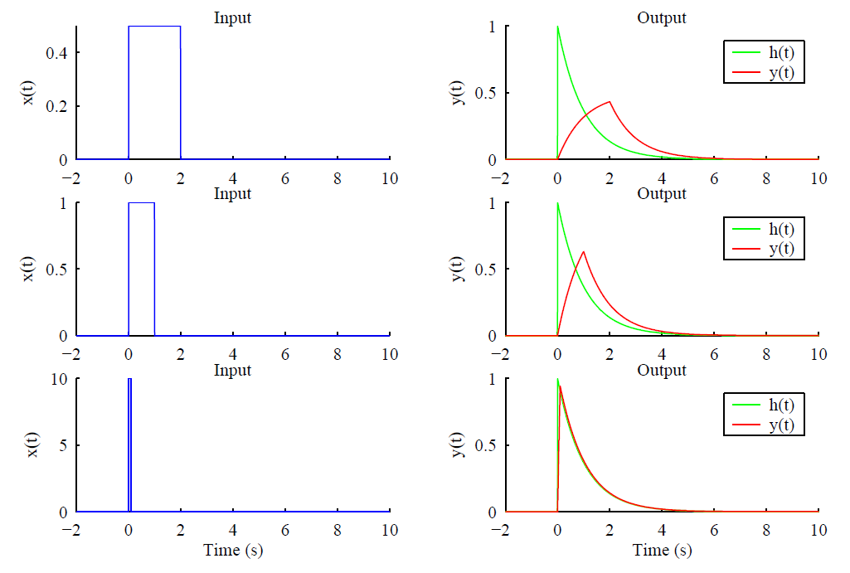
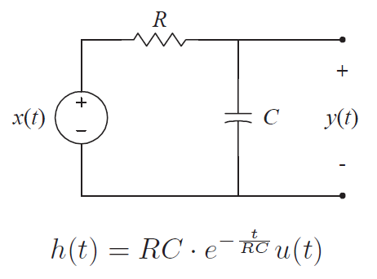
Example: RC Circuit Analysis

Slide 33
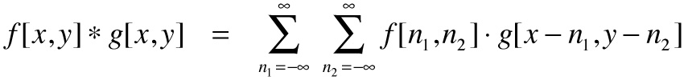
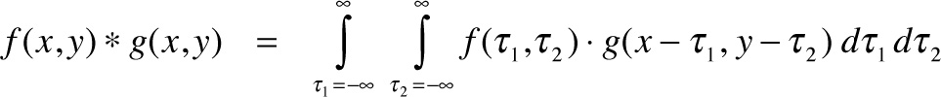
Discrete Convolution in 2D

Slide 34
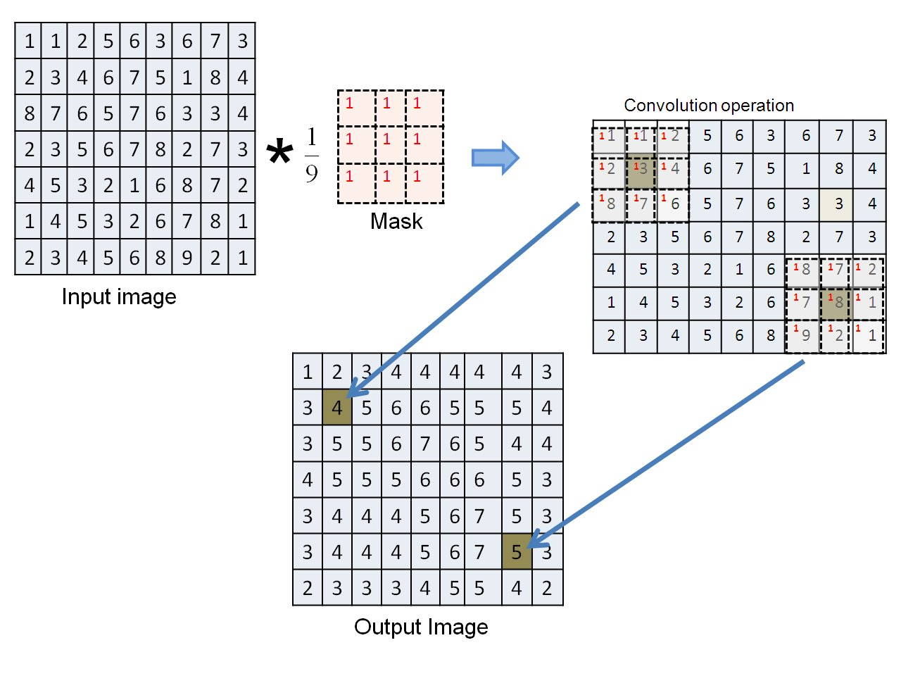
Example: Image Blurring

Slide 35
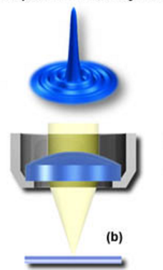
Example: PSF for Imaging
Physical Reason: Each small bright spot can only be focused into an Airy disk.
Ideal
Detector

Slide 36
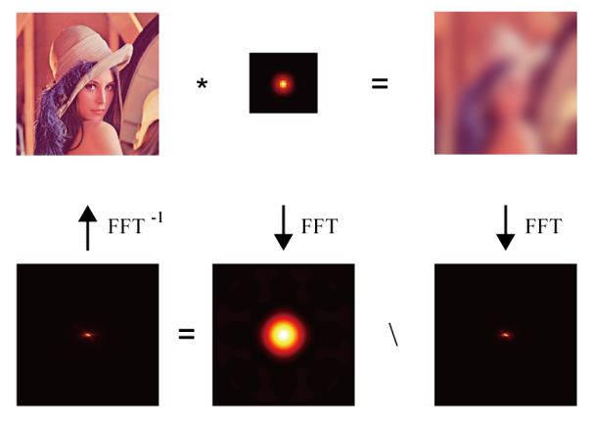
Example: Inverse Filtering
Image
PSF
Blurred
FFT⁻¹
FFT
FFT
In the Fourier Domain

Slide 37
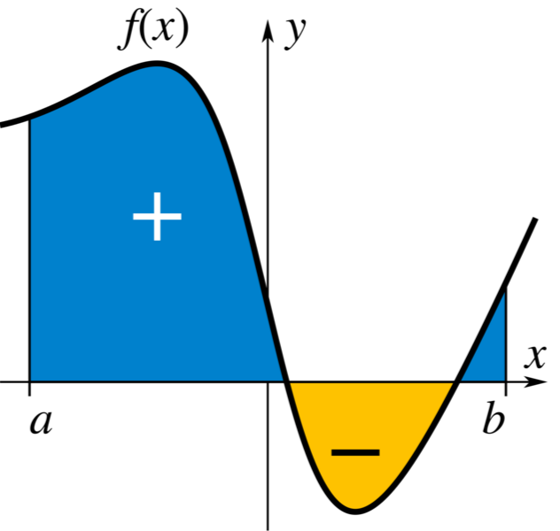
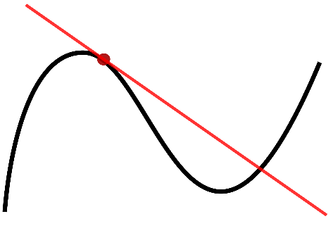


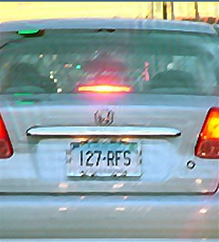
Image Deconvolution

Slide 38
Convolution Properties
Commutative: h(n)*f(n)=f(n)*h(n)
Associative: h(n)*[f(n)*g(n)]=[h(n)*f(n)]*g(n)
Distributive: h(n)*[f(n)+g(n)]=h(n)*f(n)+h(n)*g(n)
The same as the multiplication, and is indeed the multiplication in disguise, as you will see in Fourier Analysis!
Quiz: If y(n)=h(n)*x(n), prove y(n-k)=h(n)*x(n-k).
This can be immediately justified based on the meaning of convolution!

Slide 39
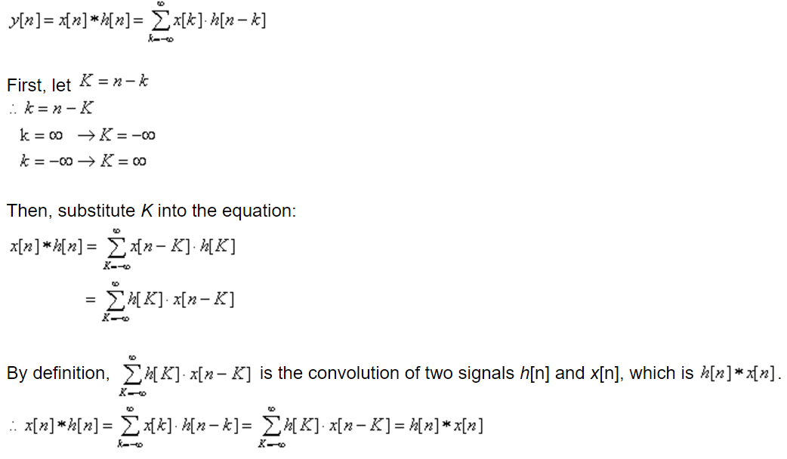
Proof of Commutative Property

Slide 40
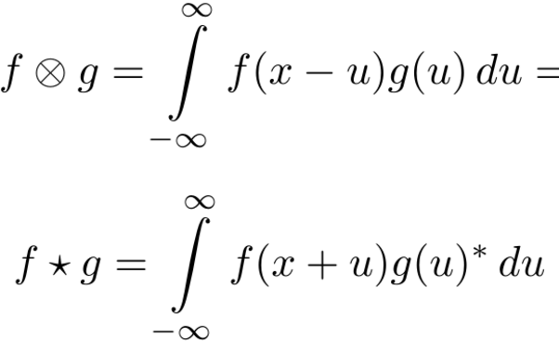
Convolution vs Cross-correlation
*

Slide 41
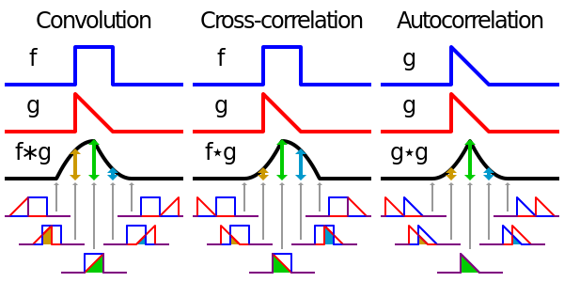
Convolution vs Cross-correlation

Slide 42
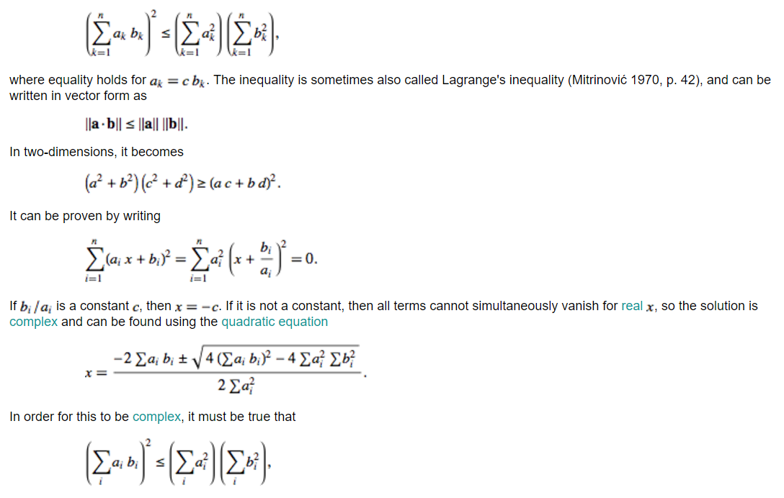

Cauchy–Schwarz Inequality

Slide 43
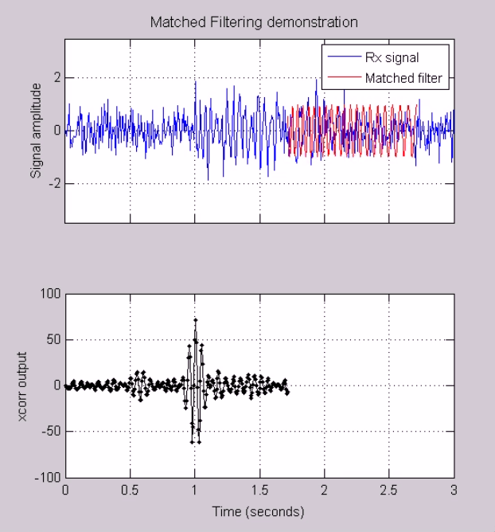
Example: Signal Detection
http://www.michw.com/tag/matlab/

Slide 44
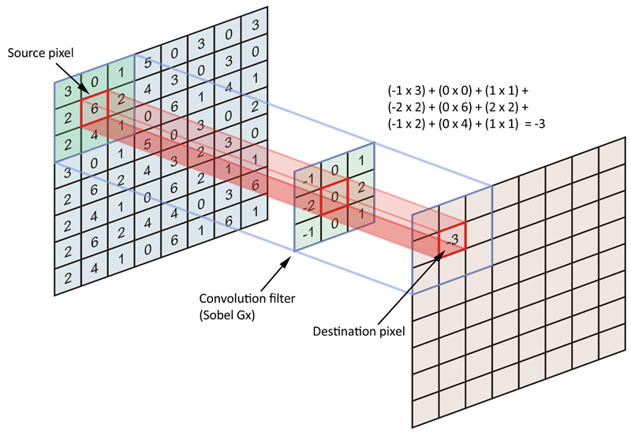
Example: Feature Extraction

Slide 45
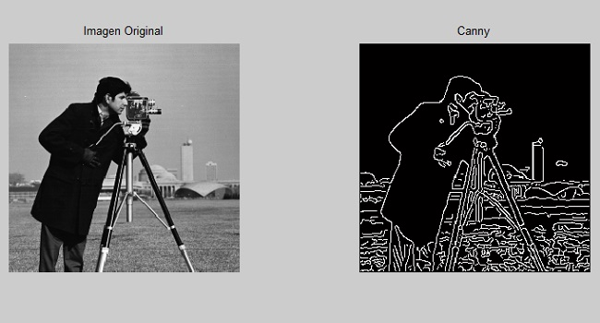
Example: Edge Detection
The Canny edge detector uses a multi-stage algorithm to detect a wide range of edges in images.

Slide 46
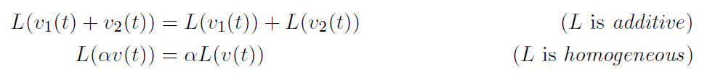
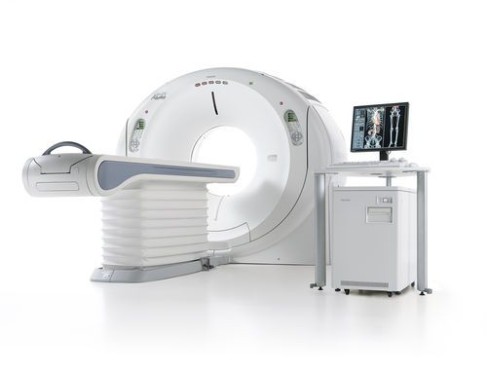

Summary
Linear System → Shift-invariant → Convolution

Slide 47
Homework for BB-04
Suppose RC=1s, please use MatLab to plot the first row.
Due date: One week from now (by midnight next Friday). Please upload your report to MLS, including both the script and the figures in a word file.

