Slide 1

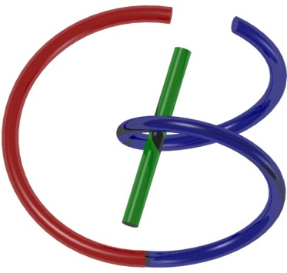

38655 BMED-2300-02
Lecture 5: Fourier Series
Ge Wang, PhD
Biomedical Imaging Center
CBIS/BME, RPI
wangg6@rpi.edu
January 30, 2018

Slide 2
BB Schedule for S18
Tue | Topic | Fri | Topic
1/16 | Introduction | 1/19 | MatLab I (Basics)
1/23 | System | 1/26 | Convolution
1/30 | Fourier Series | 2/02 | Fourier Transform
2/06 | Signal Processing | 2/09 | Discrete FT & FFT
2/13 | MatLab II (Homework) | 2/16 | Network
2/20 | No Class | 2/23 | Exam I
2/27 | Quality & Performance | 3/02 | X-ray & Radiography
3/06 | CT Reconstruction | 3/09 | CT Scanner
3/20 | MatLab III (CT) | 3/23 | Nuclear Physics
3/27 | PET & SPECT | 3/30 | MRI I
4/03 | Exam II | 4/06 | MRI II
4/10 | MRI III | 4/13 | Ultrasound I
4/17 | Ultrasound II | 4/20 | Optical Imaging
4/24 | Machine Learning | 4/27 | Exam III
Office Hour: Ge Tue & Fri 3-4 @ CBIS 3209 | wangg6@rpi.edu
Kathleen Mon 4-5 & Thurs 4-5 @ JEC 7045 | chens18@rpi.edu

Slide 3

Outline

Slide 4
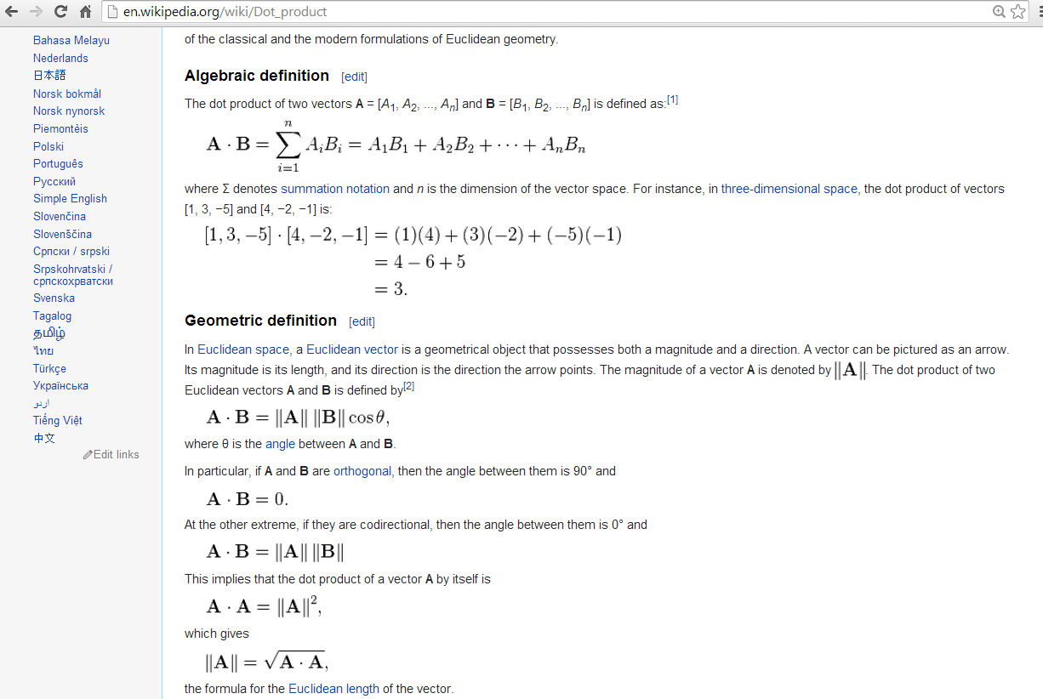
Inner Product: Sum of Products of Paired Data

Slide 5
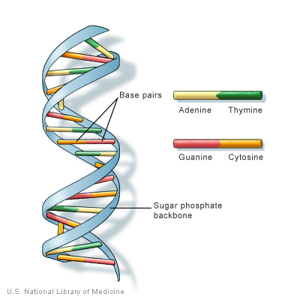
As DNA for Data Science

Slide 6

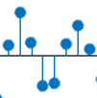
Inner Product from Linear System
x(n)
h
y(n)
δ(n)
h
h(n)
δ(n-k)
h
h(n-k)
x(k)δ(n-k)
h
x(k)h(n-k)
x(k)δ(n-k)
h
x(k)h(n-k)
x(n)
h
x(k)h(n-k)

Slide 7
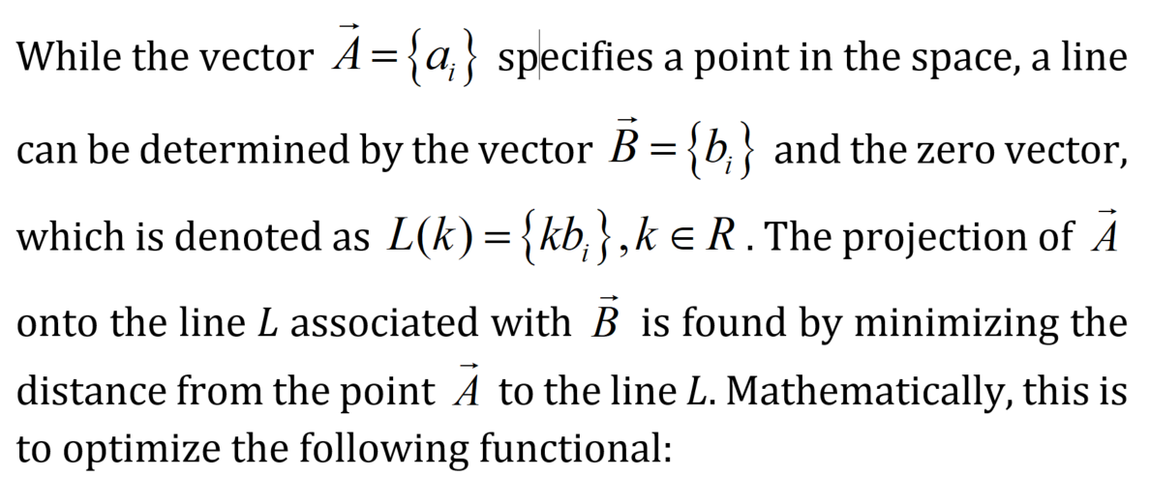
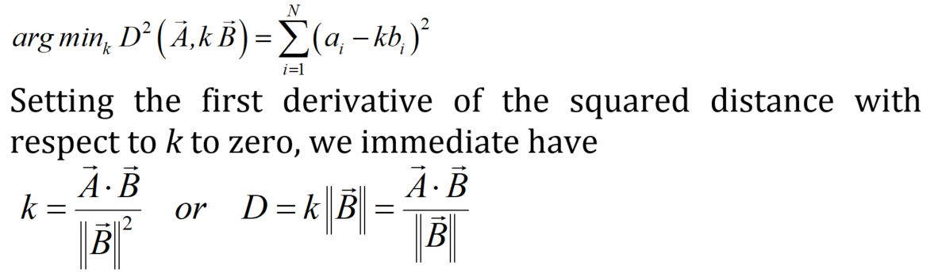

Inner Product from Geometry

Slide 8
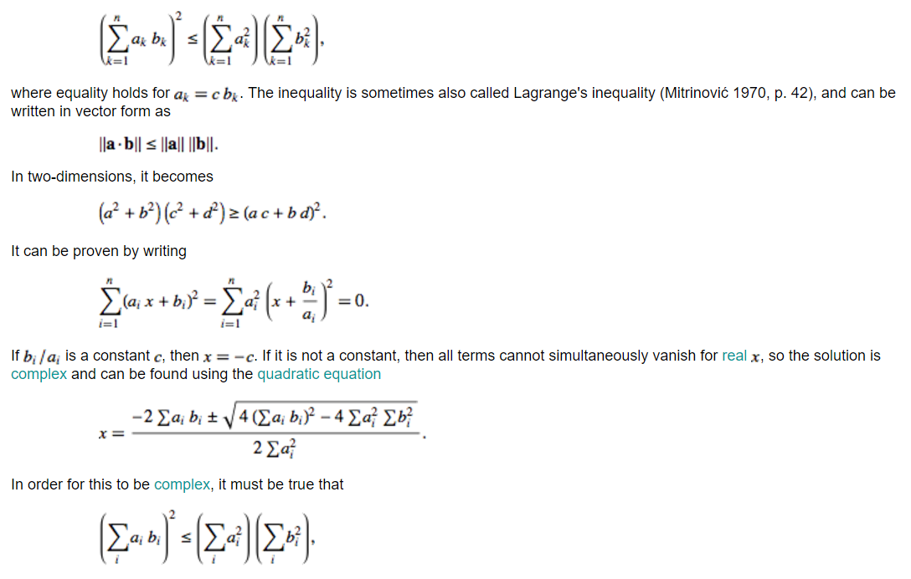

Inner Product in C–S Inequality

Slide 9

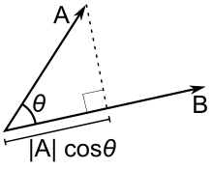

Geometric Proof (Easy)

Slide 10
R^{N} Space
Points
Distance
Projection (Min Distance from V to the OW line)
Angle/Orthogonality
Basis/Dimensionality
V
θ
W
O

Slide 11
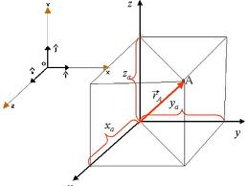
3D Orthogonal Representation

Slide 12
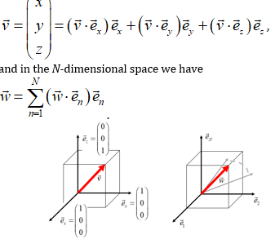
ND Orthogonal Representation

Slide 13
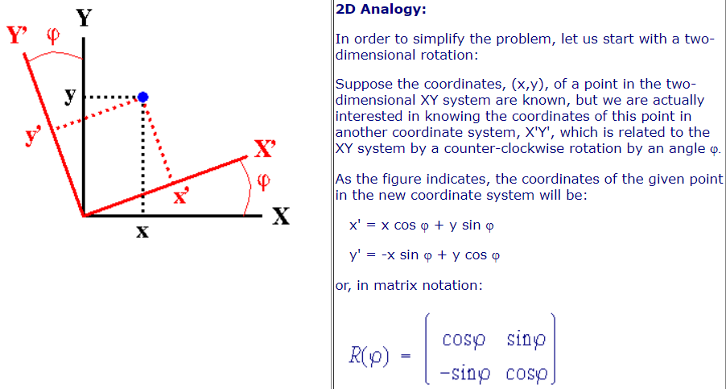
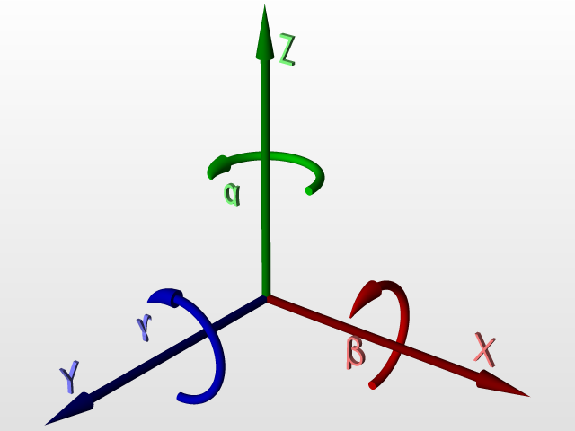
Basis Not Unique
http://www.ccp14.ac.uk/ccp/web-mirrors/klaus_eichele_software/klaus/nmr/conventions/euler/euler.html

Slide 14
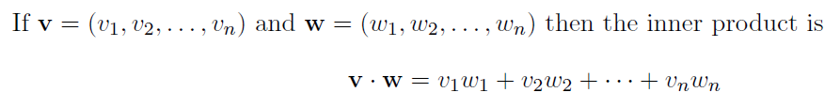

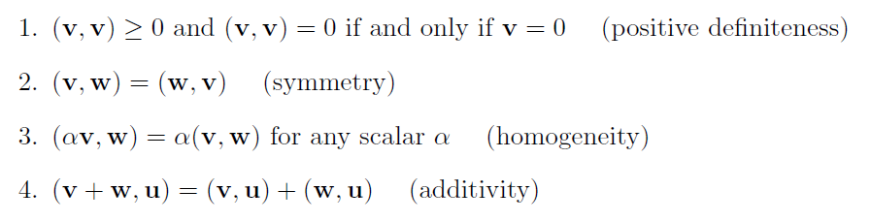
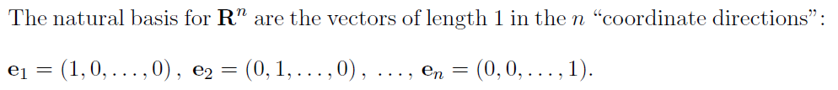

Vector Space

Slide 15
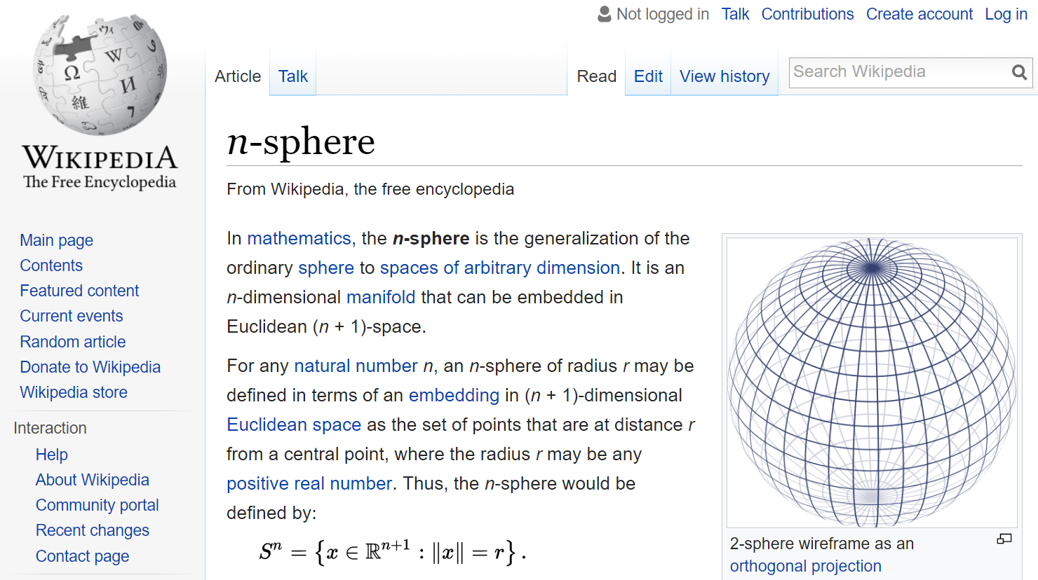
Point = Vector

Slide 16
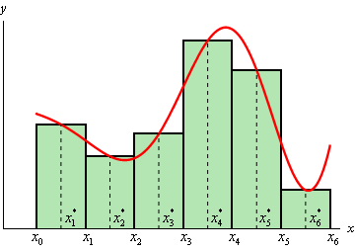
Vector = Function

Slide 17
Functional Space
Can we find a basis? δ(x-a), a in R

Slide 18
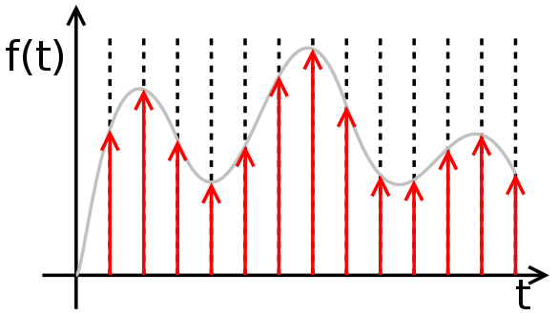
Function As a Sum of Impulses

Slide 19

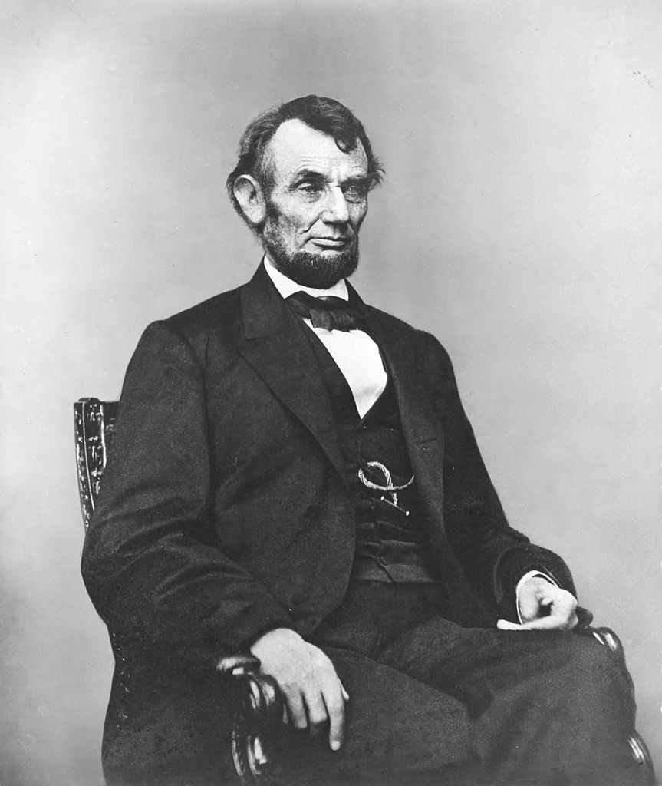
Pixel: Picture Element

Slide 20
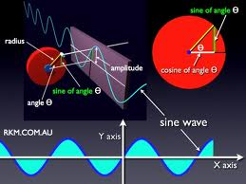
Sine Wave Comes Naturally

Slide 21
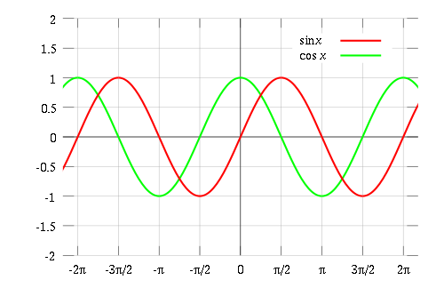
Sinusoidal Basis: Even & Odd

Slide 22
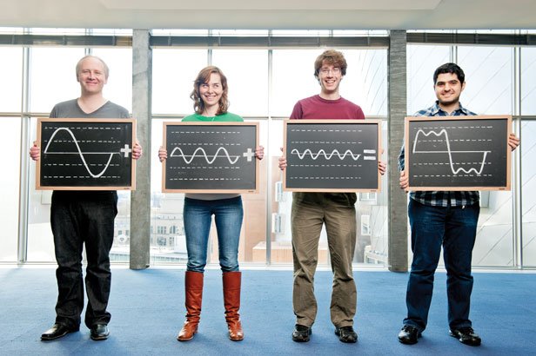
Function As Sum of Waves

Slide 23
Demo: Spectral Synthesis

Slide 24
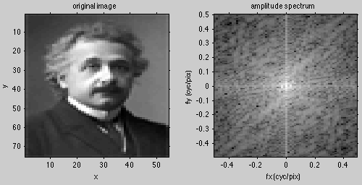

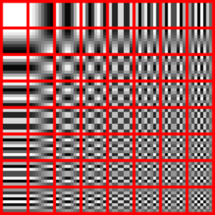
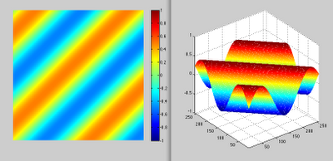
Fourier Analysis

Slide 25

Duality of Information
Particle
Wave

Slide 26
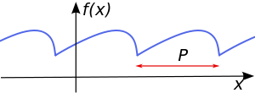

Periodic Function

Slide 27
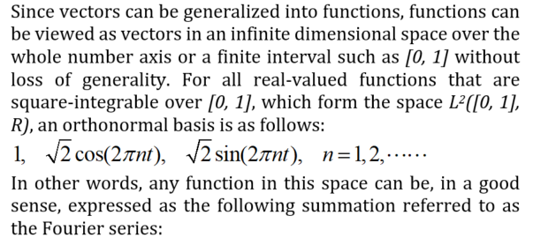
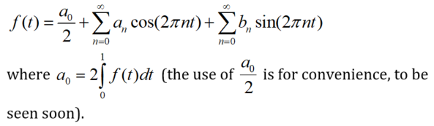
Fourier Series (Unit Period)

Slide 28
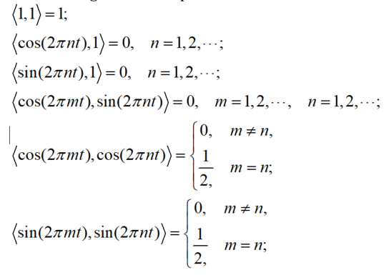
Orthogonal Representation

Slide 29
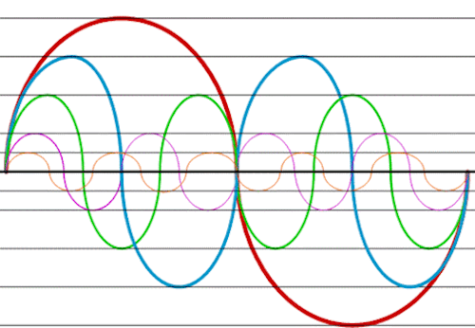

Harmonics

Slide 30

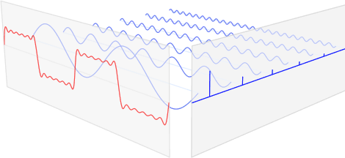
Fourier Series (Unit Period)
Direct Component
Even Parts Odd Parts

Slide 31
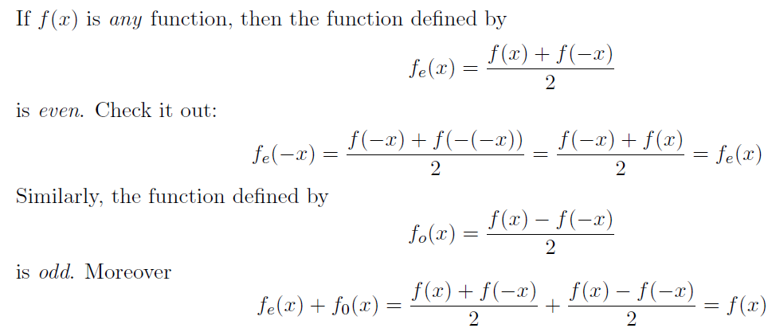
Even & Odd Functions

Slide 32
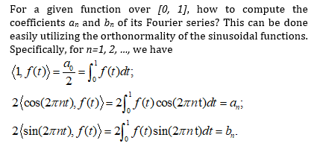
Fourier Coefficients (Unit Period)

Slide 33
Fourier Series (Real Form)

Slide 34








Complex Representation
Conjugate

Slide 35
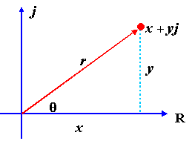


Two Popular Systems

Slide 36
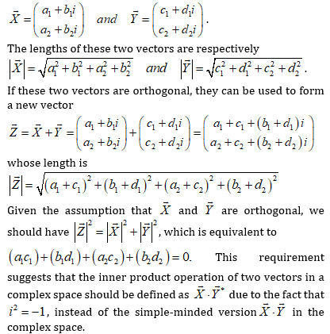

Complex Inner Product

Slide 37
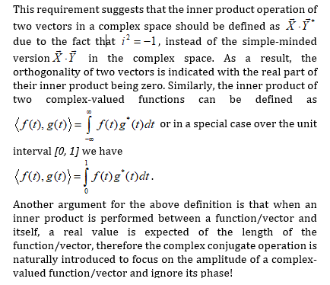
Complex Inner Product

Slide 38
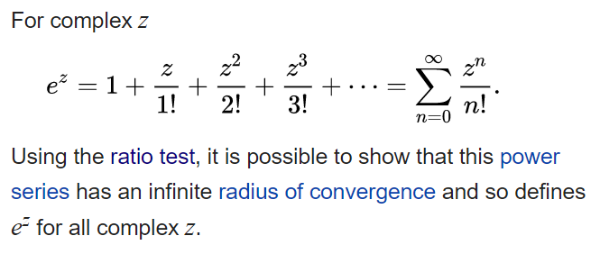



Euler’s Formula

Slide 39
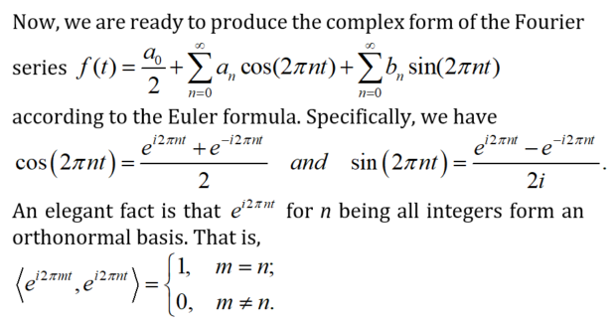
Real Form to Complex Form

Slide 40

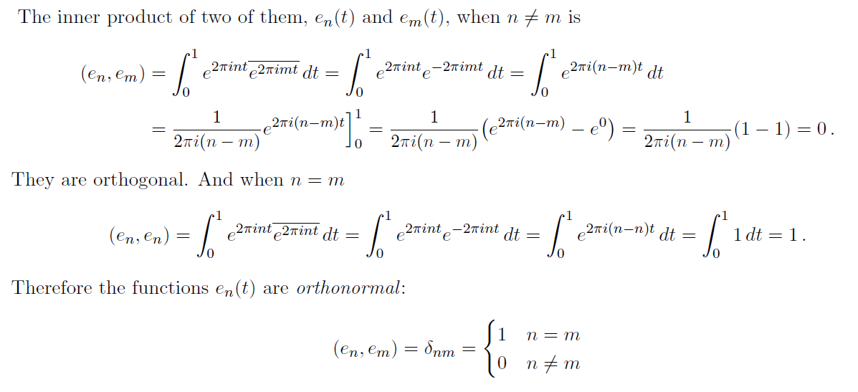
Orthonormal Basis

Slide 41
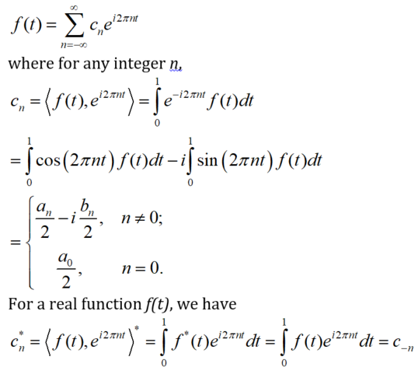
Fourier Series (Complex Form)

Slide 42
Fourier Series Visualized

Slide 43
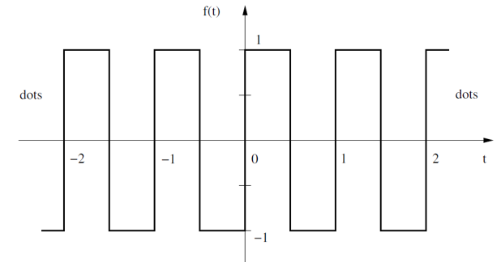
Example: Square

Slide 44
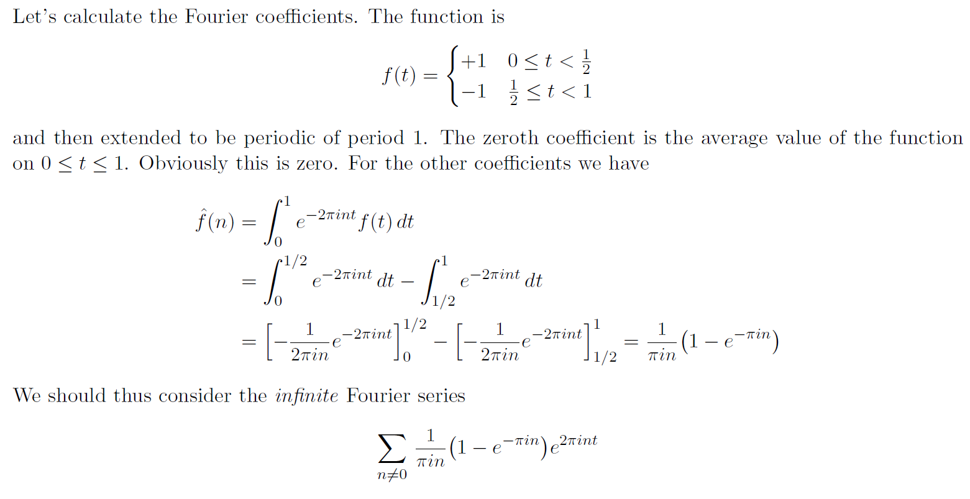
Example: Square

Slide 45
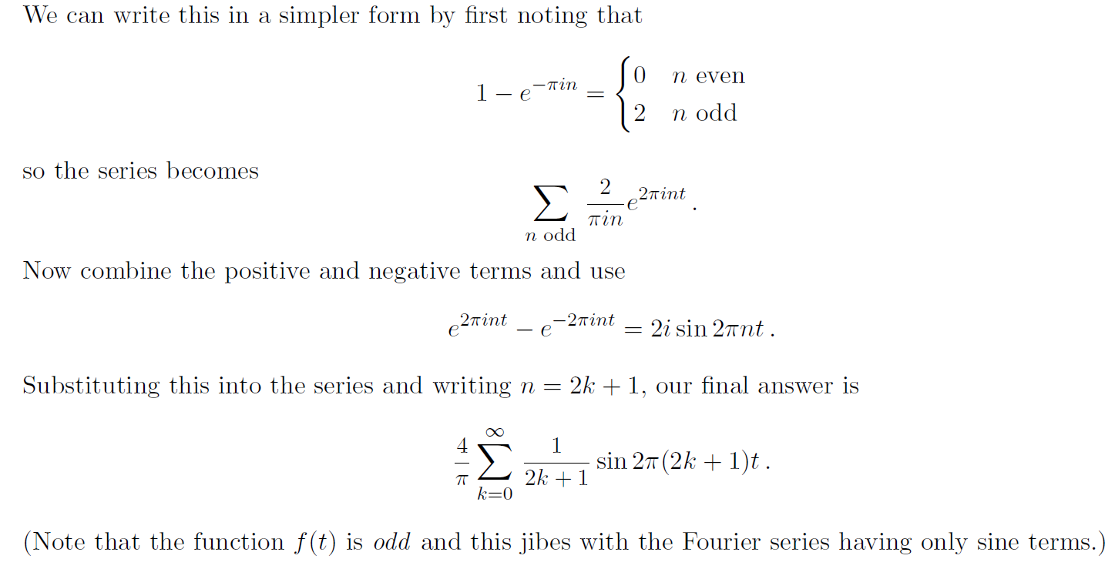
Only Odd Terms

Slide 46
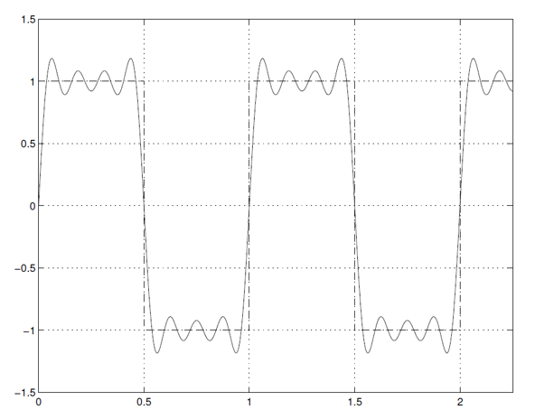
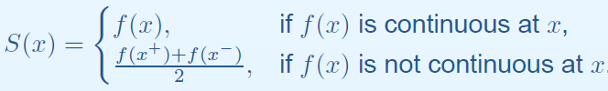
Error Due to Finite Terms

Slide 47
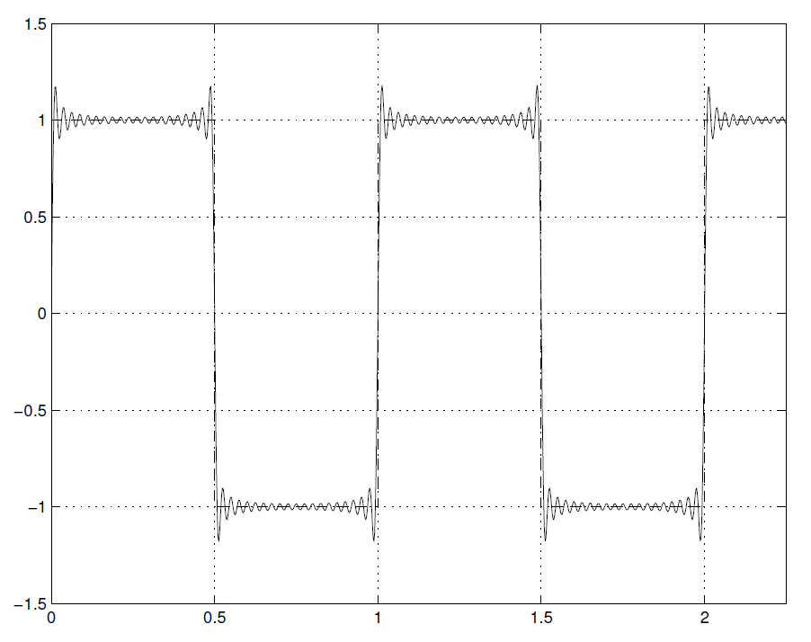
Errors Due to Gibbs Effect

Slide 48
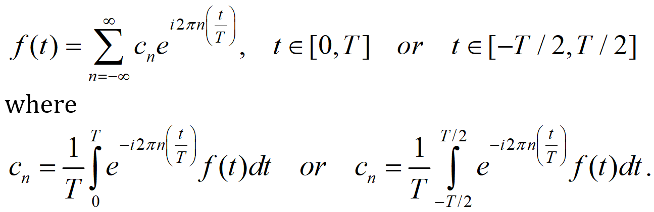
When Period Isn’t Unit

Slide 49
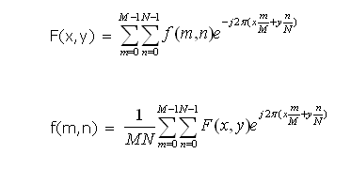
2D Fourier Series

Slide 50
Homework for BB05
Derive the formulas for the coefficients of the Fourier series in real notations (become familiar with the ideas I explained to you today).
Watch https://www.youtube.com/watch?v=05jUkVtIwVs, and implement the square wave example.
Due date: One week from now (by midnight next Tuesday). Please upload your report to MLS, including both the script and the figures in a word file.

