Slide 1

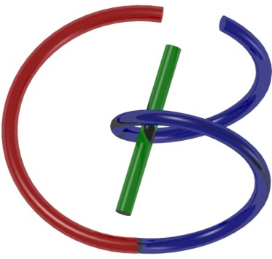

38655 BMED-2300-02
Lecture 6: Fourier Transform
Ge Wang, PhD
Biomedical Imaging Center
CBIS/BME, RPI
wangg6@rpi.edu
February 2, 2018

Slide 2
BB Schedule for S18
Tue | Topic | Fri | Topic
1/16 | Introduction | 1/19 | MatLab I (Basics)
1/23 | System | 1/26 | Convolution
1/30 | Fourier Series | 2/02 | Fourier Transform
2/06 | Signal Processing | 2/09 | Discrete FT & FFT
2/13 | MatLab II (Homework) | 2/16 | Network
2/20 | No Class | 2/23 | Exam I
2/27 | Quality & Performance | 3/02 | X-ray & Radiography
3/06 | CT Reconstruction | 3/09 | CT Scanner
3/20 | MatLab III (CT) | 3/23 | Nuclear Physics
3/27 | PET & SPECT | 3/30 | MRI I
4/03 | Exam II | 4/06 | MRI II
4/10 | MRI III | 4/13 | Ultrasound I
4/17 | Ultrasound II | 4/20 | Optical Imaging
4/24 | Machine Learning | 4/27 | Exam III
Office Hour: Ge Tue & Fri 3-4 @ CBIS 3209 | wangg6@rpi.edu
Kathleen Mon 4-5 & Thurs 4-5 @ JEC 7045 | chens18@rpi.edu

Slide 3
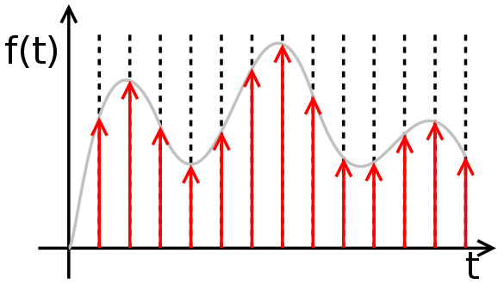
As a Sum of Impulses

Slide 4
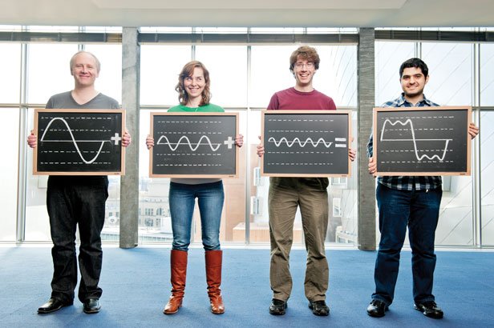
As Sum of Waves

Slide 5

Fourier Series (Real Form)

Slide 6



Fourier Series (Complex Form)
Unit Period

Slide 7
When Period Isn’t Unit

Slide 8



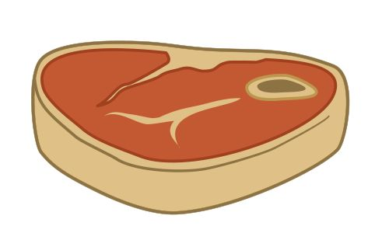
Common Sense
Simple versus Complex Methods
Divide and Conquer Strategies

Slide 9

Outline

Slide 10
When Period Isn’t Unit

Slide 11
Inserting Coefficients
Right Hand Side: Inner products at infinitely many discrete frequency points u=n/T, and for a sufficiently large T and all integer n the interval for u is dense on the whole number axis, and the distance between adjacent frequencies is infinitesimal Δu=1/T.

Slide 12
Δu=1/T
u
-T/2
u=n/T
T/2
Inner products at many discrete points u=n/T, and for a sufficiently large T and all integer n the interval for u is dense on the whole axis, and the distance between adjacent frequencies is infinitesimal Δu=1/T.

Slide 13
Forward & Inverse Transforms
(since u=n/T)
(since du=1/T)

Slide 14
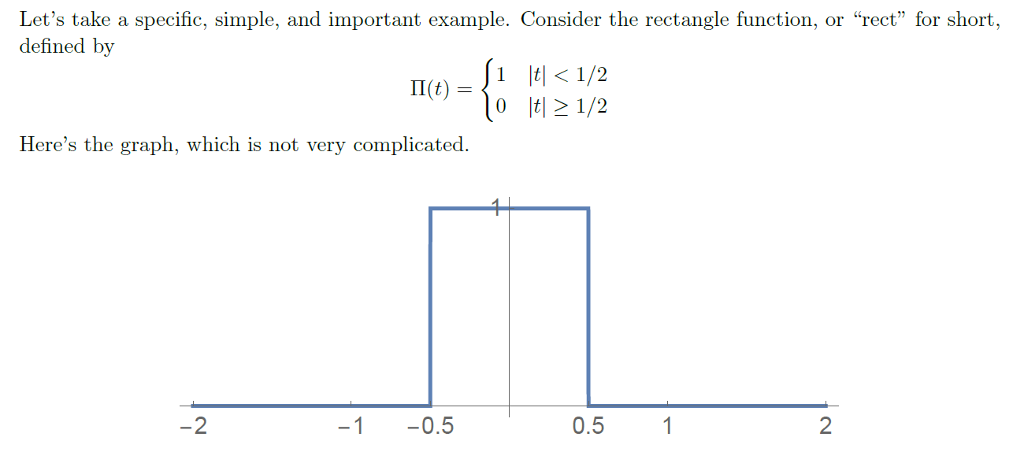
Rectangular/Gate Function

Slide 15
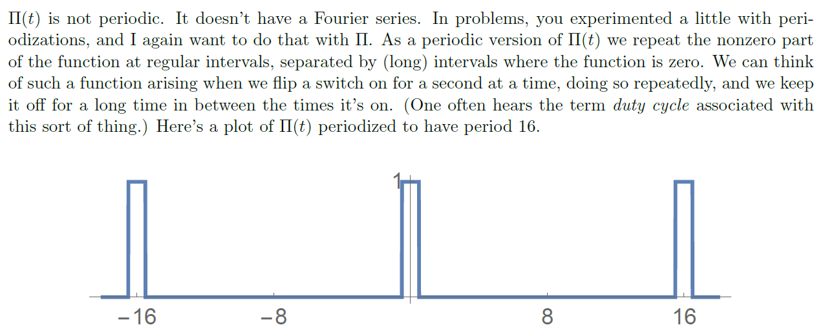
Periodization

Slide 16
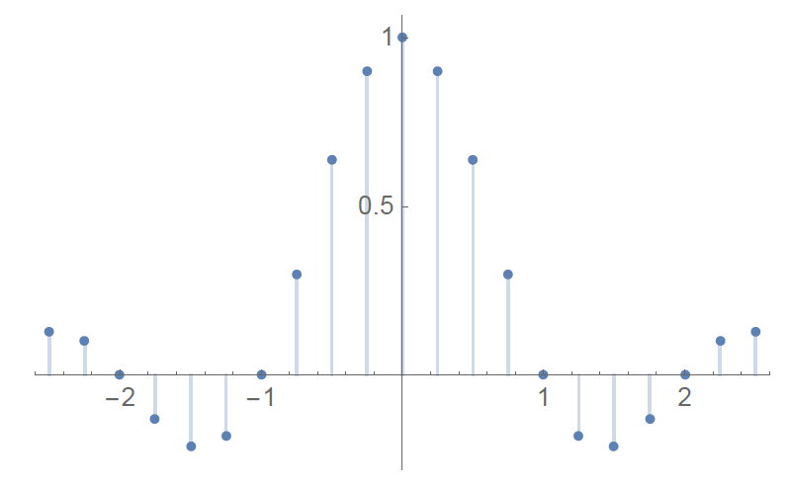
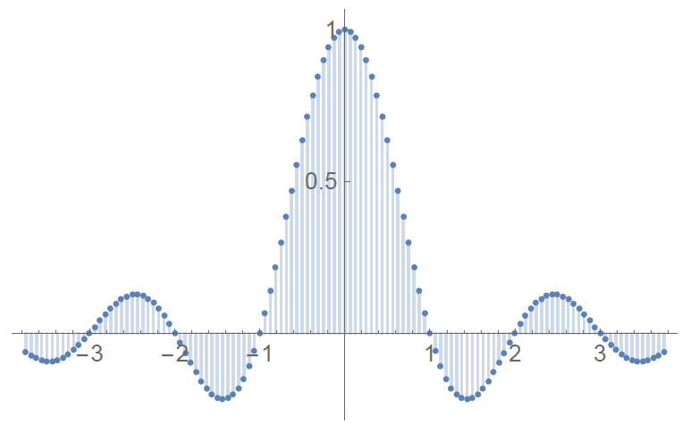
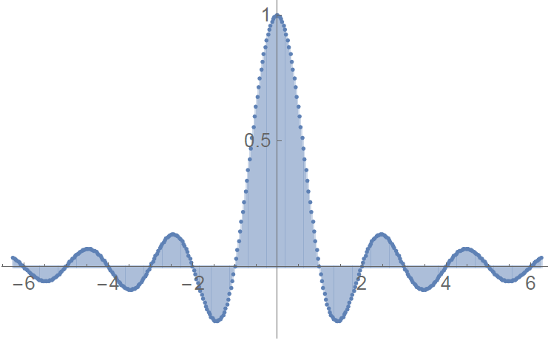
As Period Gets Larger

Slide 17
Fourier Transform Pair

Slide 18
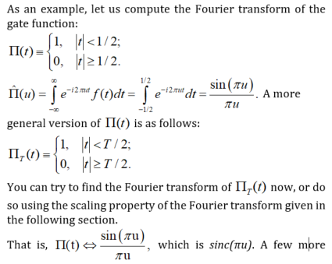
Example 1: Gate Function

Slide 19
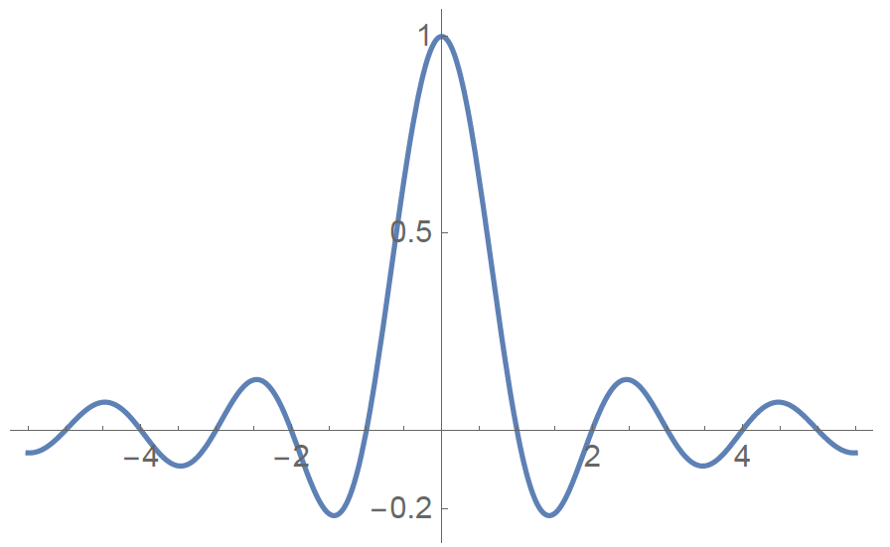
Sinc Function

Slide 20
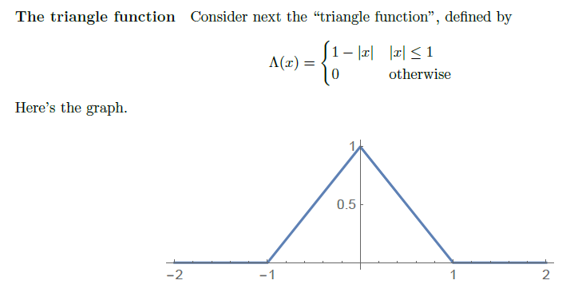
Example 2: Triangle Function

Slide 21
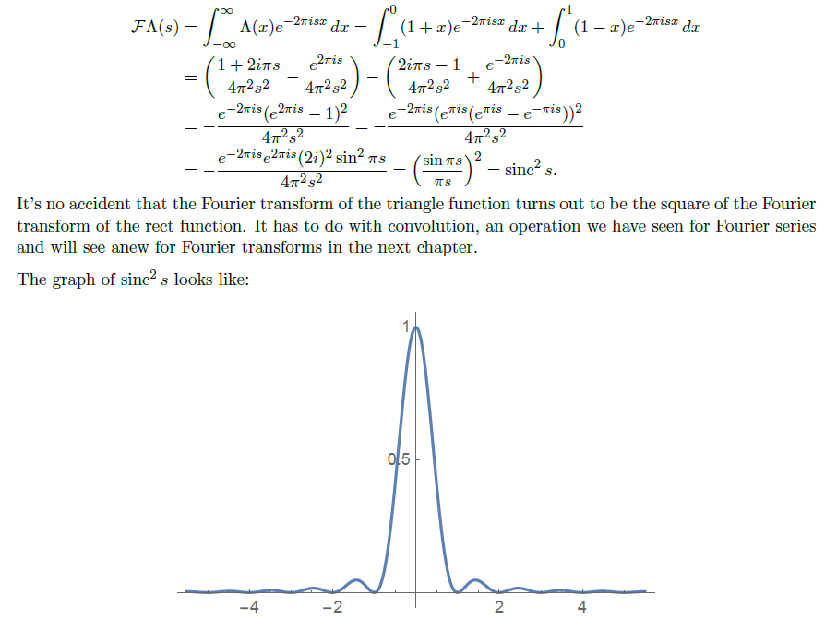
Sinc²

Slide 22

More Examples

Slide 23
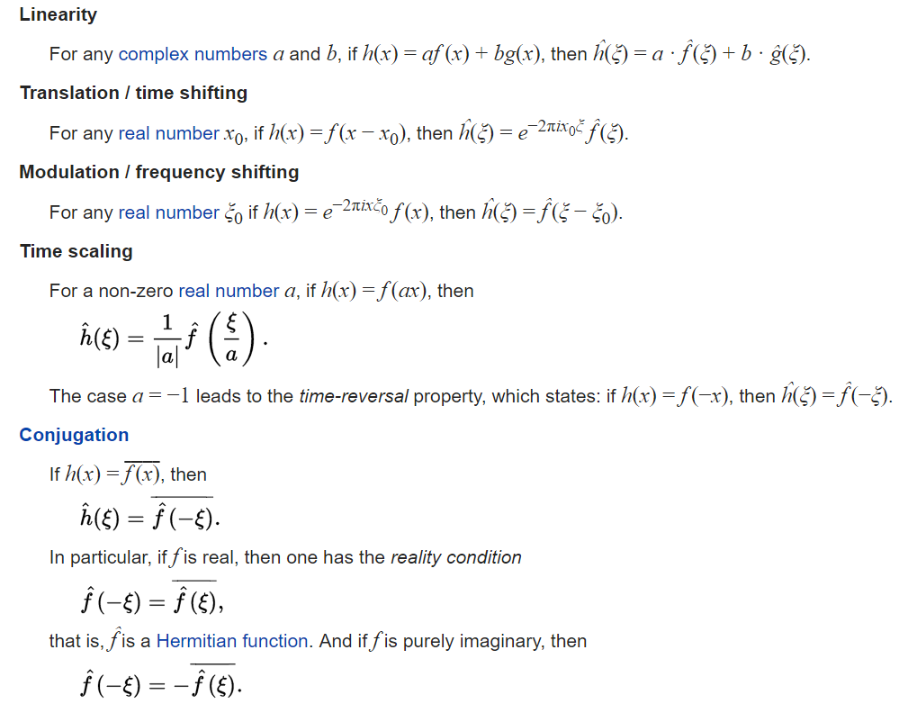

Basic Properties

Slide 24
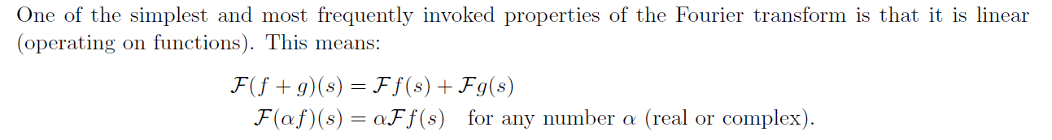
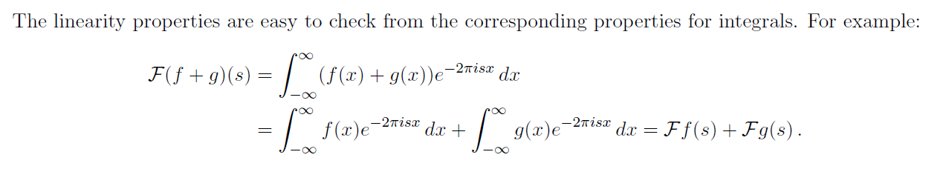
Linearity

Slide 25
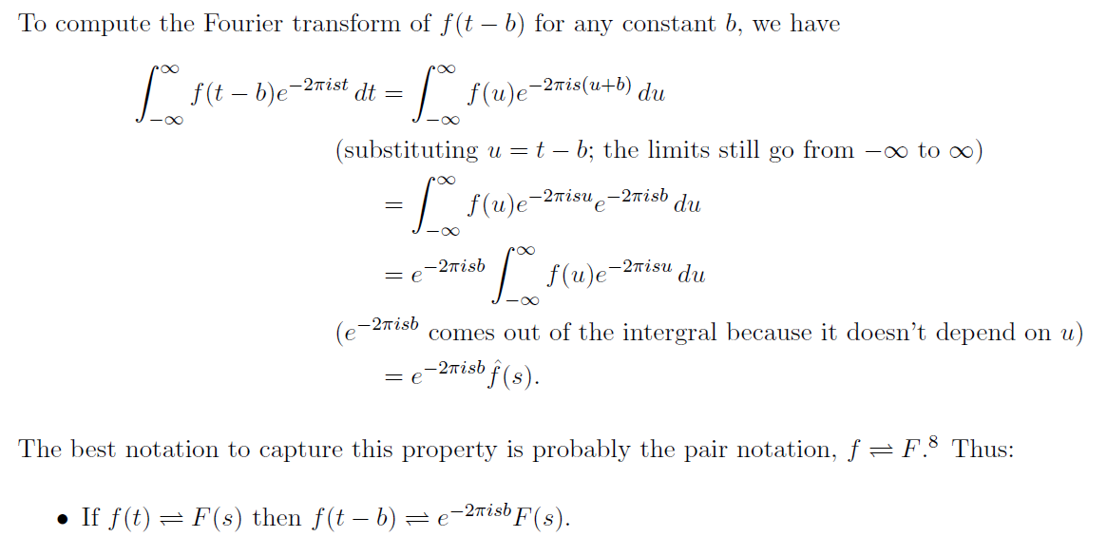
Shift

Slide 26
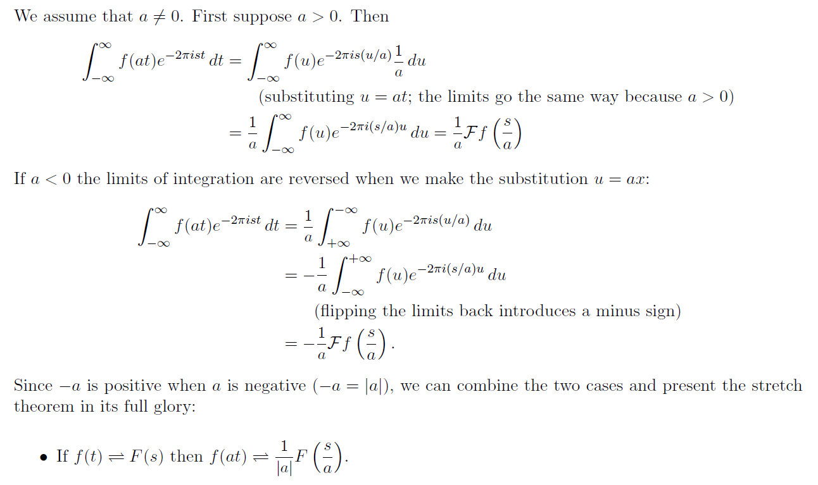
Scaling

Slide 27
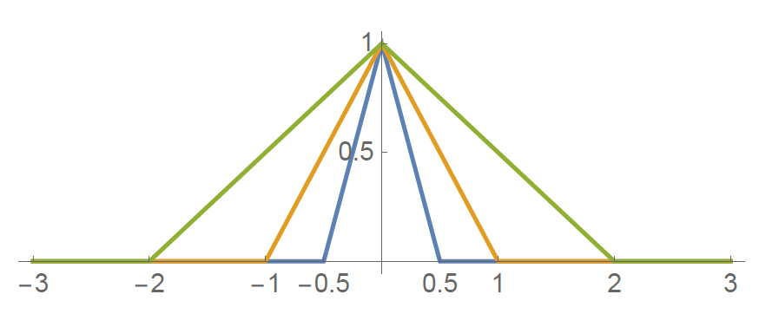
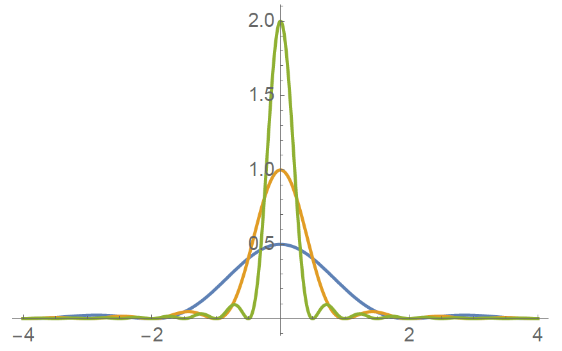
Example

Slide 28
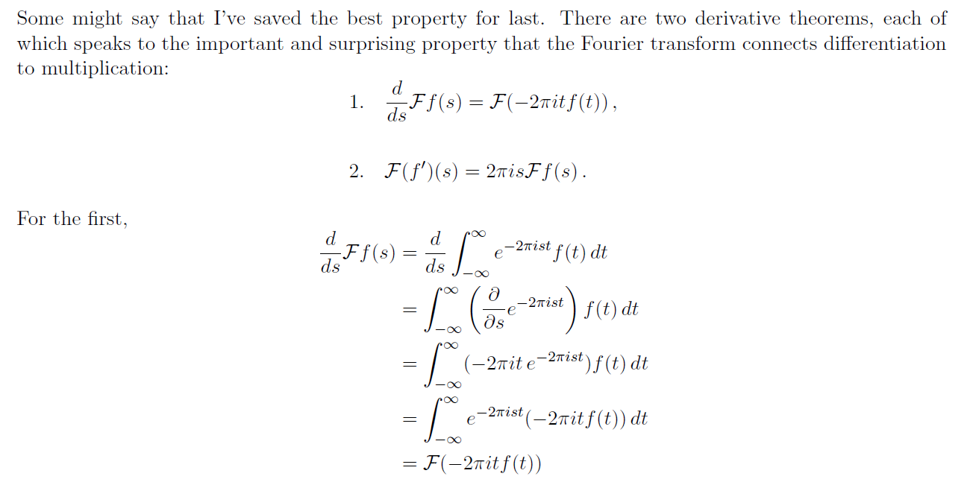
Derivation

Slide 29
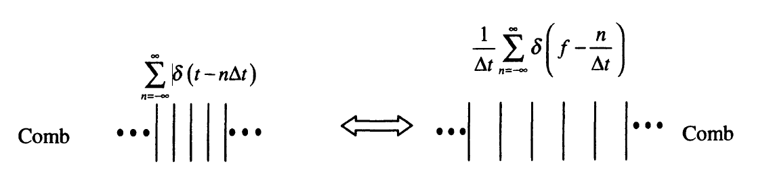
Paired Combs

Slide 30
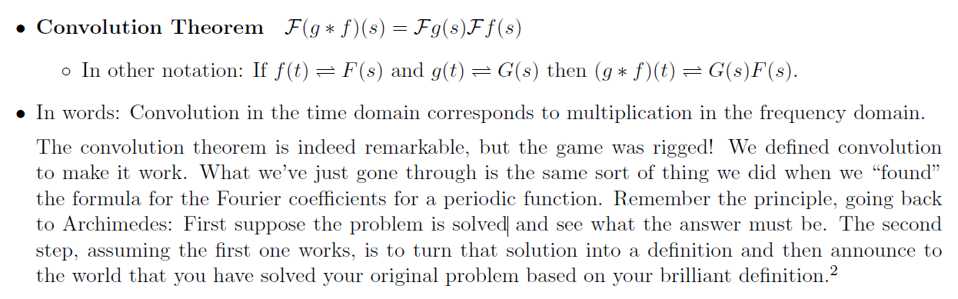
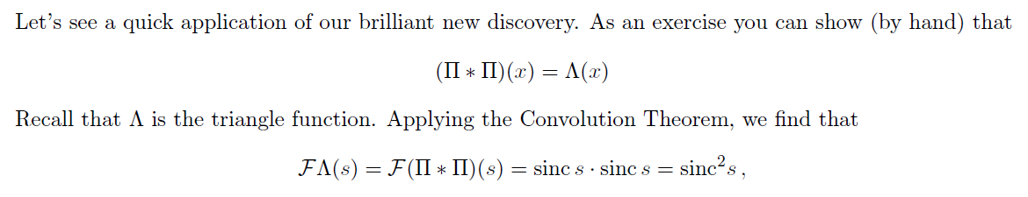
Convolution Theorem

Slide 31
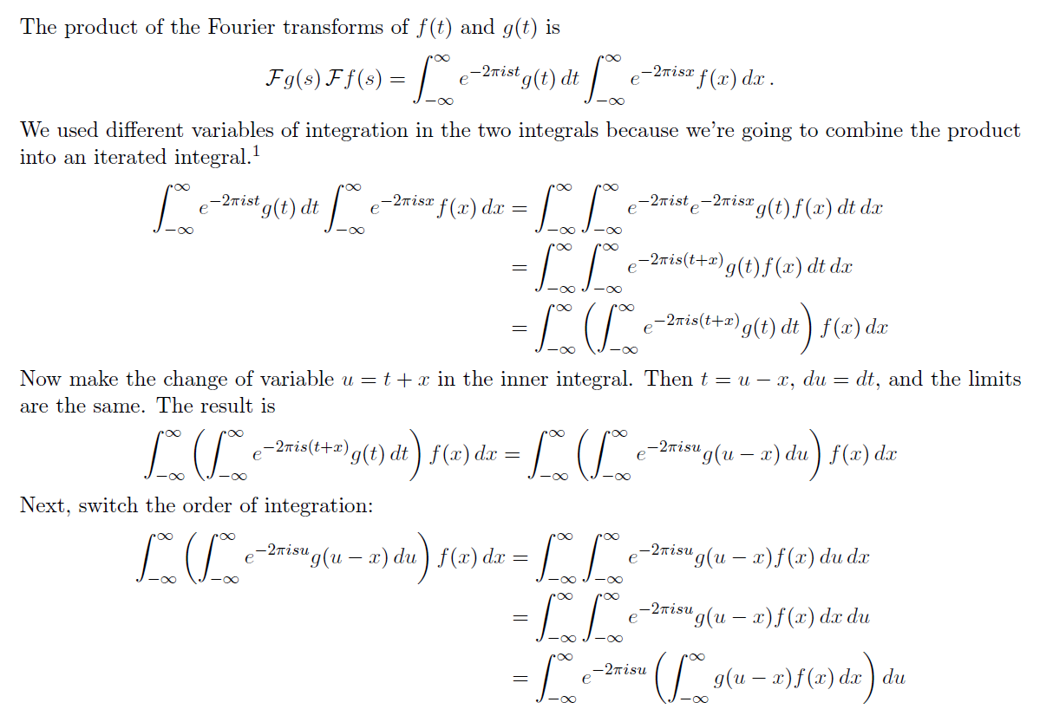
Why?

Slide 32

Why?
For a shift-invariant linear system, a sinusoidal input will only generate a sinusoidal output at the same frequency. Therefore, a convolution in the t-domain must be a multiplication in the Fourier domain.
The above invariability only holds for sinusoidal functions. Therefore, the convolution theorem exists only with the Fourier transform.
If you are interested, you could write a paper out of these comments.

Slide 33

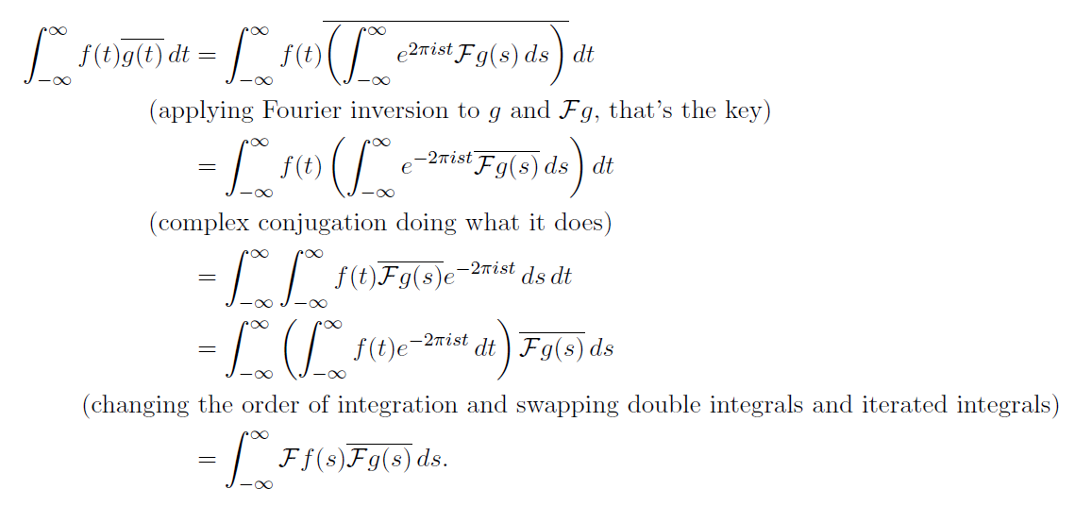
Parseval's Identity

Slide 34
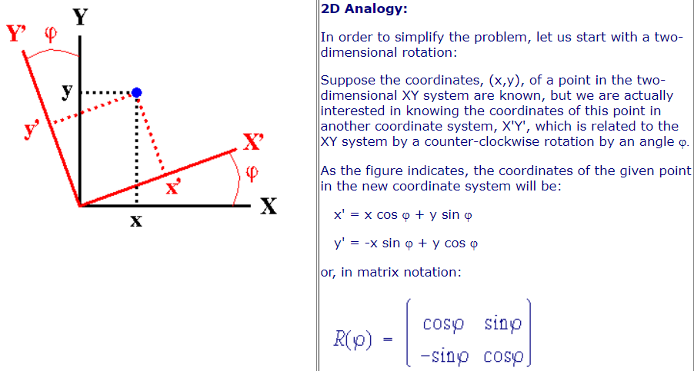
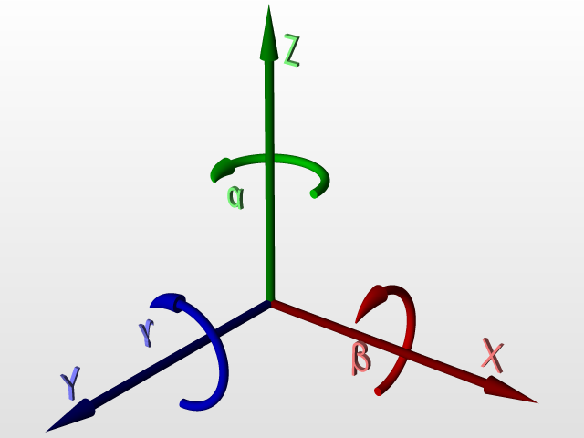
Why?

Slide 35
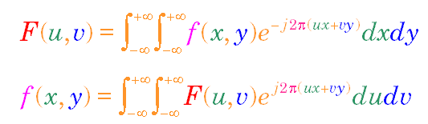
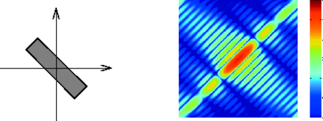
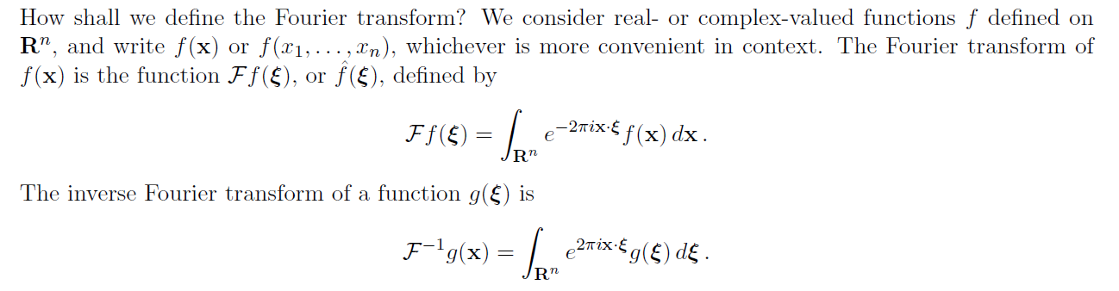
2D Fourier Transform

Slide 36
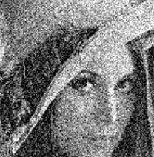
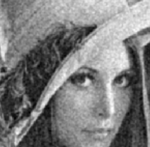
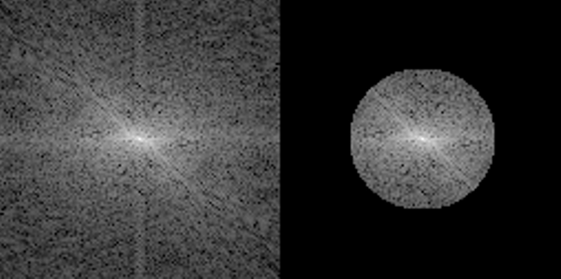
Noise Suppression
FT
IFT

Slide 37
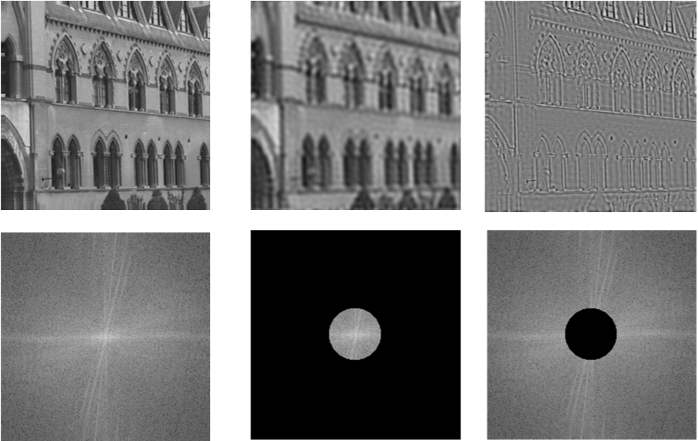
Low-/High-pass Filtering

Slide 38
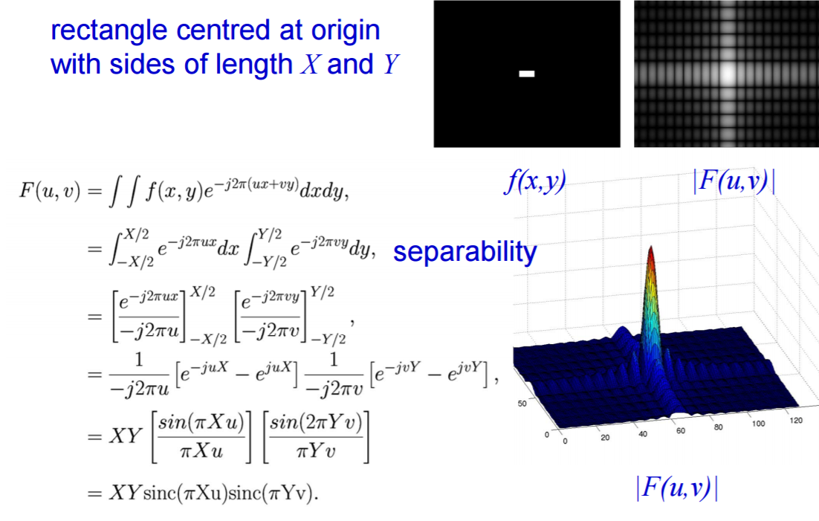
Example: 2D Rectangle Function
Rectangle of Sides X and Y, Centered at Origin

Slide 39
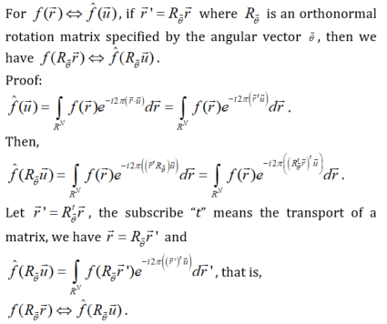
Rotation Property

Slide 40
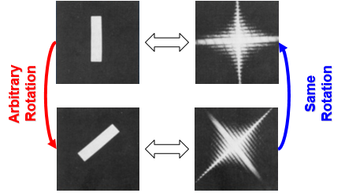
Why?

Slide 42
Homework for BB06
Read about the uncertainty property of Fourier transform, and write no more than three sentences to explain what it is.
Analytically compute the Fourier transform of exp(bt)u(-t), where b is positive, u(t) is the step function (u(t)=1 for positive t and 0 otherwise).
Due date: One week from now (by midnight next Friday). Please upload your report to MLS.
https://www.youtube.com/watch?v=1hX_MUh8wfk

