Slide 1

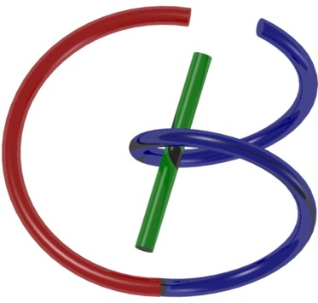
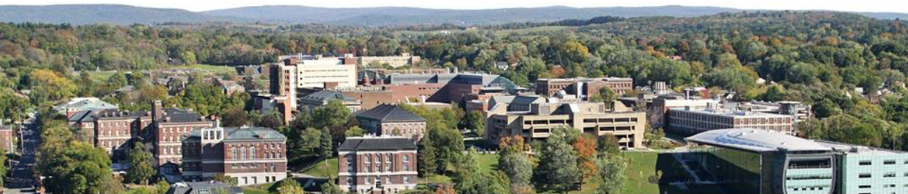
38655 BMED-2300-02
Lecture 7: Signal Processing
Ge Wang, PhD
Biomedical Imaging Center
CBIS/BME, RPI
wangg6@rpi.edu
February 6, 2018

Slide 2
BB Schedule for S18
Tue | Topic | Fri | Topic
1/16 | Introduction | 1/19 | MatLab I (Basics)
1/23 | System | 1/26 | Convolution
1/30 | Fourier Series | 2/02 | Fourier Transform
2/06 | Signal Processing | 2/09 | Discrete FT & FFT
2/13 | MatLab II (Homework) | 2/16 | Network
2/20 | No Class | 2/23 | Exam I
2/27 | Quality & Performance | 3/02 | X-ray & Radiography
3/06 | CT Reconstruction | 3/09 | CT Scanner
3/20 | MatLab III (CT) | 3/23 | Nuclear Physics
3/27 | PET & SPECT | 3/30 | MRI I
4/03 | Exam II | 4/06 | MRI II
4/10 | MRI III | 4/13 | Ultrasound I
4/17 | Ultrasound II | 4/20 | Optical Imaging
4/24 | Machine Learning | 4/27 | Exam III
Office Hour: Ge Tue & Fri 3-4 @ CBIS 3209 | wangg6@rpi.edu
Kathleen Mon 4-5 & Thurs 4-5 @ JEC 7045 | chens18@rpi.edu

Slide 3
Logo for Foundation
Operator Need to Shift & Scale

Slide 4





Fourier Series & Transform

Slide 5
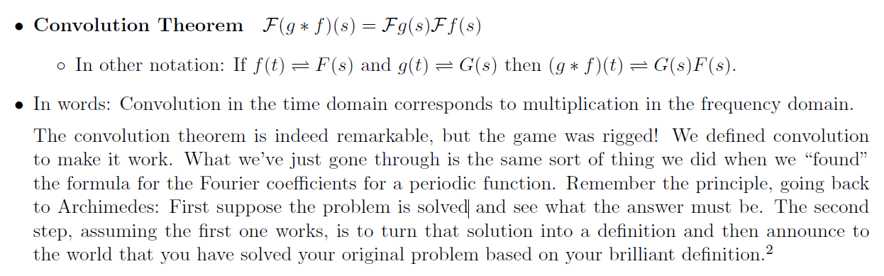
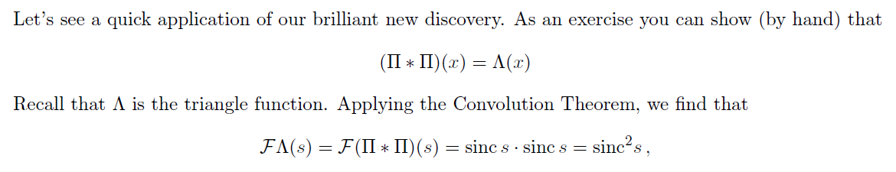
Convolution Theorem

Slide 6

Why?
For a shift-invariant linear system, a sinusoidal input will only generate a sinusoidal output at the same frequency. Therefore, a convolution in the t-domain must be a multiplication in the Fourier domain.
The above invariability only holds for sinusoidal functions. Therefore, the convolution theorem exists only with the Fourier transform.
If you are interested, you could write a paper out of these comments.

Slide 7
Why?
For a shift-invariant linear system, a sinusoidal input will only generate a sinusoidal output at the same frequency.
The above invariability only holds for sinusoidal functions unless the impulse response is a delta function.

Slide 8

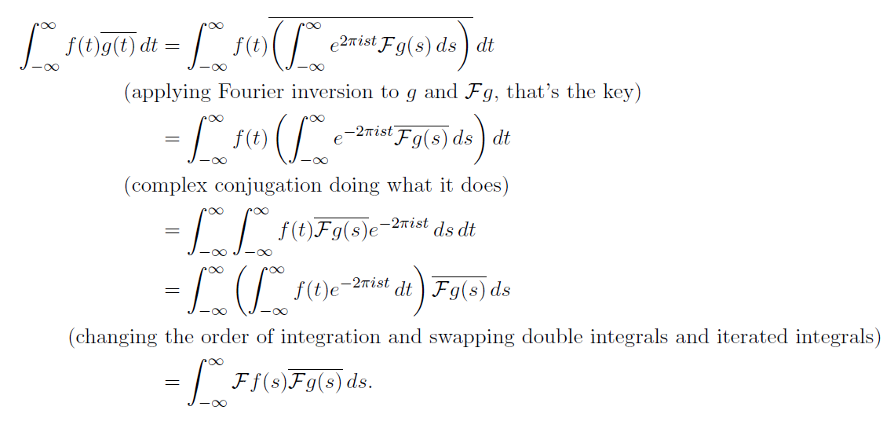
Parseval's Identity

Slide 9
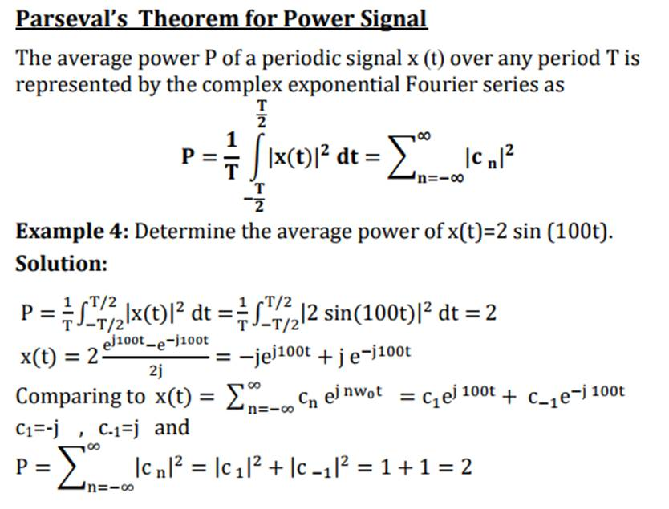

Slide 10
Representing a Continuous Function
The product of the delta function and a continuous function f can be measured to give a unique result
Therefore, a sample is recorded

Slide 11
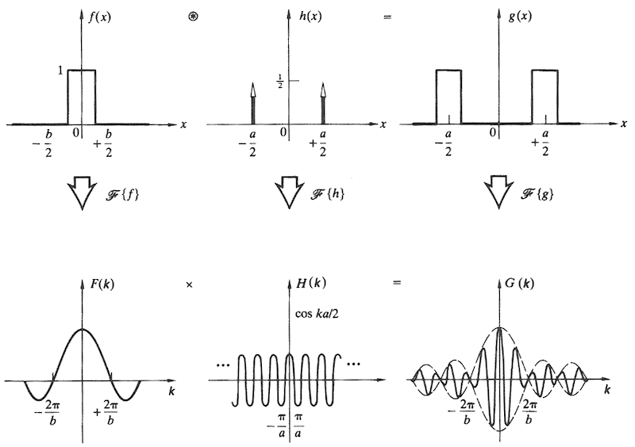
Convolution Theorem

Slide 12
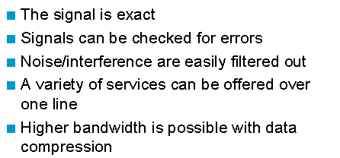
Why Digital?
Let’s Study How to Process Digital Signal Next!

Slide 13
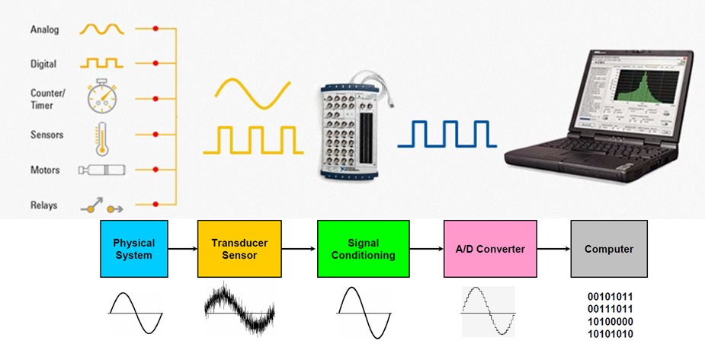
Into Computer

Slide 14
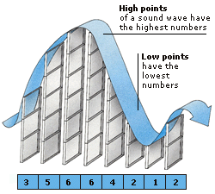

Slide 15
Analog to Digital

Slide 16
Continuous Wave
5*sin(2π4t)
Second

Slide 17
Well Sampled
Second
Frequency = 4 Hz, Rate = 256 Samples/s

Slide 18
Under-sampled
Under-sampled signal can confuse you when reconstructed

Slide 19
Continuous vs Discrete
→

Slide 20
Aliasing Problem
→
→

Slide 21
In Spatial Doman
×
=

Slide 22
In Frequency Domain
∗
=

Slide 23
Conditioning in Spatial Domain
×
=

Slide 24
Better Off in Frequency Domain
⊗
=

Slide 25
Ideal Sampling Filter
It is a sinc function in the spatial domain,
with infinite ringing

Slide 26
Cheap Sampling Filter
It is a sinc function in the frequency domain,
with infinite ringing

Slide 27
Gaussian Sampling Filter
Fourier transform of Gaussian = Gaussian
Good compromise as a sampling filter

Slide 28
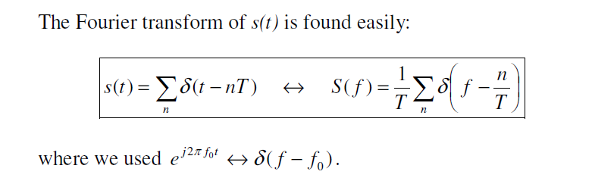
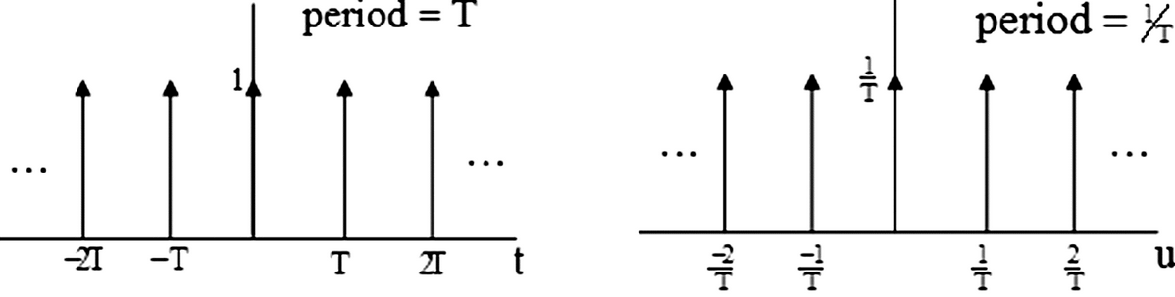
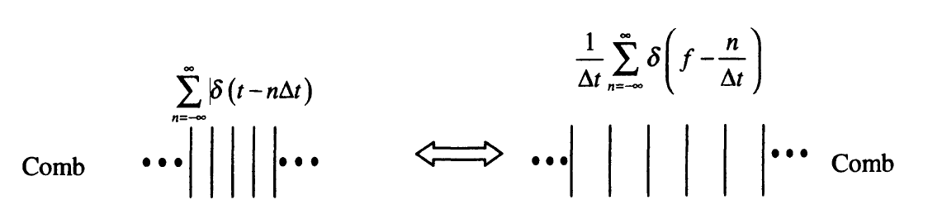
Comb & Its Mirror in Fourier Space

Slide 29
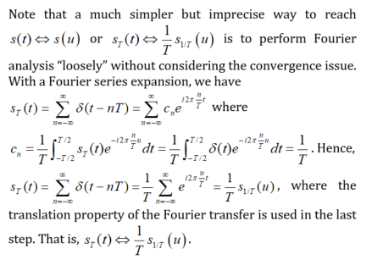
Fourier Transform of S_{T}(t)

Slide 30
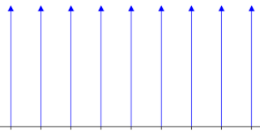
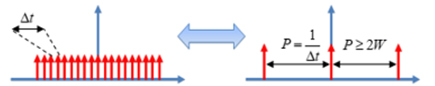
Comb S_{T}(t) & Its Mirror

Slide 31
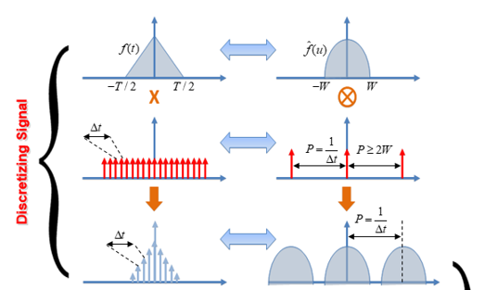
Sampling Signal

Slide 32
Fourier Series (Real Form)

Slide 33
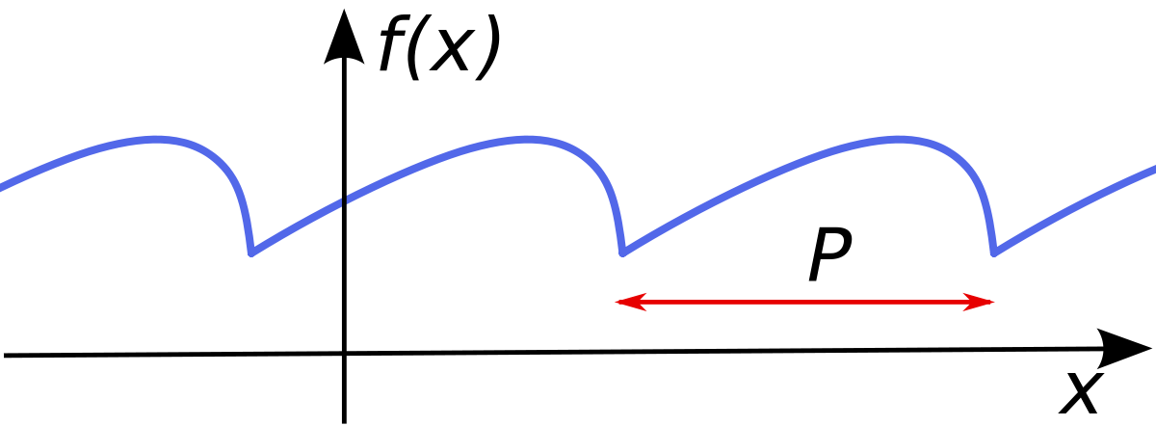
Sampling Problem

Slide 34
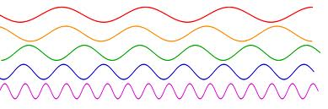
How to Estimate DC?

Slide 35
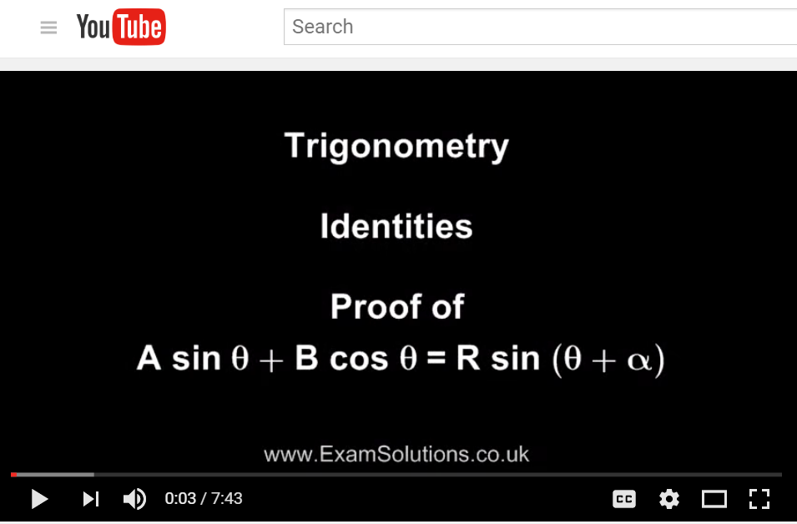
Unknowns: Amplitude & Phase

Slide 36
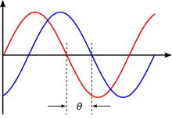

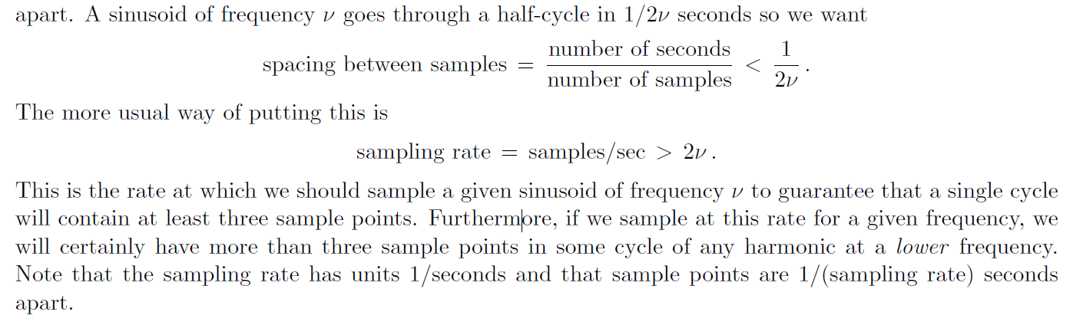
Heuristic Analysis
Nyquist Sampling Rate!

Slide 37
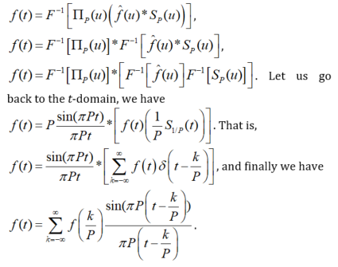
Derivation of the Sampling Theorem

Slide 38

Sampling Theorem

Slide 39
Derivation of the Sampling Theorem

Slide 40
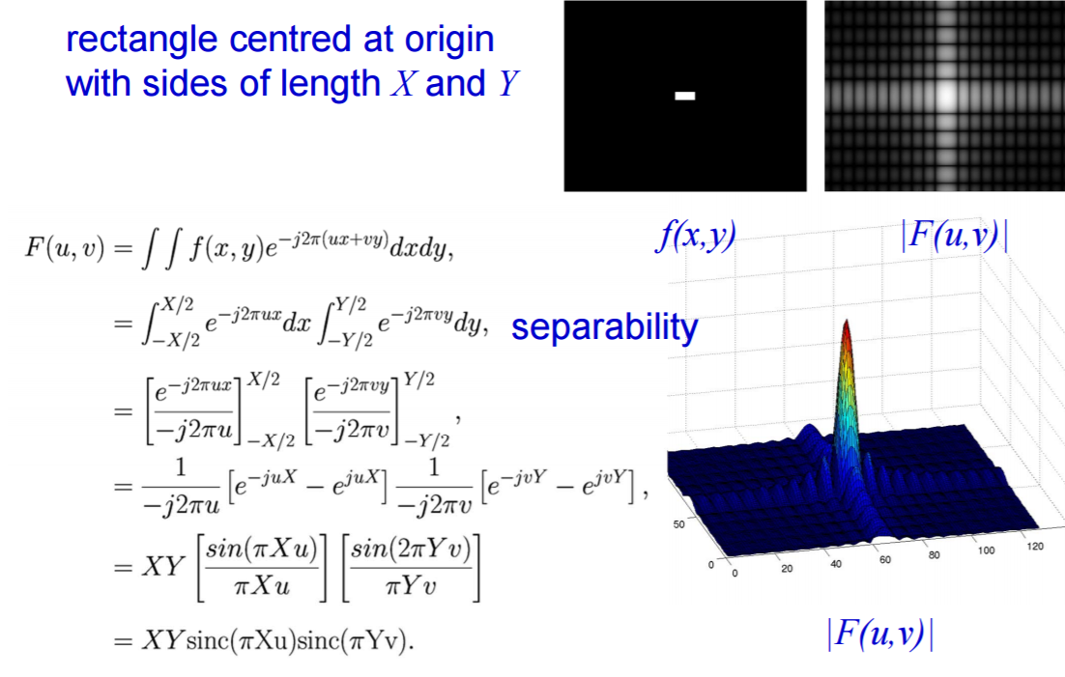
Example: 2D Rectangle Function
Rectangle of Sides X and Y, Centered at Origin

Slide 41
Derivation of the Sampling Theorem

Slide 42
Comb & Its Mirror in Fourier Space

Slide 43
Derivation of the Sampling Theorem

Slide 44
Analog to Digital

Slide 45
Derivation of the Sampling Theorem

Slide 46
Copying via Convolution with Delta

Slide 47
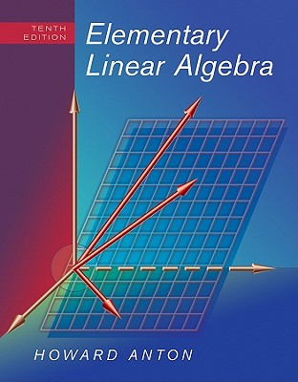
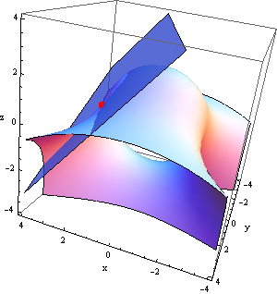
Revisit to Linear Systems
Ax=b
How to solve a system of linear equations if the unknown vector is sparse?

Slide 48
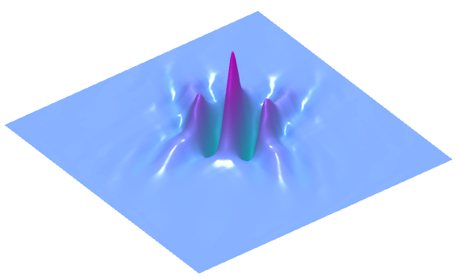
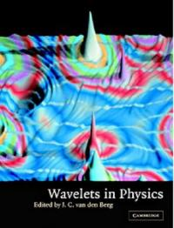

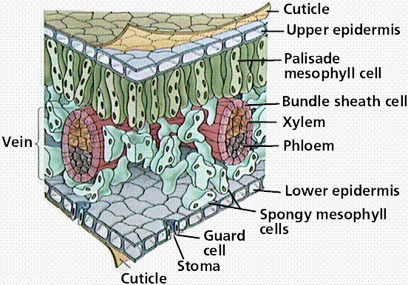
Sparsity Everywhere

Slide 49
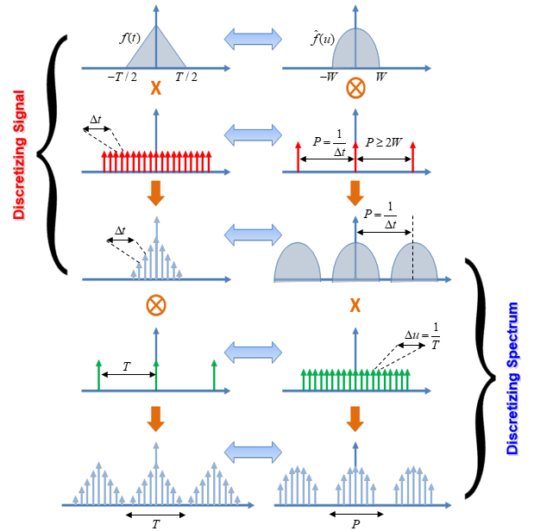
Big Picture

Slide 50
Homework for BB07
Please specify a continuous signal, sample it densely enough, and then reconstruct it in MatLab. Please comment your code clearly, and display your results nicely.
Due date: One week from now (by midnight next Tuesday). Please upload your report to MLS, including both the script and the figures in a word file.
https://www.youtube.com/watch?v=1hX_MUh8wfk

