Slide 1

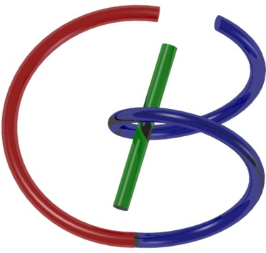
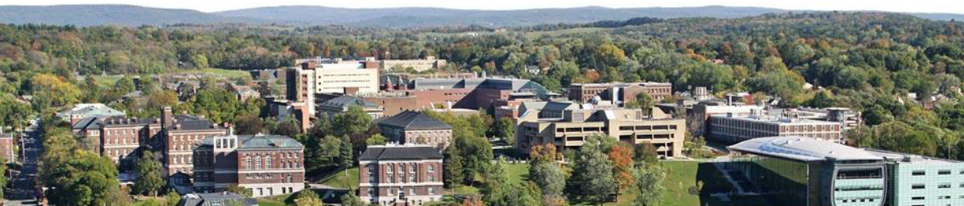
38655 BMED-2300-02
Lecture 8: Discrete FT
Ge Wang, PhD
Biomedical Imaging Center
CBIS/BME, RPI
wangg6@rpi.edu
February 9, 2018

Slide 2
BB Schedule for S18
Tue | Topic | Fri | Topic
1/16 | Introduction | 1/19 | MatLab I (Basics)
1/23 | System | 1/26 | Convolution
1/30 | Fourier Series | 2/02 | Fourier Transform
2/06 | Signal Processing | 2/09 | Discrete FT & FFT
2/13 | MatLab II (Homework) | 2/16 | Network
2/20 | No Class | 2/23 | Exam I
2/27 | Quality & Performance | 3/02 | X-ray & Radiography
3/06 | CT Reconstruction | 3/09 | CT Scanner
3/20 | MatLab III (CT) | 3/23 | Nuclear Physics
3/27 | PET & SPECT | 3/30 | MRI I
4/03 | Exam II | 4/06 | MRI II
4/10 | MRI III | 4/13 | Ultrasound I
4/17 | Ultrasound II | 4/20 | Optical Imaging
4/24 | Machine Learning | 4/27 | Exam III
Office Hour: Ge Tue & Fri 3-4 @ CBIS 3209 | wangg6@rpi.edu
Kathleen Mon 4-5 & Thurs 4-5 @ JEC 7045 | chens18@rpi.edu

Slide 3

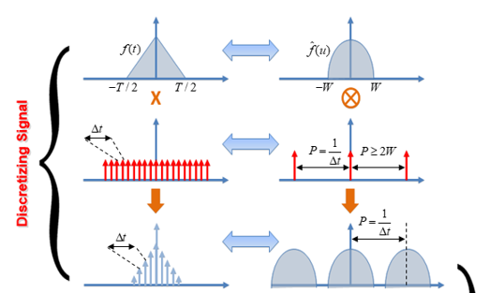

Sampling Theorem

Slide 4
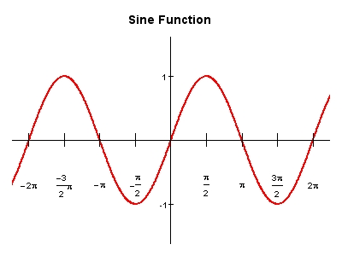
What If P=2W

Slide 5
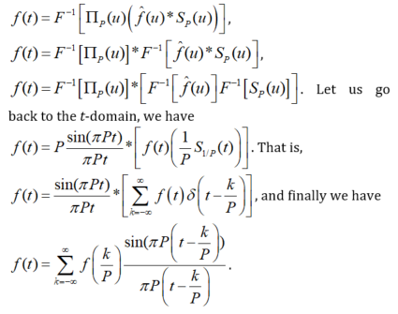
Derivation of the Sampling Theorem
https://dsp.stackexchange.com/questions/37480/formulating-a-function-on-matlab-for-the-shannon-interpolation-formula

Slide 6
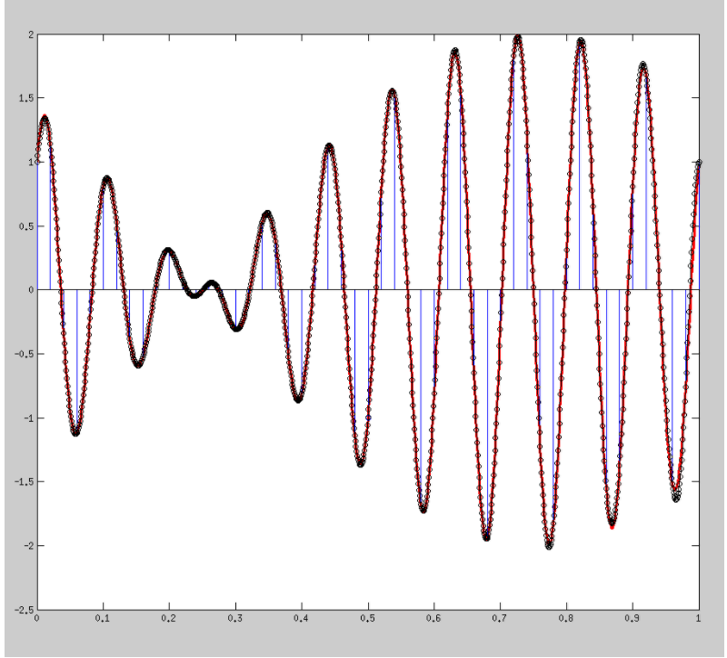
Good Case: True versus Sampled

Slide 7
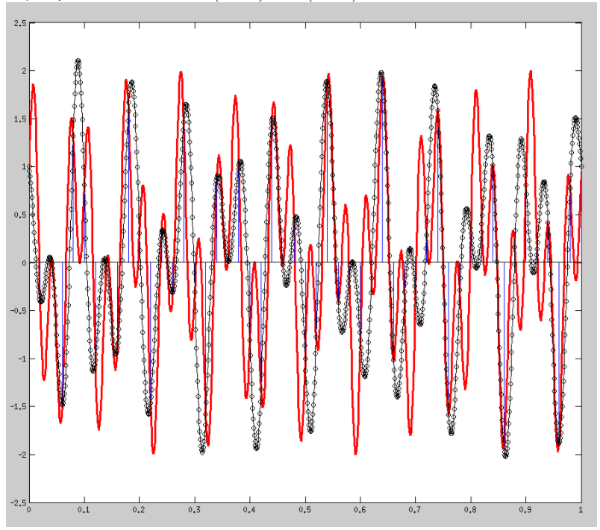
Bad Case: True versus Sampled

Slide 8
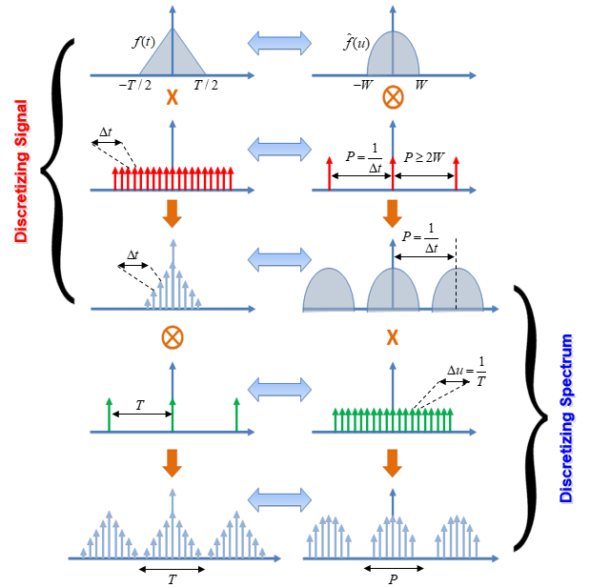
Big Picture

Slide 9
Signal Sampling
Continuous Signal
Shah Function (Impulse Train)
Sampled Function

Slide 10
Spectral Duplication
Sampled Function
Sampling
Frequency
There will be no overlap if

Slide 11
Nyquist Theorem
If
Aliasing
When can we recover F(u) from F_{S}(u)?
Only if
(Nyquist Frequency)
We can use
Then
and
Sampling frequency must be greater than

Slide 12
Why Non-unique?

Slide 13
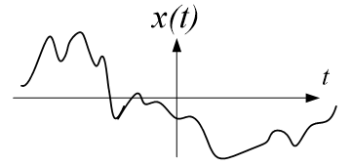
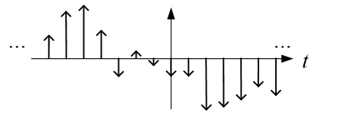
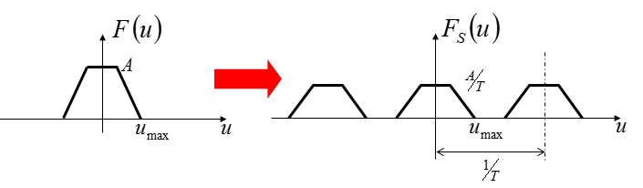
Digitization Not Finished Yet

Slide 14
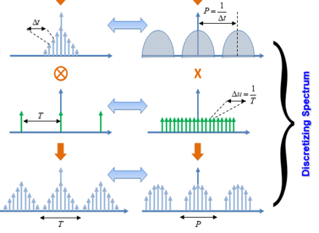
Discretizing Spectrum

Slide 15
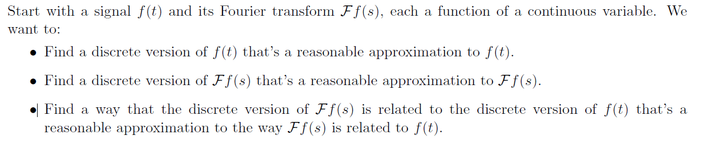
From Continuous to Discrete
f(t)
g(t)
F(t)
G(t)
Continuous
Discrete

Slide 16
Big Picture

Slide 17
Key Variables

Slide 18

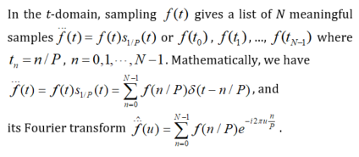
Direct Fourier Transform of

Slide 19
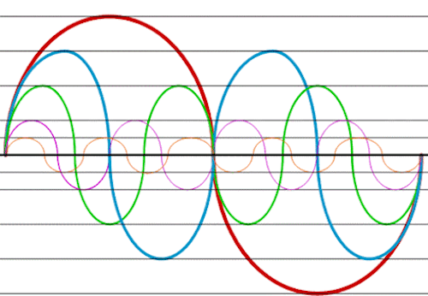
Continuous FT of Sampled f(t)

Slide 20
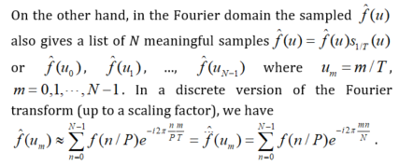

Sampling in the Fourier Domain

Slide 21
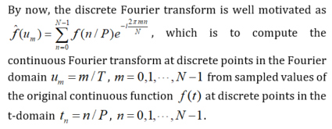
Discrete Fourier Transform

Slide 22
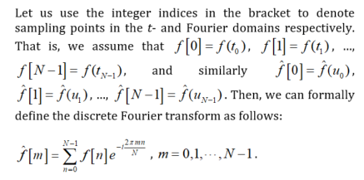
Use of Integer Indices

Slide 23
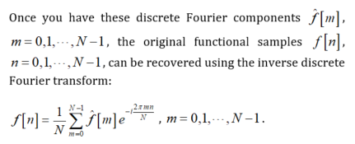
Inverse Discrete Fourier Transform

Slide 24
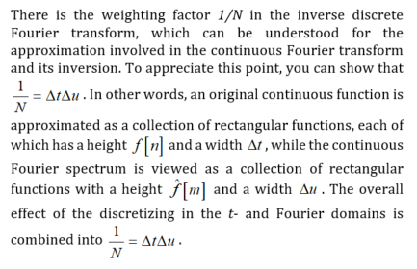
Why 1/N?

Slide 25
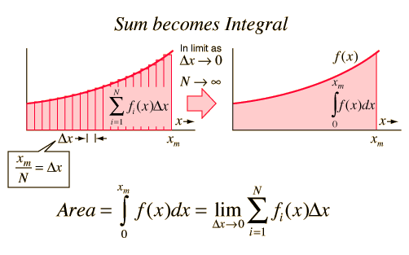
Perspective 1: Discretization

Slide 26
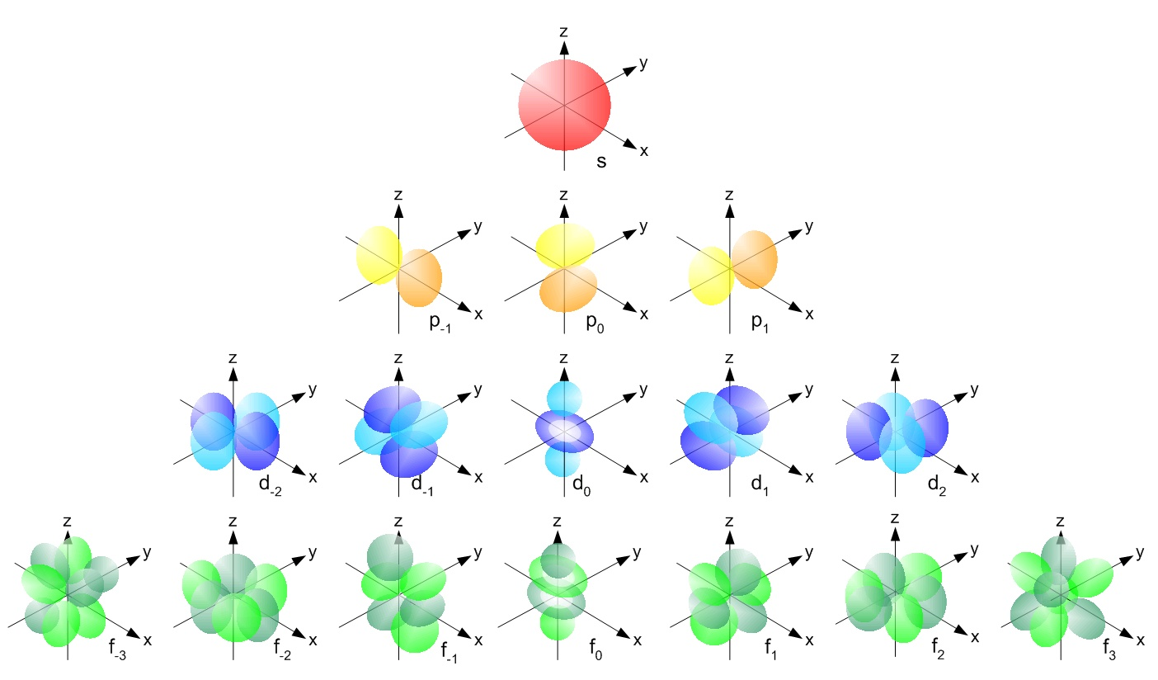
Perspective 2: Harmonics

Slide 27
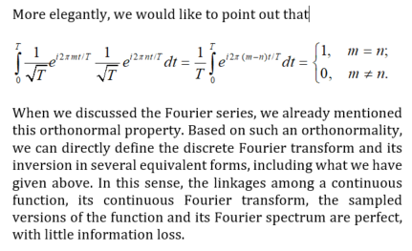
Orthonormal Basis

Slide 28

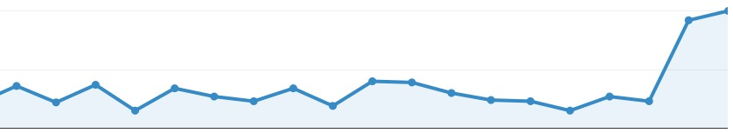
Discrete FT in Different Notations
Vector of N Elements
Only Needs N Basis Functions
N Harmonic Orthogonal
Basis Functions Are Enough
Frequencies Differ by
Constant Increment
Forward & Inverse Transforms
Are Symmetric

Slide 29

FFT
Fast Fourier Transform (FFT) is an efficient algorithm for performing a discrete Fourier transform
FFT published by Cooley & Tukey in 1965
In 1969, the 2048 point analysis of a seismic trace took 13 ½ hours. Using the FFT, the same task on the same machine took 2.4 seconds!

Slide 30
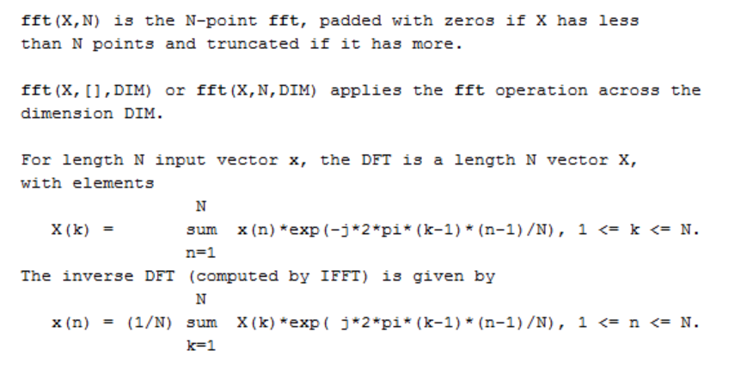
FFT & IFFT

Slide 31
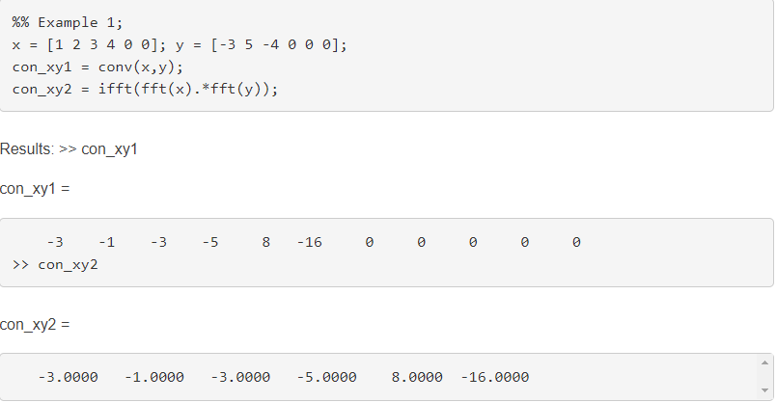
Application 1: Discrete Convolution
https://www.mathworks.com/matlabcentral/answers/38066-difference-between-conv-ifft-fft-when-doing-convolution

Slide 32
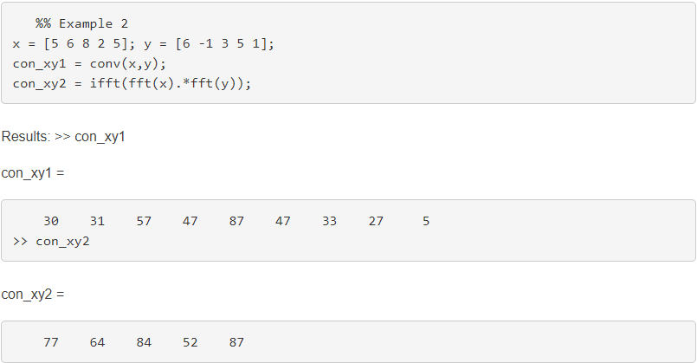
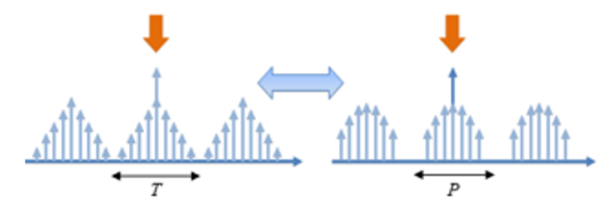
Circular Convolution

Slide 33
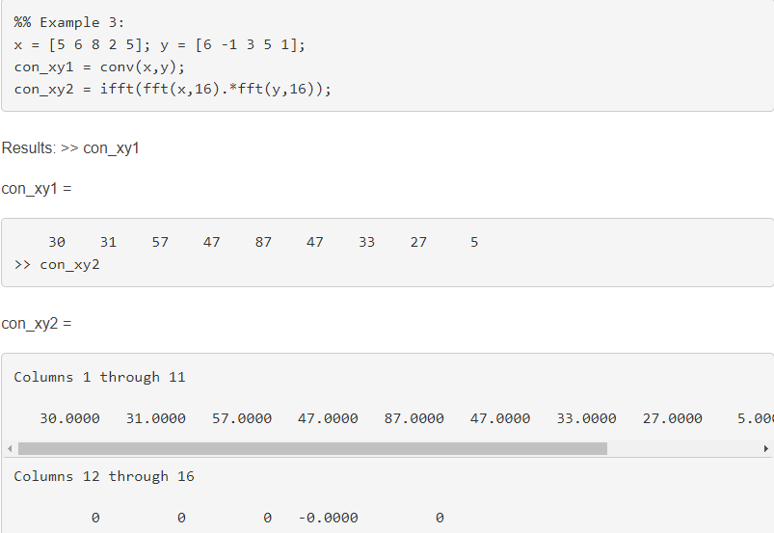
Zero Padding

Slide 34
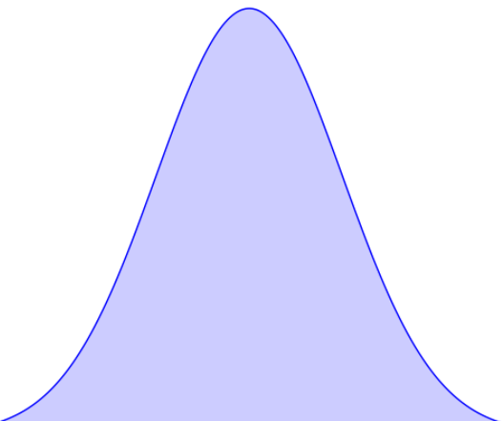
Zero Padding Illustrated

Slide 35
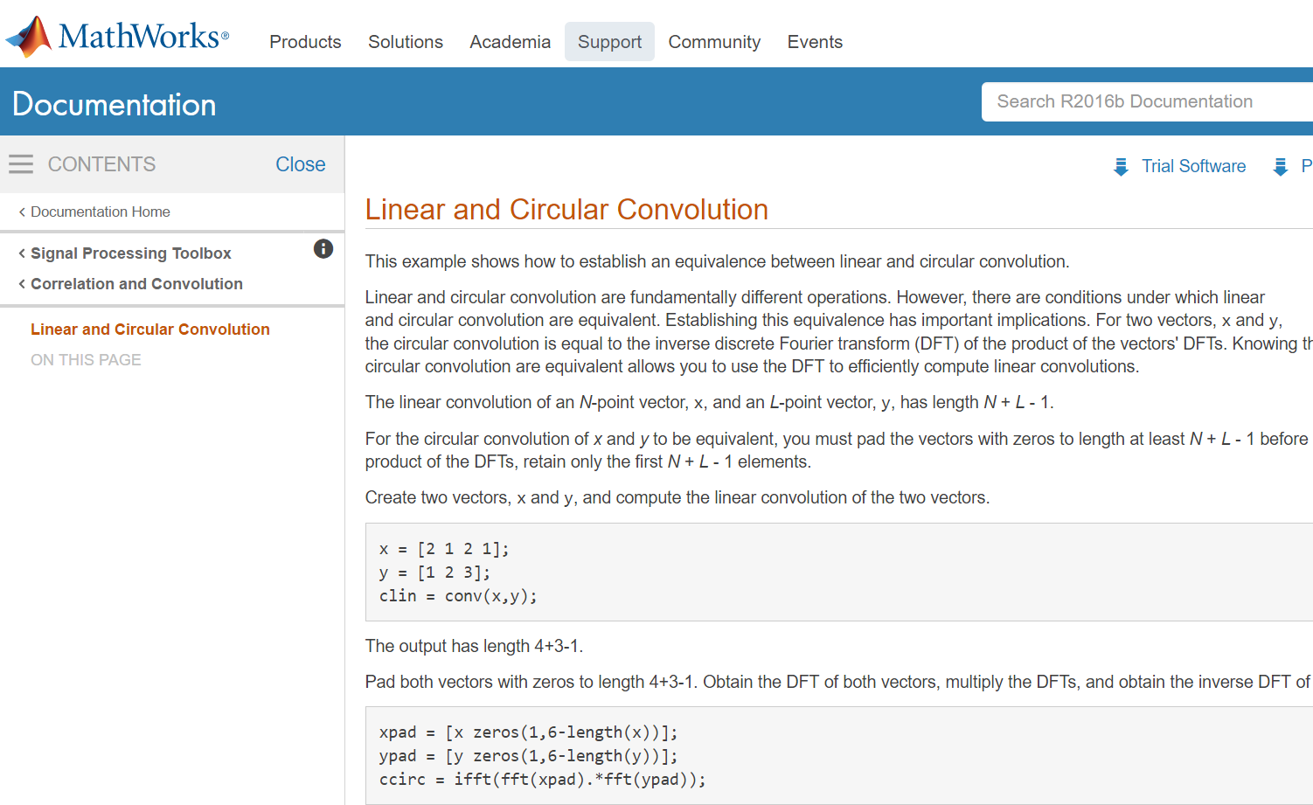
Further Reading

Slide 36

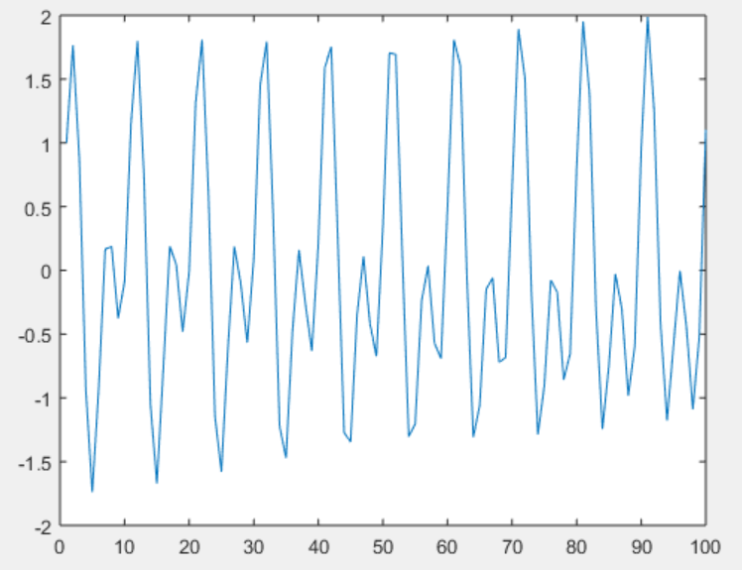
Application 2: Spectral Analysis
Fs = 1e3;
t = 0:0.001:1‐0.001;
x = cos(2*pi*100*t)+sin(2*pi*202.5*t);
Plot(x(1:100));
https://www.mathworks.com/help/signal/ug/amplitude-estimation-and-zero-padding.html

Slide 37
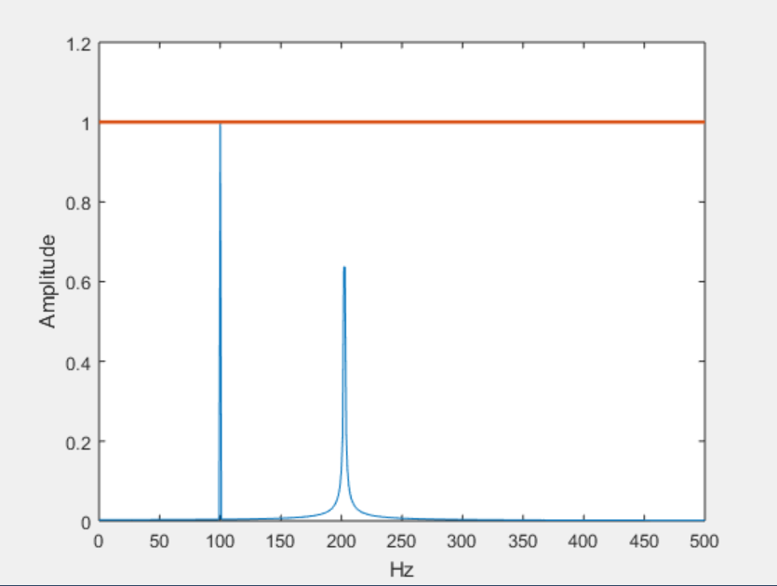
Without Zero Padding
xdft = fft(x);
xdft = xdft(1:length(x)/2+1);
xdft = xdft/length(x);
xdft(2:500) = 2*xdft(2:500);
freq = 0:Fs/length(x):Fs/2;
plot(freq,abs(xdft))
hold on
plot(freq,ones(length(x)/2+1,1),'LineWidth',2)
xlabel('Hz')
ylabel('Amplitude')
hold off

Slide 38
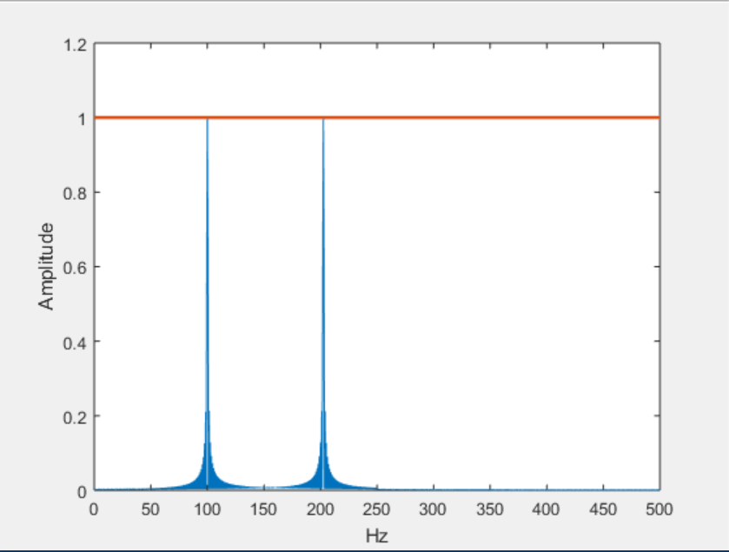
Zero Padding
xdft = fft(x,2000);
xdft = xdft(1:length(xdft)/2+1);
xdft = xdft/length(x);
xdft(2:500) = 2*xdft(2:500);
freq =0:Fs/(2*length(x)):Fs/2;
plot(freq,abs(xdft))
hold on
plot(freq,ones(2*length(x)/2+1,1),'LineWidth',2)
xlabel('Hz')
ylabel('Amplitude')
hold off

Slide 39

Note: Impossible into Possible

Slide 40

Convergence Issue

Slide 41
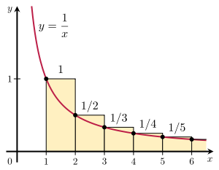
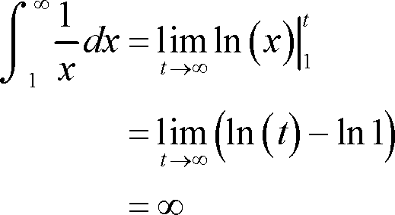
Increasingly Smaller, Not Enough

Slide 42
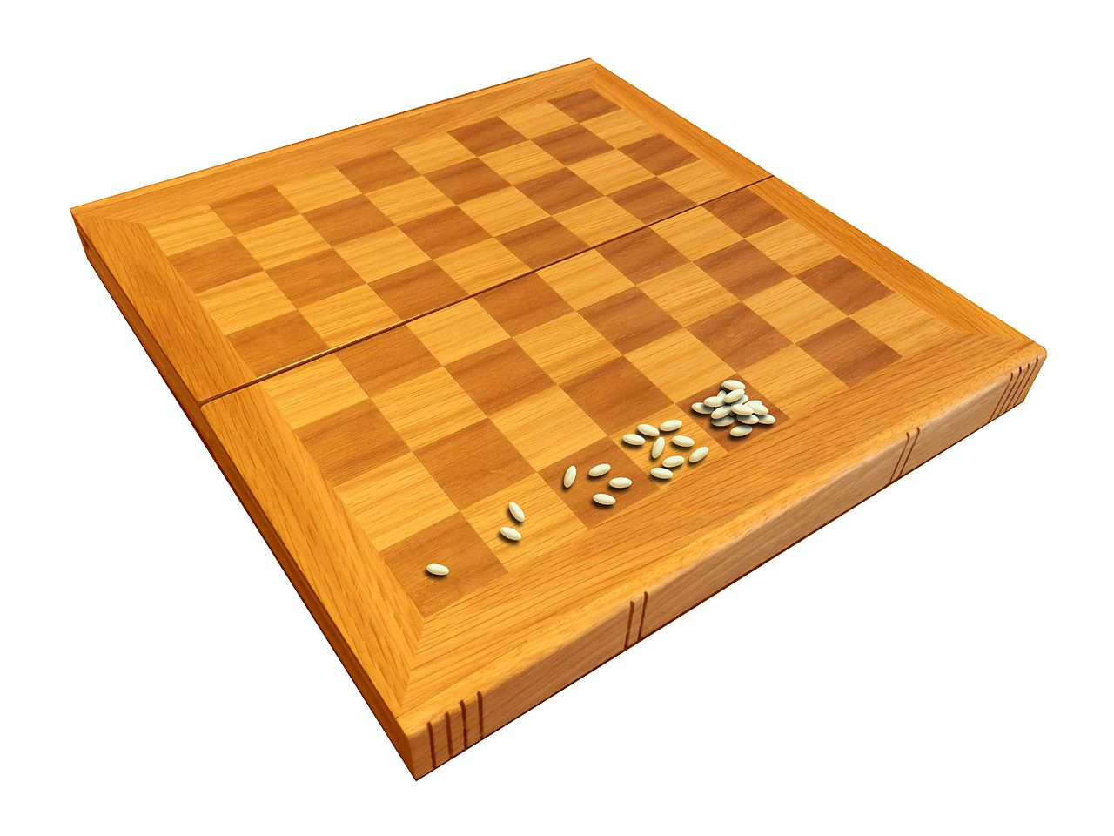
Wheat & Chessboard Problem
Exponential growth never can go on very long in a finite space with finite resources.

Slide 43
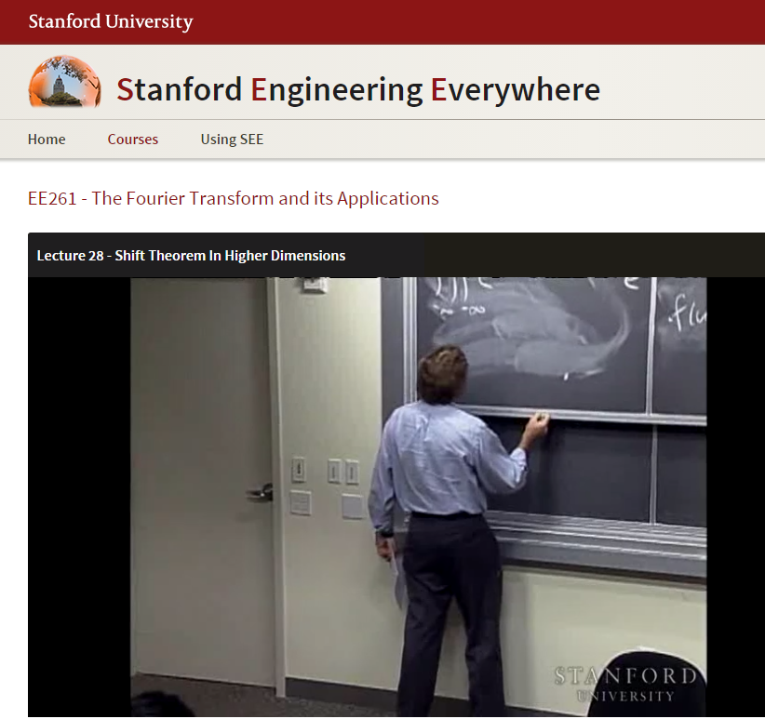
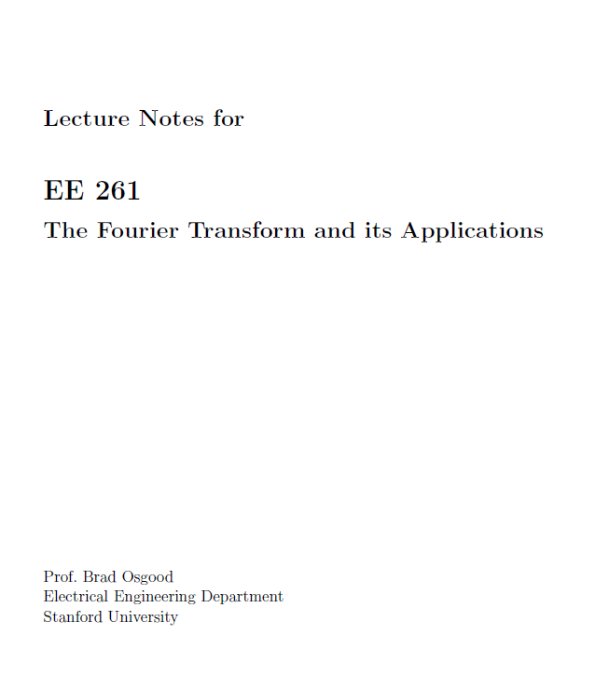
https://see.stanford.edu/Course/EE261
https://see.stanford.edu/materials/lsoftaee261/book-fall-07.pdf

Slide 44
https://see.stanford.edu/Course/EE261
https://see.stanford.edu/materials/lsoftaee261/book-fall-07.pdf

Slide 45

Art_X

Slide 46
ArtX HW: Do an Overview Poster
DFT & FFT
Signal Processing
Fourier Series
Fourier Transform
Periodic
Non-periodic
Convolution
Shift-invariant Linear System
Function/System
Due Next Fri

Slide 47
