Slide 1

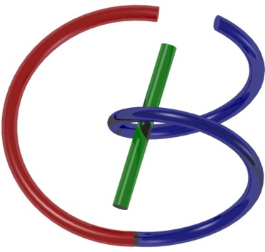
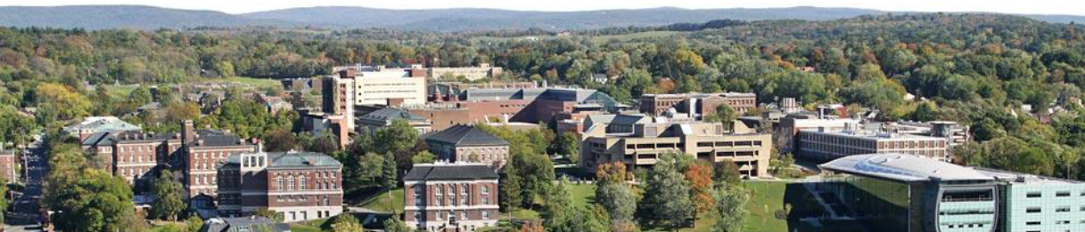
38655 BMED-2300-02
Lecture 13: CT Reconstruction
Ge Wang, PhD
Biomedical Imaging Center
CBIS/BME, RPI
wangg6@rpi.edu
March 6, 2018

Slide 2

Are Your Scores Good?

Slide 3
BB Schedule for S18
Tue | Topic | Fri | Topic
1/16 | Introduction | 1/19 | MatLab I (Basics)
1/23 | System | 1/26 | Convolution
1/30 | Fourier Series | 2/02 | Fourier Transform
2/06 | Signal Processing | 2/09 | Discrete FT & FFT
2/13 | MatLab II (Homework) | 2/16 | Network
2/20 | No Class | 2/23 | Exam I
2/27 | Quality & Performance | 3/02 | X-ray & Radiography
3/06 | CT Reconstruction | 3/09 | CT Scanner
3/20 | MatLab III (CT) | 3/23 | Nuclear Physics
3/27 | PET & SPECT | 3/30 | MRI I
4/03 | Exam II | 4/06 | MRI II
4/10 | MRI III | 4/13 | Ultrasound I
4/17 | Ultrasound II | 4/20 | Optical Imaging
4/24 | Machine Learning | 4/27 | Exam III
Office Hour: Ge Tue & Fri 3-4 @ CBIS 3209 | wangg6@rpi.edu
Kathleen Mon 4-5 & Thurs 4-5 @ JEC 7045 | chens18@rpi.edu

Slide 4
Some Tips
Basic Books:
Ge’s Book & Green Book
Understand Logic Flow/Key Ideas from Lectures/PPTs
Gain Skills from Homework & Textbook Questions
Have Habit of Doing Preview-Listening-Review, & Repeated Reviews

Slide 5
CT Reconstruction
Duality of Information
Algebraic Approach
Solution Uniqueness
Data Independence/Sufficiency
Analytic Approach
Fourier Slice Theorem
Filtered Backprojection
Examples
Numerical Examples
Clinical Images

Slide 6

Duality of Information
Particle
Wave
Image = Collection of Pixels/Voxels
Image = Superposition of Waves/Wavelets

Slide 7
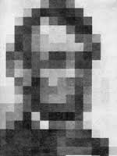
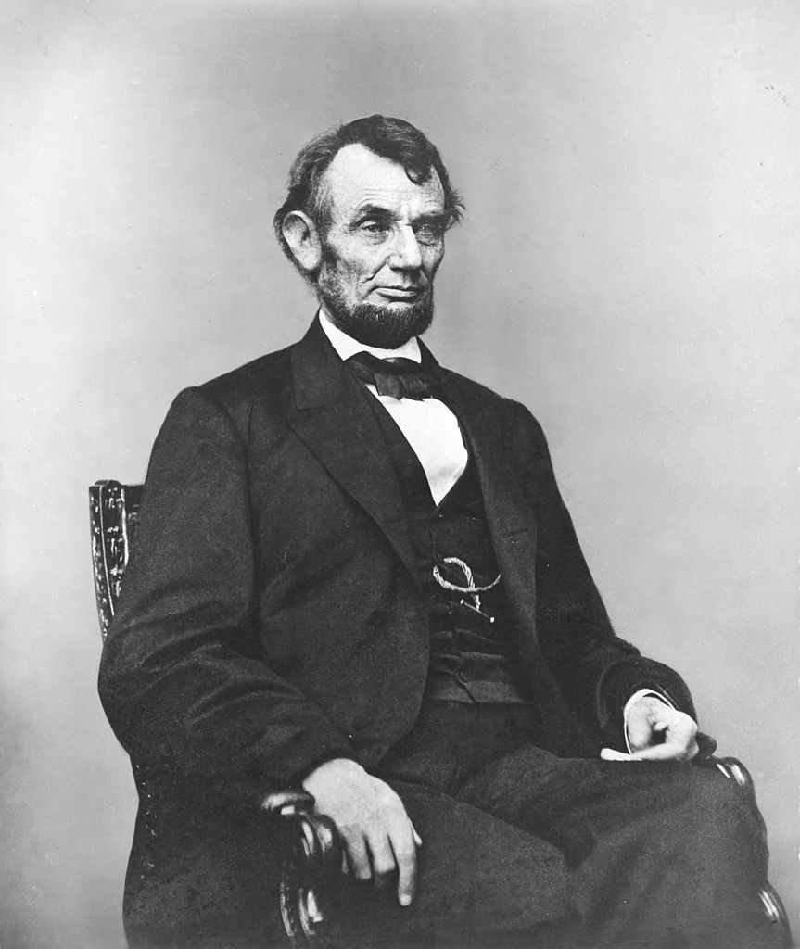
Pixel: Picture Element

Slide 8
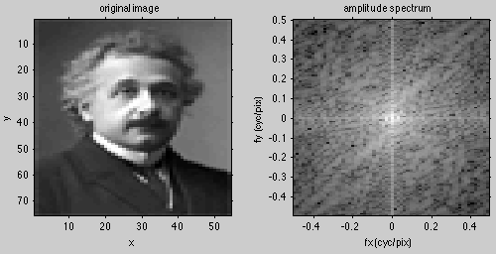

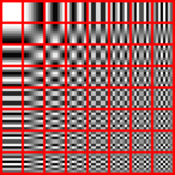
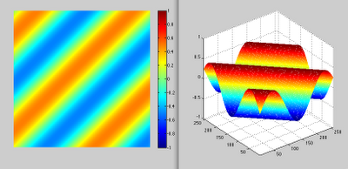
Fourier Analysis

Slide 9
CT Reconstruction
Duality of Information
Algebraic Approach
Solution Uniqueness
Data Independence/Sufficiency
Analytic Approach
Fourier Slice Theorem
Filtered Backprojection
Examples
Numerical Examples
Clinical Images

Slide 10
Linear Equation
Ni
No
μ_{κ}
Δx
Ray-sum
Line integral
X-ray measurement gives data as ray sums or line integrals

Slide 11
Data Independence
By “onion-peeling”, each x-ray path carries unique information, and all “pixels” can be resolved.

Slide 12
Data Sufficiency
There exists at least a source on any line
intersecting a cross-section
These represent the maximum amount of data you can measure, which happens to be sufficient

Slide 13


Projection & Sinogram
Projection: All ray-sums in a direction
Sinogram (Radon Transform): All projections
y
θ
p(θ,t)
t
p(θ,t)
π
θ
x
f(x,y)
X-rays
t
Sinogram

Slide 14

Computed Tomography
Computed tomography (CT): Image reconstruction from projections
y
p(θ,t)
t
p(θ,t)
f(x,y)
θ
x
f(x,y)
X-rays

Slide 15
Sum Game
μ₁=4
μ₂=3
μ₃=2
μ₄=1
A practical problem has many more unknowns but the idea is the same!

Slide 16
Trial & Error
6
4
Error
0
0
4
3
3
2
Guess 1
0
0
2
1
3
2
Guess 0
4
3
2
Guess 2
Update a guess based on data differences
−2
Error
2
1

Slide 17
Algebraic Approach
Convert X-ray data into line integrals to form a system of linear equations
Solve the system of linear equations to reconstruct an underlying image
Regularize the image reconstruction with various prior knowledge
Iteratively refine an intermediate image until the outcome is satisfactory

Slide 18
CT Reconstruction
Duality of Information
Algebraic Approach
Solution Uniqueness
Data Independence/Sufficiency
Analytic Approach
Fourier Slice Theorem
Filtered Backprojection
Examples
Numerical Examples
Clinical Images

Slide 19
Probing Waves
No any info in projection data along non-orthogonal directions
Info in projection data along the orthogonal direction

Slide 20

Fourier Slice Theorem
1D Fourier Transform
X-rays
2D Fourier Transform
Imagine that f(x,y) is a superposition of various 2D waves propagating along different orientations at all frequencies… …

Slide 21
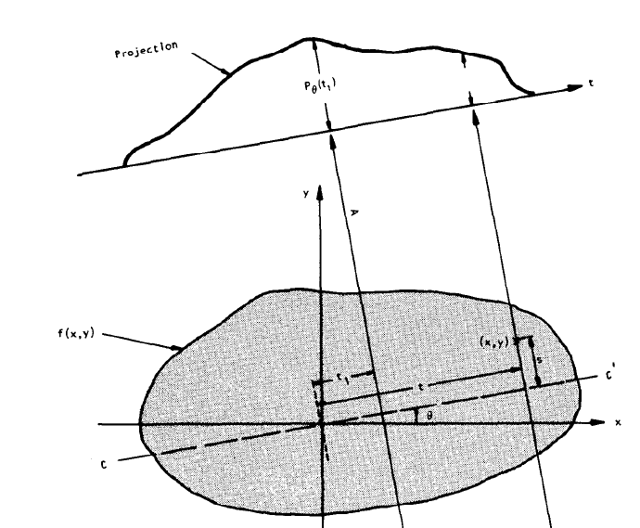
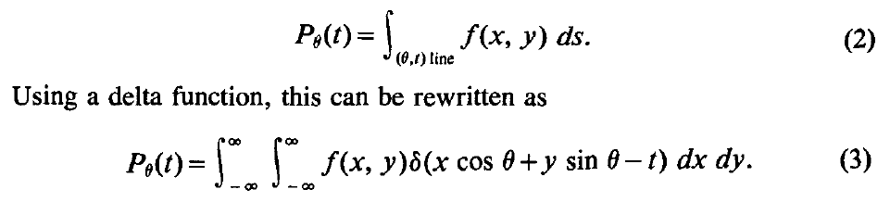
Kak’s Book Chapter 3

Slide 22
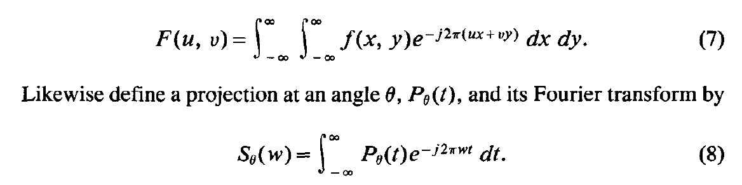
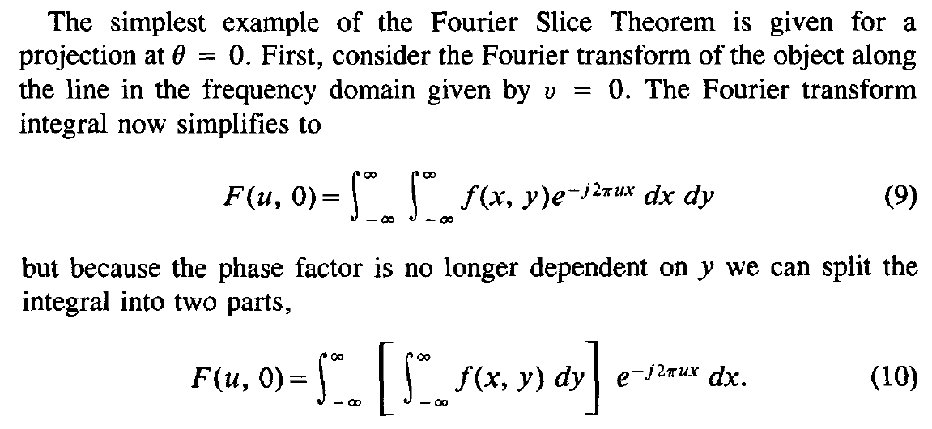
Simplest Example

Slide 23
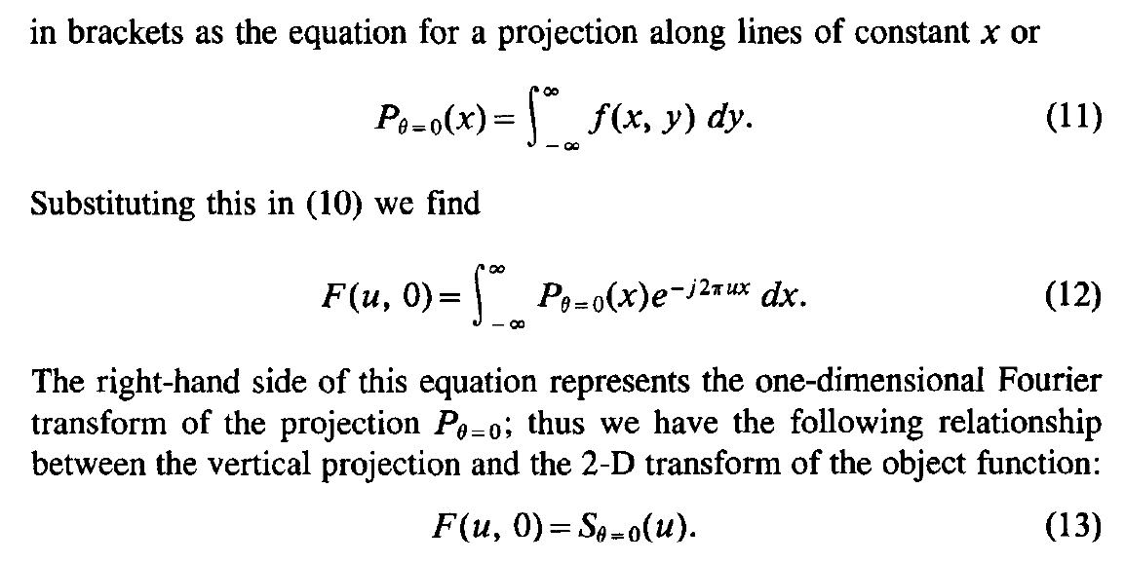
Along Vertical Direction

Slide 24
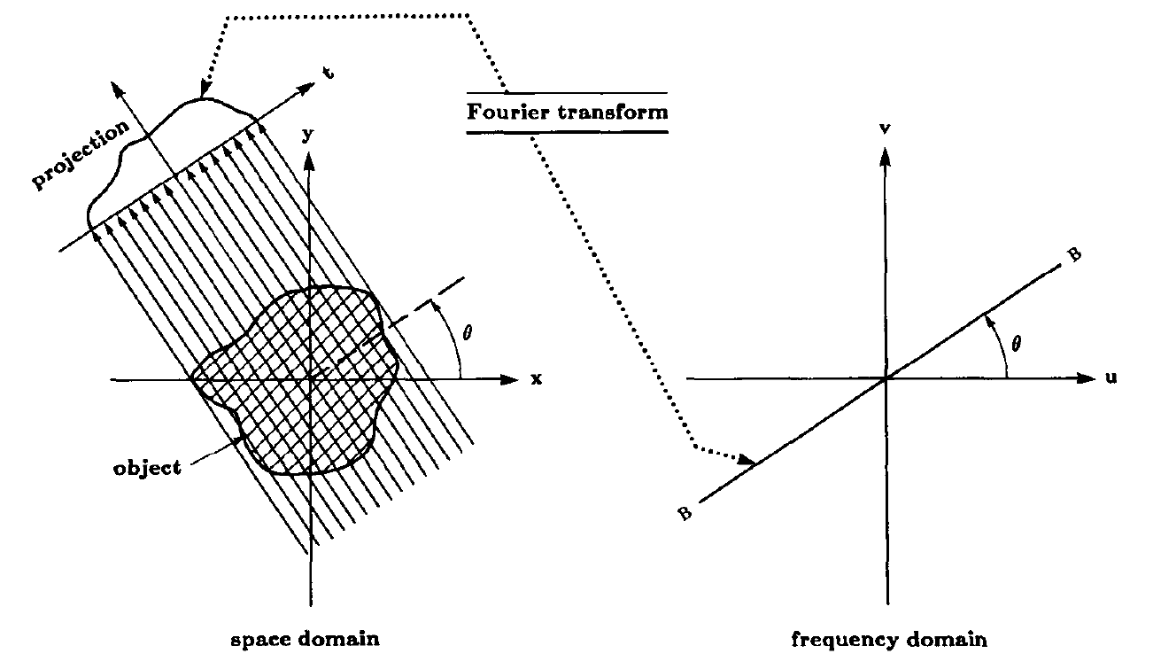
Along Any Direction

Slide 25
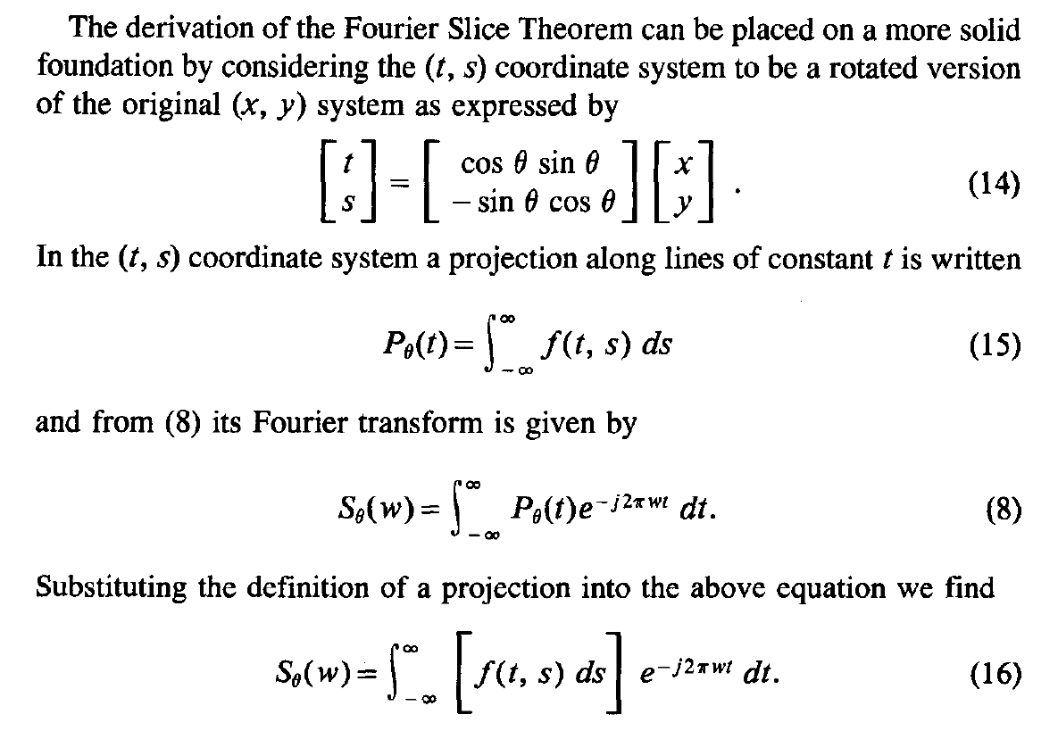
Fourier Slice Theorem

Slide 26
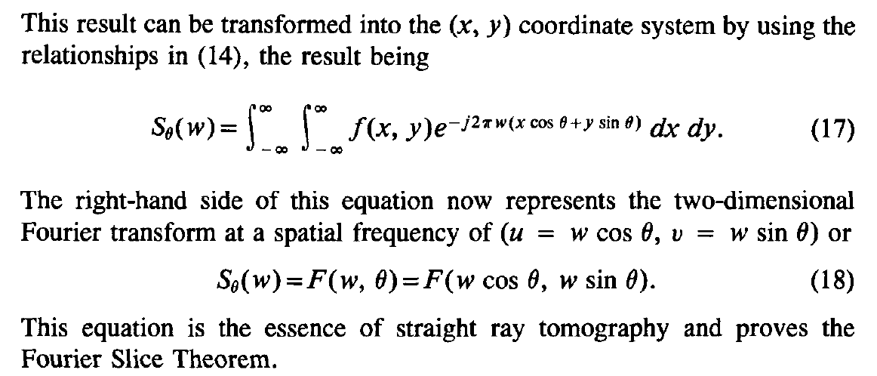
Fourier Slice Theorem

Slide 27
From Projections to Image
F⁻¹[F(u,v)]
y
v
x
u
f(x,y)
P(θ,t)
F(u,v)
X-ray data are essentially samples in the Fourier space, and image reconstruction can be done via inverse Fourier transform!

Slide 28
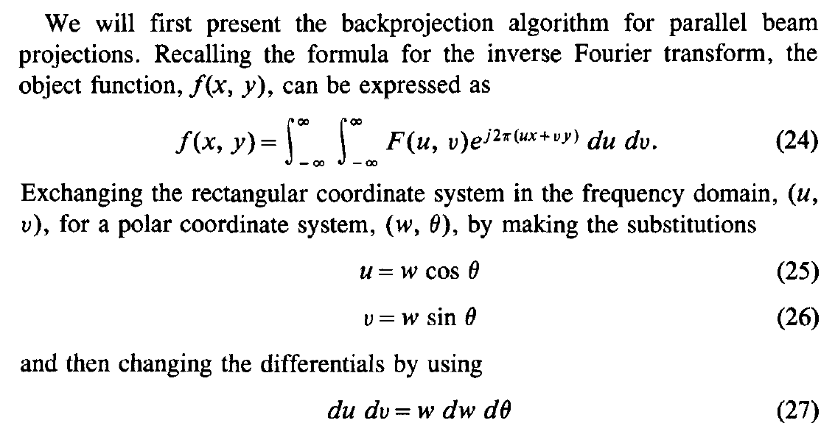
Filtered Backprojection
The idea is to express f(x,y) in terms of the Fourier transform in polar coordinates

Slide 29
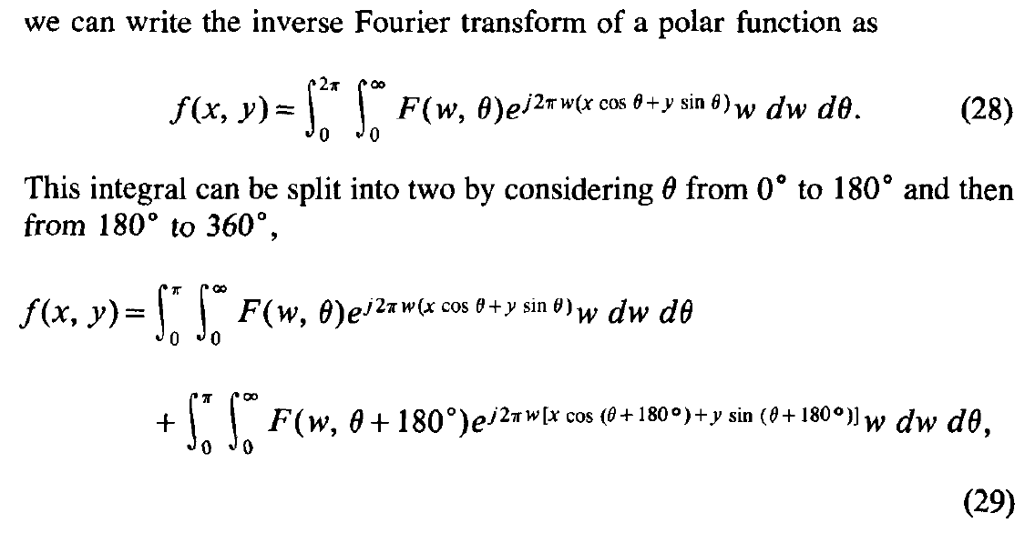
Filtered Backprojection
Half-scan over 0-180 Degrees Gives Sufficient Information for Image Reconstruction

Slide 30
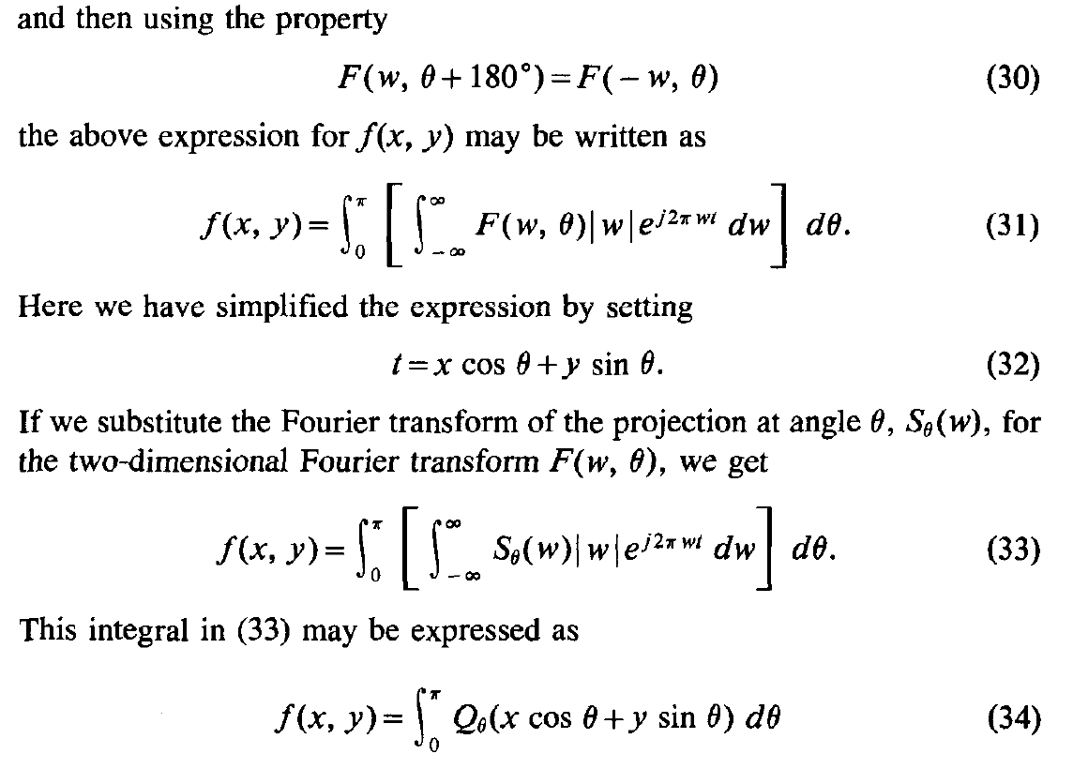

Filtered Backprojection

Slide 31


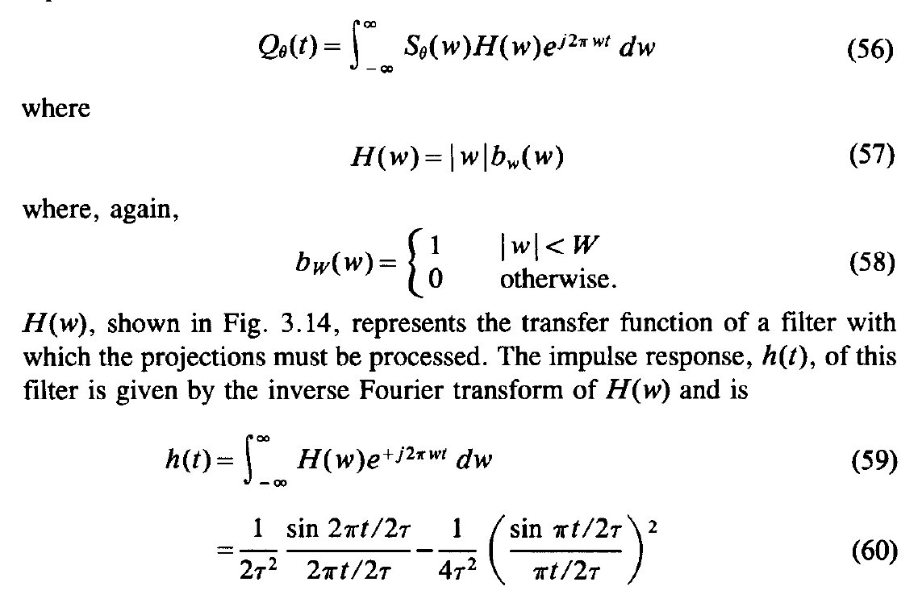
Ramp Filter

Slide 32
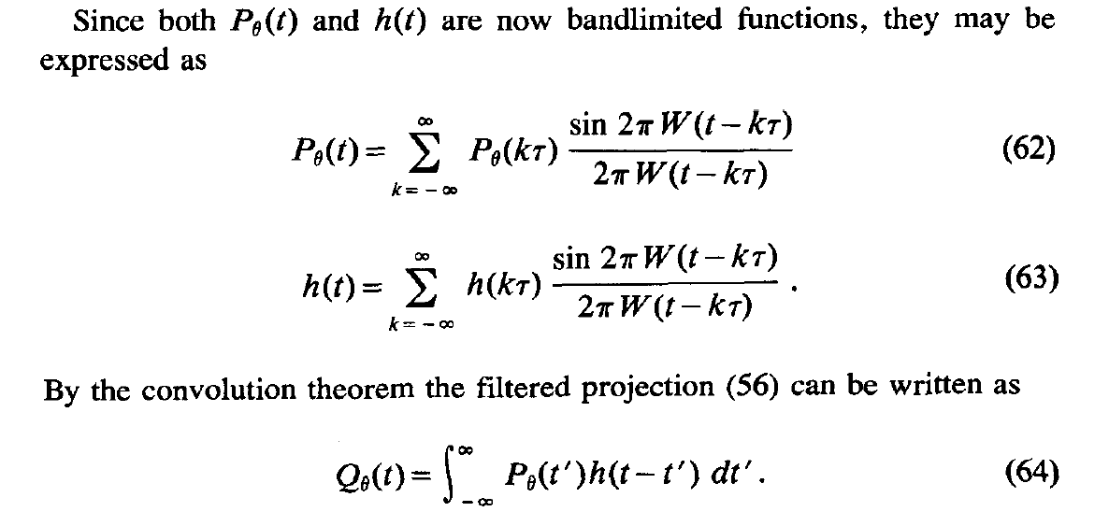
Bandlimited Expression

Slide 33
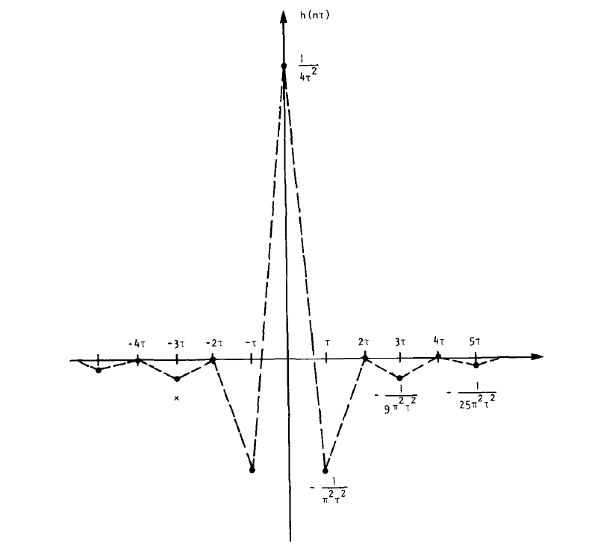
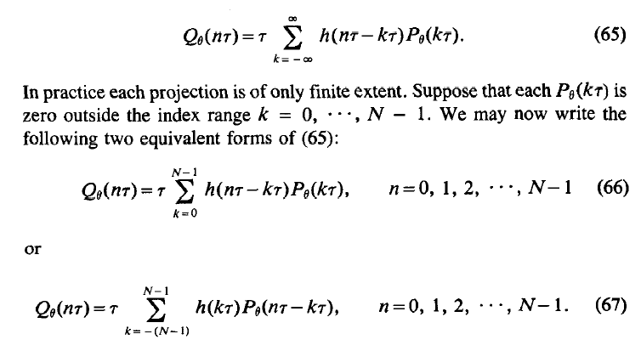
Digital Filtration

Slide 34
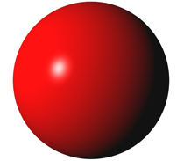
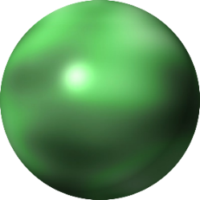
2D Fourier Transform
Extended Fourier Slice Theorem
3D Fourier Transform
Fourier slice theorem can be generalized into other forms… …

Slide 35
Analytic Approach
Convert X-ray data into the Fourier/Radon space
Invert the Fourier/Radon transform according to a closed-form formula
In the reconstruction process, some filtering/processing steps may be used
Noise/incompleteness/inconsistency may induce stronger artifacts than iterative reconstruction

Slide 36
CT Reconstruction
Duality of Information
Algebraic Approach
Solution Uniqueness
Data Independence/Sufficiency
Analytic Approach
Fourier Slice Theorem
Filtered Backprojection
Examples
Numerical Examples
Clinical Images

Slide 37
Image to Projection
Projection
Image
Sinogram

Slide 38

Backprojection
Projection

Slide 39

Backprojection to Image
Sinogram
Backprojected Image

Slide 40
Filtered Backprojection
P(θ,t)
P’(θ,t)
f(x,y)
f(x,y)
1) Convolve projections with a filter
2) Backproject filtered projections

Slide 41
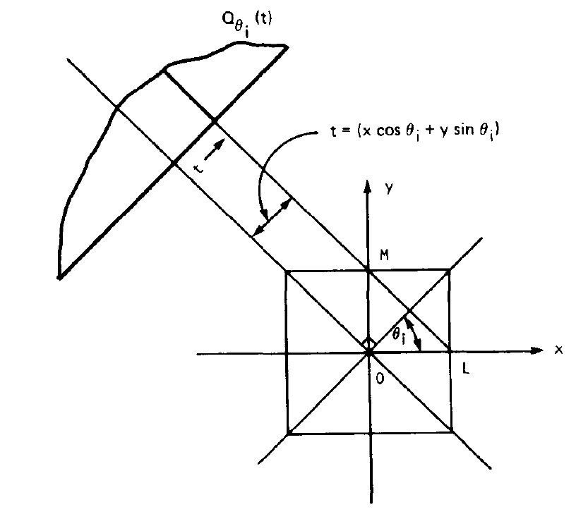
Filtered Backprojection

Slide 42

Projection to Filtered Projection
Sinogram
Filtered Sinogram

Slide 43

Filtered Backprojection to Image
Filtered Sinogram
Reconstructed Image

Slide 44
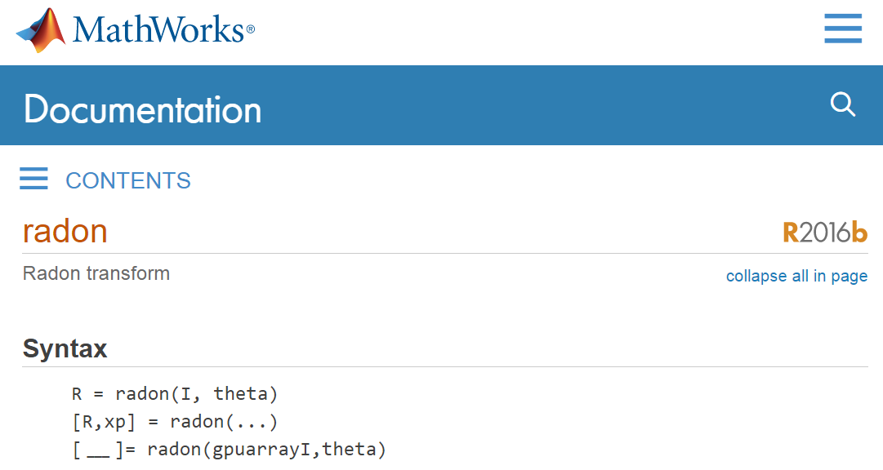
Radon Transform

Slide 45
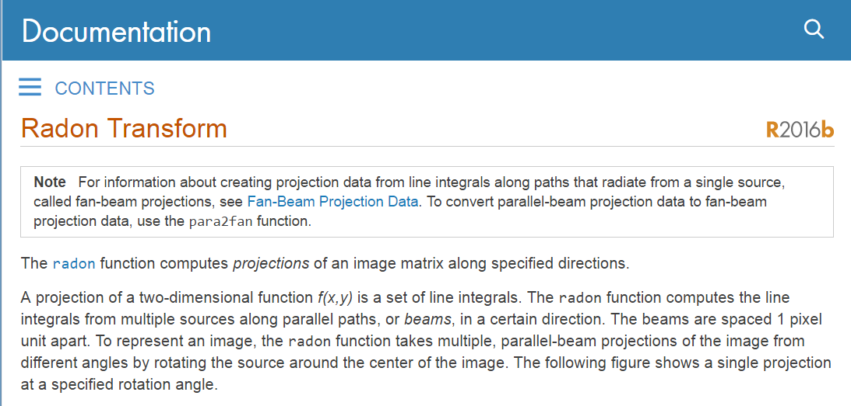
Radon Parameters

Slide 46
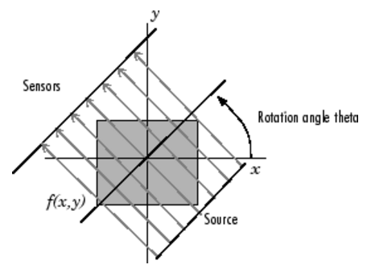
Parallel Beam Geometry

Slide 47
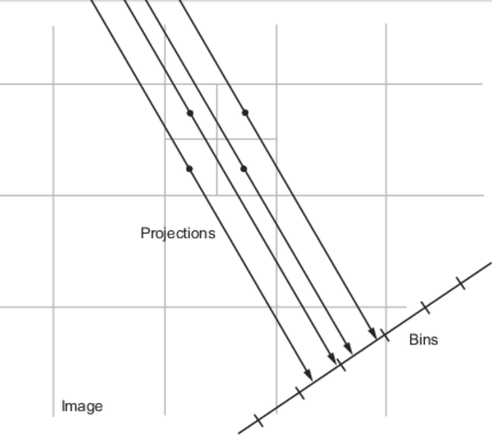
Projection Algorithm

Slide 48

Sample Radon Code
I = zeros(100,100);
I(25:75,25:75) = 1;
imshow(I)
theta = 0:180;
[R,xp] = radon(I,theta);
imagesc(theta,xp,R);
title('R_{\theta} (X\prime)');
xlabel('\theta (degrees)');
ylabel('X\prime');
set(gca,'XTick',0:20:180);
colormap(hot);
colorbar

Slide 49
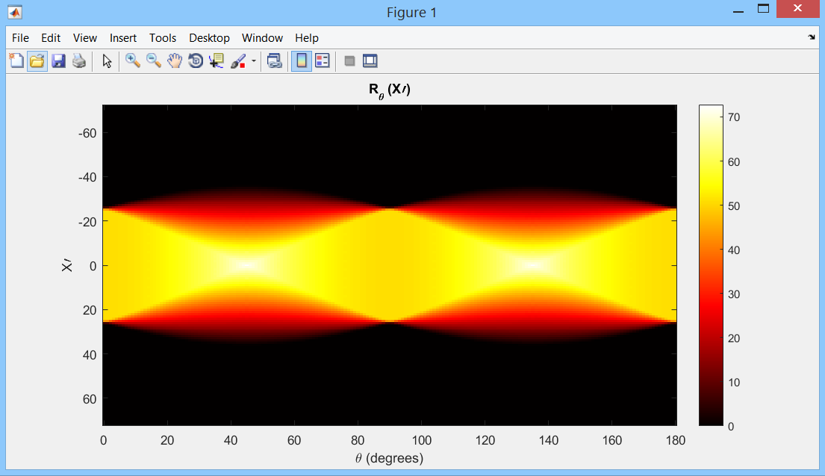
Sinogram Display

Slide 50
Sample iRadon Code
P = phantom(128);
R = radon(P,0:179);
I1 = iradon(R,0:179);
I2 = iradon(R,0:179,'linear','none');
subplot(1,3,1), imshow(P), title('Original')
subplot(1,3,2), imshow(I1), title('Filtered backprojection')
subplot(1,3,3), imshow(I2,[]), title('Unfiltered backprojection')

Slide 51
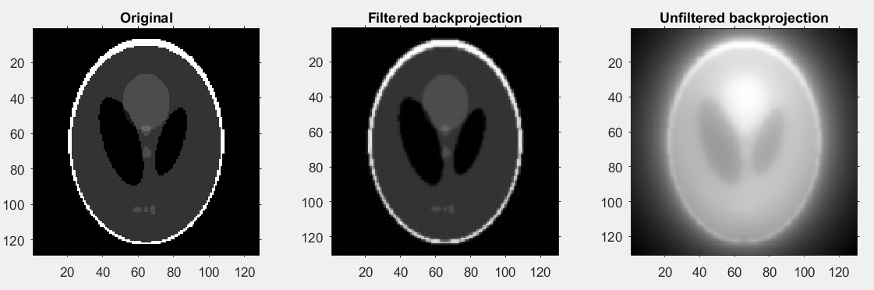
Reconstructed Results

Slide 52
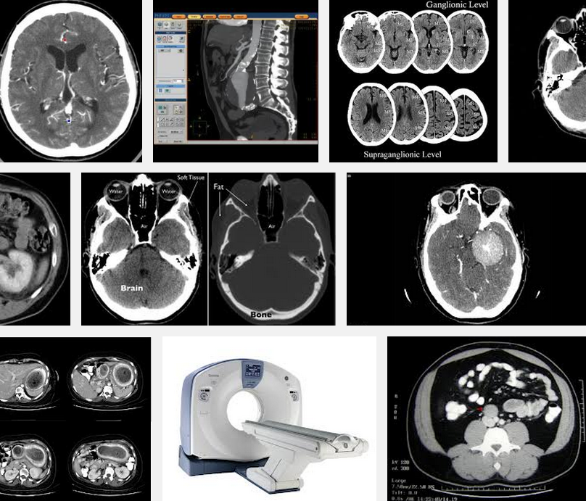
Clinical Examples

Slide 53
BB13 Homework
Read the web page carefully and run the codes on your PC:
http://www.mathworks.com/help/images/radon-transform.html?refresh=true
Then write a similar page with an ellipse as your object (instead of the square).
Use the iradon function to reconstruct your ellipse.
Due Date: Same (Week Later)

