Slide 1

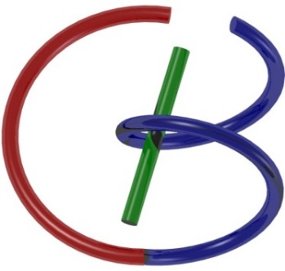
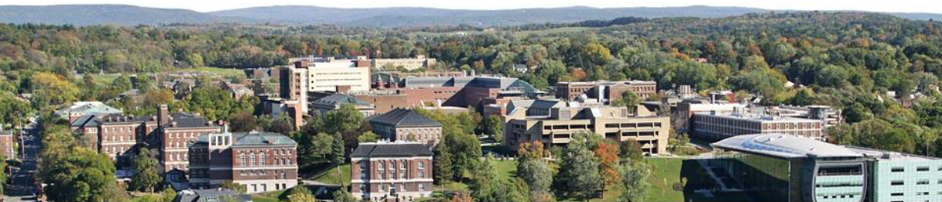
Python, Colab, TensorFlow, &
MNIST Example
Christopher Wiedeman, Huidong Xie, and Ge Wang
wiedec@rpi.edu, xieh2@rpi.edu, and wangg6@rpi.edu
Sept. 10, 2021
Notes:
Hello, since Professor Wang has a conference today out of town, I will give this hands-on introduction based on this PPT we prepared together. As he mentioned last time, we will have deep learning final projects by the end of the semester. Tentatively, we will have five lectures on deep learning hands-on, including this one.

Slide 2
Objectives
Become familiar with Google Colab for hands-on projects, with free GPU
Introduce TensorFlow & basics of deep networks
Use Tensorflow to train a network for digit recognition
You may not able to understand all the details today, but further explanations will be in subsequent lectures
Notes:
In this lecture, I am going to introduce some basic python coding knowledge, and some useful python packages I use frequently for machine learning and medical imaging. After this class, you would be able to write a deep-learning program that is able to recognize your hand-written digits. By the end of this class, you can try to write some digits using your computer and see if trained network can recognize the digits you write.
We will use Google Colab for our deep learning projects in this course. And it provides free GPU for us. Google account is required. Colab is super easy to use, to install necessary packages. There is no need to install anything on your computer.
If you have any problems, feel free to stop me and ask.

Slide 3
Outline
Foundation of Deep Learning
MNIST Demo on TensorFlow
If you have not used Python before, you will still be able to follow this lecture but we suggest to watch a Python tutorial such as https://www.youtube.com/watch?v=_uQrJ0TkZlc

Slide 4
Deep Neural Network
DNN can be simply viewed as an architecture implementing a mathematical function that maps an input to an output
DNN learns from examples/data, and then slowly adjusts their parameters to approach the desired output

Slide 5
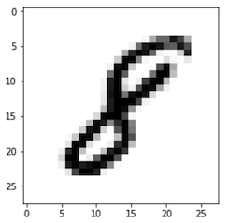

Digit Recognition
$$Before inputting to the neural network, data are in an np array$$
Input
Neural network
Output
8
$$28×28$$

Slide 6
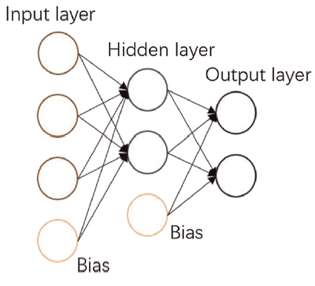
Multi-layer Neural Network

Slide 7
Outline
Foundation of Deep Learning
MNIST Demo on TensorFlow

Slide 8
How to run the MNIST script
Download the files we uploaded to LMS.
Open ‘hands_on_1_lecture.ipynb’ and choose in Google Colaboratory.
At the upper-left corner, click, “Edit->Notebook ‘settings->choose GPU”.
The network takes a few minutes to train, you will see the testing results.
I am going to explain the script line by line.

Slide 9
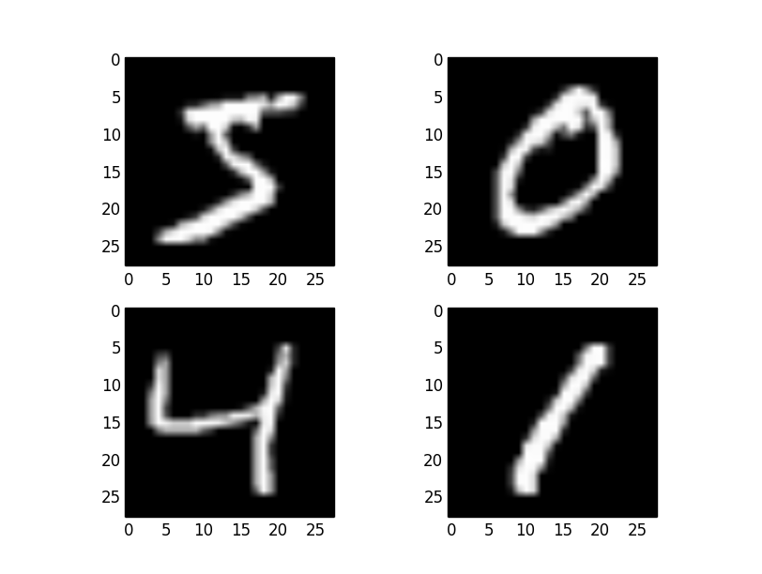
MNIST Dataset
For training a DNN, we want lots of example data
MNIST (Modified National of Standards and Technology database) is a large dataset of handwritten digits.
Training set contains 60,000 images
Testing set contains 10,000 images
All images are of 28*28 pixels

Slide 10
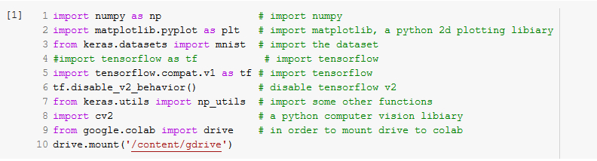
MNIST demo
First, let us import necessary packages:

Slide 11

Data Preprocessing
Then, let us load the dataset directly:
We can check the dimensionalities of x_train, y_train, x_test and y_test respectively, where x_train and x_test contain training and testing images, while y_train and y_test contain training and testing labels.

Slide 12
Data Preprocessing
Often, data must be preprocessed before feeding into the network. In this case, we will:
Distinguish between training and test data
View the data (images) and labels (answers)
Transform both into a format ideal for the network

Slide 13
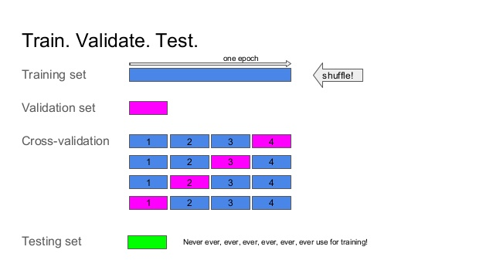
Exemplary Training Cycle

Slide 14
Training, Validation, & Testing
Training dataset is used to train a network
Validation dataset is used to oversee the network during the training process, and to fine-tune hyper-parameters of the neural network
Testing dataset is used to test the performance of the trained network
Three datasets are non-overlapped

Slide 15
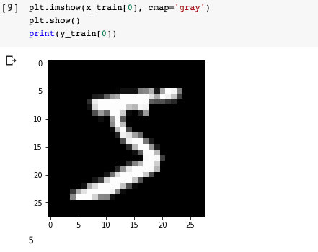
View data (images)
We can display the first digit in the dataset and the corresponding label.

Slide 16
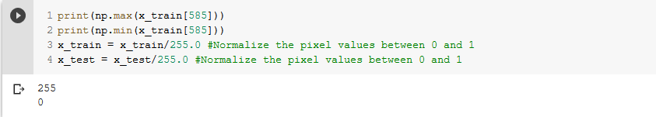
Normalize values to between 0 and 1
Currently, all pixel values are from 0-255.
It is good practice to normalize all inputs into a network from 0-1.

Slide 17
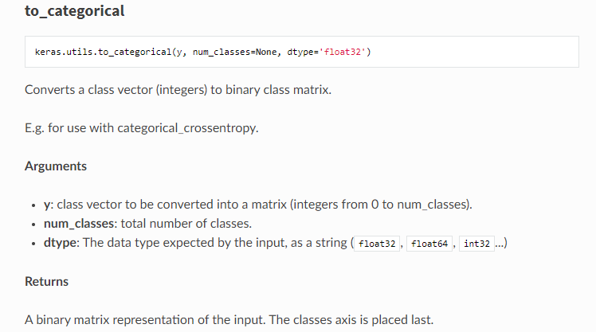
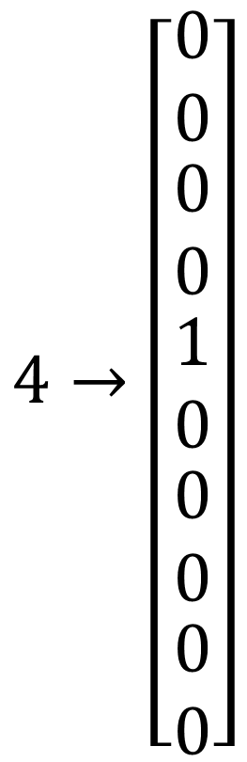
Preprocessing Labels (annotations)
We encode the labels for calculating loss:
$$4→\left[\begin{matrix}\begin{matrix}0 \\ 0\end{matrix} \\ \begin{matrix}0 \\ 0\end{matrix} \\ \begin{matrix}1 \\ 0 \\ \begin{matrix}0 \\ 0 \\ \begin{matrix}0 \\ 0\end{matrix}\end{matrix}\end{matrix}\end{matrix}\right]$$

Slide 18
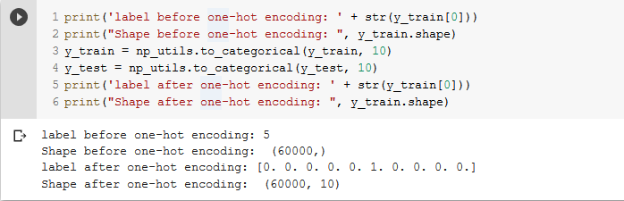
Preprocessing Labels (annotations)
In the network, each value will correspond to a probability of the digit being a number

Slide 19
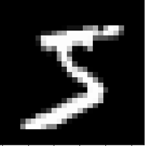
Network structure
Output is a hot vector of 10 elements representing probabilities for 10 digits
Fully-connected+softmax
Fully-connected+ReLU
flatten
28*28
784*1
1*128
10*1
Notes:
This looks like it is missing one of the ‘flatten’ or ‘pooling’ layers at the end to me. I can only count 7 layers (excluding the ‘input’ layer) in this network, but the slide prior shows eight. Also, why does the 2nd conv2d layer not increase the data size by a factor of 128? Is only one filter being applied to each ‘image’ from the previous layer?

Slide 20


Network structure
Units: # of neurons in layer
Activation: Non-linear function performed after a layer.
Notes:
This looks like it is missing one of the ‘flatten’ or ‘pooling’ layers at the end to me. I can only count 7 layers (excluding the ‘input’ layer) in this network, but the slide prior shows eight. Also, why does the 2nd conv2d layer not increase the data size by a factor of 128? Is only one filter being applied to each ‘image’ from the previous layer?

Slide 21
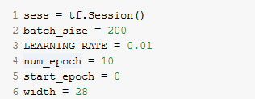
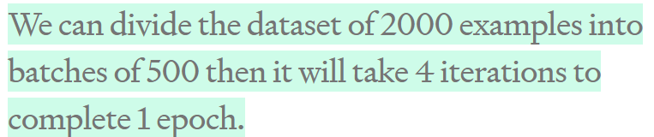
Running a Training Session
Now we must create a session to train the network with training data:
Network completes a training epoch when it cycles though all training data once.
Training occurs in ‘batches’ of examples

Slide 22
Running a Training Session
In tensorflow, we must construct a symbolic graph of operations before executing:
We specify where we will feed in data as ‘placeholders’.

Slide 23
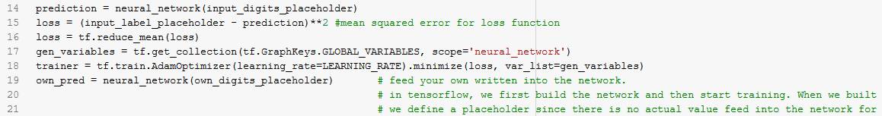
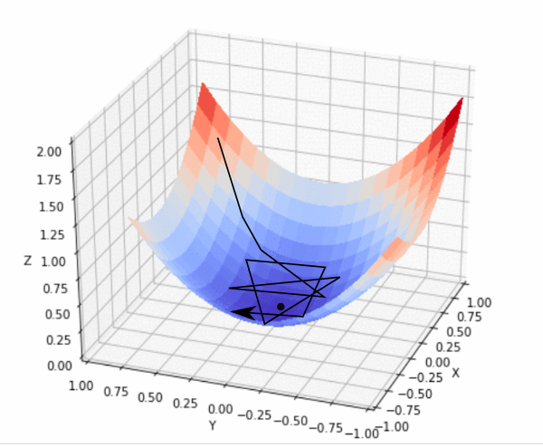
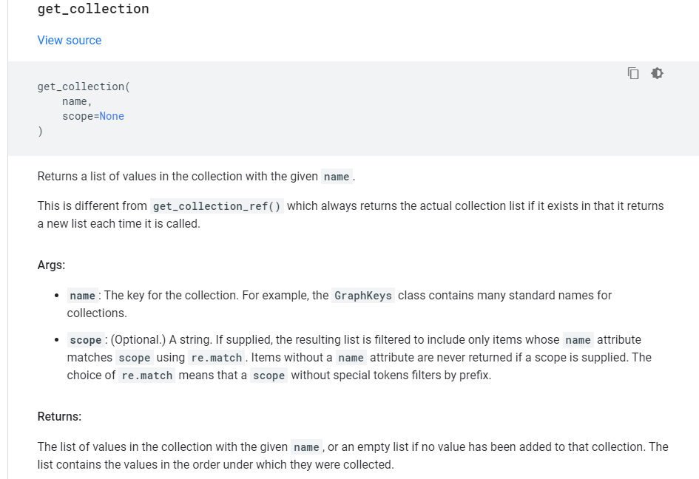
MNIST Demo
Defined a loss function and select an optimizer:

Slide 24
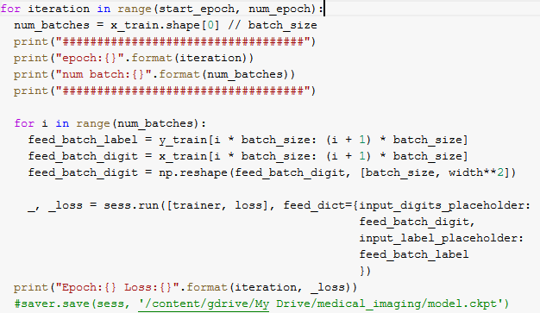
MNIST Demo: Training Part
Create Batch
Flatten image
Training
Print loss per epoch

Slide 25
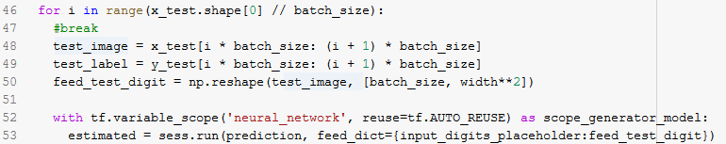
MNIST Testing

Slide 26
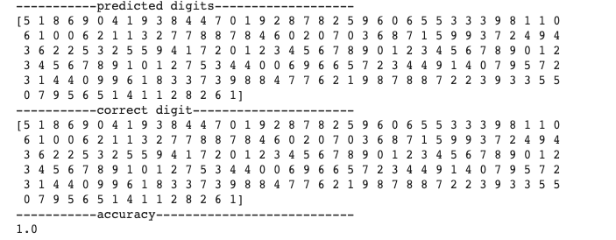
MNIST Test Results

Slide 27



Testing with Your Digits
Let us write some digits using MS Word, name image files as ‘own_3.png’, ‘own_9.png’, etc., and then upload them to the folder we created, ‘bmed6590medical_imaging’. Or you can upload the digits I wrote to your Google Drive.

Slide 28

Writing/Drawing Digits
Draw a digit
Change page color to black

Slide 29
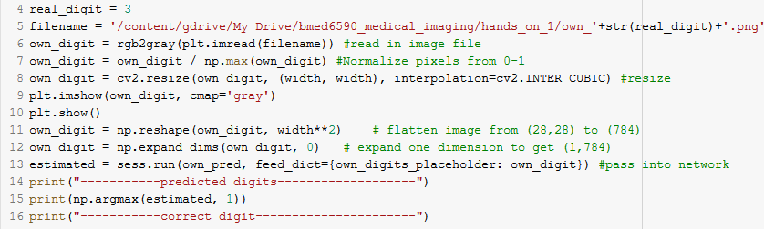
Recognizing Your Digits

Slide 30
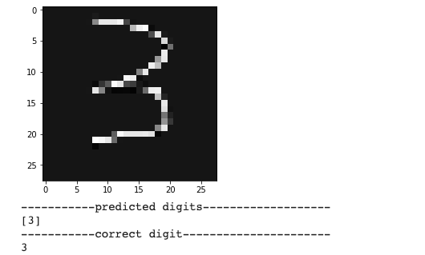
Typical Result

Slide 31
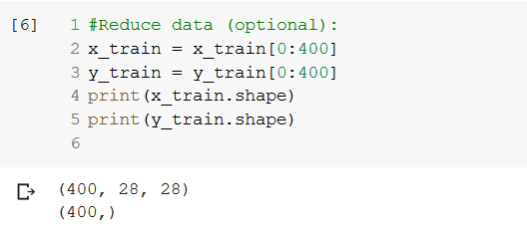
Effect of Lower Training Data
Adequate and comprehensive training data is crucial for good results.
Limited data is a huge challenge in the deep learning field.
Try reducing the training data:

Slide 32
Supervised vs Unsupervised Learning
Supervised learning: We have both input and desired output data in a perfect correspondence. The network is designed to learn a mapping from an input to the matched output. The hope is to predict the output given a new input.
Unsupervised learning: We have input data only without knowledge on their labels. The goal is to model hidden patterns of the input data.

Slide 33
Assignment
Alter aspects of the neural network, data, etc. and report the results. Try to achieve a superior network performance.
Some ideas for alteration:
Network architecture (neurons, layers)
Network activation function(s)
Learning Rate
Number of epochs/batch sizes

Slide 34
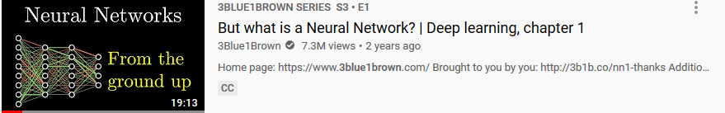
Supplementary Material
https://www.youtube.com/watch?v=aircAruvnKk&t=1s https://www.youtube.com/watch?v=IHZwWFHWa-w&t=656s
https://www.youtube.com/watch?v=Ilg3gGewQ5U
https://www.youtube.com/watch?v=tIeHLnjs5U8
Watch 4-part series on deep-learning

