Slide 1

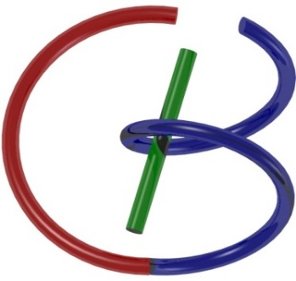
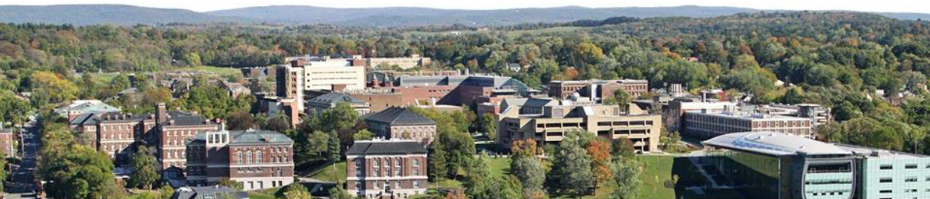
Deep CT Recon & Hands-on 3
Ge Wang
AI-based X-ray Imaging System (AXIS) Lab
Rensselaer Polytechnic Institute, Troy, New York, USA
Oct. 5, 2021

Slide 2
MI Schedule for F21
Tue | Topic | Fri | Topic
08/31 | Introduction | 09/03 | Neuron, Network & Backpropagation
09/07 | No Class | 09/10 | Hands-on 1: Python, Colab, & TensorF
09/14 | Architectures & Training | 09/19 | Hands-on 2: MNIST Classification
09/21 | Image Quality I | 09/24 | CT Physics
09/28 | CT Reconstruction | 10/01 | Deep CT Reconstruction
10/05 | Hands-on 3: CT Networks | 10/08 | More CT Contents
10/12 | MRI Physics | 10/15 | Spin-Echo
10/19 | K-Space Theorem | 10/22 | More MRI Contents
10/26 | Mid Exam | 10/29 | Deep MRI Reconstruction
11/02 | Hands-on 4: MRI Networks | 11/05 | Nuclear Physics
11/09 | Nuclear Imaging | 11/12 | US Imaging
11/16 | Optical Imaging | 11/19 | Multimodality Imaging
11/23 | Hands-on 5: Image Conversion | 11/26 | Thanksgiving
11/30 | Image Quality II | 12/03 | Stability, Interpretability, & Others
12/07 | Overview | 12/10 | Final Exam
Office Hour: Teaching Day 5-6pm: https://rensselaer.webex.com/meet/wangg6

Slide 3
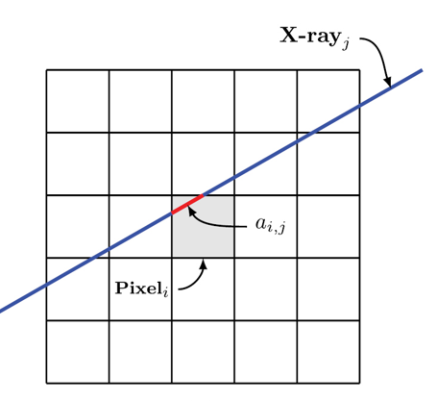
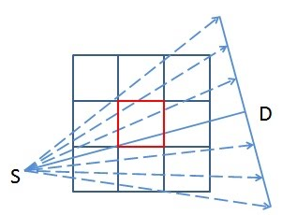
Weighted Contributions
Pixels contributed to a datum with different weights
Error correction-based updates should use the same weights

Slide 4
Generalized: Matrix A & Its Transpose A^{T}
Ax=y
A: m x n (2 x 3)
x: n x1 (3 x 1)
A^{T}y’=x’
A^{T}: n x m (3 x 2)
y’: m x 1 (2 x 1)
x in R³
y in R²
x’ in R³
y’ in R²

Slide 5
Simplified: Matrix A & Its Transpose A^{T}
Ax=y
A: 1 x 2
x: 2 x 1)
A^{T}y’=x’
A^{T}: 2 x 1
y’: 1 x 1
x in R²
y in R
y’ in R
x’ in R²

Slide 6
Specified: Matrix A & Its Transpose A^{T}
Ax₁+bx₂=y
A: (a b)
x: (x₁ x₂) ^{T}
ay’=x₁’
by’=x₂’
A^{T}: (a b)^{T}
y’
x
y
y’
x’

Slide 7
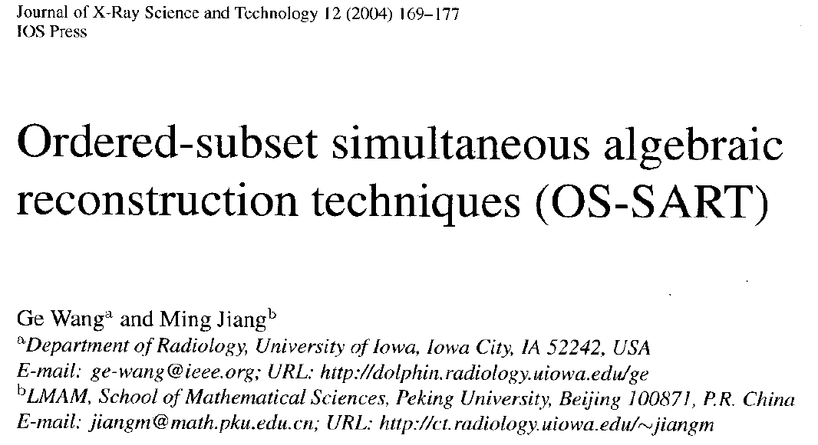
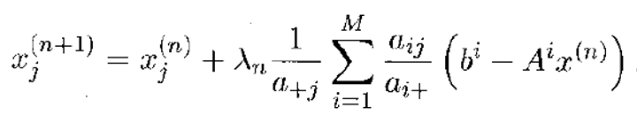
Heuristically-derived SART Formula
Relative Contribution Weight
Error
Relative Rectifying Factor

Slide 8
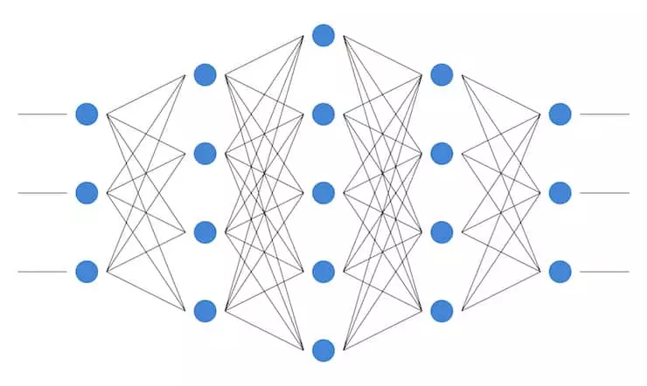
AUTOMAP with $O\left(N^{4}\right)$ Complexity
$O\left(N^{3}×N_{v}\right)$ Complexity
$N:$# of Data or Pixels per Row
$N_{v}:$# of views
Reshape
To a Vector
$$3×3$$
k-space Data
FC Layers to All Pixels
$3×3$ Image
Zhu B, Liu JZ, Cauley SF, Rosen BR, Rosen MS: Image reconstruction by domain-transform manifold learning. Nature 555:487–492, 2018
Notes:
In the literature, only a few deep-learning methods were proposed for reconstructing medical images directly from raw data. AUTOMAP, published last year on Nature, is the first work trying to learn the reconstruction process. N denotes the dimension of reconstructed image. AUTOMAP use 3 fully-connected layers to the the mapping between raw k-space data to a corresponding MRI images. The basic idea of AUTOMAP could be illustrated here. Due to the intrinsic relation between frequency domain and time domain, every pixel in k-space domain is related every pixel in image domain. Fully-connected layer is able to learn this relation. Without a doubt, similar idea could be applied to CT since sinograms and images are also correlated. If we directly apply AUTOMAP for CT applications, the complexity would be $O\left(N^{3}×N_{v}\right)$. N_v donotes the number of view. There are two problems if we use AUTOMAP for CT: 1. Due to the large computational complexity, AUTOMAP is not able to train normal size CT images on modern GPUs. In the AUTOMAP paper, authors used 128*128 images. 2. FC layers imply that all the pixels in both domain are correlated, but this is not the true for CT. In CT imaging, x-ray are used to take line integral at various angle, so a single point in the sinogram only relate to a line in the field of view.

Slide 9
iCTNet with $O\left(N^{2}×N_{c}\right)$ Complexity
FC
$3×3$ image
FC
$3×3$ final output
$4×3$ sinogram
$4α×3$ sinogram
$3×3$ image
*Li, Y., Li, K., Zhang, C., Montoya, J. and Chen, G., “Learning to Reconstruct Computed Tomography (CT) Images Directly from Sinogram Data under A Variety of Data Acquisition Conditions,” IEEE Transactions on Medical Imaging, 1–1 (2019).
Notes:
The second work trying to learn the reconstruction process is the iCTNet published on IEEE transaction on medical imaging this year. N_c denotes the number of detectors. The overall idea of iCTNet can be summarized here. Assume a CT scanner with 3 detectors and 4-view sinogram is acquired. iCTNet contains a total of 12 layers, in the first 8 layers, convolutional layers are used to de-noised sinogram, and to learn the interpolation process, generating a learned full-view sinogram with number of view $4α$, where$α$ is a hyperparameter in iCTNet. Then, instead of feeding the whole sinogram into one large FC layer, iCTNet feeds projection at each angle in to a small FC layer, thereby reducing the computation burden. Rotation operations are used to synthesis the analytical FBP method and then one convolutional layer is used to combine all the images at different angle, generating final output.

Slide 10
Our Key Idea: Smart BP with $O\left(N2\right)$ Complexity
Learned Filtered Projection
Smart Backpropagation with Learned Weights Restricted to a Single X-ray Path

Slide 11
Our Key Idea: Smart BP with $O\left(N\right)$ Complexity
Learned Filtered Projection
Smart Backpropagation with Learned Weights Restricted to a Single X-ray Path
Notes:
Our method is able to learn the reconstruction process as low as O(N) parameters. As illustrated here, blue boxes represent a 3*3 CT image, and 2 projections are acquired at the angles shown here. Yellow dots represent points in the acquired projections. AUTOMAP assumes that these 6 dots are related to all 9 pixels. iCTNet assumes that projection at a particular angle only relates to the back-projected image at this angle. Our method, DNA assumes that every single dot only relates to a single line in the field of view. Which is true for CT scans. And the analytical FBP method also has this assumption. In order words, our method learn the reconstruction process in a point-wise manner. Instead of trying to learn the whole reconstructed image using one large FC layer, proposed method takes a single point as input and tries to learn a single line in the field of view.

Slide 12
Outline
CT System & Scanning
Cone-beam CT
Spiral Cone-beam CT

Slide 13
Data Acquisition System (DAS)
Pre-Collimator
Post-Collimator
Source
Detector
Scattering
Filter
Patient

Slide 14
CT Scanner
Gantry
Source
Display
Control
Console
Table
Computer
Analysis
Detectors
Data Acquisition
System
Storage/Cloud

Slide 15
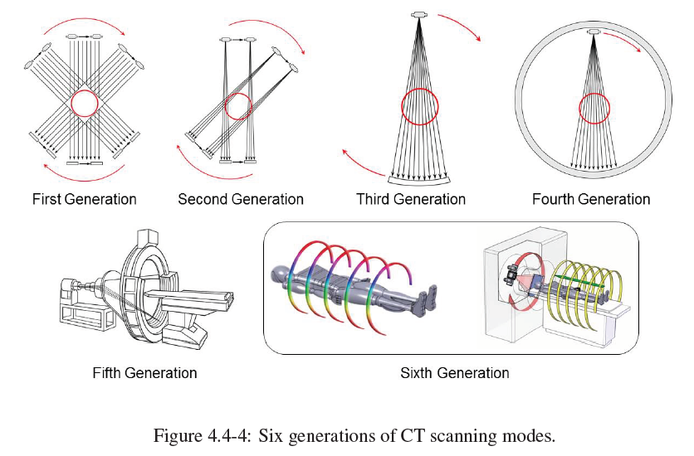
CT Scanning Modes

Slide 16
Outline
CT System & Scanning
Cone-beam CT
Spiral Cone-beam CT

Slide 17
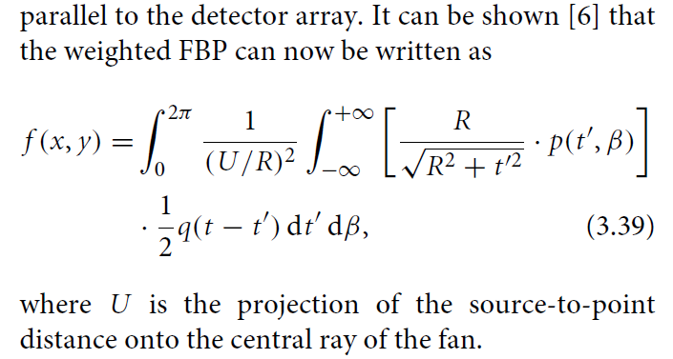

Equi-spatial Fan-beam Formula

Slide 18
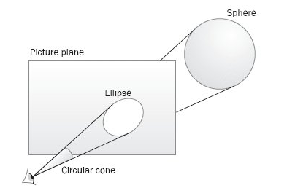
δ(x, y, z) to δ(u,v) with Magnification & Distortion
A cone-beam projection of a 3D delta function is a magnified/demagnified 2D delta function with or without distortion

Slide 19
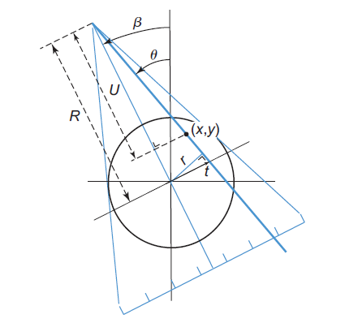
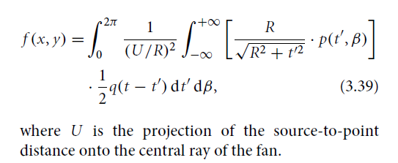
Obliqueness of the Detector Array

Slide 20
Divergence of the X-ray Beam
This Scaling Factor Applies the Same Way from the Opposite View Angles (Generally Speaking, Either Magnified or De-magnified Depending on Which Side)

Slide 21
Difference Between θ & β Angles
For Simplicity, Let Us Only Consider the Impulse (Red) Near the System Origin

Slide 22
From Full-scan to Half-scan
Full-scan Fan-beam Dataset (360˚) Consists of Two Parallel-beam Datasets (180˚)

Slide 23
Cone-beam Geometry
Cone-beam geometry is a natural extension of fan-beam geometry
An order of magnitude improvement of data acquisition speed relative to fan-beam geometry
Object
Source
Detector Plate
Feldkamp LA, Davis LC, Kress JW: Practical cone-beam algorithm.
Journal of the Optical Society of America A 1:612-619, 1984

Slide 24
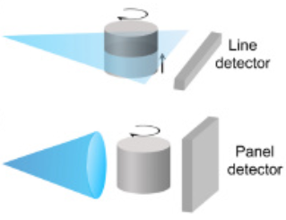
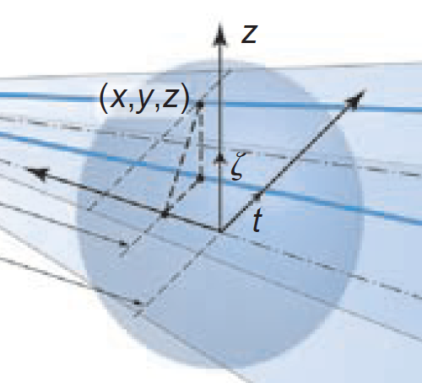
Fan-beam to Cone-beam Projection Data

Slide 25
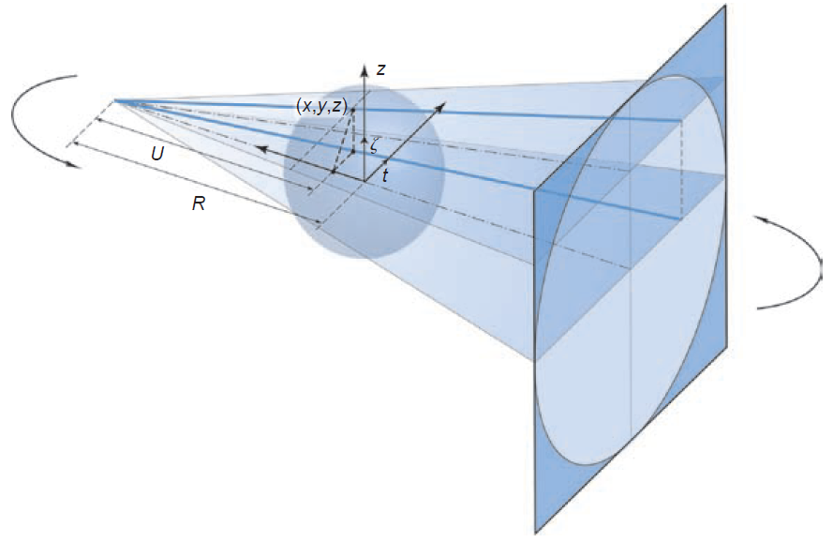
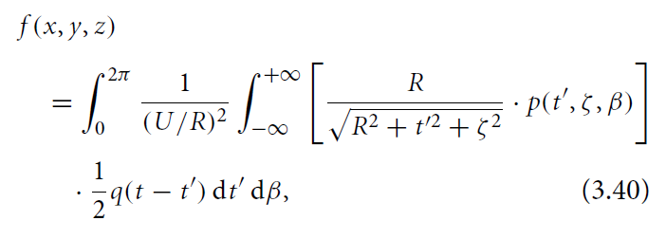
Cone-beam Data Scaled Back
The detector plane mapped onto
the t-z plane
(which is convenient, being consistent to the fan-beam case)

Slide 26
Cone-Beam to Fan-Beam Data (Point-wise)
Tilted fan
Virtual in-plane
X-ray source
γ
Object point
Tilting angle
X-ray source

Slide 27
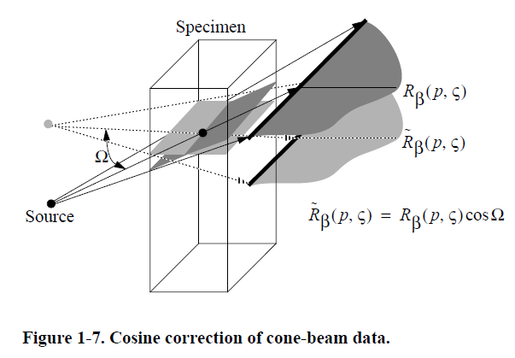
Cone-Beam to Fan-Beam Data (Segment-wise)
Wang G, Zhao SY, Cheng PC: Exact and approximate cone-beam X-ray microtomography (Chap. 1). Focus on multidimensional microscopy (I) (Editors: Cheng PC, Huang PP, Wu JL, Wang G, Kim HG), World Scientific, Singapore, 233-261, 1999

Slide 28
Cone-beam Data Correction
α
β
General Scanning Trajectory
$$\frac{R}{\sqrt{R^{2}+{t′}^{2}+ϛ^{2}}}=\frac{\sqrt{R^{2}+{t′}^{2}}}{\sqrt{R^{2}+{t′}^{2}+ϛ^{2}}}∙\frac{R}{\sqrt{R^{2}+{t′}^{2}}}$$

Slide 29
Obliqueness Correction
An X-ray Hits the 2D Detector Plate Obliquely, Determined by Two Angles
Obliqueness Correction in Fan-beam Formula
Obliqueness Correction in Cone-beam Formula
$$\frac{R}{\sqrt{R^{2}+{t′}^{2}+ϛ^{2}}}=\frac{\sqrt{R^{2}+{t′}^{2}}}{\sqrt{R^{2}+{t′}^{2}+ϛ^{2}}}∙\frac{R}{\sqrt{R^{2}+{t′}^{2}}}$$

Slide 30
Homework
Read papers #4-6 to understand what I explained in the class on iterative and deep reconstruction
Watch the hands-on3 video, do hands-on 3 assignments, and report your experience in deep denoising and deep reconstruction (Network principle, training & testing time, error analysis)

Slide 31
Homework
Please run through all these codes according to the explained steps
Report on your experience in using the post-processing and direct mapping methods, principle summary, training and testing time, error relative to the gold standard.

