Slide 1

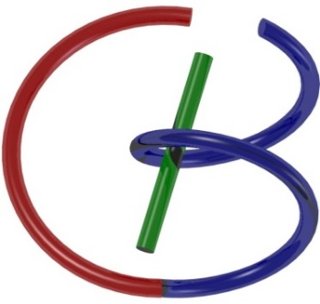
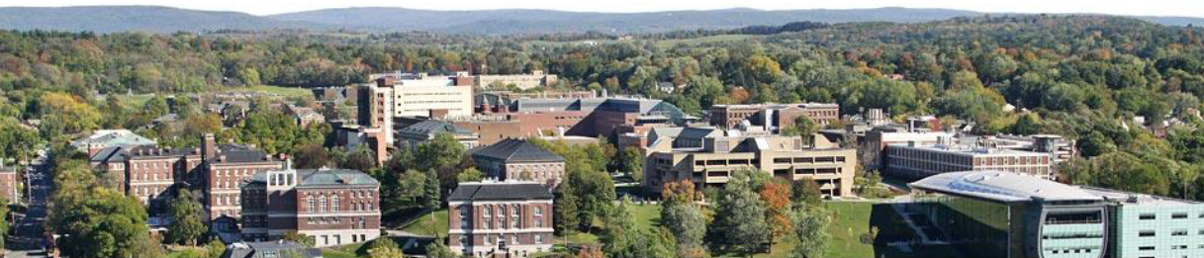
CT Reconstruction – Fan-beam Geometry
Ge Wang
AI-based X-ray Imaging System (AXIS) Lab
Rensselaer Polytechnic Institute, Troy, New York, USA
September 8, 2023

Slide 2
Outline
X-ray Nature
Wave
Particle
X-ray Attenuation
Mechanisms
Beer’s Law
X-ray Tubes/Sources & Detectors
Sources & Detectors
X-ray Radiography
Radiation Dose
Dosimetry
Low-dose CT

Slide 3
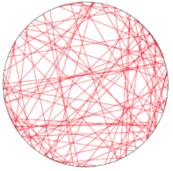
System of Linear Equations

Slide 4
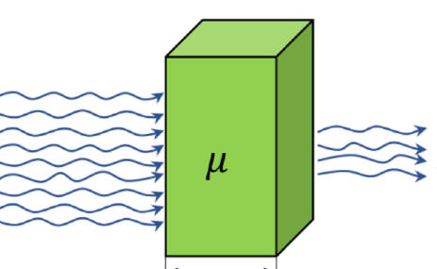
Derivation of Beer’s Law

Slide 5
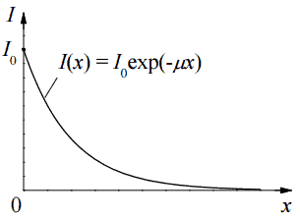
Beer’s Law Gives a Linear Equation
Beer’s Law
$$\int_{−∞}^{∞}{μ\left(x\right)dx} =ln⁡(\frac{I_{0}}{I})$$
$$I\left(x\right)=I_{0}e^{−\int_{−∞}^{x}{μ\left(s\right)ds}}$$
Each beam measures a line integral

Slide 6

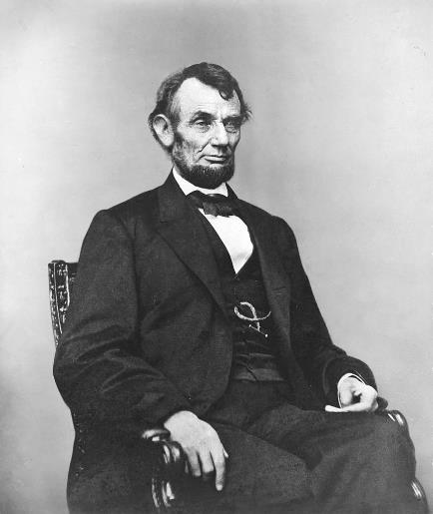
Pixels Are Picture Elements

Slide 7
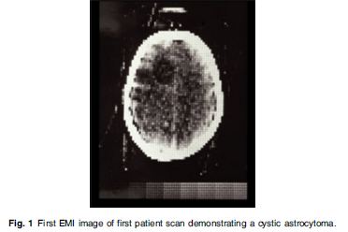
Sum Game
μ₁=4
μ₂=3
μ₃=2
μ₄=1
Practical Problems Involve Many More Unknowns

Slide 8

Parallel-beam Scanning
y
Computed tomography (CT): Image reconstruction from projections
Radon Transform
t
p(θ,t)
t
p(θ,t)
f(x,y)
θ
x
f(x,y)
X-rays

Slide 9
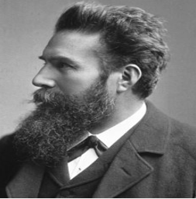
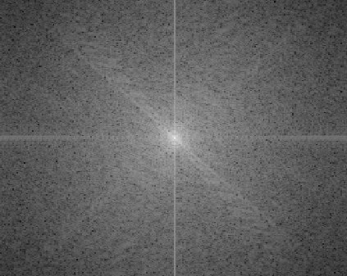

Sinusoidal Waves Are Building Blocks

Slide 10
Fourier Slice Theorem
y
v
p(θ,t)
F[p(θ,t)]
t
No information in line integrals along non-vertical directions
θ
x
θ
u
f(x,y)
F(u,v)
X-rays
Information on horizontal waves are in vertical projection data

Slide 11
Outline
Parallel-beam Case
Fan-beam Case
Heuristic Extension

Slide 12
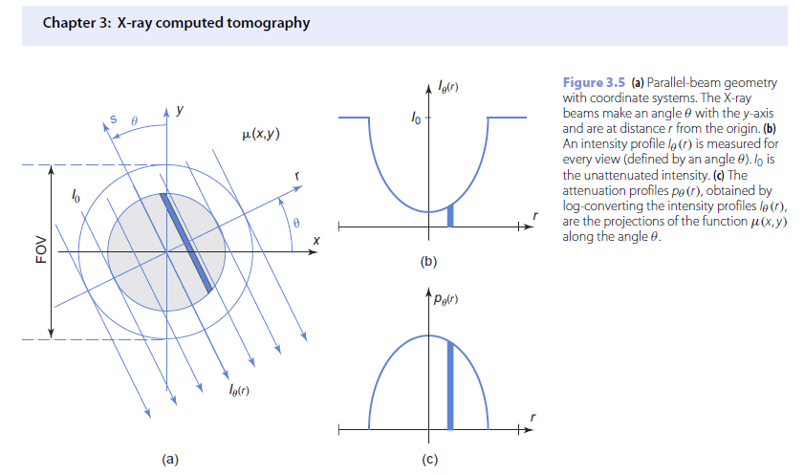
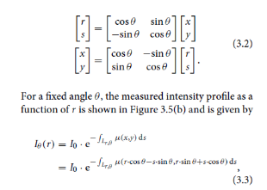
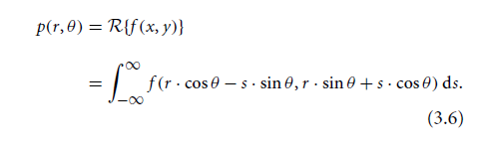
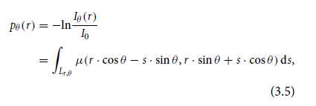

Slide 13
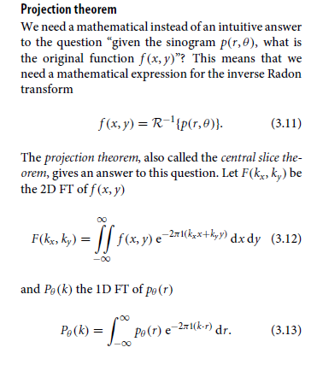
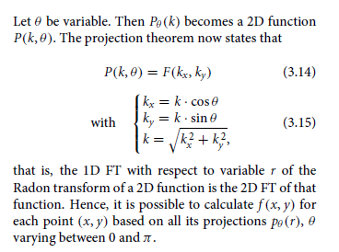
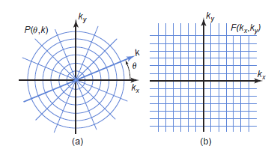
Fourier Slice Theorem

Slide 14
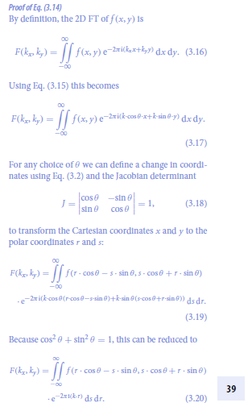
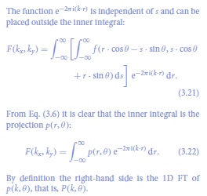

Slide 15
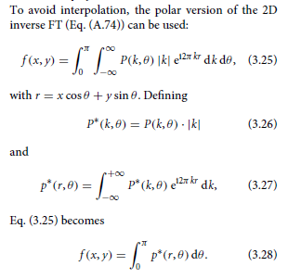
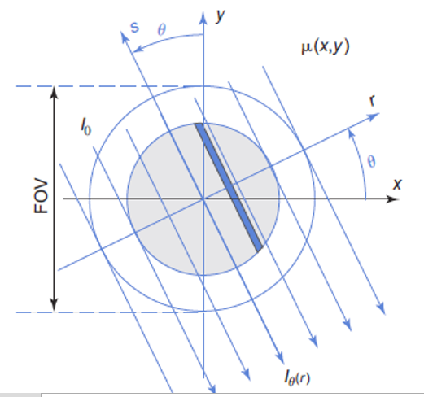
Parallel-beam FBP

Slide 16
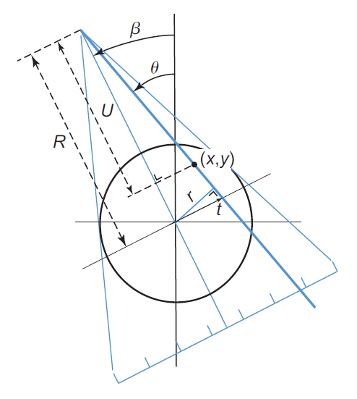
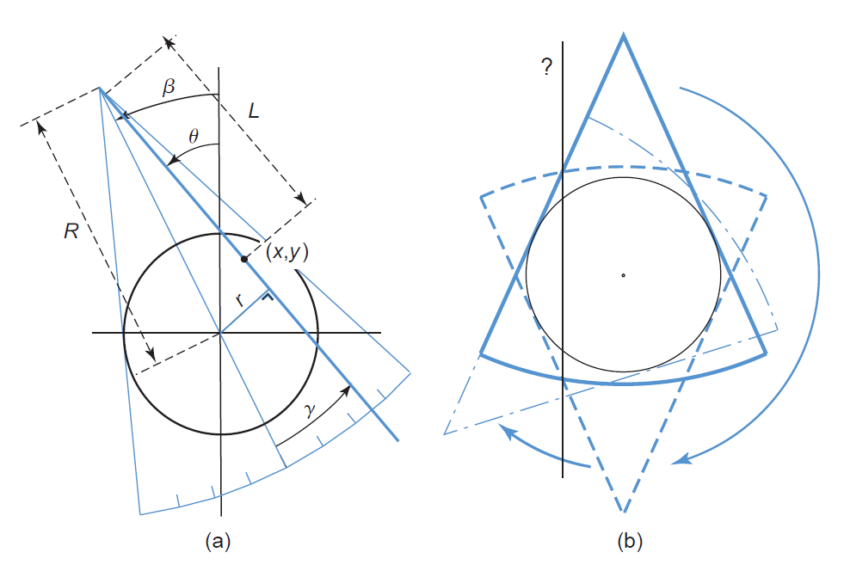
Equi-angular/spatial Fan-beam Geometry
Homework on Half-scan

Slide 17

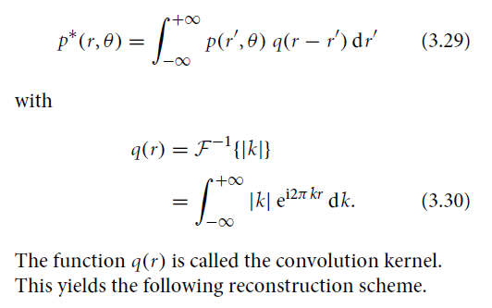
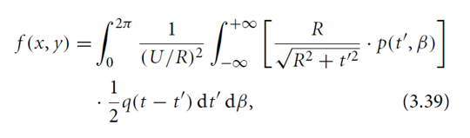
Parallel- to Fan-beam FBP
Parallel-beam
Filtered Backprojection
Key Idea: Convert Parallel-beam Data to Fan-beam Data
Fan-beam
Filtered Backprojection

Slide 18
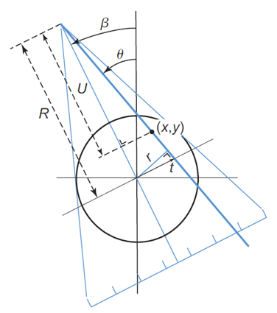
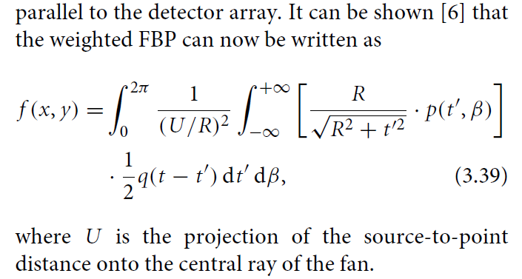

Equi-spatial Fan-beam Formula

Slide 19
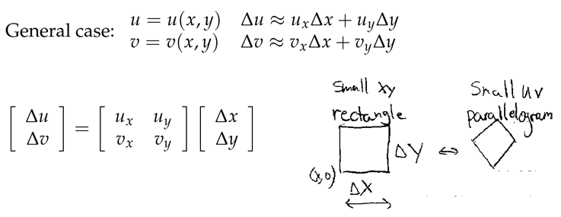
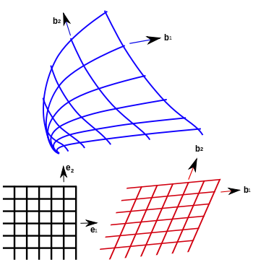
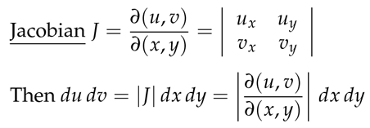
Fan-beam FBP = Parallel-beam FBP
Key Idea: Convert Parallel-beam Data to Fan-beam Data

Slide 20
Fan- to Parallel-beam FBP
Parallel-beam
Filtered Backprojection
Key Idea: Convert Fan-beam Data to Parallel-beam Data or We Do It Heuristically!
Fan-beam
Filtered Backprojection

Slide 21
Heuristics behind the Fan-beam Formula
If you want to see directly the correctness of the fan-beam formula, you can read the rest of the slides.
The key idea is that if we just consider a point object near the system origin, then all the factors in the fan-beam formula becomes immediately clear!
And that understanding is valid no matter the source to the original distance is large or small. Hence, we got a generalized fan-beam formula!

Slide 22
Equi-spatial Fan-beam Formula

Slide 23
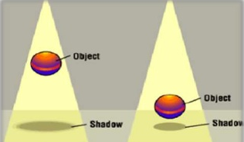
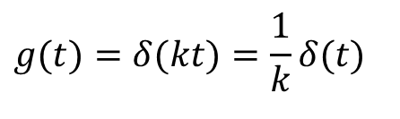



Delta Function on a Scaled Axis
Projecting with a Divergent Beam: The Impulse Becomes Stronger (Larger Area)
$$δ(kt)$$
$$0.5∗t$$
$$g(t)=δ(kt)=\frac{1}{k}δ(t)$$
$$t$$

Slide 24
Delta Function on a Tilted Axis
Projecting onto a Tilted Plane: The Impulse Becomes Stronger (Larger Area)

Slide 25
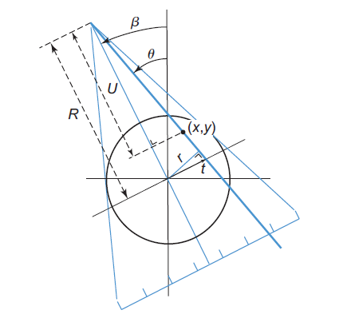
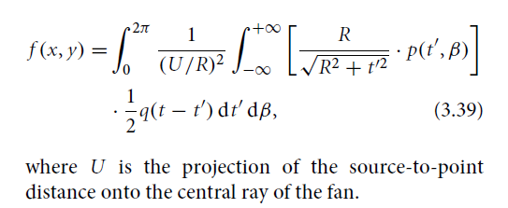
Obliqueness of the Detector Array

Slide 26
Divergence of the X-ray Beam
This Scaling Factor Applies the Same Way from the Opposite View Angles (Generally Speaking, Either Magnified or De-magnified Depending on Which Side)

Slide 27
Difference Between θ & β Angles
For Simplicity, Let Us Only Consider the Impulse (Red) Near the System Origin
Notes:
Note that dtheta and dbeta are both angular weights. Their sums are both 2pi. Hence, we can make weights for dtheta uniform just as the weights for dbeta is naturally uniform. Hence, the results are the same.
Note that dt’ is for equi-spatial fan-beam data, and needs to be converted to parallel-beam dt. Here we have a cosine factor. Also, dbeta and dtheta should be (U/R)*the same cosine factor

Slide 28
From Full-scan to Half-scan
Full-scan Fan-beam Dataset (360˚) Consists of Two Parallel-beam Datasets (180˚)

Slide 29
Equi-spatial Fan-beam Formula

Slide 30
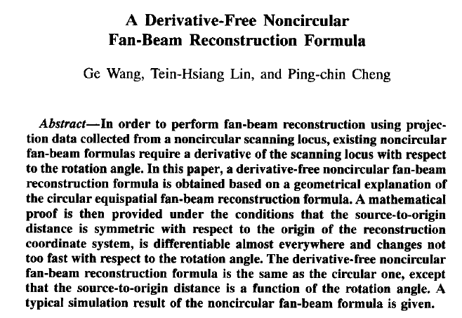
Extended Fan-beam Formula

Slide 31
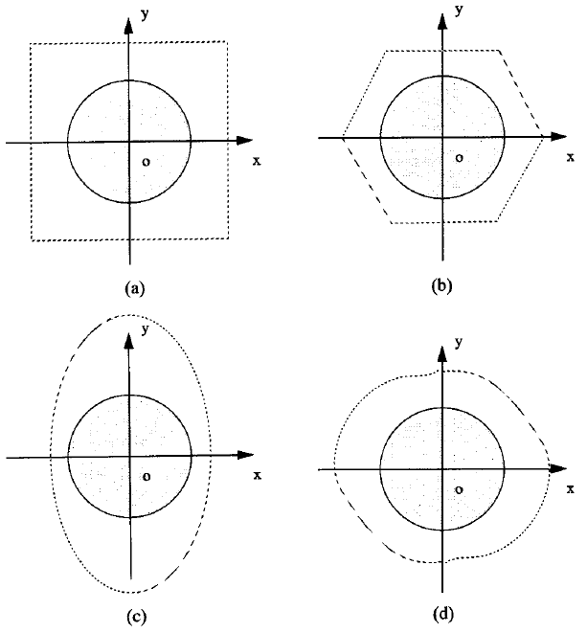
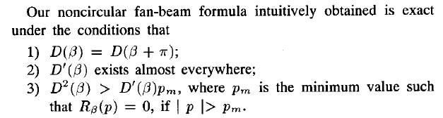
More General Scanning Trajectory

Slide 32



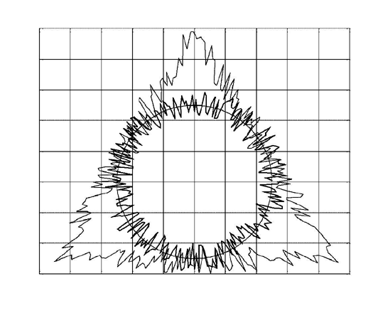
Simulation Results
Circle-like and triangle-like random scanning loci
True slice from the 3D Shepp-Logan phantom
Computed using the circle-like locus
Computed using the triangle-like locus
Effectiveness of the derivative-free noncircular fan-beam reconstruction (256² pixels, 256 projections, 256 detectors)

Slide 33
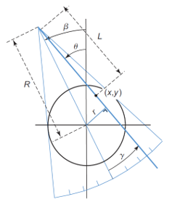
Homework
What is the angular range [0, x] for β so that fan-beam projection data meet the sufficient condition for image reconstruction? In other words, x=?

Slide 34
Homework
There is a mathematical error in my paper, please find it, and email me (I am curious to see who is the first)
https://ieeexplore.ieee.org/document/242365/

