Slide 1
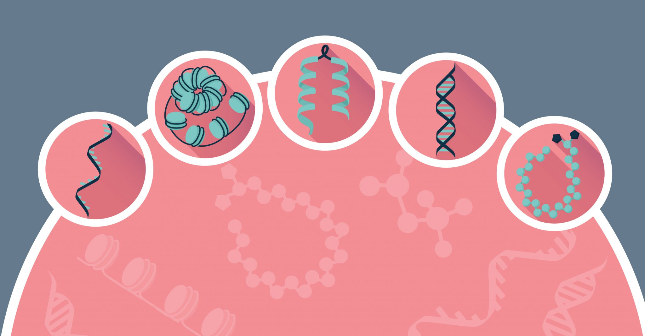
Single cell multi-omics
Clara Tang, Paul Blakely

Slide 2
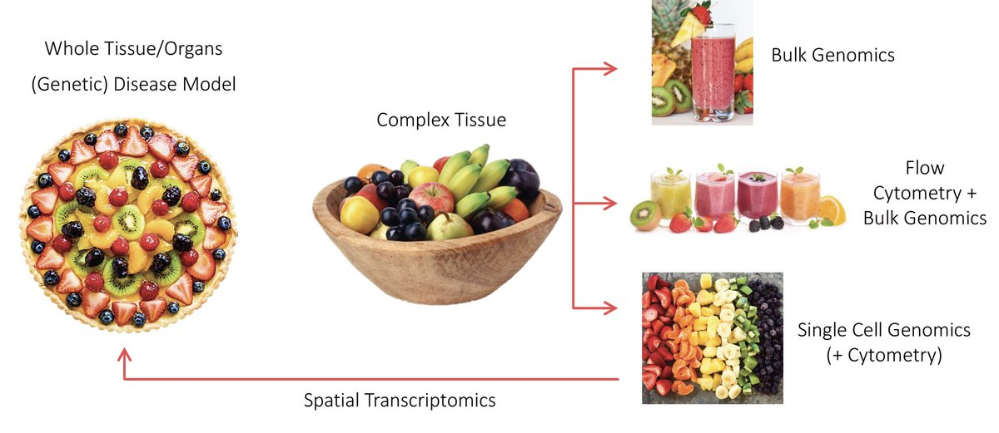

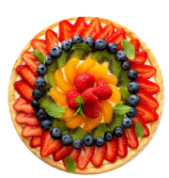
Single cell/nuclei multi-omics
Spatial transcriptomics
RNA-seq
ATAC-seq
ChIP-seq
+Cytometry
After clustering
https://twitter.com/LGMartelotto/status/1186745128615985152

Slide 3
snRNAseq
Extract nuclei from sample of interest
Nuclei are more stable to expression changes from dissociation
Removes transcriptional noise from dead/dying cells
Good for frozen clinical samples (low viability)
Most often used for neuronal samples (difficult to isolate, too large)
Can use fluorescence activated nuclei sorting (FANS) for sorting
Data from nuclei detects fewer genes per cell
Nuclei data has much higher percentage of intronic reads

Slide 4
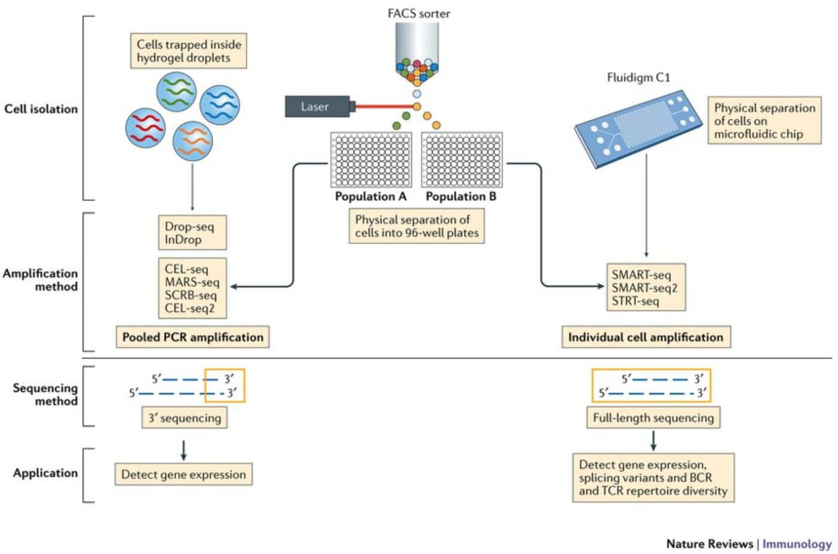
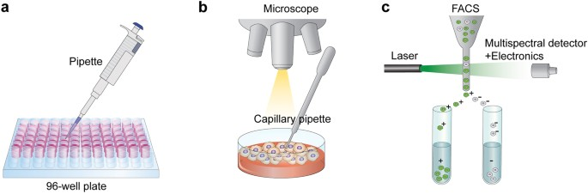
Basics of single cell technology
Single cell isolation
Droplet-based:
Drop-seq
Chromium 10X
Non droplet-based:
Smart-seq/Smart-seq2
https://doi.org/10.1038/nri.2017.76
Notes:
Droplet-based:
tissue sample must be dissociated into suspension
cells will be encapsulated into a water-in-oildroplet individually
high-throughput and low cost
Non droplet-based:
Smart-seq(2): manual cell picking with micro capillary pipettes

Slide 5
Basics of single cell technology
Sequencing method
3’ (or 5’)-end sequencing:
More accurate quantification through use of unique molecular identifiers (UMI) that can help distinguish biological from PCR duplicates
More cells sequenced -> cheaper per cell
Fewer genes sequenced per cell -> drop out
Full length sequencing:
Can detect expression at isoform level
Can detect allele-specific differences in expression
Smaller number of cells but deeper

Slide 6
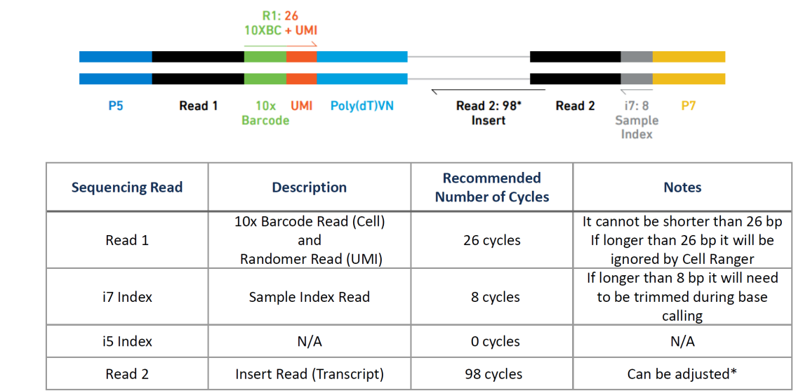
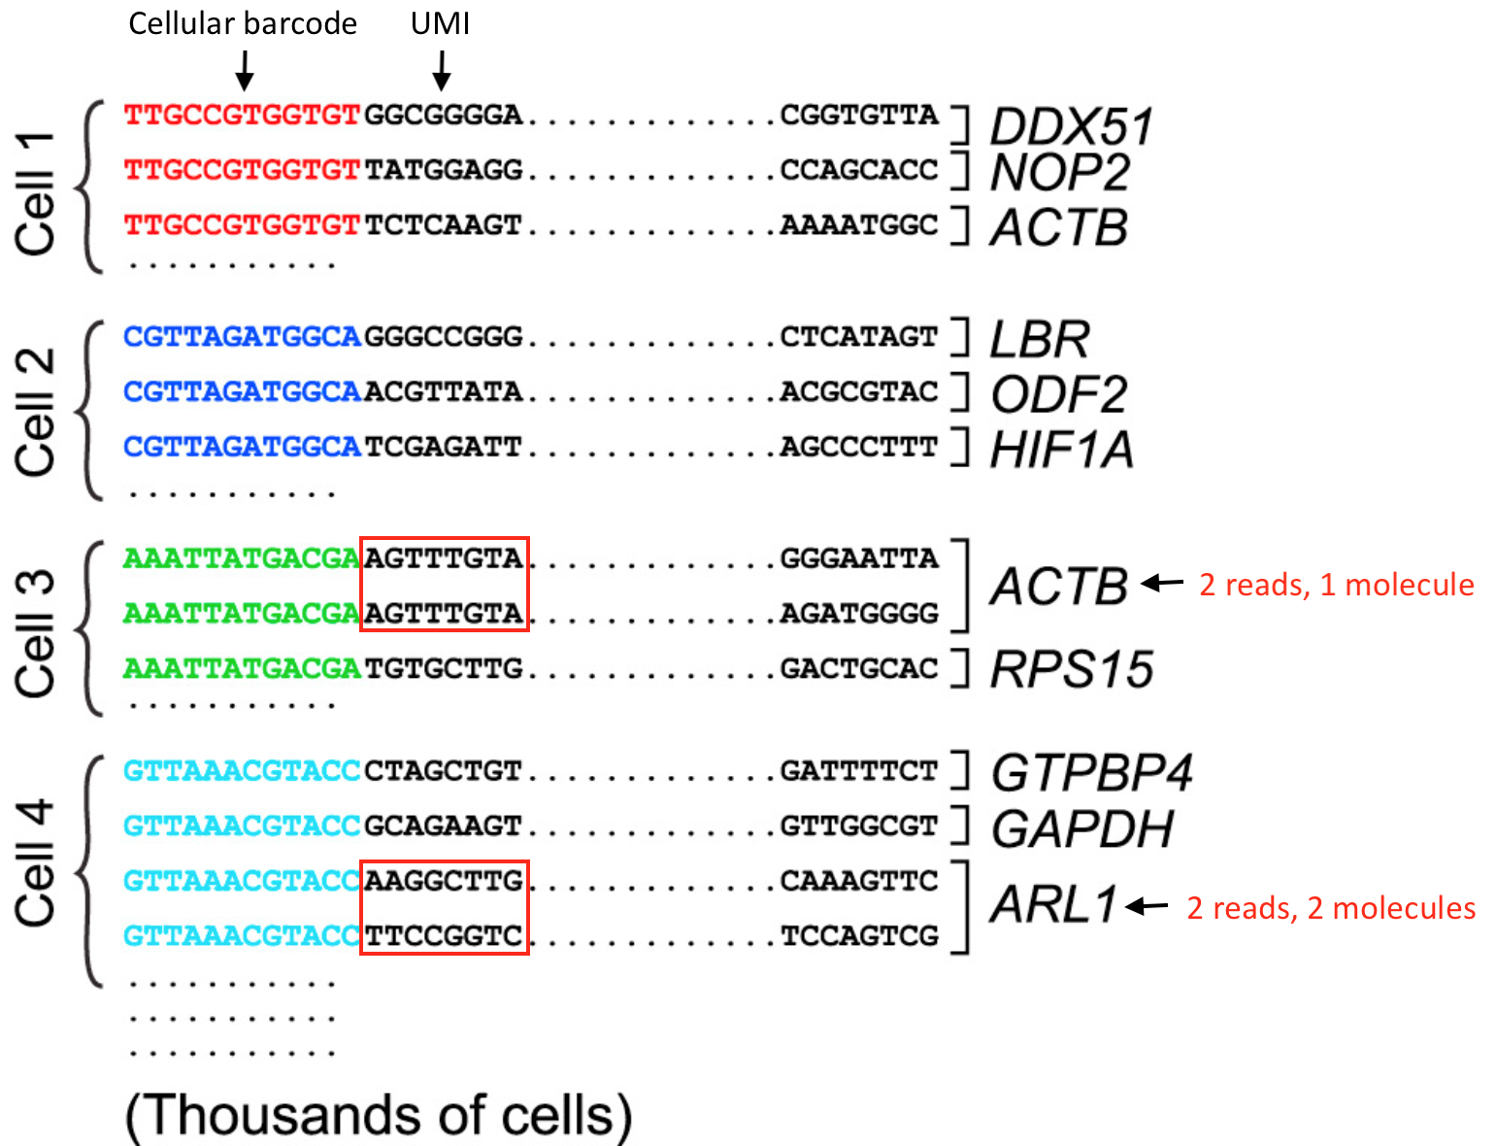
Basics of single cell technology
Library preparation
Barcodes and Unique molecular identifiers (UMI)
Paired-end sequencing output: two fastq files (5’ and 3’ directions)
First read of the pair (R1) contains the barcode + UMI
Second read of the pair (R2) captures the RNA sequence
https://hbctraining.github.io
Notes:
For the 3’-end sequencing methods, reads originating from different molecules of the same transcript would have originated only from the 3’ end of the transcripts, so would have a high likelihood of having the same sequence. However, the PCR step during library preparation could also generate read duplicates. To determine whether a read is a biological or technical duplicate, these methods use unique molecular identifiers, or UMIs.
Reads with different UMIs mapping to the same transcript were derived from different molecules and are biological duplicates - each read should be counted.
Reads with the same UMI originated from the same molecule and are technical duplicates - the UMIs should be collapsed to be counted as a single read.
In image below, the reads for ACTB should be collapsed and counted as a single read, while the reads for ARL1 should each be counted.

Slide 7
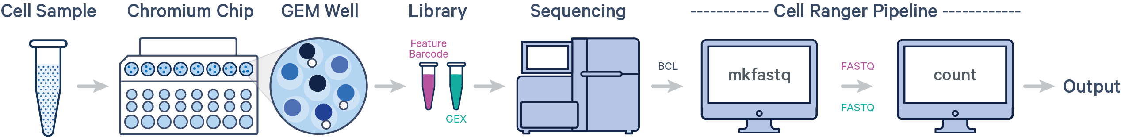
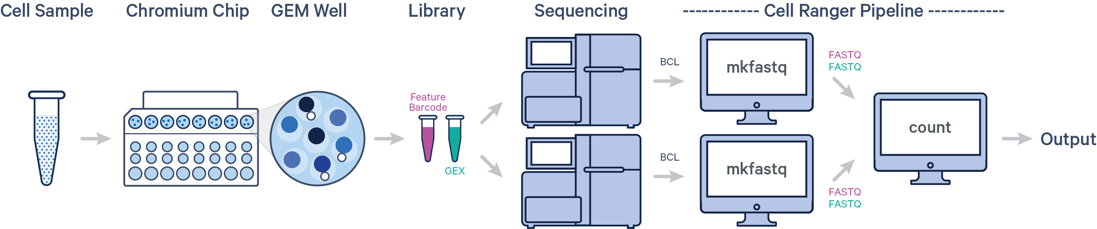
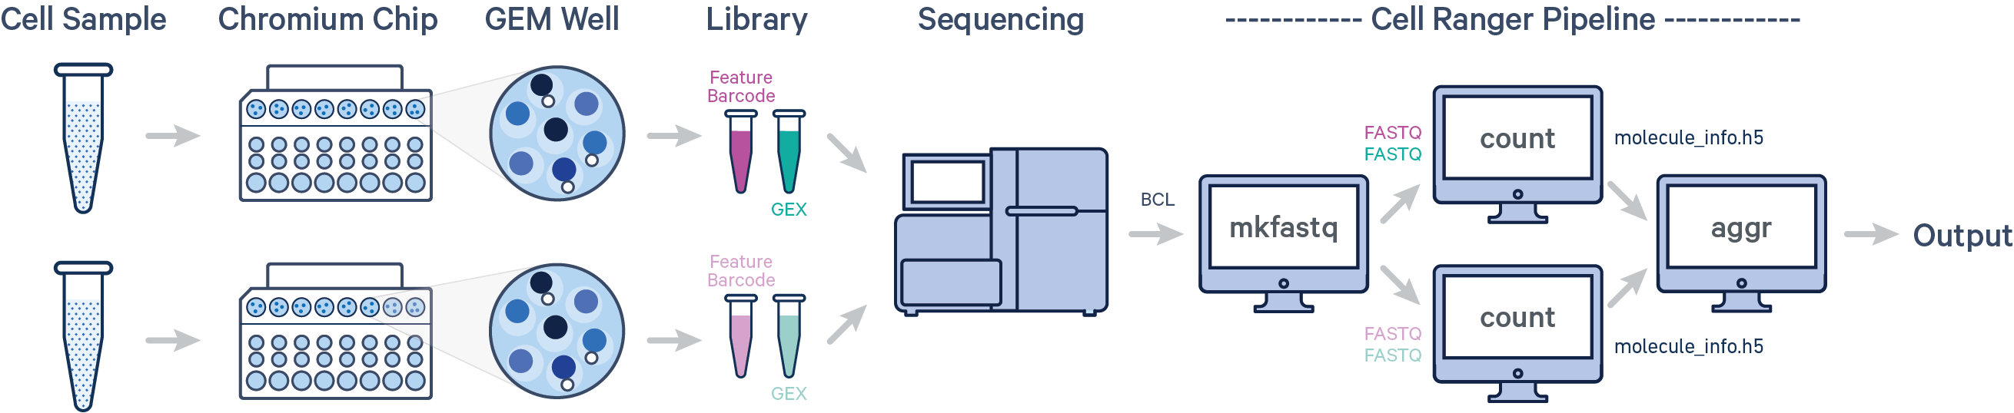
Cell Ranger
Cell Ranger workflow starts with demultiplexing the BCL files for each flow cell directory
One sample, one GEM well, one flow cell
One sample,
one GEM well, multiple flow cells
Multiple samples, multiple GEM wells, one flow cell

Slide 8
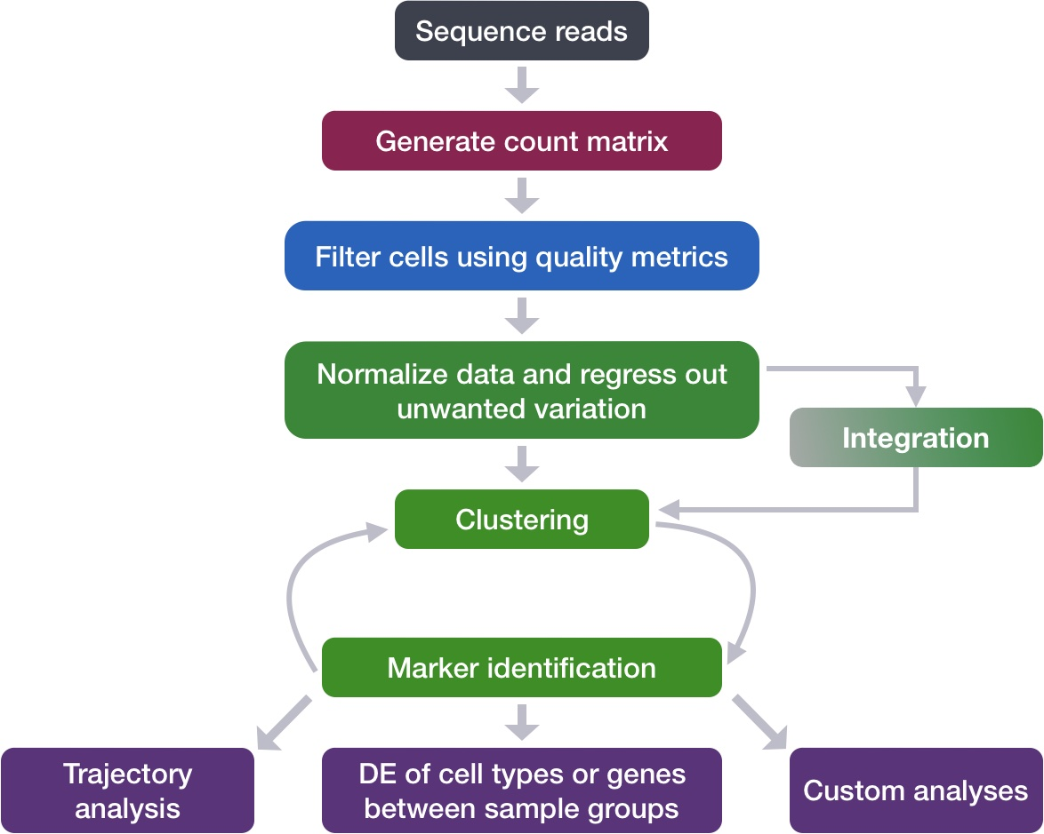
ScRNA-seq workflow
Quality control
Dimension reduction and visualization
Clustering
Integration
Marker identification
Differential expression analysis
Custom analyses …
Seurat in R
Scanpy in python
https://hbctraining.github.io/scRNA-seq_online/lessons/postQC_workflow.html

Slide 9
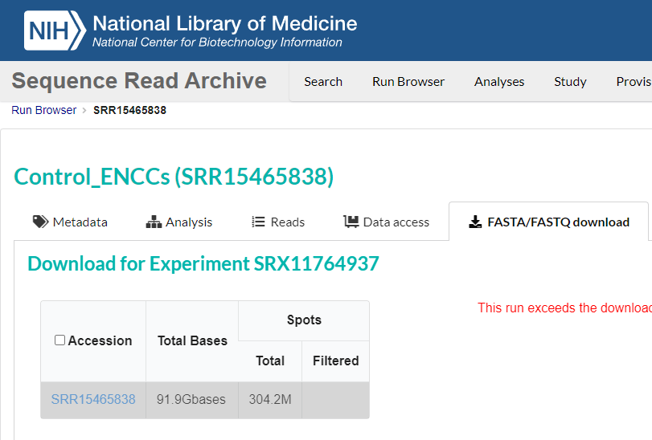
Public resources of sc/snRNA-seq

Slide 10
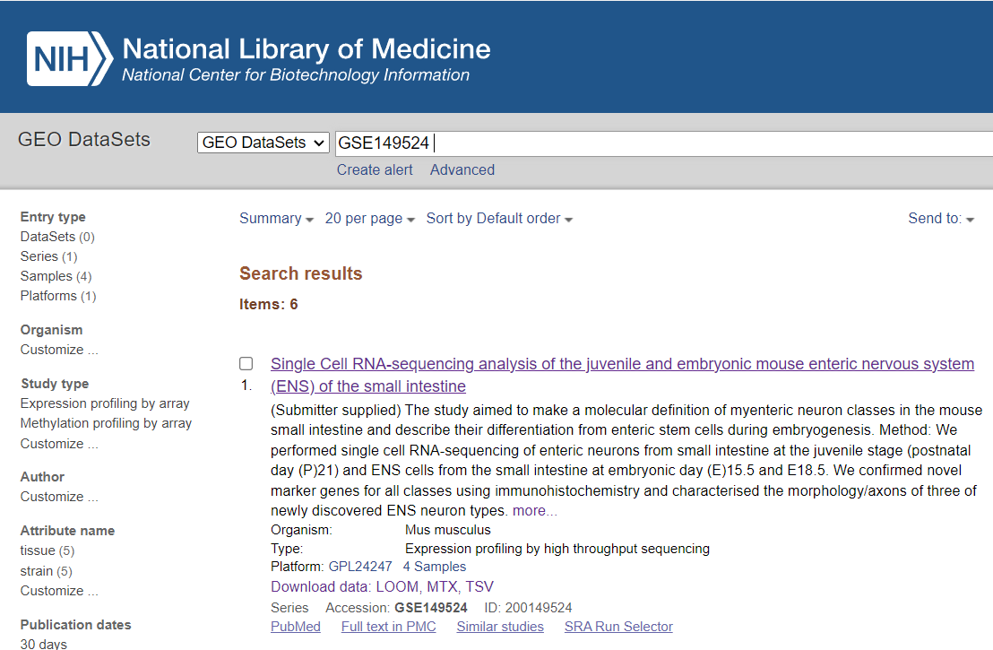
Public resources of sc/snRNA-seq

