Slide 1
R and RStudio installation
R: https://cloud.r-project.org/
RStudio: https://posit.co/download/rstudio-desktop/

Slide 2

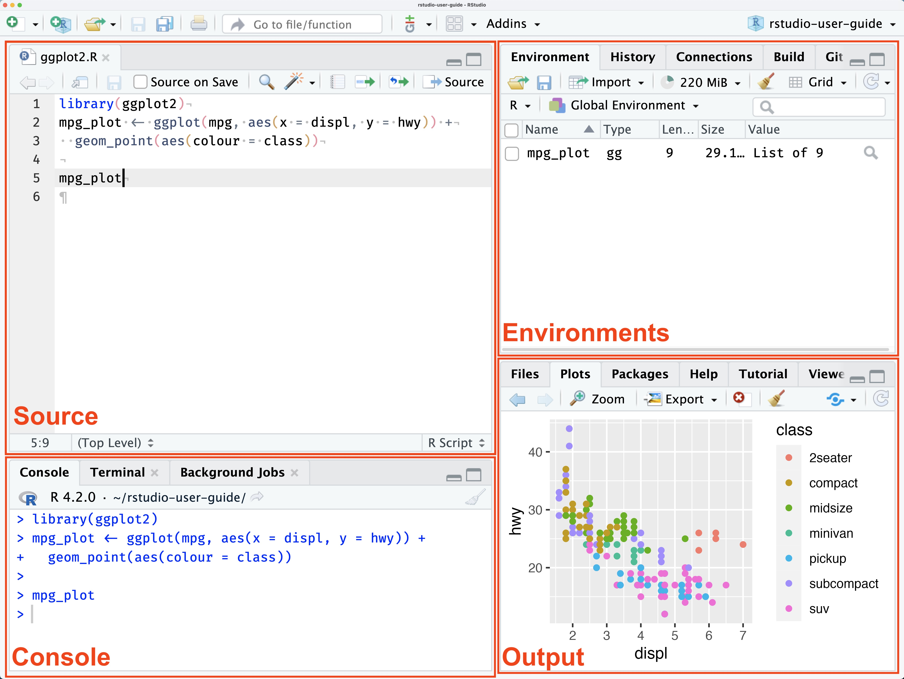

Slide 3
Bioinformatics workshop 2024
Introduction to R programming (2 wks)
Basic omics data analysis (2 wks)
Public bioinformatics resources for genomic analysis interpretation (1wk)
Machine learning (1wk)
Bridging the research findings to clinical application (1wk)

Slide 4
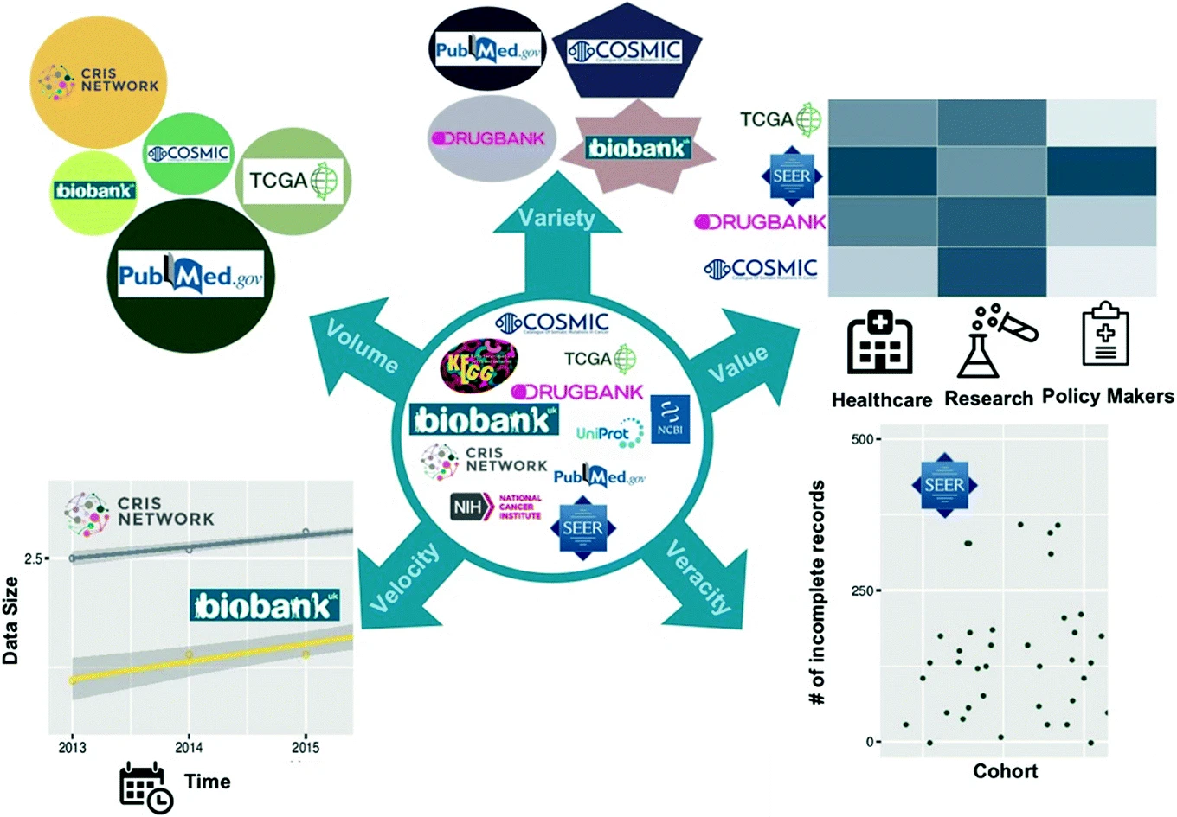
Big Biomedical Data
Ref: https://link.springer.com/chapter/10.1007/978-3-030-06149-4_2
Notes:
Volume denotes that generation and collection of data are produced at increasingly big scales.
Velocity represents that data is rapidly and timely generated and collected.
Variety indicates heterogeneity in data types, formats, structuredness, and data generation scale.
Veracity refers to noise and quality issues in the data.
Finally, value denotes the benefit and usefulness that can be obtained from processing and mining big data

Slide 5

Introduction to R
Clara Tang, Paul Blakely

Slide 6

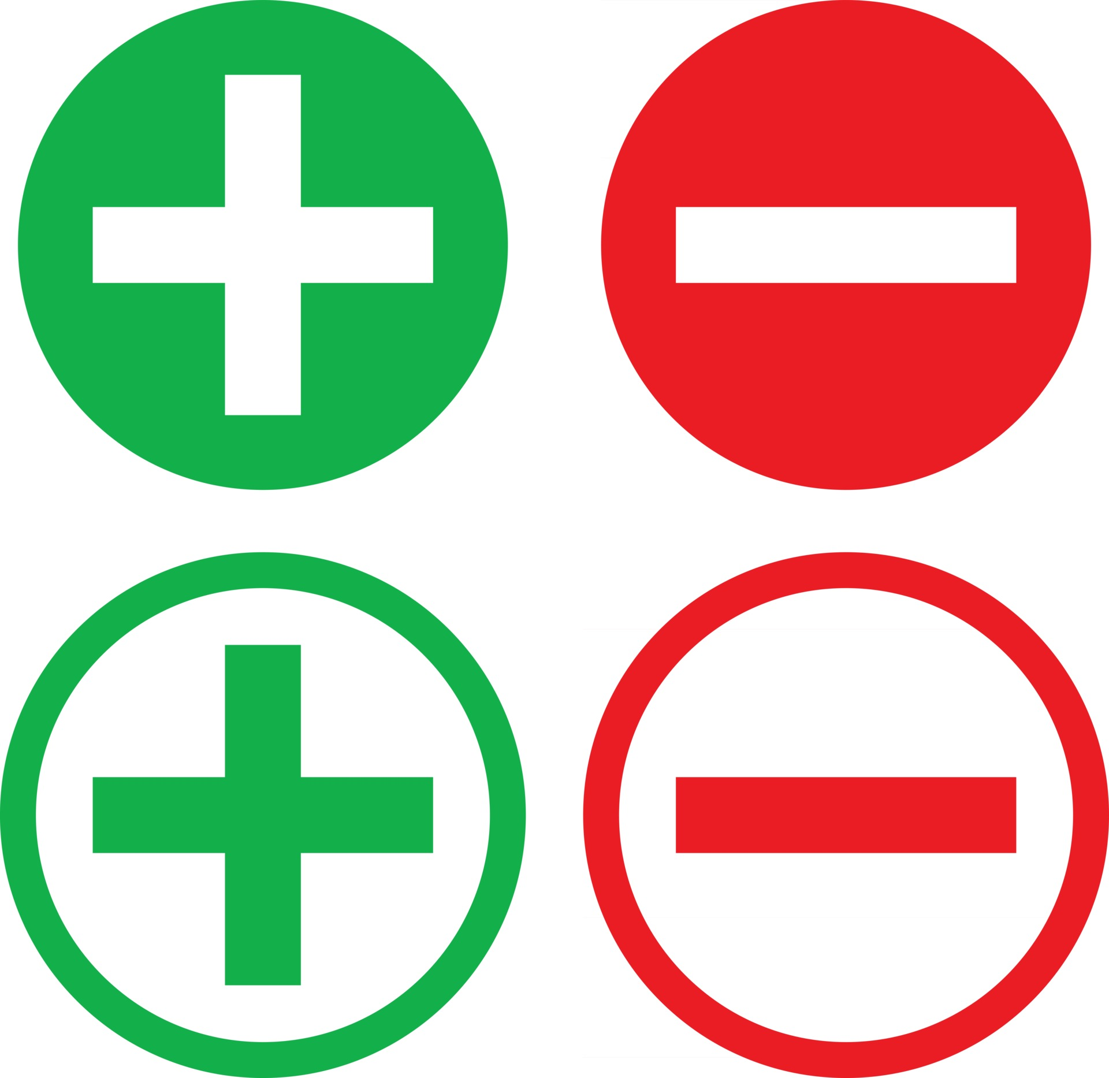
R programming
R is a programming language used for statistical computing and graphical presentation
Free, open source
Platform Independent
Lots of community-developed packages
Memory-intensive since objects are stored in physical memory
Can be slow when compared to other languages like python

Slide 7
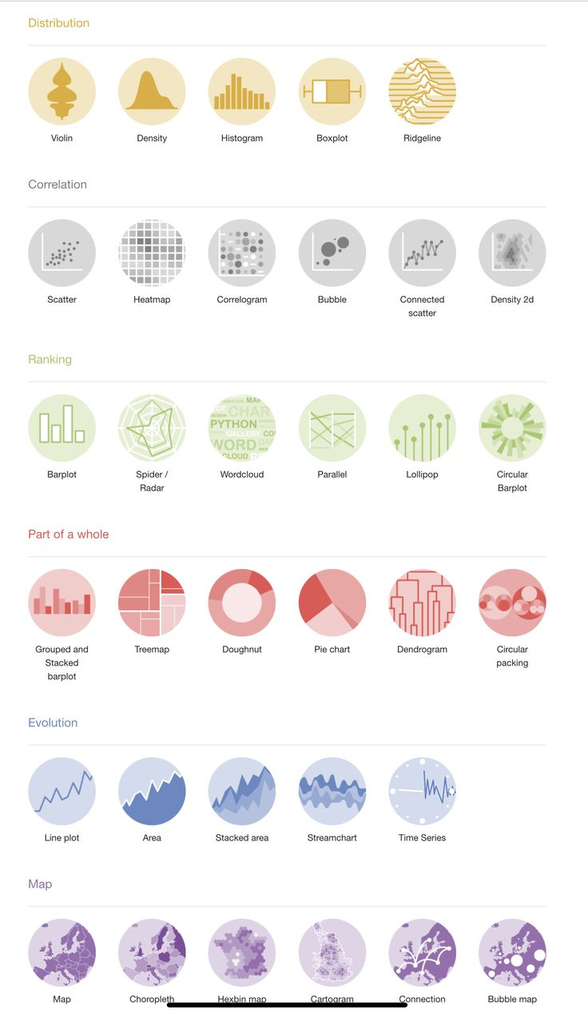
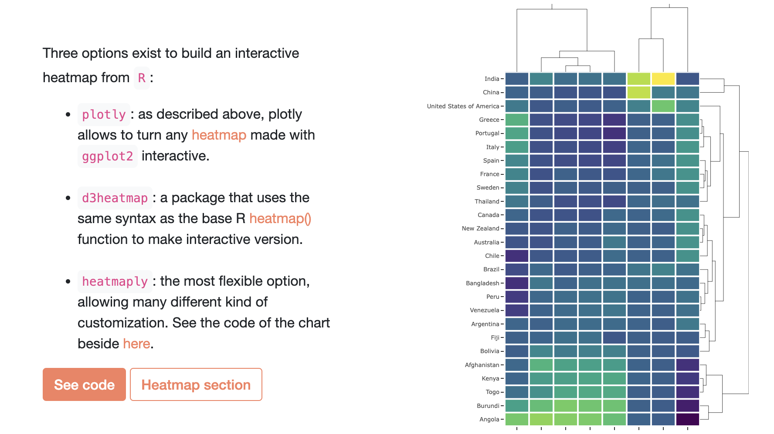
R programming : graphical representation
The R Graph Gallery: https://r-graph-gallery.com/
https://bookdown.org/content/b298e479-b1ab-49fa-b83d-a57c2b034d49/

Slide 8
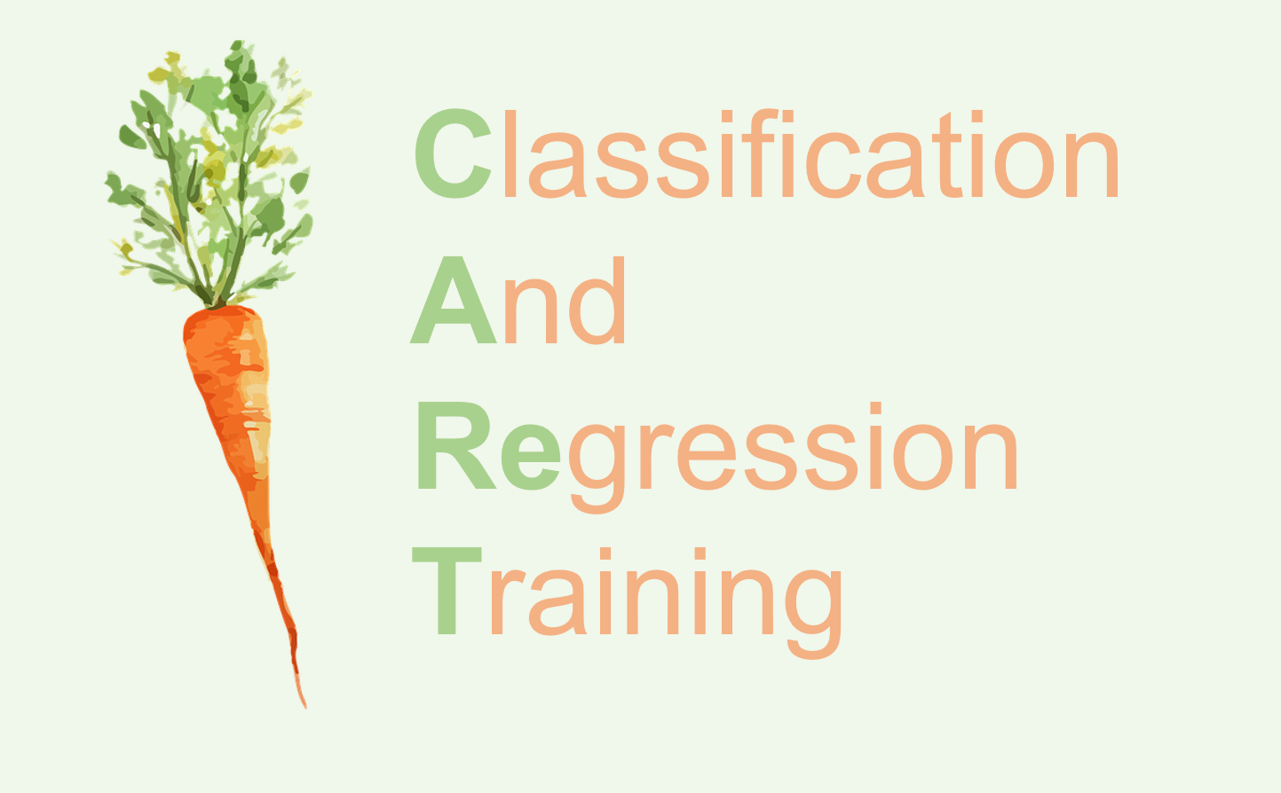
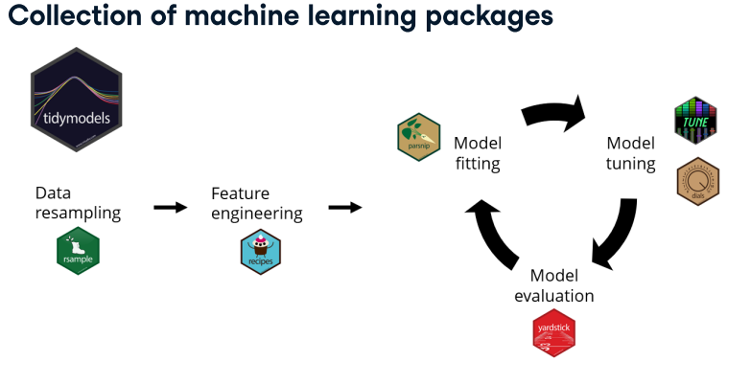
R programming : packages for data science
Bioconductor package platform for genomics data
https://www.bioconductor.org
Seurat: single cell data analysis
caret : toolkit for machine learning
tidymodels
Keras
tensorflow for R
deep learning API

Slide 9
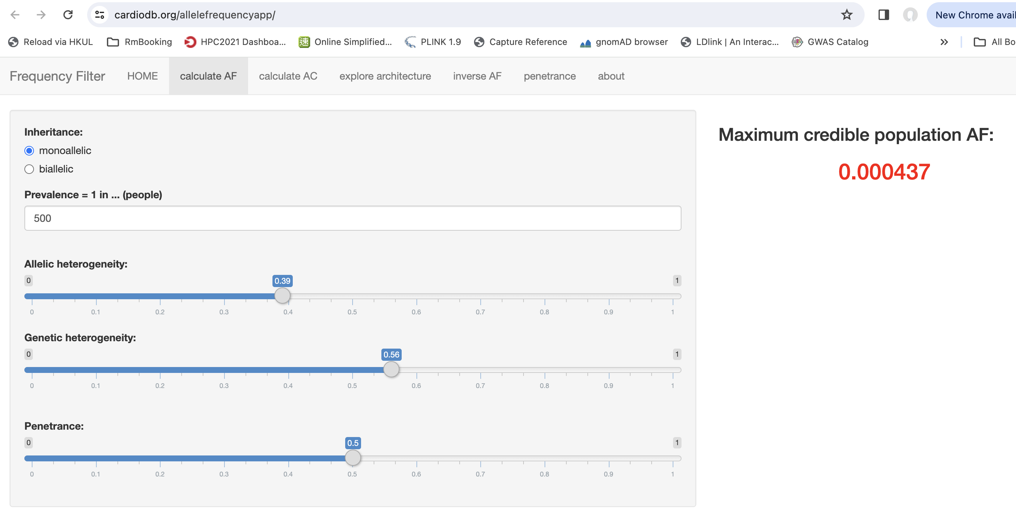
R programming : packages for data science
shiny: create interactive web applications

Slide 10
R and RStudio

Slide 11
https://docs.posit.co/ide/user/ide/guide/ui/ui-panes.html

Slide 12
Learning objectives of today
1. R basics
2. Common data types
3. Common data structures
4. Data input
5. Data management
6. Basic statistical tests

