Slide 1
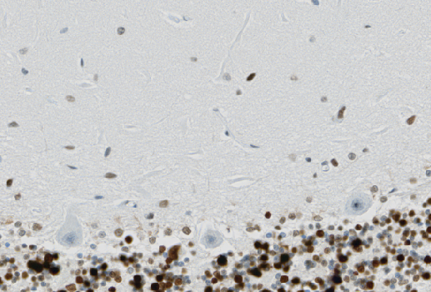
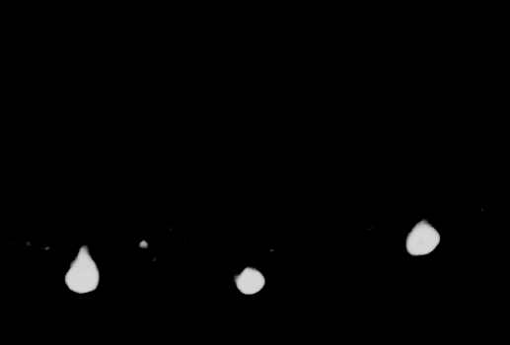
Purkinje Cell Model
YAPiC
input histology image
output image

Slide 2
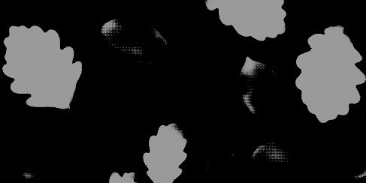
Oak Leaf Model
YAPiC
Input image
output image

