Slide 1
A Pipeline for Differential Gene Expression Analysis from RNA-seq Data (in Yeast)
Group Mango
Nick Alberts
Nikos Pappas
Adithi Varadarajan
Geert van Geest
Marcel van de Streek

Slide 2
Outline
Introduction
Pipeline components (Results and Disussion)
Biological results
Conclusions
Future work

Slide 3
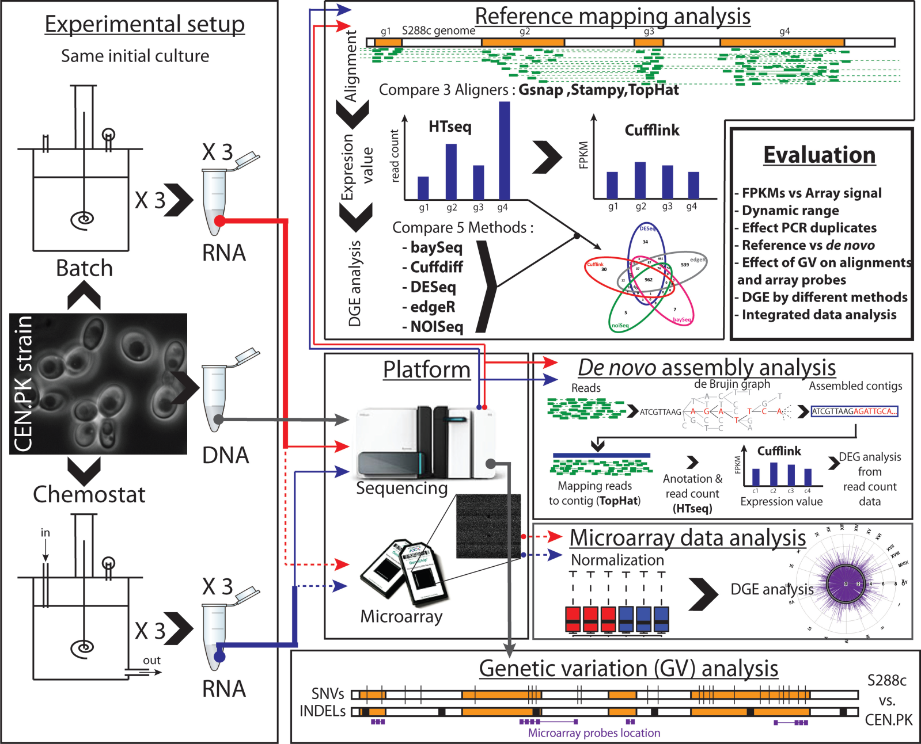
Background in Experimental Setup
Nookaew et al., 2012, Nucl. Acids Res.

Slide 4
Goals
Build a working pipeline for the DGE analysis of RNA-seq data
Extract biological meaning out of the results of the analysis

Slide 5
MoSCoW list
SHOULD
Choose appropriate software for:
Mapping
Count reads
Normalization
Mapping quality
MUST
Data format
Quality control
Quality improvement
Mapping
Count reads
Data normalization
Differential expression
Enrichment
GEERT – NIKOS – ADITHI – MARCEL - NICK
COULD (future)
Output comparison:
Aligner: Stampy
DE: EdgeR
De novo assembly
Handle missing values
Networks assembly
Motif recognition

Slide 6
