Slide 1
Pipeline for Differential Gene Expression Progress presentation
Group Mango
Adithi Varadarajan, Nikos Pappas, Geert van Geest, Nick Alberts, Marcel van de Streek

Slide 2
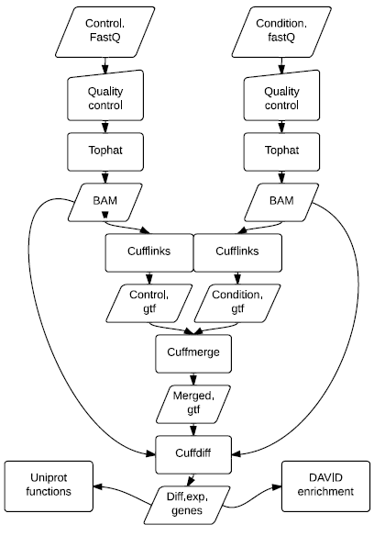
PREVIOUSLY
MUST
Data format
Quality control
Quality improvement
Mapping
Count reads
Data normalization
Differential expression
Enrichment

Slide 3
THIS WEEK
Got familiar with the software used in the pipeline
Understand I/O
Explore options
Produce output
Script for automation (Individual parts)
Are we on the right track?
Ref. Genome: S. cerevisiae iGenome EF2
RNA-Seq data: Nookaew et al., 2012

Slide 4
SO FAR…
QUALITY
CONTROL
Fastx toolkit, FastQC,
Trimmomatic
MAPPING
TopHat
TRANSCRIPT ASSEMBLY
Cufflinks Cuffmerge
DIFFERENTIAL EXPRESSION
Cuffdiff
Initial goal: Finish on Friday 07/03
On schedule
ENRICHMENT ANALYSIS
UniProt
DAVID

Slide 5
REMAINING ISSUES
Cufflinks, Cuffmerge
Adapt options to get “better” results
Cuffdiff
Inproper input from Cufflinks

Slide 6
NEXT WEEK
MONDAY : Clubbing , Bugfixing
TUESDAY: Biological inferences/Report writing
WEDNESDAY: Biological Inferences/Report writing
THURSDAY: Add ‘Coulds’ - Compare mappers
- Use R for visualization
- DESeq
- Motif recognition - De novo assembly FRIDAY: Final Presentation

