Slide 1





!(intergalactic popular beverage)
This Photo by Unknown Author is licensed under CC BY-SA
This Photo by Unknown Author is licensed under CC BY-SA
This Photo by Unknown Author is licensed under CC BY-NC-ND

Slide 2
SLURM: Workload manager for HPC batch cluster
S. Ravichandran* and Dennis Foley⁺ *ABCS, ⁺IT Operations
LBR, FNLCR
https://github.com/FNLCR-Bioinformatics/ProgrammersCorner-Parallelization

Slide 3
Agenda
To introduce the SLURM scheduler/resource manager batch system replacing the current PBS job scheduler
Why the change?
Key SLURM commands
Compare with PBS
Couple of examples using SLURM

Slide 4
What is SLURM
Simple Linux Unified Resource Manager
Written in C (half a million-lines of code)
Linux utility for Resource management for job scheduling and resource management
Open source utility widely used in other computing centers
Research centers, across the globe

Slide 5
Why Enterprise Information Technology is migrating to SLURM?
Make the new batch system compatible with CIT’s Beowulf computing cluster
Linux distribution OS will change from Ubuntu to CentOS in the next six months
The proprietary Moab/Torque scheduler/resource manager will be replaced by SLURM during the migration

Slide 6
New System aiming to bring a large performance boost
Information gleaned from Dr. Doug O’Neal’s email
Servers
HPE DL360 Gen 14 servers (no hyper-threading)
System
2 Intel Skylake processors
18 physical cores each running at 2.7GHz.
768GB memory, SSD system disk, and a 960GB SSD scratch disk.
Few systems
2 Nvidia GTX 1080Ti graphics cards
Support image processing and machine learning efforts
Contact x 5115 for any questions on the new batch

Slide 7
Useful commands
sinfo: View information & status of SLURM nodes and partitions
pbsnodes -a
sbatch/scancel: Submit/cancel a batch (script) to SLURM
qsub/qdel
sacct: To display accounting data for all jobs
squeue: To view information about all jobs located in SLURM scheduling queue
squeue –u username
https://slurm.schedmd.com/

Slide 8
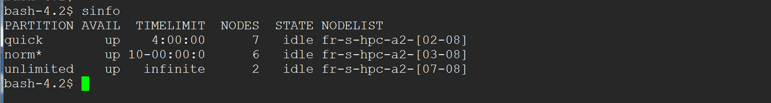
sinfo: information on nodes & partitions
PARTITIONs are equivalent to the old batch queues
quick partition contains 7 nodes (for now, each node = 16 cores)
normal partition contains 6 nodes
unlimited partition contains 2 nodes
TIMELIMIT Column contains the maximum time allowed for each
4:00:00 means hr:min:sec

Slide 9
Examples
How to submit a job using AMBER as an example

Slide 10
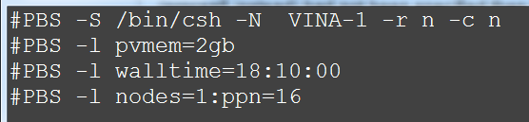
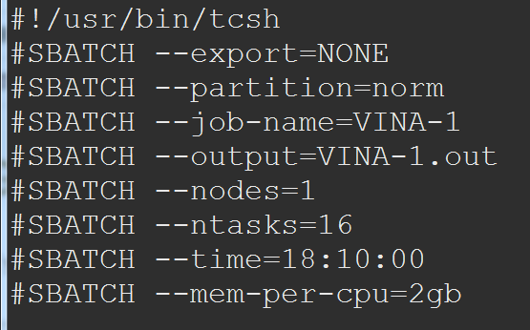
PBS → SLURM
PBS | SLURM | What it means?
qsub <job-file> | sbatch <job-file> | Submit the script to queue
qsub –I | salloc <options> | Request interactive job
showstart | squeue –start | Display estimated start time
qstat <-u username> | squeue <-u username> | Check jobs for username
qstat <queue> | squeue –p <partition> | Display queue/partition information
qstat –f <job-id> | scontrol show job <job-id> | Display detailed job details (WorkDir, .e or .o output file dir location etc.)
qdel <job-id> | scancel <job-id> | Delete <job-id>

Slide 11
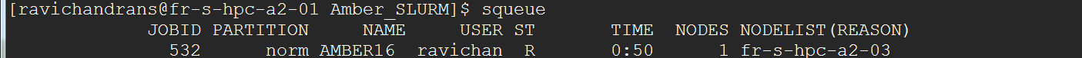
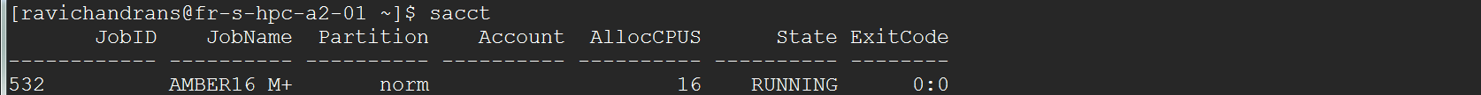
sinfo
sbatch
scancel 532
squeue
squeue –u ravichandrans
sacct

Slide 12
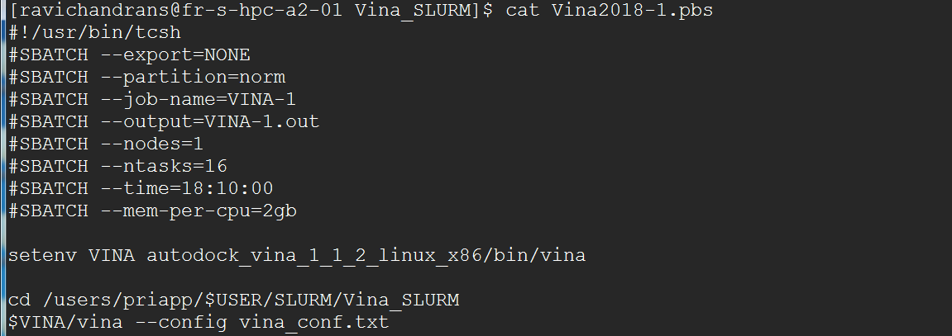
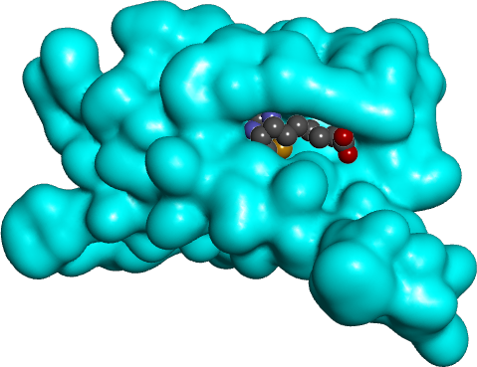
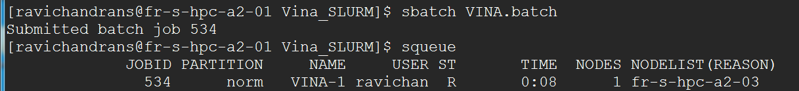

Slide 13
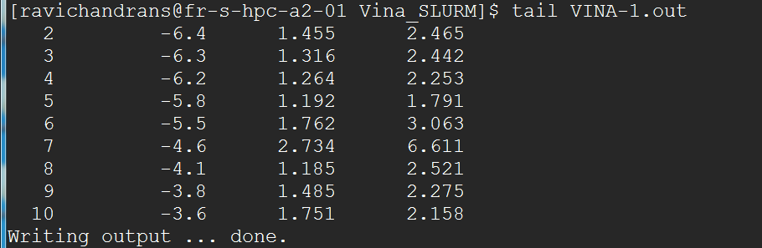

Slide 14
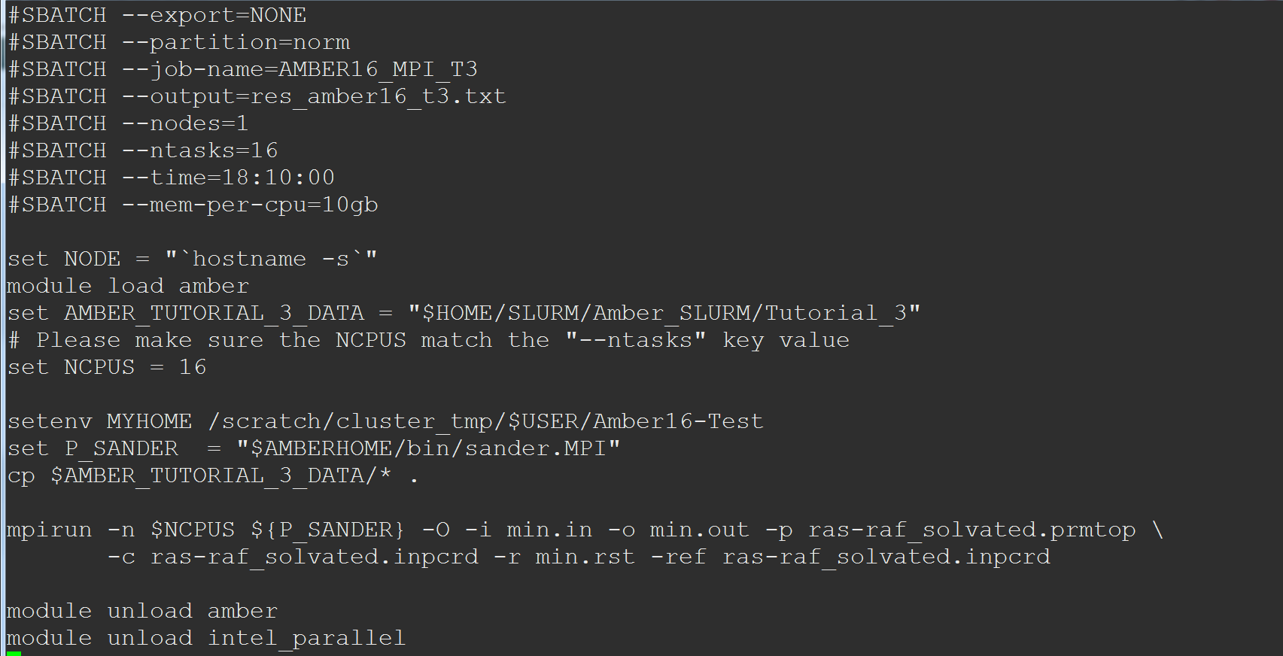
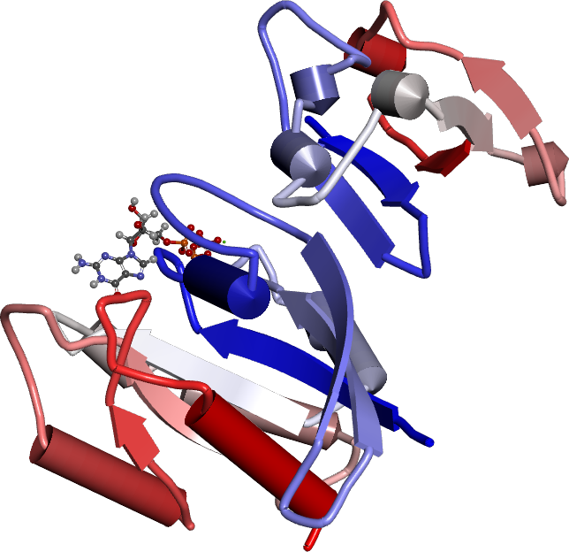
Thanks to Dennis Foley for providing the script
H-Ras and C-Raf1 Complex
Partition key says where to run
Example: 18 hours and 10 minutes
Notes:
Ras-Raf Complex with GTP

Slide 15
Additional Information
https://slurm.schedmd.com/
HPC NIH
https://hpc.nih.gov/docs/pbs2slurm.html

Slide 16

Thanks
Email me if you want to look at the SLURM template for AMBER (Molecular Dynamics program)
This Photo by Unknown Author is licensed under CC BY-NC-ND
Ravi & Dennis

