Slide 1
Day 10
Clean code & Standards

Slide 2
What is a clean coding style?
Consistent
Legible
Standard
Straight-forward

Slide 3
Why should code be clean?
Makes it easier for others to read
Can easily search in code
Works as a kind of annotation (e.g. cases)

Slide 4
Who decides if it’s clean?
Official style guides
most importantly: PEP-8, Zen of Python
Projects usually have official guidelines
When in doubt, set a style and stick to it!

Slide 5
Import this
Beautiful is better than ugly.
Explicit is better than implicit.
Simple is better than complex.
Complex is better than complicated.
Flat is better than nested.
Sparse is better than dense.
Readability counts.
Special cases aren't special enough to break the rules.
Although practicality beats purity.
Errors should never pass silently.
Unless explicitly silenced.
In the face of ambiguity, refuse the temptation to guess.
There should be one-- and preferably only one --obvious way to do it.
Although that way may not be obvious at first unless you're Dutch.
Now is better than never.
Although never is often better than *right* now.
If the implementation is hard to explain, it's a bad idea.
If the implementation is easy to explain, it may be a good idea.
Namespaces are one honking great idea -- let's do more of those!

Slide 6
Quick rundown of PEP-8
When in doubt, check: https://www.python.org/dev/peps/pep-0008
Most IDEs provide guidelines,
many addons for Jupyter do the same

Slide 7
Some common rules
4 spaces as indentation
2 blank lines before + after functions
Blank lines to separate logical units
Use spaces after commas, (semi-)colons, and operators only
Use camelCase or snake_case
Capitalize classes , lowercase objects
Use ALL_CAPS for constants

Slide 8
Python and Underscores
_name often indicates internally used variables that you should avoid accessing directly
__name__ denotes internally used functions, don’t redefine them unless you know what you’re doing
If you have to assign a value, but aren’t going to use it, convention says: assign it to _

Slide 9
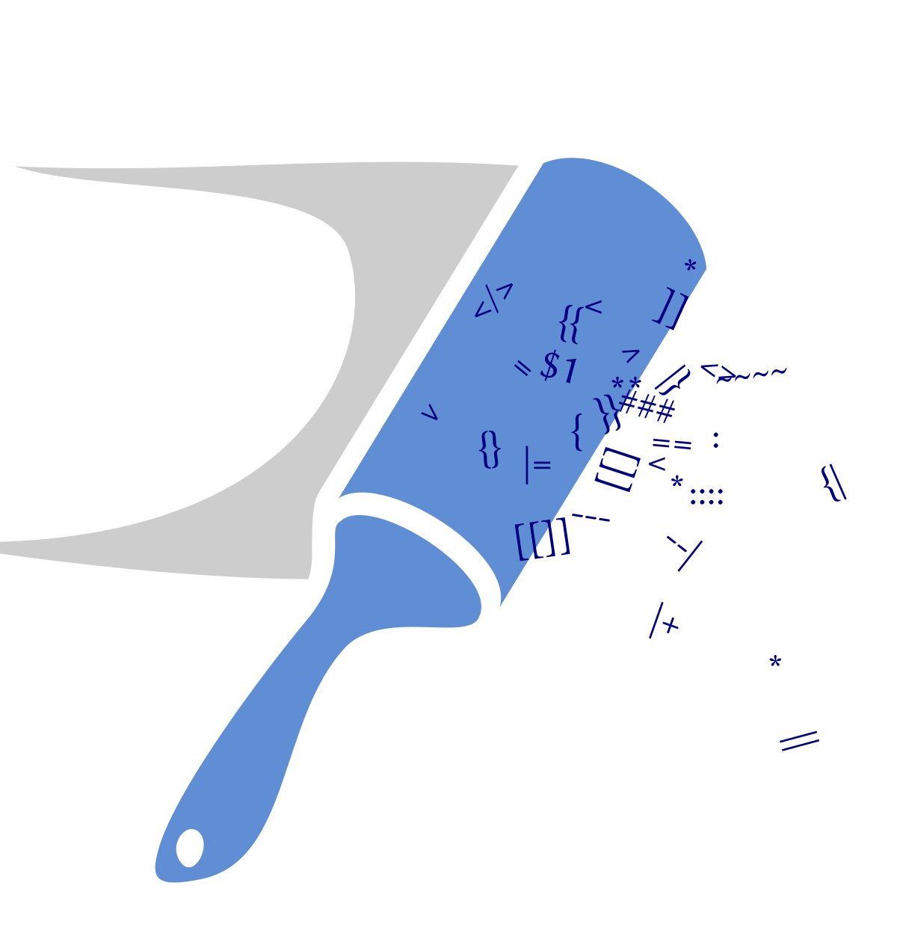
What is Linting?
Automatic comment on style,
reformatting and stylistic corrections by a tool
Often also flags errors, bugs, inefficiencies
Makes it easy to keep a common style in a team

Slide 10
Tools
PyLint & Flake8 can be called from the command line,
score your code and make changes if wanted
Most IDEs include some linting from the get-go
Linting for Jupyter: nblint, Black, and other addons

Slide 11
Should I use it?
We won’t really look at style unless it’s terrible.
If it helps you, feel free to use it. Often linting quickly finds typos etc., so it can be a great help.

Slide 12
Exercises
Go over your old code and see if and how much the style differs from the standards. Correct it where you can.
Code review: Check and correct the style of your professional FizzBuzz. Then hand it to a partner to go over it and have them give you detailed feedback with whatever they think about it.

