Slide 1
Day 10
Code efficiency

Slide 2
What makes code efficient?
Avoid unnecessary calculations
Use pre-built code (Numpy, Pandas, etc.)
Be aware what is loaded into memory
Vectorize
Parallelize (not in this course)

Slide 3
Using pre-built code
NumPy, Pandas, SciPy, etc. are super efficient
When you code something equivalent yourself,
it will be slower

Slide 4
Memory management
Don’t load huge files into memory (>4/8 GB)
Read files line by line and sort out as you go
Specialized libraries for handling large files (e.g. Dask)

Slide 5
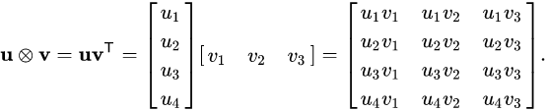
Vectorize
Using highly optimized NumPy code
Replace loops operating on single values with linear algebra:
For u in list_1:
for v in list_2:
x = u * v

