Slide 1
Day 10
Debugging

Slide 2
What is debugging?
Find problems in your code
Wrong Output
Errors that shouldn’t happen
Fix them

Slide 3
Amateur level: Print debugging
Find the line of code where the program crashes
Print every relevant variable before it crashes
See which ones are wrong

Slide 4
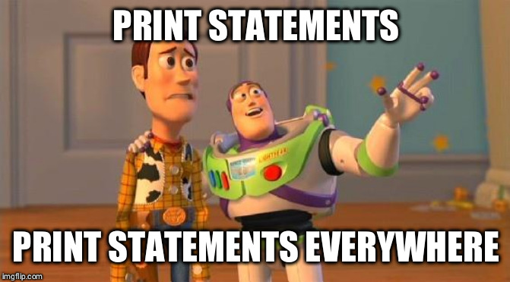
Print Debugging

Slide 5
Pro level: Debuggers
Allow pausing of code mid-execution
Going through code step-by-step
Manipulation of variables and code
Show control-flow visually

Slide 6
Debuggers
Graphical Debugger
Easy for beginners
Included in most IDEs
Command line debugger
Less accessible, often simpler

Slide 7
Debugging Tips and Tricks
Take a walk. No really, take a walk!
Talk to a colleague / friend and explain your Code to them. They don’t have to know anything about coding.
When your (colleagues / friends / grandma / hamster) won’t listen to you:
Explain it to yourself, or even better, talk to a rubber duck!

Slide 8

Rubber Duck Debugging

