Slide 1
Day 2
Data Types and Structures

Slide 2
Recap:
How to use the Bash or Powerpoint shell
How to start Python Interactive shell
How to run Python scripts
Differences between scripts and interactive mode
Variables
Strings

Slide 3
Today’s menu
Booleans: To Be or Not To Be
If-else statements
Lists
Dictionaries
Loops
More coding!

Slide 4
Excursion: Googling things
Your script fails. The Error shown is TypeError: unsupported operand type(s) for +: 'int' and 'str'. What could this mean?
Google the Error and see what pops up.
You want to capitalize one letter in the middle of the String. How do you do that? If you find a solution: Perfect! In either case: Google it.
What are good sources for programming advice?
What are not so great sources?

Slide 5
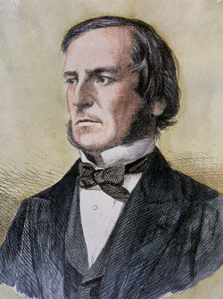
Booleans
Essentially truth values : True, False
Can calculate as with numbers
Often used to make decisions

Slide 6
If-statements
You can make choices based on data
Often useful in loops
if {condition}:
executed if condition == True
elif {condition2}:
executed if condition2 ==True
else:
executed in all other cases
Plan A
if
x
elif
Plan B
else
Plan C

Slide 7
Now you!
Test if a number is odd or even:
  Take an integer as input
  Test number with if-else condition
  Print out some message depending on the result

Slide 8
Lists
A collection of items
Linear organization
Anything can be in a list
List = [‘Spam’, ‘Spam’, ‘Bacon’, ‘Eggs’, ‘Spam’]
Content
next
Content
next
Content
next
Content
next

Slide 9
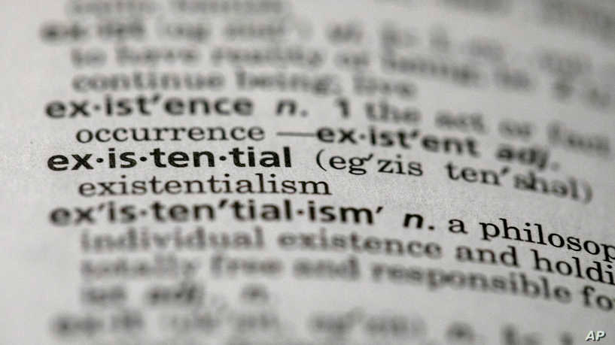

Dictionaries
Word: Explanation
dictionary = {key1: value1, key2:value2, …}
dictionary[key1] = value1

Slide 10
Loops
Loops repeat an action many times
Rules are the same every repetition
Modification with logic possible
Different kinds of loops
For-loops
While-loops

Slide 11
Indentation
Loop
Loop content part 1
Loop content part 2
Code continues here
Another loop
Loop content
More content

Slide 12
Indentation
People argue (a lot) over tabs vs spaces
Ultimately it doesn’t matter
Just use things consistently
If you mix tabs and spaces your PC explodes

Slide 13
For loops
Repeats code for ever element of an iterable
Strict order: first → last
Very common and very useful construct

Slide 14
Exercises
Take in a number, print out all the numbers from 0 to your number, using a for loop
Turtle exercise

Slide 15
Slightly better exercises
Calculate GC-content in the example file. Do it first using a for loop and if-statement. Then do it using list.count(element).
Count point mutations in http://rosalind.info/problems/hamm/
FizzBuzz: Pass a programmer interview question
Count content of A, T, G, C using a dictionary and ONE loop
Transcribe DNA into RNA

Slide 16
While loop
Keeps repeating actions while a condition is True
Only stops when condition is False
Inherent danger for endless loops
More specialized use cases than For loop
while {condition}:
loop code here

Slide 17
Break conditions
Loop stops when x is False
While loops need some condition met to stop
These are break conditions
while x:
{code}

Slide 18
Exercises
Make someone enter their height and weight. Check whether the input is an integer. If not, ask again, nicely.
Write a “Guess the number” game.

Slide 19
Break and continue
while x:
if things_broke:
break
else:
do_stuff
You can also explicitly cancel loops
break statement stops the loop immediately
Or cancel loop iterations
continue statement skips the current round
for element in list:
if element not in other_list:
continue
do_stuff

Slide 20
Careful with mutables!
Lists and dictionaries are so called mutables
Mutables are object that can be changed
list1 = list2 creates a pointer, not a copy, to list1
Same goes for dictionaries

Slide 21
List comprehensions
Identical to a for loop
But very compact
squares = []
For x in range(1,10):
x2 = x**2
squares.append(x2)
squares = [x**2 for x in range(1,10)]

Slide 22
Exercises
Complement a strand of DNA using a list comprehension.
Transcribe that complemented strain.

