Slide 1

Differences in software performance
for analyses of High Throughput
Ion Torrent DNA barcodes
Alex Hoogkamer,
Thomas Bolderink
Roeben Vink
Supervisors: Dr. Sigrid Beiboer, Dr. Barbara Gravendeel and Dr. Rutger Vos

Slide 2
Contents
Traditional Chinese medicine (TCMs)
High throughput (Ion Torrent) DNA barcoding
Project flowchart
Research questions
Software performance
Preliminary conclusion
Next steps

Slide 3
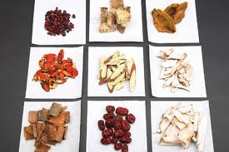
Traditional Chinese Medicines (TCMs)
Herbal medicine
Customs
Unknown content

Slide 4
High Throughput Ion Torrent
DNA barcoding
Short Genetic Markers
Ion Torrent NGS

Slide 5
Plan of Action
Program Learning
Early Report and Presentation
Acquisition of Programs
Completion of Testing
Initial Testing
Pipeline Design and Creation
Final Report and Presentation
Project flowchart
Data Preparation
Alignment
Trimming
Quality Control
E-Value
Bit-Score
Integration
User Interface
Clustering
Serial BLAST
Global BLAST

Slide 6
Plan of Action
Program learning
Early Report and Presentation
Acquisition of Programs
Completion of Testing
Initial Testing
Pipeline Design and Creation
Final Report and Presentation
Data Preparation
Alignment
Trimming
Quality Control
E-Value
Bit-Score
Integration
User Interface
Clustering
Serial BLAST
Global BLAST

Slide 7
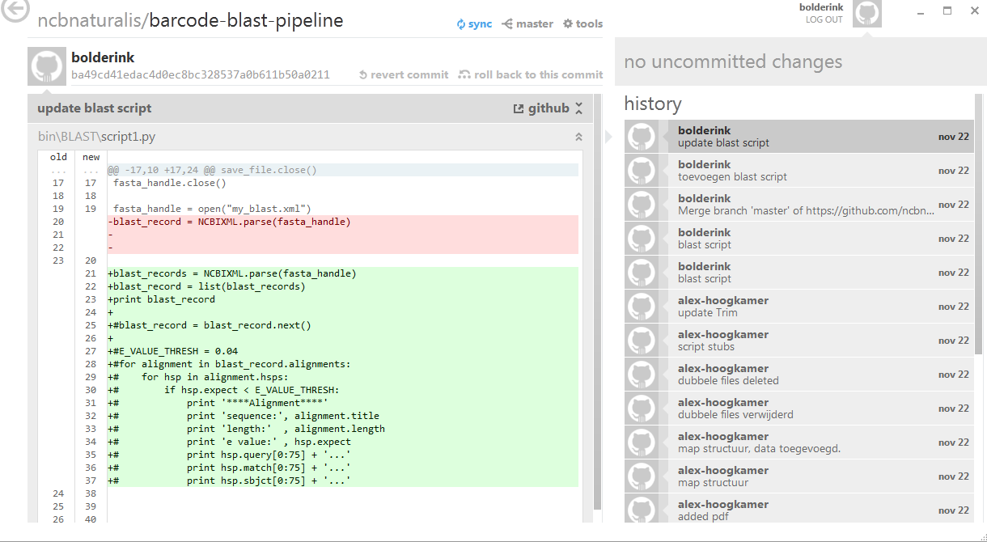
Github
Online version control program

Slide 8
Research Questions
Question 1
Why do different software packages give different blast results?
Hypotheses 1
Different packages use different settings for global blasts
Different packages trim the reads differently
Different packages use different reference databases

Slide 9
Research Questions
Question 2
What would be the added value of a self designed pipeline?
Hypotheses 2
Self designed pipeline is freeware (most other packages are not)
The package’s features will be specialized for this type of project.

Slide 10
Sofware Packages
Geneious (version 6.0.3, tested on Windows 7)
CLC Bio (version 6.7.1, tested on Windows 7)
Torrent Suite (tested on Linux)

Slide 11
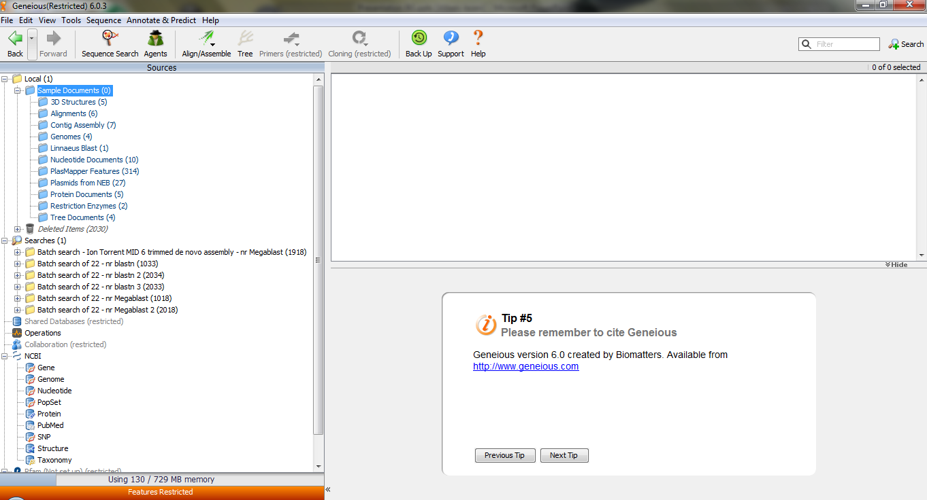
Geneious
http://www.geneious.com/
3 week trial version
Single stand-alone student license: $395 per year

Slide 12
CLC Genomics Workbench
http://www.clcbio.com/
Shareware with limited options after 2 weeks
Single stand-alone license: $4,995 (student) $9,990 (industrial)

Slide 13
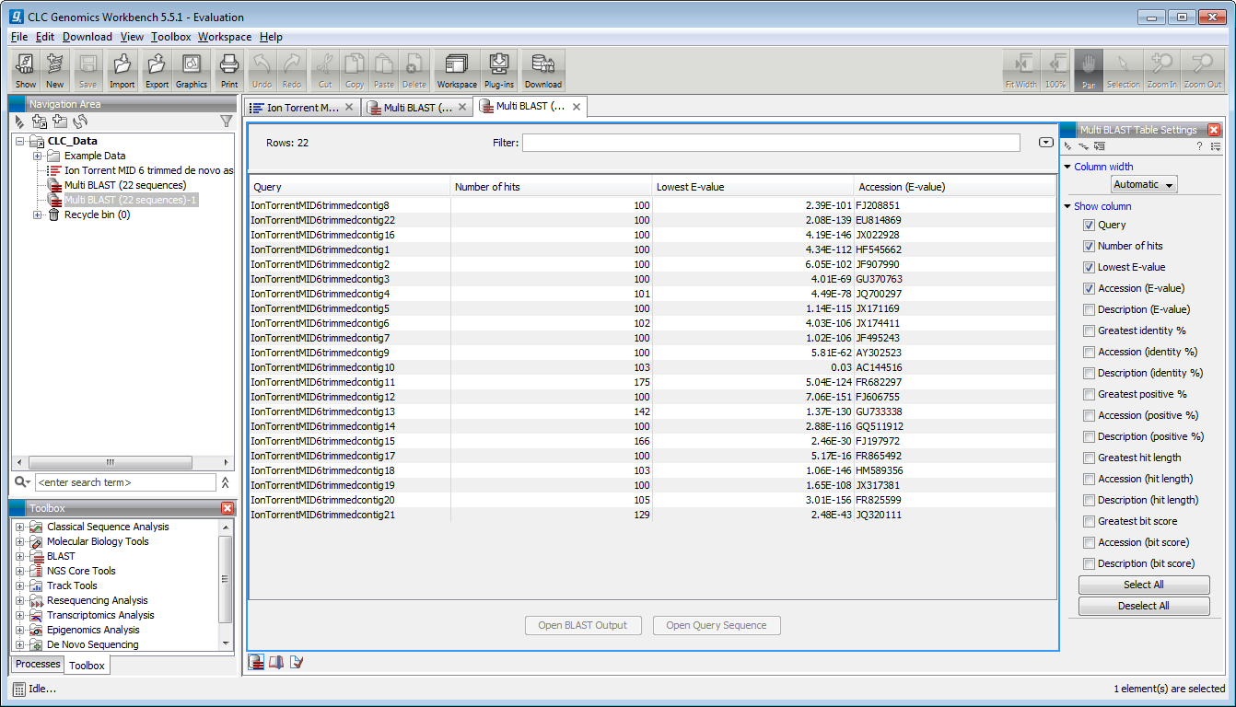

Slide 14
Ion Torrent Suite
http://www.lifetechnologies.com
Open Source on GitHub Please add a screen dump picture of startup window

Slide 15
Comparison of default settings

Slide 16
Comparison of performance
with default settings
CLC Bio
NCBI BLAST
Geneious
Notes:
Ion torrent is not good for this comparison because it can not blast.

Slide 17
Comparison of performance with settings adjusted
CLC Bio
NCBI BLAST
Geneious
Notes:
All results are roughly the same but are still different in all three programs

Slide 18
Preliminary conclusion
Results are more similar after adjustment of default settings as compared with default values
Likely causes for remaining differences:
Randomized presentation of Blast results
Priority differences between E-values and similarities found

Slide 19
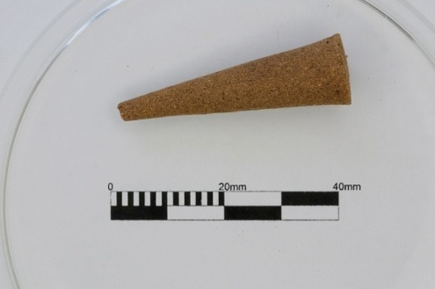

Next steps
Run Ion Torrent data obtained of incense cone with fully known ingredients provided by retailer > which package retrieves most accurate data?
Design a pipeline for data handling ourselves
Compare performance of own pipeline with CLC bio, Geneious and Ion Torrent Suite > is our own pipeline more accurate than best performing commercially available package?
Notes:
Compare the software with the insence data

Slide 20
Acknowledgements
Elza Duijm (Ion Torrent technician Naturalis)
Henry Heuveling van Beek (Seven Mountains ltd.)
Denise Rijkeboer (BaSc Forensic Science)
Tamara Peelen (Dutch Customs Laboratory)

