Slide 1


Differences in software performance
for analyses of High Throughput
Ion Torrent DNA barcodes
Alex Hoogkamer,
Thomas Bolderink
Roeben Vink
Supervisors: Dr. Sigrid Beiboer, Dr. Barbara Gravendeel and Dr. Rutger Vos

Slide 2
Contents
Traditional Chinese medicine (TCMs)
High throughput (Ion Torrent) DNA barcoding
Project flowchart
Research questions
Software performance
Conclusions
Next steps

Slide 3
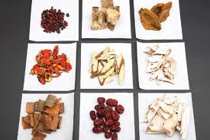
Traditional Chinese Medicines (TCMs)
Herbal medicine
Under customs surveillance
Unknown contents

Slide 4
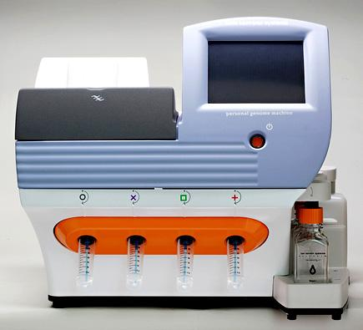
High Throughput Ion Torrent
DNA barcoding
Short Genetic Markers
Ribosomal DNA (nrITS1)
In Fasta format
Ion Torrent Next Generation Sequencing

Slide 5
Educational Goals
Writing reports in English
Gaining experience in completing and managing a 20 weeks project
Learning how to recommend software based on our own research
Learning to work with Microsoft Word
Communication with teachers and clients

Slide 6

Deliverables
Software comparison and recommendation
Software pipeline
Project report

Slide 7
Research Questions
Question 1
Why do different software packages give different blast results?
Hypotheses 1
Different packages use different settings for global blasts
Different packages trim the reads differently
Different packages use different reference databases

Slide 8
Research Questions
Question 2
What would be the added value of an in-house designed pipeline?
Hypotheses 2
In-house pipelines are freeware (most other packages are not).
The package’s features will be specialized for this type of project.

Slide 9
Plan of Action
Program Learning
Early Report and Presentation
Acquisition of Programs
Completion of Testing
Initial Testing
Pipeline Design and Creation
Final Report and Presentation
Project flowchart
Data Preparation
Alignment
Trimming
Quality Control
E-Value
Bit-Score
Integration
User Interface
Clustering
Serial BLAST
Global BLAST

Slide 10
Plan of Action
Program learning
Early Report and Presentation
Acquisition of Programs
Completion of Testing
Initial Testing
Pipeline Design and Creation
Final Report and Presentation
Data Preparation
Alignment
Trimming
Quality Control
E-Value
Bit-Score
Integration
User Interface
Clustering
Serial BLAST
Global BLAST

Slide 11
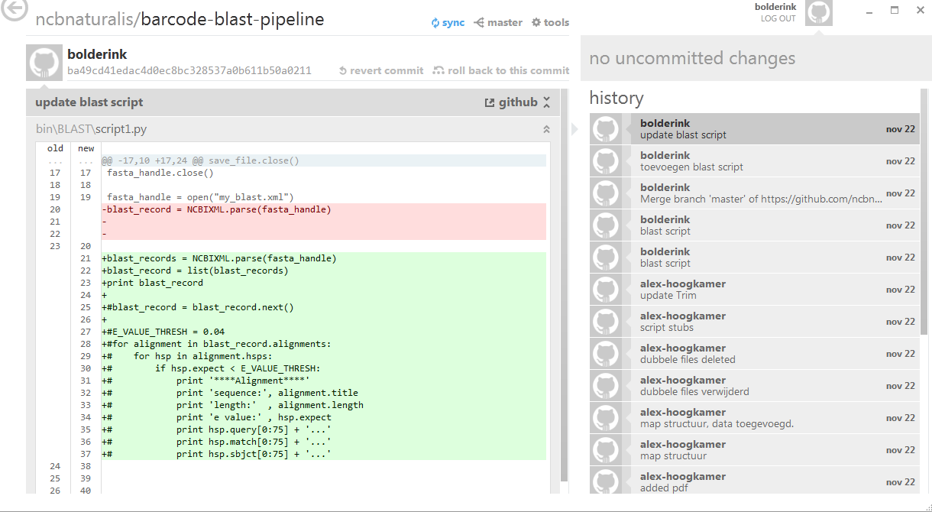
Github
Online version control program
Notes:
Geef grondige uitleg over Github+GUI

Slide 12
Software packages
Geneious (version 6.0.3, tested on Windows 7)
CLC Bio (version 6.7.1, tested on Windows 7)
Torrent Suite (tested on Linux)
CITES checker (our own product, tested on Linux)

Slide 13
Geneious
http://www.geneious.com/
3 week trial version.
Single stand-alone student license: $395 per year

Slide 14
CLC Genomics Workbench
http://www.clcbio.com/
Shareware with limited options after 2 weeks
Single stand-alone license: $4,995 (student) $9,990 (industrial)

Slide 15
Ion Torrent Suite
http://www.lifetechnologies.com
Open Source on GitHub
Freeware
Notes:
ION TORRENT suite is niet gebruikt voor de comparisons omdat het geen BLAST functie heeft

Slide 16
CITES checker
In-house development
Open source on GitHub
Customized to report occurrences in the CITES appendices
Freeware

Slide 17
Validation
Ion Torrent data of a single TCM (incense stick) were analysed with four different software programs
Data obtained were compared in terms of: - fungal and plant species retrieved (same as information provided by retailer?) - values of query results (>97%?)

Slide 18
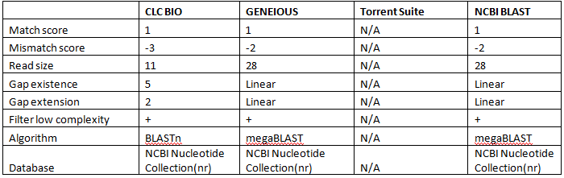
Comparison of default settings

Slide 19
Comparison of performance
with default settings
CLC Bio
NCBI BLAST
Geneious
CITES-checker
Though only Geneious provides Aquilaria in this sample,
CITES-checker finds that exact hit on contig 5.
Notes:
Ion torrent is not good for this comparison because it can not blast.

Slide 20
Comparison of performance
with default settings
CLC Bio
NCBI BLAST
Geneious
CITES-checker
Though only Geneious provides Aquilaria in this sample,
CITES-checker finds that exact hit on contig 5.
Notes:
Ion torrent is not good for this comparison because it can not blast.

Slide 21
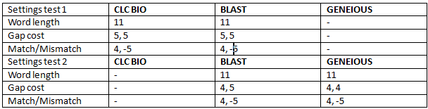
Comparison of performance with extreme settings
CITES-checker was included as well, using CLC BIO’s Settings.

Slide 22
Comparison of performance with extreme settings
CLC Bio
NCBI BLAST
Geneious
CITES-checker
Notes:
All results are roughly the same but are still different in all three programs

Slide 23
Comparison of performance with extreme settings
CLC Bio
NCBI BLAST
Geneious
CITES-checker
Again, CITES-checker does not list the Aquilaria hit; however, CITES-checker still finds the exact same hit on contig 5 instead.
Notes:
All results are roughly the same but are still different in all three programs

Slide 24
Comparison of performance with extreme settings
Settings used for Geneious were not equal to those used for the other programs because Geneious disallows settings chosen by users.
Under the closest extreme setting Geneious still returned the same results.

Slide 25
Conclusions
Problem 1: Why do different software packages give different results?
Hypothesis 1: Different programs use different default settings.
Answer 1: Different programs use different settings, yet the databases are the same.
Notes:
Hyp: perform more or less accurate BLASTs, trim the reads differently or not at all, and/or do not use the same reference databases.

Slide 26
Conclusions
Problem 2: What is the added value of a newly designed pipeline?
Hypothesis 2: It is free, flexible and accurate.
Answer 2: It is free, customizable and similar in results to the most accurate of the programs we studied.

Slide 27

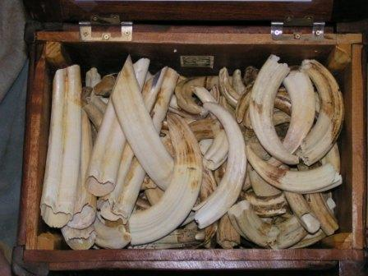
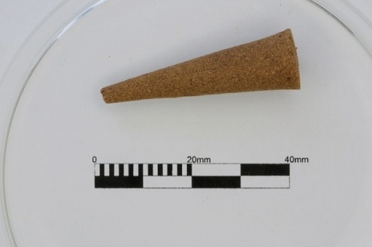
Next steps
CITES-checker can easily be adapted for a plethora of different applications; already working is identification of CITES Appendix listed species traded as medicines and confiscated by customs.
Notes:
Compare the software with the insence data

Slide 28
Next steps
CITES-checker should be further adapted to account for variations in taxonomic spelling between NCBI and the CITES Appendices.
Notes:
Compare the software with the insence data

Slide 29
Acknowledgements
Elza Duijm (Ion Torrent technician Naturalis)
Henry Heuveling van Beek (Seven Mountains ltd.)
Denise Rijkeboer (BaSc Forensic Science)
Tamara Peelen (Dutch Customs Laboratory)

