Slide 1

Differences in software performance
for analyses of High Throughput
Ion Torrent DNA barcodes
Alex Hoogkamer,
Thomas Bolderink
Roeben Vink
Supervisors: Dr. Sigrid Beiboer, Dr. Barbara Gravendeel and Dr. Rutger Vos

Slide 2
Contents
Traditional Chinese medicine (TCMs)
High throughput (Ion Torrent) DNA barcoding
Project flowchart
Research questions
Software performance
Preliminary conclusion
Next steps

Slide 3
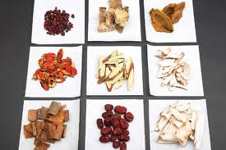
Traditional Chinese Medicines (TCMs)
Herbal medicine
Customs
Unknown content

Slide 4
High Throughput Ion Torrent
DNA barcoding
Short Genetic Markers
Ion Torrent NGS

Slide 5
Goals
Writing reports in English.
Gaining experience in a 20 weeks project.
Examining software.
Learn how to recommend software based on own research.
Programming a pipeline.
Learning to work with Microsoft Word.
Communication with teachers and clients.
Project management.
Learning to write a Plan of Action showing insight in the assignment.
Pipeline design.

Slide 6
Research Questions
Question 1
Why do different software packages give different blast results?
Hypotheses 1
Different packages use different settings for global blasts
Different packages trim the reads differently
Different packages use different reference databases

Slide 7
Research Questions
Question 2
What would be the added value of an in-house designed pipeline?
Hypotheses 2
In-house pipelines are freeware (most other packages are not).
The package’s features will be specialized for this type of project.

Slide 8
Plan of Action
Program Learning
Early Report and Presentation
Acquisition of Programs
Completion of Testing
Initial Testing
Pipeline Design and Creation
Final Report and Presentation
Project flowchart
Data Preparation
Alignment
Trimming
Quality Control
E-Value
Bit-Score
Integration
User Interface
Clustering
Serial BLAST
Global BLAST

Slide 9
Plan of Action
Program learning
Early Report and Presentation
Acquisition of Programs
Completion of Testing
Initial Testing
Pipeline Design and Creation
Final Report and Presentation
Data Preparation
Alignment
Trimming
Quality Control
E-Value
Bit-Score
Integration
User Interface
Clustering
Serial BLAST
Global BLAST

Slide 10
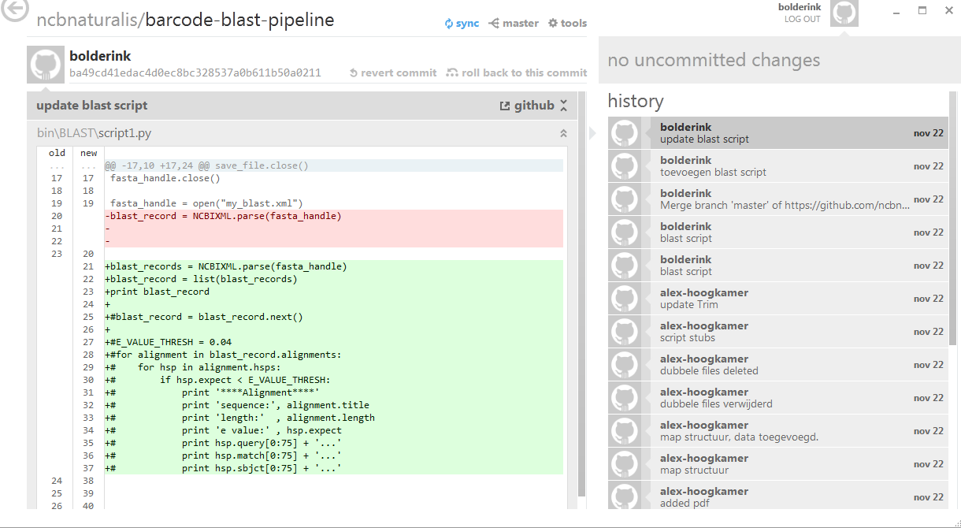
Github
Online version control program

Slide 11
Sofware Packages
Geneious (version 6.0.3, tested on Windows 7)
CLC Bio (version 6.7.1, tested on Windows 7)
Torrent Suite (tested on Linux)
CITES checker (our own product, tested on Linux)

Slide 12
Geneious
http://www.geneious.com/
3 week trial version
Single stand-alone student license: $395 per year

Slide 13
CLC Genomics Workbench
http://www.clcbio.com/
Shareware with limited options after 2 weeks
Single stand-alone license: $4,995 (student) $9,990 (industrial)

Slide 14
Ion Torrent Suite
http://www.lifetechnologies.com
Open Source on GitHub
Freeware

Slide 15
CITES checker
In-house development
Open source on GitHub

Slide 16
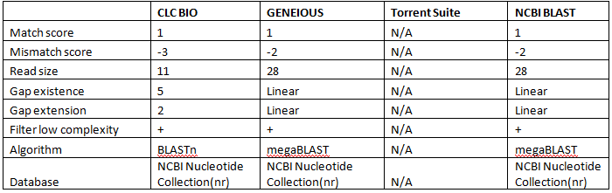
Comparison of default settings

Slide 17



Comparison of performance
with default settings
CLC Bio
NCBI BLAST
Geneious
CITES checker
Notes:
Ion torrent is not good for this comparison because it can not blast.

Slide 18
Comparison of performance
with default settings
CLC Bio
NCBI BLAST
Geneious
CITES checker
Notes:
Ion torrent is not good for this comparison because it can not blast.

Slide 19

Comparison of performance with extreme settings
CLC Bio
NCBI BLAST
Geneious
CITES checker
Notes:
All results are roughly the same but are still different in all three programs

Slide 20
Comparison of performance with extreme settings
CLC Bio
NCBI BLAST
Geneious
CITES checker
Notes:
All results are roughly the same but are still different in all three programs

Slide 21
Conclusions
Problem 1: Why do different software packages give different results?
Hypothesis 1: Different programs use different settings.
Awnser 1: Different programs use different settings, yet the databases are the same.
Notes:
Hyp: perform more or less accurate BLASTs, trim the reads differently or not at all, and/or do not use the same reference databases.

Slide 22
Conclusions
Problem 2: What is the added value of a newly designed pipeline?
Hypothesis 2: It is free, flexible and accurate.
Awnser 2: It is free, flexible and similar in results to the most accurate of the researched programs.

Slide 23

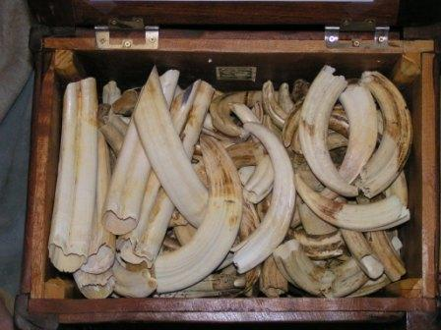
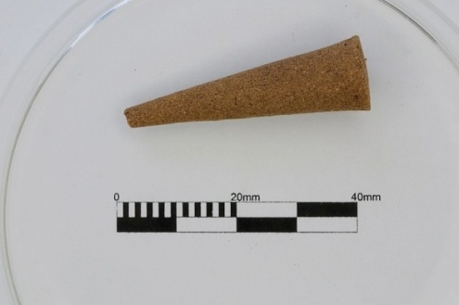
Next steps
CITES-checker can easily be adapted for a plethora of different uses pertaining to illegal organics in border security and customs.
Notes:
Compare the software with the insence data

Slide 24
Acknowledgements
Elza Duijm (Ion Torrent technician Naturalis)
Henry Heuveling van Beek (Seven Mountains ltd.)
Denise Rijkeboer (BaSc Forensic Science)
Tamara Peelen (Dutch Customs Laboratory)

