Slide 1
Differences in software performance for analyses of High Throughput Ion Torrent DNA barcode data.
Alex Hoogkamer,
Thomas Bolderink
Roeben vink
Supervisor: Dr. Sigrid Beiboer, Dr. Barbara Gravendeel and Dr. Rutger Vos

Slide 2
Introduction
Traditional Chinese medicine (TCM’s)
Barcoding
Ion Torrent data

Slide 3
Research questions
Main question
Why does different software give different blast results?
Sub questions
Do different software use different settings for more or less accurate blast?
Is there a difference in the way the software trims the reads?
Do they use the same database?

Slide 4
Software
Geneious
CLC Bio
Torrent Suite

Slide 5
Geneious
http://www.geneious.com/
Freeware
Cost for a single computer: $395

Slide 6
CLC Bio (Genomics Workbench)
http://www.clcbio.com/
Shareware with limited options after 2 weeks
Cost for a single computer:$4,995 (student) $9,990 (Industrial)

Slide 7
Ion Torrent Suite
http://www.lifetechnologies.com
Open Source on GitHub Cost: N/A

Slide 8
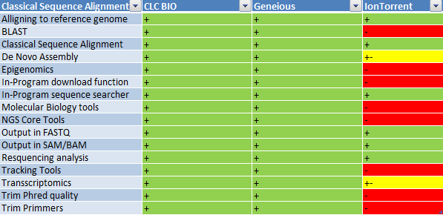
Comparison
Notes:
Ion torrent is not good

Slide 9
Comparison
CLC Bio
NCBI BLAST
Geneious
Notes:
All results are roughly thesame but are still different in all three programs

Slide 10
What does this mean?
Results are the same, accession numbers are not
Likely causes include:
Similar results but different result handling
Randomized data collection serverside
Small priority differences in clientside task handling

Slide 11
Next steps
Compare the software with a true dataset
Building a pipeline
- Biopython
Notes:
Compare the software with the insence data

