Slide 1

Getting set up on the UoN HPC “Ada”
LIFE4138
Notes:
Ada Lovelace – considered the world’s first computer programmer!

Slide 2
Learning Objectives
Understand what the HPC is
Understand what resources are available to you on the HPC
Understand what a terminal and shell are
Understand what the SSH command does and how to use it
Use SSH to log in to your Ada account
Understand what an SSH config file is
Create and use an SSH config file to log in to Ada
Know where to go for further support with the HPC

Slide 3

What is an HPC?
HPC = high-performance computing; a cluster provides shared compute resources
Connect to it remotely from your terminal
Login nodes = shared access points for logging in, submitting jobs, and brief tasks such as viewing output
Compute nodes = where scheduled computational work runs
Notes:
[Sources]
Operational Ada resource statements are retained from the source deck and should be verified before teaching.

Slide 4

Resources on Ada
Login nodes =
    hpclogin01
    hpclogin02
Compute nodes =
    63 standard nodes, each with 96 cores & 361 GB RAM
    10 high-memory nodes, each with 96 cores & 1495 GB RAM
    4 GPGPU nodes, each with 96 cores, 747 GB RAM & 8 Nvidia A100 GPUs, with 80GB GPU memory each.
Notes:
GPGPU - General-Purpose computing on Graphics Processing Units

Slide 5

Exploration tier (your accounts semesters 1 & 2)
This tier gives you a ‘sandpit’ where you can develop your HPC skills.
The Exploration tier gives the exploration user:
simultaneous use of up to 96 CPU cores
360 GB memory (RAM)
Job lengths of up to 2 days.
1TB of storage (disk space) by default.
Exploration tier users that need extra resource will be advised to apply for the ‘production’ tier.

Slide 6

Production tier (your accounts semester 3)
The Production tier is for university research projects, where you and your project team have existing HPC user experience.
Production tier gives the production user:
Simultaneous use of up to 600 CPU cores
3000 GB memory (RAM).
Job lengths of up to 7 days
1TB of storage (disk space) by default.
Production users can also apply for larger limits on CPU cores, memory (RAM), and storage, and all requests will be considered.

Slide 7


Slide 8
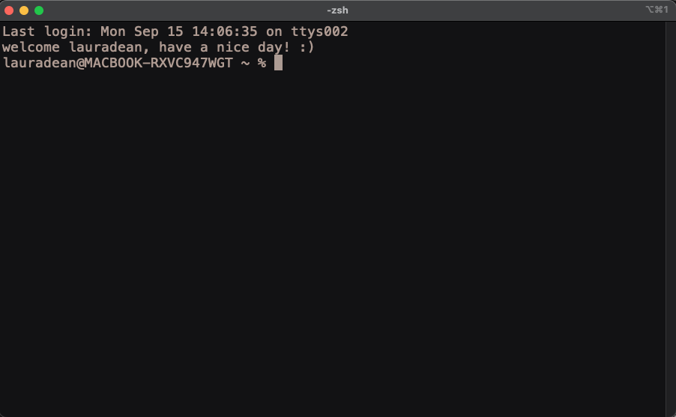
The terminal
A terminal is a command line interface or CLI
It allows you to have text & command-based interaction with your computer
It’s essentially a box where you can type things
Similar to a graphical user interface (GUI), which is menu-driven and what you are probably used to.
A CLI sends your typed commands to a shell
The shell interprets and executes the commands
This is basically all happening in the background when you run a GUI on your computer anyway, you just don’t see it!

Slide 9
The terminal
HINT – your command prompt is customizable, but we will come back to that!
A part that tells you who you are and what computer you are communicating with
The command prompt. NOTE this tells you your terminal is ready to receive a new typed command from you. If you don’t see it – your computer is still executing something else.

Slide 10
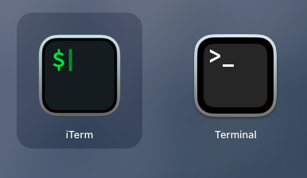
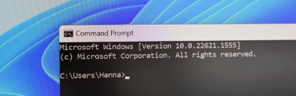

The terminal
macOS includes the Terminal app
Other terminal apps are available, such as iTerm2
Windows includes Command Prompt and PowerShell
For this course, use WSL with a Linux distribution such as Ubuntu
Notes:
[Sources]
- Microsoft Learn, Install WSL: https://learn.microsoft.com/en-us/windows/wsl/install

Slide 11

The shell
A shell interprets commands typed in a terminal
There are many different types of shell
macOS uses Z shell (Zsh) by default
Windows commonly uses PowerShell
Linux HPC systems commonly use Bash
Bash and Zsh share core syntax; PowerShell differs
We will learn Bash-compatible commands because they are used on the Linux-based HPC systems in this course
Notes:
[Sources]
- GNU Bash manual: https://www.gnu.org/software/bash/manual/
- Apple Support, use zsh as the default shell: https://support.apple.com/en-gb/102360

Slide 12
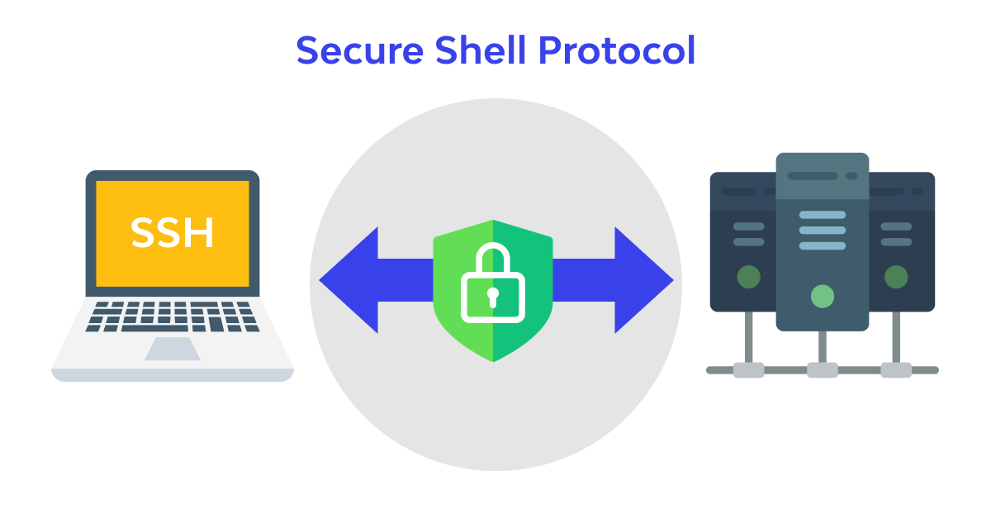
SSH – secure shell – used to connect to a remote machine
When you type commands into a terminal on your laptop
YOU ARE INTERACTING WITH YOUR OWN MACHINE
To connect to a remote machine we use the SSH command.
Once you have successfully executed the ssh command you will be logged in to a remote machine (via the internet).
Everything you type will then be executed on the remote machine NOT your own laptop.
This will remain the case until you log out by typing exit, or by closing the terminal window (or if your connection to the remote machine drops because of a network interruption).

Slide 13
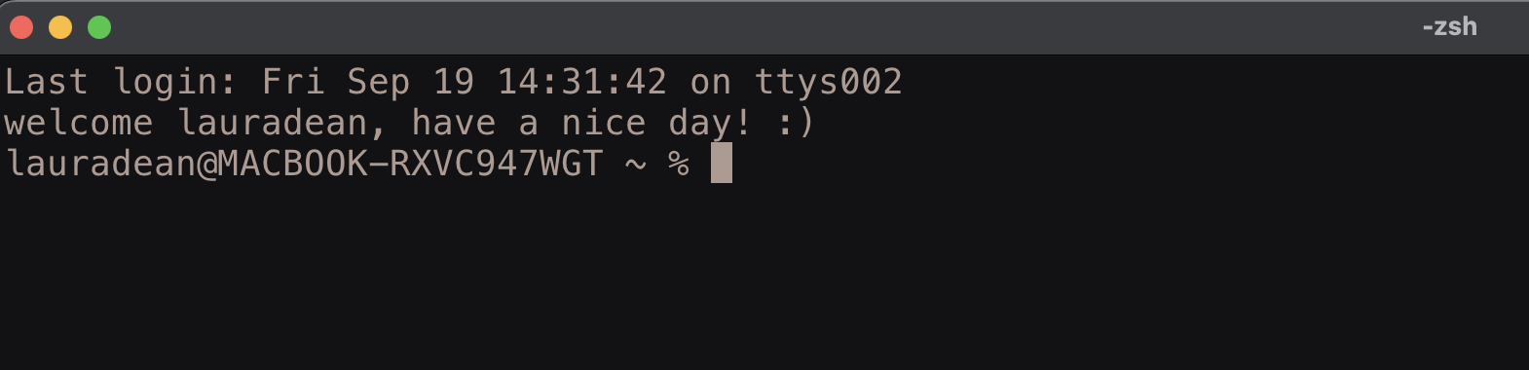
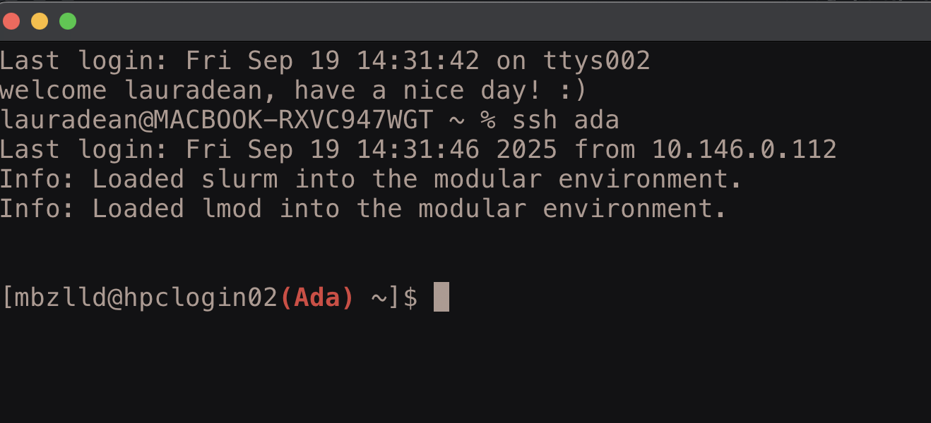
SSH – always look at your command prompt
When I first open a terminal, I am interacting with my own laptop
After connecting to ada using ssh, I am interacting with Ada, not my own laptop

Slide 14
SSH command structure
ssh – secure shell basic command:
ssh username@hpclogin02.ada.nottingham.ac.uk
command
Name of user on the remote machine
Symbol to separate username from host address
Host address of remote machine. This can be an IP address or a domain name as above.
one space
On Ada this is your university username e.g. mine is mbzlld
You can use either hpclogin01 or hpclogin02 here (these are the two login nodes on Ada).

Slide 15

EXERCISE: Connect to the UoN HPC – Ada
**Always connect to the VPN before trying to log in to Ada (even on campus)**
Then open a terminal (terminal or iTerm2 for Mac users, WSL/Ubuntu for Windows users)
Type this command into your terminal (replacing ‘username’ with your university username)
You should be prompted to enter your password (type your university password and hit return) – NOTE: you will not see any characters when you type your password. This is a safety feature but rest assured you are typing. If you get it wrong you will get multiple attempts.
The first time you log in you will get a message about whether you trust this machine and want to add it to known hosts. Type y or yes to add to known hosts.
You should be connected. Check you see the word Ada at your command prompt:
Then log out with the command: exit
ssh username@hpclogin02.ada.nottingham.ac.uk

Slide 16
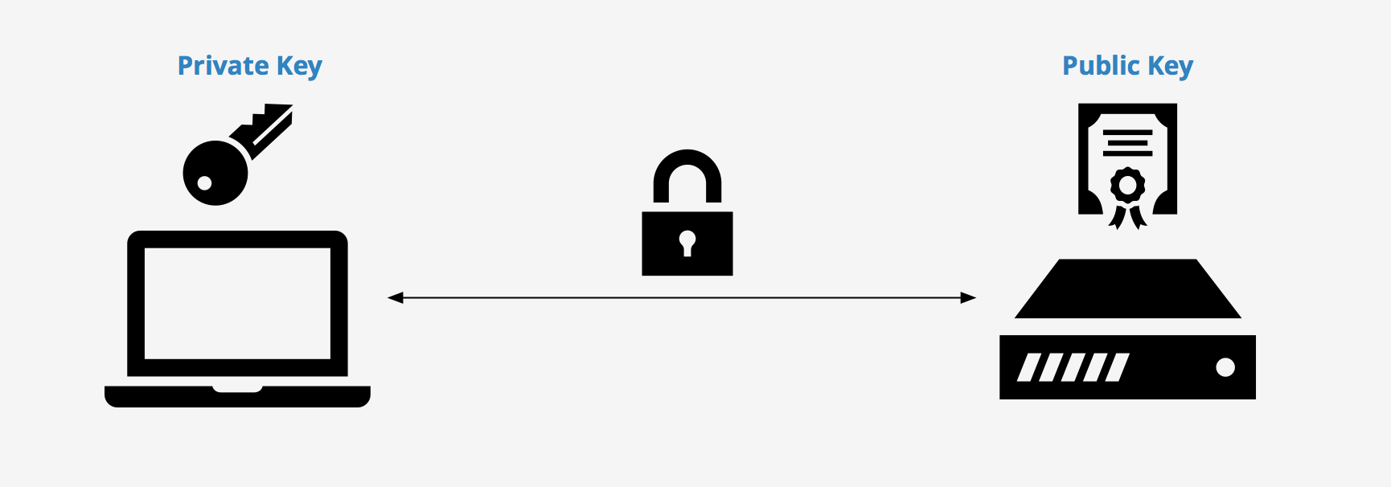
SSH keys
SSH key pairs allow key-based login to a remote machine
Keep your private key only on your own device and never share it
Copy only the public key to a host you are authorised to use
Allow you to login without typing your password
Notes:
[Sources]
- OpenBSD manual, ssh-keygen: https://man.openbsd.org/ssh-keygen

Slide 17
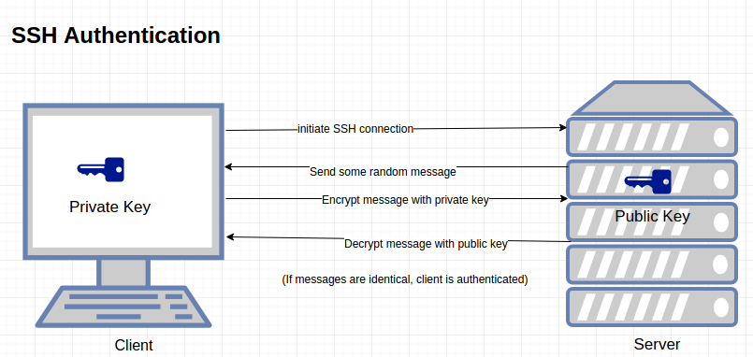
ssh keys – how they work

Slide 18
EXERCISE: set up key-based SSH login
SSH keys authenticate your device to the HPC; your private key stays on your device
Open WSL/Ubuntu on Windows or Terminal on macOS
Create an Ed25519 key pair. Accept the default file location and leave the passphrase blank:
ssh-keygen -t ed25519
This creates ~/.ssh/id_ed25519 (private) and ~/.ssh/id_ed25519.pub (public). Never share the private key.
Copy the public key to Ada; replace username and enter your Ada password when prompted:
ssh-copy-id username@hpclogin02.ada.nottingham.ac.uk
Test the connection. You should not need to enter your password this time:
ssh username@hpclogin02.ada.nottingham.ac.uk
Notes:
[Sources]
- OpenBSD manual, ssh-keygen: https://man.openbsd.org/ssh-keygen

Slide 19
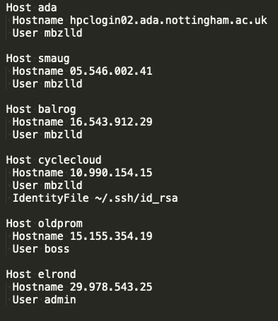

ssh config file
Example:
An ssh config file specifies information about the different hosts you connect to
The config file is located here: ~/.ssh/config
It allows you to login without having to remember the domain name or ip address of each machine you want to ssh into.
Makes life much easier if you regularly use multiple HPCs

Slide 20
Setting up a config file
We will create a config file together… use nano or vim or whatever text editor you prefer!
E.g. type nano ~/.ssh/config OR vim ~/.ssh/config into your terminal to create the file, type the text from the example below then save.
Example config file: replace ‘username’ with your University username; indentation improves readability and the host/user values must be exact
Host ada
Hostname hpclogin02.ada.nottingham.ac.uk
User username
After you have created your config file try logging in using the command: ssh ada
Notes:
[Sources]
- OpenBSD manual, ssh_config: https://man.openbsd.org/ssh_config

Slide 21
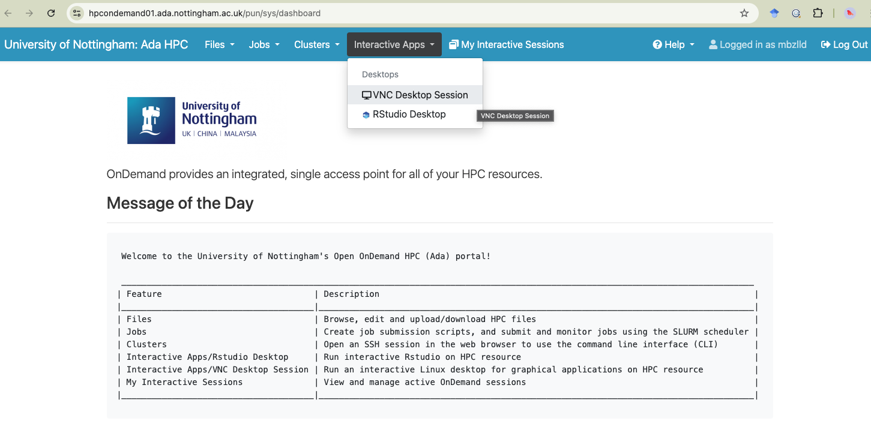
OpenOnDemand
https://hpcondemand01.ada.nottingham.ac.uk

Slide 22

UoN HPC – Ada – support & information
The sharepoint site:
Commands, partitions and resources:
https://uniofnottm.sharepoint.com/sites/DigitalResearch/SitePages/Ada-Commands-Partitions-and-Resources.aspx
Software modules:
https://uniofnottm.sharepoint.com/sites/DigitalResearch/SitePages/Ada-Compute-software.aspx
The IT helpdesk: (if you need something that requires admin rights, this is your only option!)
https://www.nottingham.ac.uk/dts/help/self-service-portal/self-service-portal.aspx
Me! : laura.dean@nottingham.ac.uk or teams chat

