Slide 1

How to use the UoN HPC “Ada”
LIFE4138

Slide 2
Learning Objectives
Setup your ssh config file
Know how to write a job submission script
Know how to submit and manage a job using basic slurm commands
Know how to access software on the HPC
Know how to copy files between the HPC and your local machine
Know where to go for further support

Slide 3
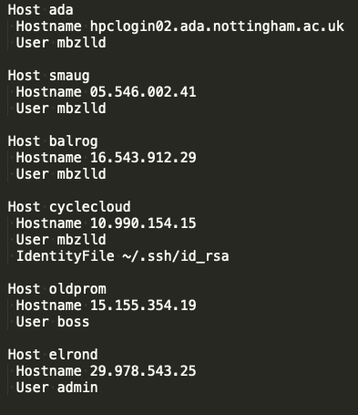

ssh config file
Example:
An ssh config file specifies information about the different hosts you connect to
The config file is located here: ~/.ssh/config
It allows you to login without having to remember the domain name or ip address of each machine you want to ssh into.
Makes life much easier, especially if you regularly use multiple HPCs

Slide 4
Setting up a config file
We will create a config file together… use nano or vim or whatever text editor you prefer!
E.g. type nano ~/.ssh/config OR vim ~/.ssh/config into your terminal to create the file, type the text from the example below then save.
Example config file: replace ‘username’ with your University username, spaces and indentation must be exact!
Host ada
Hostname hpclogin02.ada.nottingham.ac.uk
User username
After you have created your config file try logging in using the command: ssh ada
Notes:
[Sources]
- OpenBSD manual, ssh_config: https://man.openbsd.org/ssh_config

Slide 5

How to use Ada
login to a login node using your ssh command
Write job submission scripts & save them on Ada
Submit jobs to compute nodes using the slurm scheduler
Interpret output once jobs complete

Slide 6
provides information to the slurm scheduler about the job you are requesting
The scheduler cannot run your job without this information
Job submission / slurm script
Example job submission script:
#!/bin/bash
#SBATCH --partition=defq
#SBATCH --cpus-per-task=8
#SBATCH --mem=5g
#SBATCH --time=00:10:00
#SBATCH --job-name=my_job
#SBATCH --output=/gpfs01/home/username/slurm-%x-%j.out
#SBATCH --error=/gpfs01/home/username/slurm-%x-%j.err
#SBATCH --mail-type=ALL
#SBATCH --mail-user=username@exmail.nottingham.ac.uk
# Write out a test file to check our job ran
echo “hello world” > ~/our_test_output.txt
NOTE: replace username with your own university username

Slide 7
Job submission script
Example job submission script:
#!/bin/bash
#SBATCH --partition=defq
#SBATCH --cpus-per-task=8
#SBATCH --mem=5g
#SBATCH --time=00:10:00
#SBATCH --job-name=my_job
#SBATCH --output=/gpfs01/home/username/slurm-%x-%j.out
#SBATCH --error=/gpfs01/home/username/slurm-%x-%j.err
#SBATCH --mail-type=ALL
#SBATCH --mail-user=username@exmail.nottingham.ac.uk
# Write out a test file to check our job ran
echo “hello world” > ~/our_test_output.txt
#!/bin/bash
The shebang – tells the operating system which interpreter to use to when executing the script
NOTE: replace username with your own university username

Slide 8
Job submission script
Example job submission script:
#!/bin/bash
#SBATCH --partition=defq
#SBATCH --cpus-per-task=8
#SBATCH --mem=5g
#SBATCH --time=00:10:00
#SBATCH --job-name=my_job
#SBATCH --output=/gpfs01/home/username/slurm-%x-%j.out
#SBATCH --error=/gpfs01/home/username/slurm-%x-%j.err
#SBATCH --mail-type=ALL
#SBATCH --mail-user=username@exmail.nottingham.ac.uk
# Write out a test file to check our job ran
echo “hello world” > ~/our_test_output.txt
--partition=
Select the type of compute node you want to use
(we will talk about the different partitions that are available to you later)
NOTE: replace username with your own university username

Slide 9
Job submission script
Example job submission script:
#!/bin/bash
#SBATCH --partition=defq
#SBATCH --cpus-per-task=8
#SBATCH --mem=5g
#SBATCH --time=00:10:00
#SBATCH --job-name=my_job
#SBATCH --output=/gpfs01/home/username/slurm-%x-%j.out
#SBATCH --error=/gpfs01/home/username/slurm-%x-%j.err
#SBATCH --mail-type=ALL
#SBATCH --mail-user=username@exmail.nottingham.ac.uk
# Write out a test file to check our job ran
echo “hello world” > ~/our_test_output.txt
--cpus-per-task=
Select how many cores you want your job to use. This is where you can sometimes make a lot of things much faster by requesting more cores.
NOTE: replace username with your own university username

Slide 10
Job submission script
Example job submission script:
#!/bin/bash
#SBATCH --partition=defq
#SBATCH --cpus-per-task=8
#SBATCH --mem=5g
#SBATCH --time=00:10:00
#SBATCH --job-name=my_job
#SBATCH --output=/gpfs01/home/username/slurm-%x-%j.out
#SBATCH --error=/gpfs01/home/username/slurm-%x-%j.err
#SBATCH --mail-type=ALL
#SBATCH --mail-user=username@exmail.nottingham.ac.uk
# Write out a test file to check our job ran
echo “hello world” > ~/our_test_output.txt
--mem=
Select how much RAM to allocate to your job.
Units:
g = gb – gigabytes
m = mb – megabytes
NOTE: replace username with your own university username

Slide 11
Job submission script
Example job submission script:
#!/bin/bash
#SBATCH --partition=defq
#SBATCH --cpus-per-task=8
#SBATCH --mem=5g
#SBATCH --time=00:10:00
#SBATCH --job-name=my_job
#SBATCH --output=/gpfs01/home/username/slurm-%x-%j.out
#SBATCH --error=/gpfs01/home/username/slurm-%x-%j.err
#SBATCH --mail-type=ALL
#SBATCH --mail-user=username@exmail.nottingham.ac.uk
# Write out a test file to check our job ran
echo “hello world” > ~/our_test_output.txt
--time=
Select the maximum amount of time your job can run for.
Units:
hh:mm:ss
NOTE: replace username with your own university username

Slide 12
Job submission script
Example job submission script:
#!/bin/bash
#SBATCH --partition=defq
#SBATCH --cpus-per-task=8
#SBATCH --mem=5g
#SBATCH --time=00:10:00
#SBATCH --job-name=my_job
#SBATCH --output=/gpfs01/home/username/slurm-%x-%j.out
#SBATCH --error=/gpfs01/home/username/slurm-%x-%j.err
#SBATCH --mail-type=ALL
#SBATCH --mail-user=username@exmail.nottingham.ac.uk
# Write out a test file to check our job ran
echo “hello world” > ~/our_test_output.txt
--job-name=
Short useful name for you to identify your job (no spaces allowed!)
NOTE: replace username with your own university username

Slide 13
Job submission script
Example job submission script:
#!/bin/bash
#SBATCH --partition=defq
#SBATCH --cpus-per-task=8
#SBATCH --mem=5g
#SBATCH --time=00:10:00
#SBATCH --job-name=my_job
#SBATCH --output=/gpfs01/home/username/slurm-%x-%j.out
#SBATCH --error=/gpfs01/home/username/slurm-%x-%j.err
#SBATCH --mail-type=ALL
#SBATCH --mail-user=username@exmail.nottingham.ac.uk
# Write out a test file to check our job ran
echo “hello world” > ~/our_test_output.txt
--output=
Name and location of output file (all output that would be printed to the screen if you ran your script directly in the terminal will be stored here)
If you do not specify a separate error file, errors will also be written to your output file.
%x = Job name (taken from --job-name=)
%j = Job ID (allocated upon submission)
NOTE: replace username with your own university username

Slide 14
Job submission script
Example job submission script:
#!/bin/bash
#SBATCH --partition=defq
#SBATCH --cpus-per-task=8
#SBATCH --mem=5g
#SBATCH --time=00:10:00
#SBATCH --job-name=my_job
#SBATCH --output=/gpfs01/home/username/slurm-%x-%j.out
#SBATCH --error=/gpfs01/home/username/slurm-%x-%j.err
#SBATCH --mail-type=ALL
#SBATCH --mail-user=username@exmail.nottingham.ac.uk
# Write out a test file to check our job ran
echo “hello world” > ~/our_test_output.txt
--error=
OPTIONAL: Name and location of error file (any errors that would be printed to the screen if you ran your script directly in the terminal will be stored here)
If you do not specify a separate error file, errors will be written to your output file.
%x = Job name (taken from --job-name=)
%j = Job ID (allocated upon submission)
NOTE: replace username with your own university username

Slide 15
Job submission script
Example job submission script:
#!/bin/bash
#SBATCH --partition=defq
#SBATCH --cpus-per-task=8
#SBATCH --mem=5g
#SBATCH --time=00:10:00
#SBATCH --job-name=my_job
#SBATCH --output=/gpfs01/home/username/slurm-%x-%j.out
#SBATCH --error=/gpfs01/home/username/slurm-%x-%j.err
#SBATCH --mail-type=ALL
#SBATCH --mail-user=username@exmail.nottingham.ac.uk
# Write out a test file to check our job ran
echo “hello world” > ~/our_test_output.txt
--mail-type=ALL
--mail-user=
OPTIONAL: receive an email when your job starts running and when it completes.
NOTE: replace username with your own university username

Slide 16
Job submission script
Example job submission script:
#!/bin/bash
#SBATCH --partition=defq
#SBATCH --cpus-per-task=8
#SBATCH --mem=5g
#SBATCH --time=00:10:00
#SBATCH --job-name=my_job
#SBATCH --output=/gpfs01/home/username/slurm-%x-%j.out
#SBATCH --error=/gpfs01/home/username/slurm-%x-%j.err
#SBATCH --mail-type=ALL
#SBATCH --mail-user=username@exmail.nottingham.ac.uk
# Write out a test file to check our job ran
echo “hello world” > ~/our_test_output.txt
The main body of your script – the bit where you write what you want the script to actually do!
NOTE: replace username with your own university username

Slide 17
PRACTICAL: Write your own
Login to the HPC using the command ssh ada
Use your preferred command line text editor (e.g. nano / vim) to create a file named my_test_script.sh
Type the text below into your file and save it DO NOT TRY TO RUN IT JUST YET
#!/bin/bash
#SBATCH --partition=defq
#SBATCH --cpus-per-task=1
#SBATCH --mem=1g
#SBATCH --time=00:05:00
#SBATCH --job-name=my_job
#SBATCH --output=/gpfs01/home/username/slurm-%x-%j.out
#SBATCH --error=/gpfs01/home/username/slurm-%x-%j.err
#SBATCH --mail-type=ALL
#SBATCH --mail-user=username@exmail.nottingham.ac.uk
# Write out a test file to check our job ran
echo “hello world” > ~/our_test_output.txt
NOTE: replace username with your own university username

Slide 18

UoN HPC – Ada – SLURM commands:
sbatch - submit a job
squeue - list jobs and show their status
scancel - delete jobs
sacct – get info on past jobs
srun – request an interactive session on a compute node
Soooo much more – check out the docs!
https://slurm.schedmd.com/documentation.html

Slide 19
How to submit and monitor your script:
Now have a go at running the script you just wrote
Submit your job script using the command:
sbatch my_script.sh
Monitor your job using the command:
squeue –l –u username
Cancel your job using the command:
scancel job_id_number
(NOTE: the jobid number is in the first column of the output from squeue)

Slide 20
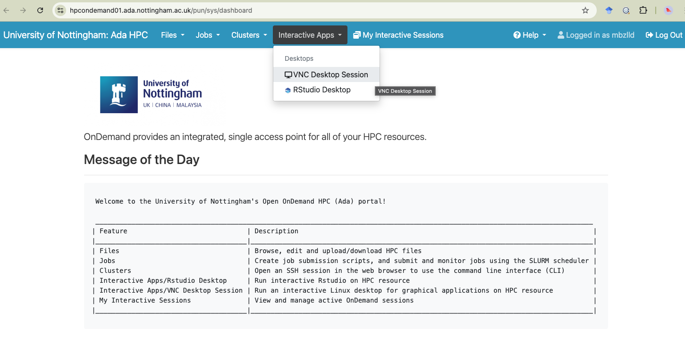
OpenOnDemand
https://hpcondemand01.ada.nottingham.ac.uk

Slide 21
Partitions on Ada:
Example job submission script:
#!/bin/bash
#SBATCH --partition=defq
#SBATCH --cpus-per-task=8
#SBATCH --mem=5g
#SBATCH --time=00:10:00
#SBATCH --job-name=my_job
#SBATCH --output=/gpfs01/home/username/slurm-%x-%j.out
#SBATCH --error=/gpfs01/home/username/slurm-%x-%j.err
#SBATCH --mail-type=ALL
#SBATCH --mail-user=username@exmail.nottingham.ac.uk
# Write out a test file to check our job ran
echo “hello world” > ~/our_test_output.txt
--partition=
Select the type of compute node you want to use

Slide 22
UoN HPC – Ada – partitions:
Partition name | Type of node
defq | Standard compute nodes with 96 cores and 384 GB (361 GB usable) memory. There are 63 nodes in this partition. The maximum job walltime allowed is 7 days (168 hours).
shortq | Standard compute nodes with 96 cores and 384 GB (361 GB usable) memory. There are 6 nodes in this partition. The maximum job walltime allowed is 12 hours.
devq | Standard compute nodes with 96 cores and 384 GB (361 GB usable) memory. This queue shares the nodes with 'defq' partition, but limits total number of cores per user to 96, and number of jobs to 4. The maximum job walltime allowed is 1 hour.
hmemq | High memory compute node with 96 cores and 1536 GB (1495 GB usable) memory. There are 10 nodes in this partition. The maximum job walltime allowed is 7 days (168 hours).
ampereq | GPGPU (ampere) compute node with 96 cores and 768 GB (747 GB usable) memory, and 8 Nvidia A100 GPUs There are 2 nodes in this partition. The maximum job walltime allowed is 7 days (168 hours).
ampere-devq | GPGPU (ampere) compute node with 96 cores and 768 GB (747 GB usable) memory, and 8 Nvidia A100 GPUs This queue shares the nodes with 'ampereq' partition, but limits total number of cores per user to 12, number of GPUs per user to 1, and number of jobs to 4. The maximum job walltime allowed is 1 hour
ampere-mq | GPGPU (ampere) compute node with 96 cores and 768 GB (747 GB usable) memory, and 8 Nvidia A100 GPUs, each A100 split into 7x 'MIG' instances There are 2 nodes in this partition. The maximum job walltime allowed is 7 days (168 hours).
ampere-m-devq | GPGPU (ampere) compute node with 96 cores and 768 GB (747 GB usable) memory, and 8 Nvidia A100 GPUs, each A100 split into 7x 'MIG' instances This queue shares the nodes with 'ampere-mq' partition, but limits total number of cores per user to 12, number of GPUs per user to 1, and number of jobs to 4. The maximum job walltime allowed is 1 hour.
normal jobs
quick jobs
testing
high memory
GPU (graphics processing unit)
GPU - testing
Notes:
Defq is the one for accessing normal HPC nodes. This is probably the main queue you will want to use
If you need to run jobs with more than 361 GB memory e.g. genome assemblies you would use hmemq
If you want access to GPU nodes use ampere
GPU – graphics processing Unit

Slide 23

Accessing software on Ada
Pre-installed software available to you as modules
Software you install yourself with Conda
Software containers (singularity, docker) – we will not cover software containers in this module but you should be aware that they exist and you can use them on Ada

Slide 24
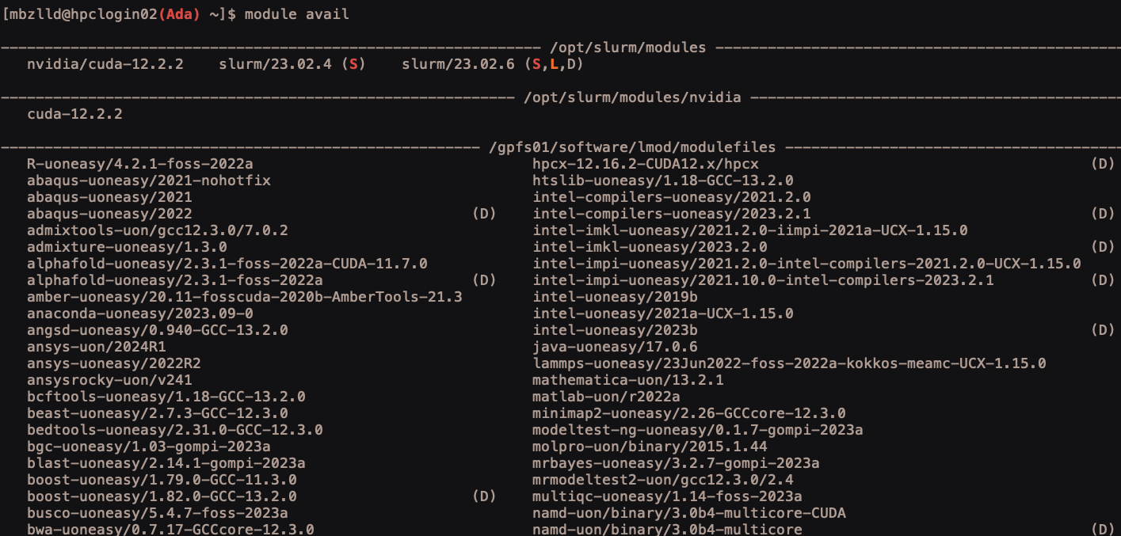
UoN HPC – Ada – software modules
TO SEE ALL AVAILABLE SOFTWARE module avail e.g.:
sticky
loaded
default
And many more…
Notes:
Software on Ada must be loaded from environment modules
To list all available software use module avail
S by a module means the module is sticky and requires the –force flag to unload (you shouldn’t need to mess with these!
L by a module means the module is currently loaded
D by a module means this is the default version of the software

Slide 25
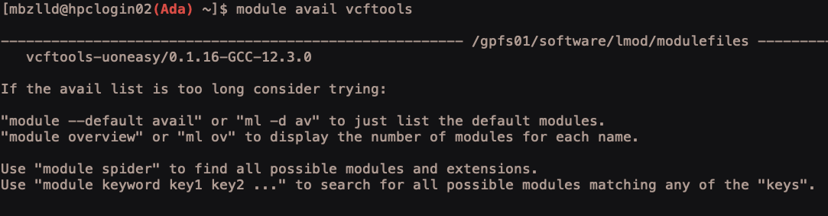
UoN HPC – Ada – software modules
TO SEARCH FOR SOFTWARE module avail software_name e.g.:
TO LOAD SOFTWARE: module load module_name e.g. :
TO UNLOAD SOFTWARE: module unload module_name e.g. :
Notes:
Software on Ada must be loaded from environment modules
To search for a specific software use module avail software_name
To load modules use module load module_name
To unload use module unload module_name

Slide 26
PRACTICAL: using software modules
Write another job submission script - try loading a module in the script and printing the help using the --help flag
#!/bin/bash
#SBATCH --partition=defq
#SBATCH --cpus-per-task=1
#SBATCH --mem=1g
#SBATCH --time=00:05:00
#SBATCH --job-name=module_test
#SBATCH --output=/gpfs01/home/username/slurm-%x-%j.out
#SBATCH --error=/gpfs01/home/username/slurm-%x-%j.err
# load a module
module load samtools-uoneasy/1.22.1-GCC-14.2.0
# print the help
samtools --help
# unload the module
module unload samtools-uoneasy/1.22.1-GCC-14.2.0
Notes:
Software on Ada must be loaded from environment modules
To search for a specific software use module avail software_name
To load modules use module load module_name
To unload use module unload module_name

Slide 27
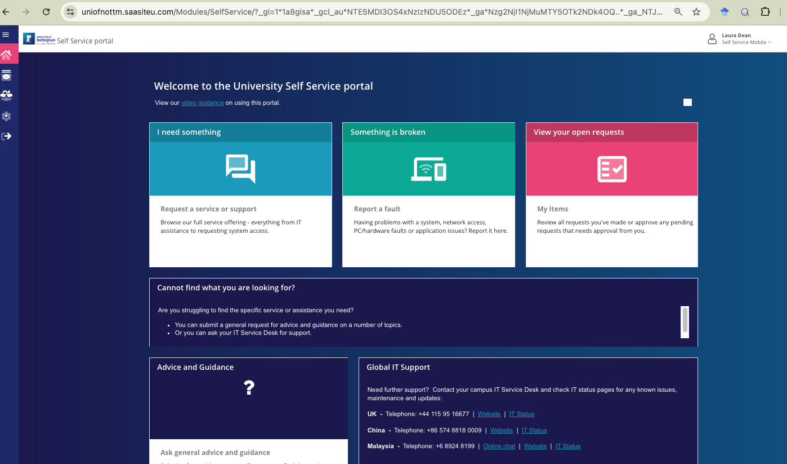
requesting new software modules
Use the IT self-service portal to request new software modules
https://www.nottingham.ac.uk/dts/help/self-service-portal/self-service-portal.aspx
Notes:
Software on Ada must be loaded from environment modules
To search for a specific software use module avail software_name
To load modules use module load module_name
To unload use module unload module_name

Slide 28
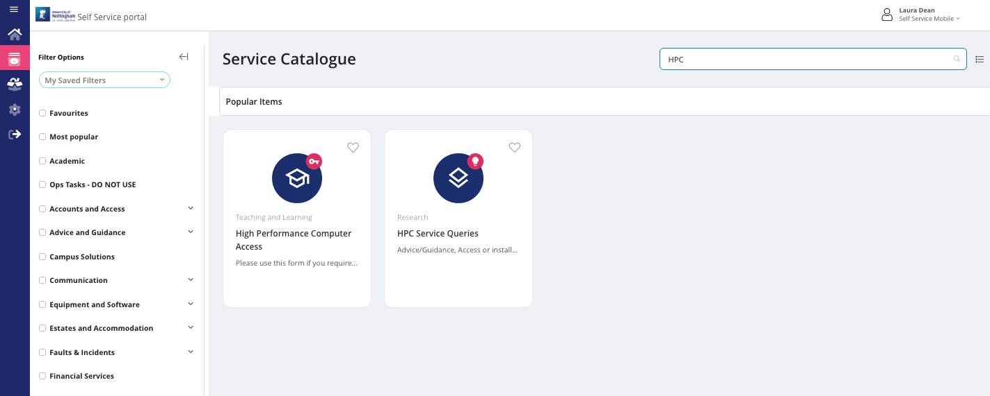
requesting new software modules
Search HPC and use the HPC Service Queries option
Notes:
Software on Ada must be loaded from environment modules
To search for a specific software use module avail software_name
To load modules use module load module_name
To unload use module unload module_name

Slide 29

UoN HPC – Ada – conda
You can install and use Conda just as you did on your own laptops
TO DOWNLOAD: wget https://repo.anaconda.com/miniconda/Miniconda3-latest-Linux-x86_64.sh
TO INSTALL: bash Miniconda3-latest-Linux-x86_64.sh
Say yes to everything it asks you during the install process - accept the license terms with yes and accept the default install location by pressing return
Log out of Ada and back in again
Then run the following commands:
conda config --set auto_activate_base false
conda config --set env_prompt '({name})'
conda config --append channels conda-forge
conda config --append channels bioconda
conda deactivate
Then create environments and install software just like you have on your own laptop!

Slide 30
EXAMPLE: using conda in a job submission script
#!/bin/bash
#SBATCH --partition=defq
#SBATCH --cpus-per-task=1
#SBATCH --mem=1g
#SBATCH --time=00:05:00
#SBATCH --job-name=my_job
#SBATCH --output=/gpfs01/home/username/slurm-%x-%j.out
#SBATCH --error=/gpfs01/home/username/slurm-%x-%j.err
# source your bash profile so you can use conda
source $HOME/.bash_profile
# activate conda environment
conda activate environment_name
# do some tasks within conda environment
# deactivate conda environment
conda deactivate
Small quirk - Conda will not work unless you source your bash profile before you use it

Slide 31
Moving data between local and remote machines
scp = secure copy
To copy whole directories add the –r flag
For copying files and directories to / from a HPC and your local machine
ALWAYS RUN THIS COMMAND FROM YOUR LOCAL MACHINE! (not when you are logged in to Ada)
To copy a file from Ada to the current directory on your laptop:
scp ada:~/path/to/file/file.txt ./
To copy a file from the current directory on your laptop to Ada:
scp file.txt ada:~/path/to/dir/

Slide 32
OpenOnDemand
https://hpcondemand01.ada.nottingham.ac.uk

Slide 33

UoN HPC – Ada – support & information
The sharepoint site:
Commands, partitions and resources:
https://uniofnottm.sharepoint.com/sites/DigitalResearch/SitePages/Ada-Commands-Partitions-and-Resources.aspx
Software modules:
https://uniofnottm.sharepoint.com/sites/DigitalResearch/SitePages/Ada-Compute-software.aspx
The IT helpdesk: (if you need something that requires admin rights, this is your only option!)
https://www.nottingham.ac.uk/dts/help/self-service-portal/self-service-portal.aspx
Me! : laura.dean@nottingham.ac.uk or teams chat

Slide 34
UoN HPC – Ada – SLURM commands:
Check your storage:
mmlsquota -u username --block-size G dss2fs01:HOME

