Slide 1
Daniel Udwary Tony Wildish NERSC Data Science Engagement Group
Anaconda

Slide 2
What is Anaconda and why will it make your computing life better?
Anaconda started as an open-source distribution of Python.
But it’s also expanded to cover other languages and software
Easy access to thousands of packages
“conda install” for pre-compiled packages
pip still available
Provides virtual environments for non-Python software
Puts software management in hands of the user
No waiting for consultants to install packages
Control over which versions of packages are installed
Provides some package management routes for other languages

Slide 3
Pros and Cons of Adopting Anaconda
Advantages:
Easy access to a broad variety of software and their dependencies
No need to go through “configure && make && make install && repeat”
Portability of environments
Build once, use on all current NERSC machines
Can export an environment and provide it to users outside NERSC/JGI
Anaconda is the default Python on Denovo, Cori, Edison
Reproducibility and transparency
Opportunity to revisit some stale workflows
Users have control of the software
Disadvantages
Users have control of the software
Some duplication of packages in user environments
Time and effort might be required to adapt

Slide 4
Anaconda simplifies virtual environments
Anaconda is built around creating and using virtual environments
Python installed to a central location
You create an “environment”, which contains packages and executables that differ from central python installation
You can install any packages you want in your environment, without NERSC involvement
When activated, your python environment takes PATH precedence
You can have as many environments as you like, and swap between them

Slide 5
How you’ll use Python at NERSC
Load a python module (on Cori. Default on Denovo)
$ module load python
Create an environment with any packages you need
$ conda create --prefix $BSCRATCH/mypythonenv biopython
Activate the environment
$ source activate $BSCRATCH/mypythonenv
(mypythonenv)$
Do your python stuff
Deactivate or swap environments as needed
$ source deactivate
-or-
$ source activate $BSCRATCH/anotherenv

Slide 6
Creating an Anaconda environment
$ conda create --name <env_name>
By default, will create a new env in ~/.conda/envs
(But, do we like to run out of $HOME?)
Better:
$ conda create --mkdir --prefix $BSCRATCH/mynewenv
Would create a new envs directory in my $BSCRATCH dir
Name of this env would be “mynewenv”
$ conda create --clone <firstenv> -p <newenv>
Duplicate an existing env (could be a path to an env)

Slide 7
Installing and finding packages
Anaconda distribution comes with >150 packages pre-installed
$ conda list
If an environment is active, will only list packages installed to that environment
Several hundred more available
$ anaconda search –t conda <package>
Search for ~700 pre-compiled conda packages
https://docs.continuum.io/anaconda/pkg-docs.html
$ anaconda search –t pypi <package>
Search the Python Package Index (>100k)
install with pip

Slide 8
Installing packages
Easiest route:
(myenv)$ conda install scipy biopython
Install as many packages as possible at same time to make it easier to resolve dependencies
“conda install” pulls from continuum.io’s custom repo
Pre-compiled executables
Can specify versions, if available:
$ conda install biopython=1.65
Anaconda keeps track of revisions to your environments
$ conda list --revisions
Pip also available
Custom packages, or packages from PyPI
Many packages pre-installed to Anaconda central location, and linked. You don’t need to install common packages, unless you want to define a version explicitly.

Slide 9
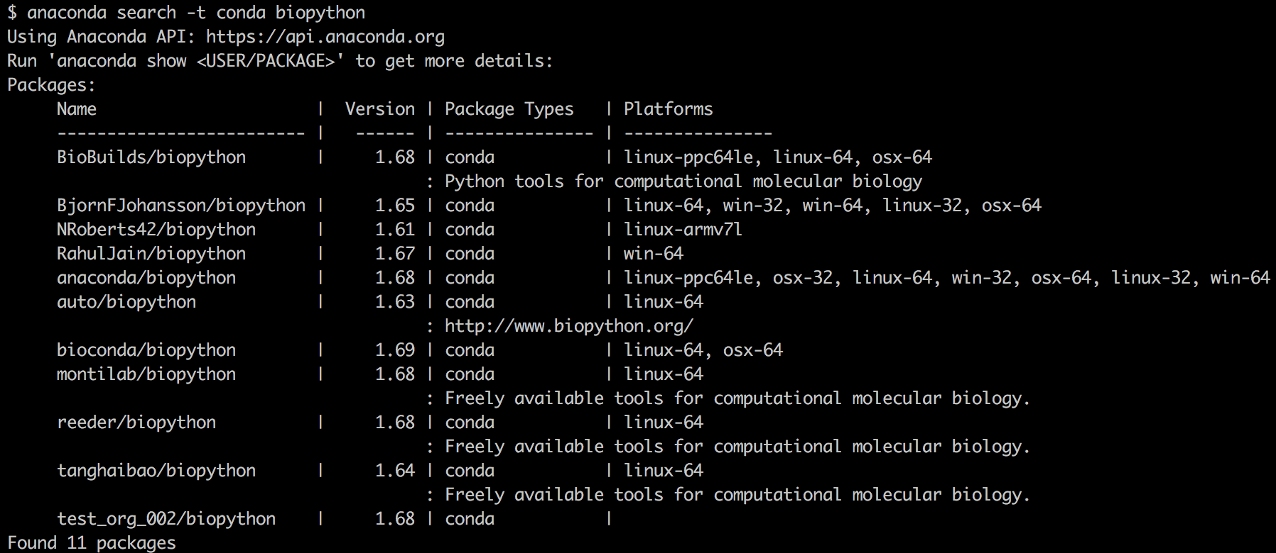
Installing packages
Anaconda packages might be in a “channel”
$ conda install –c bioconda biopython

Slide 10
Anaconda is NOT just for Python anymore
Over 3000 bioinformatics software packages in the “bioconda” channel
https://bioconda.github.io/recipes.html
Recent assessment for prok supergroup:
Requested 89 software modules for Denovo
64 were immediately available through Anaconda/bioconda channel

Slide 11
Other languages in Anaconda
You can also install R and R packages
$ conda install –c r r-essentials
And Perl
$ conda install –c BioBuilds perl-bioperl
Activating an environment with R or Perl installed to it will supercede loaded NERSC modules.
Pre-pending of directories to $PATH

Slide 12
Removing packages or environments
Remove a package from an environment
$ conda remove --name myenv biopython
Remove an environment completely
$ conda remove --name myenv --all
Revert to a previous revision
$ conda install --revision 3

Slide 13
Best practices: Share environments
At NERSC:
Put shared environment in a shared directory
Projectdirs, DnA
env directory and files within must be readable+executable
$ source activate /global/projectb/scratch/dudwary/sharetest
Extract and Re-Import an environment
$ source activate myenv
$ conda env extract > environment.yml
$ conda create -f environment.yml

Slide 14
More Best Practices
Not all packages are available for all OSs
So, extracting an environment built on Denovo often won’t work on Mac or Windows, and vice versa
This is not a truly portable solution, like containers are
Should you put Anaconda in a container?
Miniconda might be a much better option if you want to containerize a python environment. Same environment management, but no pre-installed packages.
Like with containers, avoid “jack-of-all-trades” environments
Especially if using other languages or setting env variables.
Keep them simple and swap as needed.
Be aware that NERSC will do “conda update --all”
Package upgrades will happen, may introduce bugs or lose backward compatibility
Creating an environment and defining needed versions of packages will avoid that issue

Slide 15
Where to get more help
Add a “--help” to almost any conda command
$ conda create –help
Anaconda cheatsheet:
https://conda.io/docs/_downloads/conda-cheatsheet.pdf
Anaconda online documentation
https://conda.io/docs/
NERSC Office Hours
consult@nersc.gov

Slide 16
Exercises
Use Anaconda to install the list of software from the Module exercises:
last, mash, mummer, prodigal, vsearch, zlib
Install all of them to a single Anaconda environment
Bonus points:
Don’t install to your home directory
Do it with a single command
Note which other packages come along as dependencies
Decide whether using Anaconda or making modules for each software tool was more efficient and sustainable

