Slide 1
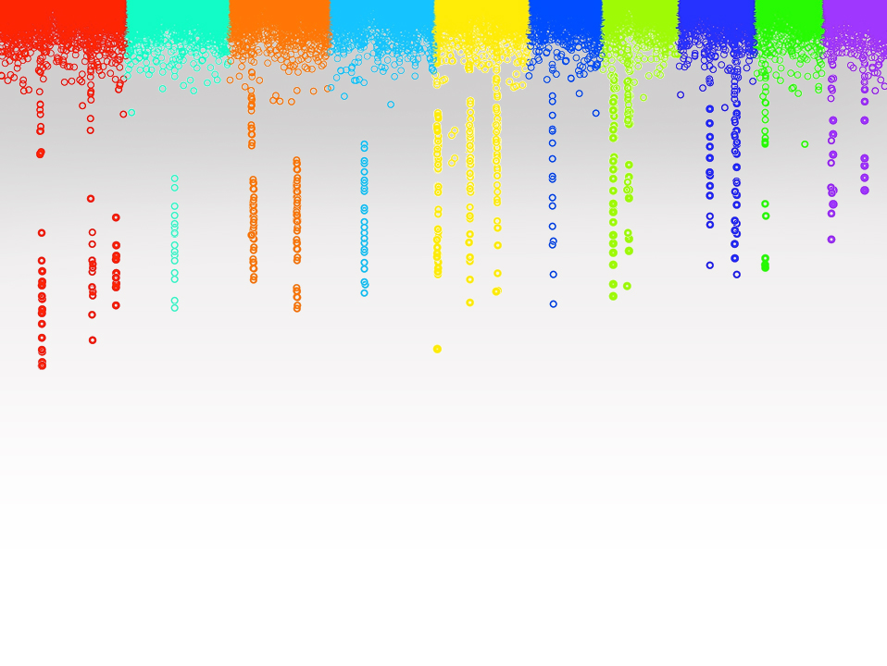

Statistical Genomics
Lecture 8: Linkage
Zhiwu Zhang
Washington State University

Slide 2
Outline
Linkage and recombination
Hardy-Weinberg principle
LD measurements
D
D’
R2
Causes of LD
LD decade

Slide 3
Sex chromosome & Linkage
Thomas Hunt Morgan
(Nobel Prize 1933)
Fly Room at Columbia University

Slide 4
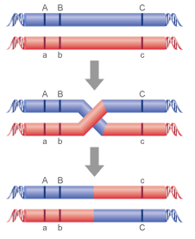
Recombination
recombination rate (r): proportion of recombined
r=1%: centi-Morgan

Slide 5
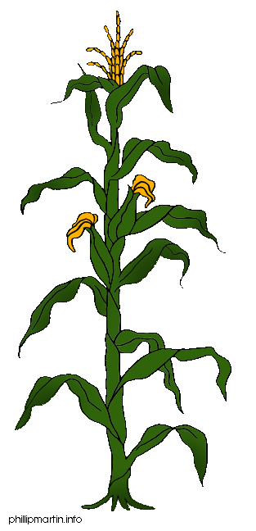
Linkage analysis
Parents
X
F1
F1 gametes
F2 Phenotype
Here lies my QTL
F2 Genotype

Slide 6
Genetics
Breed A
Breed B
M
D
m
d
M
D
m
d
F1
r
M
D
m
d
BCA
F2
M
D
M
D
M
?
M
?
m
?
M
?
m
?
M
?
m
?
m
?

Slide 7
Probability
BCA
M
D
M
D
 | D | d
MM | n1 | n2
Mm | n3 | n4
M
?
m
?
P(?=D | MM)=1-r
P(?=D | Mm)=r
P(?=d | MM)=r
P(?=d | Mm)=1-r
P= r^{(n2+n3)} (1-r)^{(n1+n4)}

Slide 8
Mapping: vary r to maximize P
P= r^{(n2+n3)} (1-r)^{(n1+n4)}
 | D | d
MM | 25 | 25
Mm | 25 | 25
 | D | d
MM | 35 | 15
Mm | 15 | 35
 | D | d
MM | 45 | 5
Mm | 5 | 45
 | D | d
MM | 50 | 0
Mm | 0 | 50

Slide 9
Multiple markers
M1
M2
M3
M4
Gene
M5
r1
r2
r3
r4
r5
P1
P2
P3
P4
P5
P= P1*P2*P3*P4*P5

Slide 10
Multiple markers
M1
M2
M3
M4
Gene
M5
r1
r2
r3
r4
r5
P1
P2
P3
P4
P5
P= P1*P2*P3*P4*P5

Slide 11
Multiple markers
M1
M2
M3
M4
Gene
M5
r1
r2
r3
r4
r5
P1
P2
P3
P4
P5
P= P1*P2*P3*P4*P5

Slide 12
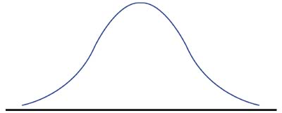
Quantitative traits
Probability having the gene
Probability of phenotype given the gene effect
X
Probability
Probability at gene effect
LOD=Log
Probability of no effect

Slide 13
Multiple genes
M1
M2
Gene
M3
M4
Gene
M5
Population
Single marker to multiple marker
Binary trait to quantitative trait
Single gene to multiple gene
Re-map markers
…

Slide 14
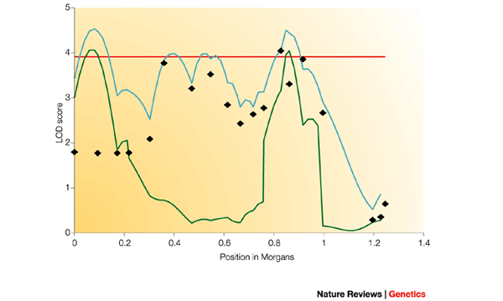
Real example
5
4
3
2
1
0
LOD score
0 0.2 0.4 0.6 0.8 1.0 1.2 1.4
Position in Morgan
Nat Rev Genet 3: 11-21 (2002)

Slide 15
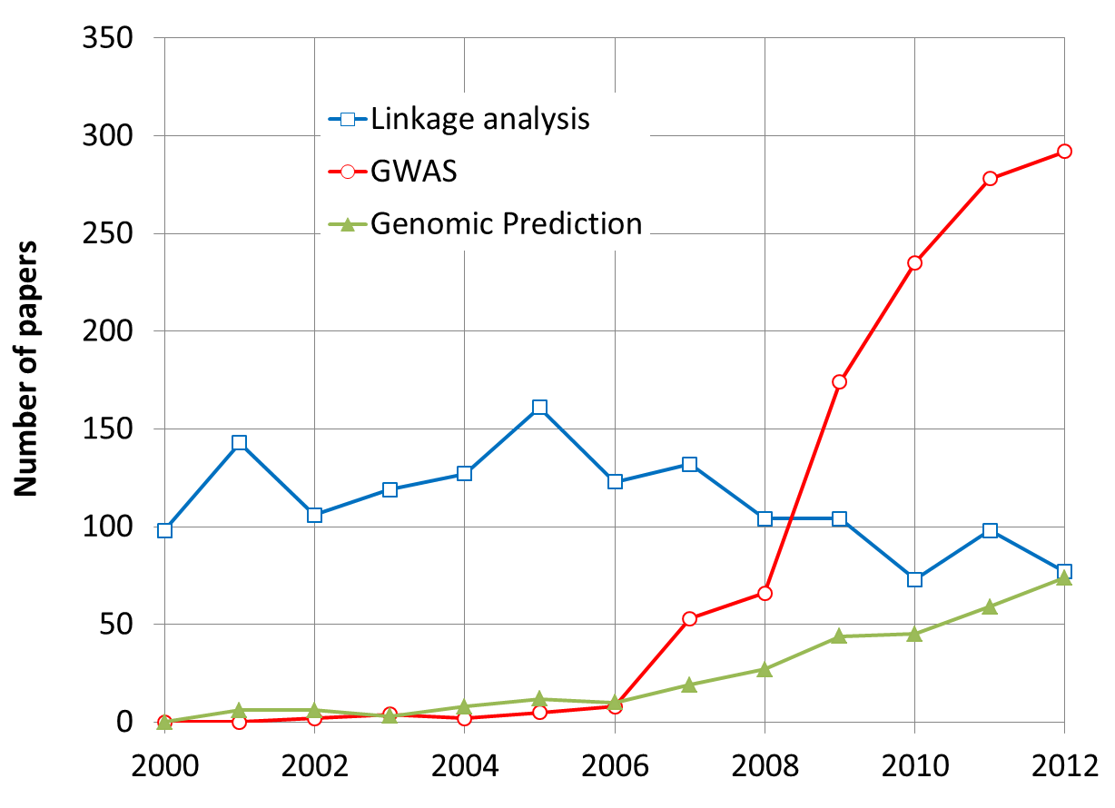
By May 31, 2013

Slide 16
Linkage disequilibrium (association)
 | AA | TT | SUM
Herbicide Resistant | 35 | 5 | 40
Non herbicide Resistant | 35 | 25 | 60
SUM | 70 | 30 | 100
Observed
 | AA | TT | SUM
Herbicide Resistant | 28 | 12 | 40
Non herbicide Resistant | 42 | 18 | 60
SUM | 70 | 30 | 100
Expected
49/28+49/12+49/42+49/18=9.72
1-pchisq(9.72,1)
0.0018

Slide 17
The Hardy–Weinberg principle
Allele and genotype frequencies in a population will remain constant from generation to generation in the absence of other evolutionary influences.
These influences include non-random mating, mutation, selection, genetic drift, gene flow and meiotic drive.
f(A)=p, f(a)=q, then f(AA)=p², f(aa)=q², f(Aa)=2pq

Slide 18
Linkage equilibrium
Random join between alleles at two or more loci
P_{AB}=P_{A}P_{B}
D(ifference)=0

Slide 19
Linkage Disequilibrium (LD)
Loci and allele | A | a | B | b
frequency | .6 | .4 | .7 | .3
Gametic type | AB | Ab | aB | ab
Observed | 0.5 | 0.1 | 0.2 | 0.2
Frequency equilibrium | 0.42 | 0.18 | 0.28 | 0.12
Difference | 0.08 | -0.08 | -0.08 | 0.08
D =P_{AB}-P_{A}P_{B} =P_{ab}-P_{a}P_{b}
=-(P_{Ab}-P_{A}P_{b}) =-(P_{aB}-P_{a}P_{B})

Slide 20
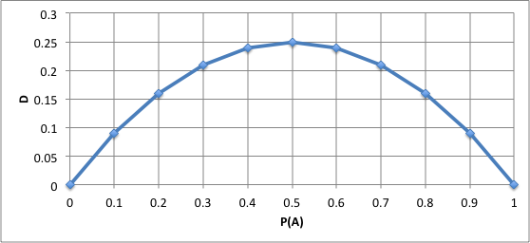
D depends on allele frequency
Vary even with complete LD
P_{Ab}=P_{aB}=0
P_{AB}=1-P_{ab}=P_{A}=P_{B}
D=P_{A}-P_{A}P_{A}

Slide 21
Property of D
Deviation between observed and expected
Extreme values: -0.25 and 0.25
Non LD: D=0
Dependency on allele frequency

Slide 22
D’
Lewontin (1964) proposed standardizing D to the maximum possible value it can take:
D’=D/D_{Max} =0.08/0.18=0.44
D_{max}: the maximum D for given allele frequency
D_{max}= min(P_{A}P_{B}, P_{a}P_{b}) if D is negative, or min(P_{A}P_{b}, P_{a}P_{B}) if D is positive
Range of D’: -1 to 1

Slide 23
R²
Hill and Robertson (1968) proposed the following measure of linkage disequilibrium:
r² (Δ²)=D²/(P_{A}P_{B}P_{a}P_{b})
Square makes positive
The product of allele frequency creates penalty for 50% allele frequency.
Range: 0 to 1

Slide 24
Causes of LD
Mutation
Selection
Inbreeding
Genetic drift
Gene flow/admixture

Slide 25
Mutation and selection
mutation
A____Q
Generation 1
A____q
A____q
A____q
A____q
A____q
A____q
Generation 2
A____q
A____Q
Selection
A____Q
A____q
A____q
A____q
Generation 3
A____Q
A____Q
Selection
A____Q
A____q
A____Q
A____q

Slide 26
Change in D over time
c: recombination rate
D_{t}=D₀(1-c)^{t}
t=log(D_{t}/D₀)/log(1-c)
if c=10%, it takes 6.5 generation for D to be cut in half
1Mb=1cM,
if two SNPs 100kb apart,
c=1% / 10 = 0.001
It takes 693 generations for D to be cut in half

Slide 27
Human out of Africa
https://arstechnica.com/science/2015/12/the-human-migration-out-of-africa-left-its-mark-in-mutations/

Slide 28
Change in D over time
c=.01
c=.05
c=.1
c=.25

Slide 29
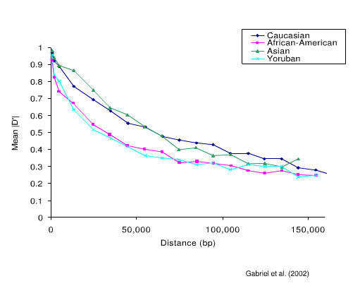
LD decay over distance

Slide 30
Highlight
Trait-marker association
Hardy-Weinberg principle
Linkage an recombination
LD measurements
D
D’
R2
Causes of LD
LD decade

