Slide 1
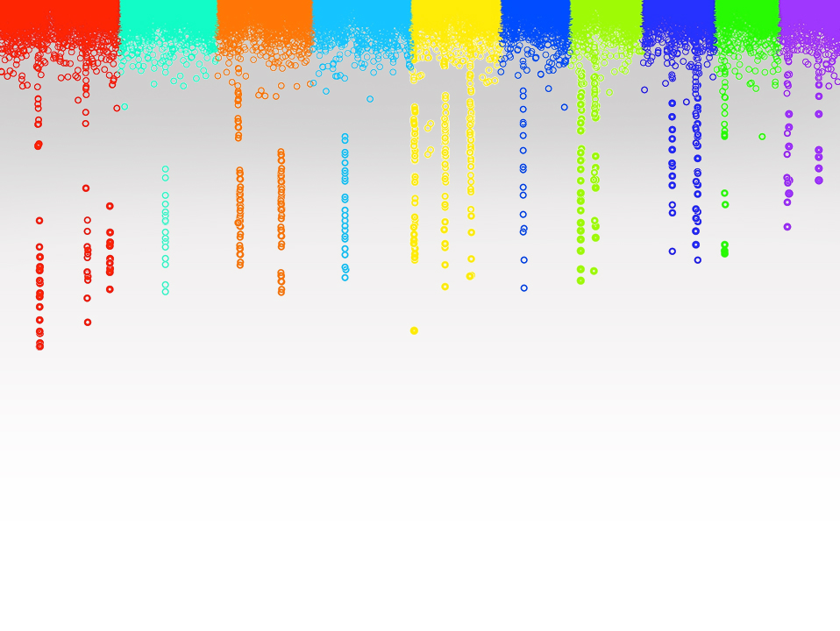

Statistical Genomics
Lecture 11: Power, type I error and FDR
Zhiwu Zhang
Washington State University

Slide 2
Guest lectures
Monday (Feb 12)
Mark Swanson
Principal Component Analysis (PCA)
Outdoor activities
Friday (Feb 16)
Jiabo Wang
General Linear Model (GLM)
GAPIT

Slide 3
Outline
Simulation of phenotype from genotype
GWAS by correlation
Power
FDR
Cutoff
Null distribution of p values
Resolution
QTN bins and non-QTN bins

Slide 4
GWAS by correlation
myGD=read.table(file="http://zzlab.net/GAPIT/data/mdp_numeric.txt",head=T)
myGM=read.table(file="http://zzlab.net/GAPIT/data/mdp_SNP_information.txt",head=T)
setwd("~/Dropbox/Current/ZZLab/WSUCourse/CROPS545/Demo")
source("G2P.R")
source("GWASbyCor.R")
X=myGD[,-1]
set.seed(99164)
mySim=G2P(X= myGD[,-1],h2=.75,alpha=1,NQTN=10,distribution="norm")
p= GWASbyCor(X=X,y=mySim$y)
color.vector <- rep(c("deepskyblue","orange","forestgreen","indianred3"),10)
m=nrow(myGM)
plot(t(-log10(p))~seq(1:m),col=color.vector[myGM[,2]])
abline(v=mySim$QTN.position, lty = 2, lwd=2, col = "black")

Slide 5
Resolution and bin approach
10Kb is really good, 100Kb is OK
Bins with QTNs for power
Bins without QTNs for type I error

Slide 6
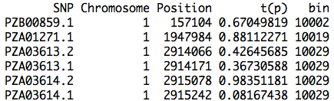
Bins (e.g. 100Kb)
bigNum=1e9
resolution=100000
bin=round((myGM[,2]*bigNum+myGM[,3])/resolution)
result=cbind(myGM,t(p),bin)
head(result)
Minimum p value within bin

Slide 7
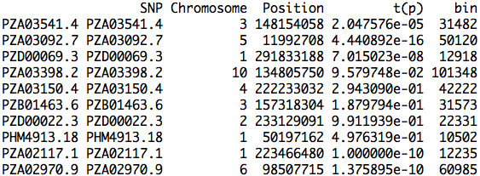
Bins of QTNs
QTN.bin=result[mySim$QTN.position,]
QTN.bin

Slide 8
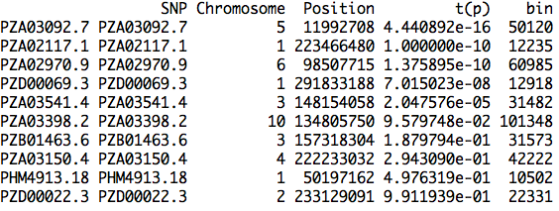
Sorted bins of QTNs
index.qtn.p=order(QTN.bin[,4])
QTN.bin[index.qtn.p,]

Slide 9
FDR and type I error
Total number of bins: 3054 (size of 100kb)
N | bin | t(p)
1 | 50120 | 4.44E-16
2 | 12235 | 1.00E-10
3 | 60985 | 1.38E-10
4 | 12918 | 7.02E-08
5 | 31482 | 2.05E-05
6 | 101348 | 9.58E-02
7 | 31573 | 1.88E-01
8 | 42222 | 2.94E-01
9 | 10502 | 4.98E-01
10 | 22331 | 9.91E-01
Power
0.1
0.2
0.3
0.4
0.5
0.6
0.7
0.8
0.9
1
#False bins
0
0
0
0
2
416
608
782
1001
1335
FDR
0
0
0
0
0.285714286
0.985781991
0.988617886
0.989873418
0.991089109
0.992565056
TypeI Error
0
0
0
0
0.000654879
0.1362148
0.19908317
0.256057629
0.327766863
0.437131631
0.285714286=2/(2+5)
0.000654879=2/3054

Slide 10
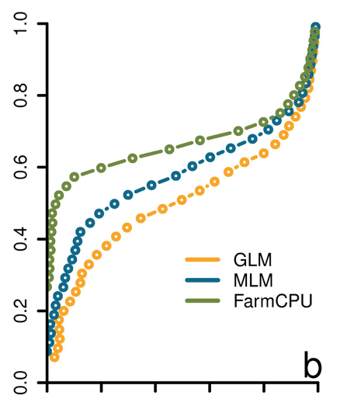
ROC curve
Receiver Operating Characteristic
"The curve is created by plotting the true positive rate against the false positive rate at various threshold settings." -Wikipedia
Power
FDR
Liu et. al. PLoS Genetics, 2016

Slide 11
GAPIT.FDR.TypeI Function
library(compiler) #required for cmpfun
source("http://www.zzlab.net/GAPIT/gapit_functions.txt")
myStat=GAPIT.FDR.TypeI(
WS=c(1e0,1e3,1e4,1e5), GM=myGM,
seqQTN=mySim$QTN.position,
GWAS=result)
str(myStat)

Slide 12
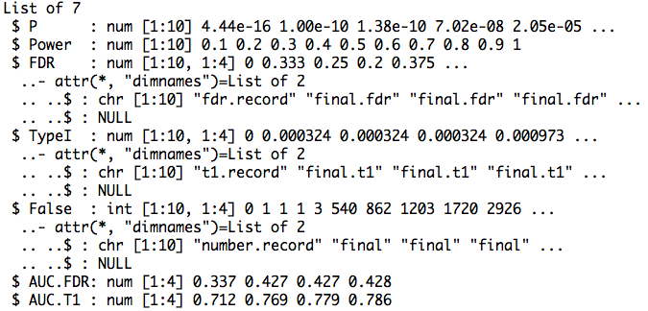
Return

Slide 13
Area Under Curve (AUC)
par(mfrow=c(1,2),mar = c(5,2,5,2))
plot(myStat$FDR[,1],myStat$Power,type="b")
plot(myStat$TypeI[,1],myStat$Power,type="b")

Slide 14
Replicates
nrep=100
set.seed(99164)
statRep=replicate(nrep, {
mySim=G2P(X=myGD[,-1],h2=.5,alpha=1,NQTN=10,distribution="norm")
p=p= GWASbyCor(X=myGD[,-1],y=mySim$y)
seqQTN=mySim$QTN.position
myGWAS=cbind(myGM,t(p),NA)
myStat=GAPIT.FDR.TypeI(WS=c(1e0,1e3,1e4,1e5), GM=myGM,seqQTN=mySim$QTN.position,GWAS=myGWAS,maxOut=100,MaxBP=1e10)
})

Slide 15
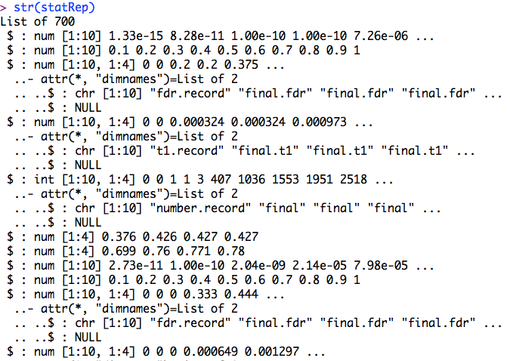
str(statRep)

Slide 16
Means over replicates
power=statRep[[2]]
#FDR
s.fdr=seq(3,length(statRep),7)
fdr=statRep[s.fdr]
fdr.mean=Reduce ("+", fdr) / length(fdr)
#AUC: power vs. FDR
s.auc.fdr=seq(6,length(statRep),7)
auc.fdr=statRep[s.auc.fdr]
auc.fdr.mean=Reduce ("+", auc.fdr) / length(auc.fdr)

Slide 17
Plots of power vs. FDR
theColor=rainbow(4)
plot(fdr.mean[,1],power , type="b", col=theColor [1],xlim=c(0,1))
for(i in 2:ncol(fdr.mean)){
lines(fdr.mean[,i], power , type="b", col= theColor [i])
}

Slide 18
Plots of AUC
barplot(auc.fdr.mean,
names.arg=c("1bp", "1K", "10K","100K"),
xlab="Resolution",
ylab="AUC")

Slide 19
ROC with different heritability
h²= 25% vs. 75%
10 QTNs
Normal distributed QTN effect
100kb resolution
Power against Type I error

Slide 20
Simulation and GWAS
nrep=100
set.seed(99164)
#h2=25%
statRep25=replicate(nrep, {
mySim=G2P(X=myGD[,-1],h2=.25,alpha=1,NQTN=10,distribution="norm")
p=p= GWASbyCor(X=myGD[,-1],y=mySim$y)
seqQTN=mySim$QTN.position
myGWAS=cbind(myGM,t(p),NA)
myStat=GAPIT.FDR.TypeI(WS=c(1e0,1e3,1e4,1e5), GM=myGM,seqQTN=mySim$QTN.position,GWAS=myGWAS,maxOut=100,MaxBP=1e10)})
)})
#h2=75%
statRep75=replicate(nrep, {
mySim=G2P(X=myGD[,-1],h2=.75,alpha=1,NQTN=10,distribution="norm")
p=p= GWASbyCor(X=myGD[,-1],y=mySim$y)
seqQTN=mySim$QTN.position
myGWAS=cbind(myGM,t(p),NA)
myStat=GAPIT.FDR.TypeI(WS=c(1e0,1e3,1e4,1e5), GM=myGM,seqQTN=mySim$QTN.position,GWAS=myGWAS,maxOut=100,MaxBP=1e10)})

Slide 21
Means and plot
power25=statRep25[[2]]
s.t1=seq(4,length(statRep25),7)
t1=statRep25[s.t1]
t1.mean.25=Reduce ("+", t1) / length(t1)
power75=statRep75[[2]]
s.t1=seq(4,length(statRep75),7)
t1=statRep75[s.t1]
t1.mean.75=Reduce ("+", t1) / length(t1)
plot(t1.mean.25[,4],power25, type="b", col="blue",xlim=c(0,1))
lines(t1.mean.75[,4], power75, type="b", col= "red")

Slide 22
Highlight
Simulation of phenotype from genotype
GWAS by correlation
Power
FDR
Cutoff
Null distribution of p values
Resolution
QTN bins and non-QTN bins

