Slide 1
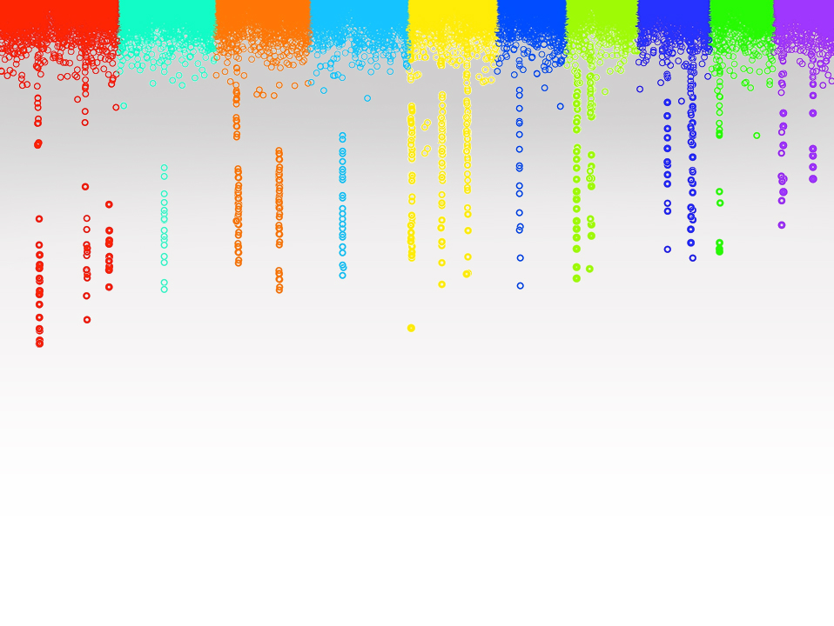

Statistical Genomics
Lecture 16: Likelihood and estimates of variances
Zhiwu Zhang
Washington State University

Slide 2
Outline
Solve MLM with unknown heritability
Likelihood(Uni-variate)
Multi-variate likelihood
Full and REML
EM algorith
EMMA

Slide 3
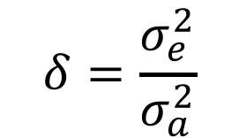
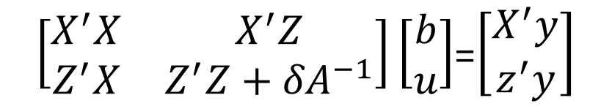
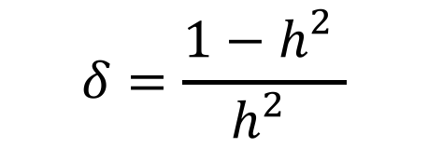
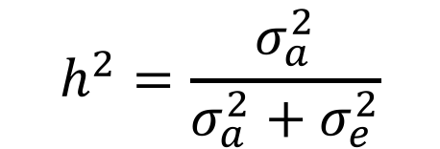
Mixed Model Equation
y = Xb + Zu + e
$\left[\begin{matrix}X^{′}X & X^{′}Z \\ Z^{′}X & Z^{′}Z+{δA}^{−1}\end{matrix}\right]\left[\begin{matrix}b \\ u\end{matrix}\right]$=$\left[\begin{matrix}X^{′}y \\ z^{′}y\end{matrix}\right]$
$$δ=\frac{σ_{e}^{2}}{σ_{a}^{2}}$$
$$h^{2}=\frac{σ_{a}^{2}}{σ_{a}^{2}+σ_{e}^{2}}$$
$$δ=\frac{{1−h}_{}^{2}}{h_{}^{2}}$$

Slide 4
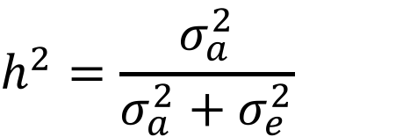
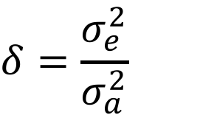
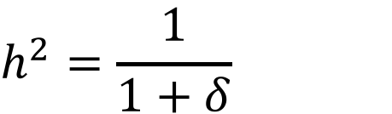
Unknown heritability
$$h^{2}=\frac{σ_{a}^{2}}{σ_{a}^{2}+σ_{e}^{2}}$$
$$δ=\frac{σ_{e}^{2}}{σ_{a}^{2}}$$
$$h^{2}=\frac{1}{1+δ}$$

Slide 5
A variable was observed as 95 from a normal distribution. The mean and SD of the distribution are most likely to be:
100 and 1
100 and 2
85 and 5
85 and 10

Slide 6
By approximation
100 and 1: 5 SD from mean, P<<1%
100 and 2: 2.5 SD from mean, 1%<P<5%
85 and 5 : 2 SD from mean, P=5%
85 and 10 : 1 SD from mean, P=32%

Slide 7


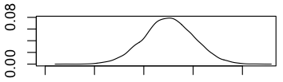
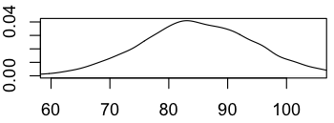
Visualization
x=rnorm(10000,100,1)
plot(density(x),xlim=c(60,105))
x=rnorm(10000,100,2)
plot(density(x),xlim=c(60,105))
x=rnorm(10000,85,5)
plot(density(x),xlim=c(60,105))
x=rnorm(10000,85,10)
plot(density(x),xlim=c(60,105))

Slide 8
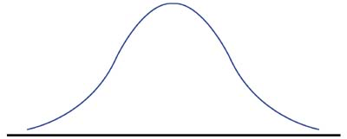
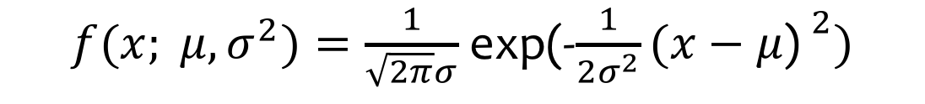
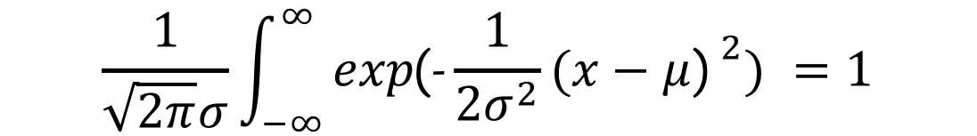
By density function
68% of data
95% of data
99.7% of data
-3
-2
-1
0
1
2
3
$f(x; μ,σ^{2})=\frac{1}{\sqrt{2π}σ}$ exp(-$\frac{1}{2σ^{2}}{(x−μ\text{) }}^{2})$
$$\frac{1}{\sqrt{2π}σ}\int_{−∞}^{∞}{exp\text{(−}\frac{1}{2σ^{2}}{(x−μ\text{) }}^{2}) }=1$$

Slide 9
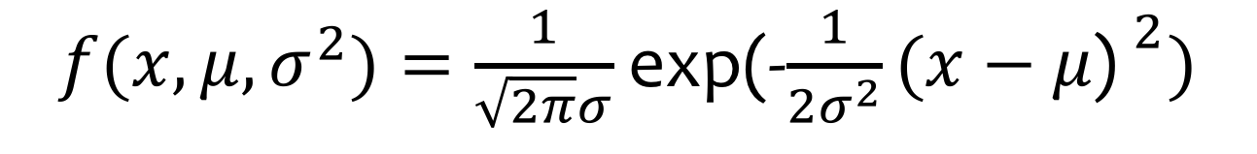
Density function of uni-variate normal distribution
$f(x,μ,σ^{2})=\frac{1}{\sqrt{2π}σ}$ exp(-$\frac{1}{2σ^{2}}{(x−μ\text{) }}^{2})$
dnormal=function(x=0,mean=0,sd=1){
p=1/(sqrt(2*pi)*sd)*exp(-(x-mean)^2/(2*sd^2))
return(p)
}

Slide 10

Density function of normal distribution
x=c(95,95,95,95)
mean=c(100,100,85,85)
sd=c(1,2,5,10)
dnormal(x,mean,sd)
dnorm(x,mean,sd)

Slide 11
Two variables were observed as 95 and 97 from a normal distribution. The mean and SD of the distribution are most likely to be:
100 and 1
100 and 2
85 and 5
85 and 10
mean=c(100,100,85,85)
sd=c(1,2,5,10)
x1=rep(95,4)
x2=rep(97,4)
p1=dnormal(x1,mean,sd)
p2=dnormal(x2,mean,sd)
p1*p2
A: 6.5pe-09
B: 5.7e-04
C: 4.8e-05
D: 4.7e-04

Slide 12

Three individuals have kinship of and observations of 95, 100 and 70, respectively. The population has mean of 90. Square root of genetic and residual variances are most likely to be:
95 and 5
5 and 95
50 and 50
I do not know

Slide 13
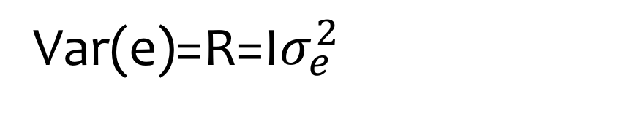
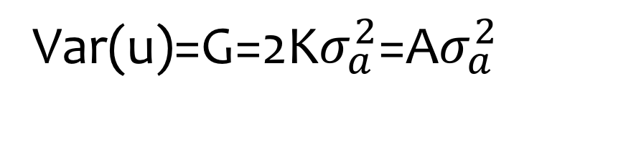
Variance in MLM
y = Xb + Zu + e
Var(y)=V=Var(u)+Var(e)
Var(u)=G=2K$σ_{a}^{2}$=A$σ_{a}^{2}$
Var(e)=R=I$σ_{e}^{2}$

Slide 14
Density function of multi-variate normal distribution
$f(x; μ, H)=\frac{1}{({2π)}^{n/2}{\left|V\right|}^{1/2}}$ exp(- $\frac{1}{2}{(x−μ\text{) }}^{T}V^{−1}(x−μ\text{)})$
dmnormal=function(x=0,mean=0,V=NULL){
n=length(x)
p=1/(sqrt(2*pi)^n*sqrt(det(V)))*exp(-t(x-mean)%*%solve(V)%*%(x-mean)/2)
return(p)
}

Slide 15

Density function of multi-variate normal distribution
x=matrix(c(100,95,70),3,1)
mean=rep(90,3)
K=matrix(c(1,.75,.25,.75,1,.25,.25,.25,1),3,3)
va=95
ve=5
V=2*K*va+ve
dmnormal(x,mean,V)
va=5
ve=95
V=2*K*va+ve
dmnormal(x,mean,V)
va=50
ve=50
V=2*K*va+ve
dmnormal(x,mean,V)

Slide 16
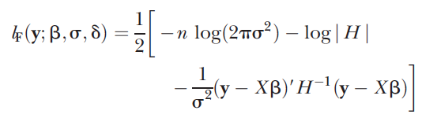
Log Likelihood
$f(x; μ, H)=\frac{1}{({2π)}^{n/2}{\left|V\right|}^{1/2}}$ exp(- $\frac{1}{2}{(x−μ\text{) }}^{T}V^{−1}(x−μ\text{)})$
$$σ_{}^{2}=σ_{a}^{2}, H=σ_{}^{−1}V$$

Slide 17
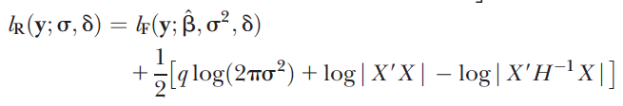
Full and REsidual Maximum Likelihood
q is rank of X

Slide 18
Differences between Full ML and REML
Features | Full ML | REML
Likelihood | y | residual: y-Xb
Fixed effect | Depend on | Removed
Model comparison | Fixed effects | random effect
Bias | Negatively | Unbiased

Slide 19
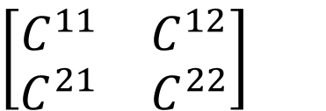
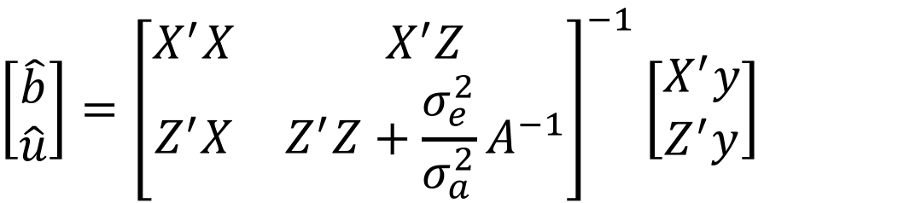
Expectation and Maximization (EM)
y = Xb + Zu + e
Maximization (M) step
$$\left[\begin{matrix}\hat{b} \\ \hat{u}\end{matrix}\right]={\left[\begin{matrix}X^{′}X & X^{′}Z \\ Z^{′}X & Z^{′}Z+{\frac{σ_{e}^{2}}{σ_{a}^{2}}A}^{−1}\end{matrix}\right]}^{−1}\left[\begin{matrix}X^{′}y \\ Z^{′}y\end{matrix}\right]$$
$$\left[\begin{matrix}C^{11} & C^{12} \\ C^{21} & C^{22}\end{matrix}\right]$$

Slide 20
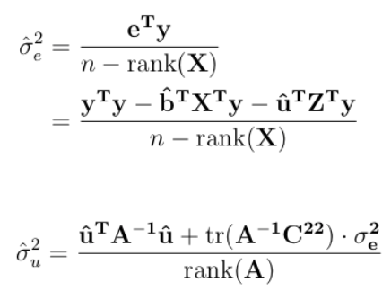
Expectation and Maximization (EM)
Expectation (E) step
tr=Trace=sum of diagonals
rank=max dimension of non singular submatrix

Slide 21
EM is time demanding
Maximization (M) step
Until converge
Expectation (E) step

Slide 22
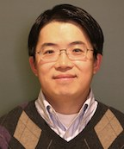

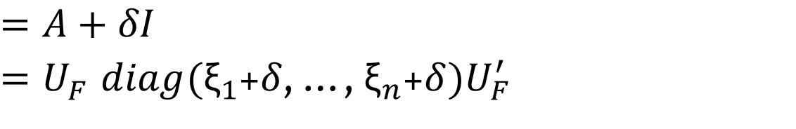
EMMA: two dimensions to one dimension optimization
Kang, H. M. et al. Efficient control of population structure in model organism association mapping. Genetics 178, 1709–1723 (2008).
Kang
$$H=σ_{}^{−1}V$$
$$=A+δI$$
$=U_{F}^{}diag({\text{ξ}}_{1}$+$δ$, …, ${\text{ξ}}_{n}$+$δ)U_{F}^{′}$
U_{F} and ξ are eigen vector and values of spectral decomposition of A matrix

Slide 23
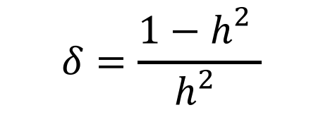
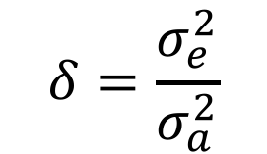
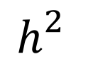
Iterations in EMMA R package
$$δ=\frac{σ_{e}^{2}}{σ_{a}^{2}}$$
$$δ=\frac{{1−h}_{}^{2}}{h_{}^{2}}$$
$$h_{}^{2}$$
= 0.01, 0.02, …, 0.98, 0.99

Slide 24
Highlight
Solve MLM with unknown heritability
Likelihood (Uni-variate)
Multi-variate likelihood
Full and REML
EM algorithm
EMMA

