Slide 1
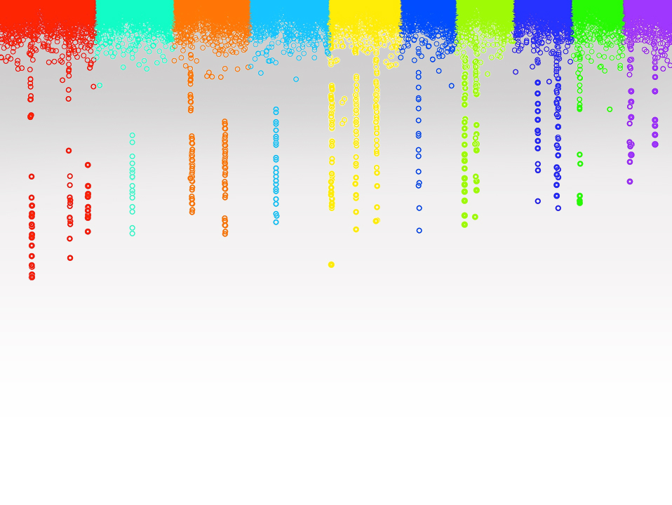

Statistical Genomics
Lecture 17: Heritability and P3D
Zhiwu Zhang
Washington State University

Slide 2
Outline
Complexity of computing time
Idea of P3D
Consideration of heritability

Slide 3

Computing time of inverse
n=500
a=matrix(sample(100,n*n,replace=T),n,n)
ptm <- proc.time()
b=solve(a)
proc.time() - ptm
proc.time() - ptm
user system elapsed
0.284 0.004 0.291
n | 500 | 1000 | 2000
Time | 0.291 | 2.235 | 16.762
Ratio (n) | 1 | 2 | 2
Ratio (Time) | 1 | 7.7 | 7.5
T $∝$ n³

Slide 4

Computing time of MLM GWAS
T $∝$ m
n³
p
Number of markers
Number of individuals
Estimation of variances
EMMA
Kang, 2008
Literature h²
J Deckker, 2009

Slide 5
Computing time of genetic evaluation
T $∝$ m
n³
p
Number of markers
(1)
Number of individuals
(10M)
Estimation of variances
(1)
A week!

Slide 6

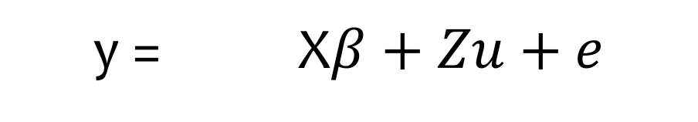
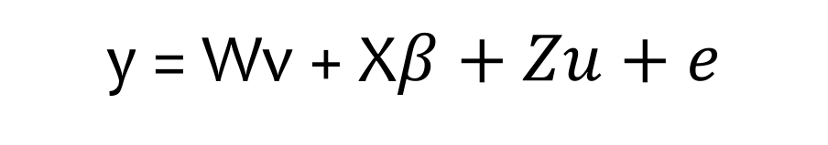
genetic evaluation strategy for GWAS
y = X$β+Zu+e$
y = Wv + X$β+Zu+e$

Slide 7
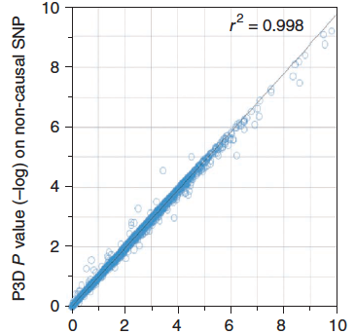
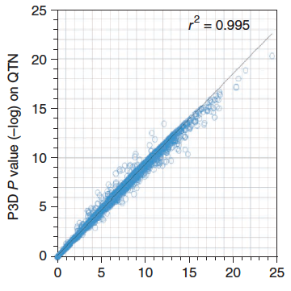
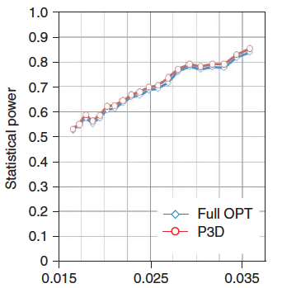
Completely different story
Full optimization: estimate h² for every SNPs
P3D: Estimate h² without SNP and fix it for testing SNPs

Slide 8

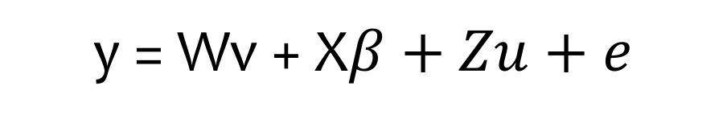
P3D
Population Parameters Previously Determined
y = Wv + X$β+Zu+e$
C is compression level in CMLM

Slide 9
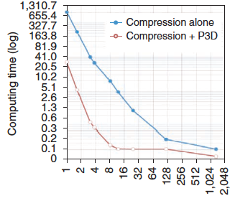
Compression + P3D
Compression levels
100~10,000X faster

Slide 10
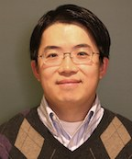

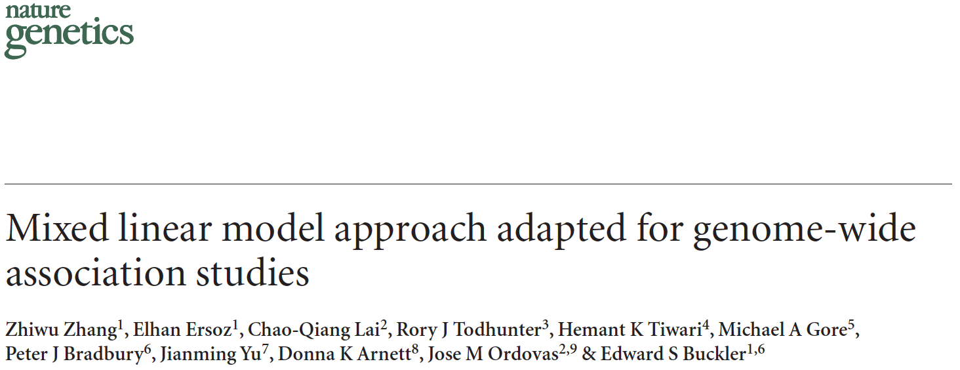
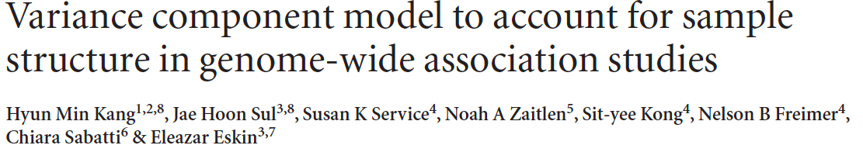
P3D/EMMAx
Kang
Zhang
Zhang, Z. et al. Mixed linear model approach adapted for genome-wide association studies. Nat Genet 42, 355–360 (2010).
Kang, H. M. et al. Variance component model to account for sample structure in genome-wide association studies. Nat Genet 42, 348–354 (2010).

Slide 11
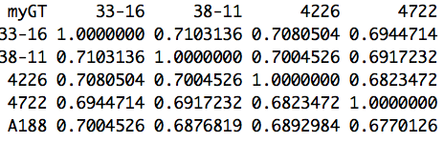
EMMA kinship
Non singular
Diagonals: 1
What is the impact oh h²?

Slide 12
A kinship matrix was incorrectly used as Numerator Relationship Matrix (NRM), which is twice of kinship matrix, to estimate heritability. In this case, the estimated and true heritabilities have relationship of:
Estimated < True
Estimated = 2 True
Estimated = ½ True
Estimated > True

Slide 13
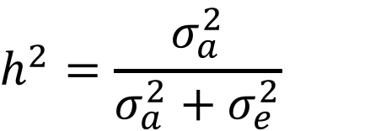
By definition of heritability
Estimated < True
Estimated = 2 True
Estimated = ½ True
Estimated > True
$$h^{2}=\frac{σ_{a}^{2}}{σ_{a}^{2}+σ_{e}^{2}}$$

Slide 14
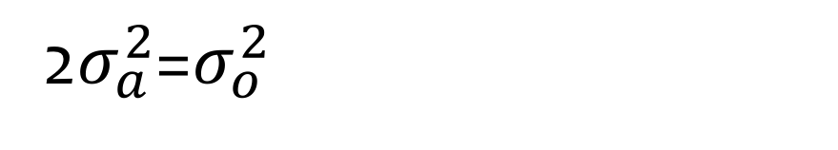
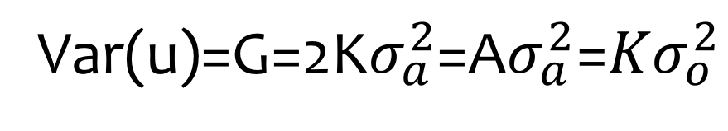
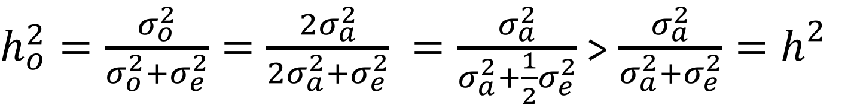
Genetic variance
Var(u)=G=2K$σ_{a}^{2}$=A$σ_{a}^{2}\text{=}Kσ_{o}^{2}$
2$σ_{a}^{2}$=$σ_{o}^{2}$
$h_{o}^{2}=\frac{σ_{o}^{2}}{σ_{o}^{2}+σ_{e}^{2}}=\frac{{2σ}_{a}^{2}}{{2σ}_{a}^{2}+σ_{e}^{2}} =\frac{σ_{a}^{2}}{σ_{a}^{2}+{\frac{1}{2}σ}_{e}^{2}}$ > $\frac{σ_{a}^{2}}{σ_{a}^{2}+σ_{e}^{2}}{=h}_{}^{2}$

Slide 15

By definition of heritability
Estimated < True
Estimated = 2 True
Estimated = ½ True
Estimated > True
$h_{o}^{2}=\frac{σ_{a}^{2}}{σ_{a}^{2}+{\frac{1}{2}σ}_{e}^{2}}$ > $\frac{σ_{a}^{2}}{σ_{a}^{2}+σ_{e}^{2}}{=h}_{}^{2}$

Slide 16
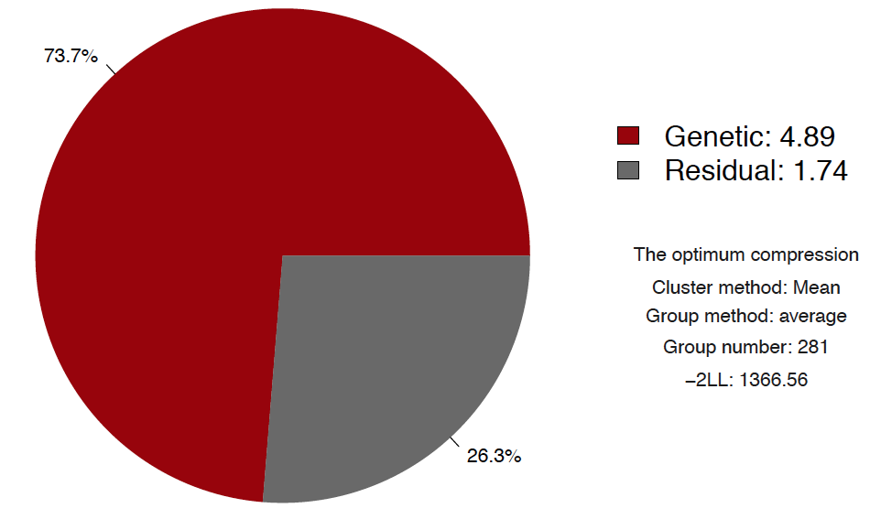
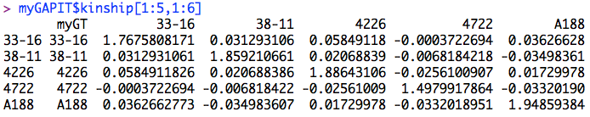
Find out with GAPIT
library('MASS') # required for ginv
library(multtest)
library(gplots)
library(compiler) #required for cmpfun
library("scatterplot3d")
source("http://www.zzlab.net/GAPIT/emma.txt")
source("http://www.zzlab.net/GAPIT/gapit_functions.txt")
source("~/Dropbox/GAPIT/Functions/gapit_functions.txt")
myGD=read.table(file="http://zzlab.net/GAPIT/data/mdp_numeric.txt",head=T)
myGM=read.table(file="http://zzlab.net/GAPIT/data/mdp_SNP_information.txt",head=T)
setwd("~/Dropbox/Current/ZZLab/WSUCourse/CROPS545/Demo")
source("G2P.R")
X=myGD[,-1]
index1to5=myGM[,2]<6
X1to5 = X[,index1to5]
set.seed(99163)
mySim=G2P(X= X1to5,h2=.75,alpha=1,NQTN=10,distribution="norm")
setwd("~/Desktop/temp")
myY=cbind(as.data.frame(myGD[,1]), mySim$y)
myGAPIT=GAPIT(
Y=myY,
GD=myGD,
GM=myGM,
QTN.position=mySim$QTN.position,
PCA.total=3,
group.from=1000000,
group.to=1000000,
group.by=10,
memo="MLM")
myGAPIT$kinship[1:5,1:6]

Slide 17
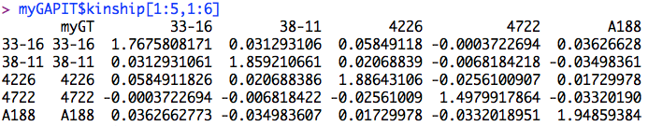
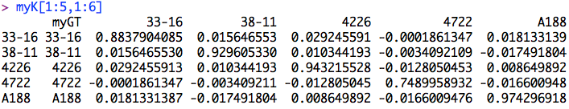
Kinship from GAPIT
myK=myGAPIT$kinship
myK[,-1]=myK[,-1]/2
myK[1:5,1:6]

Slide 18
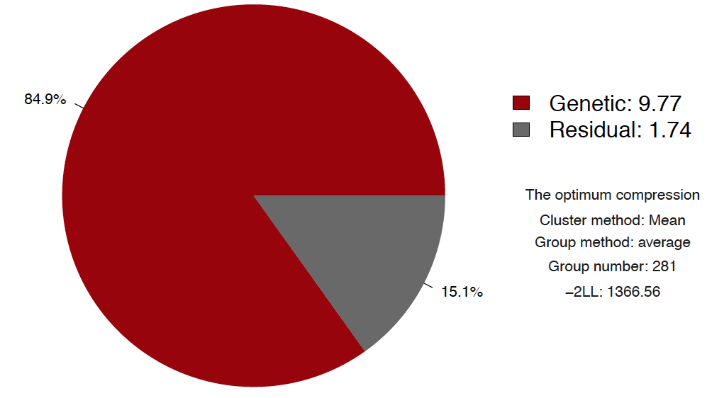
Using half of relationship
myGAPIT2=GAPIT(
Y=myY,
GD=myGD,
GM=myGM,
KI=myK,
QTN.position=mySim$QTN.position,
PCA.total=3,
group.from=1000000,
group.to=1000000,
group.by=10,
memo="MLM2")

Slide 19
Full vs. half
.5x

Slide 20
K and 2K are the same for P value

Slide 21
Highlight
Complexity of computing time
Idea of P3D
Consideration of heritability

