Slide 1
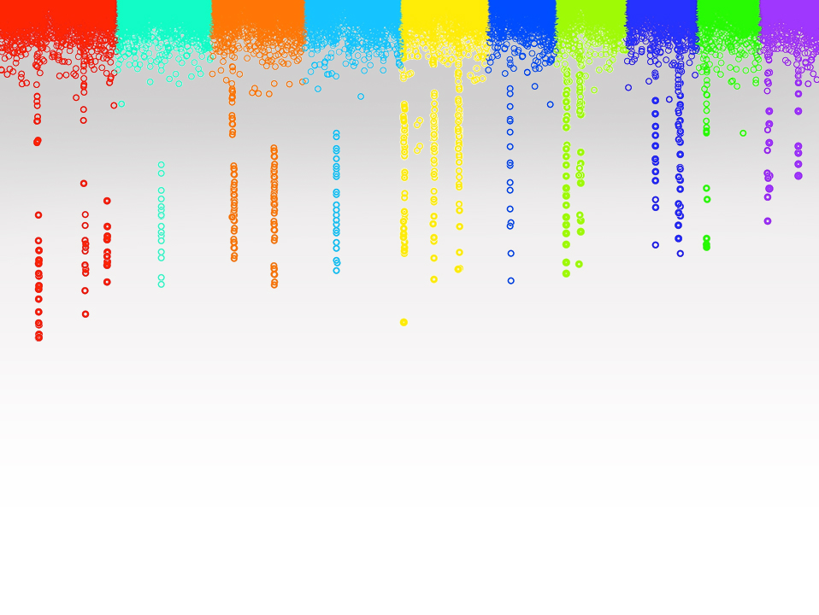

Statistical Genomics
Lecture 20: MLMM
Zhiwu Zhang
Washington State University

Slide 2
Administration
Crop and Soil Science Seminar
Monday, March 26, 1:10pm, Johnson Hall 343
Student Presentations
Yvonne Thompson, Alexandra Davis, Jacob Lamkey

Slide 3
Outline
Stepwise regression
Criteria
MLMM
Power vs FDR and Type I error
Replicate and mean

Slide 4
Testing SNPs, one at a time
Phenotype
Population
structure
Unequal
relatedness
Y = SNP + Q (or PCs) + Kinship + e
(fixed effect)
(fixed effect)
(random effect)
General Linear Model (GLM)
Mixed Linear Model (MLM)
(Yu et al. 2005, Nature Genetics)

Slide 5
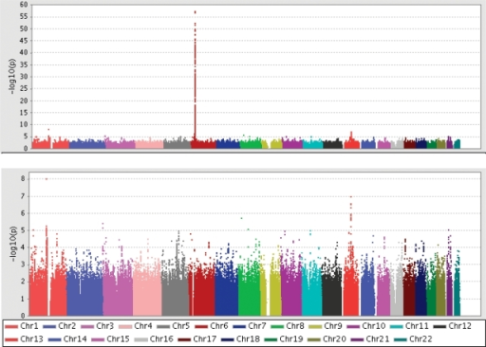
Hind from MHC (Major histocompatibility complex)

Slide 6
Stepwise regression
Choose m predictive variables from M (M>>m) variables
The challenges :
Choosing m from M is an NP problem
Option: approximation
Non unique criteria

Slide 7
Stepwise regression procedures
sequence of F-tests or t-tests
Adjusted R-square
Akaike information criterion (AIC)
Bayesian information criterion (BIC)
Mallows's Cp
PRESS
false discovery rate (FDR)
Why so many?

Slide 8
Stepwise regression Forward
Test M variables one at a time
Fit the most significant variable as covariate
Test rest variables one at a time
Is the most
influential variable
significant
Yes
No
End

Slide 9
Stepwise regression Backward
Test m variables simultaneously
Is the least
influential variable
significant
Yes
End
No
Remove it and test the rest (m)

Slide 10
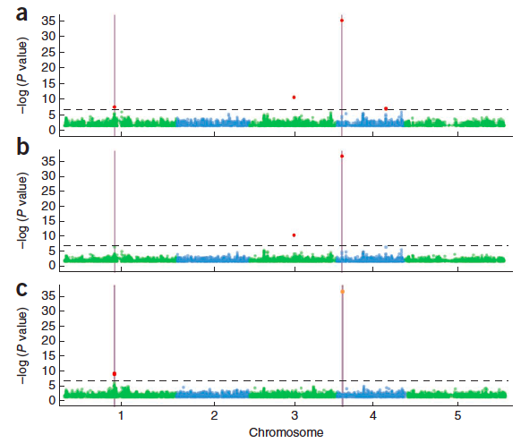
Nature Genetics, 2012, 44, 825-830
Two QTNs
GLM
MLM
MLMM

Slide 11
MLMM
y = SNP + Q + K + e
Most significant SNP as pseudo QTN
y = SNP + QTN1 + Q + K + e
Most significant SNP as pseudo QTN
y = SNP + QTN1 + QTN2 + Q + K + e
So on and so forth until…

Slide 12
Forward regression
y = SNP +QTN1+QTN2+…+ Q + K + e
Var(u)
Var(y)
Stop when the ratio close to zero

Slide 13
Backward elimination
y = QTN₁+QTN₂+…+QTN_{t}+ Q + K + e
Remove the least significant pseudo QTN
y = QTN₁+QTN₂+…+QTN_{t-1}+ Q + K + e
Until all pseudo QTNs are significant

Slide 14
Final p values
Pseudo QTNs:
y = QTN₁+QTN₂+…+ Q + K + e
Other markers:
y = SNP +QTN₁+QTN₂+…+ Q + K + e

Slide 15
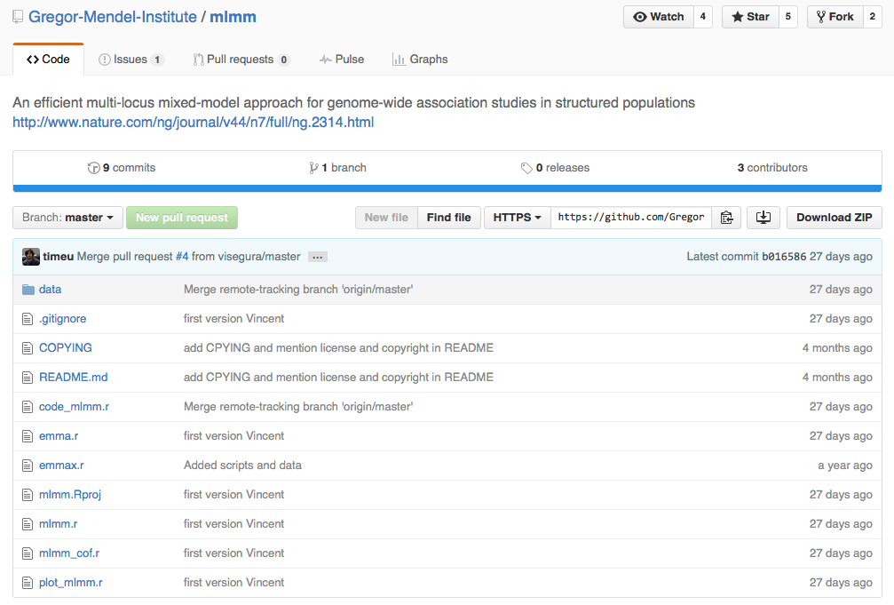
MLMM R on GitHub

Slide 16
#Siultate 10 QTN on the first chromosomes
X=myGD[,-1]
index1to5=myGM[,2]<6
X1to5 = X[,index1to5]
taxa=myGD[,1]
set.seed(99164)
GD.candidate=cbind(taxa,X1to5)
mySim=GAPIT.Phenotype.Simulation(GD=GD.candidate,GM=myGM[index1to5,],h2=.5,NQTN=10,QTNDist="norm")
myy=as.numeric(mySim$Y[,-1])
myMLMM<-mlmm_cof(myy,myX,myPC[,1:2],myK,nbchunks=2,maxsteps=20)
myP=myMLMM$pval_step[[1]]$out[,2]
myGI.MP=cbind(myGM[,-1],myP)
setwd("~/Desktop/temp")
GAPIT.Manhattan(GI.MP=myGI.MP,seqQTN=mySim$QTN.position)
GAPIT.QQ(myP)
rm(list=ls())
setwd('/Users/Zhiwu/Dropbox/Current/ZZLab/WSUCourse/CROPS545/mlmm-master')
source('mlmm_cof.r')
library("MASS") # required for ginv
library(multtest)
library(gplots)
library(compiler) #required for cmpfun
library("scatterplot3d")
source("http://www.zzlab.net/GAPIT/emma.txt")
source("http://www.zzlab.net/GAPIT/gapit_functions.txt")
source("/Users/Zhiwu/Dropbox//GAPIT/functions/gapit_functions.txt")
setwd("/Users/Zhiwu/Dropbox/Current/ZZLab/WSUCourse/CROPS512/Demo")
myGD <- read.table("mdp_numeric.txt", head = TRUE)
myGM <- read.table("mdp_SNP_information.txt" , head = TRUE)
#for PC and K
setwd("~/Desktop/temp")
myGAPIT0=GAPIT(GD=myGD,GM=myGM,PCA.total=3,)
myPC=as.matrix(myGAPIT0$PCA[,-1])
myK=as.matrix(myGAPIT0$kinship[,-1])
myX=as.matrix(myGD[,-1])

Slide 17
GAPIT.FDR.TypeI Function
myGWAS=cbind(myGM,myP,NA)
myStat=GAPIT.FDR.TypeI(WS=c(1e0,1e3,1e4,1e5),
GM=myGM,
seqQTN=mySim$QTN.position,
GWAS=myGWAS)

Slide 18
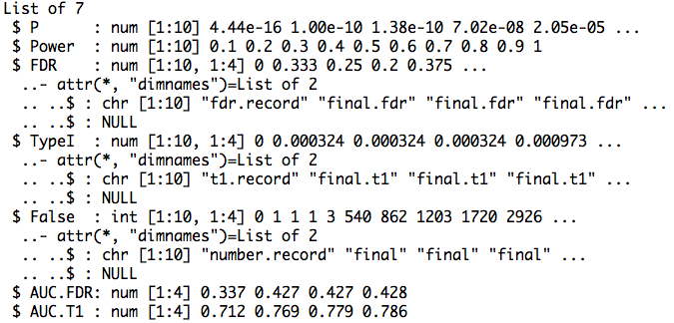
Return

Slide 19
Area Under Curve (AUC)
par(mfrow=c(1,2),mar = c(5,2,5,2))
plot(myStat$FDR[,1],myStat$Power,type="b")
plot(myStat$TypeI[,1],myStat$Power,type="b")

Slide 20
Replicates
nrep=10
set.seed(99164)
statRep=replicate(nrep, {
mySim=GAPIT.Phenotype.Simulation(GD=GD.candidate,GM=myGM[index1to5,],h2=.5,NQTN=10,QTNDist="norm")
myy=as.numeric(mySim$Y[,-1])
myMLMM<-mlmm_cof(myy,myX,myPC[,1:2],myK,nbchunks=2,maxsteps=20)
myP=myMLMM$pval_step[[1]]$out[,2]
myGWAS=cbind(myGM,myP,NA)
myStat=GAPIT.FDR.TypeI(WS=c(1e0,1e3,1e4,1e5),GM=myGM,seqQTN=mySim$QTN.position,GWAS=myGWAS)
})

Slide 21
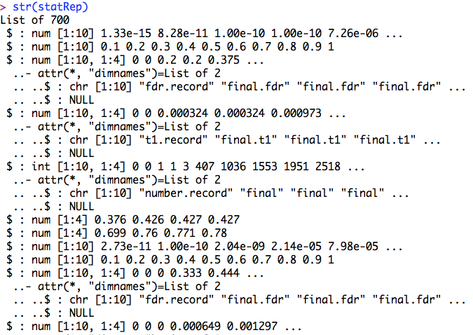
str(statRep)

Slide 22
Means over replicates
power=statRep[[2]]
#FDR
s.fdr=seq(3,length(statRep),7)
fdr=statRep[s.fdr]
fdr.mean=Reduce ("+", fdr) / length(fdr)
#TypeI
s.t1=seq(4,length(statRep),7)
t1=statRep[s.t1]
t1.mean=Reduce ("+", t1) / length(t1)

Slide 23
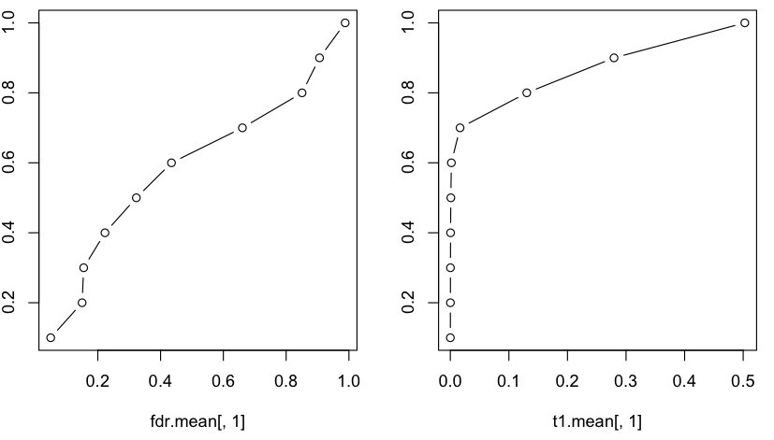
Area Under Curve (AUC)
par(mfrow=c(1,2),mar = c(5,2,5,2))
plot(fdr.mean[,1],power , type="b")
plot(t1.mean[,1],power , type="b")

Slide 24
Highlight
Stepwise regression
Criteria
MLMM
Power vs FDR and Type I error
Replicate and mean

