Slide 1
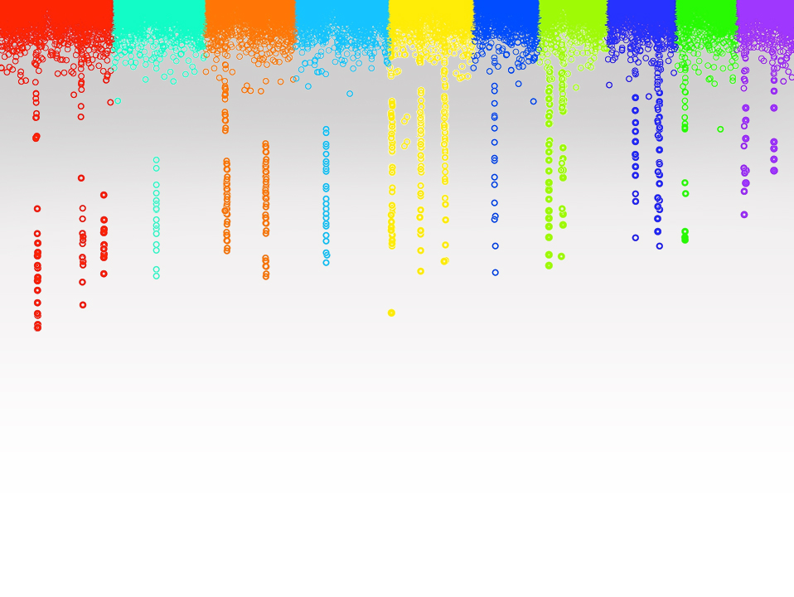

Statistical Genomics
Lecture 22: Marker Assisted Selection
Zhiwu Zhang
Washington State University

Slide 2
Administration
Homework 5, due April 12, Wednesday, 3:10PM
Final exam: May 4 (Thursday), 120 minutes (3:10-5:10PM), 50

Slide 3
Outline
Success of MAS
Reasons of low impact
Complex traits
Environment effect
Prediction by GAPIT
Modeling MAS

Slide 4
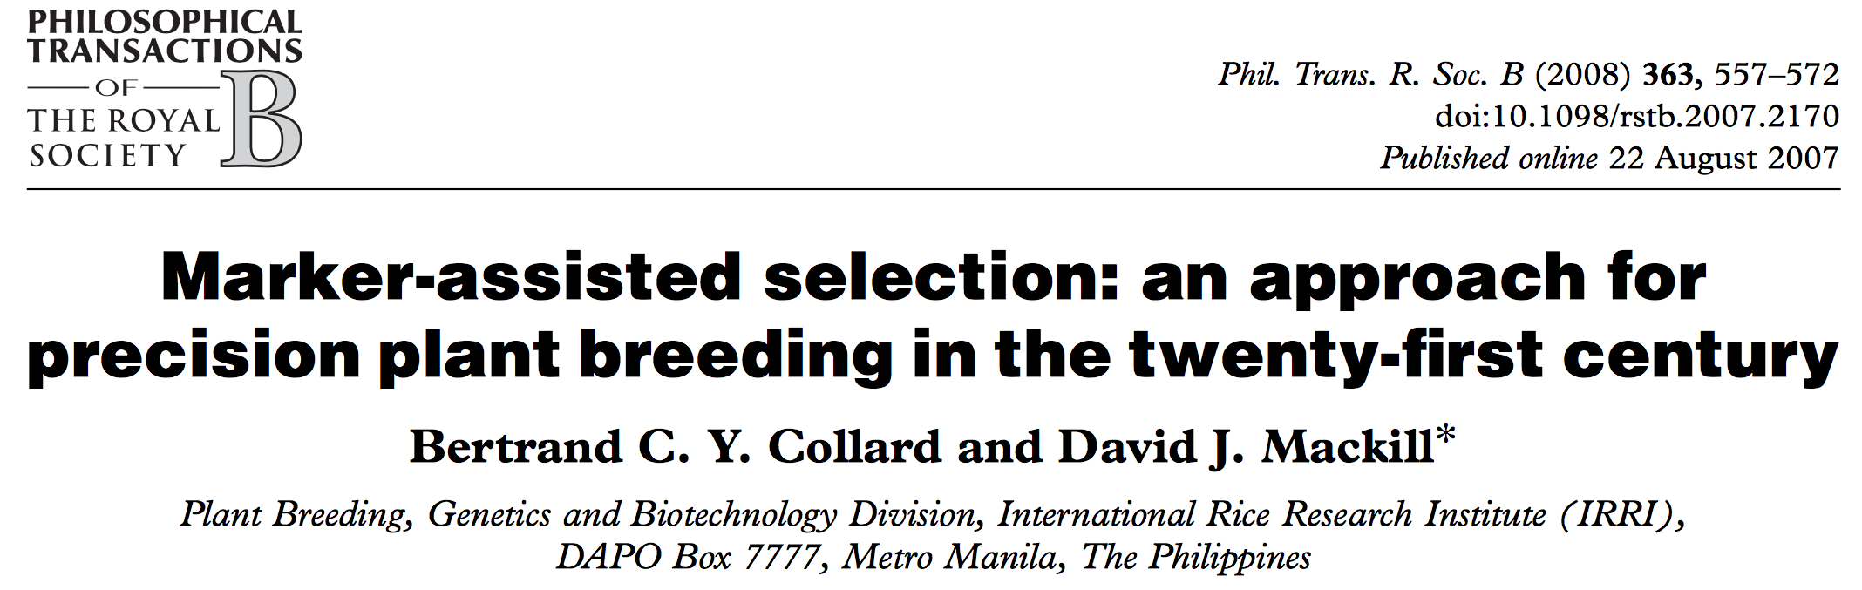
A high impact review article (968 citations by March 31, 2017)

Slide 5
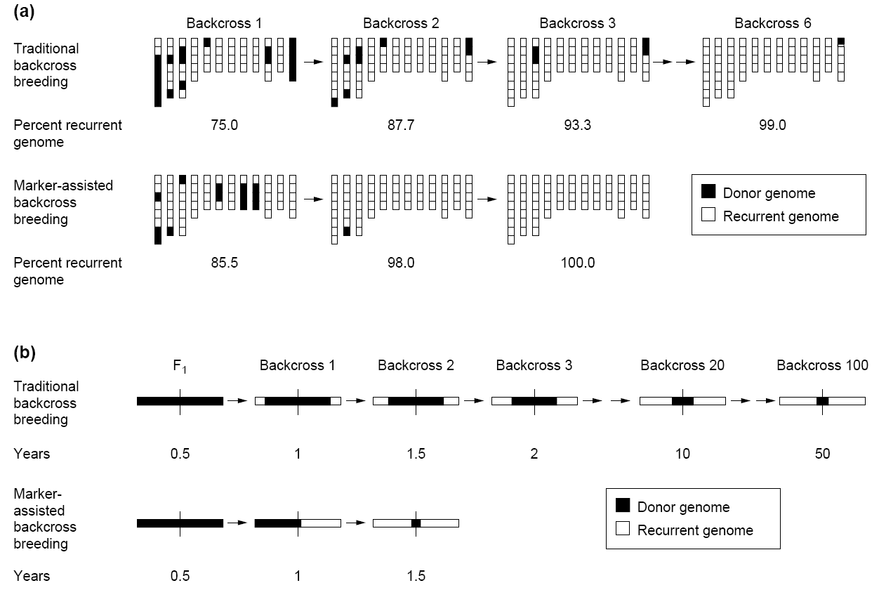

Recurrent genome recovery
30 progeny per backcross
Backcross 100
Traditional method achieve only 99% in 6 generations
100% can be achieved in only three generations by MAS
Tanksley et al. Biotechnology 1989

Slide 6
Explanations on low impact of MAS
Bertrand C. Y. Collard and David J. Mackill, Phil. Trans. R. Soc. B (2008) 363, 557–572
(a) Still at the early stages of DNA marker technology development
(b) Marker-assisted selection results may not be published
(c) Reliability and accuracy of quantitative trait loci mapping studies
(d) Insufficient linkage between marker and gene/ quantitative trait locus
(e) Limited markers and limited polymorphism of markers in breeding material
(f ) Effects of genetic background
(g) Quantitative trait loci x environment effects
(h) High cost of marker-assisted selection
(i) ‘Application gap’ between research laboratories and plant breeding institutes
(j) ‘Knowledge gap’ among molecular biologists, plant breeders and other disciplines

Slide 7
Missing heritability
Over 100 known loci only explained 20% of variation of human height that has70~80% heritability
Teri A. Manolio et al. , Finding the missing heritability of complex diseases, Nature, 2009 October 8; 461(7265): 747–753

Slide 8
Predicting a complex trait
1o genes
50% heritability
Environmental effects
QTL by GWAS
Predicting phenotype and breeding value

Slide 9
Simulation of environment effects
Examples: Nursery of maize 282 association panel
Tropical lines: planting one week earlier
Stiff Stalk lines: removing tillers

Slide 10
mdp_env.txt
Taxa | SS | NSS | Tropical | Early | Tiller
33-16 | 0.014 | 0.972 | 0.014 | 0 | 0
38-11 | 0.003 | 0.993 | 0.004 | 0 | 0
4226 | 0.071 | 0.917 | 0.012 | 0 | 0
4722 | 0.035 | 0.854 | 0.111 | 0 | 0
A188 | 0.013 | 0.982 | 0.005 | 0 | 0
A214N | 0.762 | 0.017 | 0.221 | 0 | 1
A239 | 0.035 | 0.963 | 0.002 | 0 | 0
A272 | 0.019 | 0.122 | 0.859 | 1 | 0
A441-5 | 0.005 | 0.531 | 0.464 | 0 | 0
A554 | 0.019 | 0.979 | 0.002 | 0 | 0
A556 | 0.004 | 0.994 | 0.002 | 0 | 0
A6 | 0.003 | 0.03 | 0.967 | 1 | 0
A619 | 0.009 | 0.99 | 0.001 | 0 | 0
A632 | 0.993 | 0.004 | 0.003 | 0 | 1

Slide 11
GAPIT.Phenotype.Simulation
function(GD,
GM=NULL,
h2=.75,
NQTN=10,
QTNDist="normal",
effectunit=1,
category=1,
r=0.25,
CV,
cveff=NULL){
…, environment component,...
})

Slide 12
Environment component
vy=effectvar+residualvar
ev=cveff*vy/(1-cveff)
ec=sqrt(ev)/sqrt(diag(var(CV[,-1])))
enveff=as.matrix(myCV[,-1])%*%ec

Slide 13
Prediction with GAPIT
QTN
GWAS
h2: optimum heritability
Pred
compression
kinship.optimum: group kinship
kinship: individual kinship
PCA
SUPER_GD
P: single column with order same as marker

Slide 14
GWAS
$ GWAS :'data.frame': 3093 obs. of 9 variables:
..$ SNP : Factor w/ 3093 levels "abph1.1","abph1.10",..: 3040 2759 1036 635 ...
..$ Chromosome : int [1:3093] 1 3 3 1 5 2 2 2 4 2 ...
..$ Position : int [1:3093] 23267335 161573186 66922282 280215046 274038 ...
..$ P.value : num [1:3093] 5.49e-10 4.06e-07 2.19e-06 3.86e-05 2.28e-04 ...
..$ maf : num [1:3093] 0.4342 0.0516 0.1975 0.121 0.3149 ...
..$ nobs : int [1:3093] 281 281 281 281 281 281 281 281 281 281 ...
..$ Rsquare.of.Model.without.SNP: num [1:3093] 0.94 0.94 0.94 0.94 0.94 ...
..$ Rsquare.of.Model.with.SNP : num [1:3093] 0.949 0.946 0.945 0.944 0.943 ...
..$ FDR_Adjusted_P-values : num [1:3093] 1.70e-06 6.28e-04 2.25e-03...

Slide 15
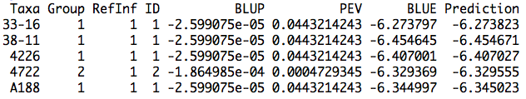
Pred
$ Pred :'data.frame': 281 obs. of 8 variables:
..$ Taxa : Factor w/ 281 levels "33-16","38-11",..: 1 2 3 4 5 6 7 8 9 10 ...
..$ Group : Factor w/ 8 levels "1","2","3","4",..: 1 1 1 2 1 3 1 4 4 1 ...
..$ RefInf : Factor w/ 1 level "1": 1 1 1 1 1 1 1 1 1 1 ...
..$ ID : Factor w/ 8 levels "1","2","3","4",..: 1 1 1 2 1 3 1 4 4 1 ...
..$ BLUP : num [1:281] -0.000026 -0.000026 -0.000026 -0.000186 -0.000026 ...
..$ PEV : num [1:281] 0.044321 0.044321 0.044321 0.000473 0.044321 ...
..$ BLUE : num [1:281] -6.27 -6.45 -6.41 -6.33 -6.34 ...
..$ Prediction: num [1:281] -6.27 -6.45 -6.41 -6.33 -6.35 ...

Slide 16
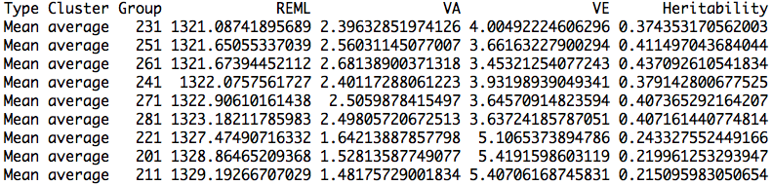
compression
$ compression :'data.frame': 9 obs. of 7 variables:
..$ Type : Factor w/ 1 level "Mean": 1 1 1 1 1 1 1 1 1
..$ Cluster : Factor w/ 1 level "average": 1 1 1 1 1 1 1 1 1
..$ Group : Factor w/ 9 levels "201","211","221",..: 4 6 7 5 8 9 3 1 2
..$ REML : Factor w/ 9 levels "1321.08741895689",..: 1 2 3 4 5 6 7 8 9
..$ VA : Factor w/ 9 levels "1.48175729001834",..: 4 8 9 5 7 6 3 2 1
..$ VE : Factor w/ 9 levels "3.45321254077243",..: 6 4 1 5 3 2 7 9 8
..$ Heritability: Factor w/ 9 levels "0.215095983050654",..: 4 8 9 5 7 6 3 2 1

Slide 17
Prediction modeling
Model | Phenotype | genetic value
y=PC + e
y=C1 + … + C10 + e
y=C1 + … + C10 + PC + e
y=C1 + … + C10 + PC+ ENV+ e
y=C1 + … + C200 + PC + ENV + e

Slide 18
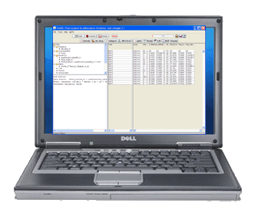
Modeling MAS

Slide 19
Setup GAPIT
#source("http://www.bioconductor.org/biocLite.R")
#biocLite("multtest")
#install.packages("gplots")
#install.packages("scatterplot3d")#The downloaded link at: http://cran.r-project.org/package=scatterplot3d
library('MASS') # required for ginv
library(multtest)
library(gplots)
library(compiler) #required for cmpfun
library("scatterplot3d")
source("http://www.zzlab.net/GAPIT/emma.txt")
source("http://www.zzlab.net/GAPIT/gapit_functions.txt")

Slide 20
Import data and simulate phenotype
myGD=read.table(file="http://zzlab.net/GAPIT/data/mdp_numeric.txt",head=T)
myGM=read.table(file="http://zzlab.net/GAPIT/data/mdp_SNP_information.txt",head=T)
myCV=read.table(file="http://zzlab.net/GAPIT/data/mdp_env.txt",head=T)
#Simultate 10 QTN on the first half chromosomes
X=myGD[,-1]
index1to5=myGM[,2]<6
X1to5 = X[,index1to5]
taxa=myGD[,1]
set.seed(99164)
GD.candidate=cbind(taxa,X1to5)
source("~/Dropbox/GAPIT/Functions/GAPIT.Phenotype.Simulation.R")
mySim=GAPIT.Phenotype.Simulation(GD=GD.candidate,GM=myGM[index1to5,],h2=.5,NQTN=10, effectunit =.95,QTNDist="normal",CV=myCV,cveff=c(.51,.51))
setwd("~/Desktop/temp")

Slide 21
Prediction with PC and ENV
myGAPIT <- GAPIT(
Y=mySim$Y,
GD=myGD,
GM=myGM,
PCA.total=3,
CV=myCV,
group.from=1,
group.to=1,
group.by=10,
QTN.position=mySim$QTN.position,
#SNP.test=FALSE,
memo="GLM",)
ry2=cor(myGAPIT$Pred[,8],mySim$Y[,2])^2
ru2=cor(myGAPIT$Pred[,8],mySim$u)^2
par(mfrow=c(2,1), mar = c(3,4,1,1))
plot(myGAPIT$Pred[,8],mySim$Y[,2])
mtext(paste("R square=",ry2,sep=""), side = 3)
plot(myGAPIT$Pred[,8],mySim$u)
mtext(paste("R square=",ru2,sep=""), side = 3)

Slide 22
Prediction with top ten SNPs
ntop=10
index=order(myGAPIT$P)
top=index[1:ntop]
myQTN=cbind(myGAPIT$PCA[,1:4], myCV[,2:3],myGD[,c(top+1)])
myGAPIT2<- GAPIT(
Y=mySim$Y,
GD=myGD,
GM=myGM,
#PCA.total=3,
CV=myQTN,
group.from=1,
group.to=1,
group.by=10,
QTN.position=mySim$QTN.position,
SNP.test=FALSE,
memo="GLM+QTN",
)
Improved
Improved

Slide 23
Prediction with top 200SNPs
ntop=200
index=order(myGAPIT$P)
top=index[1:ntop]
myQTN=cbind(myGAPIT$PCA[,1:4], myCV[,2:3],myGD[,c(top+1)])
myGAPIT2<- GAPIT(
Y=mySim$Y,
GD=myGD,
GM=myGM,
#PCA.total=3,
CV=myQTN,
group.from=1,
group.to=1,
group.by=10,
QTN.position=mySim$QTN.position,
SNP.test=FALSE,
memo="GLM+QTN",
)
Improved
No Improve

Slide 24
Outline
Success of MAS
Reasons of low impact
Complex traits
Environment effect
Prediction by GAPIT
Modeling MAS

