Slide 1
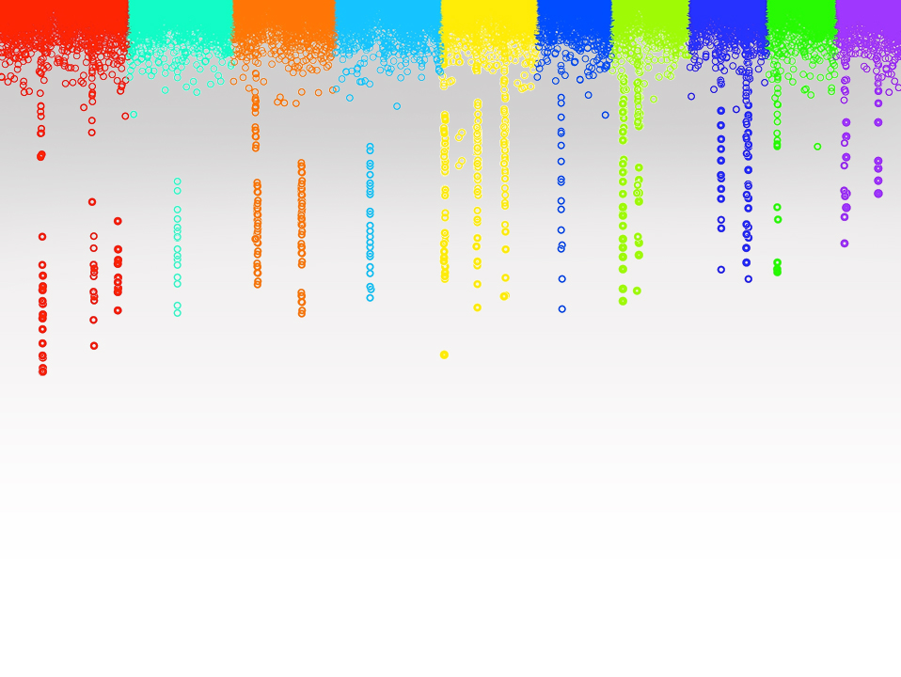

Statistical Genomics
Lecture 23: Cross validation
Zhiwu Zhang
Washington State University

Slide 2
Outline
Cross validation
K-fold validation
Jack knife
Re-sampling
Two ways of calculating accuracy
Bias and correction

Slide 3
Models for GWAS&GS
GLM and Stepwise regression
QTNs +
y = PC + SNP + e
FarmCPU: -2LL
BLINK: -2LL
y = PC + u(Kinship) + e
QTNs
MAS
BLUP/gBLUP
y = PC + QTNs + e
SUPER
Complementary
y = PC + u(Kinship) + SNP + e
QTNs +
MLM and MLMM

Slide 4
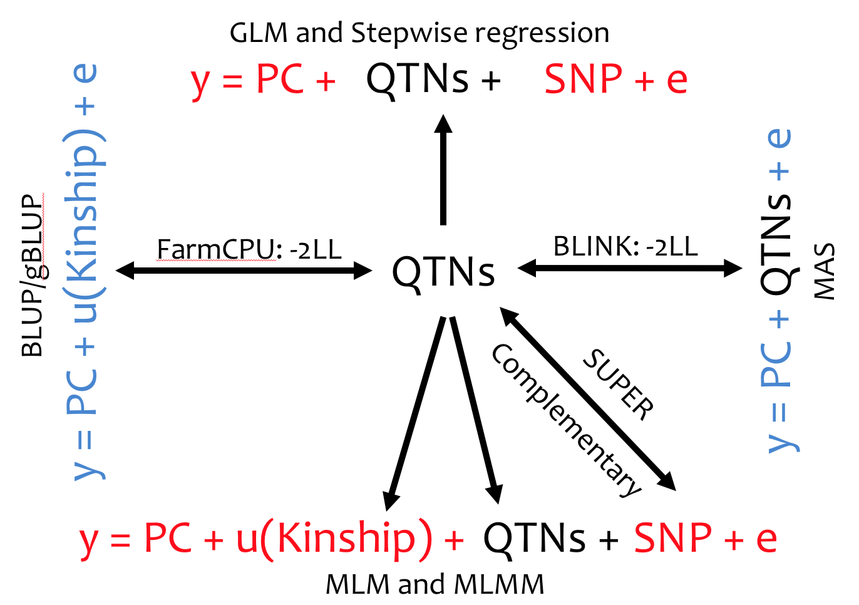
Which method does not involve with QTNs?
CMLM
SUPER
MLMM
FarmCPU
BLINK
The answer is A

Slide 5
Which method does not involve with kinship?
CMLM
SUPER
MLMM
FarmCPU
BLINK
The answer is E

Slide 6
Which method uses QTNs to build kinship?
MLM
CMLM
ECMLM
MLMM
FarmCPU
BLINK
The answer is E

Slide 7
Which model can be used for genomic selection?
1
2
1 and 2
3 and 4
2 and 3
1 and 4
The answer is C
3
4

Slide 8
All the models can be used for GS if remove the term of ___
E
SNP
QTNs
U
Kinship
PC
Y
The answer is B

Slide 9
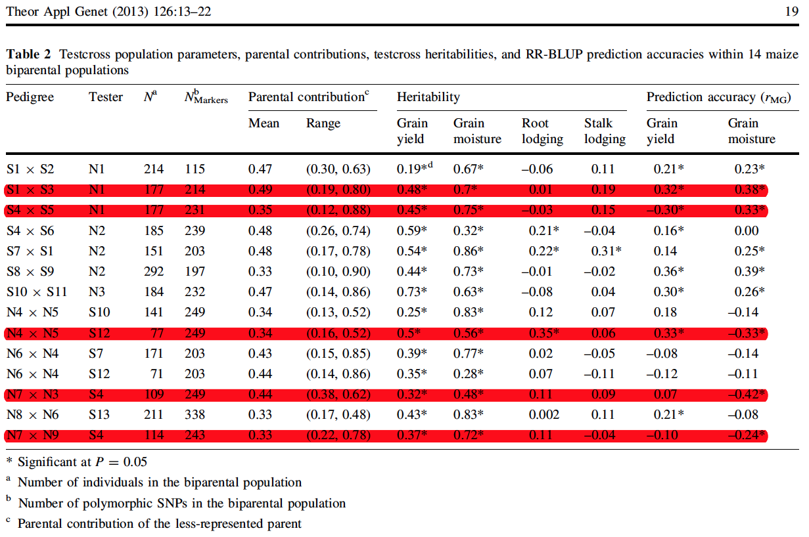
Negative prediction accuracy
Theor Appl Genet. 2013 Jan;126(1):13-22
Genomewide predictions from maize single-cross data.
Massman JM1, Gordillo A, Lorenzana RE, Bernardo R.

Slide 10
Five fold Cross validation
Inference
Reference
By Yao Zhou

Slide 11
Jack Knife
Until every individuals get predicted
Inference
Inference

Slide 12
Jack Knife: extreme case of K=N
N: number of individuals
K: number of folds
Leave-one-out cross-validation
Inference (training) contain only one individuals
Not possible to calculate correlation between observed and predicted within inference
Evaluation of accuracy must be hold until every individuals receive predictions.
Resampling is not available

Slide 13
Re-sampling: stochastic validation
Sample partial population, e.g., 20%, as inference (testing), and leave the rest as reference (Training)
Instantly evaluate accuracy of inference
Repeated for multiple times
Average accuracy across replicates
Some individuals may never be in the testing

Slide 14
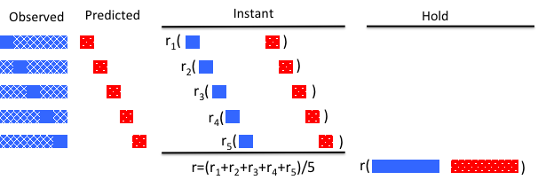
Two ways of calculating correlation

Slide 15
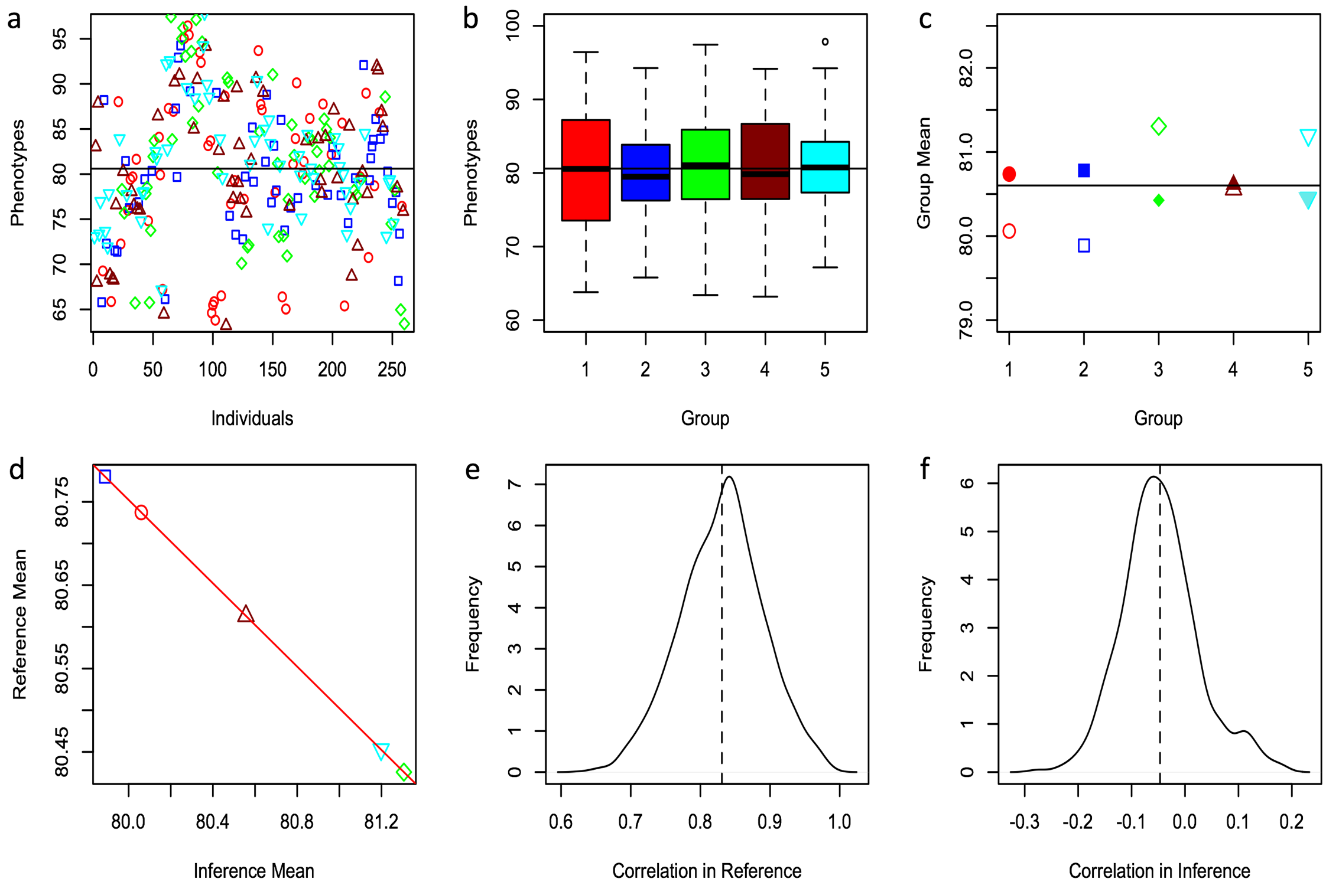
Artefactual negative hold accuracy

Slide 16
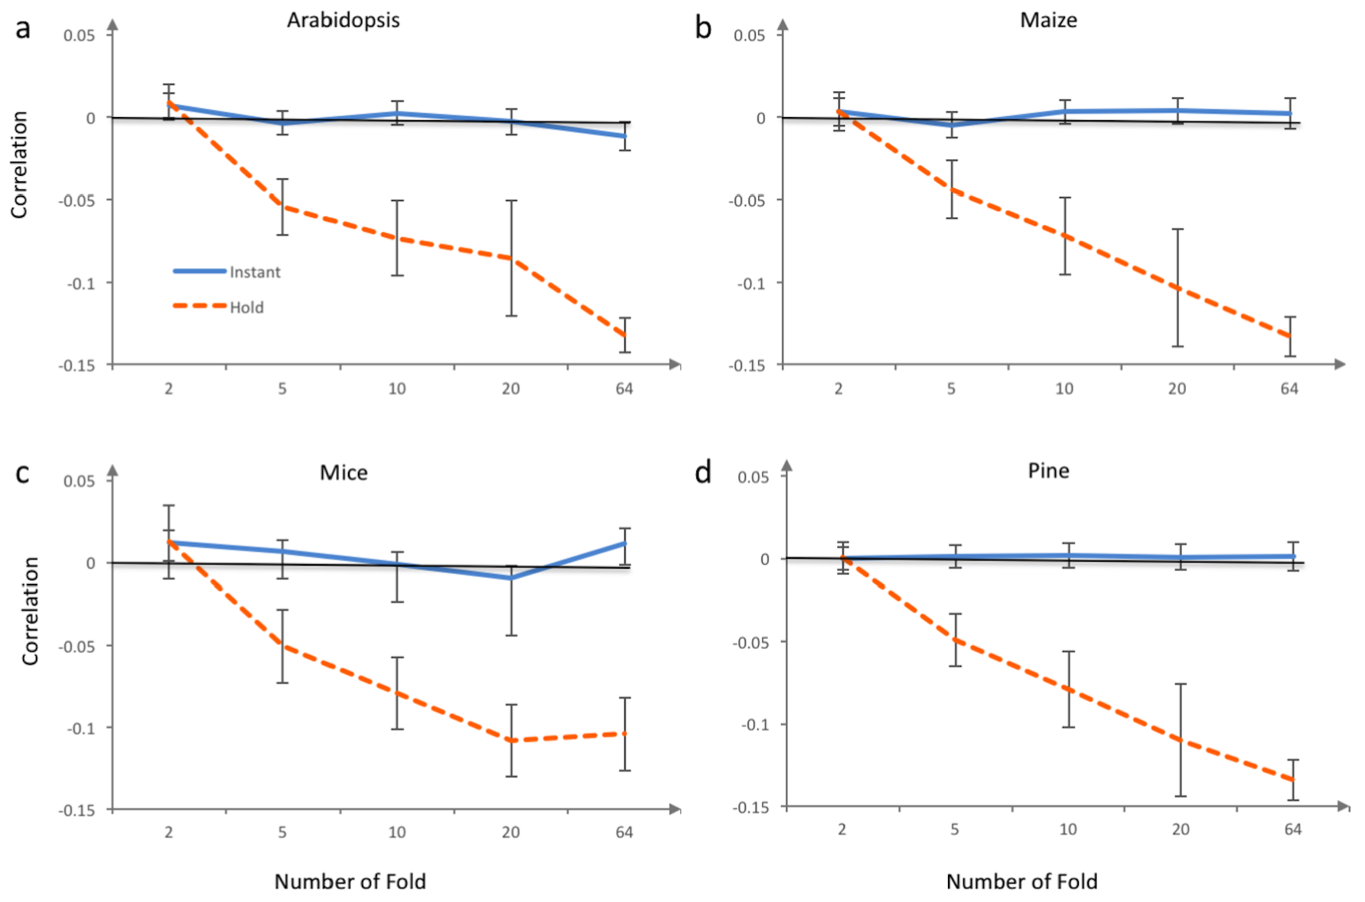
Hold bias relates to number of fold

Slide 17
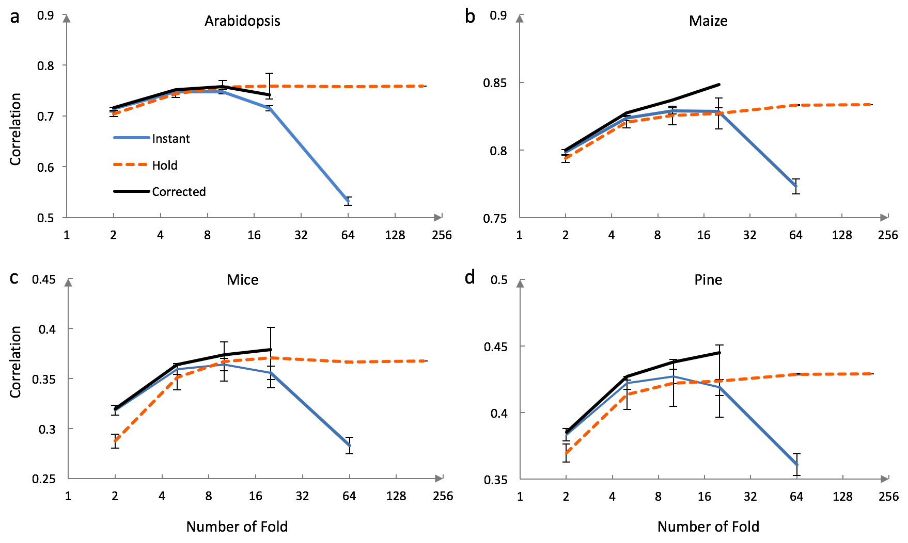
Problem of instant accuracy

Slide 18
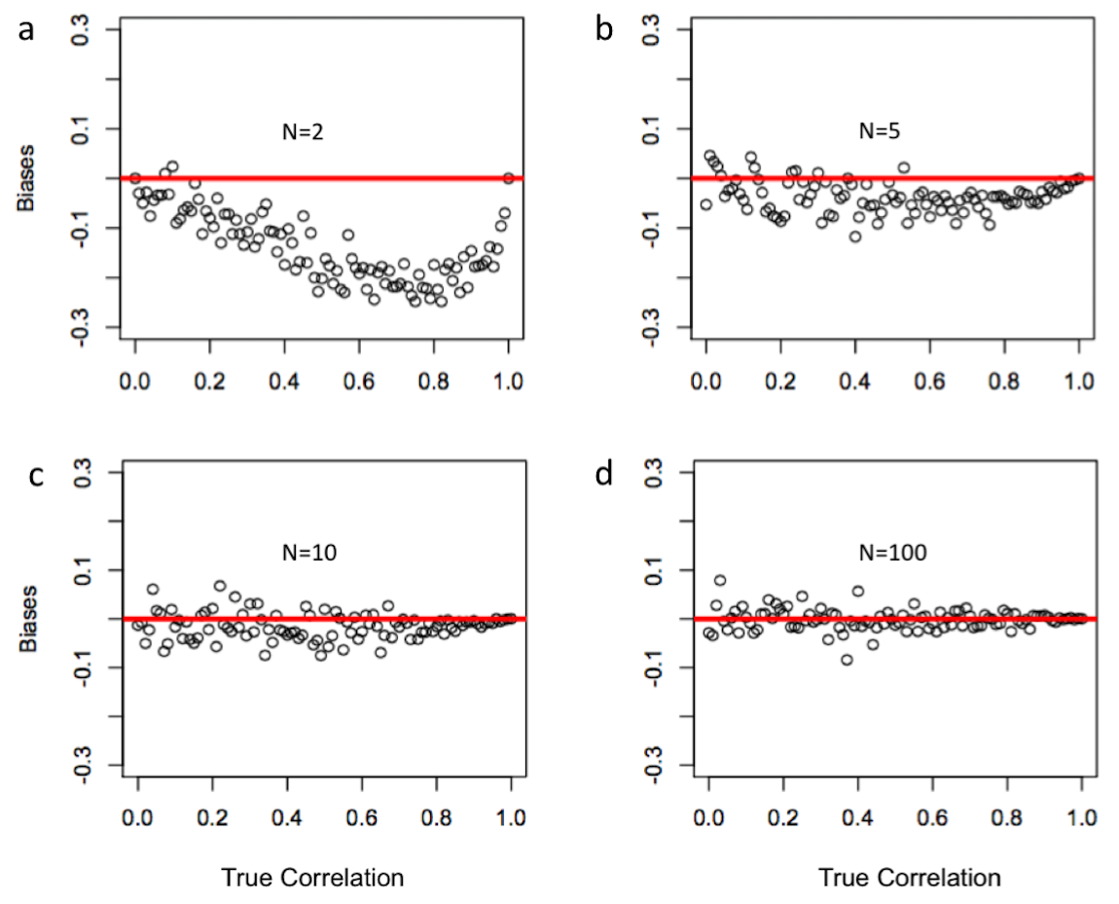
Small sample causes bias

Slide 19
Correction of instant accuracy

Slide 20
Highlight
GS by GWAS
Over fitting
Cross validation
K-fold validation
Jack knife
Re-sampling
Two ways of calculating accuracy
Bias and correction

