Slide 1
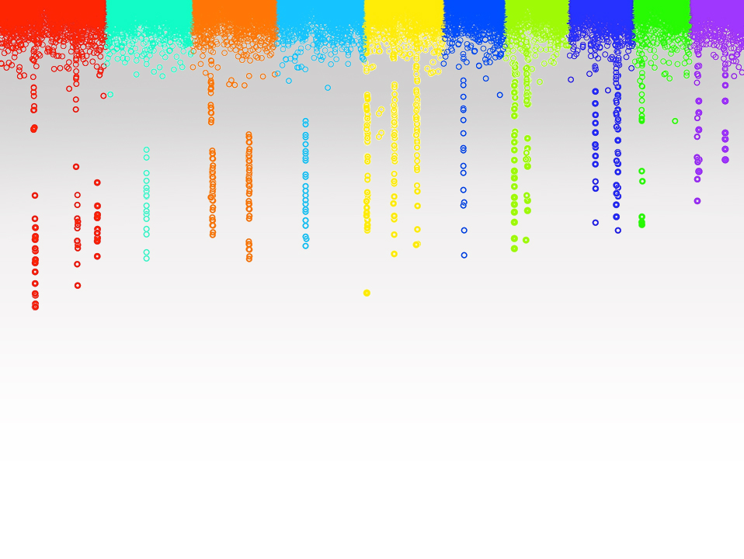

Statistical Genomics
Lecture 25: Ridge Regression
Zhiwu Zhang
Washington State University

Slide 2
Outline
Concept development
Ridge Regression
rrBLUP package

Slide 3
Development of genomic Selection
MAS
works for a few genes
Over-fit
CV
Inaccurate
Does not works for polygenes
Whole genome
Concept in 1990s implement in 2000s
RR and Bayes
gBLUP
=RR
Pedigree+Marker
cBLUP/sBLUP

Slide 4
Concept development
Over fitting
Governed by less parameters
Free fixed effects into random effects
Only regulate their distribution
Random effects = total genetic effects of individuals
Random effects = effects of markers

Slide 5
Fixed effect
Specific interest, nothing behind, e.g. a fertilizer
Limited levels, e.g. M and F only for sex
Access to any specific level
No distribution

Slide 6
Random effect
Population behind, e.g. average and variance
Many levels, e.g. individuals genetic effects
Distribution
No control to access a specific level

Slide 7


Pioneers of implementation
RR and Bayes

Slide 8
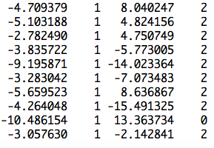
Fixed effect model
observation
mean
PC2
SNP1 | SNP2 | … | SNP4 | SNP5
S1 | S2 | … | S4 | S5
0 | 1 | … | 2 | 0
2 | 2 | … | 0 | 2
2 | 0 | … | 2 | 2
0 | 2 | … | 0 | 0
[
]
b=
b0
b1
x2
x3
x5
x6
y
1
x1
]
[
y = Xb +e

Slide 9
Fixed effect model over-fitting
observation
mean
PC2
SNP1 | SNP2 | … | SNP9 | SNP10
S1 | S2 | … | S9 | S10
0 | 1 | … | 2 | 0
2 | 2 | … | 0 | 2
2 | 0 | … | 2 | 2
0 | 2 | … | 0 | 0
[
]
b=
b0
b1
x2
x3
x9
x10
y
1
x1
]
[
y = Xb +e

Slide 10
BLUP of individuals
observation
mean
PC2
Ind1 | Ind2 | … | Ind19 | Ind20
u1 | u2 | … | u19 | u20
1 | 0 | … | 0 | 0
0 | 1 | … | 0 | 0
0 | 0 | … | 1 | 0
0 | 0 | … | 0 | 1
u=
]
[
[
b=
b0
b1
]
y
1
x1
x2
=X
Z
[
]
y = Xb + Zu +e

Slide 11
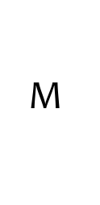
Switch individuals to SNPs
observation
mean
PC2
SNP1 | SNP2 | … | SNPm-1 | SNPm
S1 | S2 | … | Sm-1 | Sm
0 | 1 | … | 2 | 0
2 | 2 | … | 0 | 2
2 | 0 | … | 2 | 2
0 | 2 | … | 0 | 0
s=
]
[
[
b=
b0
b1
]
1
x1
=X
M
y
[
]
y = Xb + Ms +e

Slide 12
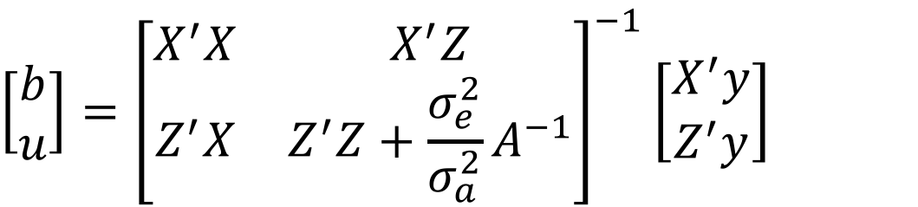
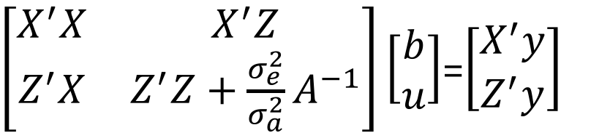
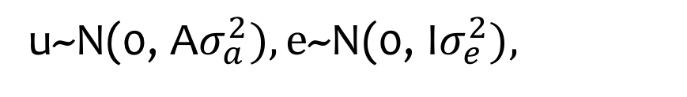
BLUP on individuals
y = Xb + Zu + e
u~N(0, A$σ_{a}^{2}),\text{e}\text{\sim }\text{N}\text{(0,} \text{I}σ_{e}^{2}),$
$\left[\begin{matrix}X^{′}X & X^{′}Z \\ Z^{′}X & Z^{′}Z+{\frac{σ_{e}^{2}}{σ_{a}^{2}}A}^{−1}\end{matrix}\right]\left[\begin{matrix}b \\ u\end{matrix}\right]$=$\left[\begin{matrix}X^{′}y \\ Z^{′}y\end{matrix}\right]$
$$\left[\begin{matrix}b \\ u\end{matrix}\right]={\left[\begin{matrix}X^{′}X & X^{′}Z \\ Z^{′}X & Z^{′}Z+{\frac{σ_{e}^{2}}{σ_{a}^{2}}A}^{−1}\end{matrix}\right]}^{−1}\left[\begin{matrix}X^{′}y \\ Z^{′}y\end{matrix}\right]$$

Slide 13
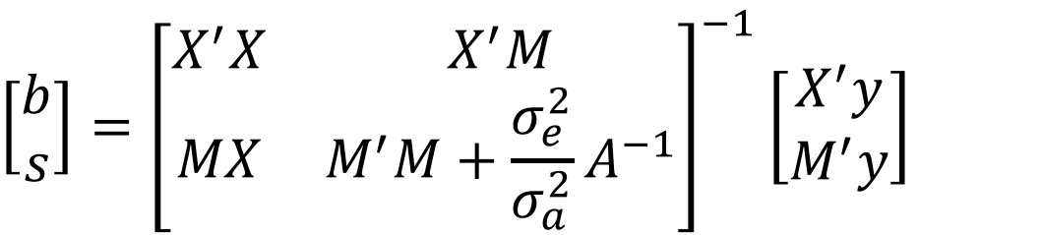
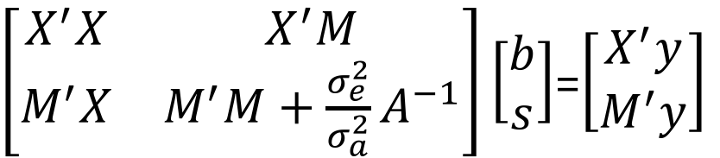
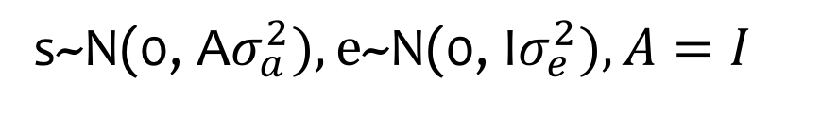
BLUP on markers (Z to M, and u to s)
y = Xb + Ms + e
s~N(0, A$σ_{a}^{2}),\text{e}\text{\sim }\text{N}\text{(0,} \text{I}σ_{e}^{2}), A=I$
$\left[\begin{matrix}X^{′}X & X^{′}M \\ M^{′}X & M^{′}M+{\frac{σ_{e}^{2}}{σ_{a}^{2}}A}^{−1}\end{matrix}\right]\left[\begin{matrix}b \\ s\end{matrix}\right]$=$\left[\begin{matrix}X^{′}y \\ M^{′}y\end{matrix}\right]$
$$\left[\begin{matrix}b \\ s\end{matrix}\right]={\left[\begin{matrix}X^{′}X & X^{′}M \\ MX & M^{′}M+{\frac{σ_{e}^{2}}{σ_{a}^{2}}A}^{−1}\end{matrix}\right]}^{−1}\left[\begin{matrix}X^{′}y \\ M^{′}y\end{matrix}\right]$$

Slide 14
Ridge Regression
Independently invented in many contexts
Different names: e.g. Tikhonov regularization (1963), Phillips–Twomey method, and constrained linear inversion
Tikhonov, A. N. (1963). "О решении некорректно поставленных задач и методе регуляризации". Doklady Akademii Nauk SSSR 151: 501–504.. Translated in "Solution of incorrectly formulated problems and the regularization method". Soviet Mathematics 4: 1035–1038.
Phillips, D. L. (1962). "A Technique for the Numerical Solution of Certain Integral Equations of the First Kind". Journal of the ACM 9: 84. doi:10.1145/321105.321114.

Slide 15
rrBLUP vs. gBLUP
rrBLUP
s~N(0, I σ_{r}²)
y=x₁s₁ + x₂s₂ + … + x_{p}s_{p} + e
gBLUP
~N(0,
σ_{a}²)
U
A

Slide 16

u=Ms
if A=MM$′$

Slide 17
R packages for ridge regression
rrBlupMethod6
ridge
Lm.ridge (from MASS): library(MASS)
rrBLUP

Slide 18
rrBLUP R package
Ridge Regression + BLUP
EMMA to estimate variance components

Slide 19
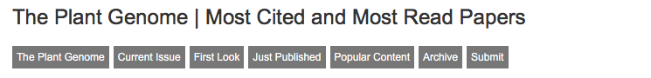
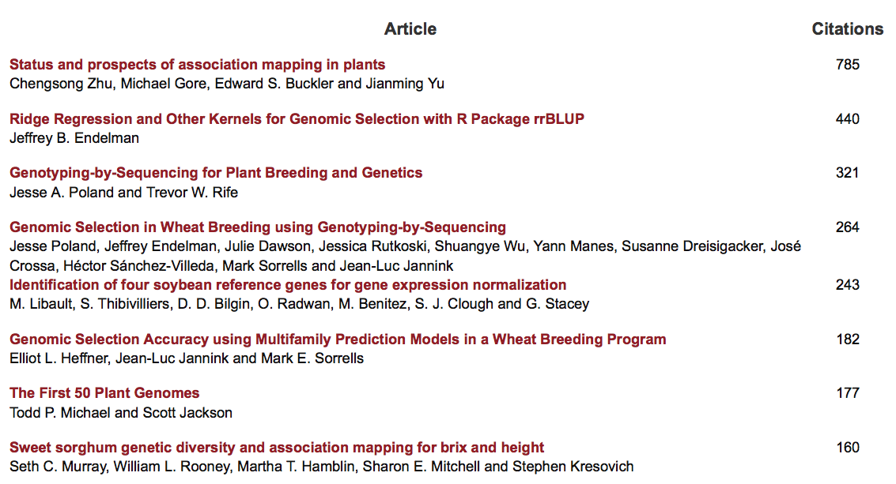
75% from Cornell

Slide 20
rrBLUP on CRAN
rrBLUP: Ridge Regression and Other Kernels for Genomic Selection
Software for genomic prediction with the RR-BLUP mixed model. One application is to estimate marker effects by ridge regression; alternatively, BLUPs can be calculated based on an additive relationship matrix or a Gaussian kernel.
Version: 4.4
Depends: R (≥ 2.14)
Suggests: parallel
Published: 2015-10-28
Author: Jeffrey Endelman
Maintainer: Jeffrey Endelman <endelman at wisc.edu>
License: GPL-3
URL: http://potatobreeding.cals.wisc.edu/software
NeedsCompilation: no
Citation: rrBLUP citation info
Materials: NEWS
CRAN checks: rrBLUP results
Downloads:
Reference manual: rrBLUP.pdf
Package source: rrBLUP_4.4.tar.gz
Windows binaries: r-devel: rrBLUP_4.4.zip, r-release: rrBLUP_4.4.zip, r-oldrel: rrBLUP_4.4.zip
OS X Snow Leopard binaries: r-release: rrBLUP_4.4.tgz, r-oldrel: rrBLUP_4.3.tgz
OS X Mavericks binaries: r-release: rrBLUP_4.4.tgz
Old sources: rrBLUP archive
Reverse dependencies:
Reverse depends: GeneticSubsetter
Reverse imports: PopVar

Slide 21
Setup GAPIT
#Import GAPIT
#source("http://www.bioconductor.org/biocLite.R")
#biocLite("multtest")
#install.packages("EMMREML")
#install.packages("gplots")
#install.packages("scatterplot3d")
library('MASS') # required for ginv
library(multtest)
library(gplots)
library(compiler) #required for cmpfun
library("scatterplot3d")
library("EMMREML")
source("http://www.zzlab.net/GAPIT/emma.txt")
source("http://www.zzlab.net/GAPIT/gapit_functions.txt")

Slide 22
Import data and simulation
#Import demo data
myGD=read.table(file="http://zzlab.net/GAPIT/data/mdp_numeric.txt",head=T)
myGM=read.table(file="http://zzlab.net/GAPIT/data/mdp_SNP_information.txt",head=T)
myCV=read.table(file="http://zzlab.net/GAPIT/data/mdp_env.txt",head=T)
#Simultate 10 QTN on the first half chromosomes
X=myGD[,-1]
index1to5=myGM[,2]<6
X1to5 = X[,index1to5]
taxa=myGD[,1]
set.seed(99164)
GD.candidate=cbind(taxa,X1to5)
mySim=GAPIT.Phenotype.Simulation(GD=GD.candidate,GM=myGM[index1to5,],h2=.5,NQTN=20, effectunit =.95,QTNDist="normal",CV=myCV,cveff=c(.01,.01))

Slide 23
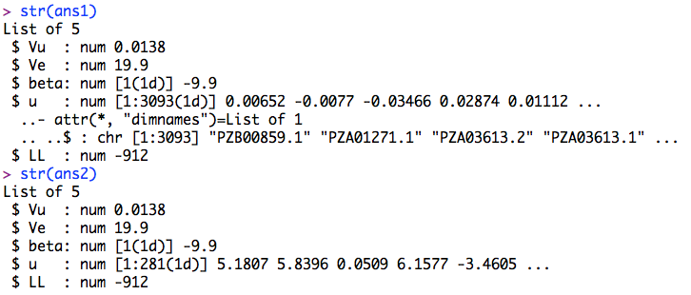
Ridge Regression vs. gBLUP
#Import rrBLUP
#install.packages("rrBLUP")
library(rrBLUP)
#prepare data
y <- mySim$Y[,2]
M=as.matrix(X)
#Ridge Regression
ans1 <- mixed.solve(y=y,Z=M)
#gBLUP
K <- tcrossprod(M) #K = MM'
ans2 <- mixed.solve(y=y,K=K)
#Compare GEBV
plot(M%*%ans1$u, ans2$u)

Slide 24
rrBLUP vs GAPIT
myGAPIT <- GAPIT(
Y=mySim$Y,
GD=myGD,
GM=myGM,
group.from=1000,
group.to=1000)
order.raw=match(taxa,myGAPIT$Pred[,1])
plot(ans2$u, myGAPIT$Pred[order.raw,5])
first=c("c","a","b","d")
second=c("a","d","c","e","f")
match(first,second)
[1] 3 1 NA 2

Slide 25
Highlight
Concept development
Ridge Regression
rrBLUP package

