Slide 1
Profile Hidden Markov Models
Profile Hidden Markov Models
Weicheng Zhang
CSCI 8990, Research Seminar
Summer, 2001

Slide 2
Outline
  I. Introduction
  II. Hidden Markov Models (HMMs)
  III. Profile HMMs
  IV. Profile HMM software
  V. Profile HMM libraries
  VI. Conclusion
  VII. Demo

Slide 3
I Introduction
Classification of protein structures are:
1. Primary structure: linear sequence of amino acid residues in a protein.
2. Secondary structure: refers to regularities in local conformations, such
as α helices and β structures (including β sheets).
3. Tertiary structure: completely folded and compacted polypeptide chain,
which may contain one or more globular units, or domains.
4. Quaternary structure: the association of two or more polypeptide chains
into a multisubunit or oligomeric protein.

Slide 4
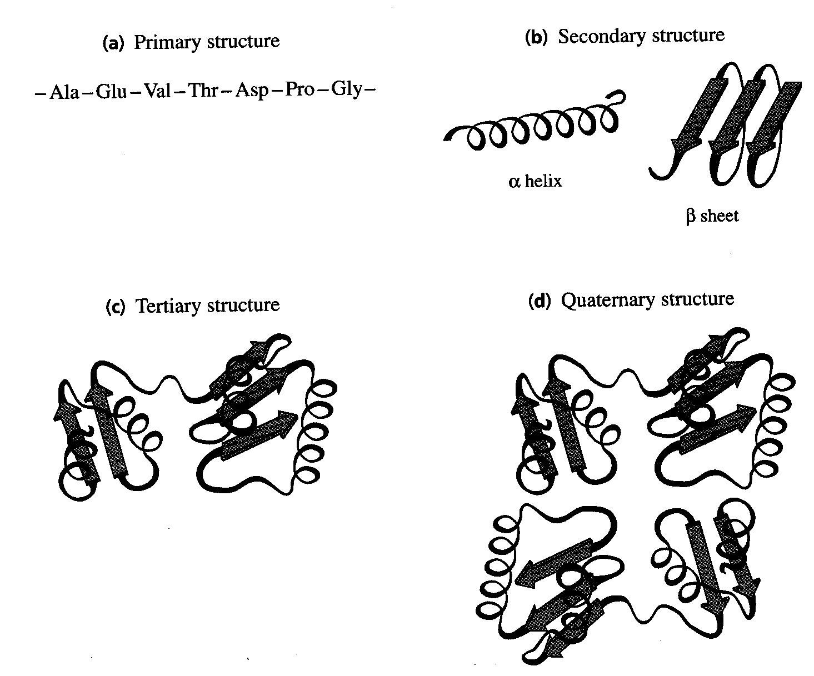
Protein Structure
Link to 20 amino acids

Slide 5
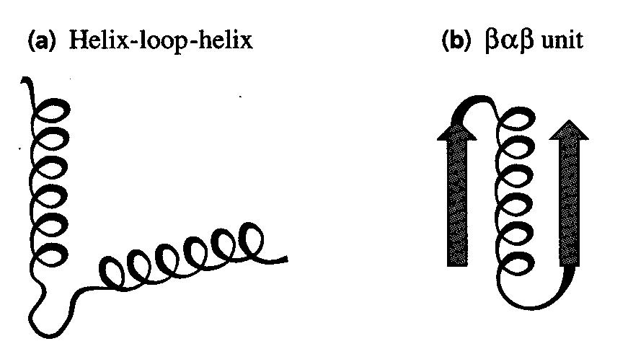
Protein Structure - concepts
Motif (protein sequence pattern): is recognizable combinations of
α helices and β strands that appear in a number of proteins.
Domain consists of combinations of motifs, the size of domains varies from about 25 to 30 amino acid residues to about 300, with an average of about 100.

Slide 6
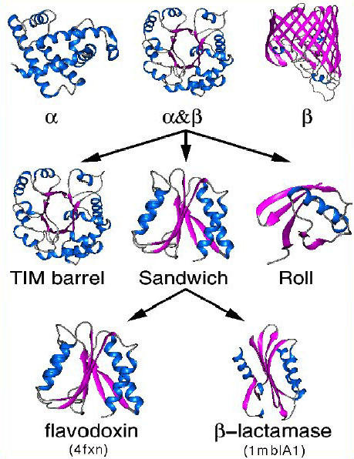
Protein Structure

Slide 7
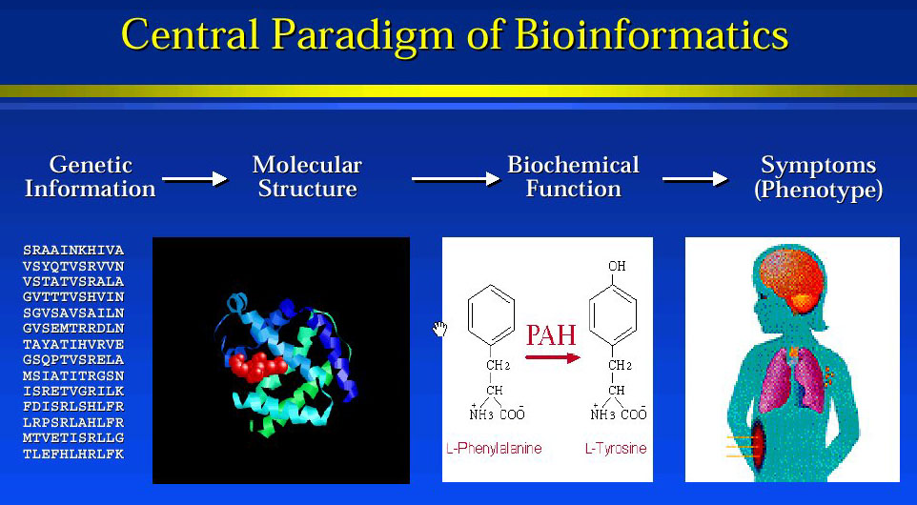
Central Paradigm of Bioinformation

Slide 8
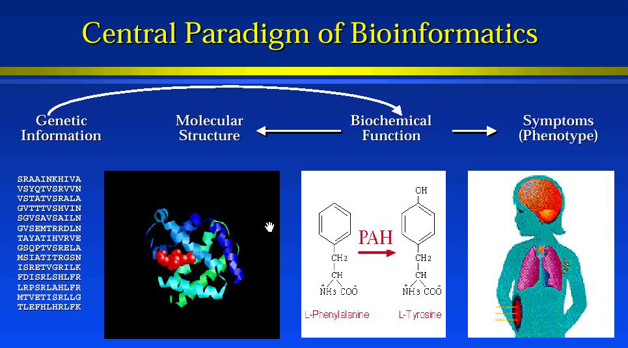
Central Paradigm of Bioinformation

Slide 9
I Introduction
Multiple sequences: Proteins, RNAs in genomes can usually be classified into families of related sequences and structures. On the basis of similarities in their sequences and structures.
What’s protein family? The members in the family have:
1) Same function; and
2) Clear evolutionary relationship; and
3) Patterns of conservation, some positions are more conserved than the others, and some regions seem to tolerate insertions and deletions more than other regions, the similarity usually > 25% .
Example: A MutT (or Nudix) Protein Family

Slide 10
Query ???
Query?
Suppose I have a query protein sequence, and I am interested in which family it belongs to? What function does it have?
Answer !
This problem arises especially in high throughout genome sequence analysis, there are two methods to solve this problem.
1) BLAST method. However, sometimes the standard “top hit” BLAST analyses can be confused by proteins with several distinct domains.
2) profile HMMs method.

Slide 11
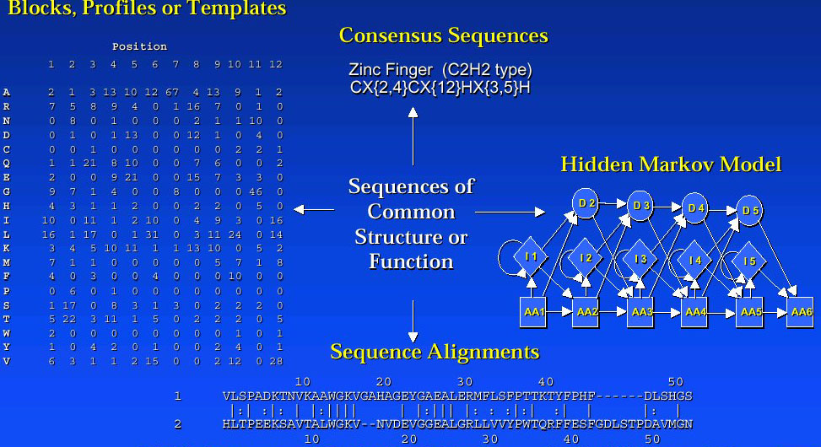
Sequence representation

Slide 12
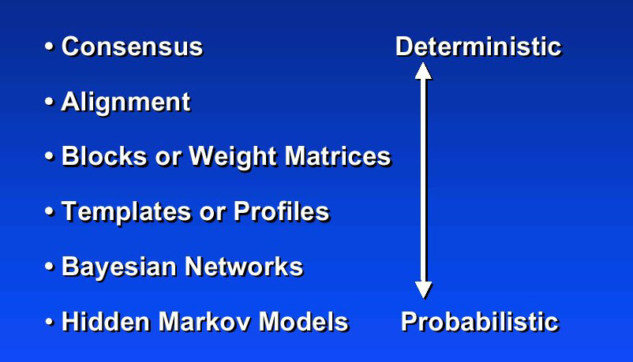
Sequence representation

Slide 13
BLAST
BLAST® (Basic Local Alignment Search Tool) is a set of similarity search programs designed to explore all of the available sequence databases regardless of whether the query is protein or DNA.
The BLAST programs have been designed for speed, with a minimal sacrifice of sensitivity to distant sequence relationships. The scores assigned in a BLAST search have a well-defined statistical interpretation, making real matches easier to distinguish from random background hits.
1) Original BLAST for no gap sequences
2) Gapped BLAST for well delimited regions
3) PSI-BLAST for families

Slide 14
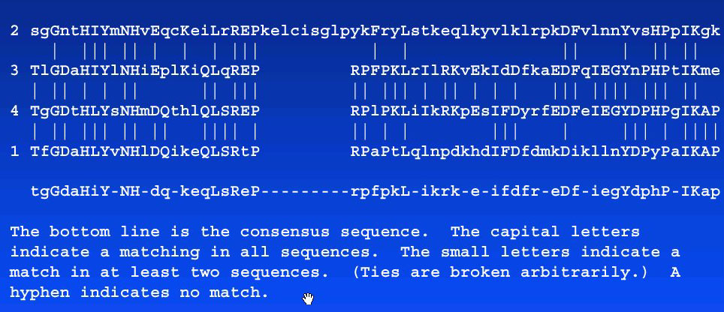
Multiple sequence alignments

Slide 15
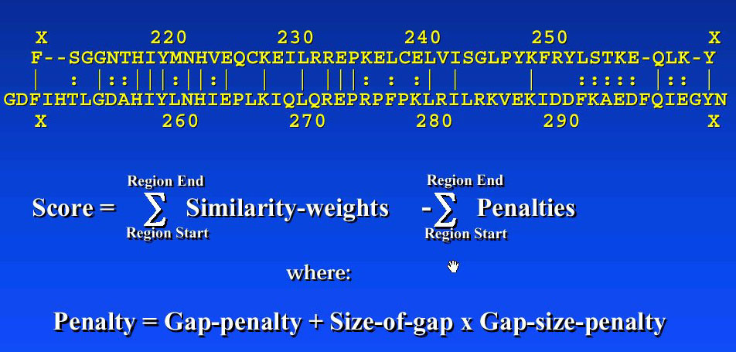
Sequence Alignment

Slide 16
Profile methods
Background: when studying protein sequence families, people found that some regions have been better conserved than others during evolution. These regions are generally important for the function of a protein and/or for the maintenance of its 3D structure.
Profile: By analyzing the constant and variable properties of such groups of similar sequences, it is possible to derive a profile for a protein family or domain, which distinguishes its members from all other unrelated proteins. Profile methods were introduced in 1980’s.

Slide 17
Profile methods
In addition to the sequences themselves, a profile contains the following information:
1) which types of residues are allowed at what position;
2) which positions are highly conserved, which ones are not;
3) which positions or regions can allow insertions,
which regions may be deleted.
Purpose: A protein profile can be used to assign a newly sequenced protein to a specific protein family and thus to formulate hypotheses about its function.

Slide 18
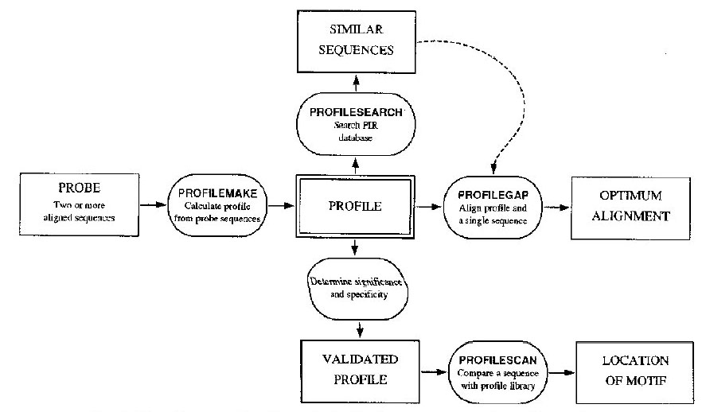
Profile protocol - flow diagram

Slide 19
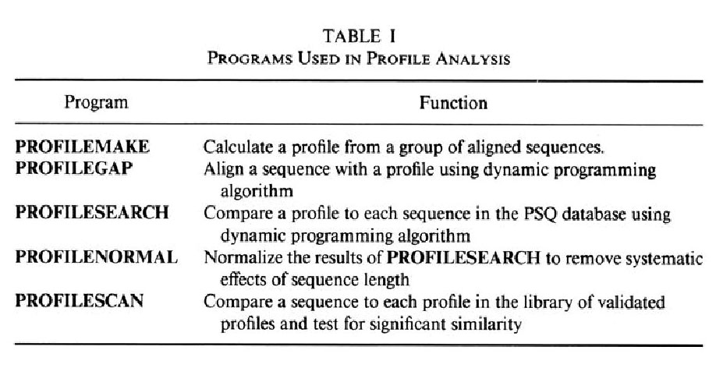
Profile programs

Slide 20
II Hidden Markov Models
Hidden Markov models (HMMs): are a class of probabilistic models that describes a probability distribution over a potentially infinite number of sequences. Imagining a DNA motif as below:
ACA - - - ATG
TCA ACT ATC
ACA C - - AGC
AGA - - - ATC
ACC G - - ATC
4 bases in DNA
A: adenine
G: guanine
C: cytosine
T: thymine

Slide 21
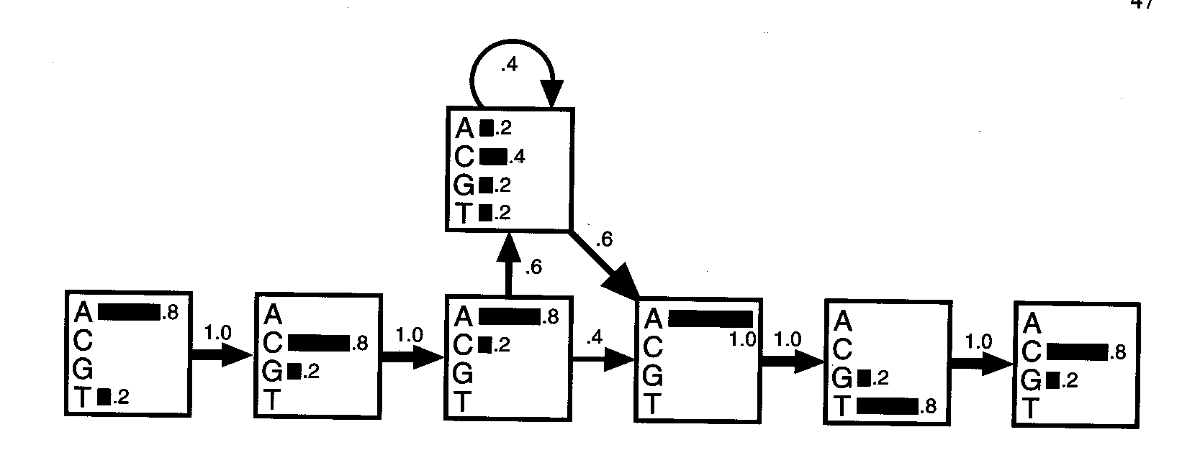
II Hidden Markov Models
ACA - - - ATG
TCA ACT ATC
ACA C - - AGC
AGA - - - ATC
ACC G - - ATC
A HMM model for a DNA motif alignments, The transitions are shown with arrows whose thickness indicate their probability. In each state, the histogram shows the probabilities of the four bases.

Slide 22
II Hidden Markov Models
To score a sequence using probability:
Consensus sequence:
P (ACACATC) = 0.8x1 x 0.8x1 x 0.8x0.6 x 0.4x0.6 x 1x1 x
0.8x1 x 0.8 = 4.7 x 10 ⁻²
ACAC - - ATC

Slide 23
II Hidden Markov Models
To score a sequence using probability:
Highly implausible sequence:
P(TGCTAGG) = 0.0023 x 10 ⁻²
TGCT - - AGG

Slide 24
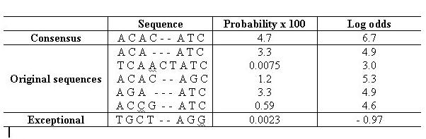
II Hidden Markov Models
To score the sequence using log-odds:
log-odds for sequence S = log [P(S)/(0.25) ^{L}] = log P(S) - L Log 0.25
Probabilities and log-odds scores for the 5 sequences in the alignment and for the consensus sequence and the exceptional sequence.

Slide 25
II Hidden Markov Models
Dynamic HMM algorithms: Forward (for scoring) and Viterbi (for alignment) were used. They have a worst case of O(NM²) in time and O(NM) in space for a sequence of length N and an HMM of M states.
For profile HMMs: that have a constant number of state transitions per state rather than the vector of M transitions per state in fully connected HMMs, both algorithms run in O(NM) in time and O(NM) in space.

Slide 26
II Hidden Markov Models
Parameters set: an HMM can be built from prealigned (prelabeled) sequences (i.e, where the state paths are assumed to be known). It’s simply a matter of converting observed counts of symbol emissions and state transitions into probabilities. In building a profile HMM, an existing multiple alignment is given as input.
HMM training algorithms: BaumWelch expectation maximization or gradient descent algorithms. Gibbs sampling, simulated annealing and genetic algorithm training methods seem better at avoiding spurious local optima in training HMMs and HMM like models.

Slide 27
II Hidden Markov Models
HMM applications in computational biology:
1. Linear sequence analysis;
2. Genefinding;
3. Radiation hybrid mapping;
4. Genetic linkage mapping;
5. Phylogenetic analysis;
6. Secondary structure predication (neural net methods);

Slide 28
III Profile Hidden Markov Models
Profile HMMs: were introduced into computational biology in the late 1980’s, and for use as profile models since 1994. Profile HMMs and HMM-based genefinders are the most successful HMM applications in computational biology.

Slide 29
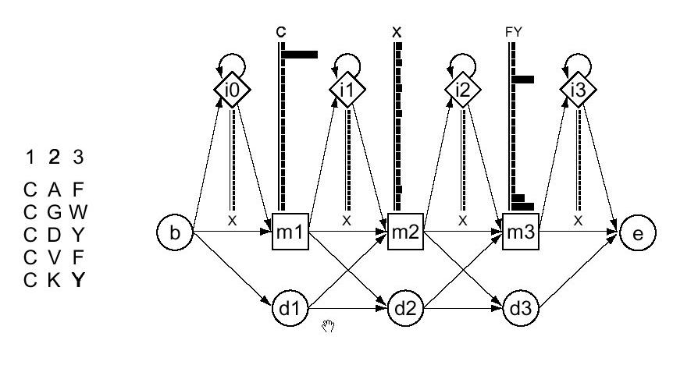
III Profile Hidden Markov Models
A small profile HMM (right) representing a short multiple alignment of five sequences (left) with three consensus columns.

Slide 30
III Profile Hidden Markov Models
A linear hidden Markov model is a sequence of nodes, each corresponding to a column in a multiple alignment. In our HMMs, each node has a main state (square), insert state (diamond) and delete state (circle).

Slide 31
III Profile Hidden Markov Models
Each sequence uses a series of these states to traverse the model from start to end. Using a main state indicates that the sequence has a character in that column, while using a delete state indicates that the sequence does not. Insert states allow sequences to have additional characters between columns. In many ways, these models correspond to profiles.

Slide 32
III Profile Hidden Markov Models
The primary advantage of these models over standard methods of sequence search is their ability to characterize an entire family of sequences.
Thus, each position has a distribution of amino acid, as do transitions between states. That is, these linear HMMs have position-dependent character distributions and position-dependent insertion and deletion gap penalties. The alignment of each of a family to a trained model automatically yields a multiple alignment among those sequences.

Slide 33
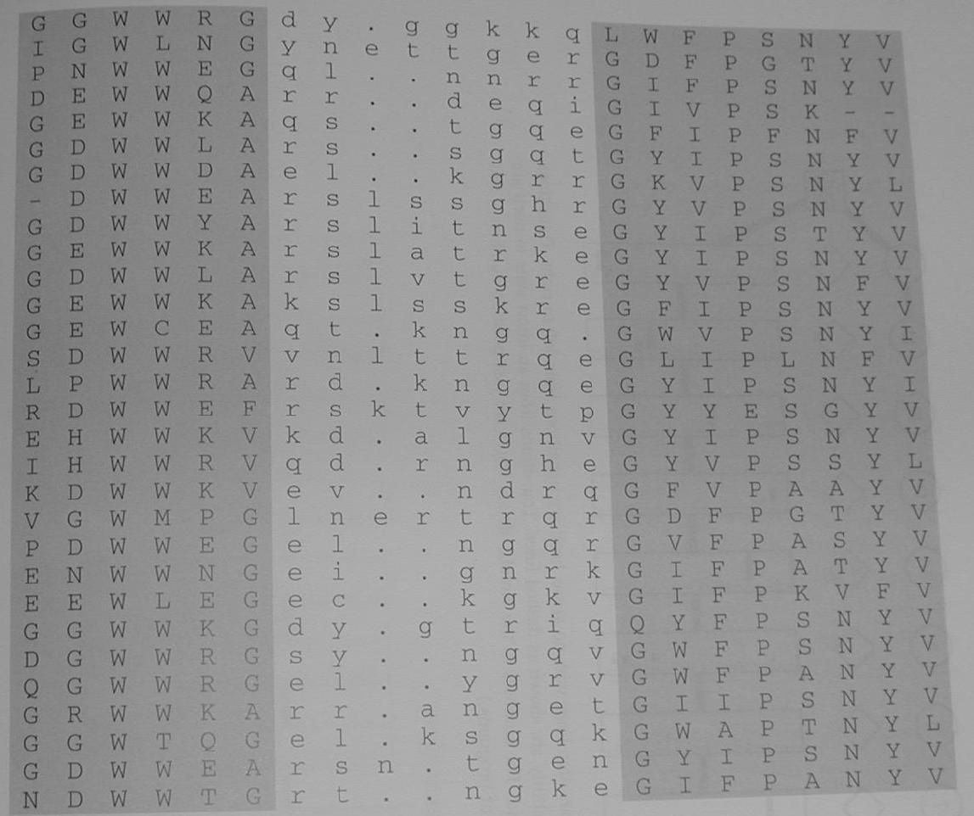
III PHMM example
An alignment of 30 short amino acid sequences chopped out of a alignment of the SH3 domain. The shaded area are the most conserved and were represented by the main states in the HMM. The unshaded area was represented by an insert state.

Slide 34
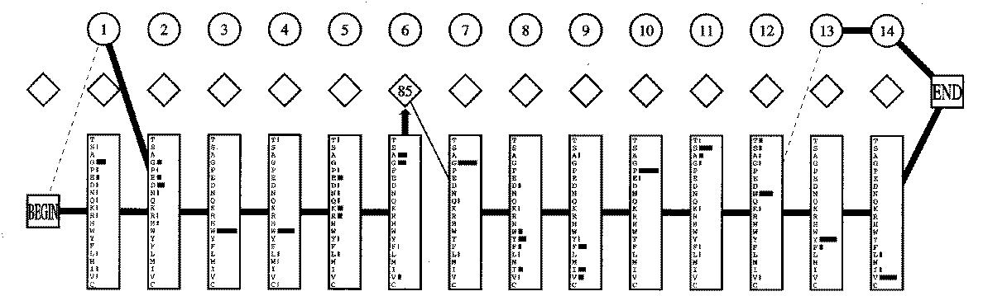
III PHMM example
Note: transition lines with no arrow head are from left to right. Transitions with probability zero are not shown, and those with very small probability are shown as dashed lines. Transitions from an insert state to itself are not shown; instead the probability times 100 is shown in the diamond. The numbers in the circular delete states are just position numbers. (from SAM package of programs)

Slide 35
IV Profile HMM Software
      PROBE http://www.ncbi.nlm.nih.gov/
      BLOCKS http://www.blocks.fhcrc.org/
      META-MEME http://www.cse.ucsd.edu/users/bgrundy/metameme.1.0.html
      SAM http://www.cse.ucsc.edu/research/compbio/sam.html
      HMMERS http://hmmer.wustl.edu/
      HMMpro http://www.netid.com/
      GENEWISE http://www.sanger.ac.uk/Software/Wise2/
      PSI-BLAST http://www.ncbi.nlm.nih.gov/BLAST/newblast.html

Slide 36
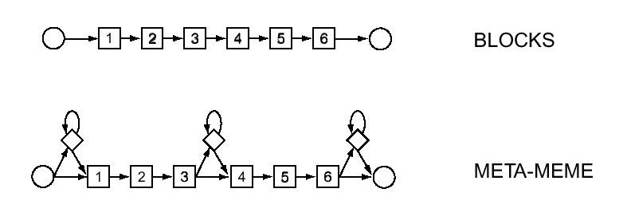
IV Profile HMM Software
The difference between these software packages is the model architecture they adopt: “profile” models & “motif” models.
Motif model architecture: modeling one or more ungapped blocks of sequence consensus separated by a small number of insert states. Can be viewed as special cases of profile HMMs.

Slide 37
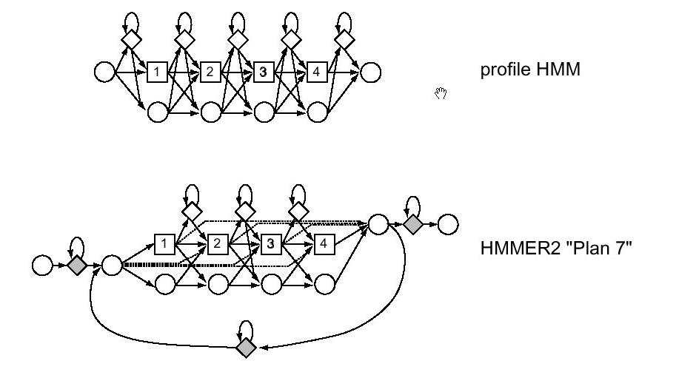
IV Profile HMM Software
Profile model architecture: models with an insert and delete state associated with each match state, allowing insertion and deletion anywhere in a target sequence.

Slide 38
IV Profile HMM Software
Since profile HMMs allow insertions and deletions anywhere in a target sequence. Intuitively, they should be more sensitive than ungapped models.
However, in practice there is a tradeoff between increasing the descriptive power of the model and the difficulty in determining an increasingly large number of free parameters.
A complex model is more prone to overfitting the training data and failing to generalize to other sequences.
SAM and HMMERS use mixture Dirichlet priors on most distributions to help avoid overfitting and to limit the effective number of free parameters.

Slide 39
V Profile HMM Libraries
Profile HMM software is well suited for modeling a particular sequence family of interest and finding additional similarities (domains) in a sequence database.
Building a library of profile HMMs requires a large number of multiple alignments of common protein domains. A database of annotated multiple alignments and prebuilt profile HMMs becomes desirable.

Slide 40
V Profile HMM Libraries
Two large collections of annotated profile HMMs are:
1) Pfam database: http://www.sanger.ac.uk/Pfam/
2) PROSITE profile database: http://www.expasy.ch/prosite/
Pfam is a collection of protein families and domains. Pfam contains multiple protein alignments and profile-HMMs of these families.
PROSITE is a database of protein families and domains. It consists of biologically significant sites, patterns and profiles that help to reliably identify to which known protein family (if any) a new sequence belongs.

Slide 41
V Profile HMM Libraries
Since PROSITE and Pfam are independent projects, there is some overlap between the two databases.
Pfam database focuses on “classical” domains with a high proportion of extracellular modules. The current release of the Pfam database 6.5 (July 2001) contains 2929 families.
PROSITE profile database emphasizes domains in intracellular proteins, which involved in signal transduction, DNA repair, cell cycle regulation etc. The current release of the PROSITE profile database 16.42 (July 12, 2001) contains 1089 documentation entries that describes 1474 different patterns, rules and profiles.

Slide 42
V Profile HMM Libraries
Both databases are available via WWW servers, including on line analysis servers for submitting protein sequence queries.
However, None of the profile servers is mature: both profile software and profile databases are rapidly improving and changing.
Various database teams begin actively sharing alignment and annotation data. This is extremely valuable.
Users are well advised to search several domain annotation servers.

Slide 43
VI Conclusion
Three principal advances on Profile HMM methods:
1. Motif based HMMs have been introduced as an alternative to the original Krogh profile HMM architecture.
2. Large libraries of profile HMMs and multiple alignments have become available, as well as compute servers to search query sequences against these resources.
3. There has been an increasing incursion of profile HMM methods into the area of protein structure prediction by fold recognition.

Slide 44
VI Conclusion
Profile HMM method is a complement to BLAST and FASTA analyses
It will provide a second tier of solid, sensitive, statistically based analysis tools, based on the combination of powerful new HMM software and large sequence alignment databases of conserved protein domains.

Slide 45
Reference
  1. Eddy S.R., Profile hidden markov models, Bioinformatics 14:755-763, 1998. A review of the profile HMM literature from 1996-1998.
  2. Sonnhammer E.L.L., S.R. Eddy, E. Birney, A. Bateman, R. Durbin. Pfam: Multiple Sequence alignments and HMM-Profiles of Protein Domains. Nucl. Acids Res., 26:320-322, 1998.
  3. Eddy S.R., Hidden Markov models and Large Scale Genome Analysis. Transactions of the American Crystallographic Association , 1997. From a talk on HMMER and Pfam given at the 1997 ACA annual meeting in St. Louis.
  4. Krogh Anders, An introduction to hidden Markov models for biological sequences. Computational Methods in Molecular Biology, 45-63, 1998. Elsevier.

Slide 46
VII DEMO
Pfam
Prosite profiles
BLAST
Hemoglobin sequence (146 amino acid residues):
vhfsdaerda iaaiwgkihi deigpqslar vlivypwtqr yfskfgdmss vaaisgnpkv aahgkvvlga lekgvknldn vkatysnlsq lhceklnvdp dnfralgdci tivvaskfgn aftpelqnaw hkflsvvaaa lssryf

