Slide 1
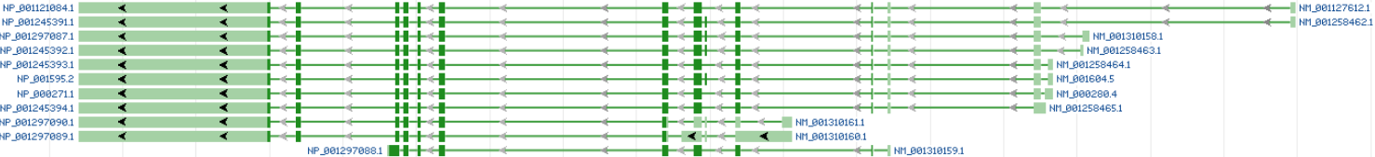
42bp exon, included only in the isoform 5a isoform mRNAs.

