Slide 1
Multiple Alignment
Jack Leunissen
Laboratory of Bioinformatics

Slide 2
Multiple Alignment
The purpose of a multiple alignment is to line up all residues that were derived from the same residue position in the ancestral gene or protein in any number of sequences

Slide 3
Multiple Alignment
The purpose of a multiple alignment is to line up all residues that were derived from the same residue position in the ancestral gene or protein in any number of sequences
gap = insertion or deletion

Slide 4
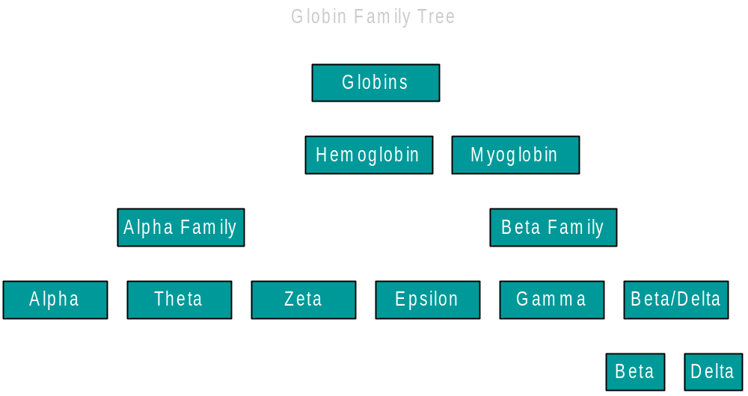
Hierarchy Of Alignments

Slide 5
From Pairwise To Multiple
Two sequences
Three sequences

Slide 6
And Beyond ...
Assuming that it takes 1 kilobyte (1kb) to store one single sequence, then ...
To do simultaneous alignment it takes for
  2 sequences : 1 megabyte of memory
  3 sequences : 1 gigabyte of memory
  4 sequences : 1 terabyte of memory
  5 sequences : 1 petabyte of memory
  6 sequences : 1 exabyte of memory

Slide 7
Iterative Approach
Or: the way we did multiple alignment in the middle ages
First do all the easy alignments
Then gradually add all the difficult ones
But how do we know what alignments are easy or difficult?

Slide 8
Iterative Algorithm
as applied in ClustalW and similar programs
Do a pairwise comparison of all sequences
From this, calculate how sequences are related to each other (the more similar are easier to align)
Perform multiple alignment in order; the most similar are aligned first, the others are saved for later

Slide 9
1: Pairwise Comparison
Compare every single sequence to every other sequence, using pairwise sequence alignment
      seq 1 ↔ seq 2 ⇒ 0.91
      seq 1 ↔ seq 3 ⇒ 0.23
      …
      seq 8 ↔ seq 9 ⇒ 0.87
Record the resulting similarity scores
  You can in fact use either similarities or differences between sequence

Slide 10
2: Calculate The Guide Tree
Construct a guide tree from the matrix containing the pairwise comparison values, using a (relatively simple) clustering algorithm
  UPGMA (PileUp & Clustal V)
  Neighbor-Joining (Clustal W, Clustal X)

Slide 11
How UPGMA Works ...
A
C
4
3
2
2
2
3
D
B
1
E

Slide 12

UPGMA - Step 1
D
E

Slide 13

UPGMA - Step 2
D
E
A
B

Slide 14

UPGMA - Step 3
C
D
E
A
B

Slide 15

UPGMA - Step 4
C
D
E
A
B

Slide 16
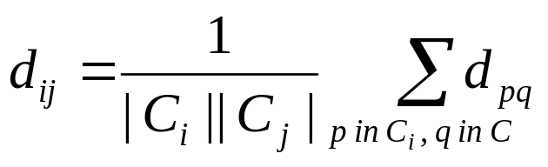
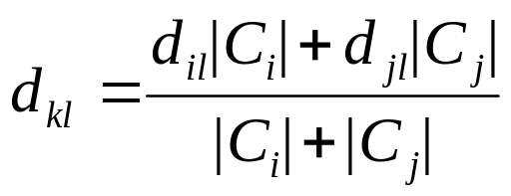
Note!
For the sake of simplicity, the algorithm shown in the previous slides is actually not the Unweighted PGMA, but the Weighted PGMA.
To turn WPGMA into UPWGMA, we need to include the number of sequences to calculate the new distance:

Slide 17
3: Multiple Alignment
Using the guide tree, we start aligning groups of sequences
The purpose of the guide tree is to know which sequences are most alike; so we can align the “easy” ones first, and postpone the tricky ones to later in the procedure!

Slide 18
Input: Unaligned Sequences
A mthislgslyshktaktingsdeaskmewhf
B mthvslgsmyshktgrtingsdqaskkmewhy
C mshisitmyshktartidgseqaskmewhy
D mthipigsmyshktaravngseqasklqwhy
E mthipigsmystartincseqasklewhy

Slide 19
Multiple Alignment
C
D
mthipigsmyshktaravngseqasklqwhy
mthipigsmys--tartincseqasklewhy
E
A
B

Slide 20
Multiple Alignment
C
D
mthipigsmyshktaravngseqasklqwhy
mthipigsmys--tartincseqasklewhy
E
A
mthislgslyshktaktingsdeas-kmewhf
mthvslgsmyshktgrtingsdqaskkmewhy
B

Slide 21
Multiple Alignment
C
mshisi-tmyshktartidgseqaskmewhy
mthipigsmyshktaravngseqasklqwhy
mthipigsmys--tartincseqasklewhy
D
E
A
mthislgslyshktaktingsdeas-kmewhf
mthvslgsmyshktgrtingsdqaskkmewhy
B

Slide 22
Multiple Alignment
C
mshisi-tmyshktartidgseqas-kmewhy
mthipigsmyshktaravngseqas-klqwhy
mthipigsmys--tartincseqas-klewhy
D
E
A
mthislgslyshktaktingsdeas-kmewhf
mthvslgsmyshktgrtingsdqaskkmewhy
B

Slide 23
Output: Aligned Sequences
A mthislgslyshktaktingsdeas-kmewhf
B mthvslgsmyshktgrtingsdqaskkmewhy
C mshisi-tmyshktartidgseqas-kmewhy
D mthipigsmyshktaravngseqas-klqwhy
E mthipigsmys--tartincseqas-klewhy

Slide 24
GSSQVRAHGQ KVADALSL-A ERLDDLPHAL SALSHLHA-Q LRVDPASFQL
GSAQLRAHGS KVVAAVGD-A KSIDDI--AL SKLSELHAYI LRVDPVNFKL
GSAQVKGHGK KVADALTN-A AHVDDMPNAL SALSDLHAHK LRVDPVNFKL
PDAVMGNPKV KAHGKKVLGA FSDGLAHLDN LKGTFATLSE LHCDKLHVDP
PDAVMGNPKV KAH-KKVLGA FSDGLAHLDN LKGTFS-LSE LHCDKLHVDP

Slide 25
Things To Remember ...
Most multiple alignment programs are GLOBAL alignment programs
The guide tree is NOT the phylogenetic tree

Slide 26
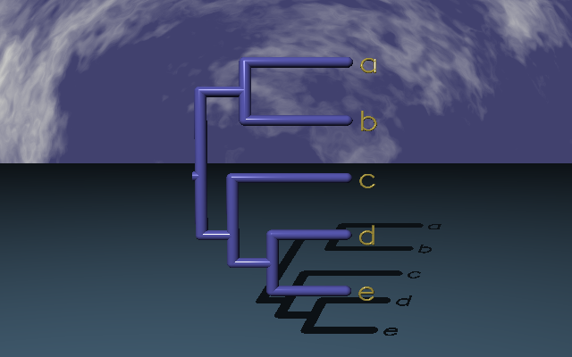
… no matter how beautiful it looks!

Slide 27
Things To Remember ...
Most multiple alignment programs are GLOBAL alignment programs
The guide tree is NOT the phylogenetic tree
A multiple alignment program is the starting point, not the end point of producing a good, meaningful alignment

Slide 28
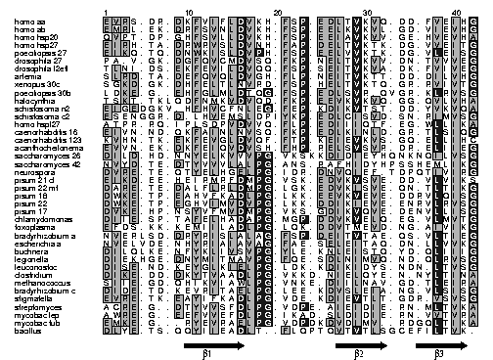

Slide 29
How UPGMA Works ...
A
C
4
3
2
2
2
3
D
B
1
E

Slide 30
How UPGMA Works ...
badly!
A
C
3
3.5
2
1.5
3
2
D
B
2
E

Slide 31
Running PileUp
Sequences must be in GCG format, either in separate files (using a file-of-filenames) or in an existing MSF or RSF file
Suppress the tree output (option C), since it is of no use!
...

Slide 32
Running Clustal W
Input can be in either Clustal, EMBL, PIR, Fasta or GCG (MSF) format
Clustal can align individual sequences as well as existing alignments

Slide 33
wombat KFTGLTQEELLTLLQQMIKYQVLEGNVGYLRVDYIPGQEVVEKVGEFLVNDVWKKLMGTSSLVLDLQHSTGGEVSGIPFVISYLHQGDNLLHVDTVYDRP
opossum KFANVTQEELLTLLQQMIKYQVLEGNVGYLRVDYIPGQEVVEKVGEFLVNNIWKKLMGTSALVLDLQHSSGGEVSGIPFVISYLHQGDIVLHIDTVYDRP
3t_sloth XXNNLTQDKLLTRLQKDIHSEVLEGNVAYLRVDDILGQEQMSQLGGILGAEAWKELTKTSALVLDLRHCTGGHVSGIPYIVSYLHPGNSVLHVDTIYNRP
Af_elepha APTNLTEEEMLSELQTSMSYKVLEGNVGYLRVDNIPGQEVLNQLGAFLVTHVWKQLMGSSALVLDLRHCTGGHVSSIPYLISYLHPGGTVLHVDTIYNRP
dugong APTNLTQEELLSELQTSMSYKVLDGNVGYLRVDNIPGQEVLSRLGGFLVTHIWKQLMGSSALVLDLRHCMGGHVSSIPYIISYLHPGGAVLHVDTIYNRP
hyrax APTNLTQEELLSELQTSMSYKVLEGNVGYLRVDNIPGQDVLNQLGGFLVTHVWKQLMGSSALVLDLRHCTGGHVSSIPYLISYLHPGSTVLHVDTIYNRP
aardvark TPANLTQEELLSELQRSMSYQVLEGNVGYLRVDSIPGQEVLSQLEDFLVPHVWRQLMGSSALVLDLRYCTGGHVSSIPYFISYLHPGGTVLHVDTIYNRP
el_shrew -PTNLTQEELLSELERSMSYRILDGNVGYLQIDNIPGQEVLSRLGAFLVAHVWRQLMGTSALVLDLRQCTGGHVSSIPYLISYLHPAGTVLHVDTIYNRP
mouse VLTNLTREELLAQIQRNIRHEVLEGNVGYLRVDDLPGQEVLSELGEFLVSHVWRQLMSTSSLVLDLRHCSGGHFSGIPYVISYLHPGNTVMHVDTVYDRP
NA_porcup APTNLSQEELLAGLQKSIRHEVLEGNVGYLRVDDLPSQEVLSRLGTLLMTNVWKQLMGTSALVLDLRQCPSGHVSGIPYI?SYLHPGNTVLHVDTIYNRP
rabbit APSNLTQEELLAWLQKSIQHEILEHNVGYLRVDDLPGQEVLSKLGGFLVAHVWGQLMGTSALVLDLRHCTGGHVSGIPYVISYLHPGNTVVHVDTIYDRP
galago TLTNLTQEELLAWLQRGLRYEVLEGNVGYLRVDDIPGQEVLSKLGAFLVAHVWGKLMGTSALVLDLRHCTGGQVSGIPYVISYLHPGNTILHVDTIYDRP
human ALTSLSEEELLAWLQRGLRHEVLEGNVGYLRVDSVPGQEVLSMMGEFLVAHVWGNLMGTSALVLDLRHCTGGQVSGIPYIISYLHPGNTILHVDTIYNRP
fl_lem AFTNLTQEELLAWLQKGIHHEVLEGNVGYLRVDDLPGQEVLSKLGEFLVAHIWSKLIDTSALVLDLRHCTGGQVSGIPYIISYLHPGNTAVHVDTIYDRP
tr_shrew AFDSLTQEELLTHLQEGIRHEVLEGNVGYLRLDDLPNQEVLNQLGAFLVTHVWMKLMGTSALVLDLRHCTRGHVSGIPYVISYLHPGSTVLHVDTIYNRP
hedgehog ALRNLTQEQLLVQVQKSIHHEILEGNVGYLRMDDIPGQEVVSKLGGFLAASVWTKLMGTSALVLDLRHCTGGHVSGVPYLVSYLHSGNTVLHVDTIYDRP
shrew APSNLTQEELLSELQRAIRYQVLAANVGYLGRDNLPGQEVVTILGALLVANVWGKLIATSPLVLDLRHCTGGHVSGIPYVISYLYPGNTVLHMDTIYDRP
r_ear_bat ALTNLTQEELLAQLQKGIHYDILESNVGYLRVDDIPSQEVVSKLGDFLVANIWRKLLGTSALVLDLRHCTGGHVSGIPYVISYLHPGNTVLHVDTIYDRP
fl_fox ALTHLTQEELLAQLQKGIRHDVLEGNVGYLRVDDIPNQEVVSKLGGFLVENIWRKLMGTSALVLDLRHCTGGHVSGIPYVISYLHPGNTILHVDTIYDRP
pangolin ELTDLTQEELLAQLQKGIHHEVLEGNVGYLRVDNIPGQEVLSELGDFLVAHIWQKLMGTSALVLDLRHCTTGHVSGIPYVISYLHPGNTVLHVDTIYNRP
cat ALTNLTKEEMLARLQKGIRHEVLEGNVGYLRVDDIPSQEVVSKLGGFLVASVWRKLMGTSALVLDLRHCTGGHVSGIPYVISYLHPGNTVLHVDTIYDRP
fox ALTNLTREELLARLQKGIRHEVLEGNVGYLRVDDIPGQEVVDKLGSFLVASIWRKLMGTSALVLDLRHCTGGHISGIPYVVSYLHPGNTVLHVDTIYDRP
tapir ALTDLTPEELLARLQKDIRHDILEGNVGYLRVDDIPGQEVVSKLGDFLVANIWRKLLDTSALVLDLRHCTGGHVSGIPYIISYLHPGNTVLHVDTIYDRP
horse ALTNLTQEELLARLQEGIRYDILEGDVGYLRVDNIPGQEVVSKLGGFLVDNVWRKLMGTSALVLDLRHCTGGHVSGIPYIISYLHPGNTVLHVDTIYDRP
mi_whal ALMNLTLEELIAGLQNGLRHEVLEGNVGYLRVDDIPGQEVMSKLRSFLVANVWRKLMGTSALVLDLRHCTGGQISGIPYVISYLHPGNTVLHVDTIYDRP
hippo ALKNLTLEELIAGLQNGLHHEVLEGNVGYLRVDDIPGQEVMSKLRSFLVANVWRKLMGTSALVLDLRHCTGGRISGIPYVISYLHPGNTVLHVDTIYDRP
cow AVTNLTLEEIIAGLQDGLRHEILEGNVGYLRVDDIPGQEVMSKLRSFLVANVWRKLVNTSALVLDLRHCTGGHVSGIPYVISYLHPGSTVSHVDTVYDRP
pig ALRNLTLEELIEGLHNSLRHEVLEGNVGYLRVDDIPGQEVMNKLGSFLVVNVWEKLMGTSALVLDLRHCTRGHVSGIPYVISYLHPGNTVLHVDTIYDRP

Slide 34
hom_aa EVRS-DR-DK FVIFLDVKH- FSP-EDLTVK VQ-DD-FVEI HG----KHNE R-QDD---HG --Y--IS-R- ---EFHRRYR
hom_ab EMRL-EK-DR FSVNLDVKH- FSP-EELKVK VL-GD-VIEV HG----KHEE R-QDE---HG --F--IS-R- ---EFHRKYR
hom_p20 QVPT-DP-GH FSVLLDVKH- FSP-EEIAVK VV-GE-HVEV HA----RHEE R-PDE---HG --F--VA-R- ---EFHRRYR
hom_hsp27 EIRH-TA-DR WRVSLDVNH- FAP-DELTVK TK-DG-VVEI TG----KHEE R-QDE---HG --Y--IS-R- ---CFTRKYT
poecil_27 EIKQ-TQ-DN WKISLDVPH- FSP-EELVVK TK-DG-VLEI SG----KHEE R-KDE---HG --F--VS-R- ---SFTRKYT
dros_27 PA-V-GK-DG FQVCMDVSQ- FKP-NELTVK VV-DN-TVVV EG----KHEE R-EDG---HG --M--IQ-R- ---HFVRKYT
dros_l2efl TLNI-DS-EK FEVILDVQQ- FSP-SEITVK VA-DK-FVIV EG----KHEE K-QDE---HG --Y--VS-R- ---QFSRRYQ
artemia SLRD-TA-DE FQVQLDVGH- FLP-NEITVK TT-DD-DILV HG----KHDE R-SDE---YG --H--VQ-R- ---EFRRRYR
xenop_30c SGKD-GK-DH FELTLNVRD- FSP-HELTVK TQ-GR-RVIV TG----KH-E RKSDTE--DG N-YF-HEYR- ---EWKREAE
poecil_30b LDKE-G--EH FGLMLDTQG- FSP-EDLSVR -QVGR-KLRV SG----KT-E KKQEDG--KG S-YS-YSLQ- ---EFRQEFD
halocyn TSKT-TKLQD FNMKVDVQD- FKP-EEVKVK VQ-GG-QVLV HA----KR-E NR-DEG--DG M-FA-YSCS- ---EFKRAFI
schisto_n2 EIGEDGKV-H FHVCFNLEG- FEP-KDIKVT ST-DD-YVKV QA----KKET KTED-----S SC----S-R- ---EFCRVIE
schisto_c2 ESENGGR-D- LHVEMSLDPI YKP-EDLCIS VD-SN-RIMV SG----CHYM N-GD----HS SSY---T-K- ----FTHSYE
hom_hspl27 ATPR-RQ-IP LSDPVDVVQ- FLP-EDIIIQ TF-EG-WLLI KA----QHGT R-MDE---HG --F--IS-R- ---SFTRQYK
caeno_16 EIVN-ND-QK FAINLNVSQ- FKP-EDLKIN LD-GR-TLSI QG----EQ-E LKTD----HG --Y---SKK- ---SFSRVIL
caeno_123 KVHN-TK-EK FEVGLDVQF- FTP-KEIEVK VS-GQ-ELLI HC----RH-E TRSDN---HG T-V---A-R- ---EINRAYK
acantho EVVN-EK-DK FEIQVDVSH- FHP-RELSVS VR-DR-ELII EG----HHKE R-TDQS---G NGI----ER- ---HFVRKFV
sacchar_26 DILD-HD-NN YELKVVVPG- VKSKKDIDIE YHQNKNQILV SG-------E IPSTL-NEES KDKVKVKESS SG-KFKRVIT
sacchar_42 NVYD-TE-DT YVVVLALPG- ANS-RAFHID YHPSSHEMLI KG-----KIE DRV---GIDE K-FLKITELK YG-AFERTVK
neurospora DVRE-TE-QT YELHGELPG- IDR-DNVQIE F-TDPQTIVI RG-----RVE REEKPKAPAE K-YWV-SERS IG-EFSRTFN
pis_21_cl EIKD-EE-HE IRMRFDMPG- VSK-EDVKVS VE-DD-VLVI KS------DH REENG---GE DCWSR---KS YS-CYDTRLK
pis_22_mt DARE-TE-DA LFLRLDMPG- LGK-EDVKIS VE-QN-TLTI KG------EE GAKES-EEKE --------KS -GRRFSSRID
pis_18 DWKE-TP-EA HVFKADLPG- LKK-EEVKVE VE-DDRVLQI SG-------E RSVEK-EDKN DEWHRV-ERS SG-KFLRRFR
pis_22 DWKE-TP-EG HVIMVDVPG- LKK-DDIKIE VE-ENRVLRV SG-------E RKKEE-DKKG DHWHRV-ERS YG-KFWRQFK
pis_17 DVKE-HP-NS YVFMVDMPG- VKS-GDIKVQ VE-DENVLLI SG-------E RKREE-EKEG VKYLKM-ERR IG-KLMRKFV
chlamyd DIIE-SP-TA FELHADAPG- MGP-DDVKVE LQ-EG-VLMV TG-------E RKLSHTTKEA GGKVWRSERT A-YSFSRAFS
toxoplasma EFDS-KK-KE MIILADLPG- LQK-DDVTME VD-NG-AIVI KG-------E K----TSKEA E-KVILTERV SGY-FARRFQ
bradyrh_a NVERLSD-DR YRISLALAG- FSP-DEITVT AE-QS-VLTI EG----RKGE KGRRD----- FVYRGISSRP ----FKRQFG
escher_a NVELVDE-NH YRIAIAVAG- FAE-SELEIT AQ-DN-LLVV KGAHADEQKE R-T------- YLYQGIAERN ----FERKFQ
buchnera DILQLKE-NF YKLIVSVPG- YLE-KNLEIS TQ-YD-QLII IG--KKEITE N-TNE-KKET VEKILHQEIY TG-DFSLSFR
legionella DIEKHGE-DN YMITMAVPG- FQE-SDLNIM VQ-ND-QLRV SG----RIQE KETKES---- -EYL-HRGIV TR-AFEQTFR
leuco DISE-ND-KE YGLKIELPG- LDK-KDIKID YS-NDN-LTV SGVLSSKAEE KD---KKKNN VVR---SERR YG-NYSRSYY
clostrid DIKE-DD-DK YTVAADLPG- VKKD-NIELQ YE-N-NYLTI NA----KRDD ---IVETKDD NNNFVRRERS YG-ELRRSFY
methanococ SIIE-GD-QH IKVIAWLPG- VNKE-DIILN AV-GD-TLEI RA----KR-- -SPLMIT-ES ER-IIYSEIP EEEEIYRTIK
bradyrh_c DIDE-TD-KE VRITAELPG- LEE-KDVSLE IA-NG-VLSI SG-------E KKS--EEDKA RRF---SERY YG-RFERRIP
stigmatel EVRE-TK-EA YIFKADLPG- VDE-KDIEVT LT-GDR-VSV SG----KR-E R---ESREES ERFYAY-ERT FG-SFSRAFT
strepto ACRE-G--DT YVVSFDLPG- VDPE-AIEID IE-RN-MLTV KA-------E RGPAGN--AE HVRMEVAERP LG-VFSRQLV
myco_lep AWRE-G--EE FVVEFDLPG- IKAD-SLDID IE-RN-VVTV RA-------E R-PGVD--PD REMLA-AERP RG-VFNRQLV
myco_tub EMKE-G---R YEVRAELPG- VDPDKDVDIM V--RDGQLTI KA-------E RTEQ---KD- --FDGRSEFA YG-SFVRTVS
bacillus DLYE-TS-QQ YIIEADLT-- FLQPTQVTVT LSGCEFILTV K--------- ---------- ---------S SGQTFEKQMM

Slide 35
Dependencies
Pairwise Alignment Step
Order:
  independent
Memory:
  depend on longest pair
Time:
  quadratic
Multiple Alignment Step
Order:
  order in guide tree
Memory:
  depends on alignment
Time:
  linear

Slide 36
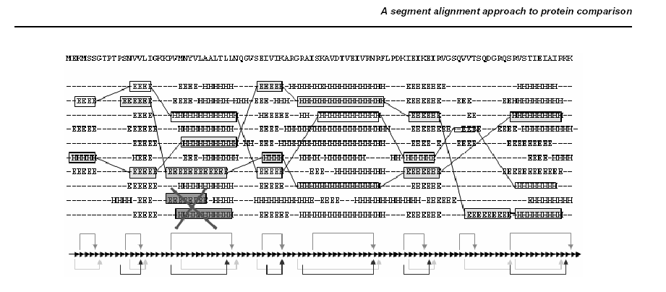
Alternative Approaches

Slide 37
Progressive approaches
Global: clustalw
Partially ordered graphs: poa
Local, whole segments: dialign
Extension of matching triplets: t-coffee

Slide 38
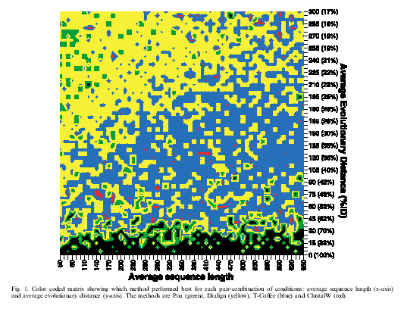
Program Performance
from: Lassmann & Sonnhammer (2002)

Slide 39
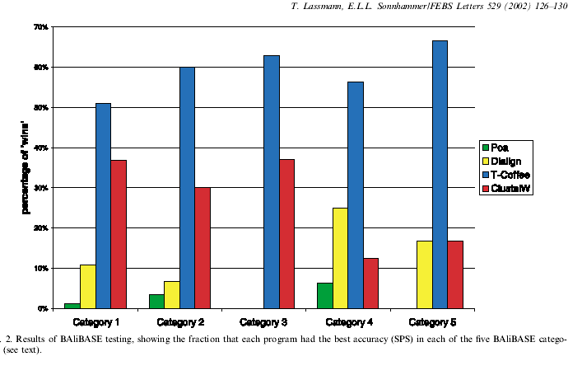
Alignment Accuracy
Source: Lassmann & Sonnhammer (2002)

