Slide 1
Protein Sequence Analysis
Jack Leunissen
Wageningen University
The Netherlands

Slide 2
TOEVOEGEN…
Plaatje GCPR eiwit en membraan
Plaatje amfipatische helix
Plaatje antigen/antilichaam complex

Slide 3
Protein Sequence Analysis
Protein Motif Searching
Hydropathy Plot
Secondary Structure Prediction
Hydrophobic Moment

Slide 4
Protein Motif Searching

Slide 5
What is a motif?
A motif is a description of a particular element (of three dimensional structure) that contains a specific sequence pattern
Motifs are identified by
  3D structural alignment
  Multiple sequence alignment
  Pattern searching programs

Slide 6
What is a motif?
Motifs are regions of similarity based on multiple alignments
Single motifs
Multiple motifs
Whole domains
Motif
Insertions
Adapted from D. Martin

Slide 7
Protein Motif Searching
Strict consensus pattern
  use only strictly conserved residues
But what about:
  variable residues?
  gaps?
C--QASCDGIPLKMNDC
C---VTCEGLPMRMDQC
CERTLGCQPMPVH---C
C C P C
C?????C???P?????C

Slide 8
Protein Motif Searching
Strict consensus patterns contain
  no alternative residues
  no flexible regions
  no mismatches
  no gaps
C--QASCDGIPLKMNDC
C---VTCEGLPMRMDQC
CERTLGCQPMPVH---C
C C P C
CxxxxxCxxxPxxxxxC

Slide 9
Computer Lingo Intermezzo
Regular expressions are widely used in computer string searching
Example: the UNIX “grep” command(s):
  % who | egrep ‘[Jj]ohns*on’
  will list all logged-on users who’s name is Johnson, Johnsson, johnson, johnsson, ...

Slide 10
Protein Motif Searching
Most motifs defined as regular expressions
Motifs can contain
  alternative residues
  flexible regions
C-x(2,5)-C-x-[GP]-x-P-x(2,5)-C.
CXXXCXGXPXXXXXC
| | | | |
FGCAKLCAGFPLRRLPCFYG

Slide 11
Protein Motif Searching
Motifs can not contain
  mismatches
  gaps
Some programs can handle this, but irrespectively of the pattern position!
C-x(2,5)-C-x-[GP]-x-P-x(2,5)-C.
CXXCXGXPXXXXX-C
| ?| | | ?|
FGCA-CAGFPLRRLPKCFYG

Slide 12
Protein Motif Searching
Consensus patterns
  no alternative residues
  no flexible regions
  no mismatches
  no gaps
Regular expressions
  allow alternative residues
  allow flexible regions
  no mismatches
  no gaps
C--QASCDGIPLKMNDC
C---VTCEGLPMRMDQC
CERTLGCQPMPVH---C
PERL regex:
/C.{2,5}C.[GP].P.{2,5}C/
CxxxxxCxxxPxxxxxC
C C P C

Slide 13
The PROSITE Syntax
A-[BC]-X-D(2,5)-{EFG}-H.
  A
  B or C
  anything
  2-5 D’s
  not E, F, or G
  H

Slide 14
Protein Motif Searching
Mandatory motifs characterise a protein (super-) family
ID SUBTILASE_ASP; PATTERN.
DE Serine proteases, subtilase family, aspartic acid active site.
PA [STAIV]-x-[LIVMF]-[LIVM]-D-[DSTA]-G-[LIVMFC]-x(2,3)-[DNH].
ID SUBTILASE_HIS; PATTERN.
DE Serine proteases, subtilase family, histidine active site.
PA H-G-[STM]-x-[VIC]-[STAGC]-[GS]-x-[LIVMA]-[STAGCLV]-[SAGM].
ID SUBTILASE_SER; PATTERN.
DE Serine proteases, subtilase family, serine active site.
PA G-T-S-x-[SA]-x-P-x(2)-[STAVC]-[AG].

Slide 15
Protein Motif Searching
Possible motifs occur frequently in proteins; they may not actually be present, such as
  Post-translational modification sites
  Leucine zippers
ID ASN_GLYCOSYLATION; PATTERN.
DE N-glycosylation site.
PA N-{P}-[ST]-{P}.
ID LEUCINE_ZIPPER; PATTERN.
DE Leucine zipper pattern.
PA L-x(6)-L-x(6)-L-x(6)-L.

Slide 16
Profiles: the consensus revisited
Weight matrix
  A profile of the occurrence of an amino acid at a particular position
  Provides a more sensitive match for less similar sequences
  Computationally expensive compared to a single sequence search

Slide 17
Profiles
Many motifs cannot be easily defined using simple patterns
Such motifs can be defined using profiles
A profile is constructed from a multiple sequence alignment. For each position, each amino acid is given a score depending on how likely it is to occur

Slide 18
Profiles
A more formal definition:
  A profile is a position-dependant scoring matrix, including position-specific gap penalties, created by evaluating the likelihood of occurrence for every residue position in a multiple alignment

Slide 19
Amino Acid groups
Proteins have a variety of side chains with similar physico-chemical properties.
C_{SS}
P
A
G
I
V
T
C_{SH}
S
L
N
M
D
Y
K
E
F
H
Q
W
R
Polar
Charged
Aliphatic
Aromatic
Small
Hydrophobic

Slide 20
Cons A B C D E F G H I K L M⇒ N P Q R S T V W Y Z Gap Len ..
W -27 -23 1 -37 -28 51 -35 13 16 -9 31 20 -14 -24 -22 16 -11 -15 -2 90 46 -24 100 100
A 77 28 12 36 35 -39 68 -6 -9 0 -19 -9 21 27 18 -19 32 27 11 -64 -33 23 100 100
F -50 -70 -10 -100 -70 150 -60 -10 70 -70 120 50 -50 -70 -80 -50 -30 -30 20 130 140 -70 100 100
Q 17 49 -46 58 56 -63 19 56 -25 33 -12 -3 46 21 111 30 -3 -5 -18 -39 -44 83 50 50
A 84 18 33 20 20 -32 50 -10 -2 5 -15 -8 18 35 7 -12 58 27 7 -32 -25 10 50 50
E 25 63 -49 89 118 -61 44 33 -16 25 -27 -19 44 8 58 0 17 17 -16 -91 -41 89 100 100

Slide 21
Calculating a Profile
For each alignment position: take the (weighted) average of the appropriate rows from the scoring matrix
An (extremely
simple) example:
seq_01 A A A A A A A A A A W
seq_02 A A A A A A A A A W W
seq_03 A A A A A A A A W W W
seq_04 A A A A A A A W W W W
seq_05 A A A A A A W W W W W
seq_06 A A A A A W W W W W W
seq_07 A A A A W W W W W W W
seq_08 A A A W W W W W W W W
seq_09 A A W W W W W W W W W
seq_10 A W W W W W W W W W W

Slide 22
Excerpt from the Epprofile matrix:
A B C D E F G H I K L M N P Q R S T V W Y Z
A 15 2 3 3 3 -5 6 -1 0 0 -1 0 2 5 2 -3 4 4 2 -8 -3 2
W -8 -6 -12 -11 -11 12 -10 -1 -5 1 5 -3 -3 -8 -5 13 3 -6 -8 15 11 -8
A B C D E F G H I K L M
10A: 15.00 0.00 3.00 3.00 3.00 -5.00 6.00 -1.00 0.00 0.00 -1.00 0.00
N P Q R S T V W Y Z
2.00 5.00 2.00 -3.00 4.00 4.00 2.00 -8.00 -3.00 0.00 4.55 4.55
A B C D E F G H I K L M
5A+5W: 3.50 0.00 -4.5 -4.00 -4.00 3.50 -2.00 -1.00 -2.50 0.50 2.00 -1.50
N P Q R S T V W Y Z
-0.50 -1.50 -1.50 5.00 3.50 -1.00 -3.00 3.50 4.00 0.00 4.55 4.55
A B C D E F G H I K L M
10W: -8.00 0.00 -12.00 -11.00 -11.00 12.00 -10.00 -1.00 -5.00 1.00 5.00 -3.00
N P Q R S T V W Y Z
-3.00 -8.00 -5.00 13.00 3.00 -6.00 -8.00 15.00 1.00 0.00 4.55 4.55
prophecy (EMBOSS), using Gribskov profile type, and Epprofile matrix (= modified PAM250)

Slide 23
Excerpt from the EBLOSUM62 matrix:
A R N D C Q E G H I L K M F P S T W Y V B Z X *
A 4 -1 -2 -2 0 -1 -1 0 -2 -1 -1 -1 -1 -2 -1 1 0 -3 -2 0 -2 -1 0 -4
W -3 -3 -4 -4 -2 -2 -3 -2 -2 -3 -2 -3 -1 1 -4 -3 -2 11 2 -3 -4 -3 -2 -4
A C D E F G H I K L M
10A: 0.40 0.00 -0.20 -0.10 -0.20 0.00 -0.20 -0.10 -0.10 -0.10 -0.10
N P Q R S T V W Y
-0.20 -0.10 -0.10 -0.10 0.10 0.00 0.00 -0.30 -0.20 3.33 3.33
A C D E F G H I K L M
5A+5W: 0.10 -0.20 -0.60 -0.40 -0.10 -0.20 -0.40 -0.40 -0.40 -0.30 -0.20
N P Q R S T V W Y
-0.60 -0.50 -0.30 -0.40 -0.20 -0.20 -0.30 0.80 0.00 3.33 3.33
A C D E F G H I K L M
10W: -0.30 -0.20 -0.40 -0.30 0.10 -0.20 -0.20 -0.30 -0.30 -0.20 -0.10
N P Q R S T V W Y
-0.40 -0.40 -0.20 -0.30 -0.30 -0.20 -0.30 1.10 0.20 3.33 3.33
prophecy (EMBOSS), using Henikoff profile type, and BLOSUM62 matrix

Slide 24
Excerpt from the EBLOSUM62 matrix:
A R N D C Q E G H I L K M F P S T W Y V B Z X *
A 4 -1 -2 -2 0 -1 -1 0 -2 -1 -1 -1 -1 -2 -1 1 0 -3 -2 0 -2 -1 0 -4
W -3 -3 -4 -4 -2 -2 -3 -2 -2 -3 -2 -3 -1 1 -4 -3 -2 11 2 -3 -4 -3 -2 -4
A C D E F G H I K L M
10A: 4.0 0.0 -2.0 -1.0 -2.0 0.0 -2.0 -1.0 -1.0 -1.0 -1.0
N P Q R S T V W Y
-2.0 -1.0 -1.0 -1.0 1.0 0.0 0.0 -3.0 -2.0 3.33 3.33
A C D E F G H I K L M
5A+5W: 1.0 -2.0 -6.0 -4.0 -1.0 -2.0 -4.0 -4.0 -4.0 -3.0 -2.0
N P Q R S T V W Y
-6.0 -5.0 -3.0 -4.0 -2.0 -2.0 -3.0 8.0 0.0 3.33 3.33
A C D E F G H I K L M
10W: -3.0 -2.0 -4.0 -3.0 1.0 -2.0 -2.0 -3.0 -3.0 -2.0 -1.0
N P Q R S T V W Y
-4.0 -4.0 -2.0 -3.0 -3.0 -2.0 -3.0 11.0 2.0 3.33 3.33
prophecy (EMBOSS), using Henikoff profile type, and BLOSUM62 matrix;
all calculated amino acid distances have been multiplied by factor 10!

Slide 25
Excerpt from the EBLOSUM62 matrix:
A R N D C Q E G H I L K M F P S T W Y V B Z X *
A 4 -1 -2 -2 0 -1 -1 0 -2 -1 -1 -1 -1 -2 -1 1 0 -3 -2 0 -2 -1 0 -4
W -3 -3 -4 -4 -2 -2 -3 -2 -2 -3 -2 -3 -1 1 -4 -3 -2 11 2 -3 -4 -3 -2 -4
A C D E F G H I K L M
10A: 0.40 0.00 -0.20 -0.10 -0.20 0.00 -0.20 -0.10 -0.10 -0.10 -0.10
N P Q R S T V W Y
-0.20 -0.10 -0.10 -0.10 0.10 0.00 0.00 -0.30 -0.20 3.33 3.33
A C D E F G H I K L M
5A+5W: 0.10 -0.20 -0.60 -0.40 -0.10 -0.20 -0.40 -0.40 -0.40 -0.30 -0.20
N P Q R S T V W Y
-0.60 -0.50 -0.30 -0.40 -0.20 -0.20 -0.30 0.80 0.00 3.33 3.33
A C D E F G H I K L M
10W: -0.30 -0.20 -0.40 -0.30 0.10 -0.20 -0.20 -0.30 -0.30 -0.20 -0.10
N P Q R S T V W Y
-0.40 -0.40 -0.20 -0.30 -0.30 -0.20 -0.30 1.10 0.20 3.33 3.33
prophecy (EMBOSS), using Henikoff profile type, and BLOSUM62 matrix

Slide 26
# Matrix made by matblas from blosum62.iij
# * column uses minimum score
# BLOSUM Clustered Scoring Matrix in 1/2 Bit Units
# Blocks Database = /data/blocks_5.0/blocks.dat
# Cluster Percentage: >= 62
# Entropy = 0.6979, Expected = -0.5209
A R N D C Q E G H I L K M F P S T W Y V B Z X *
A 4 -1 -2 -2 0 -1 -1 0 -2 -1 -1 -1 -1 -2 -1 1 0 -3 -2 0 -2 -1 0 -4
R -1 5 0 -2 -3 1 0 -2 0 -3 -2 2 -1 -3 -2 -1 -1 -3 -2 -3 -1 0 -1 -4
N -2 0 6 1 -3 0 0 0 1 -3 -3 0 -2 -3 -2 1 0 -4 -2 -3 3 0 -1 -4
D -2 -2 1 6 -3 0 2 -1 -1 -3 -4 -1 -3 -3 -1 0 -1 -4 -3 -3 4 1 -1 -4
C 0 -3 -3 -3 9 -3 -4 -3 -3 -1 -1 -3 -1 -2 -3 -1 -1 -2 -2 -1 -3 -3 -2 -4
Q -1 1 0 0 -3 5 2 -2 0 -3 -2 1 0 -3 -1 0 -1 -2 -1 -2 0 3 -1 -4
E -1 0 0 2 -4 2 5 -2 0 -3 -3 1 -2 -3 -1 0 -1 -3 -2 -2 1 4 -1 -4
G 0 -2 0 -1 -3 -2 -2 6 -2 -4 -4 -2 -3 -3 -2 0 -2 -2 -3 -3 -1 -2 -1 -4
H -2 0 1 -1 -3 0 0 -2 8 -3 -3 -1 -2 -1 -2 -1 -2 -2 2 -3 0 0 -1 -4
I -1 -3 -3 -3 -1 -3 -3 -4 -3 4 2 -3 1 0 -3 -2 -1 -3 -1 3 -3 -3 -1 -4
L -1 -2 -3 -4 -1 -2 -3 -4 -3 2 4 -2 2 0 -3 -2 -1 -2 -1 1 -4 -3 -1 -4
K -1 2 0 -1 -3 1 1 -2 -1 -3 -2 5 -1 -3 -1 0 -1 -3 -2 -2 0 1 -1 -4
M -1 -1 -2 -3 -1 0 -2 -3 -2 1 2 -1 5 0 -2 -1 -1 -1 -1 1 -3 -1 -1 -4
F -2 -3 -3 -3 -2 -3 -3 -3 -1 0 0 -3 0 6 -4 -2 -2 1 3 -1 -3 -3 -1 -4
P -1 -2 -2 -1 -3 -1 -1 -2 -2 -3 -3 -1 -2 -4 7 -1 -1 -4 -3 -2 -2 -1 -2 -4
S 1 -1 1 0 -1 0 0 0 -1 -2 -2 0 -1 -2 -1 4 1 -3 -2 -2 0 0 0 -4
T 0 -1 0 -1 -1 -1 -1 -2 -2 -1 -1 -1 -1 -2 -1 1 5 -2 -2 0 -1 -1 0 -4
W -3 -3 -4 -4 -2 -2 -3 -2 -2 -3 -2 -3 -1 1 -4 -3 -2 11 2 -3 -4 -3 -2 -4
Y -2 -2 -2 -3 -2 -1 -2 -3 2 -1 -1 -2 -1 3 -3 -2 -2 2 7 -1 -3 -2 -1 -4
V 0 -3 -3 -3 -1 -2 -2 -3 -3 3 1 -2 1 -1 -2 -2 0 -3 -1 4 -3 -2 -1 -4
B -2 -1 3 4 -3 0 1 -1 0 -3 -4 0 -3 -3 -2 0 -1 -4 -3 -3 4 1 -1 -4
Z -1 0 0 1 -3 3 4 -2 0 -3 -3 1 -1 -3 -1 0 -1 -3 -2 -2 1 4 -1 -4
X 0 -1 -1 -1 -2 -1 -1 -1 -1 -1 -1 -1 -1 -1 -2 0 0 -2 -1 -1 -1 -1 -1 -4
* -4 -4 -4 -4 -4 -4 -4 -4 -4 -4 -4 -4 -4 -4 -4 -4 -4 -4 -4 -4 -4 -4 -4 1

Slide 27
We’re …
DONE!
… for the moment

Slide 28
Cons A B C D E F G H I K L M⇒
W -27 -23 1 -37 -28 51 -35 13 16 -9 31 20
A 77 28 12 36 35 -39 68 -6 -9 0 -19 -9
F -50 -70 -10 -100 -70 150 -60 -10 70 -70 120 50
Q 17 49 -46 58 56 -63 19 56 -25 33 -12 -3
A 84 18 33 20 20 -32 50 -10 -2 5 -15 -8
E 25 63 -49 89 118 -61 44 33 -16 25 -27 -19
Cons N P Q R S T V W Y Z Gap Len
W -14 -24 -22 16 -11 -15 -2 90 46 -24 100 100
A 21 27 18 -19 32 27 11 -64 -33 23 100 100
F -50 -70 -80 -50 -30 -30 20 130 140 -70 100 100
Q 46 21 111 30 -3 -5 -18 -39 -44 83 50 50
A 18 35 7 -12 58 27 7 -32 -25 10 50 50
E 44 8 58 0 17 17 -16 -91 -41 89 100 100

Slide 29
Hydropathy Plot
Prediction hydrophobic and hydrophilic regions in a protein

Slide 30
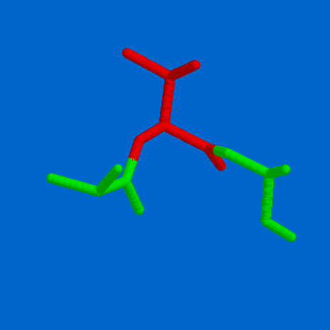
Partition Coefficients
Hydrophilic
Hydrophobic
Oil
Water

Slide 31
Hydrophobicity/Hydrophilicity Values
Fauchere & Pliska Kyte & Doolittle Hopp & Woods Eisenberg
R -1.37 -4.50 3.00 -2.53
K -1.35 -3.90 3.00 -1.50
D -1.05 -3.50 3.00 -0.90
Q -0.78 -3.50 0.20 -0.85
N -0.85 -3.50 0.20 -0.78
E -0.87 -3.50 3.00 -0.74
H -0.40 -3.20 -0.50 -0.40
S -0.18 -0.80 0.30 -0.18
T -0.05 -0.70 -0.40 -0.05
P 0.12 -1.60 0.00 0.12
Y 0.26 -1.30 -2.30 0.26
C 0.29 2.50 -1.00 0.29
G 0.48 -0.40 0.00 0.48
A 0.62 1.80 -0.50 0.62
M 0.64 1.90 -1.30 0.64
W 0.81 -0.90 -3.40 0.81
L 1.06 3.80 -1.80 1.06
V 1.08 4.20 -1.50 1.08
F 1.19 2.80 -2.50 1.19
I 1.38 4.50 -1.80 1.38
hydrophilic hydrophobic

Slide 32
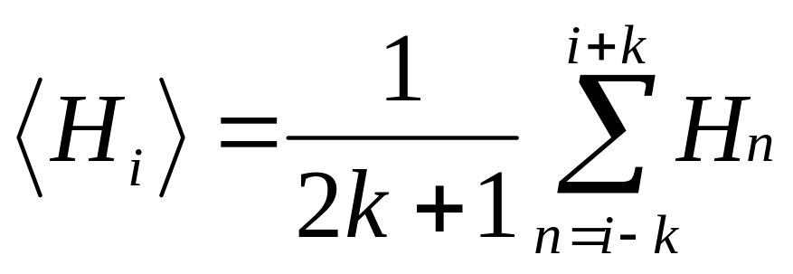
Hydrophobicity Plot
Sum amino acid hydrophobicity values in a given window
Plot the value in the middle of the window
Shift the window one position

Slide 33
Sliding Window Approach
Calculate property for first sub-sequence
Use the result (plot/print/store)
I L I K E I R
4.50 + 3.80 + 4.50 - 3.90 - 3.50 + 4.50 - 4.50
5.4 / 7 = 0.77
Move to the next position in the sequence

Slide 34
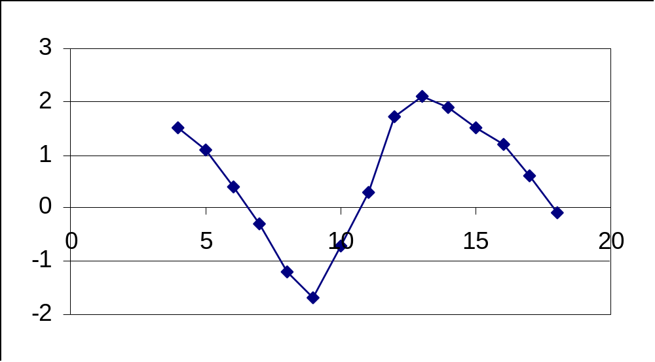
Hydrophobicity Plot

Slide 35
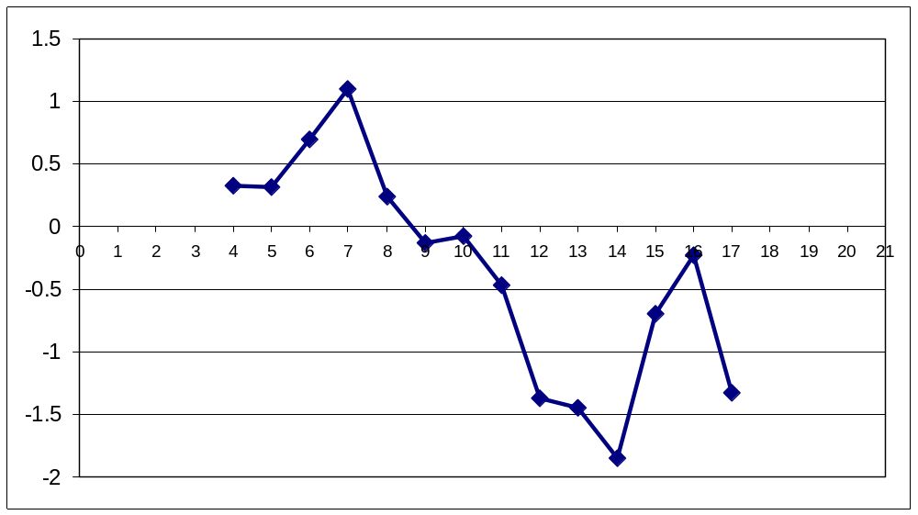
Hydrophobicity Plot
MEZCALTASTESVERYNICE

Slide 36
Hydrophobicity Plot
MEZCALTASTESVERYNICE

Slide 37
Hydrophobicity Plot
MEZCALTASTESVERYNICE

Slide 38
Hydrophobicity Plot
MEZCALTASTESVERYNICE

Slide 39
Hydrophobicity Plot
MEZCALTASTESVERYNICE

Slide 40
Hydrophobicity Plot
MEZCALTASTESVERYNICE

Slide 41
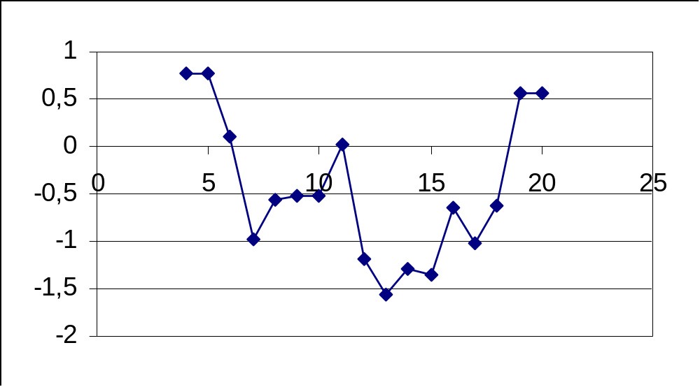
Hydrophobicity Plot
ILIKEIRISHWHISKEYYAMMIE
ILIKEIRISHWHISKEYYAMMIE
ILIKEIRISHWHISKEYYAMMIE
ILIKEIRISHWHISKEYYAMMIE
ILIKEIRISHWHISKEYYAMMIE
ILIKEIRISHWHISKEYYAMMIE

Slide 42
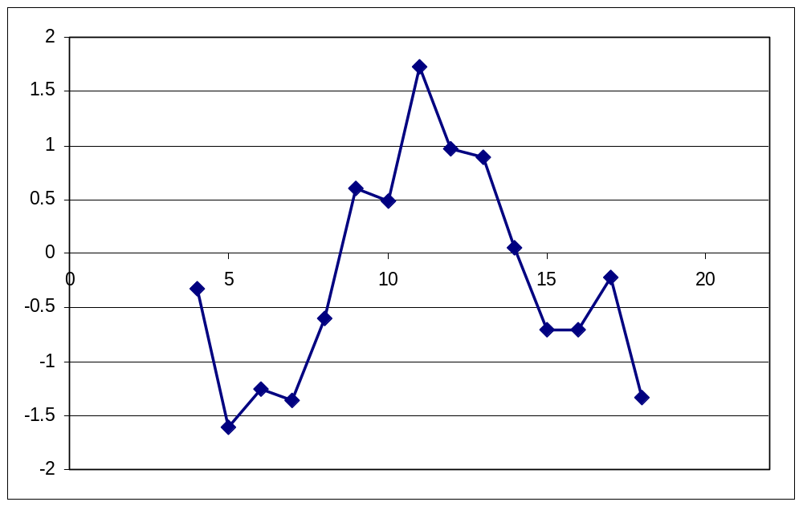
Hydrophobicity Plot
ITHINKRAKIAISVERYNICE

Slide 43
Hydrophobicity Plot
ITHINKRAKIAISVERYNICE

Slide 44
Hydrophobicity Plot
ITHINKRAKIAISVERYNICE

Slide 45
Hydrophobicity Plot
ITHINKRAKIAISVERYNICE

Slide 46
Hydrophobicity Plot
ITHINKRAKIAISVERYNICE

Slide 47
Hydrophobicity Plot
ITHINKRAKIAISVERYNICE

Slide 48
Hydrophobicity Plot
ITHINKRAKIAISVERYNICE

Slide 49
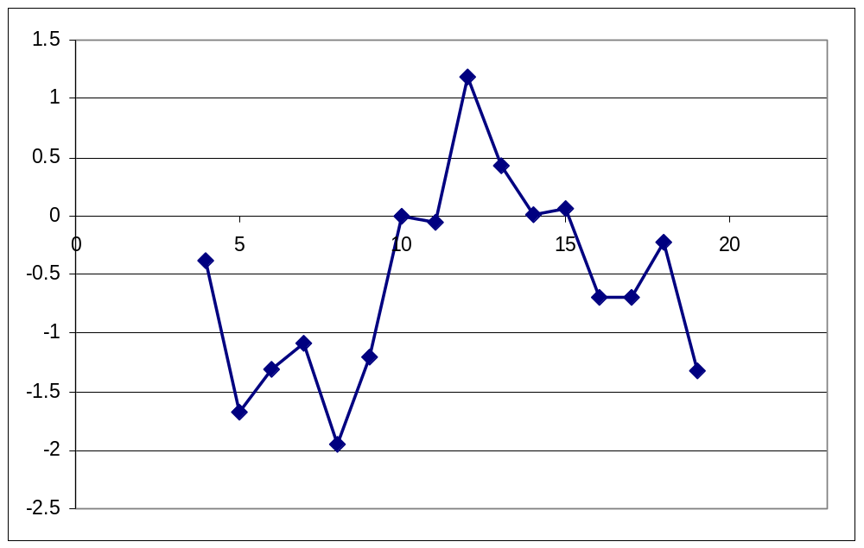
Hydrophobicity Plot
ITHINKGRAPPAISVERYNICE

Slide 50
Hydrophobicity Plot
ITHINKGRAPPAISVERYNICE

Slide 51
Hydrophobicity Plot
ITHINKGRAPPAISVERYNICE

Slide 52
Hydrophobicity Plot
ITHINKGRAPPAISVERYNICE

Slide 53
Hydrophobicity Plot
ITHINKGRAPPAISVERYNICE

Slide 54
Hydrophobicity Plot
ITHINKGRAPPAISVERYNICE

Slide 55
Hydrophobicity Plot
ITHINKGRAPPAISVERYNICE

Slide 56
Hydrophobicity Plot
ITHINKGRAPPAISVERYNICE

Slide 57
Hydrophobicity Plot
ITHINKGRAPPAISVERYNICE

Slide 58
Hydrophobicity Plot
1
0,5
0
-0,5
0
5
10
15
20
25
-1
-1,5
-2
ILIKEIRISHWHISKEYYAMMIE
ILIKEIRISHWHISKEYYAMMIE
ILIKEIRISHWHISKEYYAMMIE
ILIKEIRISHWHISKEYYAMMIE
ILIKEIRISHWHISKEYYAMMIE
ILIKEIRISHWHISKEYYAMMIE

Slide 59
Hydrophobicity Plot
1
0,5
0
-0,5
0
5
10
15
20
25
-1
-1,5
-2
ILIKEIRISHWHISKEYYAMMIE
ILIKEIRISHWHISKEYYAMMIE
ILIKEIRISHWHISKEYYAMMIE
ILIKEIRISHWHISKEYYAMMIE
ILIKEIRISHWHISKEYYAMMIE
ILIKEIRISHWHISKEYYAMMIE

Slide 60
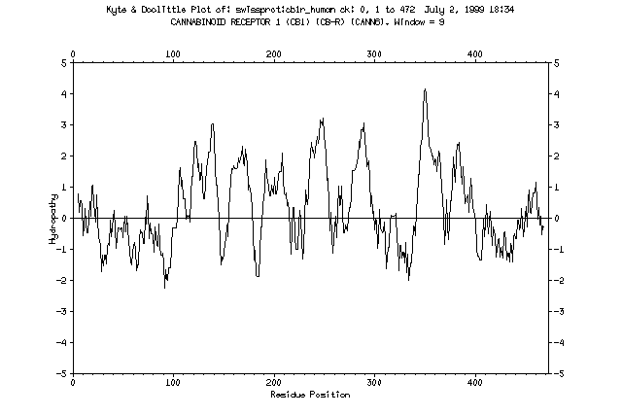

Slide 61
Transmembrane Regions
Rotation is 100 degrees per amino acid
Climbing 1.5 Angstrom
per amino acid residue

Slide 62
Transmembrane Regions
So we need approx. 30 / 1.5 = 20 amino acids to span the membrane
30 angstrom

Slide 64
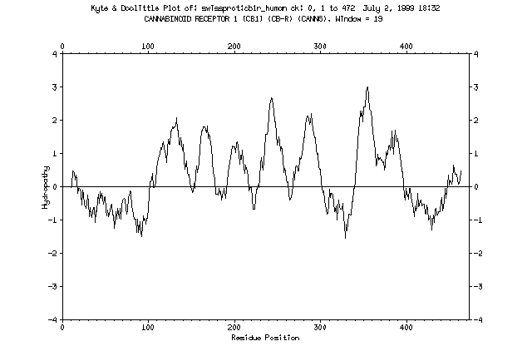
Adapting the window size to the size of the membrane spanning segment makes the picture easier to interpret

Slide 65
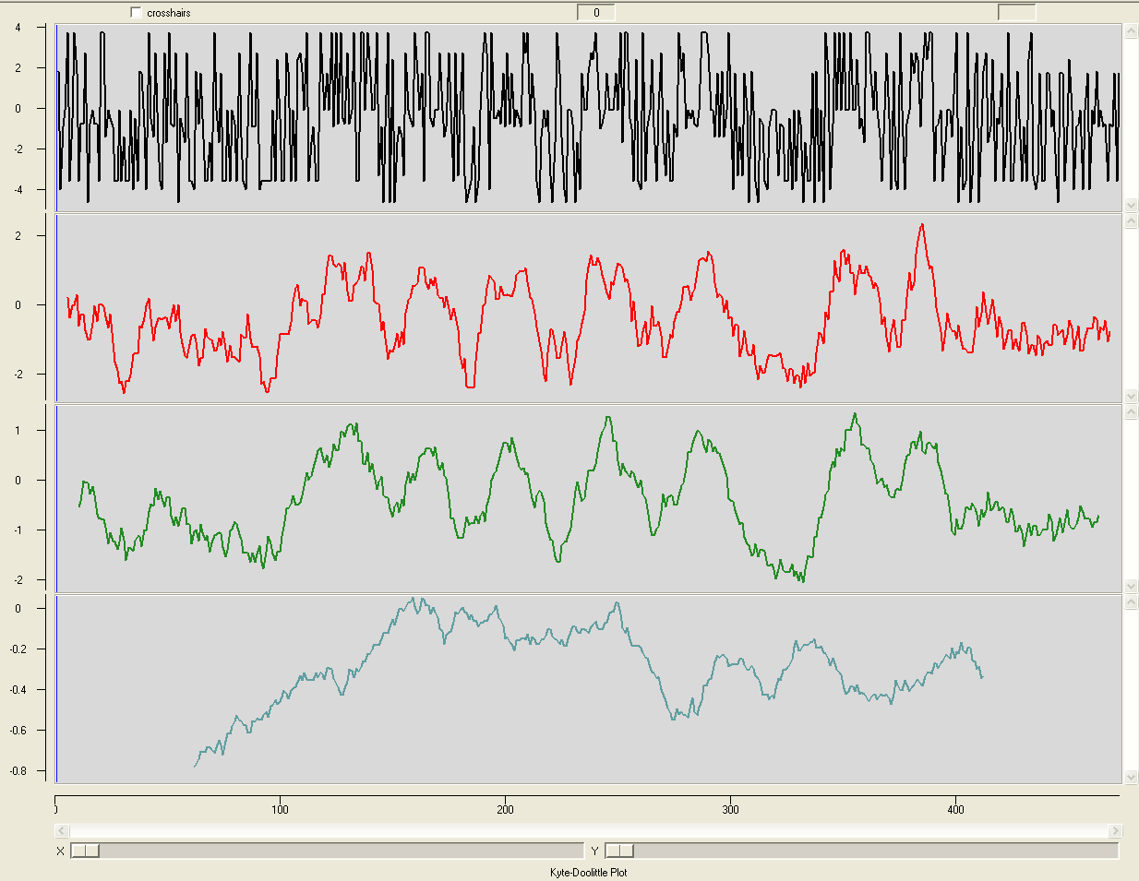
window = 1
window = 9
window = 19
window = 121

Slide 66
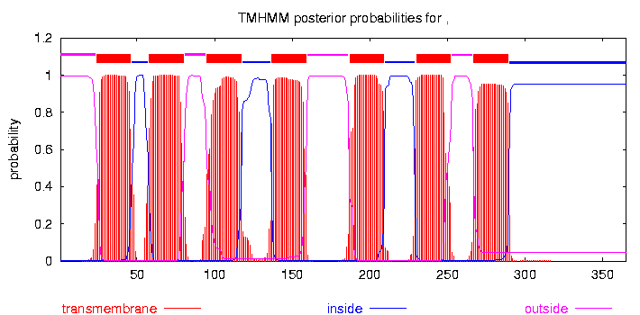

Slide 67
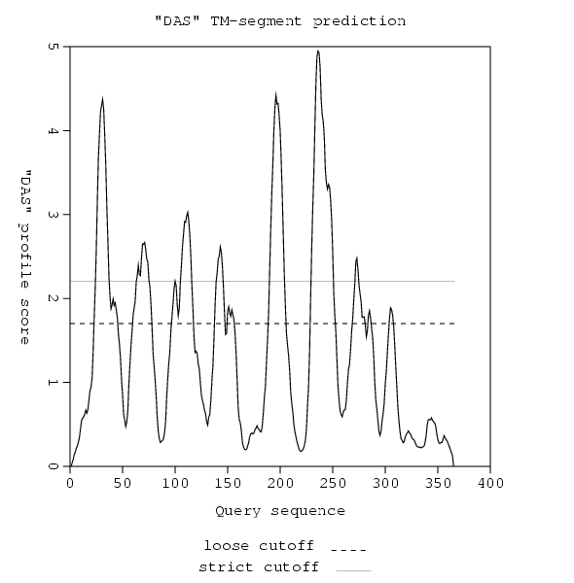

Slide 68
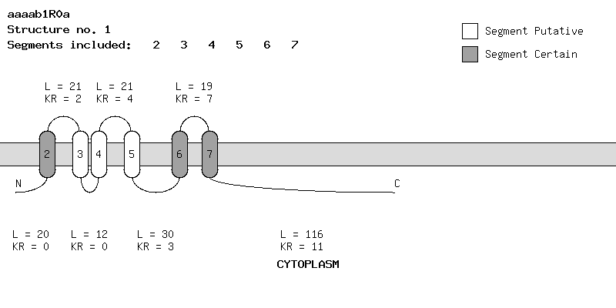

Slide 69
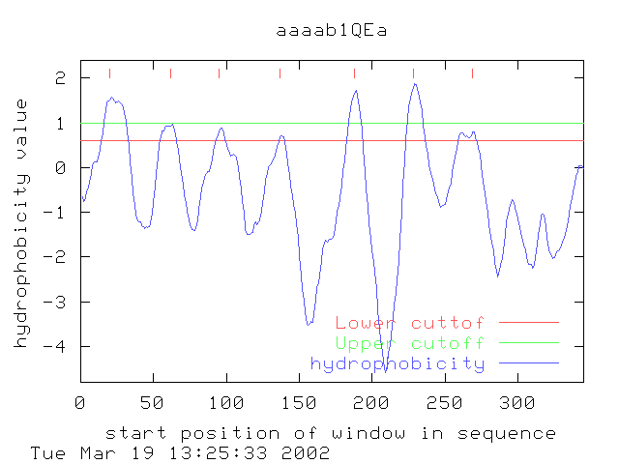

Slide 70
Secondary Structure Prediction

Slide 71
Secondary Structure Prediction
Only known as Robson’s method in the UK; the rest of the world uses its proper name, which is GARNIER or the GOR method, Dave!
Traditional methods
  Chou & Fasman
    Statistical & rule-based method
  Lim
    Stereochemical rules
  Garnier, Osguthorpe & Robson
    Statistical method
Accuracy ~ 60%

Slide 72
Secondary Structure Prediction
Traditional methods
  Chou & Fasman
    Statistical & rule-based method
  Lim
    Stereochemical rules
  Garnier, Osguthorpe & Robson
    Statistical method
Accuracy ~ 60%

Slide 73
GOR Helix Parameters
i-8 i-6 i-4 i-2 i i+2 i+4 i+6 i+8
Gly -5 -10 -15 -20 -30 -40 -50 -60 -86 -60 -50 -40 -30 -20 -15 -10 -5
ala 5 10 15 20 30 40 50 60 65 60 50 40 30 20 15 10 5
val 0 0 0 0 0 0 5 10 14 10 5 0 0 0 0 0 0
leu 0 5 10 15 20 25 28 30 32 30 28 25 20 15 10 5 0
ile 5 10 15 20 25 20 15 10 6 0 -10 -15 -20 -25 -20 -10 -5
ser 0 -5 -10 -15 -20 -25 -30 -35 -39 -35 -30 -25 -20 -15 -10 -5 0
thr 0 0 0 -5 -10 -15 -20 -25 -26 -25 -20 -15 -10 -5 0 0 0
asp 0 -5 -10 -15 -20 -15 -10 0 5 10 15 20 20 20 15 10 5
glu 0 0 0 0 10 20 60 70 78 78 78 78 78 70 60 40 20
asn 0 0 0 0 -10 -20 -30 -40 -51 -40 -30 -20 -10 0 0 0 0
gln 0 0 0 0 5 10 20 20 10 -10 -20 -20 -10 -5 0 0 0
lys 20 40 50 55 60 60 50 30 23 10 5 0 0 0 0 0 0
his 10 20 30 40 50 50 50 30 12 -20 -10 0 0 0 0 0 0
arg 0 0 0 0 0 0 0 0 -9 -15 -20 -30 -40 -50 -50 -30 -10
phe 0 0 0 0 0 5 10 15 16 15 10 5 0 0 0 0 0
tyr -5 -10 -15 -20 -25 -30 -35 -40 -45 -40 -35 -30 -25 -20 -15 -10 -5
trp -10 -20 -40 -50 -50 -10 0 10 12 10 0 -10 -50 -50 -40 -20 -10
cys 0 0 0 0 0 0 -5 -10 -13 -10 -5 0 0 0 0 0 0
met 10 20 25 30 35 40 45 50 53 50 45 40 35 30 25 20 10
pro -10 -20 -40 -60 -80 -100 -120 -140 -77 -60 -30 -20 -10 0 0 0 0

Slide 74
I S G A R N I E R H E L I X P R E D I C T
i-8 i-6 i-4 i-2 i i+2 i+4 i+6 i+8
Gly -5 -10 -15 -20 -30 -40 -50 -60 -86 -60 -50 -40 -30 -20 -15 -10 -5
ala 5 10 15 20 30 40 50 60 65 60 50 40 30 20 15 10 5
val 0 0 0 0 0 0 5 10 14 10 5 0 0 0 0 0 0
leu 0 5 10 15 20 25 28 30 32 30 28 25 20 15 10 5 0
ile 5 10 15 20 25 20 15 10 6 0 -10 -15 -20 -25 -20 -10 -5
ser 0 -5 -10 -15 -20 -25 -30 -35 -39 -35 -30 -25 -20 -15 -10 -5 0
thr 0 0 0 -5 -10 -15 -20 -25 -26 -25 -20 -15 -10 -5 0 0 0
asp 0 -5 -10 -15 -20 -15 -10 0 5 10 15 20 20 20 15 10 5
glu 0 0 0 0 10 20 60 70 78 78 78 78 78 70 60 40 20
asn 0 0 0 0 -10 -20 -30 -40 -51 -40 -30 -20 -10 0 0 0 0
gln 0 0 0 0 5 10 20 20 10 -10 -20 -20 -10 -5 0 0 0
lys 20 40 50 55 60 60 50 30 23 10 5 0 0 0 0 0 0
his 10 20 30 40 50 50 50 30 12 -20 -10 0 0 0 0 0 0
arg 0 0 0 0 0 0 0 0 -9 -15 -20 -30 -40 -50 -50 -30 -10
phe 0 0 0 0 0 5 10 15 16 15 10 5 0 0 0 0 0
tyr -5 -10 -15 -20 -25 -30 -35 -40 -45 -40 -35 -30 -25 -20 -15 -10 -5
trp -10 -20 -40 -50 -50 -10 0 10 12 10 0 -10 -50 -50 -40 -20 -10
cys 0 0 0 0 0 0 -5 -10 -13 -10 -5 0 0 0 0 0 0
met 10 20 25 30 35 40 45 50 53 50 45 40 35 30 25 20 10
pro -10 -20 -40 -60 -80 -100 -120 -140 -77 -60 -30 -20 -10 0 0 0 0

Slide 75
I S G A R N I E R H E L I X P R E D I C T
i-8 i-6 i-4 i-2 i i+2 i+4 i+6 i+8
Gly -5 -10 -15 -20 -30 -40 -50 -60 -86 -60 -50 -40 -30 -20 -15 -10 -5
ala 5 10 15 20 30 40 50 60 65 60 50 40 30 20 15 10 5
val 0 0 0 0 0 0 5 10 14 10 5 0 0 0 0 0 0
leu 0 5 10 15 20 25 28 30 32 30 28 25 20 15 10 5 0
ile 5 10 15 20 25 20 15 10 6 0 -10 -15 -20 -25 -20 -10 -5
ser 0 -5 -10 -15 -20 -25 -30 -35 -39 -35 -30 -25 -20 -15 -10 -5 0
thr 0 0 0 -5 -10 -15 -20 -25 -26 -25 -20 -15 -10 -5 0 0 0
asp 0 -5 -10 -15 -20 -15 -10 0 5 10 15 20 20 20 15 10 5
glu 0 0 0 0 10 20 60 70 78 78 78 78 78 70 60 40 20
asn 0 0 0 0 -10 -20 -30 -40 -51 -40 -30 -20 -10 0 0 0 0
gln 0 0 0 0 5 10 20 20 10 -10 -20 -20 -10 -5 0 0 0
lys 20 40 50 55 60 60 50 30 23 10 5 0 0 0 0 0 0
his 10 20 30 40 50 50 50 30 12 -20 -10 0 0 0 0 0 0
arg 0 0 0 0 0 0 0 0 -9 -15 -20 -30 -40 -50 -50 -30 -10
phe 0 0 0 0 0 5 10 15 16 15 10 5 0 0 0 0 0
tyr -5 -10 -15 -20 -25 -30 -35 -40 -45 -40 -35 -30 -25 -20 -15 -10 -5
trp -10 -20 -40 -50 -50 -10 0 10 12 10 0 -10 -50 -50 -40 -20 -10
cys 0 0 0 0 0 0 -5 -10 -13 -10 -5 0 0 0 0 0 0
met 10 20 25 30 35 40 45 50 53 50 45 40 35 30 25 20 10
pro -10 -20 -40 -60 -80 -100 -120 -140 -77 -60 -30 -20 -10 0 0 0 0

Slide 76
NOG IN TE VULLEN
Hier een dia met de vier GOR curves, waaruit duidelijk wordt dat GOR gewoon de hoogste voorspelde waarde neemt.
Maak ook duidelijk dat Chou-Fasman nog wat extra regels m.b.t. element-lengte en vormers/brekers hanteert

Slide 77
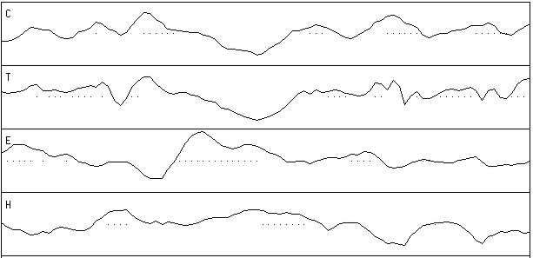
GOR Prediction
beta sheet
helix

Slide 78
Secondary Structure Prediction
Recent methods
  Neural networks = flexible statistics
  Multiple alignments = variability
  Heuristics = common sense
  Or a combination of the above
Accuracy ~ 70%

Slide 79
Heuristics
Conserved parts are structurally and/or functionally important
Segments with many gaps must be in loop regions

Slide 80
....,....1....,....2....,....3....,....4....,....5....,....6
AA |MGNITADNSSMSCTIDHTIHQTLAPVVYVTVLVVGFPANCLSLYFGYLQIKARNELGVYL|
PHD sec | EEEEEEEEEEEEEEEE EEEEEEEEE EEEEH|
Rel sec |999888777778664312114577778899998652421224545552233655401121|
detail:
prH sec |000000111111112344321110000000000001244542232323322111123434|
prE sec |000000000000011011345677778899988773000136666665542111234454|
prL sec |999888878888766543332111111100000225655310000000025766532000|
subset: SUB sec |LLLLLLLLLLLLLL.......EEEEEEEEEEEEEE.......E.EEE....LLL......|
accessibility
3st: P_3 acc |eeeeeeeeeeeebebeeebeebbbbbbbbbbbbbbbbbbbbbbbbbbbeeeeeebbbbbb|
10st: PHD acc |997667777777070777066000000000000000000000000000666777000000|
Rel acc |011000101111010111101165348589989974232478979750001111121869|
subset: SUB acc |......................bb.bbbbbbbbbbb...bbbbbbbb..........bbb|
....,....7....,....8....,....9....,....10...,....11...,....12
AA |CNLTVADLFYICSLPFWLQYVLQHDNWSHGDLSCQVCGILLYENIYISVGFLCCISVDRY|
PHD sec |HHHHHHHHHHHHHHHHHEEHHHH HHHHHHHHHEEEEHHHHHHHHHHEEE EE|
Rel sec |234678787876311431213521642122577887431133414542223323111135|
detail:
prH sec |556778887877544554455654112233677877654433245654555553334421|
prE sec |332110000001211135543110012321001011234455621122332345444356|
prL sec |000000101110234200000234764345211001111110132222111101211221|
subset: SUB sec |...HHHHHHHHH.........H..L.....HHHHHH.........H.............E|
accessibility
3st: P_3 acc |bbbbbbbbbbbbbbbbbbbbbbeee bbbbebbbebbbbbbbbbbbbbbbbbbbbbbbbb|
10st: PHD acc |000000000000000000000067750000600060000000000000000000000000|
Rel acc |858788377766363416310200003045137917423532535379878966665227|
subset: SUB acc |bbbbbb.bbbbb.b.b.b..........bb..bb.bb..b..b.b.bbbbbbbbbbb..b|

Slide 81
....,....1....,....2....,....3....,....4....,....5....,....6
AA |MGNITADNSSMSCTIDHTIHQTLAPVVYVTVLVVGFPANCLSLYFGYLQIKARNELGVYL|
PHD htm | TTTTTTTTTTTTTTTTTTTTTTTTTTTT TTTTT|
Rel htm |999999999999999998874036778888887777777777777653101332012456|
detail:
prH htm |000000000000000000012468889999998888888888888876554333456778|
prL htm |999999999999999999987531110000001111111111111123445666543221|
PHDRhtm | TTTTTTTTTTTTTTTTTTTT TT|
PHDThtm |ooooooooooooooooooooooooTTTTTTTTTTTTTTTTTTTTiiiiiiiiiiiiiiTT|
subset: SUB htm |LLLLLLLLLLLLLLLLLLLLL..HHHHHHHHHHHHHHHHHHHHHHHH..........HHH|
....,....7....,....8....,....9....,....10...,....11...,....12
AA |CNLTVADLFYICSLPFWLQYVLQHDNWSHGDLSCQVCGILLYENIYISVGFLCCISVDRY|
PHD htm |TTTTTTTTTTTTTTTTTTTTTT TTTTTTTTTTTTTTTTTTTTTTTTTTTTT|
Rel htm |777777777777777776542013443443102246777777777777777777777766|
detail:
prH htm |888888888888888888776543223223456678888888888888888888888888|
prL htm |111111111111111111223456776776543321111111111111111111111111|
PHDRhtm |TTTTTTTTTTTTTTTTT TTTTTTTTTTTTTTTTTTTTTTT |
PHDThtm |TTTTTTTTTTTTTTTTToooooooooooooooooooTTTTTTTTTTTTTTTTTTTTTTTi|
subset: SUB htm |HHHHHHHHHHHHHHHHHHHH....LL.LL.....HHHHHHHHHHHHHHHHHHHHHHHHHH|

Slide 82
Secondary Structure Prediction
Strategy
  Use as many methods as possible
  Use homologous sequences
  Combine predictions into consensus prediction

Slide 83
Why can’t it be 100% correct?
All current 2D prediction schemes are based upon observation of occurrence of 2D elements in 3D structures
Deduction of 2D elements from structures is ambiguous!

Slide 84
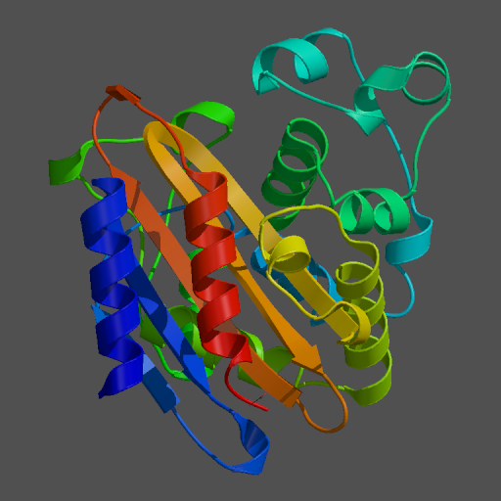
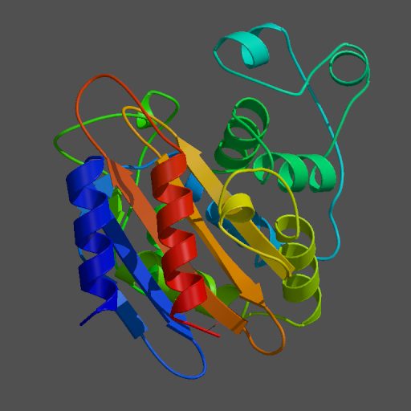
Hydrolase
PDB
H-bonds

Slide 85
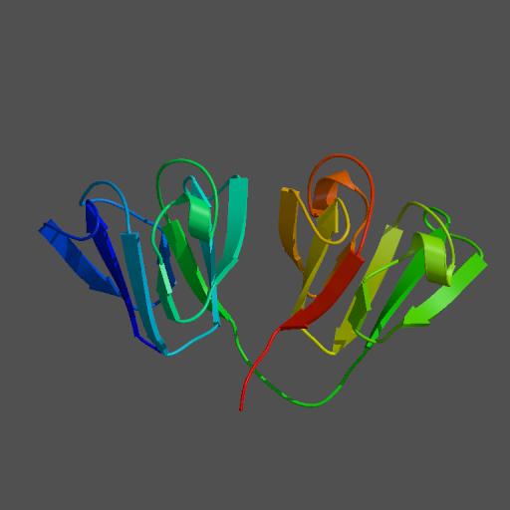
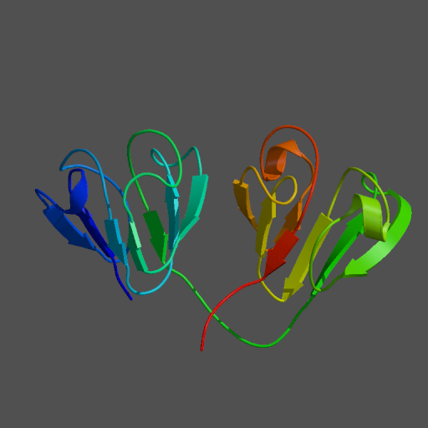
Gamma4 Crystallin
PDB
H-bonds

Slide 86
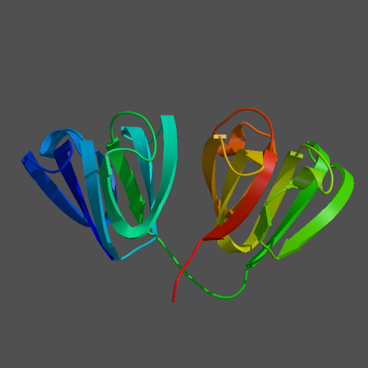
Gamma4 Crystallin
PDB
C-alpha

Slide 87
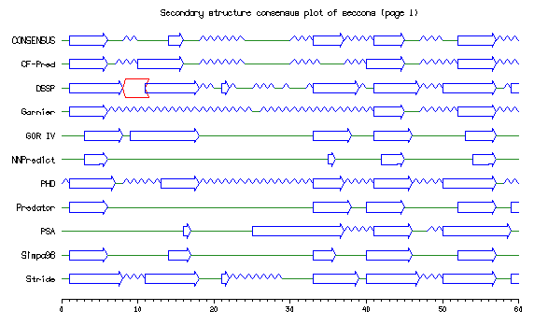

Slide 88
Hydrophobic Moment
Looking for amphipathic helices

Slide 89
Amphipathic Helices
An amphipathic helix is a helix in which there is a distinct difference in distribution of hydrophobic and hydrophilic residues

Slide 90
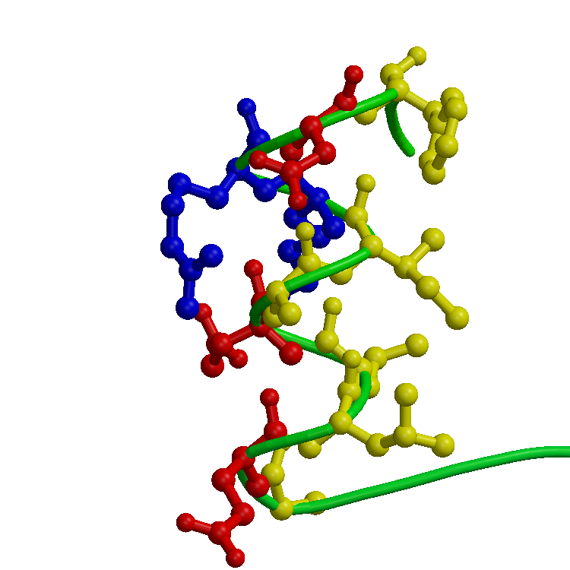
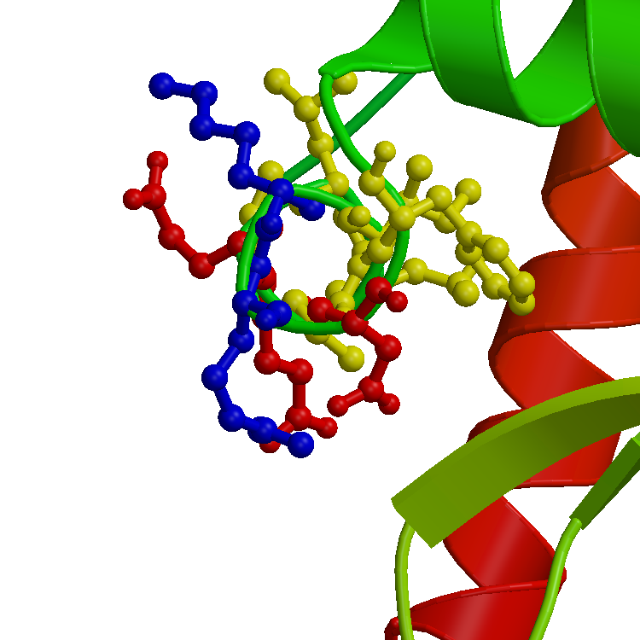

Slide 91
Hydrophobic Moment
V
Hydropathy vectors are distributed more or less equally in all directions, hence resultant vector has small or zero size
I
L
F
A
C
M

Slide 92
Hydrophobic Moment
V
Hydropathy vectors are distributed unequally over all directions, hence resultant vector has a greater than zero size.
R
L
D
A
K
M
This helix is amphipathic!

Slide 93
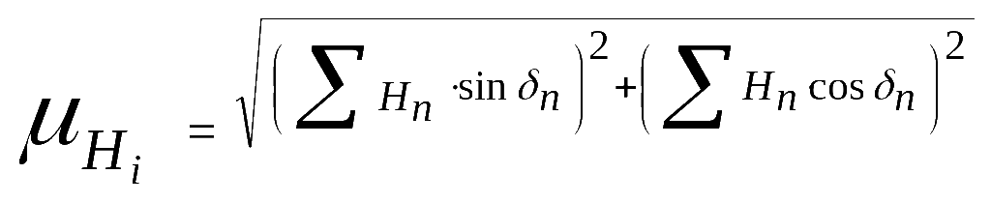
Hydrophobic Moment Plot
In text: the hydrophobic moment is the sum the vectors of the hydrophobicity values of all amino acids in a window, while imposing a certain secondary structure element to it.
Alpha-helix: delta = 100, beta-sheet: delta = ~ 160

Slide 94
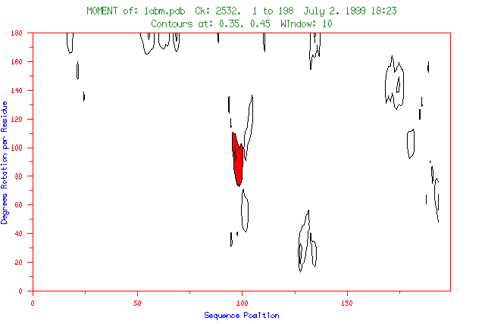
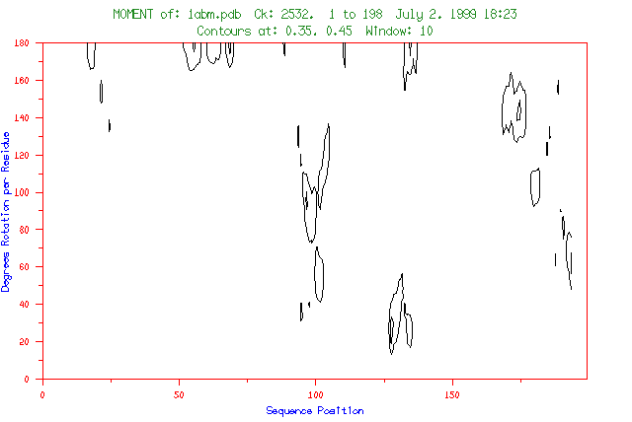

Slide 96
Contour level 2
Contour level 1

Slide 98
Contour level 2
Contour level 1

Slide 99
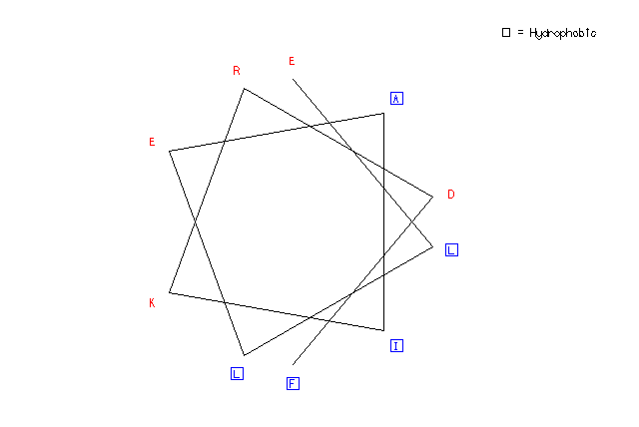
Helical Wheel Plot

Slide 100
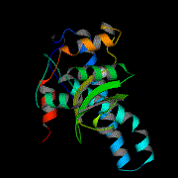
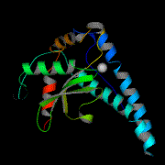
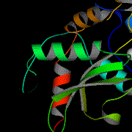
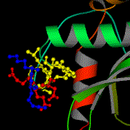
Amphipathic Helices

Slide 101
Amphipathic Helices
Manganese superoxide dismutase (PDB:1ABM)

Slide 106
hydro-
phobic
hydrophilic

Slide 107
Amphipathic Helices
Manganese superoxide dismutase (PDB:1ABM)

Slide 108
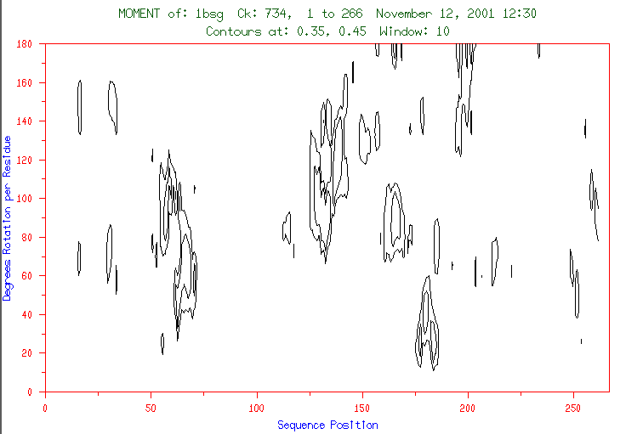

Slide 109
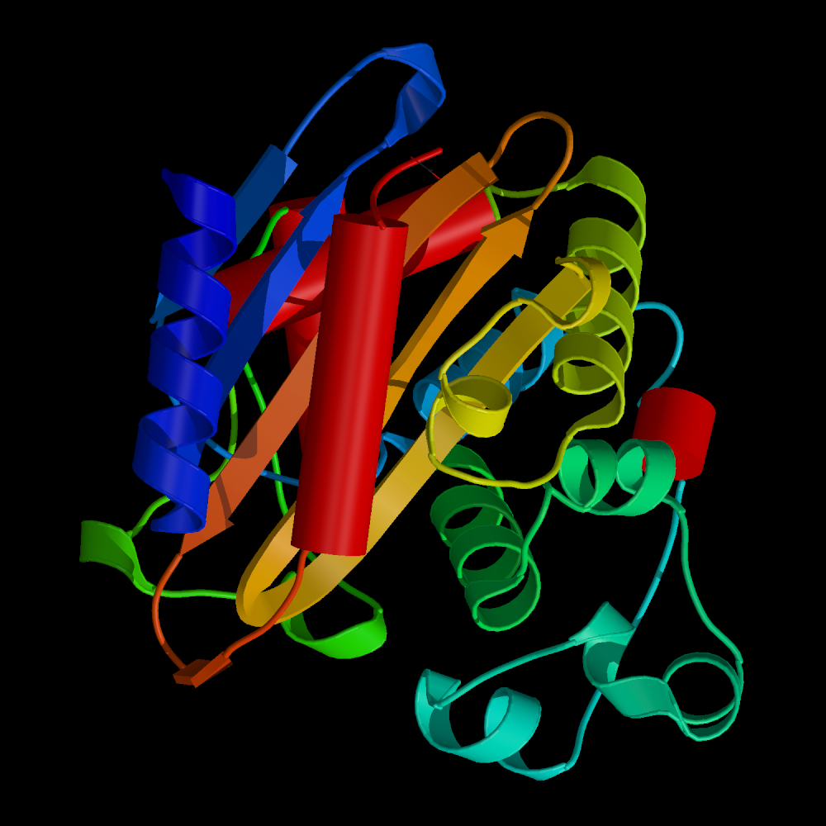
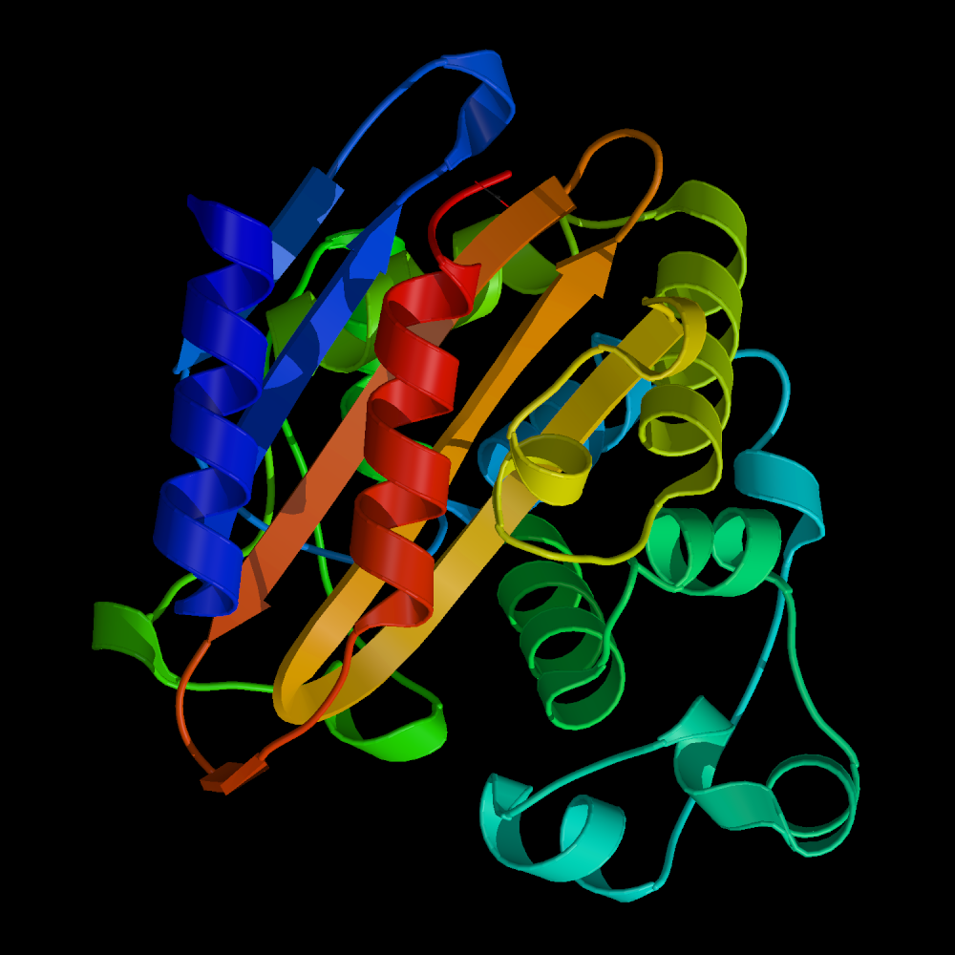
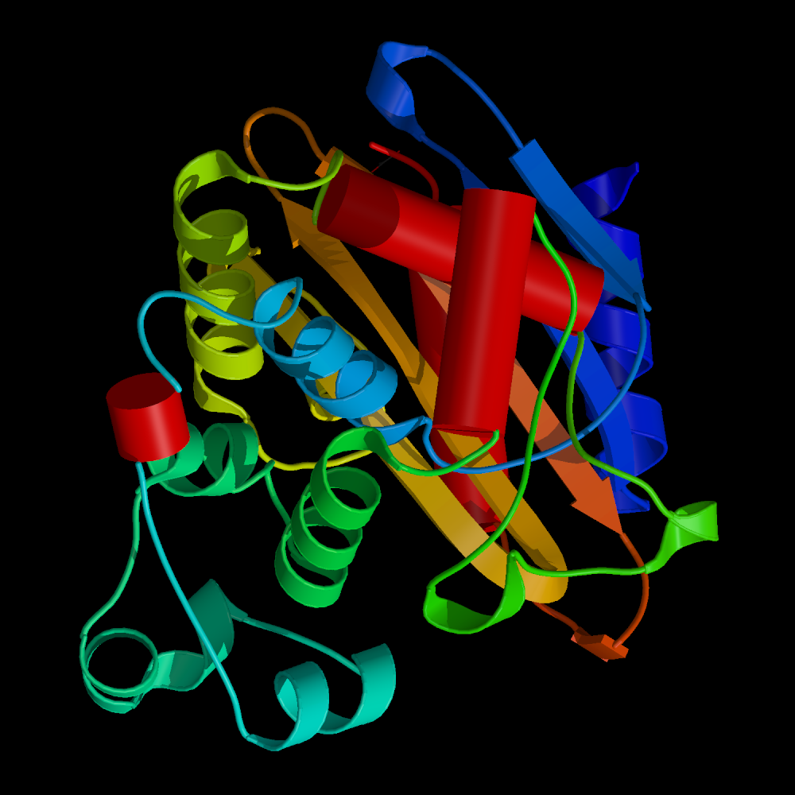

Slide 110
Coiled-Coil Prediction

Slide 111
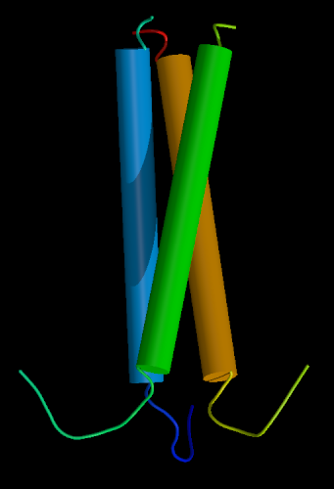
Coiled-coil helices
Intertwined helices form a three-helix bundle
Typical example: keratins, intermediary filament proteins

Slide 112
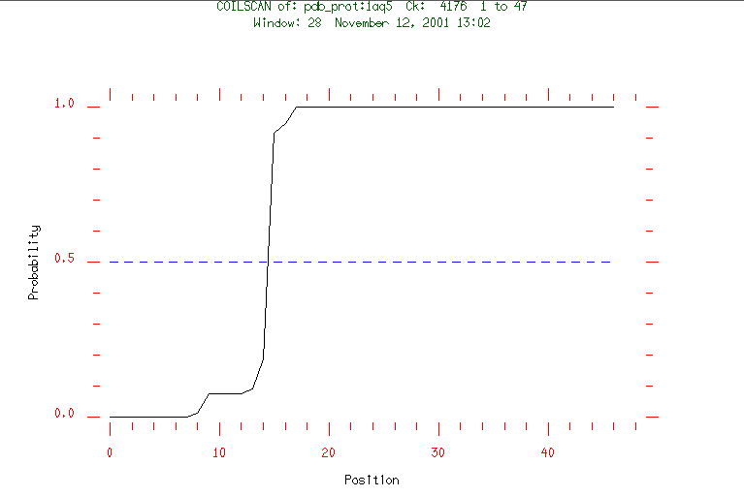

Slide 113
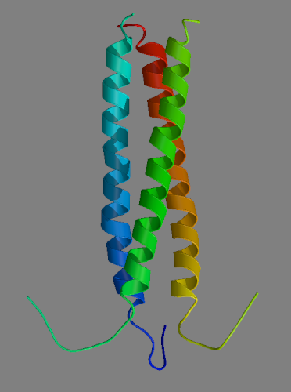
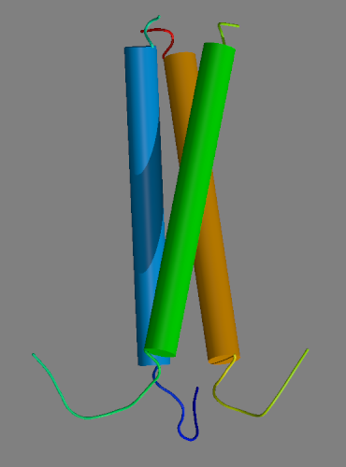
Coiled-coil Prediction
PDB:1AQ5
Chicken cartilage matrix protein

Slide 114
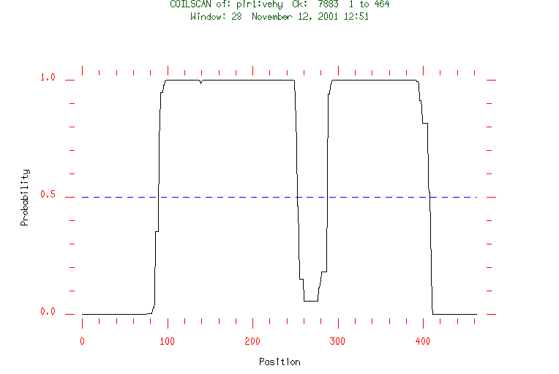
Intermediate Filament Proteins

