Slide 1
Multiple Alignment
Jack Leunissen
CMBI, Nijmegen

Slide 2
Multiple Alignment
The purpose of a multiple alignment is to line up all residues that are derived from the same residue position in the ancestral gene or protein in any number of sequences

Slide 3
From Pairwise To Multiple
Two sequences
Three sequences

Slide 4
And Beyond ...
Assuming that it takes 1 kilobyte (1kb) to store one single sequence, then ...
To do simultaneous alignment it takes for
  2 sequences : 1 megabyte of memory
  3 sequences : 1 gigabyte of memory
  4 sequences : 1 terabyte of memory
  5 sequences : 1 petabyte of memory
  6 sequences : 1 exabyte of memory

Slide 5
Multiple Alignment
Algorithm:
  Do a pairwise comparison of all sequences
  Calculate a “guide tree” from the pairwise scores, using UPGMA or Neighbor-Joining
  Perform multiple alignment in the order suggested by the guide tree

Slide 6
Pairwise Comparison
Compare every single sequence to every other sequence, using pairwise sequence alignment
      seq_1 & seq_ 2 ⇒ 0.91
      seq_ 1 & seq_ 3 ⇒ 0.23
      …
      seq_ 8 & seq_ 9 ⇒ 0.87
Record the resulting similarity scores

Slide 7
Calculate The Guide Tree
Construct a guide tree from the matrix containing the pairwise comparison values, using a clustering algorithm
  UPGMA (PileUp & Clustal V)
  Neighbor-Joining (Clustal W, Clustal X)

Slide 8
How UPGMA Works ...
A
C
4
3
2
2
2
3
D
B
1
E

Slide 9
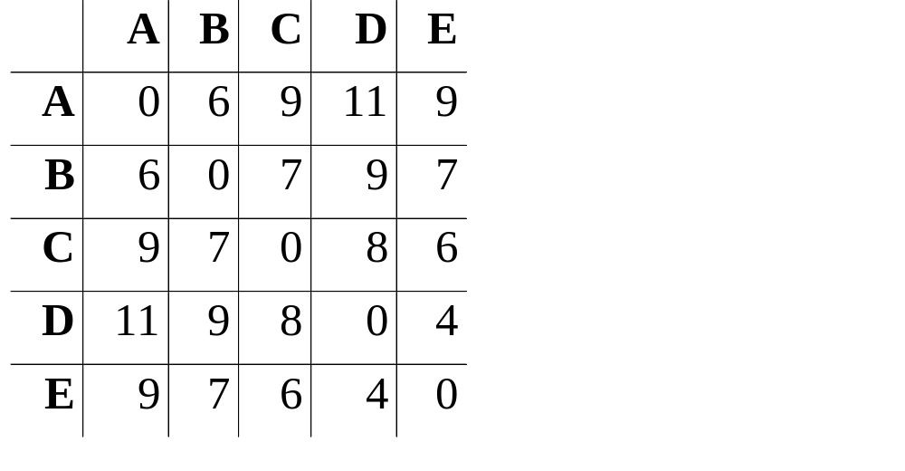
UPGMA - Step 1
D
E

Slide 10
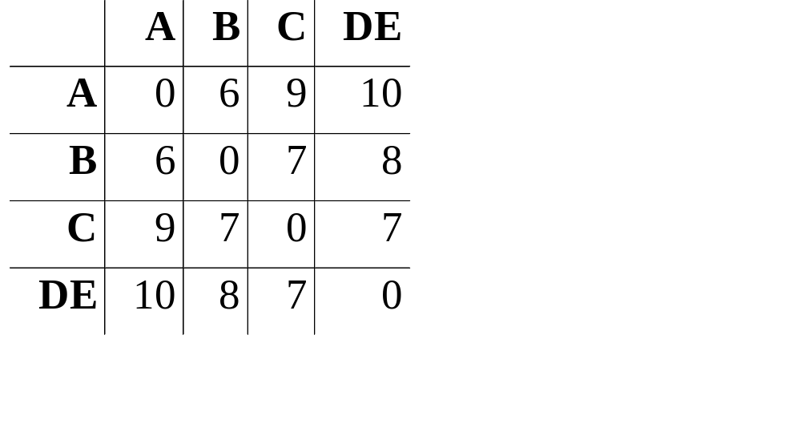
UPGMA - Step 2
D
E
A
B

Slide 11
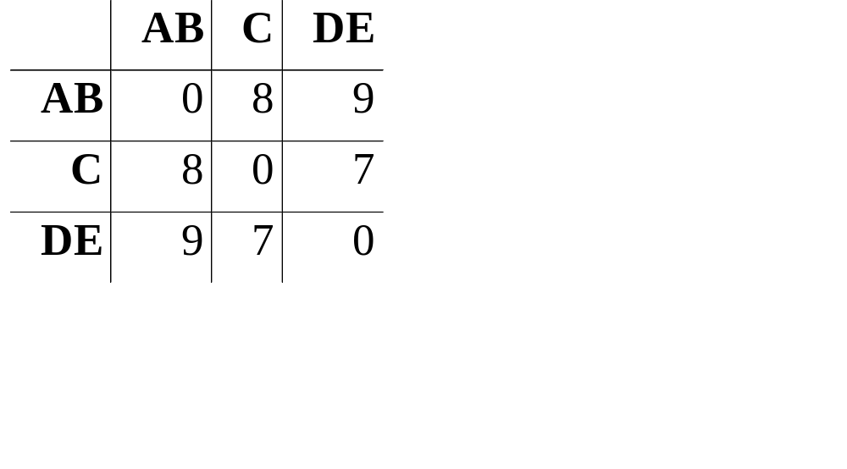
UPGMA - Step 3
C
D
E
A
B

Slide 12
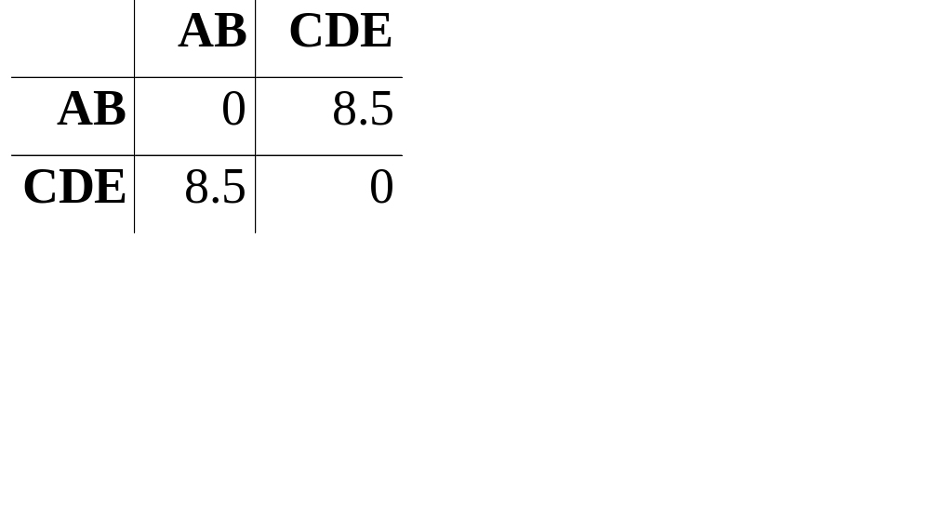
UPGMA - Step 4
C
D
E
A
B

Slide 13
How UPGMA Works ...
A
C
4
3
2
2
2
3
D
B
1
E

Slide 14
How UPGMA Works ...
Badly
A
C
3
3.5
2
1.5
3
2
D
B
2
E

Slide 15
Multiple Alignment
Using the guide tree, we start aligning groups of sequences
The purpose of the guide tree is to know which sequences are most alike; so we can align the “easy” ones first, and postpone the tricky ones to later in the procedure!

Slide 16
Multiple Alignment
C
D
E
A
B

Slide 17
Multiple Alignment
C
D
E
A
B

Slide 18
Multiple Alignment
C
D
E
A
B

Slide 19
Multiple Alignment
C
D
E
A
B

Slide 20
Things To Remember ...
All multiple alignment programs are GLOBAL alignment programs
The guide tree is NOT the phylogenetic tree

Slide 21
Running PileUp
Sequences must be in GCG format, either in separate files (using a file-of-filenames) or in an existing MSF or RSF file
Suppress the tree output (option C), since it is of no use!
...

Slide 22
Running Clustal W
Input can be in either Clustal, EMBL, PIR, Fasta or GCG (MSF) format
Clustal can align individual sequences as well as existing alignments

