Slide 1
Protein Sequence Analysis
Jack Leunissen
Wageningen University
The Netherlands

Slide 2
Protein Sequence Analysis
Protein Motif Searching
Hydropathy Plot
Secondary Structure Prediction
Hydrophobic Moment

Slide 3
Protein Motif Searching

Slide 4
What is a motif?
A motif is a description of a particular element of three dimensional structure that contains a specific sequence pattern
Motifs are identified by
  3D structural alignment
  Multiple sequence alignment
  Pattern searching programs

Slide 5
What is a motif?
Motifs are regions of similarity based on multiple alignments
Motif Databases
Single motifs
Multiple motifs
Motif
Insertions
Whole domains
Adapted from a slide by David Martin

Slide 6
Amino Acid groups
Proteins have a variety of side chains with similar physico-chemical properties.
C_{SS}
P
A
G
I
V
T
C_{SH}
S
L
N
M
D
Y
K
E
F
H
Q
W
R
Polar
Charged
Aliphatic
Aromatic
Small
Hydrophobic

Slide 7
Protein Motif Searching
Strict consensus pattern
  use only strictly conserved residues
But what about:
  variable residues?
  gaps?
C--QASCDGIPLKMNDC
C---VTCEGLPMRMDQC
CERTLGCQPMPVH---C
C C P C
CxxxxxCxxxPxxxxxC
C?????C???P?????C

Slide 8
Protein Motif Searching
Consensus patterns contain
  no alternative residues
  no flexible regions
  no mismatches
  no gaps
C--QASCDGIPLKMNDC
C---VTCEGLPMRMDQC
CERTLGCQPMPVH---C
C C P C
CxxxxxCxxxPxxxxxC

Slide 9
Protein Motif Searching
A better approach: regular expressions
Regular expressions are widely used in computer string searching
Example: the UNIX “grep” commands:
  % who | egrep ‘[Jj]ans*en’
  will list all logged-on users who’s name is Jansen, Janssen, jansen or janssen

Slide 10
Protein Motif Searching
Most motifs defined as regular expressions
Motifs can contain
  alternative residues
  flexible regions
C-x(2,5)-C-x-[GP]-x-P-x(2,5)-C.
CXXXCXGXPXXXXXC
| | | | |
FGCAKLCAGFPLRRLPCFYG

Slide 11
Protein Motif Searching
Motifs can not contain
  mismatches
  gaps
Some programs can handle this, but irrespectively of the pattern position!
C-x(2,5)-C-x-[GP]-x-P-x(2,5)-C.
CXXCXGXPXXXXX-C
| ?| | | ?|
FGCA-CAGFPLRRLPKCFYG

Slide 12
Protein Motif Searching
Consensus patterns
  no alternative residues
  no flexible regions
  no mismatches
  no gaps
Regular expressions
  allow alternative residues
  allow flexible regions
  no mismatches
  no gaps
C--QASCDGIPLKMNDC
C---VTCEGLPMRMDQC
CERTLGCQPMPVH---C
C..C.[GP].P..C
C...C.[GP].P..C
C....C.[GP].P..C
C.....C.[GP].P..C
You will loose
information!
You will miss
imperfect matches
CxxxxxCxxxPxxxxxC
C C P C

Slide 13
Protein Motif Searching
Mandatory motifs characterise a protein (super-) family
ID SUBTILASE_ASP; PATTERN.
DE Serine proteases, subtilase family, aspartic acid active site.
PA [STAIV]-x-[LIVMF]-[LIVM]-D-[DSTA]-G-[LIVMFC]-x(2,3)-[DNH].
ID SUBTILASE_HIS; PATTERN.
DE Serine proteases, subtilase family, histidine active site.
PA H-G-[STM]-x-[VIC]-[STAGC]-[GS]-x-[LIVMA]-[STAGCLV]-[SAGM].
ID SUBTILASE_SER; PATTERN.
DE Serine proteases, subtilase family, serine active site.
PA G-T-S-x-[SA]-x-P-x(2)-[STAVC]-[AG].

Slide 14
Protein Motif Searching
Mandatory motifs characterise a protein (super-) family
ID SUBTILASE_SER; PATTERN.
DE Serine proteases, serine active site.
PA G-T-S-x-[SA]-x-P-x(2)-[STAVC]-[AG].

Slide 15
Protein Motif Searching
Possible motifs occur frequently in proteins; they may not actually be present, such as
  Post-translational modification sites
  Leucine zippers
ID ASN_GLYCOSYLATION; PATTERN.
DE N-glycosylation site.
PA N-{P}-[ST]-{P}.
ID LEUCINE_ZIPPER; PATTERN.
DE Leucine zipper pattern.
PA L-x(6)-L-x(6)-L-x(6)-L.

Slide 16
Pattern Searching in GCG
FindPatterns searches for the occurrence of user-defined patterns in protein or nucleic acid databases
Motifs is a special version of FindPatterns; it compares one or more protein sequences to all of the patterns available in the PROSITE database

Slide 17
The PROSITE Syntax
A-[BC]-X-D(2,5)-{EFG}-H.
  A
  B or C
  anything
  2-5 D’s
  not E, F, or G
  H

Slide 18
GCG’s FindPatterns Syntax
A(B,C)XD{2,5}~(E,F,G)H
  A
  B or C
  anything
  2-5 D’s
  not E, F, or G
  H

Slide 19
Profiles: the consensus revisited
Weight matrix
  a profile of the occurrence of an amino acid at a particular position
  Provides a more sensitive match for less similar sequences
  Computationally expensive compared to a single sequence search

Slide 20
Profiles
Many motifs cannot be easily defined using simple patterns
Such motifs can be defined using profiles
A profile is constructed from a multiple sequence alignment. For each position, each amino acid is given a score depending on how likely it is to occur

Slide 21
Profiles
A more formal definition:
  A profile is a position-dependant scoring matrix, including position-specific gap penalties, created by evaluating the likelihood of occurrence for every residue position in a multiple alignment

Slide 22
Cons A B C D E F G H I K L M⇒ N P Q R S T V W Y Z Gap Len ..
W -27 -23 1 -37 -28 51 -35 13 16 -9 31 20 -14 -24 -22 16 -11 -15 -2 90 46 -24 100 100
A 77 28 12 36 35 -39 68 -6 -9 0 -19 -9 21 27 18 -19 32 27 11 -64 -33 23 100 100
F -50 -70 -10 -100 -70 150 -60 -10 70 -70 120 50 -50 -70 -80 -50 -30 -30 20 130 140 -70 100 100
Q 17 49 -46 58 56 -63 19 56 -25 33 -12 -3 46 21 111 30 -3 -5 -18 -39 -44 83 50 50
A 84 18 33 20 20 -32 50 -10 -2 5 -15 -8 18 35 7 -12 58 27 7 -32 -25 10 50 50
E 25 63 -49 89 118 -61 44 33 -16 25 -27 -19 44 8 58 0 17 17 -16 -91 -41 89 100 100

Slide 23
Cons A B C D E F G H I K L M⇒
W -27 -23 1 -37 -28 51 -35 13 16 -9 31 20
A 77 28 12 36 35 -39 68 -6 -9 0 -19 -9
F -50 -70 -10 -100 -70 150 -60 -10 70 -70 120 50
Q 17 49 -46 58 56 -63 19 56 -25 33 -12 -3
A 84 18 33 20 20 -32 50 -10 -2 5 -15 -8
E 25 63 -49 89 118 -61 44 33 -16 25 -27 -19
Cons N P Q R S T V W Y Z Gap Len
W -14 -24 -22 16 -11 -15 -2 90 46 -24 100 100
A 21 27 18 -19 32 27 11 -64 -33 23 100 100
F -50 -70 -80 -50 -30 -30 20 130 140 -70 100 100
Q 46 21 111 30 -3 -5 -18 -39 -44 83 50 50
A 18 35 7 -12 58 27 7 -32 -25 10 50 50
E 44 8 58 0 17 17 -16 -91 -41 89 100 100

Slide 24
Hydropathy Plot
Prediction hydrophobic and hydrophilic regions in a protein

Slide 25
Partition Coefficients
Hydrophilic
Hydrophobic
Oil
Water

Slide 26
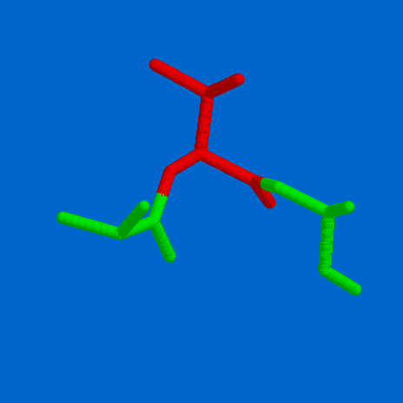
Partition Coefficients
Hydrophilic
Hydrophobic
Oil
Water

Slide 27
Hydrophobicity/Hydrophilicity Values
Fauchere & Pliska Kyte & Doolittle Hopp & Woods Eisenberg
R -1.37 -4.50 3.00 -2.53
K -1.35 -3.90 3.00 -1.50
D -1.05 -3.50 3.00 -0.90
Q -0.78 -3.50 0.20 -0.85
N -0.85 -3.50 0.20 -0.78
E -0.87 -3.50 3.00 -0.74
H -0.40 -3.20 -0.50 -0.40
S -0.18 -0.80 0.30 -0.18
T -0.05 -0.70 -0.40 -0.05
P 0.12 -1.60 0.00 0.12
Y 0.26 -1.30 -2.30 0.26
C 0.29 2.50 -1.00 0.29
G 0.48 -0.40 0.00 0.48
A 0.62 1.80 -0.50 0.62
M 0.64 1.90 -1.30 0.64
W 0.81 -0.90 -3.40 0.81
L 1.06 3.80 -1.80 1.06
V 1.08 4.20 -1.50 1.08
F 1.19 2.80 -2.50 1.19
I 1.38 4.50 -1.80 1.38

Slide 28
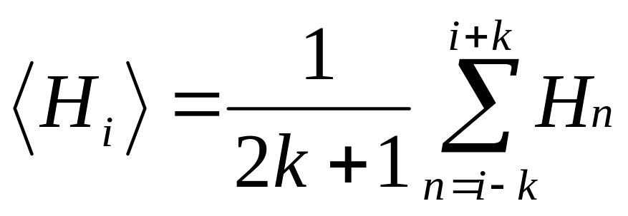
Hydrophobicity Plot
Sum amino acid hydrophobicity values in a given window
Plot the value in the middle of the window
Shift the window one position

Slide 29
Sliding Window Approach
Calculate property for first sub-sequence
Use the result (plot/print/store)
I L I K E I R
4.50 + 3.80 + 4.50 - 3.90 - 3.50 + 4.50 - 4.50
5.4 / 7 = 0.77
Move to the next position in the sequence

Slide 30
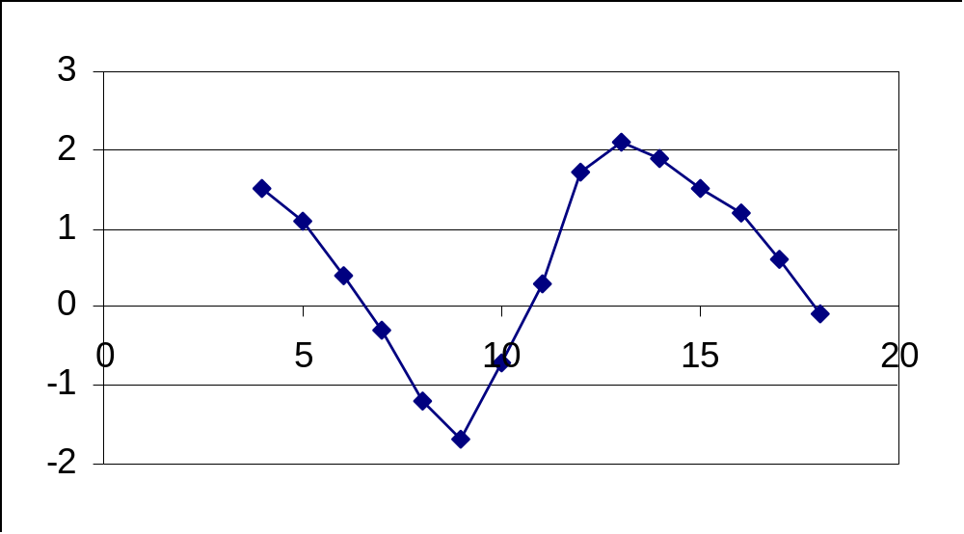
Hydrophobicity Plot

Slide 31
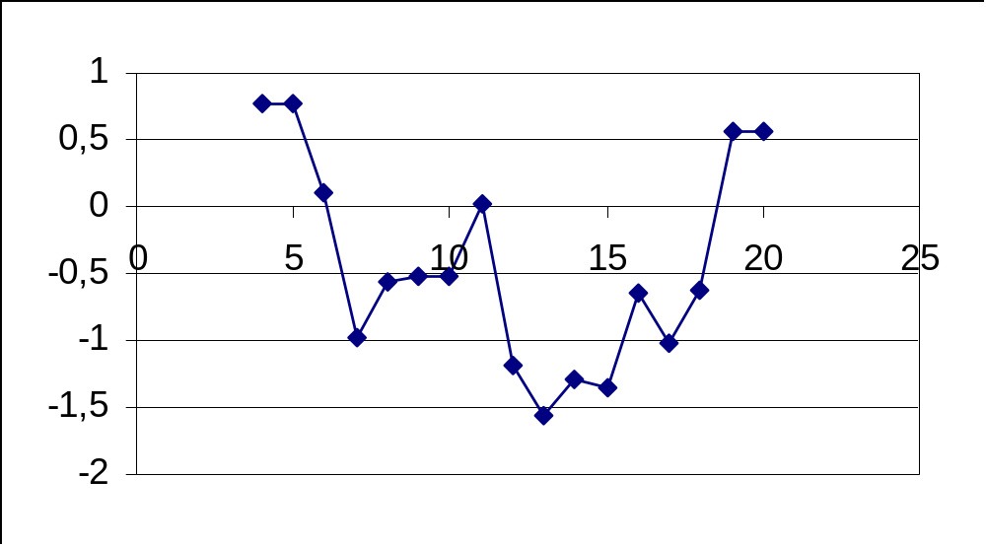
Hydrophobicity Plot
ILIKEIRISHWHISKEYYAMMIE
ILIKEIRISHWHISKEYYAMMIE
ILIKEIRISHWHISKEYYAMMIE
ILIKEIRISHWHISKEYYAMMIE
ILIKEIRISHWHISKEYYAMMIE
ILIKEIRISHWHISKEYYAMMIE

Slide 32
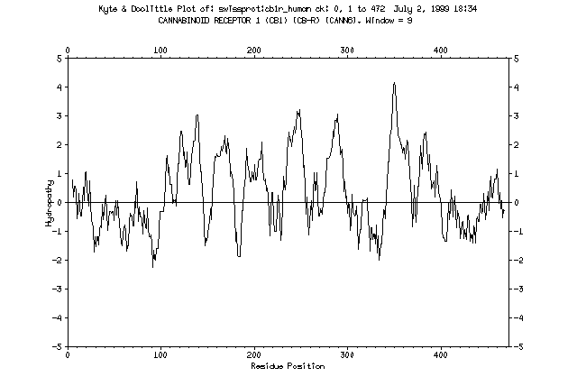

Slide 33
Transmembrane Regions
Rotation is 100 degrees per amino acid
Climbing 1.5 Angstrom
per amino acid residue

Slide 34
Transmembrane Regions
So we need approx. 30 / 1.5 = 20 amino acids to span the membrane
30 angstrom

Slide 36
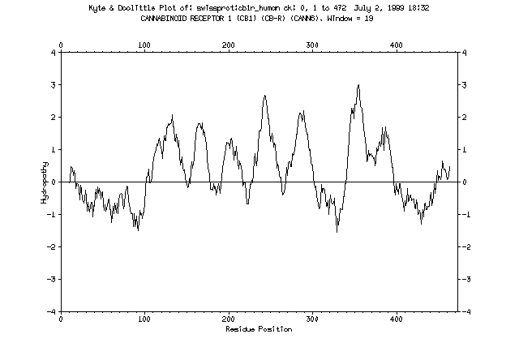
Adapting the window size to the size of the membrane spanning segment makes the picture easier to interpret

Slide 37
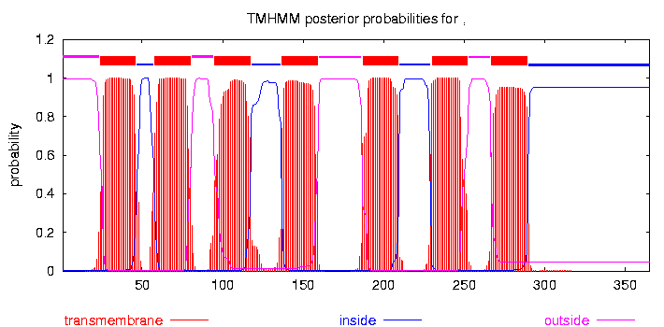

Slide 38
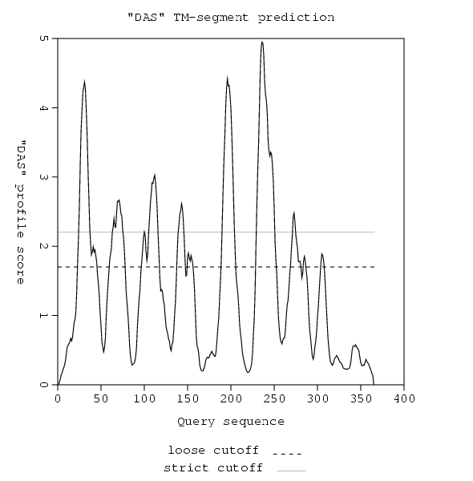

Slide 39
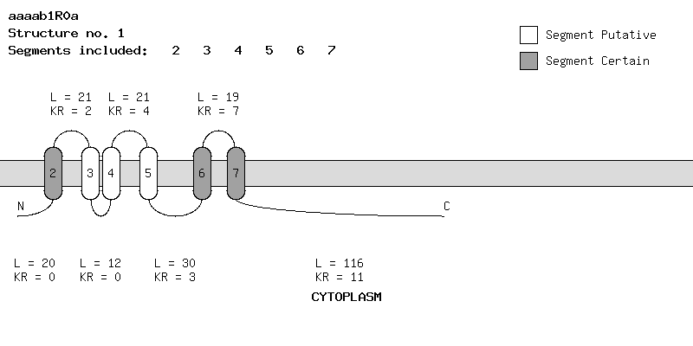

Slide 40
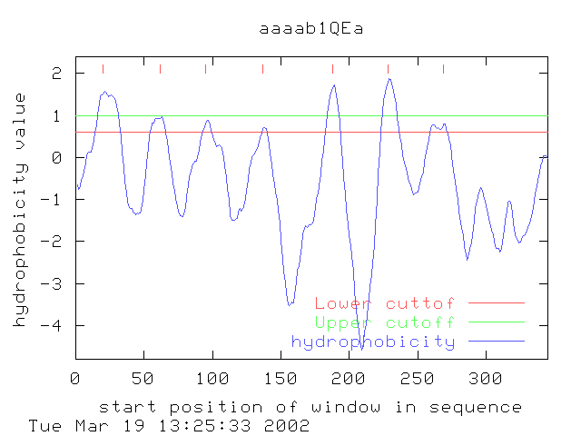

Slide 41
Secondary Structure Prediction

Slide 42
Secondary Structure Prediction
Only known as Robson’s method in the UK; the rest of the world uses its proper name, which is GARNIER or the GOR method, Dave!
Traditional methods
  Chou & Fasman
    Statistical & rule-based method
  Lim
    Stereochemical rules
  Garnier, Osguthorpe & Robson
    Statistical method
Accuracy ~ 60%

Slide 43
Secondary Structure Prediction
Traditional methods
  Chou & Fasman
    Statistical & rule-based method
  Lim
    Stereochemical rules
  Garnier, Osguthorpe & Robson
    Statistical method
Accuracy ~ 60%

Slide 44
GOR Helix Parameters
i-8 i-6 i-4 i-2 i i+2 i+4 i+6 i+8
Gly -5 -10 -15 -20 -30 -40 -50 -60 -86 -60 -50 -40 -30 -20 -15 -10 -5
ala 5 10 15 20 30 40 50 60 65 60 50 40 30 20 15 10 5
val 0 0 0 0 0 0 5 10 14 10 5 0 0 0 0 0 0
leu 0 5 10 15 20 25 28 30 32 30 28 25 20 15 10 5 0
ile 5 10 15 20 25 20 15 10 6 0 -10 -15 -20 -25 -20 -10 -5
ser 0 -5 -10 -15 -20 -25 -30 -35 -39 -35 -30 -25 -20 -15 -10 -5 0
thr 0 0 0 -5 -10 -15 -20 -25 -26 -25 -20 -15 -10 -5 0 0 0
asp 0 -5 -10 -15 -20 -15 -10 0 5 10 15 20 20 20 15 10 5
glu 0 0 0 0 10 20 60 70 78 78 78 78 78 70 60 40 20
asn 0 0 0 0 -10 -20 -30 -40 -51 -40 -30 -20 -10 0 0 0 0
gln 0 0 0 0 5 10 20 20 10 -10 -20 -20 -10 -5 0 0 0
lys 20 40 50 55 60 60 50 30 23 10 5 0 0 0 0 0 0
his 10 20 30 40 50 50 50 30 12 -20 -10 0 0 0 0 0 0
arg 0 0 0 0 0 0 0 0 -9 -15 -20 -30 -40 -50 -50 -30 -10
phe 0 0 0 0 0 5 10 15 16 15 10 5 0 0 0 0 0
tyr -5 -10 -15 -20 -25 -30 -35 -40 -45 -40 -35 -30 -25 -20 -15 -10 -5
trp -10 -20 -40 -50 -50 -10 0 10 12 10 0 -10 -50 -50 -40 -20 -10
cys 0 0 0 0 0 0 -5 -10 -13 -10 -5 0 0 0 0 0 0
met 10 20 25 30 35 40 45 50 53 50 45 40 35 30 25 20 10
pro -10 -20 -40 -60 -80 -100 -120 -140 -77 -60 -30 -20 -10 0 0 0 0

Slide 45
I S G A R N I E R H E L I X P R E D I C T
i-8 i-6 i-4 i-2 i i+2 i+4 i+6 i+8
Gly -5 -10 -15 -20 -30 -40 -50 -60 -86 -60 -50 -40 -30 -20 -15 -10 -5
ala 5 10 15 20 30 40 50 60 65 60 50 40 30 20 15 10 5
val 0 0 0 0 0 0 5 10 14 10 5 0 0 0 0 0 0
leu 0 5 10 15 20 25 28 30 32 30 28 25 20 15 10 5 0
ile 5 10 15 20 25 20 15 10 6 0 -10 -15 -20 -25 -20 -10 -5
ser 0 -5 -10 -15 -20 -25 -30 -35 -39 -35 -30 -25 -20 -15 -10 -5 0
thr 0 0 0 -5 -10 -15 -20 -25 -26 -25 -20 -15 -10 -5 0 0 0
asp 0 -5 -10 -15 -20 -15 -10 0 5 10 15 20 20 20 15 10 5
glu 0 0 0 0 10 20 60 70 78 78 78 78 78 70 60 40 20
asn 0 0 0 0 -10 -20 -30 -40 -51 -40 -30 -20 -10 0 0 0 0
gln 0 0 0 0 5 10 20 20 10 -10 -20 -20 -10 -5 0 0 0
lys 20 40 50 55 60 60 50 30 23 10 5 0 0 0 0 0 0
his 10 20 30 40 50 50 50 30 12 -20 -10 0 0 0 0 0 0
arg 0 0 0 0 0 0 0 0 -9 -15 -20 -30 -40 -50 -50 -30 -10
phe 0 0 0 0 0 5 10 15 16 15 10 5 0 0 0 0 0
tyr -5 -10 -15 -20 -25 -30 -35 -40 -45 -40 -35 -30 -25 -20 -15 -10 -5
trp -10 -20 -40 -50 -50 -10 0 10 12 10 0 -10 -50 -50 -40 -20 -10
cys 0 0 0 0 0 0 -5 -10 -13 -10 -5 0 0 0 0 0 0
met 10 20 25 30 35 40 45 50 53 50 45 40 35 30 25 20 10
pro -10 -20 -40 -60 -80 -100 -120 -140 -77 -60 -30 -20 -10 0 0 0 0

Slide 46
I S G A R N I E R H E L I X P R E D I C T
i-8 i-6 i-4 i-2 i i+2 i+4 i+6 i+8
Gly -5 -10 -15 -20 -30 -40 -50 -60 -86 -60 -50 -40 -30 -20 -15 -10 -5
ala 5 10 15 20 30 40 50 60 65 60 50 40 30 20 15 10 5
val 0 0 0 0 0 0 5 10 14 10 5 0 0 0 0 0 0
leu 0 5 10 15 20 25 28 30 32 30 28 25 20 15 10 5 0
ile 5 10 15 20 25 20 15 10 6 0 -10 -15 -20 -25 -20 -10 -5
ser 0 -5 -10 -15 -20 -25 -30 -35 -39 -35 -30 -25 -20 -15 -10 -5 0
thr 0 0 0 -5 -10 -15 -20 -25 -26 -25 -20 -15 -10 -5 0 0 0
asp 0 -5 -10 -15 -20 -15 -10 0 5 10 15 20 20 20 15 10 5
glu 0 0 0 0 10 20 60 70 78 78 78 78 78 70 60 40 20
asn 0 0 0 0 -10 -20 -30 -40 -51 -40 -30 -20 -10 0 0 0 0
gln 0 0 0 0 5 10 20 20 10 -10 -20 -20 -10 -5 0 0 0
lys 20 40 50 55 60 60 50 30 23 10 5 0 0 0 0 0 0
his 10 20 30 40 50 50 50 30 12 -20 -10 0 0 0 0 0 0
arg 0 0 0 0 0 0 0 0 -9 -15 -20 -30 -40 -50 -50 -30 -10
phe 0 0 0 0 0 5 10 15 16 15 10 5 0 0 0 0 0
tyr -5 -10 -15 -20 -25 -30 -35 -40 -45 -40 -35 -30 -25 -20 -15 -10 -5
trp -10 -20 -40 -50 -50 -10 0 10 12 10 0 -10 -50 -50 -40 -20 -10
cys 0 0 0 0 0 0 -5 -10 -13 -10 -5 0 0 0 0 0 0
met 10 20 25 30 35 40 45 50 53 50 45 40 35 30 25 20 10
pro -10 -20 -40 -60 -80 -100 -120 -140 -77 -60 -30 -20 -10 0 0 0 0

Slide 47
NOG IN TE VULLEN
Hier een dia met de vier GOR curves, waaruit duidelijk wordt dat GOR gewoon de hoogste voorspelde waarde neemt.
Maak ook duidelijk dat Chou-Fasman nog wat extra regels m.b.t. element-lengte en vormers/brekers hanteert

Slide 48
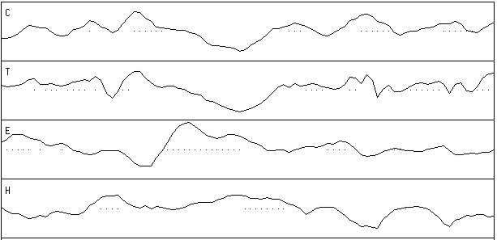
GOR Prediction
beta sheet
helix

Slide 49
Secondary Structure Prediction
Recent methods
  Neural networks = flexible statistics
  Multiple alignments = variability
  Heuristics = common sense
  Or a combination of the above
Accuracy ~ 70%

Slide 50
Heuristics
Conserved parts are structurally and/or functionally important
Segments with many gaps must be in loop regions

Slide 51
....,....1....,....2....,....3....,....4....,....5....,....6
AA |MGNITADNSSMSCTIDHTIHQTLAPVVYVTVLVVGFPANCLSLYFGYLQIKARNELGVYL|
PHD sec | EEEEEEEEEEEEEEEE EEEEEEEEE EEEEH|
Rel sec |999888777778664312114577778899998652421224545552233655401121|
detail:
prH sec |000000111111112344321110000000000001244542232323322111123434|
prE sec |000000000000011011345677778899988773000136666665542111234454|
prL sec |999888878888766543332111111100000225655310000000025766532000|
subset: SUB sec |LLLLLLLLLLLLLL.......EEEEEEEEEEEEEE.......E.EEE....LLL......|
accessibility
3st: P_3 acc |eeeeeeeeeeeebebeeebeebbbbbbbbbbbbbbbbbbbbbbbbbbbeeeeeebbbbbb|
10st: PHD acc |997667777777070777066000000000000000000000000000666777000000|
Rel acc |011000101111010111101165348589989974232478979750001111121869|
subset: SUB acc |......................bb.bbbbbbbbbbb...bbbbbbbb..........bbb|
....,....7....,....8....,....9....,....10...,....11...,....12
AA |CNLTVADLFYICSLPFWLQYVLQHDNWSHGDLSCQVCGILLYENIYISVGFLCCISVDRY|
PHD sec |HHHHHHHHHHHHHHHHHEEHHHH HHHHHHHHHEEEEHHHHHHHHHHEEE EE|
Rel sec |234678787876311431213521642122577887431133414542223323111135|
detail:
prH sec |556778887877544554455654112233677877654433245654555553334421|
prE sec |332110000001211135543110012321001011234455621122332345444356|
prL sec |000000101110234200000234764345211001111110132222111101211221|
subset: SUB sec |...HHHHHHHHH.........H..L.....HHHHHH.........H.............E|
accessibility
3st: P_3 acc |bbbbbbbbbbbbbbbbbbbbbbeee bbbbebbbebbbbbbbbbbbbbbbbbbbbbbbbb|
10st: PHD acc |000000000000000000000067750000600060000000000000000000000000|
Rel acc |858788377766363416310200003045137917423532535379878966665227|
subset: SUB acc |bbbbbb.bbbbb.b.b.b..........bb..bb.bb..b..b.b.bbbbbbbbbbb..b|

Slide 52
....,....1....,....2....,....3....,....4....,....5....,....6
AA |MGNITADNSSMSCTIDHTIHQTLAPVVYVTVLVVGFPANCLSLYFGYLQIKARNELGVYL|
PHD htm | TTTTTTTTTTTTTTTTTTTTTTTTTTTT TTTTT|
Rel htm |999999999999999998874036778888887777777777777653101332012456|
detail:
prH htm |000000000000000000012468889999998888888888888876554333456778|
prL htm |999999999999999999987531110000001111111111111123445666543221|
PHDRhtm | TTTTTTTTTTTTTTTTTTTT TT|
PHDThtm |ooooooooooooooooooooooooTTTTTTTTTTTTTTTTTTTTiiiiiiiiiiiiiiTT|
subset: SUB htm |LLLLLLLLLLLLLLLLLLLLL..HHHHHHHHHHHHHHHHHHHHHHHH..........HHH|
....,....7....,....8....,....9....,....10...,....11...,....12
AA |CNLTVADLFYICSLPFWLQYVLQHDNWSHGDLSCQVCGILLYENIYISVGFLCCISVDRY|
PHD htm |TTTTTTTTTTTTTTTTTTTTTT TTTTTTTTTTTTTTTTTTTTTTTTTTTTT|
Rel htm |777777777777777776542013443443102246777777777777777777777766|
detail:
prH htm |888888888888888888776543223223456678888888888888888888888888|
prL htm |111111111111111111223456776776543321111111111111111111111111|
PHDRhtm |TTTTTTTTTTTTTTTTT TTTTTTTTTTTTTTTTTTTTTTT |
PHDThtm |TTTTTTTTTTTTTTTTToooooooooooooooooooTTTTTTTTTTTTTTTTTTTTTTTi|
subset: SUB htm |HHHHHHHHHHHHHHHHHHHH....LL.LL.....HHHHHHHHHHHHHHHHHHHHHHHHHH|

Slide 53
Secondary Structure Prediction
Strategy
  Use as many methods as possible
  Use homologous sequences
  Combine predictions into consensus prediction

Slide 54
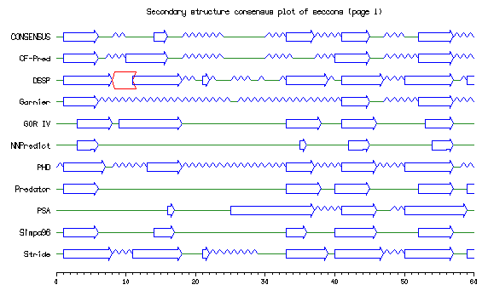

Slide 55
Why can’t it be 100% correct?
All current 2D prediction schemes are based upon observation of occurrence of 2D elements in 3D structures
Deduction of 2D elements from structures is ambiguous!

Slide 56
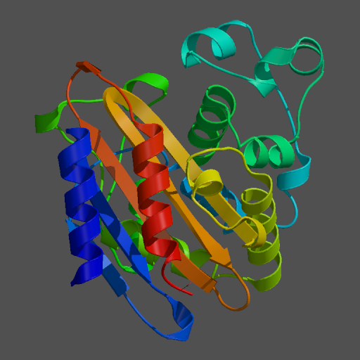
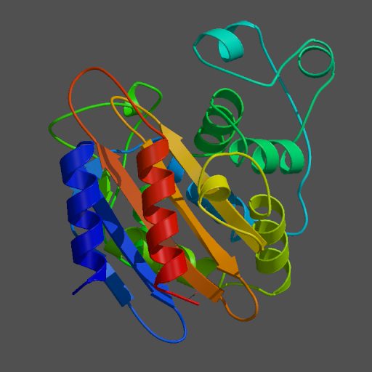
Hydrolase
PDB
H-bonds

Slide 57
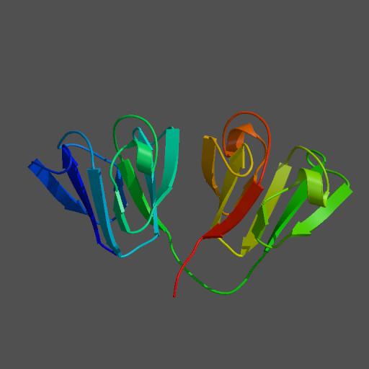
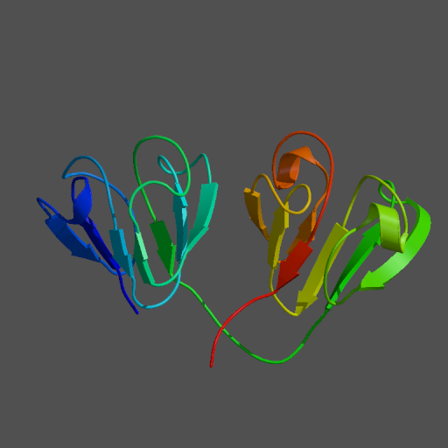
Gamma4 Crystallin
PDB
H-bonds

Slide 58
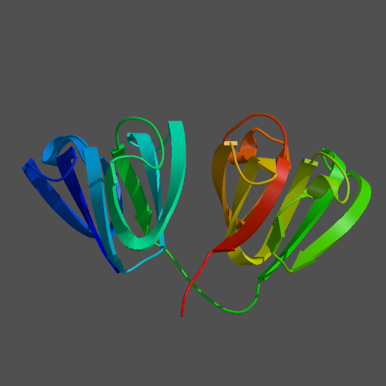
Gamma4 Crystallin
PDB
C-alpha

Slide 59
Hydrophobic Moment
Look for amphipathic helices or beta sheets

Slide 60
Amphipathic Helices
An amphipathic helix is a helix in which there is a distinct difference in distribution of hydrophobic and hydrophilic residues

Slide 61
Hydrophobic Moment
Hydropathy vectors are distributed more or less equally in all directions, hence resultant vector has small or zero size

Slide 62
Hydrophobic Moment
Hydropathy vectors are distributed unequally over all directions, hence resultant vector has a greater than zero size.
This helix is amphipathic!

Slide 63
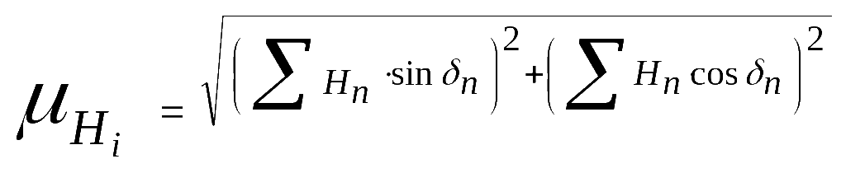
Hydrophobic Moment Plot
In text: the hydrophobic moment is the sum the vectors of the hydrophobicity values of all amino acids in a window, while imposing a certain secondary structure element to it.
Alpha-helix: delta = 100, beta-sheet: delta = ~ 160

Slide 64
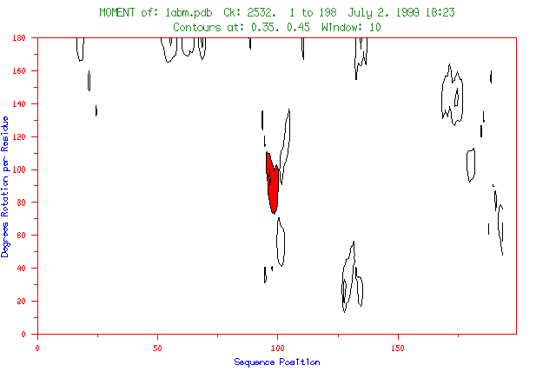
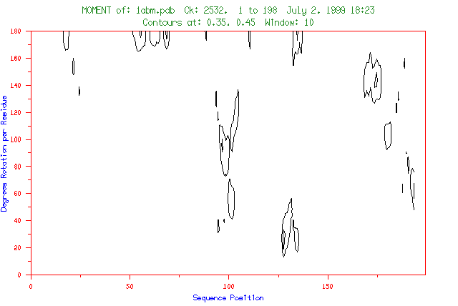

Slide 65
Contour level 2
Contour level 1

Slide 66
Contour level 2
Contour level 1

Slide 67
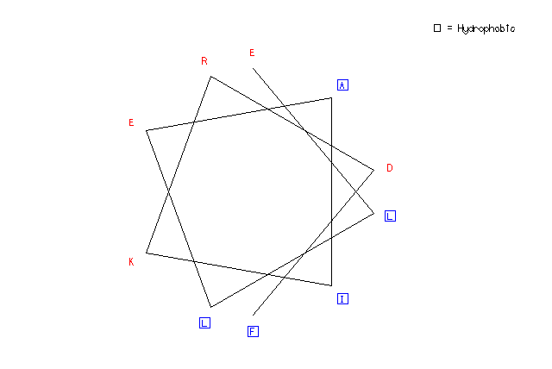
Helical Wheel Plot

Slide 68
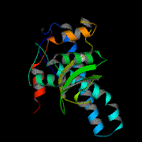
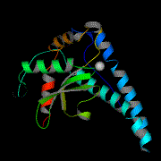
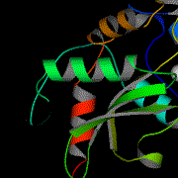
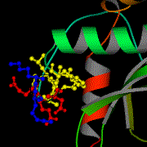
Amphipathic Helices

Slide 69
Amphipathic Helices
Manganese superoxide dismutase (PDB:1ABM)

Slide 74
hydro-
phobic
hydrophilic

Slide 75
Amphipathic Helices
Manganese superoxide dismutase (PDB:1ABM)

Slide 76
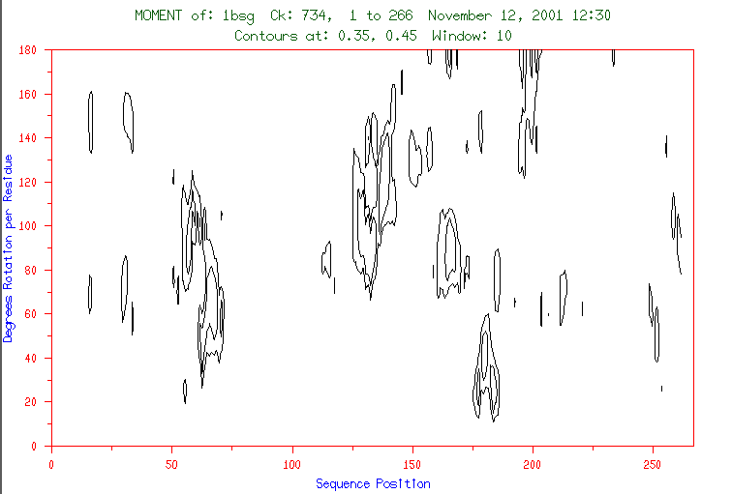

Slide 77
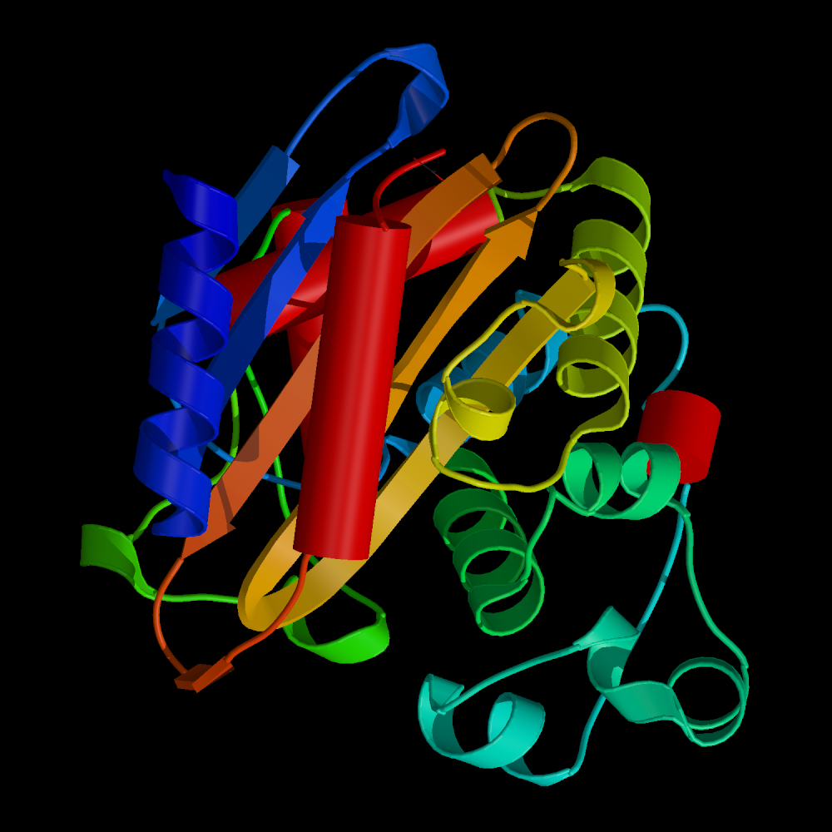
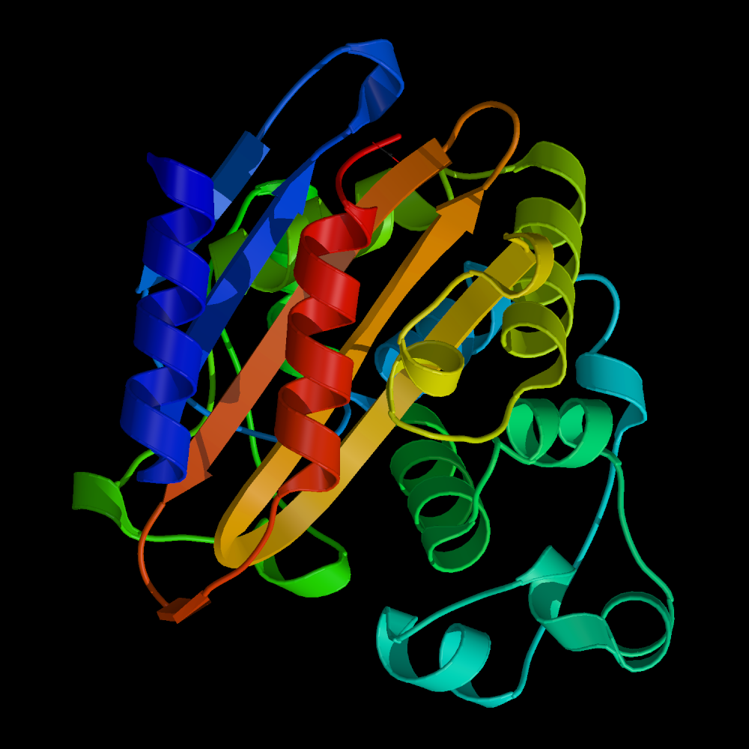
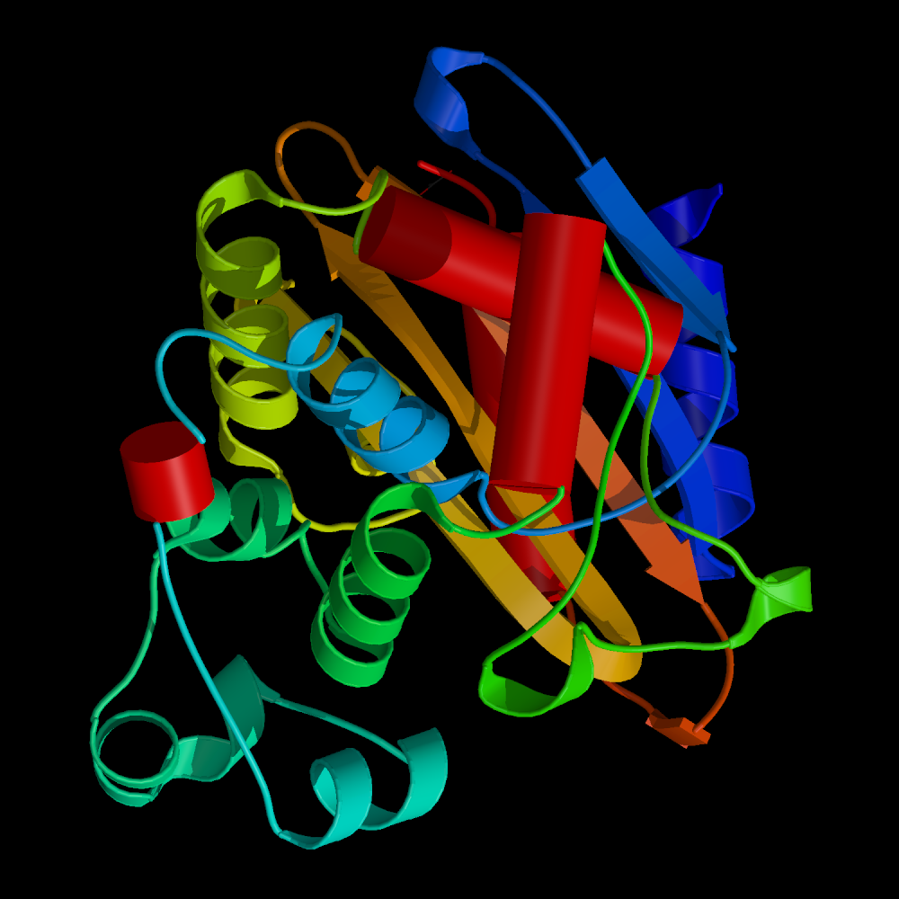

Slide 78
Coiled-Coil Prediction

Slide 79
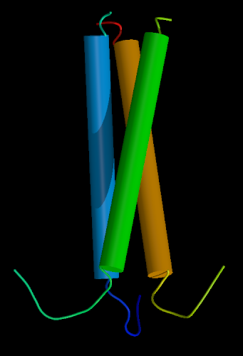
Coiled-coil helices
Intertwined helices form a three-helix bundle
Typical example: keratins, intermediary filament proteins

Slide 80
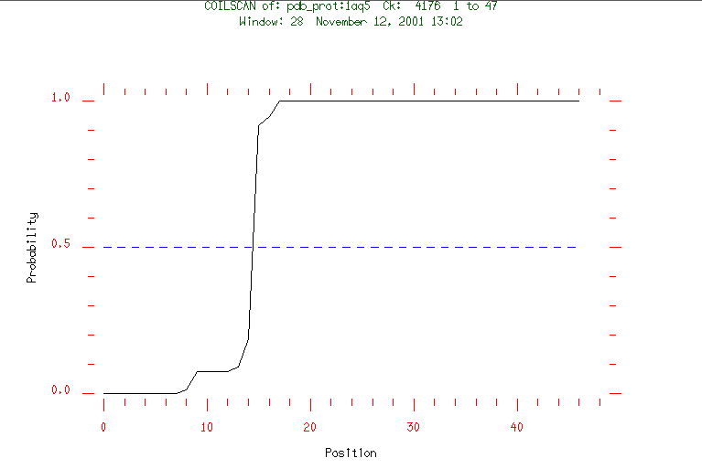

Slide 81
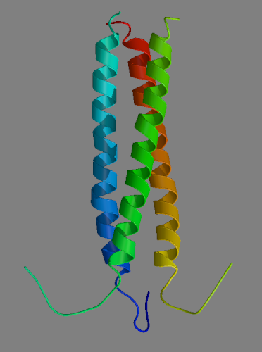
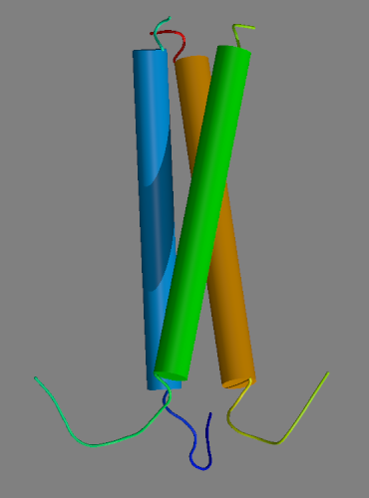
Coiled-coil Prediction
PDB:1AQ5
Chicken cartilage matrix protein

Slide 82
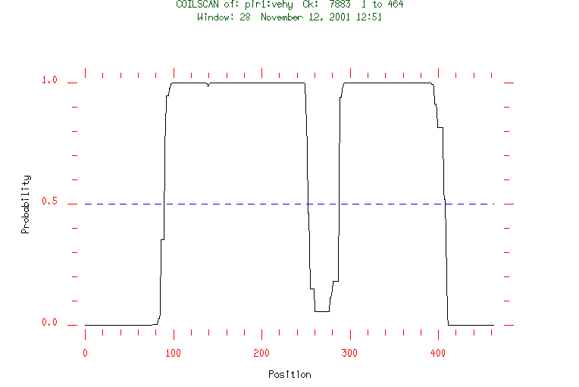
Intermediate Filament Proteins

