Slide 1
Sequence Formats:
FASTA, FASTQ
PHRED Scores coded as ASCII Characters
Notes:
A consideration of those Sequence Formats and Base Call Quality issues that are prerequisite for understanding High Throughput Sequencing (HTS).

Slide 2
Part 1 of 2
Sequence Formats: FASTA and FASTQ
Notes:
A consideration of those Sequence Formats and Base Call Quality issues that are prerequisite for understanding High Throughput Sequencing (HTS).

Slide 3
FASTA Sequence format
White Space (Space or Tab)
>
Sequence_Name_1
Sequence Annotation … … … … … … …
MDSKGSSQKGSRLLLLLVVSNLLLCQGVVSTPVCPNGPGNCQVSLRDLFDRAVMVSHYIHDLSS EMFNEFDKRYAQGKGFITMALNSCHTSSLPTPEDKEQAQQTHHEVLMSLILGLLRSWNDPLYHL VTEVRGMKGAPDAILSRAIEIEEENKRLLEGMEMIFGQVIPGAKETEPYPVWSGLPSLQTKDED ARYSAFYNLLHCLRRDSSKIDTYLKLLNCRIIYNNNC
>
Sequence_Name_2
Sequence Annotation … … … … … … …
ADQLTEEQIAEFKEAFSLFDKDGDGTITTKELGTVMRSLGQNPTEAELQDMINEVDADGNGTID FPEFLTMMARKMKDTDSEEEIREAFRVFDKDGNGYISAAELRHVMTNLGEKLTDEEVDEMIREA DIDGDGQVNYEEFVQMMTAK
>
Sequence_Name_3
Sequence Annotation … … … … … … …
LCLYTHIGRNIYYGSYLYSETWNTGIMLLLITMATAFMGYVLPWGQMSFWGATVITNLFSAIPY
IGTNLVEWIWGGFSVDKATLNRFFAFHFILPFTMVALAGVHLTFLHETGSNNPLGLTSDSDKIP
FHPYYTIKDFLGLLILILLLLLLALLSPDMLGDPDNHMPADPLNTPLHIKPEWYFLFAYAILRS
VPNKLGGVLALFLSIVILYGLMPFLHTSKHRSMMLRPLSQALFWTLTMDLLTLTWIGSQPVEYP
YTIIGQMASILYFSIILAFLPIAGXIENY
Notes:
FASTA is the most common Format for representing sequences in a file.
Each sequence starts with a Comment Line starting with a “greater than” character (‘>’)
The first item on this line is taken to be the Identifier for the stored sequence.
The Identifier is terminated by a White Space Character (Space or Tab)
The rest of the Line is taken to be Sequence Annotation.
After the initial Comment Line comes the Sequence itself, occupying one or more lines.
A single FASTA File may contain many FASTA Sequences. The end of one FASTA Sequence and the start of another is easily determined by the presence of a new Comment Line beginning with a ‘>’.

Slide 4
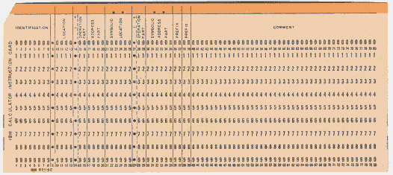
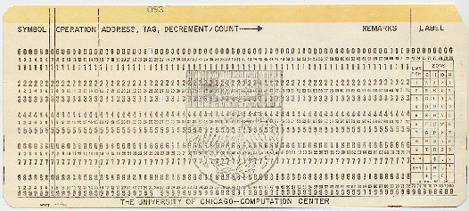
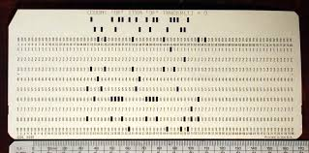
FASTA Sequence format
>
Sequence_Name_1
Sequence Annotation … … … … … … …
MDSKGSSQKGSRLLLLLVVSNLLLCQGVVSTPVCPNGPGNCQVSLRDLFDRAVMVSHYIHDLSS EMFNEFDKRYAQGKGFITMALNSCHTSSLPTPEDKEQAQQTHHEVLMSLILGLLRSWNDPLYHL VTEVRGMKGAPDAILSRAIEIEEENKRLLEGMEMIFGQVIPGAKETEPYPVWSGLPSLQTKDED ARYSAFYNLLHCLRRDSSKIDTYLKLLNCRIIYNNNC
>
Sequence_Name_2
Sequence Annotation … … … … … … …
ADQLTEEQIAEFKEAFSLFDKDGDGTITTKELGTVMRSLGQNPTEAELQDMINEVDADGNGTID FPEFLTMMARKMKDTDSEEEIREAFRVFDKDGNGYISAAELRHVMTNLGEKLTDEEVDEMIREA DIDGDGQVNYEEFVQMMTAK
>
Sequence_Name_3
Sequence Annotation … … … … … … …
LCLYTHIGRNIYYGSYLYSETWNTGIMLLLITMATAFMGYVLPWGQMSFWGATVITNLFSAIPY
IGTNLVEWIWGGFSVDKATLNRFFAFHFILPFTMVALAGVHLTFLHETGSNNPLGLTSDSDKIP
FHPYYTIKDFLGLLILILLLLLLALLSPDMLGDPDNHMPADPLNTPLHIKPEWYFLFAYAILRS
VPNKLGGVLALFLSIVILYGLMPFLHTSKHRSMMLRPLSQALFWTLTMDLLTLTWIGSQPVEYP
YTIIGQMASILYFSIILAFLPIAGXIENY
Notes:
Slight variants of FASTA Format have existed over the many years that the format has been prominent.
Some reflect restriction imposed by the limitations of Punched Cards. For example, some software would think it reasonable to “Stop reading after 80 characters”, after all, more than 80 could never fit on a standard Punched Card!
Remember Punched Cards? I do hope not! My mother told me of them long long ago.
Now, anything that vaguely follows the rules outlined above will work fine.

Slide 5
FASTA Sequence format
FASTA Sequence format
FASTA Sequence format
FASTQ Sequence format
>
Sequence_Name_1
Sequence Annotation … … … … … … …
CCGCTAGCTGGGGTATCATCAGCATGCATGGCATGAGCGTTCTTAATTCTCAGGGACTCGGAGC
AGGGCATGCAGGGAATTCGACGTTCAGGCGATTTACTTCGGCATGCATTGCGGCATTATATCGA
CTGTAGCTGACTGACTGGAGTATTAGCGCGAAAGGTCTATTTATTCTGGAGGGGCAGGTGTTCC
ACGGCATATCGGGACTATCTAACCCTCCTAGAAGTTC
MDSKGSSQKGSRLLLLLVVSNLLLCQGVVSTPVCPNGPGNCQVSLRDLFDRAVMVSHYIHDLSS EMFNEFDKRYAQGKGFITMALNSCHTSSLPTPEDKEQAQQTHHEVLMSLILGLLRSWNDPLYHL VTEVRGMKGAPDAILSRAIEIEEENKRLLEGMEMIFGQVIPGAKETEPYPVWSGLPSLQTKDED ARYSAFYNLLHCLRRDSSKIDTYLKLLNCRIIYNNNC
……………… …… ……………….X
>
Sequence_Name_2
Sequence Annotation … … … … … … …
FASTA Format is designed to store DNA, RNA, Protein Sequences with minimal Annotation.
ADQLTEEQIAEFKEAFSLFDKDGDGTITTKELGTVMRSLGQNPTEAELQDMINEVDADGNGTID FPEFLTMMARKMKDTDSEEEIREAFRVFDKDGNGYISAAELRHVMTNLGEKLTDEEVDEMIREA DIDGDGQVNYEEFVQMMTAK
Allowing DNA & Protein Ambiguity Codes, can make it difficult to ascertain Sequence Type.
>
Sequence_Name_3
Sequence Annotation … … … … … … …
Sequence Type is not specified in the FASTA format. Distinction is left to the software.
LCLYTHIGRNIYYGSYLYSETWNTGIMLLLITMATAFMGYVLPWGQMSFWGATVITNLFSAIPY
IGTNLVEWIWGGFSVDKATLNRFFAFHFILPFTMVALAGVHLTFLHETGSNNPLGLTSDSDKIP
FHPYYTIKDFLGLLILILLLLLLALLSPDMLGDPDNHMPADPLNTPLHIKPEWYFLFAYAILRS
VPNKLGGVLALFLSIVILYGLMPFLHTSKHRSMMLRPLSQALFWTLTMDLLTLTWIGSQPVEYP
YTIIGQMASILYFSIILAFLPIAGXIENY
FASTQ Format is an adaptation designed to store Sequencing Reads with minimal Annotation.
Each sequence in a FASTQ file is always the that of a single Sequencing Read.
Thus it can only ever be DNA sequence.
Notes:
FASTA Format is used to store all types of sequence data with minimal Annotation.
Where either DNA or Protein Ambiguity Codes are used, it is often impossible to determine, with certainty, the type of the sequence.
The type of sequence is not specified by FASTA Format, rather it is determined by context or by the software reading the sequences.
FASTQ Format is adapted from FASTA Format to store Sequencing Reads
Clearly FASTQ Format is therefore only used for storing DNA Sequence, with minimal Annotation.

Slide 6
FASTQ Sequence format
>
@
Sequence_Name_1
Sequence Annotation … … … … … … …
CCGCTAGCTGGGGTATCATCAGCATGCATGGCATGAGCGTTCTTAATTCTCAGGGACTCGGAGC
AGGGCATGCAGGGAATTCGACGTTCAGGCGATTTACTTCGGCATGCATTGCGGCATTATATCGA
CTGTAGCTGACTGACTGGAGTATTAGCGCGAAAGGTCTATTTATTCTGGAGGGGCAGGTGTTCC
ACGGCATATCGGGACTATCTAACCCTCCTAGAAGTTC
CCGCTAGCTGGGGTATCATCAGCATGCATGGCATGAGCGTTCTTAATTCTCAGGGACTCGGAGCAGGGCATCGAG …
+
MORE Sequence Annotation … … … … … … … … … … …
The transition from FASTA to FASTQ Format includes a couple of cosmetic “enhancements”:
The initial “>” becomes an “@”
An extra Annotation line beginning with a “+” is added.
The opportunity to include Annotation in this line is rarely used.
Currently, as the length of an individual read is modest, sequences occupy just a single line.
Notes:
In a FASTQ Format file, each new Sequencing Read is introduced by a line starting with a ‘@’ character (playing the same role as the ‘>’ character in a FASTA Format file).

Slide 7
FASTQ Sequence format
>
@
Sequence_Name_1
Sequence Annotation … … … … … … …
CCGCTAGCTGGGGTATCATCAGCATGCATGGCATGAGCGTTCTTAATTCTCAGGGACTCGGAGC
AGGGCATGCAGGGAATTCGACGTTCAGGCGATTTACTTCGGCATGCATTGCGGCATTATATCGA
CTGTAGCTGACTGACTGGAGTATTAGCGCGAAAGGTCTATTTATTCTGGAGGGGCAGGTGTTCC
ACGGCATATCGGGACTATCTAACCCTCCTAGAAGTTC
CCGCTAGCTGGGGTATCATCAGCATGCATGGCATGAGCGTTCTTAATTCTCAGGGACTCGGAGCAGGGCATCGAG …
+
!''*((((***+))%%%++)(%%%%).1***-+*''))**55CCF>>>>>>CCCCCCC655676CCGLN695KP4 …
!''*((((***+))%%%++)(%%%%).1***-+*''))**55CCF>>>>>>CCCCCCC655676CCGLN695KP4 …
The Q in FASTQ stands for Quality. A definitive purpose of the FASTQ Format is to record the Base Call Quality of each element of a Sequencing Read.
Base Call Qualities are recorded in a fourth line of the FASTQ file. Each Base Call Quality is recorded as a single printable character. Each Quality character corresponds to one Called Base.

Slide 8
FASTQ Sequence format
>
@
Sequence_Name_1
Sequence Annotation … … … … … … …
CCGCTAGCTGGGGTATCATCAGCATGCATGGCATGAGCGTTCTTAATTCTCAGGGACTCGGAGCAGGGCA
TCGAGCGATCAGCTGCATGACTGCATCAGCTGCGCATATGCGATCGGATTCGAGGGCTATGCATGCATGA
TTTCAGCATCATTCAGAGCGGACTTTACGCATCGAGCTTACACACATGCATGCATTGGTGACCTGACTGG
CCGCTAGCTGGGGTATCATCAGCATGCATGGCATGAGCGTTCTTAATTCTCAGGGACTCGGAGCAGGGCATCGAG …
+
CGCGGCGGCGGCATTGGACTTACTGCATCGATGCATCAGTTGTGATCCAGCATGCATGCATGCGATCGA
!''*((((***+))%%%++)(%%%%).1***-+*''))**55CCF>>>>>>CCCCCCC655676CCGLN695KP4 …
+
Spurious Start of new read
!''*((((***+))%%%++)(%%%%).1***-+*''))**55CCF>>>>>>CCCCCCC655676CCGLN6
@5KP455CCF>>%%%%%++)5676CCGL'*((((***+)118477GAAADVV++BBDAGGH7GGC9%%%)
ACGGTA(HG48**(@@HIA90%%++)(%>>>>>>CCJJAS!!!!)(^++K’’``’ ''*(''*(LK*&TT
+F9RSA;;::ACV6^7&&&3£22”(1!DFGH(((((<<<<%++)(%%%%).1* HIA90%%++)(%>>>
Spurious Annotation line
Spurious Read Sequence
Most printable characters, including “@” and “+” are allowable Base Call Quality codes.
Multiple line sequences could introduce Base Call Quality lines beginning with “@” or “+”.
Such lines could be misinterpreted as: “@” - The start of a new Sequencing Read,
“+” - An additional Annotation line.

Slide 9
FASTQ Sequence format
>
@
Sequence_Name_1
Sequence Annotation … … … … … … …
CCGCTAGCTGGGGTATCATCAGCATGCATGGCATGAGCGTTCTTAATTCTCAGGGACTCGGAGCAGGGCATCGAG …
+
!''*((((***+))%%%++)(%%%%).1***-+*''))**55CCF>>>>>>CCCCCCC655676CCGLN695KP4 …
>
@
Sequence_Name_2
Sequence Annotation … … … … … … …
CCGCTAGCTGGGGTATCATCAGCATGCATGGCATGAGCGTTCTTAATTCTCAGGGACTCGGAGCAGGGCATCGAG …
+
(**-+((***+))%>>CCCC!CCC655676CCGL!''*(N695KP4%%++)(%%%).1**''))**55CCF>>>> …
>
@
Sequence_Name_3
Sequence Annotation … … … … … … …
CATGAGCGTCAGCATGCATGGTCGGAGCAGGGCATCGAGTCTTAATTCTCAGGGACCCGCTAGCTGGGGTATCAT …
+
***-+*''))**55CCF>>FF>>!''*((((***+))%1CCACC%%++)(%%%).CCC655676CCGLN695KP4 …
To avoid this, even longer Read Sequences are confined to one line.

Slide 10
Enough! Take a break ….
If and when you feel strong enough, proceed to:
Part 2 of 2:
PHRED Scores coded as ASCII Characters

Slide 11
Sequence Formats:
FASTA, FASTQ
PHRED Scores coded as ASCII Characters
Notes:
A consideration of those Sequence Formats and Base Call Quality issues that are prerequisite for understanding High Throughput Sequencing (HTS).

Slide 12
Part 2 of 2
PHRED Scores coded as ASCII Characters
Notes:
A consideration of those Sequence Formats and Base Call Quality issues that are prerequisite for understanding High Throughput Sequencing (HTS).

Slide 13
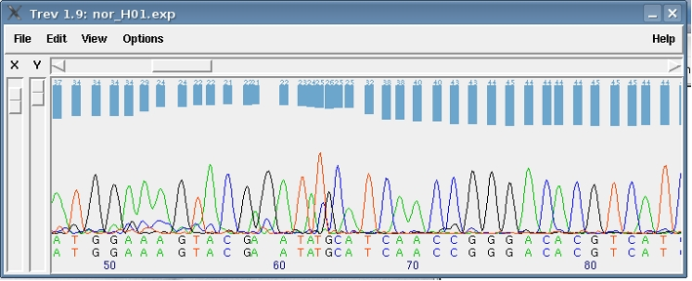
FASTQ Sequence format
Base Quality ( PHRED) Scores
With every Base Call, sequencing hardware generates a quality estimate (P)
P represents the Probability of the Base Call being incorrect
For each Base Call , 4 signals representing the possibilities of each possible Base Value are generated
The value of P for a given Base Call reflects the clarity of associated signals
Unclear signal
High P values
Clear signal
Low P values
Notes:
A quality estimate, for each Base Call, is generated by the sequencing hardware.
This is generally in the form of a “Probability of Error”. That is, the probability that the Base Call is wrong.
Typically, the sequencing hardware will generate four signals indicating the independent likelihoods of each possible base.
The base called will be the one with the clearest signal.
Where the choice of Base Call is obvious, the Probability of Error will be low.
Where the signals are in significant conflict, the Probability of Error will be high.
The illustration shows ABI traces from an old Sanger Sequencing project, but the principle is consistent with more recent technologies.

Slide 14
Base Quality ( PHRED) Scores
rrrrrrrrrrrrrrrr
Notes:
The sequencers provide a Probability of Error (P).
What is really required is an Error Rate. That is, a statement of what proportion of Base Calls of this quality will be wrong (for example, 1 in 100, 1 in 100).
Mapping P onto an exponential scale of Error Rate (1 in 10, 1 in 100, 1 in 1000 … ) is semi-logarithmic.
The range of interesting Error Rates (1 in 10 to 1 in 10000, broadly) corresponds to only a small range of P values (0.1 to 0.0001 approximately).
A linear relationship, with an evenly distributed and expanded range of values (-1 to -4), can be achieved by using Log₁₀(P), rather than P.
Negative values can be eliminated by replacing Log₁₀(P) by -1 * Log₁₀(P).
To increase the resolution of the mapping such that it is only necessary to consider Integer values from the Horizontal Axis, simply replace -1 * Log₁₀(P) by -10 * Log₁₀(P).
And so you arrive at the PHRED Score (Q, by convention) via a consideration of the logic behind its formulation.
Q = -10 * Log₁₀(P)

Slide 15
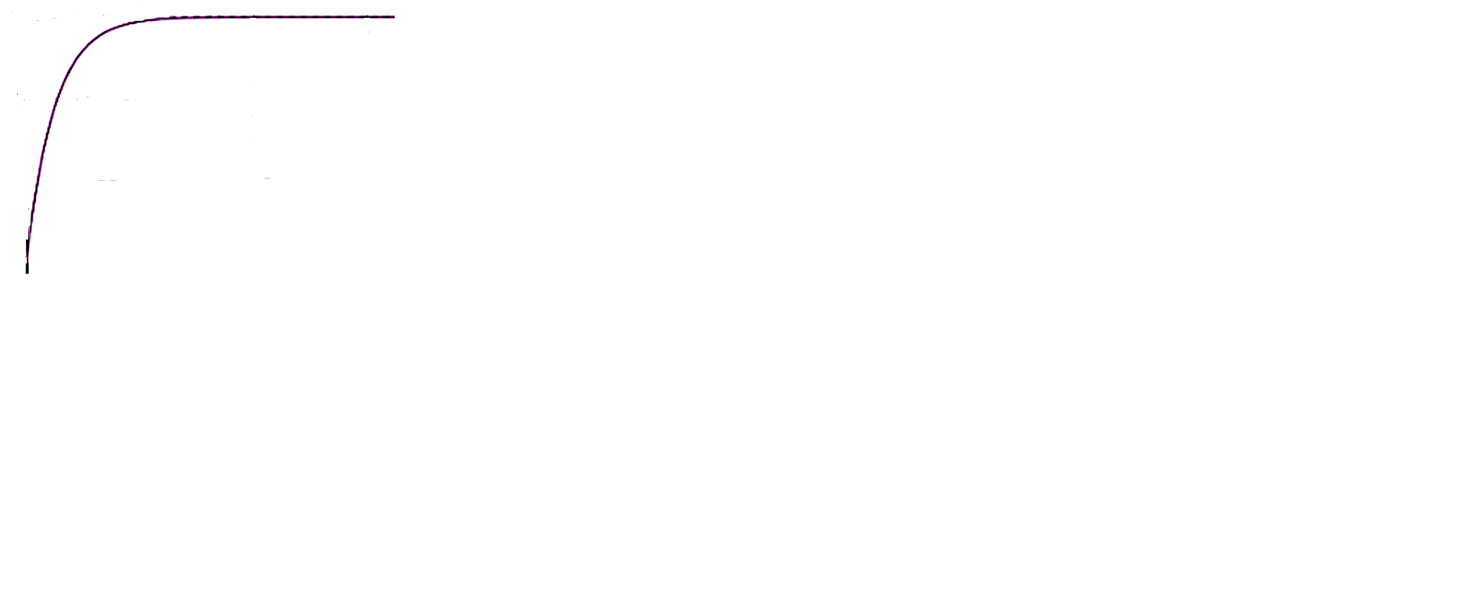
Base Quality ( PHRED) Scores
1 in 1--
1 in 10--
Base Call Error Rate
1 in 100--
1 in 1,000--
|
0.0
|
0.1
|
0.2
|
0.3
|
0.4
|
0.5
|
0.6
|
0.7
|
0.8
|
0.9
|
1.0
Probability of incorrect Base Call (P)

Slide 16
Base Quality ( PHRED) Scores
The Base Quality Scores in FASTQ files are PHRED Scores.
The PHRED Score for a given Base Call is derived from an estimate of the Probability of that Base being Called incorrectly
Where Q is the PHRED Score for a given Base Call and P is the estimated Probability of Error for that Base Call, the following formula applies:
Q = -10 * log₁₀(P)
P is a Probability and so has Range 0 → 1
Q is a function of P that has Range 0 → infinity.

Slide 17
Base Quality ( PHRED) Scores
Base Call
Error Rate
Probability of
Incorrect Call
(P)
Log₁₀(P)
PHRED Score
Q = -10Log₁₀(P)
PHRED Scores can be intuitively thought of as directly representing various Error Rates.
1 in 1
1 in 10
1 in 100
1 in 1000
1 in 10,000
1 in 100,000
1 in 1,000,000
1 in 10,000,000
…
0
1
0.1
0.01
0.001
0.0001
0.00001
0.000001
0.0000001
…
0.00
0
-1
-2
-3
-4
-5
-6
-7
…
-infinity
00
10
20
30
40
50
60
70
…
infinity
Q is a function of P that has Range 0 → infinity. and easily represents a useful subset of P Values, to an adequate accuracy, as a Two Digit Integer.

Slide 18
Base Quality ( PHRED) Scores
Base Call
Error Rate
PHRED Score
Q = -10Log₁₀(P)
PHRED Scores can be intuitively thought of as directly representing various Error Rates.
An Error Rate worse than 1 in 100 (PHRED = 20) is usually considered a disaster!
1 in 1
1 in 10
1 in 100
1 in 1000
1 in 10,000
1 in 100,000
1 in 1,000,000
1 in 10,000,000
…
0
00
10
20
30
40
50
60
70
…
infinity
Anything better than 1 in 10,000 (PHRED = 40) is usually considered as near perfect as makes no difference.
Achieving a Consensus PHRED Score of 30 (1 in 1000) is a common target for an Assembly of Reads.

Slide 19
Base Quality ( PHRED) Scores
>
@
Sequence_Name_1
Sequence Annotation … … … … … … …
CCGCTAGCTGGGGTATCATCAGCATGCATGGCATGAGCGTTCTTAATTCTCAGGGACTCGGAGCAGGGCATCGAG …
+
!''*((((***+))%%%++)(%%%%).1***-+*''))**55CCF>>>>>>CCCCCCC655676CCGLN695KP4 …
The Problem
Ideally at least, each base in a FASTQ file should correspond with one, two digit PHRED Score, represented as a Single Character.

Slide 20
Base Quality ( PHRED) Scores
>
@
Sequence_Name_1
Sequence Annotation … … … … … … …
CCGCTAGCTGGGGTATCATCAGCATGCATGGCATGAGCGTTCTTAATTCTCAGGGACTCGGAGCAGGGCATCGAG …
+
!''*((((***+))%%%++)(%%%%).1***-+*''))**55CCF>>>>>>CCCCCCC655676CCGLN695KP4 …
The Solution
Is to map the two digit Phred Scores onto a single element of the ASCII Character Set.

Slide 21
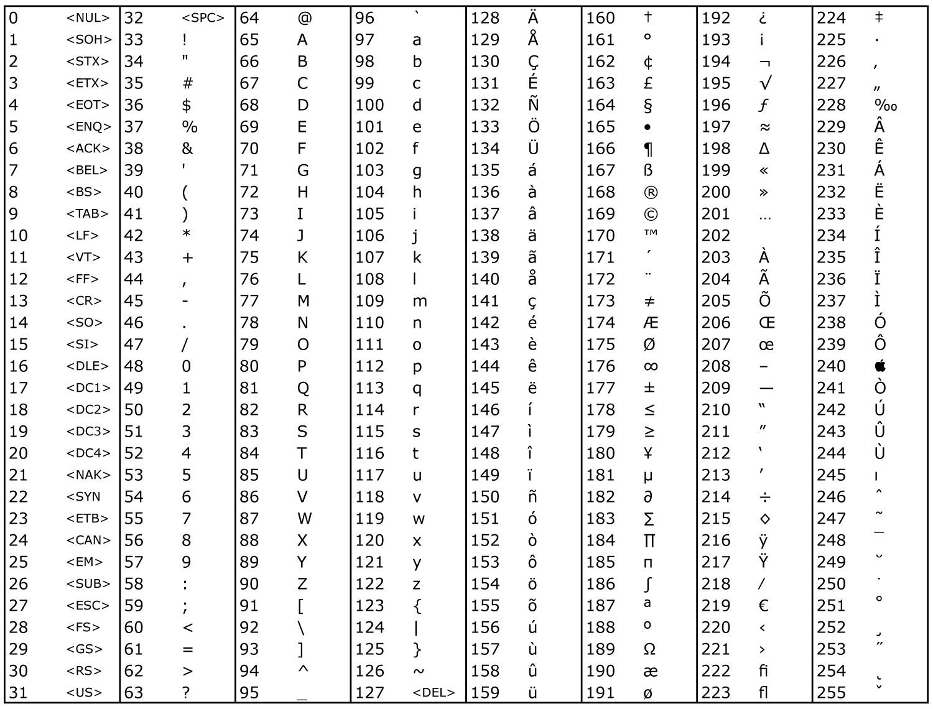
Base Quality ( PHRED) Scores
The ASCII Character Codes are Stable and Universally Accepted.
They provide a mapping of the integers 000 → 255 to a set of Individual Characters.
Not all of these characters are visibly printable. Specifically, 00 → 31 are not printable.
32 is printable, but not visible (it is a Space).
33 → 126 are all printable however, and could be used to represent the PHRED Scores 00 → 93 nicely. More than sufficient for practical purposes.

Slide 22
Base Quality ( PHRED) Scores
>
@
Sequence_Name_1
Sequence Annotation … … … … … … …
CCGCTAGCTGGGGTATCATCAGCATGCATGGCATGAGCGTTCTTAATTCTCAGGGACTCGGAGCAGGGCATCGAG …
+
!''*((((***+))%%%++)(%%%%).1***-+*''))**55CCF>>>>>>CCCCCCC655676CCGLN695KP4 …
ASCII Codes →
42
70
62
53
78
PHRED Scores→
09
37
29
20
45
Thus it is ASCII Codes that represent the Base Call Qualities (PHRED Scores) in FASTQ files.
To compute the PHRED Score from the ASCII Character, simply look up the ASCII Code and SUBTRACT 33.

Slide 23
Base Quality ( PHRED) Scores
A Warning
Long ago … the Sanger Centre coded PHRED Scores starting from ASCII Code 64 (@).
Should you across any of this older data that has not been updated to reflect the current standards, you will need to instruct the software to subtract 64 instead of 33 in order to compute the PHRED Score from the ASCII Code.

Slide 24
TO DO:
Explain phred formula better:
Log -> exponential to linear
10 -> expand range to avoid floating point
-1 -> allow unsigned integer
Add more Notes
Make video

