Slide 1
FASTA Sequence format
White Space (Space or Tab)
>
Sequence_Name_1
Sequence Annotation … … … … … … …
MDSKGSSQKGSRLLLLLVVSNLLLCQGVVSTPVCPNGPGNCQVSLRDLFDRAVMVSHYIHDLSS EMFNEFDKRYAQGKGFITMALNSCHTSSLPTPEDKEQAQQTHHEVLMSLILGLLRSWNDPLYHL VTEVRGMKGAPDAILSRAIEIEEENKRLLEGMEMIFGQVIPGAKETEPYPVWSGLPSLQTKDED ARYSAFYNLLHCLRRDSSKIDTYLKLLNCRIIYNNNC
>
Sequence_Name_2
Sequence Annotation … … … … … … …
ADQLTEEQIAEFKEAFSLFDKDGDGTITTKELGTVMRSLGQNPTEAELQDMINEVDADGNGTID FPEFLTMMARKMKDTDSEEEIREAFRVFDKDGNGYISAAELRHVMTNLGEKLTDEEVDEMIREA DIDGDGQVNYEEFVQMMTAK
>
Sequence_Name_3
Sequence Annotation … … … … … … …
LCLYTHIGRNIYYGSYLYSETWNTGIMLLLITMATAFMGYVLPWGQMSFWGATVITNLFSAIPY
IGTNLVEWIWGGFSVDKATLNRFFAFHFILPFTMVALAGVHLTFLHETGSNNPLGLTSDSDKIP
FHPYYTIKDFLGLLILILLLLLLALLSPDMLGDPDNHMPADPLNTPLHIKPEWYFLFAYAILRS
VPNKLGGVLALFLSIVILYGLMPFLHTSKHRSMMLRPLSQALFWTLTMDLLTLTWIGSQPVEYP
YTIIGQMASILYFSIILAFLPIAGXIENY

Slide 2
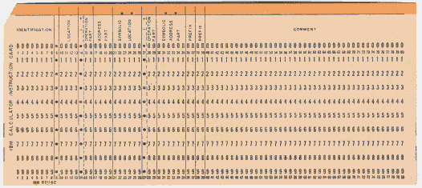
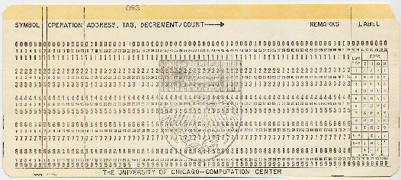
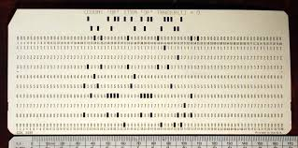
FASTQ Sequence format
FASTA Sequence format
>
Sequence_Name_1
Sequence Annotation … … … … … … …
MDSKGSSQKGSRLLLLLVVSNLLLCQGVVSTPVCPNGPGNCQVSLRDLFDRAVMVSHYIHDLSS EMFNEFDKRYAQGKGFITMALNSCHTSSLPTPEDKEQAQQTHHEVLMSLILGLLRSWNDPLYHL VTEVRGMKGAPDAILSRAIEIEEENKRLLEGMEMIFGQVIPGAKETEPYPVWSGLPSLQTKDED ARYSAFYNLLHCLRRDSSKIDTYLKLLNCRIIYNNNC
>
Sequence_Name_2
Sequence Annotation … … … … … … …
ADQLTEEQIAEFKEAFSLFDKDGDGTITTKELGTVMRSLGQNPTEAELQDMINEVDADGNGTID FPEFLTMMARKMKDTDSEEEIREAFRVFDKDGNGYISAAELRHVMTNLGEKLTDEEVDEMIREA DIDGDGQVNYEEFVQMMTAK
>
Sequence_Name_3
Sequence Annotation … … … … … … …
LCLYTHIGRNIYYGSYLYSETWNTGIMLLLITMATAFMGYVLPWGQMSFWGATVITNLFSAIPY
IGTNLVEWIWGGFSVDKATLNRFFAFHFILPFTMVALAGVHLTFLHETGSNNPLGLTSDSDKIP
FHPYYTIKDFLGLLILILLLLLLALLSPDMLGDPDNHMPADPLNTPLHIKPEWYFLFAYAILRS
VPNKLGGVLALFLSIVILYGLMPFLHTSKHRSMMLRPLSQALFWTLTMDLLTLTWIGSQPVEYP
YTIIGQMASILYFSIILAFLPIAGXIENY

Slide 3
FASTQ Sequence format
>
@
Sequence_Name_1
Sequence Annotation … … … … … … …
MDSKGSSQKGSRLLLLLVVSNLLLCQGVVSTPVCPNGPGNCQVSLRDLFDRAVMVSHYIHDLSS EMFNEFDKRYAQGKGFITMALNSCHTSSLPTPEDKEQAQQTHHEVLMSLILGLLRSWNDPLYHL VTEVRGMKGAPDAILSRAIEIEEENKRLLEGMEMIFGQVIPGAKETEPYPVWSGLPSLQTKDED ARYSAFYNLLHCLRRDSSKIDTYLKLLNCRIIYNNNC
+
MORE Sequence Annotation … … … … … … … … … … …
FASTA Format is designed to store DNA, RNA, Protein Sequences with minimal Annotation.
FASTQ Format is an adaptation designed to store Sequencing Reads with minimal Annotation.
The transition from FASTA to FASTQ Format includes a couple of cosmetic “enhancements”:
The initial “>” becomes an “@”
An extra Annotation line beginning with a “+” is added.
The opportunity to include Annotation in this line is rarely used.

Slide 4
FASTQ Sequence format
>
@
Sequence_Name_1
Sequence Annotation … … … … … … …
CCGCTAGCTGGGGTATCATCAGCATGCATGGCATGAGCGTTCTTAATTCTCAGGGACTCGGAGC
AGGGCATGCAGGGAATTCGACGTTCAGGCGATTTACTTCGGCATGCATTGCGGCATTATATCGA
CTGTAGCTGACTGACTGGAGTATTAGCGCGAAAGGTCTATTTATTCTGGAGGGGCAGGTGTTCC
ACGGCATATCGGGACTATCTAACCCTCCTAGAAGTTC
CCGCTAGCTGGGGTATCATCAGCATGCATGGCATGAGCGTTCTTAATTCTCAGGGACTCGGAGCAGGGCATCGAG …
MDSKGSSQKGSRLLLLLVVSNLLLCQGVVSTPVCPNGPGNCQVSLRDLFDRAVMVSHYIHDLSS EMFNEFDKRYAQGKGFITMALNSCHTSSLPTPEDKEQAQQTHHEVLMSLILGLLRSWNDPLYHL VTEVRGMKGAPDAILSRAIEIEEENKRLLEGMEMIFGQVIPGAKETEPYPVWSGLPSLQTKDED ARYSAFYNLLHCLRRDSSKIDTYLKLLNCRIIYNNNC
+
Sequences in a FASTA file can be DNA, RNA or Protein.
Allowing DNA & Protein Ambiguity Codes, makes it difficult to ascertain Sequence Type.
Sequence Type is not specified in the FASTA format. Distinction is left to the software.
Each sequence in a FASTQ file is always the that of a single Sequencing Read.
Thus it can only ever be DNA sequence.
Currently, the length of an individual read is modest. Generally, the sequence will be entirely contained in a single line.

Slide 5
FASTQ Sequence format
>
@
Sequence_Name_1
Sequence Annotation … … … … … … …
CCGCTAGCTGGGGTATCATCAGCATGCATGGCATGAGCGTTCTTAATTCTCAGGGACTCGGAGCAGGGCATCGAG …
+
!''*((((***+))%%%++)(%%%%).1***-+*''))**55CCF>>>>>>CCCCCCC655676CCGLN695KP4 …
The Q in FASTQ stands for Quality. A definitive purpose of the FASTQ Format is to record the Base Call Quality of each element of a Sequencing Read.
Base Call Qualities are recorded in a fourth line of the FASTQ file. Each Base Call Quality is recorded as a single printable character. Each Quality character corresponds to one Called Base.
Currently, the length of an individual read is modest. Generally, the sequence will be entirely contained in a single line.

