Slide 1
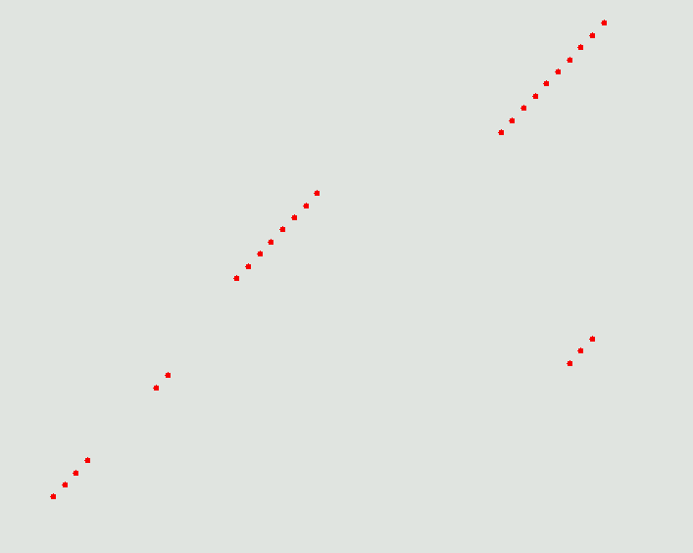
Graphical comparison of sequences using “Dotplots”.
Basic Principles.
A “word size” (11 say)
Diagonal runs of dots indicate similar regions
A “Scoring scheme”
(1 for a match,
0 for a mismatch, say)
a
A T G C
A 1 0 0 0
T 0 1 0 0
G 0 0 1 0
C 0 0 0 1
l
ATGCTTATAGG
1+1+1+1+1+1+0+1+0+1+1=9
ACCTGCCCTGTCCAGCTTACATGCATGCTTATAGGGGCATTTTACAT
Summary: Dotplots provide a comprehensive overview but NO detail.
A “Cut-off score” (8 say)
ACCTGCCGATTCCATATTACGCATGCTTCTGGGTTACCGTTCAGGGCATTTTACATGTGCTG
ATGCTTCTGGG
Notes:
Dotplots: Basic Principles:
A dotplot provides a graphical comparison of two sequences (protein or DNA, the illustration will be DNA)
First consider the sequences to be compared written out along Cartesian axes.
These sequences will be compared in fixed length sections (“words”, of 11 base pairs, say).
Each word from the horizontal sequence is compared with each word of the vertical sequence.
Words are compared by considering corresponding residues.
Using a scoring scheme (+1 for a matched pair of bases, 0 for a mismatched pair, say), a similarity score is computed for each pair of compared words.
Significant similarity is defined by the selection of a cut-off score (8, say, indicating 8 or more matched bases between words of size 11 to be significant).
Significantly matching pairs of words are indicated by drawing a dot in a position representing the middles of the matched words.
Once all possible words of the horizontal sequence have been compared to all possible words of the vertical sequence, a number of dots should have been plotted.
Roughly diagonal runs of dots indicate roughly similar regions in the two sequences being compared.
Dotplots provide a comprehensive overview, however, textual alignments are required to examine sequence similarities in detail.

Slide 2
Graphical comparison of sequences using “Dotplots”.
Scoring Schemes.
A T G C
A 1 0 0 0
T 0 1 0 0
G 0 0 1 0
C 0 0 0 1
DNA: Simplest Scheme is the Identity Matrix.
More complex matrices can be used.
For example, the default EMBOSS DNA scoring matrix is:
A T G C
A 5 -4 -4 -4
T -4 5 -4 -4
G -4 -4 5 -4
C -4 -4 -4 5
The use of negative numbers is only pertinent
when these matrices are use for computing
textual alignments.
Using a wider spread of scores eases the
Expansion of the scoring matrix to sensibly
include ambiguity codes.
Notes:
Dotplots: Scoring schemes:
DNA:
DNA sequences are generally compared on the assumption that alphabetically matching bases indicate similarity and alphabetically mismatched bases indicate dissimilarity. This is clearly a simplification, particularly for coding DNA (mismatched bases in codon position 3 will often have identical “meaning” for example). Nevertheless, this assumption requires only the simplest of scoring schemes (e.g. 1 point for each matched pair of bases, 0 for each mismatched pair of bases).
Many packages use marginally more complex scoring schemes. For example, the default DNA scoring scheme for the EMBOSS package scores +5 for each matched pair of bases and -4 for each mismatched pair of bases.
The same scoring schemes are used by programs computing textual alignments. The use of negative numbers is really an issue for certain of the textual alignment programs (further discussion later).

Slide 3
Graphical comparison of sequences using “Dotplots”.
Scoring Schemes.
A B C D E F G H I K L M N P Q R S T V W Y Z
A 2 0 -2 0 0 -4 1 -1 -1 -1 -2 -1 0 1 0 -2 1 1 0 -6 -3 0
B 0 2 -4 3 2 -5 0 1 -2 1 -3 -2 2 -1 1 -1 0 0 -2 -5 -3 2
C -2 -4 12 -5 -5 -4 -3 -3 -2 -5 -6 -5 -4 -3 -5 -4 0 -2 -2 -8 0 -5
D 0 3 -5 4 3 -6 1 1 -2 0 -4 -3 2 -1 2 -1 0 0 -2 -7 -4 3
E 0 2 -5 3 4 -5 0 1 -2 0 -3 -2 1 -1 2 -1 0 0 -2 -7 -4 3
F -4 -5 -4 -6 -5 9 -5 -2 1 -5 2 0 -4 -5 -5 -4 -3 -3 -1 0 7 -5
G 1 0 -3 1 0 -5 5 -2 -3 -2 -4 -3 0 -1 -1 -3 1 0 -1 -7 -6 -1
H -1 1 -3 1 1 -2 -2 6 -2 0 -2 -2 2 0 3 2 -1 -1 -2 -3 0 2
I -1 -2 -2 -2 -2 1 -3 -2 5 -2 2 2 -2 -2 -2 -2 -1 0 4 -5 -1 -2
K -1 1 -5 0 0 -5 -2 0 -2 5 -3 0 1 -1 1 3 0 0 -2 -3 -4 0
L -2 -3 -6 -4 -3 2 -4 -2 2 -3 6 4 -3 -3 -2 -3 -3 -2 2 -2 -1 -3
M -1 -2 -5 -3 -2 0 -3 -2 2 0 4 6 -2 -2 -1 0 -2 -1 2 -4 -2 -2
N 0 2 -4 2 1 -4 0 2 -2 1 -3 -2 2 -1 1 0 1 0 -2 -4 -2 1
P 1 -1 -3 -1 -1 -5 -1 0 -2 -1 -3 -2 -1 6 0 0 1 0 -1 -6 -5 0
Q 0 1 -5 2 2 -5 -1 3 -2 1 -2 -1 1 0 4 1 -1 -1 -2 -5 -4 3
R -2 -1 -4 -1 -1 -4 -3 2 -2 3 -3 0 0 0 1 6 0 -1 -2 2 -4 0
S 1 0 0 0 0 -3 1 -1 -1 0 -3 -2 1 1 -1 0 2 1 -1 -2 -3 0
T 1 0 -2 0 0 -3 0 -1 0 0 -2 -1 0 0 -1 -1 1 3 0 -5 -3 -1
V 0 -2 -2 -2 -2 -1 -1 -2 4 -2 2 2 -2 -1 -2 -2 -1 0 4 -6 -2 -2
W -6 -5 -8 -7 -7 0 -7 -3 -5 -3 -2 -4 -4 -6 -5 2 -2 -5 -6 17 0 -6
Y -3 -3 0 -4 -4 7 -5 0 -1 -4 -1 -2 -2 -5 -4 -4 -3 -3 -2 0 10 -4
Z 0 2 -5 3 3 -5 -1 2 -2 0 -3 -2 1 0 3 0 0 -1 -2 -6 -4 3
A C G T S W R Y K M B V H D N U
A 5 -4 -4 -4 -4 1 1 -4 -4 1 -4 -1 -1 -1 -2 -4
C -4 5 -4 -4 -4 1 -4 1 1 -4 -1 -4 -1 -1 -2 -4
G -4 -4 5 -4 1 -4 1 -4 1 -4 -1 -1 -4 -1 -2 -4
T -4 -4 -4 5 1 -4 -4 1 -4 1 -1 -1 -1 -4 -2 5
S -4 -4 1 1 -1 -4 -2 -2 -2 -2 -1 -1 -3 -3 -1 -4
W 1 1 -4 -4 -4 -1 -2 -2 -2 -2 -3 -3 -1 -1 -1 1
R 1 -4 1 -4 -2 -2 -1 -4 -2 -2 -3 -1 -3 -1 -1 -4
Y -4 -1 -4 1 -2 -2 -4 -1 -2 -2 -1 -3 -1 -3 -1 1
K -4 1 1 -4 -2 -2 -2 -2 -1 -4 -1 -3 -3 -1 -1 1
M 1 -4 -4 1 -2 -2 -2 -2 -4 -1 -3 -1 -1 -3 -1 -4
B -4 -1 -1 -1 -1 -3 -3 -1 -1 -3 -1 -2 -2 -2 -1 -1
V -1 -4 -1 -1 -1 -3 -1 -3 -3 -1 -2 -1 -2 -2 -1 -4
H -1 -1 -4 -1 -3 -1 -3 -1 -3 -1 -2 -2 -1 -2 -1 -1
D -1 -1 -1 -4 -3 -1 -1 -3 -1 -3 -2 -2 -2 -1 -1 -1
N -2 -2 -2 -2 -1 -1 -1 -1 -1 -1 -1 -1 -1 -1 -1 -2
U -4 -4 -4 5 -4 1 -4 1 1 -4 -1 -4 -1 -1 -2 5
IUB DNA Alphabet
Code Meaning
A
C
G
T/U
M `aMino` A|C
R `puRine` A|G
W `Weak` A|T
S `Strong` C|G
Y `pYrimidine` C|T
K `Keto` G|T
V `not T` A|C|G
H `not G` A|C|T
D `not C` A|G|T
B `not A` C|G|T
N `aNy` A|C|G|T
Using a wider spread of scores eases the
expansion of the scoring matrix to sensibly
include ambiguity codes.
For Protein sequence dotplots more complex scoring schemes are required.
Scores must reflect far more than alphabetic identity.
Notes:
Dotplots: Scoring schemes:
DNA:
Using a wider spread of scores eases the expansion of the scoring matrix to sensibly include ambiguity codes.
All commonly used bioinformatics packages use the IUB DNA alphabet to represent DNA sequences. This alphabet offers a code for every possible ambiguity that could occur in a DNA sequence (see illustration). The full IUB DNA alphabet is particularly useful when representing restriction enzyme cut-sites (where ambiguous positions are the norm) and incompletely sequenced DNA (N being the most commonly employed code in this context).
Providing scoring schemes that allow the use of ambiguity codes is clearly a useful idea. The Emboss example (illustrated) tries to select scores for matches including ambiguities to reflect carefully the statistical probability of a “real” match. Other packages are less precise (e.g. GCG where a match between N and N, which has only a 0.25 probability of representing a “real” match, is scored as if it was a certain match). However, irrespective of the precision with which ambiguity codes are treated in a scoring scheme, comparing DNA sequences that include more a very few ambiguity codes will not work well. Without ambiguity codes there is a 0.25 probability that bases match by chance. Adding too many ambiguities will swiftly increase noise effects to a level beyond which useful comparisons can be expected. The inclusion of ambiguity codes in scoring schemes is to allow the comparison programs to work with sequences that contain a few such codes, not to align sensibly sequences containing many ambiguities.
Protein:
For Protein sequence dotplots more complex scoring schemes are required. Clearly, scores must reflect far more than alphabetic identity. Matched amino acids that are not identical but are known to be similar cannot just be regarded as a “mismatch”.
As will be discussed in full later, the numbers for the most commonly used protein scoring schemes are derived from studies of aligned protein families. They reflect the frequency with which amino acid pairs are observed to successfully substitute for each other and the expected abundance of particular amino acids.

Slide 4
Graphical comparison of sequences using “Dotplots”.
Faster plots for perfect matches.
To detect perfectly matching words, a dotplot program has a choice of strategies
A T G C
A 1 0 0 0
T 0 1 0 0
G 0 0 1 0
C 0 0 0 1
1)
Select a scoring scheme
and a word size (11, say)
For every pair of words, compute a word match score in the normal way
l
If the maximum possible cut-off score (still 11) is not achieved
Only if the maximum possible cut-off score (11) is achieved
ATGCTTATAGG
a
ATGCTTATAGG
r
☹
1+1+1+1+1+1+1+1+1+1+1=11
1+1+1+1+1+1+0+1+0+1+1=9
ATGCTTCTGGG
Celebrate with a dot
ATGCTTCTGGG
Do not celebrate with a dot
Notes:
Faster plots for perfect matches.
If a dotplot is required only to detect words that are identical, it is possible to write code that will produce the dotplot picture much faster than for the general case.
You could, of course, use a scoring scheme, compute a word match score for all word pairs, compare that score to a cut-off score (which would be the maximum score it is possible to obtain).

Slide 5
Graphical comparison of sequences using “Dotplots”.
Faster plots for perfect matches.
To detect perfectly matching words, a dotplot program has a choice of strategies
OR
2)
For every pair of words, ……… see if the letters are exactly the same
l
If they are not
If they are
ATGCTTATAGG
a
ATGCTTATAGG
r
☹
aaaaaaaaaaa
aaaaaararaa
ATGCTTCTGGG
Celebrate with a dot
ATGCTTCTGGG
Do not celebrate with a dot
To detect exactly matching words, fast character string matching can replace
laborious computation of match scores to be compared with a cut-off score
Many packages include a dotplot option specifically for detecting exactly
matching words.
Particular advantage when seeking strong matches in long DNA sequences.
Notes:
Faster plots for perfect matches.
OR
Why not just compare the words as character strings? Computers can do this much much faster than it can compute word match scores and compare them to a cut-off score.
Many packages include a dotplot option specifically for detecting exactly matching words. For example, the program dottup in the EMBOSS package.
Such programs are clearly less versatile the general dotplot programs. However, they are very much faster. This is of particular advantage when looking for strong matches between very long DNA sequences.
Technically, exact word matching can be applied to protein sequences, though it is much less useful. In general, the word size would need to be very small to work at all. Protein sequences are normally not long enough to make the speed gain significant.
Note also that, using normal protein scoring schemes, exact word matching for proteins would not be a special case of a normal dotplot as the maximum word match score is not constant. It is a function of the words being matched.

Slide 6
Graphical comparison of sequences using “Dotplots”.
Dotplot parameters.
There are three parameters to consider for a dotplot:
1) The scoring scheme.
2) The cut-off score.
3) The word size.
Notes:
Dotplot parameters.
Dotplots are very simple. There are only 3 parameters to consider:
1) The scoring scheme.
2) The cut-off score
3) The size of window
Here we will consider each in turn.

Slide 7
Graphical comparison of sequences using “Dotplots”.
Dotplot parameters.
The Scoring scheme.
DNA
Usually, DNA Scoring schemes award a fixed reward for each matched
pair of bases and a fixed penalty for each mismatched pair of bases.
Choosing between such scoring schemes will affect only the choice of
a sensible cut-off score and the way ambiguity codes are treated.
Protein
Protein scoring schemes differ in the evolution distance assumed
between the proteins being compared. The choice is rarely crucial
for dotplot programs.
Notes:
Varying the Scoring scheme
DNA
All commonly used DNA Scoring schemes award a fixed reward for each matched pair of bases and a fixed penalty for each mismatched pair of bases.
Typically, choosing between such scoring schemes would only affect the choice of a sensible cut-off score and, marginally, affect the way ambiguity codes are treated.
Protein
For the protein scoring schemes predominantly used currently, the choice is primarily determined by the estimated evolutionary distance between the two sequences being compared. I would suggest that the choice was rarely crucial for dotplot programs (further discussion later).

Slide 8
Graphical comparison of sequences using “Dotplots”.
Dotplot parameters.
The Cut-off score.
The higher the cut-off score the less dots will be plotted.
But, each dot is more likely to be significant.
The lower the cut-off score the more dots will be plotted.
But, dots are more likely to indicate a chance match (noise).
Notes:
Varying the Cut-off score:
The higher the cut-off score the less dots will be plotted. However, each dot is more likely to be significant.
The lower the cut-off score the more dots will be plotted. However, each dot is more likely to indicate a chance match (i.e. be noise).
There is a dotplot program called dotter (by Eric Sonhammer) that allows the cut-off score to be effectively adjusted dynamically. Dots are plotted for all positions using a grey scale. The lighter the grey, the lower the word match score. The darker the dot, the higher the word match score. The user is able to dynamically adjust the ends of the “grey scale” (i.e. the word match scores represented by white and black). In this way, the dotplot can be viewed with varying cut-off specifications without the requirement of recomputing the plot.

Slide 9
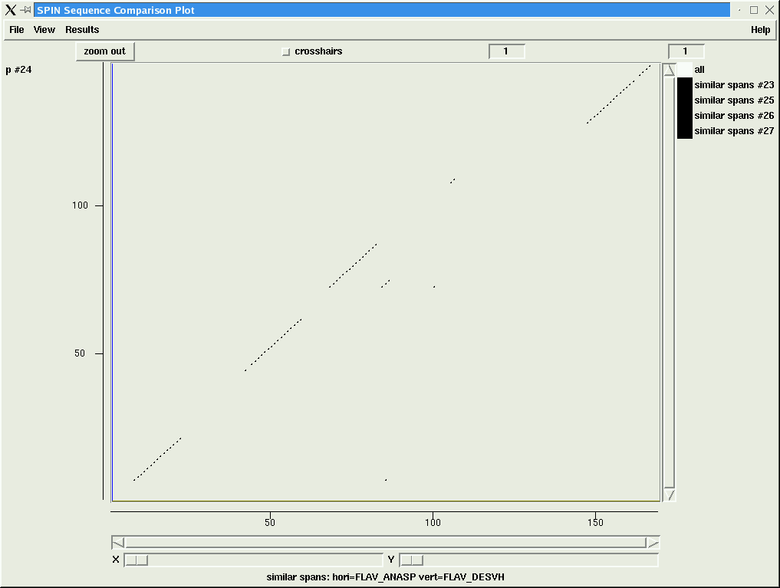



Graphical comparison of sequences using “Dotplots”.
Dotplot parameters.
The Cut-off score.
30
20
5
10
Scoring Scheme: PAM 250, Word Size: 25, Cut-off score:
More “features”, probably noise, appear obscuring the original 4 clear regions.
4 regions become clearer, some other weaker features appear
Cut-off now clearly too low. Too much noise to see interesting regions.
4 clear strong regions apparent
Notes:
Varying the Cut-off score:
Illustrated is a dotplot between 2 flavodoxin proteins from the swissprot protein sequence database (flav_anasp and flav_desvh) using a constant word size of 25, the PAM 250 scoring scheme and a variety of cut-off scores.
With a cut-off score of 30:
4 regions of promising similarity are clearly visible. There are a few other dots which could indicate interesting regions, but are not distinct enough to be sure that they are not noise.
With a cut-off score of 20:
The original 4 promising regions grow a little longer and look a little more convincing. Some new regions appear and some of the original small groups of dots grow a little. Still the best guess is that there are only 4 regions of real promise.
With a cut-off score of 10:
Things begin to get a bit messy. The original 4 matching regions are still apparent, but beginning to be obscured by dots that most probably represent nothing interesting.
With a cut-off score of 5:
Well, this just shows you can try for too many dots. The 4 regions that are probably “real” are now very difficult to see amongst the noise.
Note: In general, there is no “correct” cut-off score for a dot-plot. It is often necessary to try several values. This makes dotter (see previous slide) a particularly valuable tool, particularly as in differentiates between dots representing “strong” matches and dots and representing “weak” matches by using lighter or darker dots.

Slide 10
Graphical comparison of sequences using “Dotplots”.
Dotplot parameters.
The Word size.
Smaller words pick up smaller features.
Large words can miss small matches.
The smallest “features” are
often just “noise”.
Notes:
Varying the word size:
Arguably, the word size is the most interesting dotplot parameter to vary.
Features can be missed when plotting with a word size significantly larger than the feature.
The smaller the word size, the smaller the feature that can be detected. Smaller word size gives more detailed plots. To try for too much detail by using a very small word size normally results in a very “noisy” picture. Very small “features” are usually not real (“noise”).
Appropriate choice of cut-off score for each size of word is important and can reduce unnecessary feature loss when using larger word sizes. Spin (of the Staden package, used for all dotplots featured in this presentation) will automatically adjust the default cut-off score when a new word size is selected.

Slide 11
Graphical comparison of sequences using “Dotplots”.
Dotplot parameters.
The Word size.
For sequences with regions of small
matching features.
Small words pick small features
Individually.
Larger words show matching regions more clearly.
The lack of detail can be an advantage
Notes:
Varying the word size:
Selecting a small word size is analogous to asking the program to paint what it sees meticulously, from close range with a fine paint brush. The advantage of this is that individual features can often be identified. The drawbacks are that major regions become less apparent and there is often a build up of “noise” which makes the interpretation of the dotplot difficult.
Using a larger word size is like asking the dotplot program to stand well back and paint the generality of what it sees with a broad brush. The detail of individual features may be lost, but the main matching regions are picked out with optimal clarity. “Noise” is reduced, but it is possible that some small “real” features might be missed.

Slide 12
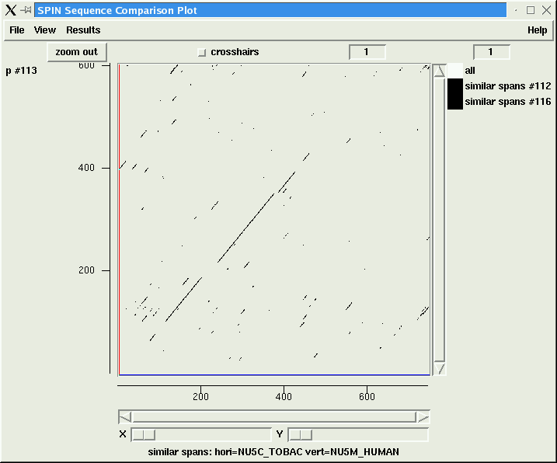
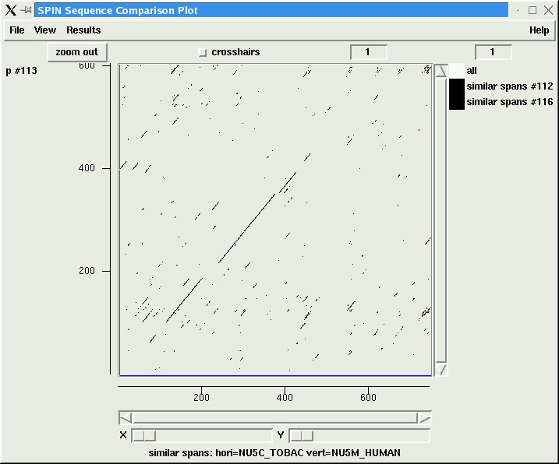
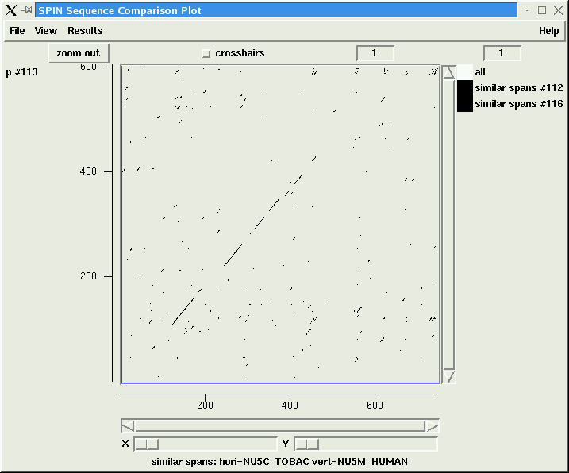
Graphical comparison of sequences using “Dotplots”.
Dotplot parameters.
The Word size.
Displaying the word 11 plot alone shows that major features are drawn in more “carefully”.
Arguably, less usefully if a broad overview is the objective.
Superimposing a plot with a smaller word size of 11 shows the emergence of extra dots.
In this case probably all noise.
Using a relatively large word size of 25, features are drawn with a broad brush.
Detail can be missed
Notes:
Varying the word size:
Here we investigate dotplots comparing 2 NADH-ubiquinone oxidoreductase chain 5 proteins, one Human (NU5M_HUMAN) and one from Tobacco (NU5C_TOBAC). Throughout, the PAM 250 scoring scheme and the default cut-off score for the chosen word size are employed.
First, the sequences are compared with a word size of 25 (cut-off default, 28). 3 strongly matching regions are clearly defined, plus a couple of shorter features (one either end) that might be of interest.
Secondly, we superimpose a dotplot using a word size of 11 (cut-off default, 24). There is no real effect to the 3 main regions or the two smaller features, but there is a considerable increase in the number of dots elsewhere. In this instance, it is probable that all the additional dots are just “noise” (it might have been more exciting to find small real features missed by the larger word size).
Finally, we remove the original word size 25 plot and leave just the word size 11 plot. Now the 3 main regions and 2 small features are represented as 8 features. Whilst it could be argued that this is a more accurate representation of the similarity between these two sequences, it is not necessarily the most useful. Dotplots are for providing an overview showing the main regions of interesting similarity between two sequences. Other methods (primarily textual alignments) exist to study the detail.

Slide 13
Graphical comparison of sequences using “Dotplots”.
Other uses of dotplots.
Detection of Repeats
Notes:
The detection of repeats:
Repeat regions within a single sequence can be detected by computing a dotplot of that sequence compared to itself. Lines of dots parrallel to the leading diagonal should be generated indicating the
A pair of matching repeat regions should generate a line of dots parallel to the leading diagonal indicating their positions. The leading diagonal itself will, of course, be drawn indicating that the whole sequence looks very similar to itself! The whole plot will, again of course, be symetrical about the leading diagonal. Some dotplot programs (including spin from the Staden package) will detect that the 2 sequences being compared are identical and will then omit to plot the leading diagonal and all the dotplot above the leading diagonal (as it will be identical to the plot below the leading diagonal).

Slide 14
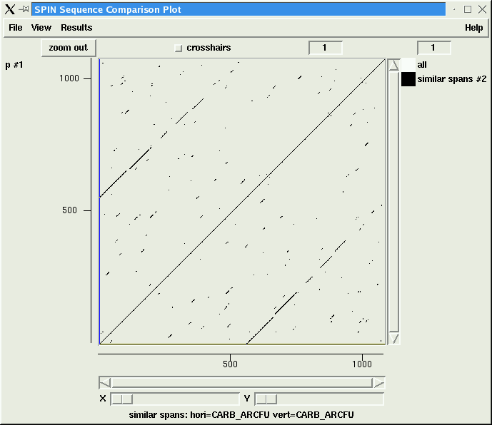
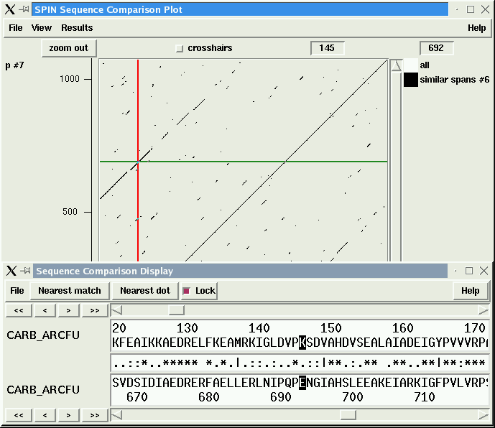

Graphical comparison of sequences using “Dotplots”.
Other uses of dotplots.
Detection of Repeats
Notes:
The detection of repeats:
Here we see an example of a dotplot revealing a single long repeat in the protein CARB_ARCFU. As can be seen from the sequence Feature Table (part of the annotation for this sequence), the second half of the protein is a repeat of the first half. This is clearly illustrated by the dotplot.
Some dotplot programs (including spin from the Staden package) allow the aligned sequence to be viewed from selected positions of the plot. From the aligned sequence, the repeat is also clear.

Slide 15
Graphical comparison of sequences using “Dotplots”.
Other uses of dotplots.
Detection of Repeats
Notes:
The detection of repeats:
Multiple repeats are detectable in a similar way. When there are many repeats, the plots can become quite involved.

Slide 16
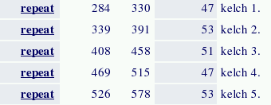
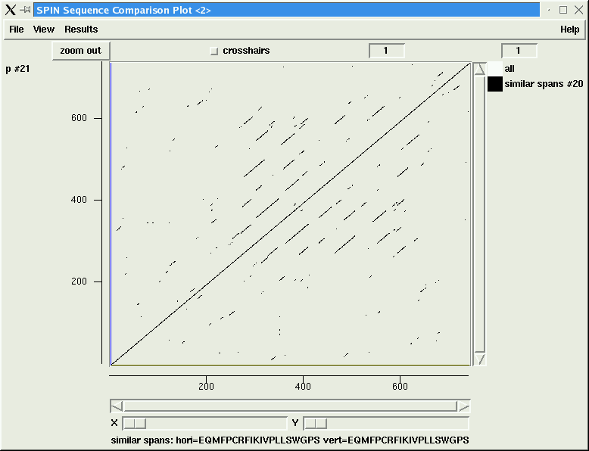
Graphical comparison of sequences using “Dotplots”.
Other uses of dotplots.
Detection of Repeats
Notes:
The detection of repeats:
Here we see an example of a human muskelin protein (MKLN_HUMAN) with 5 matching repeat regions. & 515

Slide 17
Graphical comparison of sequences using “Dotplots”.
Other uses of dotplots.
Detection of Stem Loops
Notes:
Detection of Stem Loops:
To detect stem loops using a dotplot one must compare the sequence containing the stem loop with its reverse and complement. In the illustration, we consider a DNA sequence including a stem loop, one arm of which is represented as a blue section, the other as a red section. By definition (of a stem loop), the blue section should be very similar to the reverse and complement of the red section and vice versa. The gap in between the red and blue stems is the portion of DNA that forms the loop.
First consider the stem loop sequence compared with itself. A dotplot of any sequence with itself would include an unbroken line of dots up the leading diagonal. This line of dots would be conveying the message “Gosh! The whole of this sequence looks awesomely like itself!”.
If we then reverse the vertical copy of the sequence and the dotplot will change to include an unbroken line of dots down the trailing diagonal. This line of dots would hold the message “Gosh! The vertical sequence is stunning similar to the horizontal sequence … only backwards”.
Finally, if we complement the reversed vertical sequence copy of the sequence, the blue and read stems can be considered to effectively change positions (as the complement of the blue stem must be similar to the red stem and vice versa). So the resultant dot plot will now include two aligned series of dots straddling the trailing diagonal indicating the position of the matching stems. This being the dotplot signature of a stem loop.
More generally, inverted repeats will show up in a similar fashion, but as these may be further apart, they need not be so close to the trailing diagonal.

Slide 18
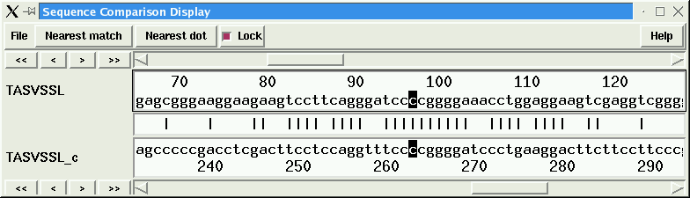
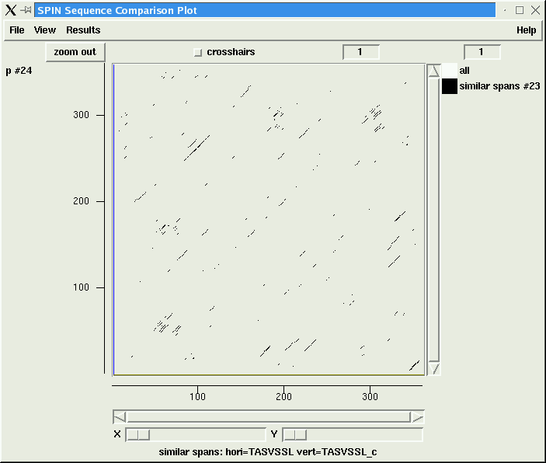
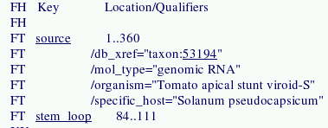
Graphical comparison of sequences using “Dotplots”.
Other uses of dotplots.
Detection of Stem Loops
Notes:
Detection of Stem Loops:
Here we show an example of a stem loop visualised using a dotplot. The EMBL entry TASVSSL (Tomato apical stunt viroid-S stem-loop RNA) has a stem loop between positions 84 and 111, as can be verified by looking at the Feature Table within the EMBL annotation.
By computing a dotplot comparing the EMBL entry (Horizontal axis) with its reverse and complement (Vertical axis), this stem loop becomes visible as a line of dots straddling the trailing diagonal of the dotplot.
Also illustrated is the sequence alignment of the stem loop.

Slide 19
The End.

