Slide 1
Bioinformatics
– a definition ?
The design, construction and use of software tools to generate, store, annotate, access and analyse data and information relating to Molecular Biology
OR
Biologists doing “stuff” with computers?
Here we consider the use of Bioinformatics tools rather than their design and construction
Here we consider the access and analysis of data and information items rather than their generation, storage or annotation
Notes:
Bioinformatics
Is the general topic of this talk, though I intend to concentrate on Bioinformatics as experienced by users rather than developers. Maybe “Freely available bioinformatics tools and their use” might be a more apt title. Either way, perhaps we should start by saying what Bioinformatics is. My own, wonderfully pretentious attempt at a definition would be:
“The design, construction and use of software tools to generate, store, annotate, access and analyse data and information relating to Molecular Biology”
An attempt to list each particular element of Bioinformatics, so that I can be specific about what I will discuss and what I will not. A more elegant definition from the European Bioinformatics Institute (EBI) web pages (http://www.ebi.ac.uk/2can/home.html) is:
“Bioinformatics is the application of computer technology to the management and analysis of biological data”
But …. Maybe it is simpler still? Is Bioinformatics really no more than:
“Biologists doing stuff with computers”?
As long as the stuff, is serious biological stuff, of course.
Here, we will consider only the software tools of Bioinformatics from a user perspective. Their design and construction is entirely another discipline.
Here, we will consider only the use of the software tools to access and analyse data and information items. Generating data and information, arranging it in databases and annotation are all very specialised activities.

Slide 2
Databases – Genes to Genomes

Slide 3


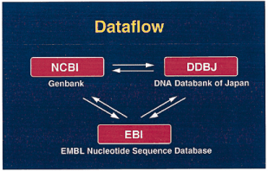


Primary DNA Sequence Databases
Original submission by experimentalists
Content controlled by the submitter
Notes:
Primary DNA Sequence Databases:
Dating from the early 1980s. Storing annotated sequence from primary research.
There are three major DNA sequence databases. They are:
EMBL (European Molecular Biology Laboratory) see, http://www.ebi.ac.uk/embl/
Genbank (from the NCBI) ) see, http://www.ncbi.nlm.nih.gov/
DDBJ (DNA Data Bank of Japan) see, http://www.ddbj.nig.ac.jp/
Since the early 1990s, these three institutions have collaborated through the
INSDC (International Nucleotide Sequence Database Collaboration) see, http://www.insdc.org/
Sequences submitted to any one of the collaborating institutes is passed on automatically to the other two.

Slide 4




Primary Protein Sequence Databases
Protein knowledgebase
consists of two sections:
Swiss-Prot, manually annotated, reviewed.
TrEMBL, automatically annotated, not reviewed.
Notes:
Primary Protein Sequence Databases:
Dating from the early 1980s.
The two main early primary protein sequence databases were:
Swissprot - http://us.expasy.org/sprot/
… all entries annotated to a high standard, consequently unlikely to be comprehensive in a practical timescale.
Protein Investigation Resource (PIR) - http://pir.georgetown.edu/
… comprised of sections of different annotation quality
Both these databases involved manual annotation. Given the rate at which new protein sequences were generated this was not going to be sufficient if the objective was to provide the community with a comprehensive set of data.
Consequently, automatically generated, automaticatically annotated and unreviewed protein databases were required. An exampe being:
Translated EMBL (TrEMBL) - http://www.bioinfo.pte.hu/more/TrEMBL.htm
… generated by translating coding regions from EMBL This process can produce questionable translations.
A similar database GenPept is constructed by similar means from GenBank.
Swissprot, PIR, and Trembl have now been merged to form UniprotKB. A Universal Protein Resource. The KB stand for Knowledge Base, making the claim that UniProtKB is more than a mere Database.
http://www.uniprot.org/
http://www.ebi.ac.uk/uniprot/
UniprotKB is divided into two Main sections:
UniProt/SwissProt … annotated to the standards of SwissProt, including all SwissProt entries.
Uniprot/Trembl … the rest, largely from Trembl
The better annotated parts of PIR are included in UniProt/SwissProt , the remainder in Uniprot/Trembl

Slide 5
Derivative Databases
Built from primary data
RefSeq
non-redundant
richly annotated
DNA, RNA, protein
diverse taxa
Submission by experimentalists
Controlled by the submitter
akin to the primary
research literature
akin to the review literature
Notes:
The Reference Sequence (RefSeq) database is a non-redundant collection of richly annotated DNA, RNA, and protein sequences from diverse taxa. The collection includes sequences from plasmids, organelles, viruses, archaea, bacteria, and eukaryotes. Each RefSeq represents a single, naturally occurring molecule from one organism. The goal is to provide a comprehensive, standard dataset that represents sequence information for a species. It should be noted, though, that RefSeq has been built using data from public archival databases only.
RefSeq biological sequences (also known as RefSeqs) are derived from GenBank records but differ in that each RefSeq is a synthesis of information, not an archived unit of primary research data. Similar to a review article in the literature, a RefSeq represents the consolidation of information by a particular group at a particular time.
GenBank is akin to the primary research literature, RefSeq is akin to the review literature
http://www.ncbi.nlm.nih.gov/RefSeq/

Slide 6




Derivative Databases
Protein domains, motifs, families
Protein domains/families represented as alignments and HMMs
Derived primarily from UniprotKB and Genpept
Aligned protein domains and consensus sequences
Derived automatically from UniprotKB
Conserved “blocks” of protein domain alignments
Derived from a subset of UniprotKB
Manually curated models for several hundred protein domains
Derived from proteins from completely sequenced genomes
Notes:
Databases:
Alignments:
There are a number of databases that store raw protein sequence alignments. These databases differ in their purpose and so their composition and structure, but all contain alignments just like those that, as discussed previously, could have been computed by any researcher using readily available bioinformatics software tools. Thus, a researcher requiring to see the alignment of a particular protein family has a choice to either:
- find the relevant protein sequences in the sequence databases and use the appropriate software tools to compute an alignment
Or
- look in the appropriate alignment database and see if someone has already computed (and, if you are lucky, checked) the desired alignment
Alignment databases include:
Pfam which stores alignments of entire protein families. Pfam has several sections including: Pfama, in which the alignments have been hand edited and are thus reliable.
Pfamb, containing alignments directly generated by alignment programs and are thus less reliable
Pfamseed containing Pfama entries that have been reduced to alignments of a representative subset of the whole protein family
Pfamhmm (2 sections, one for whole protein families, one for fragments of same) containing Hidden Markov Model Profile representations of alignments. Thes look horribly complicated (i.e. lots of numbers) but they are not really. They are the most accurate representation of the alignment. Given the alignment is representative and accurate (not necessarily true) they should therefore the best representation of the family of proteins, or feature associated with the aligned sequences.
To find out more, see:
http://www.sanger.ac.uk/Software/Pfam/
ProDom is a protein domain family database constructed automatically by clustering homologous segments. The ProDom building procedure MKDOM2 is based on recursive PSI-BLAST searches [ALTS2]. The source protein sequences are non-fragmentary sequences derived from UniProtKB (Swiss-Prot and TrEMBL databases). ProDom was first established in 1993 [SONN] and maintained by the Laboratoire de Génétique Cellulaire and the Laboratoire de Interactions Plantes-Microorganismes (INRA/CNRS) in Toulouse. It is now maintained by the PRABI (bioinformatics center of Rhone-Alpes). The ProDom database consists of domain family entries. Each entry provides a multiple sequence alignment of homologous domains and a family consensus sequence.
For further information see:
http://prodom.prabi.fr/prodom/current/html/home.php/
BLOCKS, which contains alignment of conserved regions of protein families. The BLOCKS database is used to compute scoring schemes for sequence alignment and database searching programs. For more information see:
http://blocks.fhcrc.org/
Pfam is a comprehensive collection of protein domains and families, represented as multiple sequence alignments and as profile hidden Markov models. The current release of Pfam (22.0) contains 9318 protein families. Pfam is now based not only on the UniProtKB sequence database, but also on NCBI GenPept and on sequences from selected metagenomics projects.
ProDom is a protein domain family database constructed automatically by clustering homologous segments. The ProDom building procedure MKDOM2 is based on recursive PSI-BLAST searches [ALTS2]. The source protein sequences are non-fragmentary sequences derived from UniProtKB (Swiss-Prot and TrEMBL databases). ProDom was first established in 1993 [SONN] and maintained by the Laboratoire de Génétique Cellulaire and the Laboratoire de Interactions Plantes-Microorganismes (INRA/CNRS) in Toulouse. It is now maintained by the PRABI (bioinformatics center of Rhone-Alpes). The ProDom database consists of domain family entries. Each entry provides a multiple sequence alignment of homologous domains and a family consensus sequence.
http://prodom.prabi.fr/prodom/current/html/home.php
The final release of BLOCKS was in April 2007. I mention this database here because of its role in the construction of protein alignment scoring matrices (discussed as a part of the exercises you might be doing later). It is still a valid example of a derivative database also, of course.
http://blocks.fhcrc.org/
SMART (a Simple Modular Architecture Research Tool) allows the identification and annotation of genetically mobile domains and the analysis of domain architectures. More than 500 domain families found in signalling, extracellular and chromatin-associated proteins are detectable. These domains are extensively annotated with respect to phyletic distributions, functional class, tertiary structures and functionally important residues. Each domain found in a non-redundant protein database as well as search parameters and taxonomic information are stored in a relational database system. User interfaces to this database allow searches for proteins containing specific combinations of domains in defined taxa. For all the details, please refer to the publications on SMART.
http://smart.embl-heidelberg.de/
SMART 2008:
Simple modular architecture research tool (SMART) is an online tool (http://smart.embl-heidelberg.de/) for the identification and annotation of protein domains. It provides a user-friendly platform for the exploration and comparative study of domain architectures in both proteins and genes. The current release of SMART contains manually curated models for 784 protein domains. Recent developments were focused on further data integration and improving user friendliness. The underlying protein database based on completely sequenced genomes was greatly expanded and now includes 630 species, compared to 191 in the previous release. As an initial step towards integrating information on biological pathways into SMART, our domain annotations were extended with data on metabolic pathways and links to several pathways resources. The interaction network view was completely redesigned and is now available for more than 2 million proteins. In addition to the standard web access to the database, users can now query SMART using distributed annotation system (DAS) or through a simple object access protocol (SOAP) based web service.
SMART 2000:
SMART (a Simple Modular Architecture Research Tool) allows the identification and annotation of genetically mobile domains and the analysis of domain architectures (http://SMART.embl-heidelberg.de ). More than 400 domain families found in signalling, extra-cellular and chromatin-associated proteins are detectable. These domains are extensively annotated with respect to phyletic distributions, functional class, tertiary structures and functionally important residues. Each domain found in a non-redundant protein database as well as search parameters and taxonomic information are stored in a relational database system. User interfaces to this database allow searches for proteins containing specific combinations of domains in defined taxa.
SMART 1999:
SMART is a simple modular architecture research tool and database that provides domain identification and annotation on the WWW (http://coot.embl-heidelberg.de/SMART). The tool compares query sequences with its databases of domain sequences and multiple alignments whilst concurrently identifying compositionally biased regions such as signal peptide, transmembrane and coiled coil segments. Annotated and unannotated regions of the sequence can be used as queries in searches of sequence databases. The SMART alignment collection represents more than 250 signalling and extracellular domains. Each alignment is curated to assign appropriate domain boundaries and to ensure its quality. In addition, each domain is annotated extensively with respect to cellular localisation, species distribution, functional class, tertiary structure and functionally important residues.
SMART 1998:
Accurate multiple alignments of 86 domains that occur in signaling proteins have been constructed and used to provide a Web-based tool (SMART: simple modular architecture research tool) that allows rapid identification and annotation of signaling domain sequences. The majority of signaling proteins are multidomain in character with a considerable variety of domain combinations known. Comparison with established databases showed that 25% of our domain set could not be deduced from SwissProt and 41% could not be annotated by Pfam. SMART is able to determine the modular architectures of single sequences or genomes; application to the entire yeast genome revealed that at least 6.7% of its genes contain one or more signaling domains, approximately 350 greater than previously annotated. The process of constructing SMART predicted (i) novel domain homologues in unexpected locations such as band 4.1-homologous domains in focal adhesion kinases; (ii) previously unknown domain families, including a citron-homology domain; (iii) putative functions of domain families after identification of additional family members, for example, a ubiquitin-binding role for ubiquitin-associated domains (UBA); (iv) cellular roles for proteins, such predicted DEATH domains in netrin receptors further implicating these molecules in axonal guidance; (v) signaling domains in known disease genes such as SPRY domains in both marenostrin/pyrin and Midline 1; (vi) domains in unexpected phylogenetic contexts such as diacylglycerol kinase homologues in yeast and bacteria; and (vii) likely protein misclassifications exemplified by a predicted pleckstrin homology domain in a Candida albicans protein, previously described as an integrin.

Slide 7

Derivative Databases
Protein domains, motifs, families
Protein motifs/domains represented as Patterns and/or HMMs
Both derived from UniprotKB/Swissprot
Patterns are for highly conserved short regions. Example:
R-P-C-x(11)-C-V-S
HMMs are for less conserved longer regions.
Often there will be pattern(s) and an HMM for one domain.
HMM matches
Pattern matches
Notes:
Databases:
Patterns:
Pattern databases include:
Prosite
Originally Prosite was entirely composed of simple string representaions of single regions
To find out more, see:
http://us.expasy.org/prosite/

Slide 8

Derivative Databases
Protein domains, motifs, families
Representations of domains by motif patterns (fingerPRINTS)
Derived from UniprotKB
Each FingerPrint is compose of a series of conserved regions (motifs)
A match with a FingerPrint is thus an order set of motif matches
Notes:
PRINTS is a compendium of protein fingerprints. A fingerprint is a group of conserved motifs used to characterise a protein family; its diagnostic power is refined by iterative scanning of a SWISS-PROT/TrEMBL composite. Usually the motifs do not overlap, but are separated along a sequence, though they may be contiguous in 3D-space. Fingerprints can encode protein folds and functionalities more flexibly and powerfully than can single motifs, full diagnostic potency deriving from the mutual context provided by motif neighbours.
see:
http://bioinf.man.ac.uk/dbbrowser/PRINTS/

Slide 9
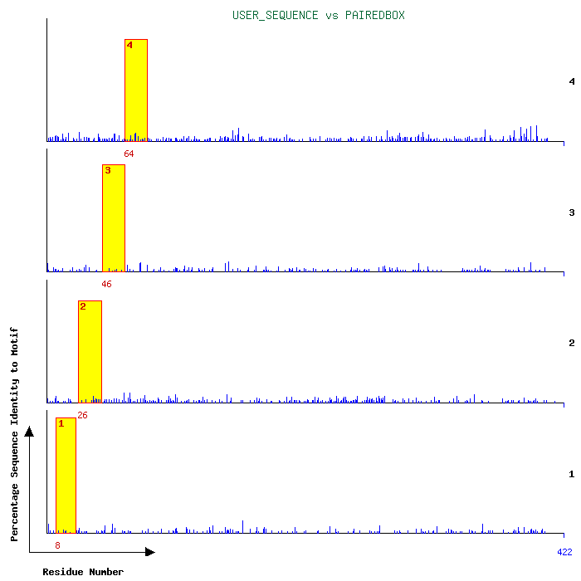
For example:
PAX6_HUMAN
matching the
Paired Box,
4 motif, Fingerprint

Slide 10

Database Access
Each database must have software to enable searching
Either by text term against annotation
And / Or by data comparison
Database inquiry by text search:
Sequence Retrieval System – SRS
Searching annotation by text match
Implemented in many places
Follows links between databases
Can allow in situ analysis of matches
Notes:
Clearly, for the databases discussed to be useful, they must have associated software to build and enact searches. Searches might be for text items occurring in the annotation or for data entries matching query sequences.
A well established search tool for text items in the data entry annotation is the Sequence Retrieval System – SRS
The core of SRS is public domain and has been implemented in many places. The range of databases offered varies according to provider. The original provider of SRS is the EBI where it offers access to a very wide range of databases. See:
http://srs.ebi.ac.uk/
An attractive feature of SRS is the way it allows users to link between related databases. For example, if a user identifies a list of DNA sequence list.
Another useful feature, implemented at many SRS sites is the possibility to analyse sequence hits without downloading them form thee database. This is primarily down using the programs of the EMBOSS packages.

Slide 11

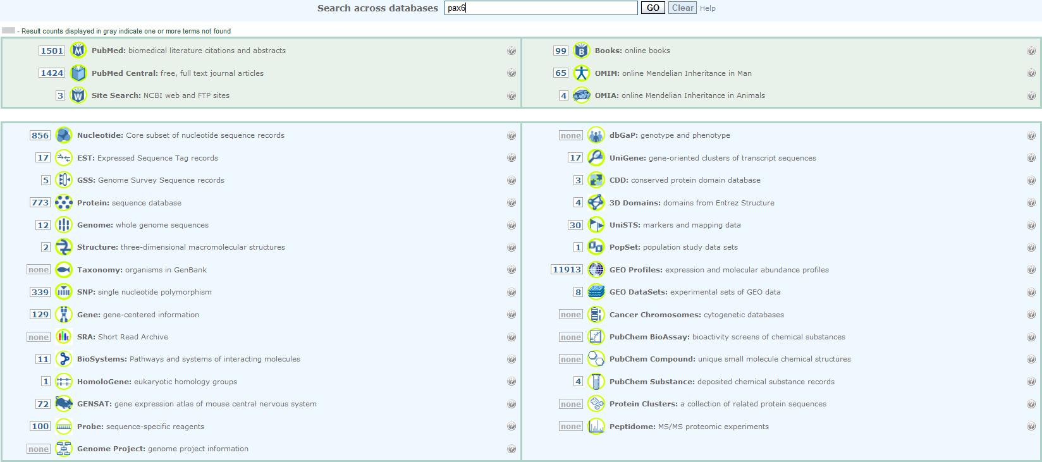
Text Search of Annotation
All the databases of the NCBI at one time

Slide 12

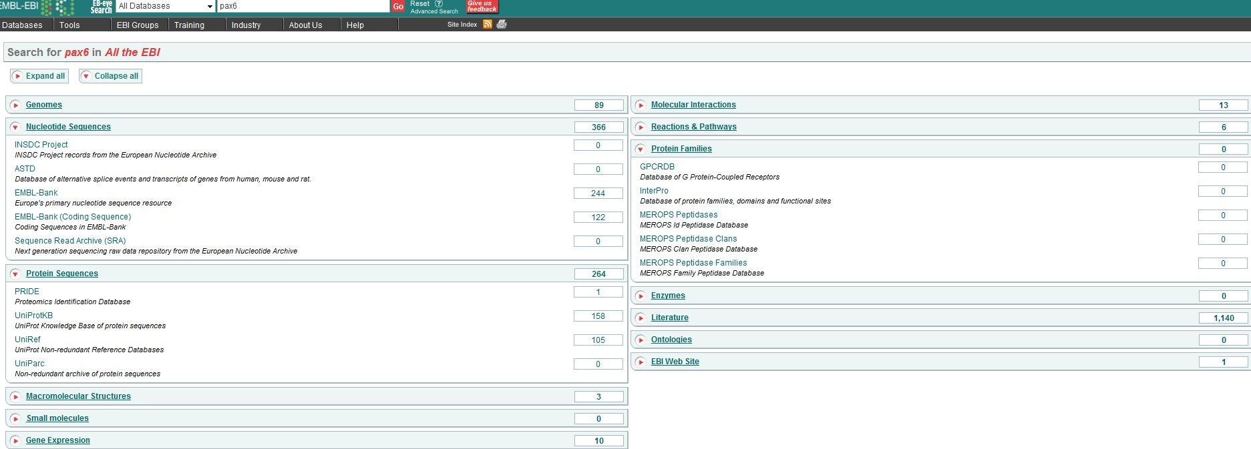
Text Search of Annotation
All the databases of the EBI at one time

Slide 13
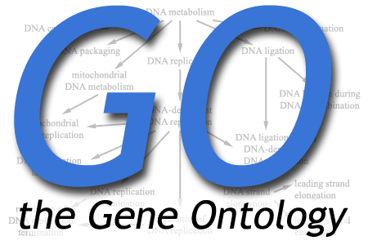

Gene Ontology – towards consistent descriptions
Inconsistent use of terms - ineffective annotation searches
Consistent descriptions in different databases
Terms define:
biological process
cellular component
molecular function
Tools for accessing GO
Notes:
The usefulness of text searching is limited by the inconsistency with which keywords are used.
The Gene Ontology (GO) project is an attempt to address this problem.
A definition from http://www.geneontology.org/
“The Gene Ontology project is a major bioinformatics initiative with the aim of standardizing the representation of gene and gene product attributes across species and databases. The project provides a controlled vocabulary of terms for describing gene product characteristics and gene product annotation data from GO Consortium members, as well as tools to access and process this data.”
Quotes from: http://www.geneontology.org/GO.doc.shtml#control
“What does the Gene Ontology Consortium do?
Biologists currently waste a lot of time and effort in searching for all of the available information about each small area of research. This is hampered further by the wide variations in terminology that may be common usage at any given time, which inhibit effective searching by both computers and people. For example, if you were searching for new targets for antibiotics, you might want to find all the gene products that are involved in bacterial protein synthesis, and that have significantly different sequences or structures from those in humans. If one database describes these molecules as being involved in 'translation', whereas another uses the phrase 'protein synthesis', it will be difficult for you - and even harder for a computer - to find functionally equivalent terms.
The Gene Ontology (GO) project is a collaborative effort to address the need for consistent descriptions of gene products in different databases ... “
“The GO project has developed three structured controlled vocabularies (ontologies) that describe gene products in terms of their associated biological processes, cellular components and molecular functions in a species-independent manner. There are three separate aspects to this effort: first, the development and maintenance of the ontologies themselves; second, the annotation of gene products, which entails making associations between the ontologies and the genes and gene products in the collaborating databases; and third, development of tools that facilitate the creation, maintenance and use of ontologies.
The use of GO terms by collaborating databases facilitates uniform queries across them. The controlled vocabularies are structured so that they can be queried at different levels: for example, you can use GO to find all the gene products in the mouse genome that are involved in signal transduction, or you can zoom in on all the receptor tyrosine kinases. This structure also allows annotators to assign properties to genes or gene products at different levels, depending on the depth of knowledge about that entity. "
And Wikipedia, of course, says:
“GO terms and the GO ontology
The Gene Ontology project provides an ontology of defined terms representing gene product properties. The ontology covers three domains; cellular component, the parts of a cell or its extracellular environment; molecular function, the elemental activities of a gene product at the molecular level, such as binding or catalysis; and biological process, operations or sets of molecular events with a defined beginning and end, pertinent to the functioning of integrated living units: cells, tissues, organs, and organisms. Each GO term within the ontology has a term name, which may be a word or string of words; a unique alphanumeric identifier; a definition with cited sources; and a namespace indicating the domain to which it belongs. Terms may also have synonyms, which are classed as being exactly equivalent to the term name, broader, narrower, or related; references to equivalent concepts in other databases; and comments on term meaning or usage. The GO ontology is structured as a directed acyclic graph, and each term has defined relationships to one or more other terms in the same domain, and sometimes to other domains. The GO vocabulary is designed to be species-neutral, and includes terms applicable to prokaryotes and eukaryotes, single and multicellular organisms.
The GO ontology is not static, and additions, corrections and alterations are suggested by, and solicited from, members of the research and annotation communities, as well as by those directly involved in the GO project. For example, an annotator may request a specific term to represent a metabolic pathway, or a section of the ontology may be revised with the help of community experts ”
From the Amigo Home page http://www.geneontology.org/amigo/help-front.shtml
“AmiGO is the official web-based set tools for searching and browsing the Gene Ontology database, which consists of a controlled vocabulary of terms covering biological concepts, and a large number of genes or gene products whose attributes have been annotated using GO terms.”
“What can I do using AmiGO?
search for a gene or gene product, or a list of gene or gene products, and view the GO term associations
perform a sequence identity BLAST search and view the GO term associations for the genes or proteins returned
search for GO terms and view the genes or gene products they are annotated to
browse the GO ontology and view terms “
“Simple Searching with AmiGO
A simple search for GO terms or for gene products is available from the AmiGO home page or by clicking on the Search link in the toolbar at the top of all pages in AmiGO. Enter one or more words into the query box and set the search type by selecting the terms or the gene or protein radio button. Examples of GO terms include DNA repair, protein kinase activity, or mitochondrion. Examples of genes or proteins include DMC1 or fuzzy onions.
If you know the name or ID of a GO term or the name or symbol of the gene product you are looking for, select the exact match checkbox to return items which fully match your query.
Click Submit Query to start the search. “

Slide 14
Database Access
Database inquiry by data comparison:
Sequence databases
BLAST - for sequence databases, DNA or Protein
Implemented in very many places
Most notably at the NCBI
Protein domain, motif, family databases
Each database has a customised search tool
To search all databases is a lot of work!
Notes:
The highest profile tool for finding sequence matches in a sequence database is BLAST
BLAST is implemented in very many places, but most notbly at the NCBI, see:
http://blast.ncbi.nlm.nih.gov/Blast.cgi
There are other tools. For protein databases their are more sensitive tools. However, BLAST is sufficient to most people’s ever need and must be the most used bioinformatics software suite.

Slide 15

Database Access
Interpro is a consortium of member databases
Interpro defines protein families, domains, regions, repeats and sites according to matches against member databases
Interpro enables any subset of member databases to be searched together
Notes:
http://www.ebi.ac.uk/interpro/index.html
InterPro is a database of protein families, domains, regions, repeats and sites in which identifiable features found in known proteins can be applied to new protein sequences.
InterPro is a consortium of member databases (including PROSITE, Pfam, Prints, ProDom, SMART and TIGRFAMs). Each member database devises methods that can be applied computationally to assign a score for a protein according to how well it matches a given signature. For some types of methods, the classification is binary (i.e. hit or miss), in other cases a numerical value is produced and a cut off point chosen to separate hits from misses. Different member databases create methods/signatures in different ways: some groups build them from alignments studied manually, others use automatic processes with some human input and correction, while ProDom uses an entirely automatic method. See the publications of the different member databases for details.
InterPro Member Databases:
The UniProt (Universal Protein Resource) is the world's most comprehensive catalog of information on proteins. It is a central repository of protein sequence and function created by joining the information contained in Swiss-Prot, TrEMBL, and PIR.
PROSITE is a database of protein families and domains. It consists of biologically significant sites, patterns and profiles that help to reliably identify to which known protein family (if any) a new sequence belongs.
HAMAP, stands for High-quality Automated and Manual Annotation of microbial Proteomes. HAMAP profiles are manually created by expert curators they identify proteins that are part of well-conserved bacterial, archaeal and plastid-encoded (i.e. chloroplasts, cyanelles, apicoplasts, non-photosynthetic plastids) proteins families or subfamilies.
Pfam is a large collection of multiple sequence alignments and hidden Markov models covering many common protein domains.
PRINTS is a compendium of protein fingerprints. A fingerprint is a group of conserved motifs used to characterise a protein family; its diagnostic power is refined by iterative scanning of UniProt. Usually the motifs do not overlap, but are separated along a sequence, though they may be contiguous in 3D-space. Fingerprints can encode protein folds and functionalities more flexibly and powerfully than can single motifs, their full diagnostic potency deriving from the mutual context afforded by motif neighbours.
The ProDom protein domain database consists of an automatic compilation of homologous domains. Current versions of ProDom are built using a novel procedure based on recursive PSI-BLAST searches (Altschul SF, Madden TL, Schaffer AA, Zhang J, Zhang Z, Miller W & Lipman DJ, 1997, Nucleic Acids Res., 25:3389-3402; Gouzy J., Corpet F. & Kahn D., 1999, Computers and Chemistry 23:333-340.) Large families are much better processed with this new procedure than with the former DOMAINER program (Sonnhammer, E.L.L. & Kahn, D., 1994, Protein Sci., 3:482-492).
SMART (a Simple Modular Architecture Research Tool) allows the identification and annotation of genetically mobile domains and the analysis of domain architectures. More than 500 domain families found in signalling, extracellular and chromatin-associated proteins are detectable. These domains are extensively annotated with respect to phyletic distributions, functional class, tertiary structures and functionally important residues. Each domain found in a non-redundant protein database as well as search parameters and taxonomic information are stored in a relational database system. User interfaces to this database allow searches for proteins containing specific combinations of domains in defined taxa.
TIGRFAMs is a collection of protein families, featuring curated multiple sequence alignments, hidden Markov models (HMMs) and annotation, which provides a tool for identifying functionally related proteins based on sequence homology. Those entries which are "equivalogs" group homologous proteins which are conserved with respect to function.
PIRSF The PIRSF protein classification system is a network with multiple levels of sequence diversity from superfamilies to subfamilies that reflects the evolutionary relationship of full-length proteins and domains. The primary PIRSF classification unit is the homeomorphic family, whose members are both homologous (evolved from a common ancestor) and homeomorphic (sharing full-length sequence similarity and a common domain architecture).
SUPERFAMILY is a library of profile hidden Markov models that represent all proteins of known structure. The library is based on the SCOP classification of proteins: each model corresponds to a SCOP domain and aims to represent the entire SCOP superfamily that the domain belongs to. SUPERFAMILY has been used to carry out structural assignments to all completely sequenced genomes. The results and analysis are available from the SUPERFAMILY website.
Gene3D database describes protein families and domain architectures in complete genomes. Protein families are formed using a Markov clustering algorithm, followed by multi-linkage clustering according to sequence identity. Mapping of predicted structure and sequence domains is undertaken using hidden Markov models libraries representing CATH and Pfam domains. Functional annotation is provided to proteins from multiple resources. Functional prediction and analysis of domain architectures is available from the Gene3D website.
PANTHER is a large collection of protein families that have been subdivided into functionally related subfamilies, using human expertise. These subfamilies model the divergence of specific functions within protein families, allowing more accurate association with function (human-curated molecular function and biological process classifications and pathway diagrams), as well as inference of amino acids important for functional specificity. Hidden Markov models (HMMs) are built for each family and subfamily for classifying additional protein sequences. PANTHER is publicly available without restriction.
InterPro documentation available at: http://www.ebi.ac.uk/interpro/

Slide 16
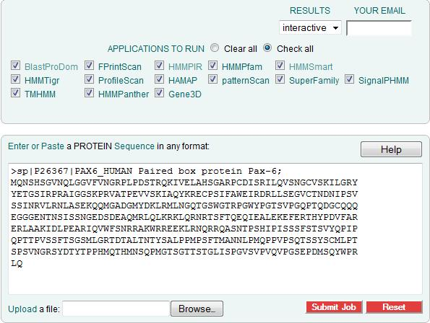
Notes:
The search tool for Interpro is InterproScan
Interpro can runs the search tools of all its constituent databases

Slide 17
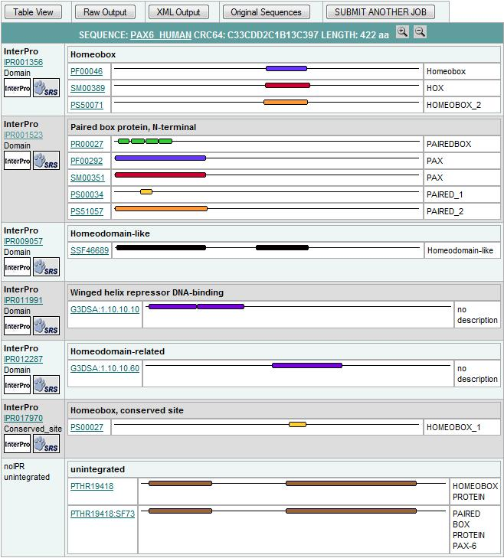

Slide 18
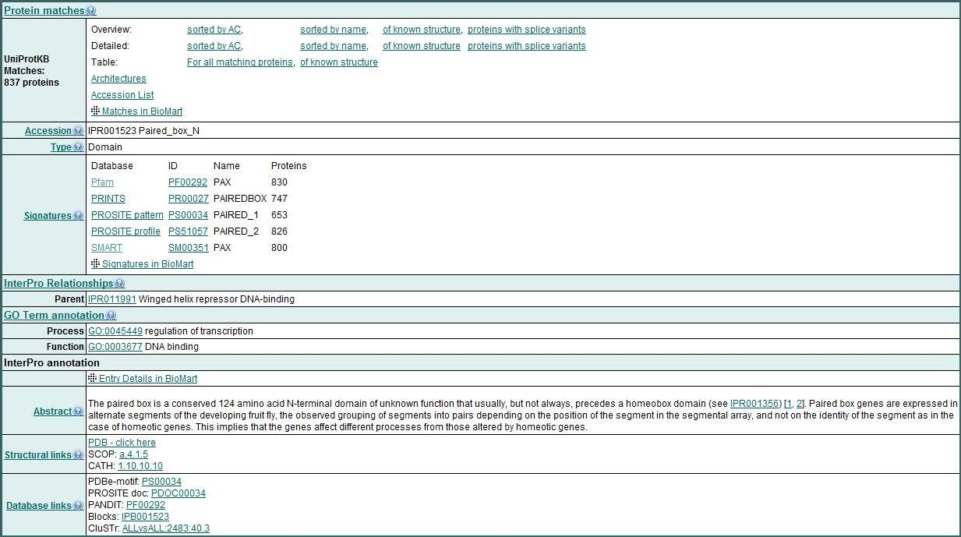

Slide 19
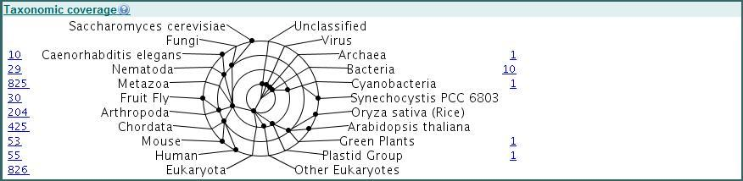


Slide 20
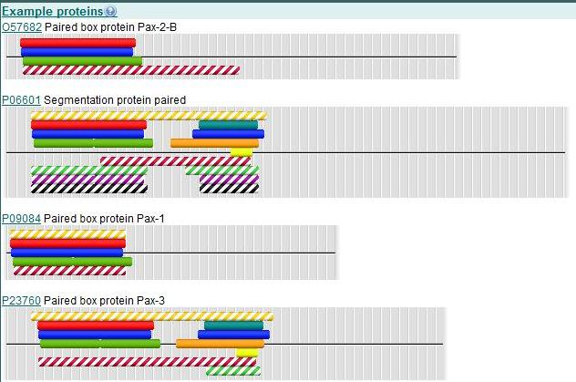
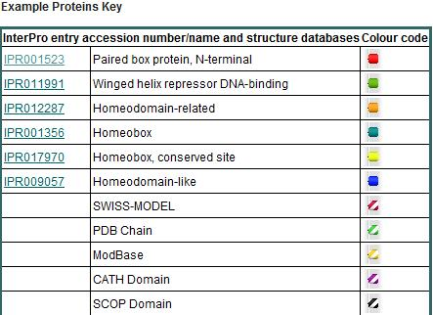

Slide 21
The End

Slide 22

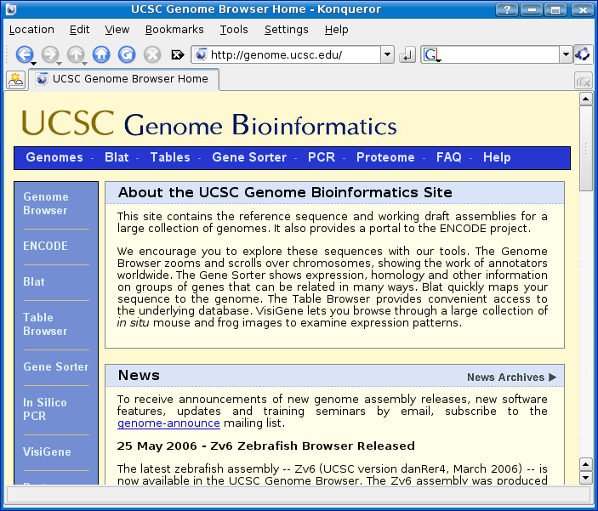

Genome databases
EBI / Sanger Institute
Notes:
Now many whole genomes are fully sequenced. For such organisms, it is clearly most appropriate to present the available sequence data as assembled chromosomes rather than gene by gene or in a fashion that reflects only the circumstances of sequencing.
The three most famous services offering the possibility to “browse genomes” and their associated genes and proteins are:
NCBI Map Viewer - http://www.ncbi.nlm.nih.gov/mapview/
... Currently the widest range of genomes, specifically plant genomes.
University of California Santa Cruz (UCSC) – http://genome.ucsc.edu/
... Unlike the other two, does not try to predict a non-redundant set of transcripts
Ensembl - http://www.ensembl.org/
… A collaborative project between the European Bioinformatics Institute (EBI) and the Wellcome Trust Sanger Institute
… Unlike te other two, the Ensembl system is Public Domain and can be set up to manage appropriate datasets anywhere

Slide 23
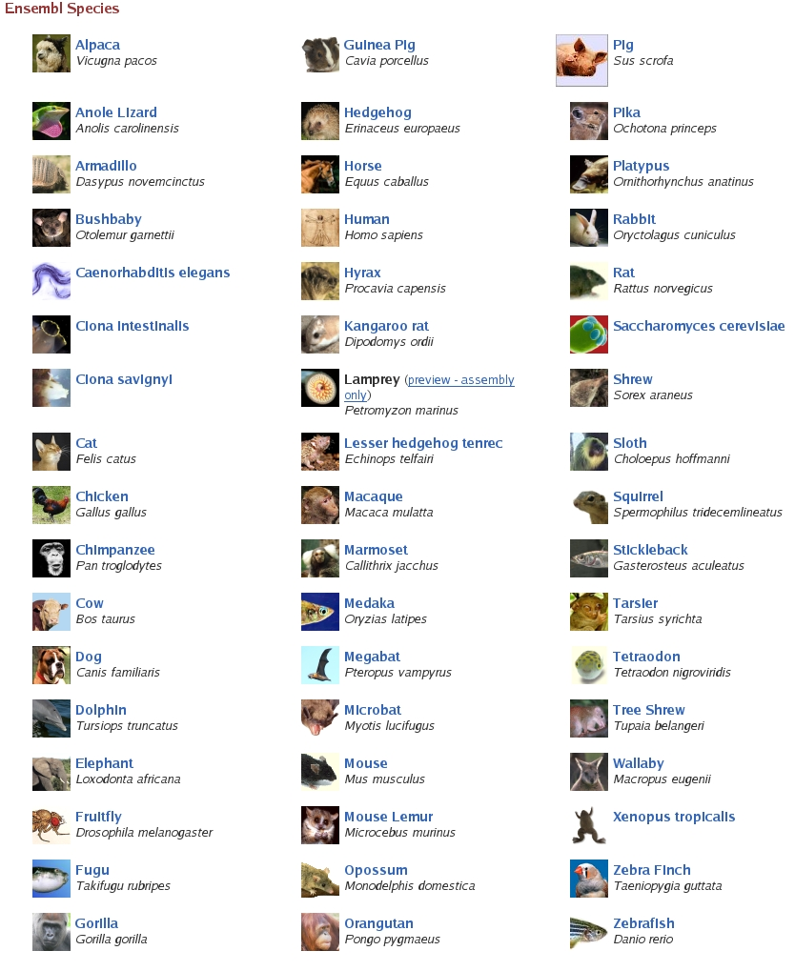
Notes:
51 Ensembl Species at present with plans for many more

Slide 24
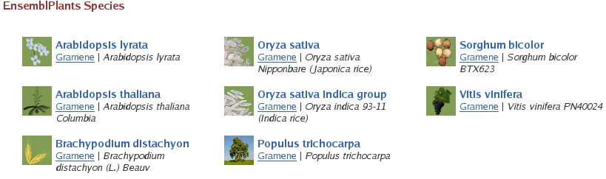


Notes:
In addition Ensembl currently offers just 8 plant species. This number is set to grow rapidly.
Arabidopsis thaliana is an example of an organism whose genome is offerred behind an Ensembl interface not managed by the main Ensembl groups. This may shortly change and Arabidopsis thaliana
Arabidopsis Ensembl is a genome browser for the commonly studied plant model organism Arabidopsis thaliana. It is curated by NASC, the European Arabidopsis stock centre, which also holds the worldwide collection of Arabidopsis lines.
NASC - http://arabidopsis.info/
Arabidopsis Ensembl - http://atensembl.arabidopsis.info/index.html

Slide 25
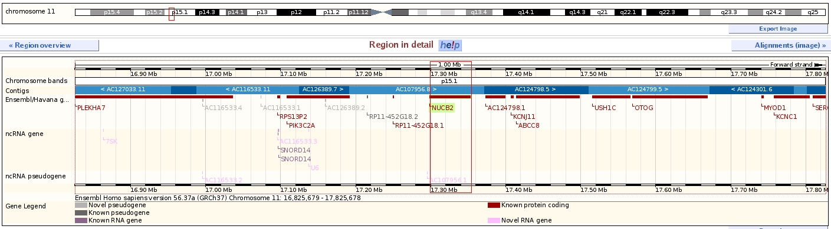
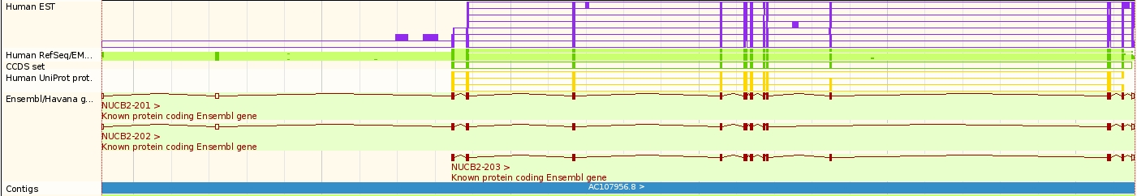

Slide 26
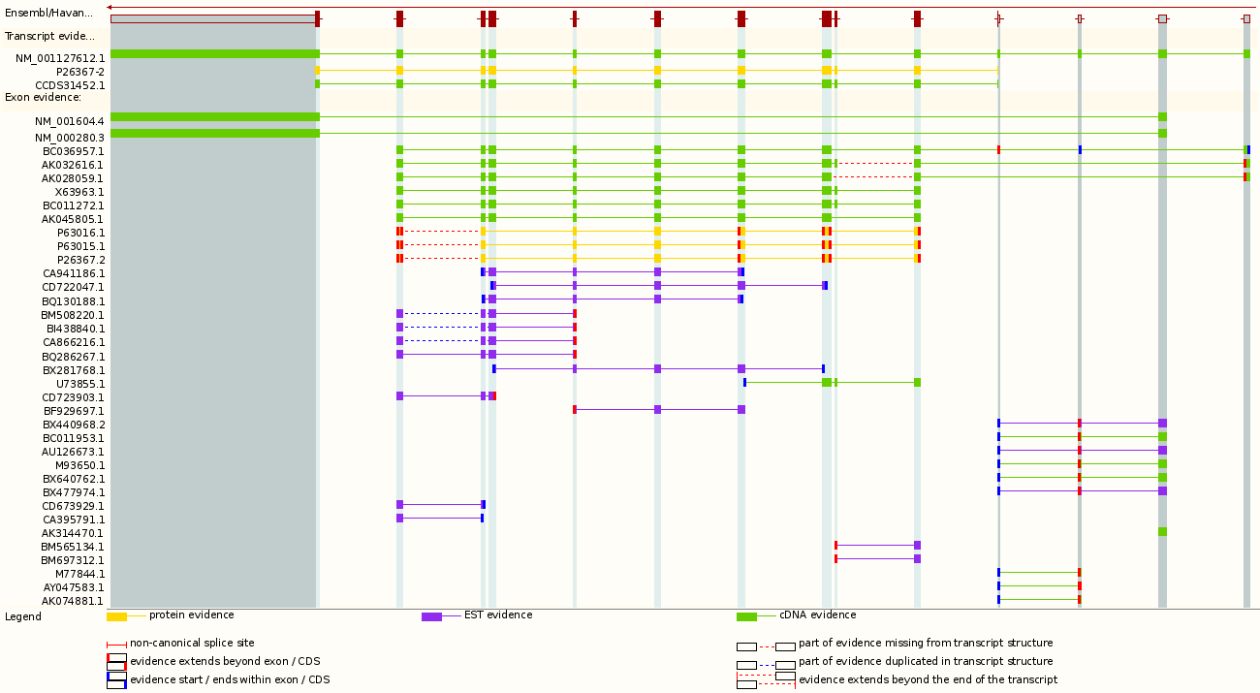

Slide 27
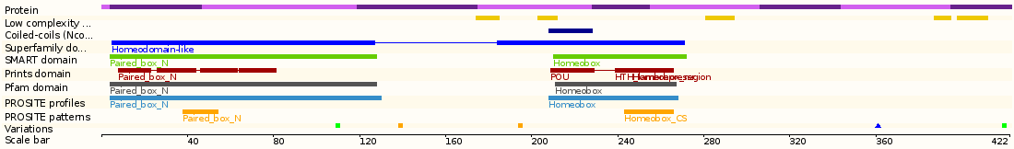
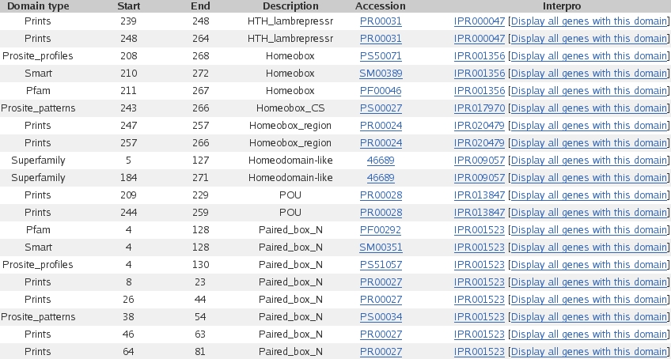

Slide 28

Levels of access to Ensembl data
Web Browser – One gene inquiry
Web constructed database query
Multi-gene inquiry/data retrieval
PERL libraries to construct customised database queries
The Ensembl Perl API
Customised inquiries – requires PERL programming experience
Notes:
Levels of access to Ensembl data
The Ensembl genome browser (or genome browsers in general) is fine for seeking out information/data related to a particular gene and/or small set of genes. However, it would be unacceptably clumsy to, for example, retrieve the sequence for a large set of related genes.
Biomart allows the construction of simple databases enquiries using a web interface. Ensembl biomart, for example, would allow a collection of genes to be identified in a variety of ways (Ensembl ID, Interpro ID …). Once a set of genes was defined, Ensembl biomart, for example, could be used to retrieve the sequence for all the genes of the set, or maybe list al the SNPs in the regions of the gene set.
The Ensembl API (Application Programme Interfaces) are essentially a set of PERL libraries to assist the production of PERL programs to interrogate the Ensembl database. There use requires some familiarity with PERL programming, but allows great freedom to customise database queries to meet most circumstances.

Slide 29





Towards unification of transcript prediction
The Consensus CDS (CCDS) project
A collaboration
A standard set of gene annotations
Notes:
The Consensus CDS (CCDS) project is a collaborative effort to identify a core set of human and mouse protein coding regions that are consistently annotated and of high quality. The long term goal is to support convergence towards a standard set of gene annotations.
http://www.ncbi.nlm.nih.gov/projects/CCDS
The main collaborating institutes are:
European Bioinformatics Institute (EBI) (Ensembl/Havana)
National Center for Biotechnology Information (NCBI) (Refseq/Map Viewer)
Wellcome Trust Sanger Institute (WTSI) (Ensembl/Havana)
University of California, Santa Cruz (UCSC) (Genome Browser group, contribution largely quality control)
This enterprise in only practical with high quality genome assemblies, hence currently efforts are concentrated on just Human and Mouse. Hopefully, the same techniques could be applied to all organisms as and when their genome assemblies become sufficiently stable .
Concentrating specifically on protein coding regions is also a first step. Once their prediction becomes more reliable, there is no reason not to build an agreed set of full transcript predictions including the un-translated regions.

Slide 30
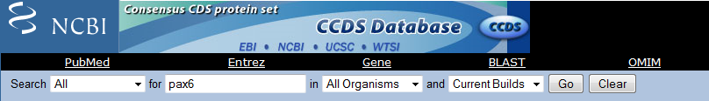
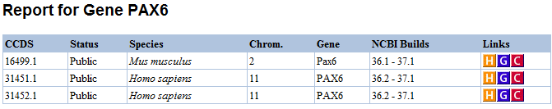
Notes:
Using the Search at the top of the CCDS Home page to look for PAX6 in “All Organisms” (i.e. Mouse & Human) gives 3 hits. 2 Human and 1 mouse. This suggests that it is agreed there are 2 agreed isoforms for PAX6 in human of known sequence (certainly confirmed by UniProtKB).

Slide 31
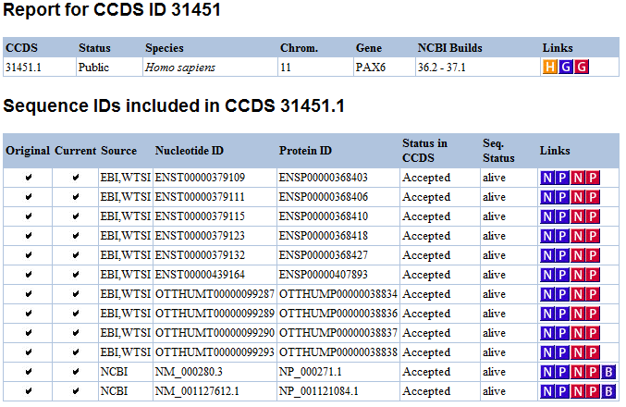
Notes:
Following the C link for CCDS 31451 shows the CCDS entry listing the Ensembl transcripts (ENST*) the Vega transcripts (OTTHUMT*) and the Refseq mRNAs (NM_*) that code for this protein.
Each transcript has a different corresponding protein entry. However, all protein entries represent the same protein (definitively), they differ only in their annotation which states their transcript of origin.

Slide 32
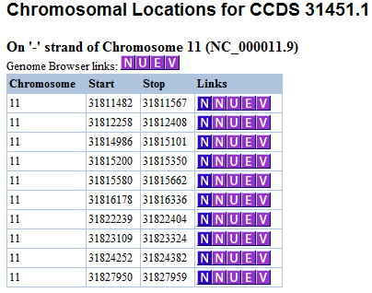
Notes:
Below the Sequence IDs is a table of the Chromosomal locations of the coding exons of the CCDS entry.

Slide 33
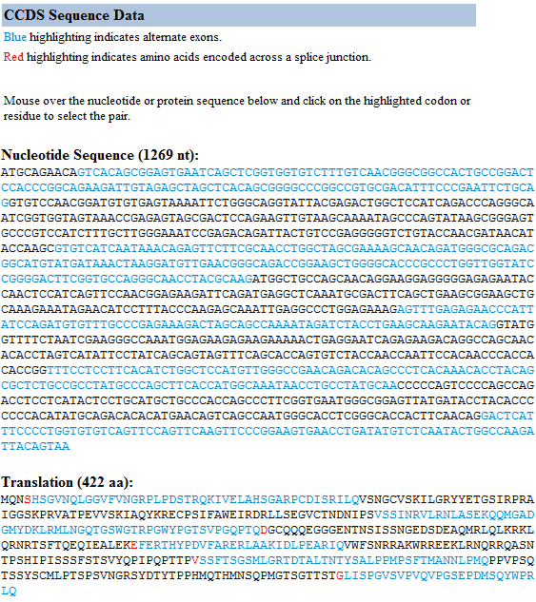
Notes:
Finally is a view of the sequence itself and its peptide translation.

Slide 34
ADVERTISMENTS
Bioinformatics and computational biology courses in Cambridge:
All courses are free! Sadly, getting to Cambridge is not.
Course list and Booking:
http://www.biomed.cam.ac.uk/gradschool/skills/bioinformatics.html
Course Timetable in Cambridge:
http://charles-wells.bio.cam.ac.uk/index.php?page=courses
Downloads:
Software installer for Windows:
http://charles-wells.bio.cam.ac.uk/downloads/BioSetup.exe
This Presentation:
http://charles-wells.bio.cam.ac.uk/downloads/Databases_Genes_Genomes.pptx
Training Manuals:
http://charles-wells.bio.cam.ac.uk/downloads/Malaysia_2009_11_Main.pdf
http://charles-wells.bio.cam.ac.uk/downloads/Transmembrane_Malaysia_2009_11.pdf

Slide 35
The End
Notes:
The End!

